Slide 1

Design & Analysis of Algorithms
Dr. Alakesh Kalita
Mathematics and Computing
IIT ISM Dhanbad

Slide 2
Hashing

Slide 3
Why hashing ?
Example: Give an algorithm for printing the repeated ASCII character if there are duplicated elements in it.
Solution (Brute Force): Given a string, for each character check whether that character is repeated or not.
The time complexity of this approach is O(n²) with O(1) space complexity. (n = 256 for ASCII Characters)
Can we improve it?
Solution: Create an array of size 256 and initialize it with all zeros. For each of the input characters go to the corresponding position and increment its count.
Time and space complexity O(n)

Slide 4
Why hashing ?
Hashing is a technique used for storing and retrieving information as quickly as possible. Hash tables are used to store data.
Average O(1)
Worst case O(n)
Time to find an element
Unsorted array
Sorted array
Linked List
Binary Tree
Binary Search Tree
Balanced BST
Priority Queue
O(n)
O(log n)
O(n)
O(n)
The common operations for hash table are:
• CreatHashTable: Creates a new hash table
• HashSearch: Searches the key in hash table
• Hashlnsert: Inserts a new key into hash table
• HashDelete: Deletes a key from hash table
• Delete Hash Table: Deletes the hash table
O(n)
O(log n)
O(n)

Slide 5
Direct addressing
Suppose you have the search key elements as follows for a small dataset
0, 1, 2, 3, 4, 5, 6, … … 100
0
1
2
3
4
5
99
100
We can use Array
Direct addressing
0, 1, 2, 3, 4, 5, 6, … … 100, 10001
Can we still efficiently use Array now?
0
1
2
3
4
5
99
100
101
102
10001
Memory wasted
Again, if the search keys are as follows: 100001, 100002, 100003, then also is not useful
Direct addressing

Slide 6
Hashing
123
112
1
11
Collision
More than one key map into the same cell.
11
29
112
1
1327
1253
994
994
25
Need better mapping, i.e., hashing function.
25
1253
1327
Hashing
Very large key space
f(x) = x % 10
Limited computer memory
storing and retrieving information
Average O(1)

Slide 7
Components of Hashing
Hashing has four key components:
1) Hash Table
Hash table is a generalization of array
2) Hash Functions
The hash function is used to transform the key into the index
A hash function that maps each item into a unique slot is referred to as a perfect hash function
  It is possible for small numbers of elements, but not feasible for large number of elements.
Folding Method: 43+56+55+64=218 which gives 218 % 11 = 9 ; 11 is hash table size
3) Collisions
Two more key elements map to same location
4) Collision Resolution Techniques
To find another location after collision

Slide 8
Characteristics of Good Hash Functions
Good hash function should have the following characteristics:
Minimize collision
Easy and quick to compute
Distribute key values evenly in the hash table

Slide 9
Hashing
Better hashing function can reduce the number of collision but can not eliminate it fully.
Collision Resolution techniques are
Chaining
  An array of linked list
Open addressing
  Linear probing (linear search)
  Quadratic probing (nonlinear search)
  Double hashing (use two hash functions)

Slide 10
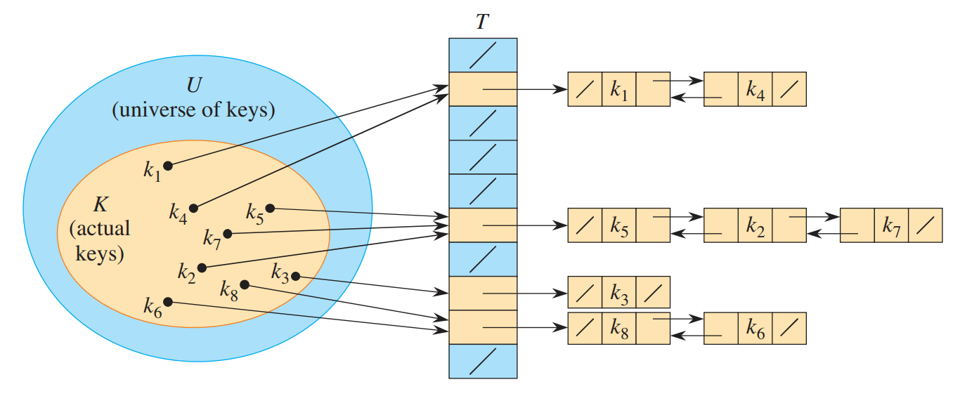
Collision Resolution Techniques
Chaining
Combines linked list representation with hash table.
When two or more records hashed to the same location,
  Records are stored into a singly-linked list called a chain.
Insertion O(1)
Searching O(n) (in worst case)
Deletion O(n)
Using proper hashing techniques
Load can be distributed to each cell uniformly (say n/m; aka load factor), and accordingly,
searching can be reduced to O(1+ n/m)
Advantage
Deletion is easy
Disadvantage
Extra space, linked list pointer

Slide 11
Collision Resolution Techniques
Open addressing
Elements are stored in the hash table itself (no extra space)
  If the hash table size is n, then we can store n elements
Load factor, ɑ = 1
To resolve collisions
  Perform re-hashing with some minor change
Linear probing
Quadratic
probing
Double hashing

Slide 12
Collision Resolution Techniques
Linear Probing
Probe a free space linearly to resolve
In worst case, need to perform m probings
Key: 1, 11, 21, 31
1
11
f(x) = x % m
11
m is hash table size
21
If the first probing cell is the same for two (or more) elements, then their subsequent probing cell sequence will also be the same.
  This problem is called as secondary clustering
31
f’(x) = (f(x) + i) % m
i is the collision number
Find out what is primary clustering.

Slide 13
Collision Resolution Techniques
Quadratic Probing
Probe a free space quadratically to resolve collision
Key: 1, 11, 21, 31
1
11
f(x) = x % m
If the first probing cell is the same for two (or more) elements, then their subsequent probing cell sequence will also be the same.
  This problem is called as secondary clustering
m is hash table size
11
f’(x) = (f(x) + C₁i + C₂i²) % m
i is the collision number
21
Find the index for 31
Therefore, linear probing is more preferable
Need to carefully choose the values of C₁, C₂, and m

Slide 14
Collision Resolution Techniques
Double hashing
Probe a free space by using two different hashing functions
Key: 1, 11, 21, 31
f₁(x) = x % m
No problem of primary and secondary clustering
However, length of probe sequence can be m²
Best known hashing technique so far.
m is hash table size
f’(x) = (f₁(x) + i* f₂(x)) % m
i is the collision number

Slide 15
Open addressing: Issue with deletion
Searching of an element takes more time after deletion of other elements
Key: 1, 11, 21, 31
f(x) = x % 10
1
11
f’(x) = ((x + i*2) % 10)
(To resolve collision)
11
Empty !!! 31 is not available
Delete 11
21
Search 31
31

Slide 16
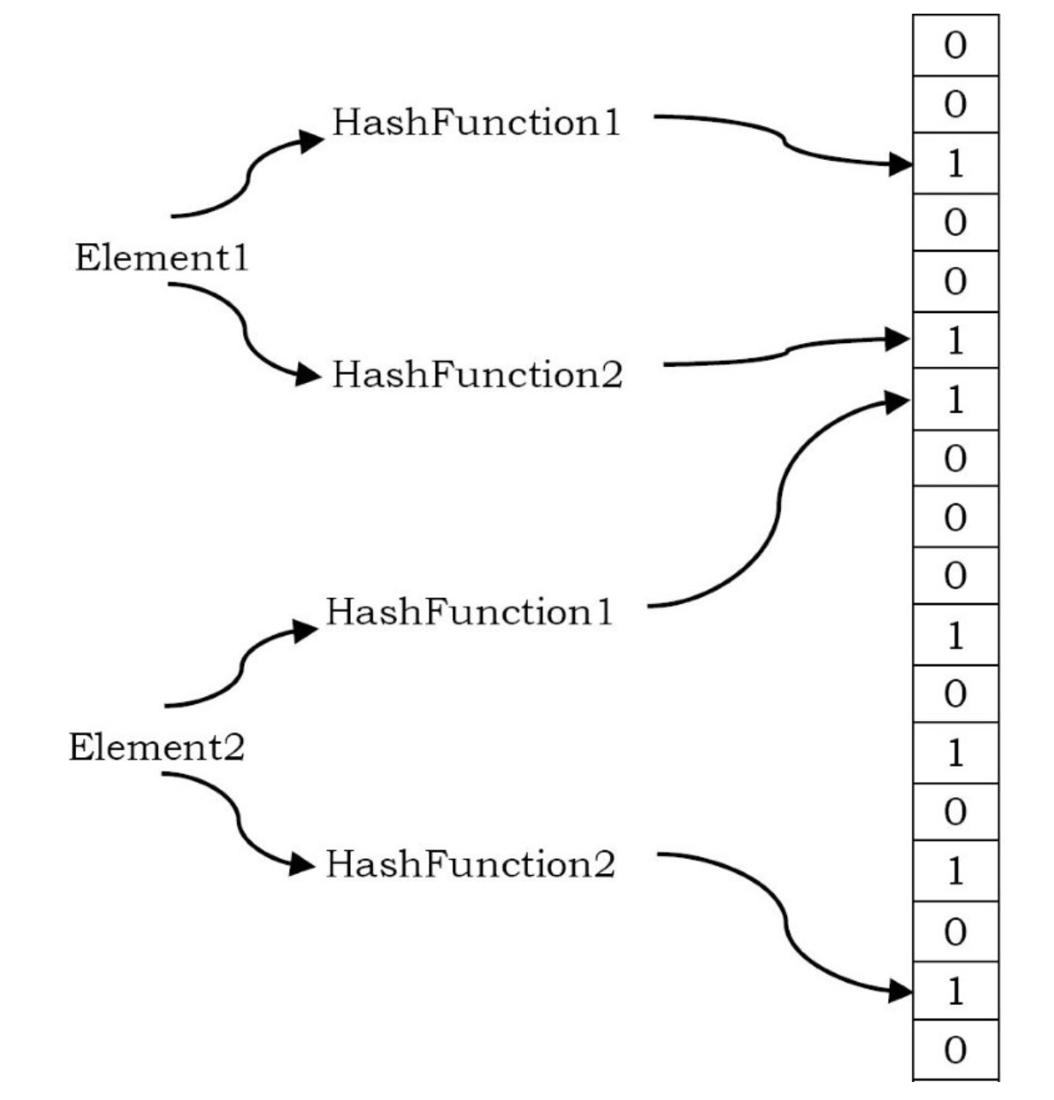
Bloom Filters
A Bloom filter is a probabilistic data structure which was designed to check whether an element is present in a set.
It tells that the searched element is not in the set with 100% accuracy
But can not give 100% guarantee that an element is present in the set
If any of them are 0, we can be 100% sure that the search element is not in the set.
However, even if all of them are one, we still can’t conclude that element is present because all of the bits could have been set by the k hash functions applied to other elements.

Slide 17
Bloom Filters
It is not possible to remove an element from a Bloom filter.
  The reason is simply that we can’t unset a bit that appears to belong to an element because it might also be set by another element.
As the bit array fills up, the probability of a false positive slowly increases
We can trade space for accuracy

Slide 18
Static Vs Dynamic Hashing
Feature | Static Hashing | Dynamic Hashing
Table Size | Fixed when the table is created | Can grow or shrink as needed
Hash Function | Fixed | Changes/adapts based on table size
Flexibility | Low — may lead to overflow or underutilization | High — handles insertions/deletions smoothly
Overflow Handling | Uses overflow chains or buckets | Uses directory structure or splitting
Used In | Simple hash tables, small-scale applications | DBMS (e.g., extendible or linear hashing)

Slide 19
Exercises
Given an array of characters, give an algorithm for removing the duplicates.
Given two arrays of unordered numbers, check whether both arrays have the same set of numbers?
Given a singly linked list, check whether it has a loop in it or not.
Given two sets A and B, and a number K, Give an algorithm for finding whether there exists a pair of elements, one from A and one from B, that add up to K

