Slide 1

Design & Analysis of Algorithms
Dr. Alakesh Kalita
Mathematics and Computing
IIT ISM Dhanbad

Slide 2
Analyzing Algorithms

Slide 3

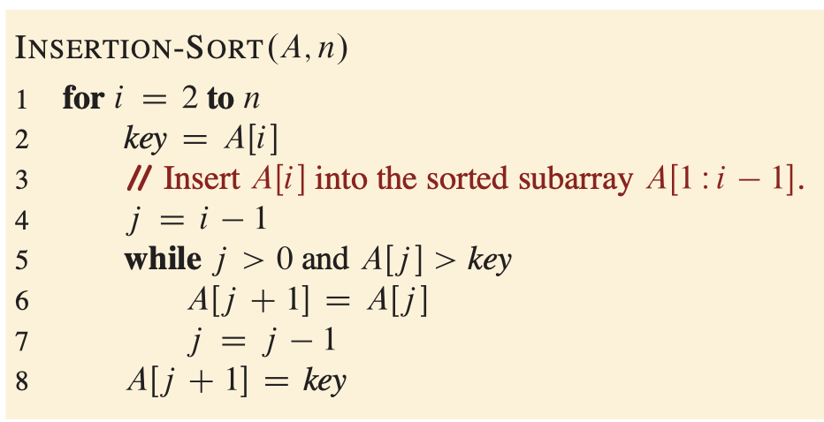
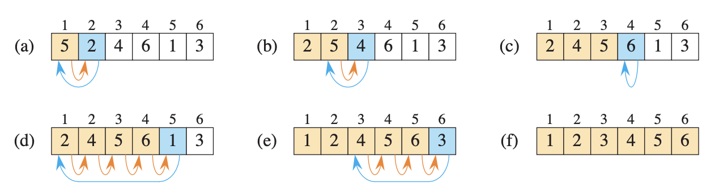
Insertion sort

Slide 4
Correctness of Insertion sort
To prove the correctness of algorithms, we typically use a method called the loop invariant technique
Using loop invariant, we can show three things:
Initialization: Holds true before the loop starts
Maintenance: It remains true after every iteration of the loop
Termination: Helps in proving that the algorithm is correct when the loop finishes

Slide 5
Correctness of Insertion sort
1. Initialization (Base Case):
Before the first iteration (i = 2), A[1] is trivially sorted (a single element).
So the invariant holds.
2. Maintenance (Inductive Step):
Assume A[0..i-1] is sorted before iteration i.
The algorithm inserts A[i] (key) into its correct position in A[1:i] by shifting larger elements right.
After insertion, A[1:i] is sorted.
So the invariant is preserved.
3. Termination:
The loop ends at i = n+1.
At this point, the invariant tells us that A[1:n] (i.e., the full array) is sorted.

Slide 6
Analyzing algorithms

Slide 7
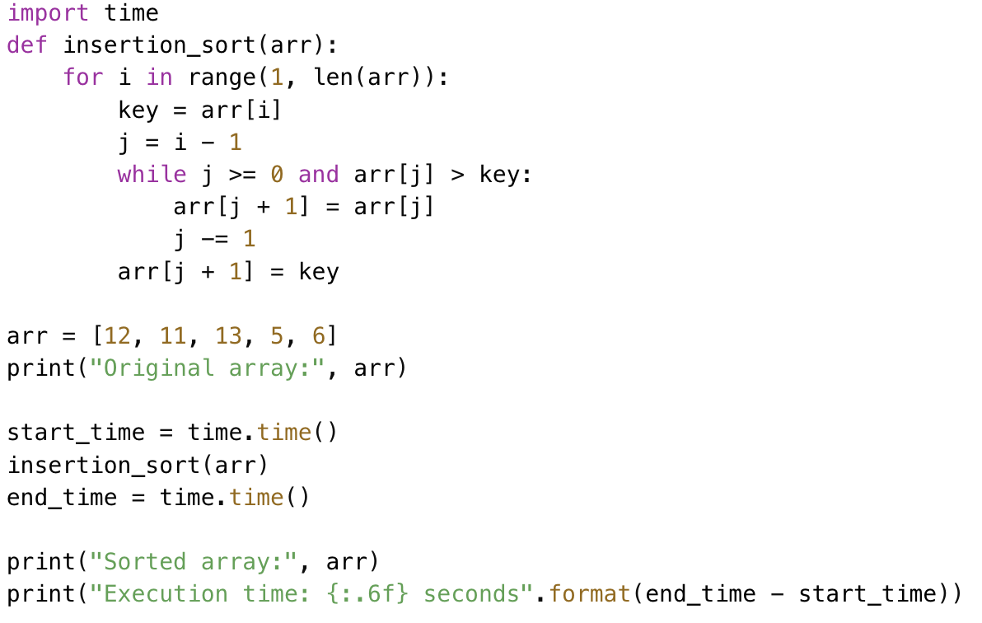


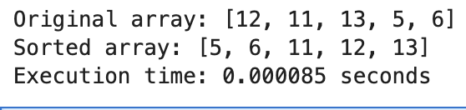
Analyzing algorithms
To generalize the time complexity formula for insertion sort, we need to analyze the insertion sort algorithm line by line.

Slide 8
Key Assumptions in Algorithm Analysis
1. Sequential Execution
Instructions are executed one after another (are in RAM)
No concurrent operations allowed
4. Ignoring Precision & Word Size
Floating Point Precision Ignored
Assume values are big but not infinite
Word size is enough to hold:
Input values
Intermediate results
2. Equal Cost for Similar Instructions
Data access or updating a variable from/of a given data structure takes constant time
5. Memory Access Assumption
Memory Hierarchy Ignored
3. No Unrealistic Assumptions
Sorting an array in constant time

Slide 9
Input size ?
1. Sorting:
Determined by the number of elements in the array or list.
2. Graph Problems:
Defined by the number of vertices (V) or edges (E).

Slide 10
Calculating Running time
The running time of an algorithm is the sum of running times of all the individual statements it executes.
Let a statement take c_{k} steps (cpu cycles) to execute.
If it is executed m times:
T(n) = c_{k}⋅m
Note: c_{k} hypothetical constant (not an actual clock time/cycle).

Slide 11
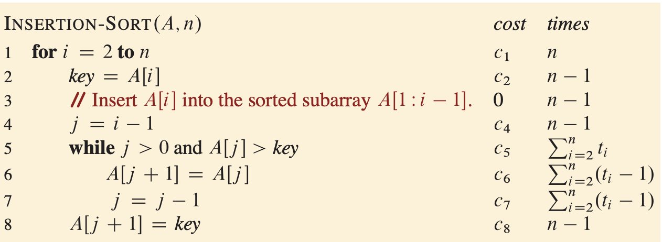
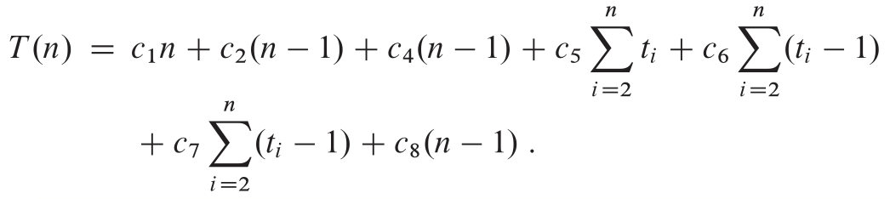
Analysis of Insertion sort

Slide 12
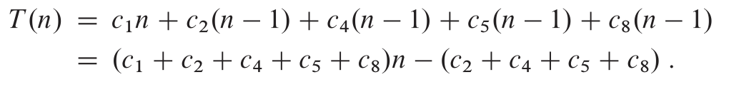
Analysis of Insertion sort
Best Case
The running time is linear function of n

Slide 13
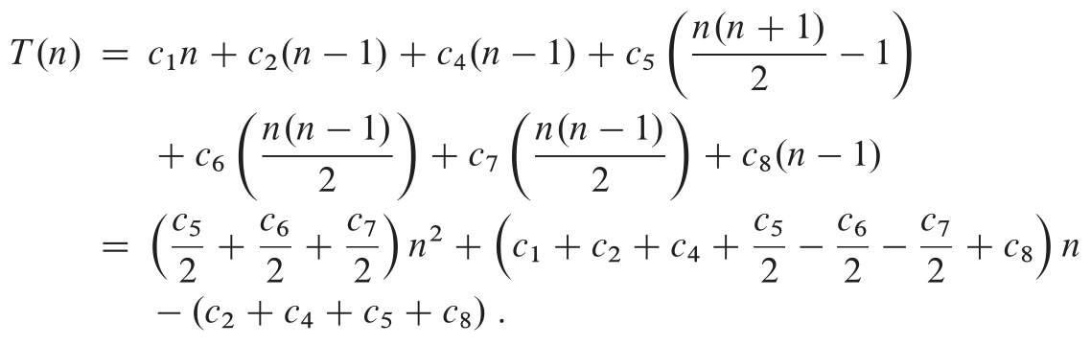
Analysis of Insertion sort
Worst Case
The running time is quadratic function of n

Slide 14
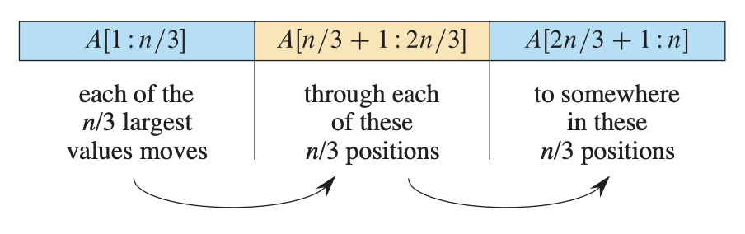
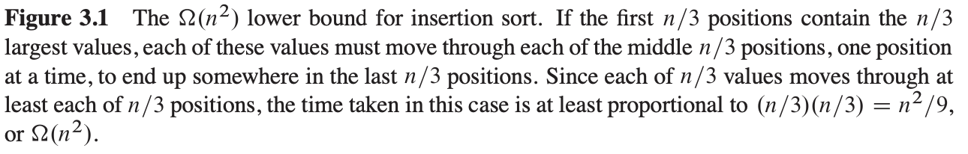
Analysis of Insertion sort
Average Case
How long does it take to determine where in subarray A [1 : i -1] to insert element A[i] for any given random input instance?
On average, half the elements in A [1 : i -1] are less than A[i]
The resulting average-case running time turns out to be a quadratic function of the input size, just like the worst case
Note: We usually consider one algorithm to be more efficient than another if its worst-case running time has a lower order of growth

Slide 15
Example Running Time Expression
Given:
T(n) = n² / 100 + 100n + 7
Asymptotic Behavior:
• n² / 100 dominates when n >> 100000
• Lower order terms become negligible for large n

Slide 16
Linear Search
What is Linear Search?
Linear Search is a straightforward algorithm to find a target element (key) in a list.
It works by checking each element in the list sequentially until the target is found or the list ends.

Slide 17
Linear Search Algorithm:
Algorithm Steps:
Start from the first element of the array.
Compare the key with the current element
If the key matches the current element, return its index.
If the key does not match
If list does not ends
Update next element as current element
Goto step 2
Else return -1
LINEAR-SEARCH(A, x)
1. for i = 1 to n
2. if A[i] == x
3. return i
4. return NIL

Slide 18
Linear Search Algorithm:
arr = [ 3, 8, 7, 1, 9 ]
key = 3
Number of comparison = 1
Best Case (Constant time)
LINEAR-SEARCH(A, x)
1. for i = 1 to n
2. if A[i] == x
3. return i
4. return NIL
key = 9
Number of comparison = 5
Worst case (linear n time)
key can be present anywhere
Average case = all possible cases / total cases
(n+1)/2

Slide 19
Linear Search Characteristics:
Key Characteristics:
Works on both sorted and unsorted arrays.
Time Complexity varies based on the position of the target element.
Advantages of Linear Search
Simple and easy to implement.
Works on both sorted and unsorted arrays.
Requires no preprocessing of the array.
Disadvantages:
Inefficient for large datasets.
Performance degrades linearly with the size of the array.

Slide 20
Contd…
1. Initialization: Before the first iteration (i = 1), the subarray is empty. So invariant holds
2. Maintenance
Assume invariant is true at iteration i; so x ∉ A[1..i−1]
Now we check:
If A[i] = x: return i (correct)
Else: move to i+1
Invariant is maintained
LINEAR-SEARCH(A, x)
1. for i = 1 to n
2. if A[i] == x
3. return i
4. return NIL
3. Termination
When loop ends:
All A[1..n] have been checked
Invariant ensures x is not in the array
Return NIL is correct

Slide 21
Question
Modify linear search to count occurrences of a target element
Use linear search to find the largest/smallest element in an array.
What is the best case, worst case, and average case execution time for the above problems?

Slide 22
Search smart, not hard !

Slide 23
Binary Search
key = 33
6
13
14
25
33
43
51
53
64
72
84
93
95
96
97
0
1
2
3
4
5
6
7
8
9
10
11
12
13
14
low
high
mid = (low+high)/2
= (0 + 14)/2
= 7

Slide 24
Binary Search
6
13
14
25
33
43
51
53
64
72
84
93
95
96
97
0
1
2
3
4
5
6
7
8
9
10
11
12
13
14
low
mid
high
Need to compare A[mid] with the key;
A[mid] > key [53> 33]
6
13
14
25
33
43
51
53
64
72
84
93
95
96
97
if A[mid] > key:
high = mid -1
0
1
2
3
4
5
6
7
8
9
10
11
12
13
14
low
high

Slide 25
Binary Search
6
13
14
25
33
43
51
0
1
2
3
4
5
6
Again, need to compare the mid with the key
if A[mid] < key:
low = mid + 1
low
mid
high
mid = (low+high)/2
= (0 + 6)/2
= 3
6
13
14
25
33
43
51
0
1
2
3
4
5
6
low
high

Slide 26
Binary Search
33
43
51
Again, need to compare the mid with the key
4
5
6
if A[mid] > key:
high = mid -1
low
high
33
43
51
mid
4
5
6
mid = (low+high)/2
= (4 + 6)/2
= 5
low
high

Slide 27
Binary Search
33
Again, need to compare the mid with the key
4
if A[mid] = key:
return mid
low
high
mid
mid = (low+high)/2
= (4 + 4)/2
= 4

Slide 28
Binary Search: Algorithm
BinarySearch(array, key):
1. Set low = 0
2. Set high = length(array) - 1
3. While low <= high:
a. Set mid = low + (high - low) // 2
b. if array[mid] == key:
return mid
c. Else If array[mid] < key:
Set low = mid + 1
d. Else:
Set high = mid - 1
4. return -1 // Target not found

Slide 29
Binary Search: Execution time analysis
6
13
14
25
33
43
51
53
64
72
84
93
95
96
97
n elements
0
1
2
3
4
5
6
7
8
9
10
11
12
13
14
6
13
14
25
33
43
51
n/2 elements
0
1
2
3
4
5
6
33
43
51
n/4 elements
for (int i = n; 1 < i; i = i/2) {
BinarySearch(low, high, arr)
}
4
5
6
33
1 elements
Ans: log n

Slide 30
Binary Search: Execution time analysis
At each step, the algorithm divides the input into two halves.
It performs a single comparison and decides whether to search in the left or right half.
T(n) = T(n/2) + c
T(n): Time complexity for an input size of n.
T(n/2): Time complexity for the reduced input size after one division.
c: Constant time for the comparison and midpoint calculation.

Slide 31
Binary Search: Execution time analysis
Using substitution method,
T(n) = T(n/2) + c
= T(n/4) + c + c
= T(n/8) + c + c + c
.
.
= T(n/2^{k}) + kc = T(1) +kc
Where, n/2^{k} =1, so k = log n

Slide 32
Binary Search: Execution time analysis
Best Case:
The best case occurs when the target element is found in the first comparison.
Time complexity: O(1).
Worst Case:
The worst case occurs when the algorithm runs until the search interval is reduced to size 1 (target not found or found at the last step).
Time complexity: O(log⁡n).
Average Case:
On average, the element is found after searching half the depth of the search tree.
Time complexity: O(log⁡n).

Slide 33
Conclusion
Binary search is an efficient divide-and-conquer algorithm.
Time complexity is log n, making it suitable for large datasets.
Precondition: The array must be sorted.

Slide 34
Conclusion
SELECTION-SORT(A, n)
1. for i ← 0 to n − 2 do
2. min_index ← i
3. for j ← i + 1 to n − 1 do
4. if A[j] < A[min_index] then
5. min_index ← j
6. end for
7. if min_index ≠ i then
8. swap A[i] and A[min_index]
9. end for

Slide 35
Selection sort: Execution time analysis
At each step, the algorithm reduces the input size by one
It performs n-1 single comparison and put the current minimum element in its correct position
T(n) = T(n-1) + c (n-1)
T(n): Time complexity for an input size of n.
T(n-1): Time complexity for the reduced input size after one division.
c: Constant time for the comparison.

