Slide 1

Design & Analysis of Algorithms
Dr. Alakesh Kalita
Mathematics and Computing
IIT ISM Dhanbad

Slide 2
Merge sort
Divide and Conquer Approach

Slide 3
Merge operation
A
1
3
5
6
B
2
4
8
9
i
i
i
j
j
j
if B[j] > A[i]:
C[m] = A[i]
m++
i++
if A[i] > B[j]:
C[m] = B[j]
m++
j++
C
1
2
3
4
5
6
8
9
m
m
m
m

Slide 4
Merge operation
A
1
2
3
4
B
5
6
7
8
i
j
j
if B[j] > A[i]:
C[m] = A[i]
m++
i++
if A[i] > B[j]:
C[m] = B[j]
m++
j++
Merging:O(n+m)
while i < len(A):
C[m] = A[i]
i += 1
m += 1
while j < len(B):
C[m] =B[j]
j += 1
m += 1
C
1
2
3
4
5
6
7
8
m
m

Slide 5
Merge Algorithm
def merge(left_half, right_half, arr):
i = j = k = 0
while i < len(left_half) and j < len(right_half):
if left_half[i] < right_half[j]:
arr[k] = left_half[i]
i += 1
else:
arr[k] = right_half[j]
j += 1
k += 1
# Copy any remaining elements from the left half
while i < len(left_half):
arr[k] = left_half[i]
i += 1
k += 1
# Copy any remaining elements from the right half
while j < len(right_half):
arr[k] = right_half[j]
j += 1
k += 1
What is the space complexity?

Slide 6
Merge Algorithm: In-place
A
1
3
5
B
2
0
7
0
7
2
5
8
9
10
i
i
i
j
j
j
def merge_two_arrays_no_extra_space(A, B):
n, m = len(A), len(B)
left, right = n - 1, 0
while left >= 0 and right < m:
if A[left] > B[right]:
swap (A[left], B[right])
left -= 1
right += 1
else:
break
sort(A)
sort(B)
Time complexity: O(min(n,m))+O(n log n) + O(m log m)

Slide 7
Gap-Merge Algorithm: In-place (shell sort like merge)
A
7
B
gap = ceil(n +m)/2 = 5
2
6
8
5
9
1
3
2
7
10
8
5
9
1
i=0
i
i
i
j= i+ gap
j
j
j
A
B
3
2
gap = ceil(gap/2) = 3
7
10
8
5
9
7
1
2
1
6
8
5
9
1
2
i
i
j
j
A
B
6
2
7
10
8
5
9
7
1
2
1
3
8
5
9
1
2

Slide 8
Merge Algorithm: In-place (shell sort)
A
B
6
2
gap = ceil(gap/2) = 2
7
10
8
5
9
7
1
2
1
3
2
8
5
9
3
1
2
i
i
j
j
i
i
j
j
A
B
6
2
gap = ceil(gap/2) = 1
7
10
8
5
9
7
1
2
1
3
2
8
5
9
3
1
2
i
j
A
B
6
2
7
8
9
5
10
7
1
2
1
3
2
8
3
9
5
1
2

Slide 9
Gap-Merge Algorithm: In-place (shell sort like merge)
def merge_gap(arr1, arr2):
n, m = len(arr1), len(arr2)
total = n + m
# initial gap = ceil(total/2)
gap = (total / 2) + (total % 2)
while gap > 0:
left = 0
right = left + gap
while right < total:
if left < n and right >= n:
# compare across arr1 and arr2
elif left >= n:
# compare within arr2
else:
# compare within arr1
…
left += 1
right += 1
if gap == 1:
break
# next gap = ceil(gap/2)
gap = (gap / 2) + (gap % 2)
Average case: ? Worst case: ?

Slide 10
Divide
mid = len(arr) // 2
left_half = arr[:mid]
right_half = arr[mid:]
4
7
2
6
1
4
7
3
divide(left_half)
divide(right_half)
4
7
2
6
1
4
7
3
4
7
2
6
1
4
7
3
4
7
2
6
1
4
7
3
if len(arr) <= 1:
return

Slide 11
Conquer (sort) and Merge
def merge_sort(arr):
if len(arr) <= 1:
return
mid = len(arr) // 2
left_half = arr[:mid]
right_half = arr[mid:]
# Recursively sort each half
merge_sort(left_half)
merge_sort(right_half)
# Merge left_half and right_half
merge(left_half, right_half, arr)
1
2
3
4
4
6
7
7
2
4
6
7
1
3
4
7
4
7
2
6
1
4
3
7
4
7
2
6
1
4
7
3

Slide 12
Merge sort Algorithm
def merge_sort(arr):
if len(arr) <= 1:
return
mid = len(arr) // 2
left_half = arr[:mid]
right_half = arr[mid:]
# Recursively sort each half
merge_sort(left_half)
merge_sort(right_half)
# Merge left_half and right_half back into arr
merge(left_half, right_half, arr)

Slide 13
Merge sort analysis
def merge_sort(arr):
if len(arr) <= 1:
return
mid = len(arr) // 2
left_half = arr[:mid]
right_half = arr[mid:]
# Recursively sort each half
merge_sort(left_half)
merge_sort(right_half)
# Merge left_half and right_half back into arr
merge(left_half, right_half, arr)
1
2
3
4
4
6
7
7
n
2
4
6
7
1
3
4
7
n
4
7
2
6
1
4
3
7
n
4
7
2
6
1
4
7
3
log n
Time complexity is 𝜃(n logn)

Slide 14
Merge sort: Space analysis
Space complexity 𝜃(n)

Slide 15
Overall Complexity Analysis
Time Complexity:
Best, Worst, Average Case: 𝜃(n log n)
Recurrence Relation: T(n) = 2T(n/2) + 𝜃(n)
Space Complexity:
Requires 𝜃(n) additional space for temporary arrays during merging.

Slide 16
Advantages and Disadvantages
Advantages:
Guaranteed 𝜃(n log n) time complexity.
Stable sort (preserves relative order of equal elements).
Insertion sort, Bubble sort are also stable
Support external sorting (part of the data can be brought into RAM)
Disadvantages:
Requires extra space proportional to the input size (not in-place algo).
Not suitable small data size due to the overhead of recursion
Insertion sort is good for small data size (n<32)

Slide 17
Question
What is the stack space of Merge sort?
Ans: log n

Slide 18
Quick sort
Divide and Conquer Approach

Slide 19
Quick Strategy
Goal: Find the correct position of an element named Pivot
3
1
2
4
5
6
7
8
In its correct position
Pivot
Greater than the pivot
Can be unordered / ordered
Less than the pivot
Can be unordered / ordered

Slide 20
Quick Strategy
3
1
2
4
5
6
7
8
In its correct position
Call QuickSort() by selecting a new pivot
Call QuickSort() by selecting a new pivot
Divide Strategy

Slide 21
Quick Sort: Partitioning
4
5
7
2
3
6
1
8
Pivot
high
low
3
1
2
4
5
6
7
8
(Goal)

Slide 22
Quick Sort: Partitioning
Pivot
4
5
7
2
3
6
1
8
i
j
Searching for the element greater
than pivot
Searching for the element less
than pivot
4
5
7
2
3
6
1
8
i
j
4
1
7
2
3
6
5
8
i
j

Slide 23
Cont …
4
1
7
2
3
6
5
8
4
1
3
2
7
6
5
8
i
j
j
i
Stop
4
1
3
2
7
6
5
8
pivot
j
i
4
1
3
2
7
6
5
8
i
j
2
1
3
4
7
6
5
8
j
pivot
i

Slide 24
Cont …
Pivot
partition (low, high)
{
pivot = A[low]
i= low, j = high
4
5
7
2
3
6
1
8
1
j
While (i<j)
{
}
i
Searching for greater
than pivot
Searching for less
than pivot
do{
i++
}while A[i] < pivot & i < high
do{
j--
}while A[j] > pivot
4
5
7
2
3
6
1
8
2
i
j
if i < j:
Swap (A[i], A[j])
4
1
7
2
3
6
5
8
3
i
j
swap(pivot, A[j])
return j }

Slide 25
QuickSort()
partition (low, high)
{
pivot = A[low]
i= low, j = high
QuickSort(low, high)
{
if (low< high):
k = partition(low, high)
QuickSort(low, k)
QuickSort(k+1, high)
}}
While (i<j)
{
}
do{
i++
}while A[i] < pivot
do{
j–-
}while A[j] > pivot
3
1
2
4
5
6
7
8
Partition position
if i < j:
Swap (A[i], A[j])
Call QuickSort() by selecting a new pivot
Call QuickSort() by selecting a new pivot
swap(pivot, A[j])
return j }

Slide 26
Quick Sort: Analysis
3
1
2
4
5
6
7
8
n
n/2
n/2
In its correct position
n/4
n/4
n/4
n/4
Call QuickSort() by selecting a new pivot
Call QuickSort() by selecting a new pivot
1
1
1
1
1
1
1

Slide 27
Cont …
Time complexity is (n logn)
n
n
n
n/2
n/2
log n
n/4
n/4
n/4
n/4
n
n
1
1
1
1
1
1
1

Slide 28
Cont …
Best-Case Recurrence Relation:
T(n)=2 T(n/2)+O(n)
T(n/2): Sorting the subarray with n/2 elements
O(n): Time taken to partition the array (compare each element with the pivot).

Slide 29
Cont …
Time complexity is (n²)
n
n
n-1
1
n-1
n
1
n-2
n - 2
1
1

Slide 30
Cont …
Worst-Case Recurrence Relation:
T(n)=T(n−1)+O(n)
T(n−1): Sorting the subarray with n−1 elements (one partition is empty, and the other contains all the elements except the pivot).
O(n): Time taken to partition the array (compare each element with the pivot).

Slide 31
Questions
What kind of input results in the worst time complexity for Quick Sort, and under what condition?
Ans: An already sorted array, when using either the first or last element as the pivot, leads to the worst time complexity.
2. How to improve the worst case time complexity of Quick Sort?
Ans:
3. Implement and compare the running times of Merge Sort, Quick Sort, Insertion sort for different values of input size?
Ans:

Slide 32
Question
What is the stack space of Quick sort in worst case?
Ans: n

Slide 33
In a software company, the manager gives an MVP award every Monday to team members based on the number of tasks they have completed. The manager uses a data structure to track how many tasks each team member has done. The information is cumulative: if a team member completed x tasks in the previous week and y tasks in the current week, x+y is stored for that employee. To find the MVP, the manager uses the QuickSort algorithm, taking the first element as the pivot, to sort the data in ascending order and then selects the last element as the MVP. Determine the time complexity considering group size is n of this QuickSort in the following cases:
In any given random week.
After a two-week Durga Puja holiday announced on a Monday, during which no employee did any work, the office reopens on Monday, and the manager must announce the MVP again. What is the time complexity?
How can the manager improve the performance of the QuickSort algorithm if there is another two-week vacation and the office is going to reopen on Monday?

Slide 34
We modify the base case of the recursion so that if the array has fewer than k elements, the subarray is sorted by insertion sort, rather than by continued recursive calls to quicksort. Argue that the randomized version of this sorting algorithm runs in O(nk +n log (n/k)) expected time.

Slide 35
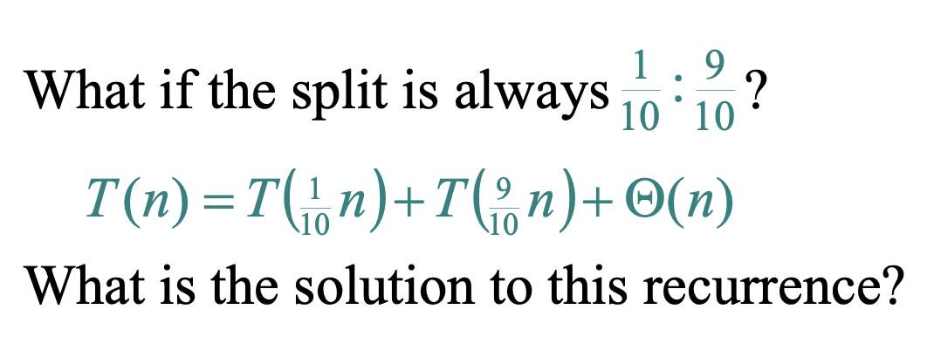
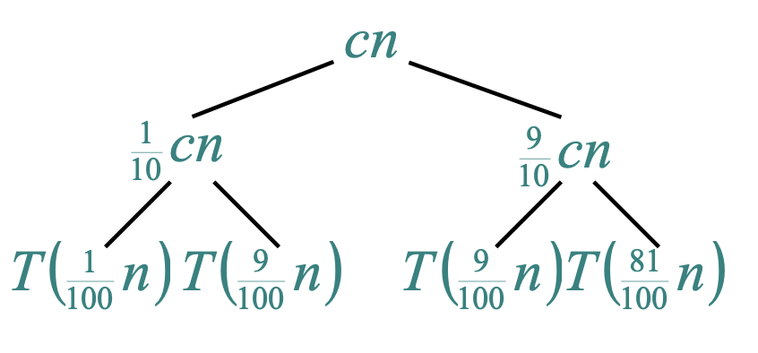

Slide 36
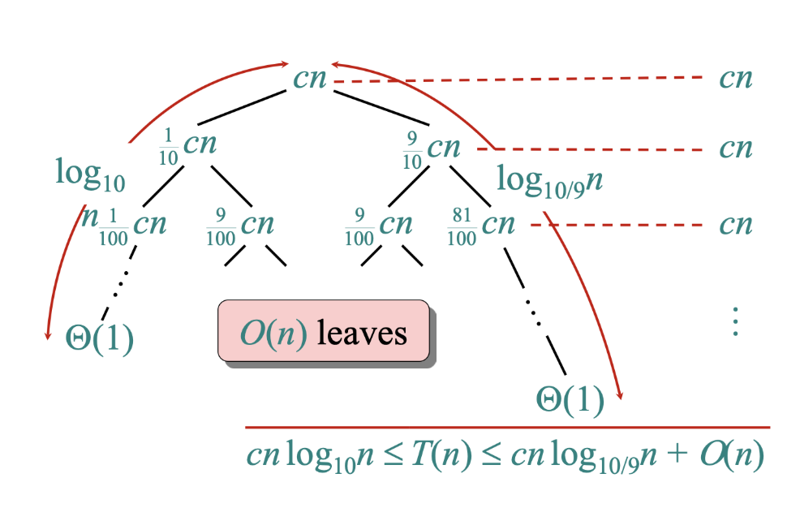

Slide 37
Probabilistic Analysis Vs Randomized Analysis
Probabilistic Analysis
We analyze an algorithm whose input is assumed to be drawn from a known probability distribution.
The algorithm itself is deterministic; no random choices internally
Source of randomness:
Comes from the input distribution, not the algorithm.
Example: In quicksort, if the pivot is always chosen as the first element, but we assume that input permutations are equally likely, the average running time is O(nlog⁡n) even though the worst case is O(n²).

Slide 38
Probabilistic Analysis Vs Randomized Analysis
Randomized Analysis
We analyze an algorithm that makes its own random choices during execution even on a fixed input.
Source of randomness:
Comes from the algorithm itself, not the input.
Example: Randomized quicksort: Pivot is chosen uniformly at random each time, so the expected running time is O(nlog⁡n) for any input.
How to find the expected running time?

Slide 39
Probabilistic Analysis and Randomized
Algorithms
The Hiring Problem

Slide 40
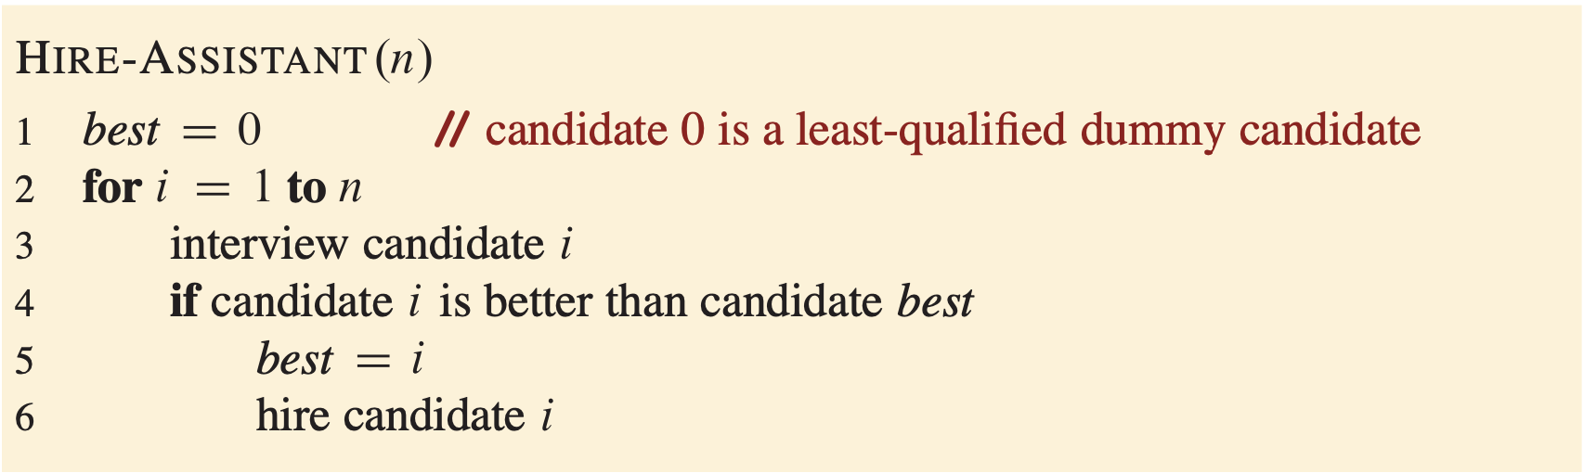
The Hiring Problem
Need to hire a new office assistant
Use an employment agency that sends one candidate per day.
Pay a small interview fee for each applicant.
Hiring is costlier: involves firing current assistant + paying hiring fee.
Candidates are numbered 1 to n and interviewed in that order.
After interviewing candidate i, determine if they are the best so far.
Maintain a dummy candidate 0 (less qualified than all others) as initial reference.
Strategy: always keep the best possible candidate at all times.
Decision rule: hire a candidate if they are better than the current assistant.

Slide 41
The Hiring Problem
Costs in Hiring Problem
Interviewing cost: c_{i}​ (low)
Hiring cost: c_{h}​ (high)
For m hires, total cost: O(c_{i}n+c_{h}m)
Always incur c_{i}​n (since all n candidates are interviewed)
Focus on analyzing c_{h}m, which depends on candidate order
Worst-Case Scenario
Candidates in strictly increasing quality order → hire n times
Total hiring cost in worst case: O(c_{h}n)
In reality: candidate arrival order unknown and uncontrollable
Leads to average-case analysis

Slide 42
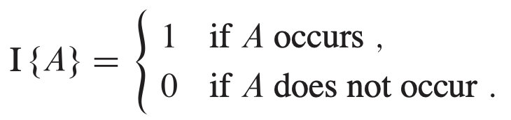
The Hiring Problem
Indicator Random Variables
Used in analyzing algorithms (e.g., hiring problem)
Method for converting between probabilities and expectations
Indicator Random Variables,

Slide 43
Expected value of an indicator
The expected value of an indicator is exactly the probability of the event.
E[I] = 1·P(Heads) + 0·P(Tails)
For any event A:
E[I_A] = P(A)
= 1·(1/2) + 0·(1/2)
E[I] = 1/2
This is Lemma 5.1 in simple language.
Because the 0 case contributes nothing, only the probability of the “Yes” case remains.

Slide 44
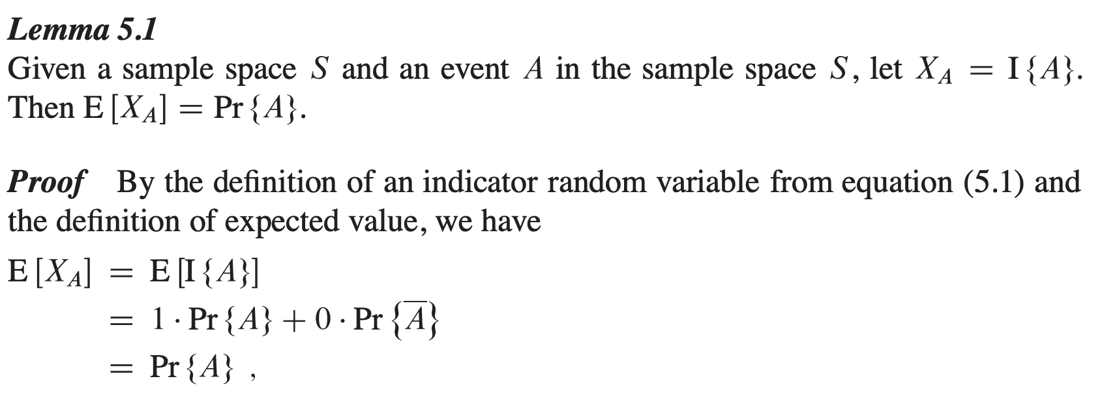
The Hiring Problem
The expected value of an indicator random variable associated with an event A is equal to the probability that A occurs.

Slide 45
Repeated flips: counting by adding 1s and 0s
Now suppose we flip a coin 4 times.
H
T
H
H
X = I₁ + I₂ + I₃ + I₄
I1 = 1
I2 = 0
I3 = 1
I4 = 1
X = 1 + 0 + 1 + 1
X = 3 heads
Here X means total number of Heads. Each indicator tells us whether one particular flip was Heads.

Slide 46
Linearity of expectation
A powerful rule: expectation of a sum equals sum of expectations.
E[I₁ + I₂ + I₃ + I₄] = E[I₁] + E[I₂] + E[I₃] + E[I₄]
Expected heads in 4 flips
= 1/2 + 1/2 + 1/2 + 1/2
= 2

Slide 47
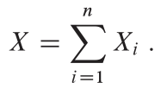
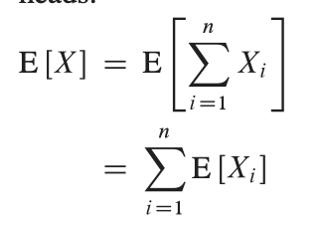
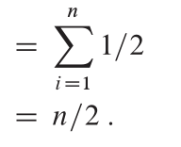
Expected number of heads in n flip coins
Where, X_{i} be the indicator random variable associated with the event in which the i-th flip comes up head.
E[X_{i}] = ?
= 1/2
Let X be the random variable denoting the total number of heads in the n coin flips
Now, we can compute the expected number of heads:

Slide 48
The Hiring Problem
Objective
Compute expected number of times (m) a new assistant is hired.
Assume candidates arrive in random order.
Using Indicator Random Variables
X_{i} be the indicator random variable associated with the event in which the i-th candidate is hired
Define X_{i} = 1 if candidate i is hired, else 0.
Lemma 5.1: E[X_{i}] = Probability(candidate i is hired).

Slide 49
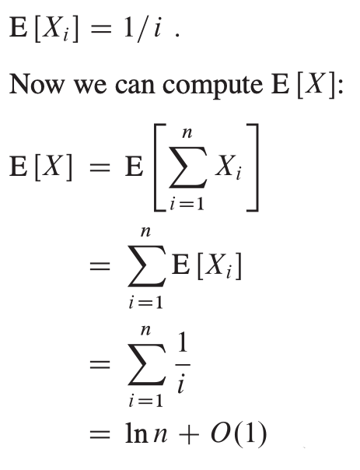
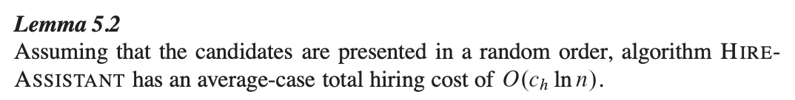
Probability of Candidate i is Hired
Candidate i hired if better than first i-1 candidates.
In random order: each of first i candidates equally likely to be best so far. So, probability = 1/i.
Thus, E[X_{i}] = 1/i = Pr {candidate i is hired}
Total hires: X = X₁ + X₂ + ... + X_{n}.

Slide 50
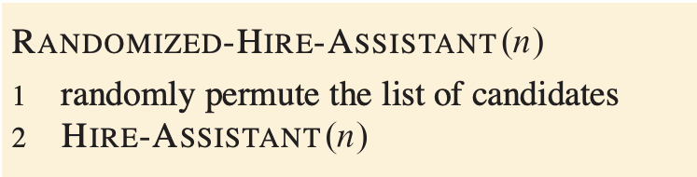
RANDOMIZED-HIRE-ASSISTANT
How to improve this algorithm?

Slide 51
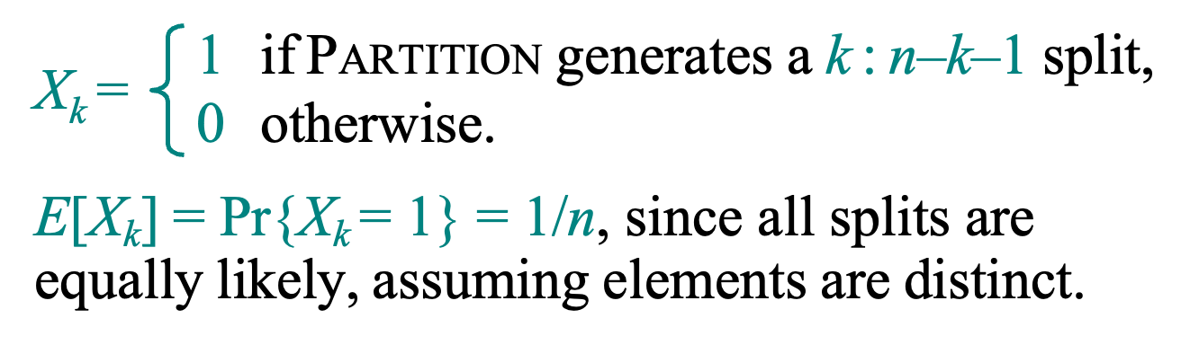
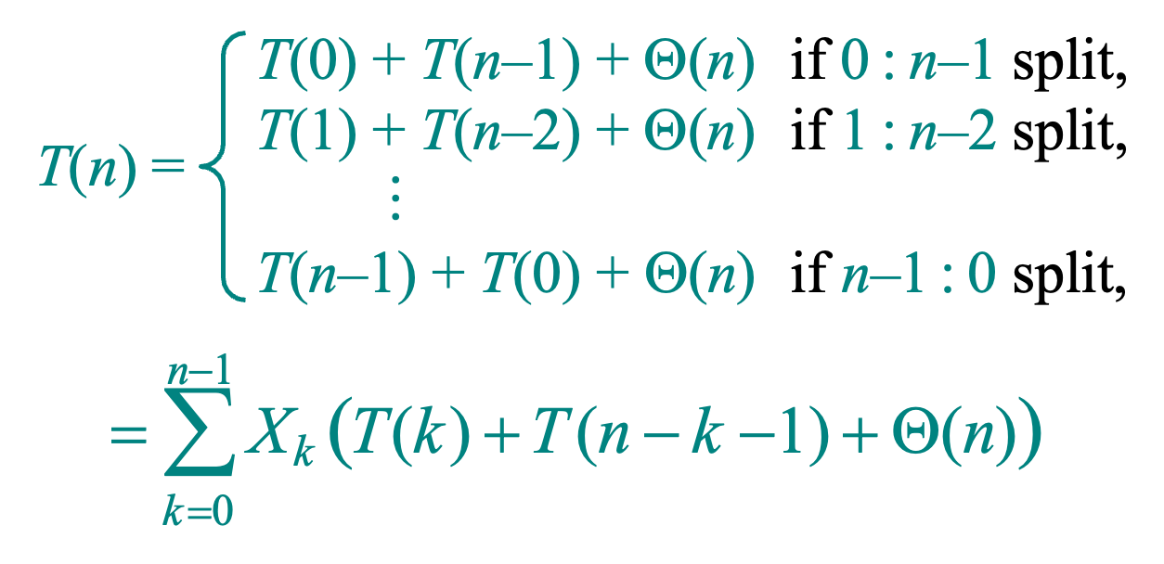
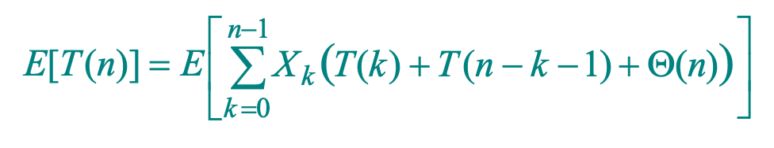
Analyze the randomized Quick sort algorithm using the indicator random variable.

Slide 52
Matrix Multiplication
Divide and Conquer Approach

Slide 53
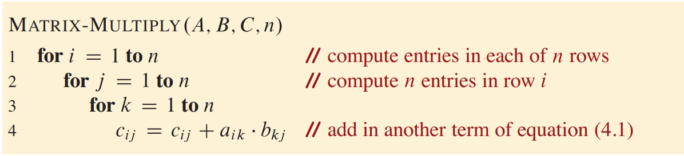
Matrix Multiplication
Time complexity is 𝜃(n³)

Slide 54
Small problem: Matrix Muti
Pseudocode:
def divide_and_conquer(problem):
if base_case(problem):
return base_solution(problem)
subproblems = divide(problem)
subresults = divide_and_conquer(subproblems)
return combine(subresults)
A₁₁ A₁₂
A₂₁ A₂₂
2 x 2
C₁₁ C₁₂
C₂₁ C₂₂
A₁₁ A₁₂
A₂₁ A₂₂
B₁₁ B₁₂
B₂₁ B₂₂
(Small Problem)

Slide 55
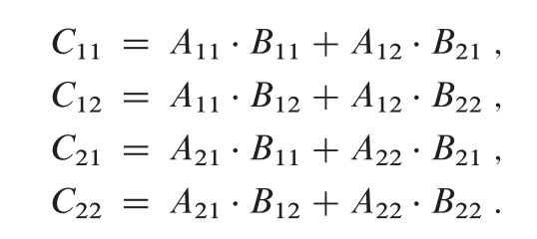
Matrix Multiplication: DnC
C₁₁ C₁₂
C₂₁ C₂₂
A₁₁ A₁₂
A₂₁ A₂₂
B₁₁ B₁₂
B₂₁ B₂₂
(Small Problem)

Slide 56
Cont …
C₁₁ C₁₂ C₁₃ C₁₄
C₂₁ C₂₂ C₂₃ C₂₄
C₃₁ C₃₂ C₃₃ C₃₄
C₄₁ C₄₂ C₄₃ C₄₄
A₁₁ A₁₂ A₁₃ A₁₄
A₂₁ A₂₂ A₂₃ A₂₄
A₃₁ A₃₂ A₃₃ A₃₄
A₄₁ A₄₂ A₄₃ A₄₄
B₁₁ B₁₂ B₁₃ B₁₄
B₂₁ B₂₂ B₂₃ B₂₄
B₃₁ B₃₂ B₃₃ B₃₄
B₄₁ B₄₂ B₄₃ B₄₄
C₁₁
C₁₂
A₁₁
A₁₂
B₁₁
B₁₂
C₂₁
C₂₂
A₂₁
A₂₂
B₂₁
B₂₂
C₁₁ = A₁₁ x B₁₁ + A₁₂ x B₂₁
C₁₂ = A₁₁ x B₁₂ + A₁₂ x B₂₂
C₂₁ = A₂₁ x B₁₁ + A₂₂ x B₂₁
C₂₂ = A₂₁ x B₁₁ + A₂₂ x B₂₁

Slide 57
C₁₁ C₁₂ C₁₃ C₁₄
C₂₁ C₂₂ C₂₃ C₂₄
C₃₁ C₃₂ C₃₃ C₃₄
C₄₁ C₄₂ C₄₃ C₄₄
A₁₁ A₁₂ A₁₃ A₁₄
A₂₁ A₂₂ A₂₃ A₂₄
A₃₁ A₃₂ A₃₃ A₃₄
A₄₁ A₄₂ A₄₃ A₄₄
B₁₁ B₁₂ B₁₃ B₁₄
B₂₁ B₂₂ B₂₃ B₂₄
B₃₁ B₃₂ B₃₃ B₃₄
B₄₁ B₄₂ B₄₃ B₄₄
C₁₁
C₁₂
A₁₁
A₁₂
B₁₁
B₁₂
C₂₁
C₂₂
A₂₁
A₂₂
B₂₁
B₂₂
Matrix_Multiplication(A, B, n)
{
if (n < = 2){
}
else{
Matrix_Multiplication(A₁₁ , B₁₁ , n/2 )+ Matrix_Multiplication(A₁₂ , B₂₁ , n/2 )
Matrix_Multiplication(A₁₁ , B₁₂ , n/2 )+ Matrix_Multiplication(A₁₂ , B₂₂ , n/2 )
Matrix_Multiplication(A₂₁ , B₁₁ , n/2 )+ Matrix_Multiplication(A₂₂ , B₂₁ , n/2 )
Matrix_Multiplication(A₂₁ , B₁₁ , n/2 )+ Matrix_Multiplication(A₂₂ , B₂₁ , n/2 )
}

Slide 58
Matrix Multiplication: Analysis
Matrix_Multiplication(A, B, n)
{
if (n < = 2){
}
else{
Matrix_Multiplication(A₁₁ , B₁₁ , n/2 )+ Matrix_Multiplication(A₁₂ , B₂₁ , n/2 )
Matrix_Multiplication(A₁₁ , B₁₂ , n/2 )+ Matrix_Multiplication(A₁₂ , B₂₂ , n/2 )
Matrix_Multiplication(A₂₁ , B₁₁ , n/2 )+ Matrix_Multiplication(A₂₂ , B₂₁ , n/2 )
Matrix_Multiplication(A₂₁ , B₁₁ , n/2 )+ Matrix_Multiplication(A₂₂ , B₂₁ , n/2 )
}
Recurrence Relation:
T(n)= 8T(n/2)+O(n²)
Time complexity is 𝜃(n³)

Slide 59
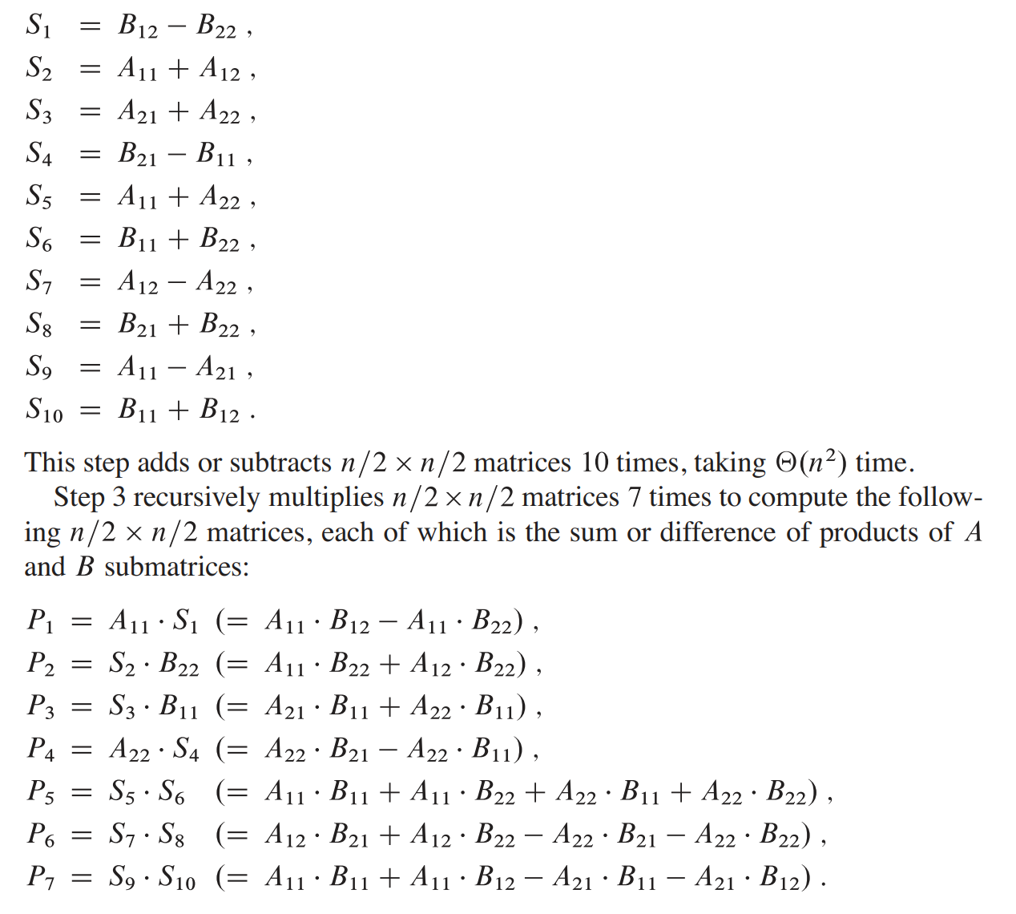




Strassen’s Matrix Multiplication
Matrix_Multiplication(A, B, n)
{
if (n < = 2):{
}
else{
mid = n/2
Matrix_Multiplication(A₁₁ , B₁₁ , n/2 )+ Matrix_Multiplication(A₁₂ , B₂₁ , n/2 )
Matrix_Multiplication(A₁₁ , B₁₂ , n/2 )+ Matrix_Multiplication(A₁₂ , B₂₂ , n/2 )
Matrix_Multiplication(A₂₁ , B₁₁ , n/2 )+ Matrix_Multiplication(A₂₂ , B₂₁ , n/2 )
Matrix_Multiplication(A₂₁ , B₁₁ , n/2 )+ Matrix_Multiplication(A₂₂ , B₂₁ , n/2 )
}
Recurrence Relation:
T(n)= 7T(n/2)+O(n²)
Time complexity is 𝜃(n^{log7}) = 𝜃(n^{2.81})

Slide 60
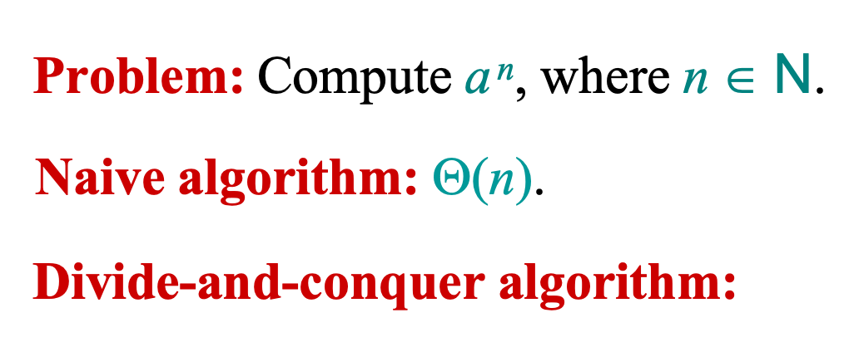
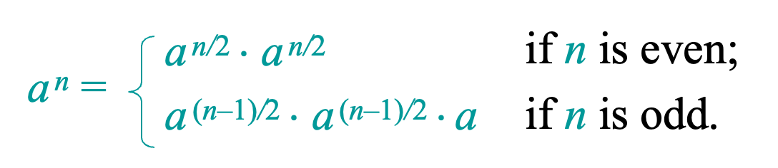
Powering a number

