Slide 1

Design & Analysis of Algorithms
Dr. Alakesh Kalita
Mathematics and Computing
IIT ISM Dhanbad

Slide 2

Dynamic Programming

Slide 3
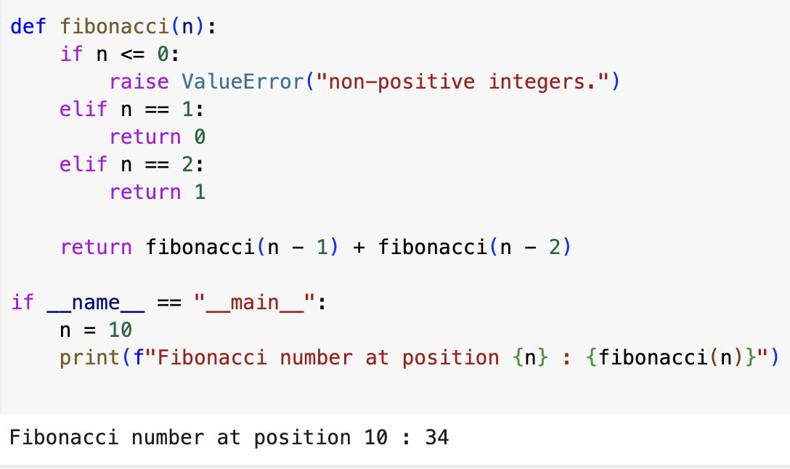

Fibonacci Number
T(n) = 2 T(n-1) + 1
O(n)
O(2^{n})

Slide 4
Fibonacci Number: Recursion Tree
fibo(6)
fibo(5)
fibo(4)
fibo(4)
fibo(3)
fibo(2)
fibo(3)
fibo(3)
fibo(2)
fibo(2)
fibo(1)
fibo(2)
fibo(1)
fibo(1)
fibo(0)
fibo(2)
fibo(1)
fibo(1)
fibo(0)
fibo(1)
fibo(0)
fibo(1)
fibo(0)
fibo(1)
fibo(0)

Slide 5
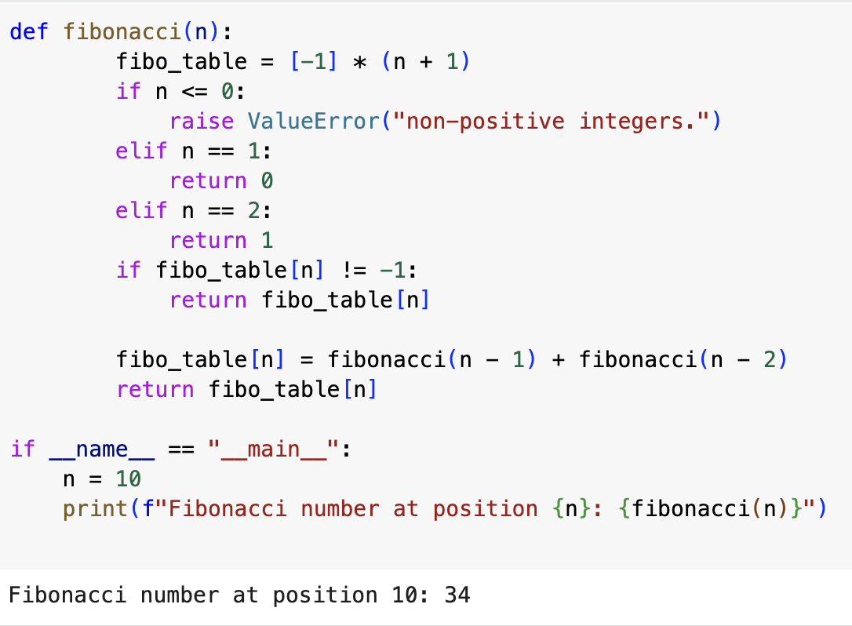
Fibonacci Number: using DP
fibo(5)
fibo(4)
fibo(3)
fibo(3)
fibo(2)
fibo(2)
fibo(1)
fibo(1)
fibo(0)
Time complexity?
Space complexity?
0
-1
-1
1
-1
1
-1
2
3
-1
-1
5
0
1
2
3
4
5
O(n): Filling the table/array
O(n): table/array size

Slide 6
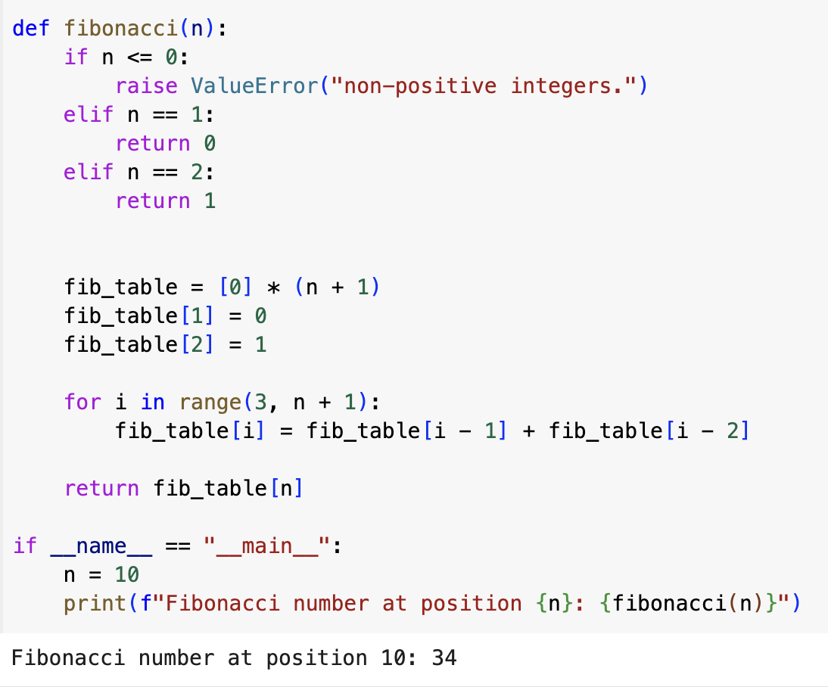
Types of DP
Space complexity :(
Top-down approach
Bottom-up approach
Need to make recursive calls and use the values if they are already computed.
It starts with lower values of input and keep building the solutions for higher values
O(n)
Note: For all problems, it may not be possible to find both top-down and bottom-up programming solutions

Slide 7
Exercises
Q. Can you improve the space complexity of the previous programs?
prev2, prev1 = 0, 1 # Base cases: F(0) = 0, F(1) = 1
for _ in range(2, n + 1):
current = prev1 + prev2
prev2, prev1 = prev1, current # Shift the values
Q. Can you find the n^{th} factorial using DP?
Ans. No benefit of DP. There is no repetitive calculation (no overlapping of sub problems).
Q. Can you use DP to implement merge sort?
Ans. sub problems are not identical.

Slide 8
0/1 Knapsack Problem: Using DP
Greedy about Profit/Weight
Maximum bag (knapsack) capacity, m = 15
Number of items, n = 2
14
15
 | Item 1 | Item 2
Profit | 5 | 15
Weight | 1 | 15
1
P/W | 5 | 1
Greedy
Fails !!!
Earned Profit = 5

Slide 9
0/1 Knapsack Problem: Using DP
Weights
0
1
2
3
W
Space complexity = O(nW)
0
0
0
0
0
0
0
1
0
Items available = 1, 2, … i
Current bag capacity = W_{c}
2
0
Profit
Items
3
0
i, W_{c}
n
0

Slide 10
0/1 Knapsack Problem: Using DP
Items
1
2
3
i
n
Include
Don’t
Include
Don’t
Include
Don’t
Include
Don’t
Brute force approach: O(2^{n})

Slide 11
0/1 Knapsack Problem: Using DP
Try to fill the KS with the earlier i-1 items
1
2
3
i
n
if i= 0 OR W_{c} = 0, then P_{i} = 0
if W_{c} < W_{i}, then P_{i} = KP(i-1, W_{c})
(Not included i)
if W_{i} < W_{c}, then P_{i} = Max(P_{i} + KP(i-1, W_{c}-W_{i}), KP(i-1, W_{c}))
included i
Not included i

Slide 12
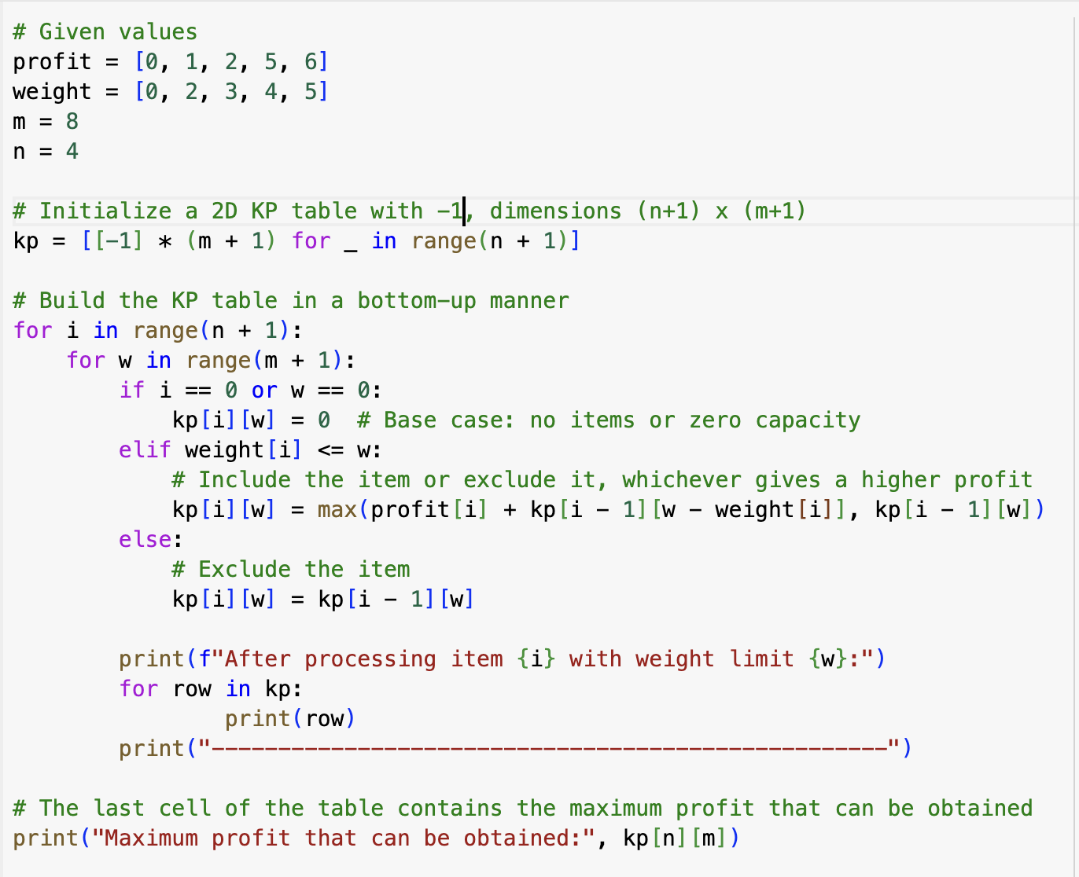
0/1 Knapsack

Slide 13
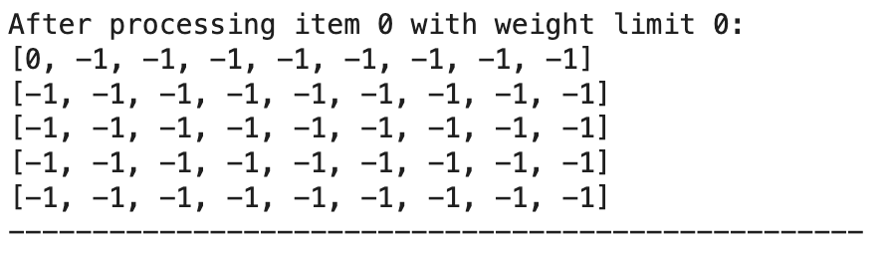
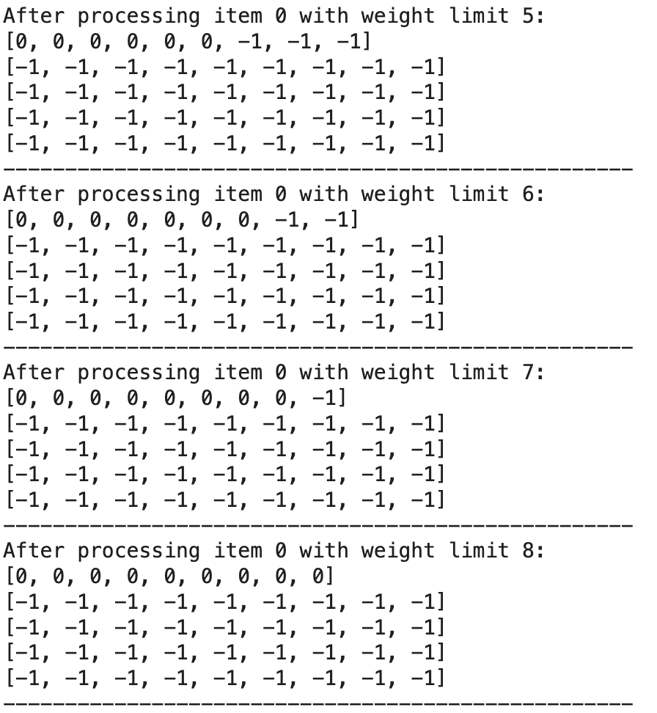
0/1 Knapsack

Slide 14
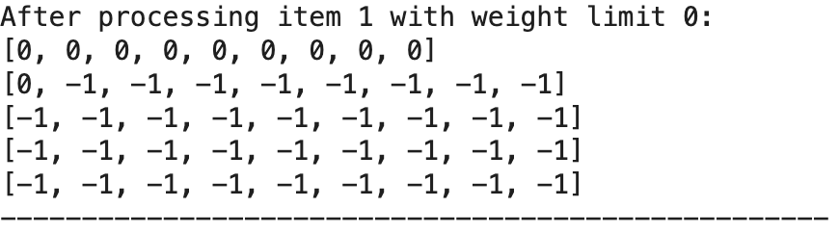
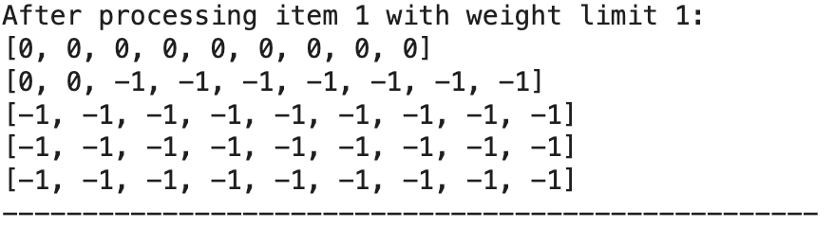
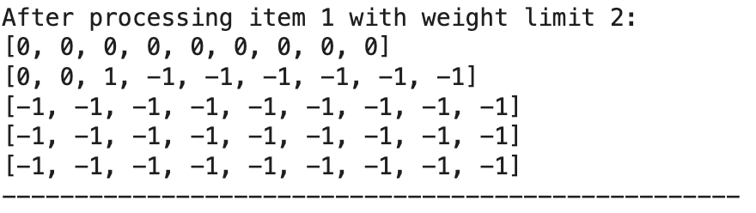
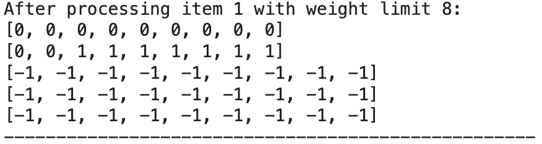
0/1 Knapsack

Slide 15
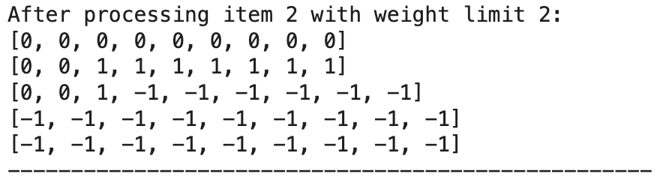
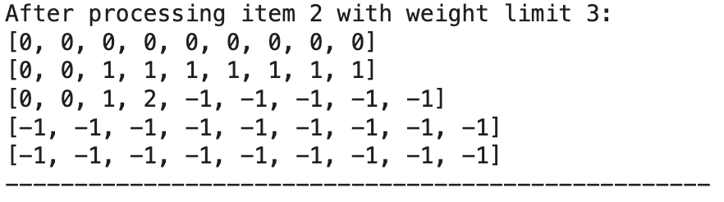
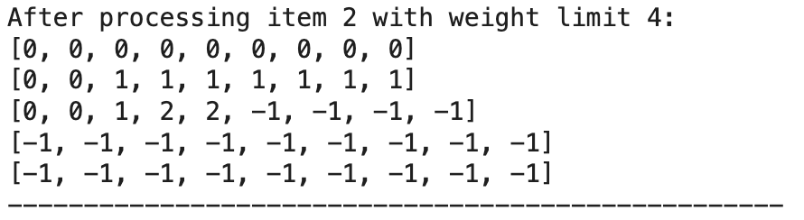
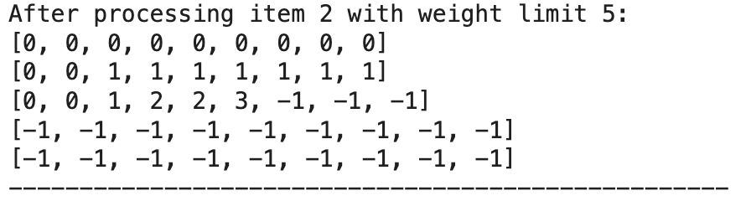
0/1 Knapsack

Slide 16
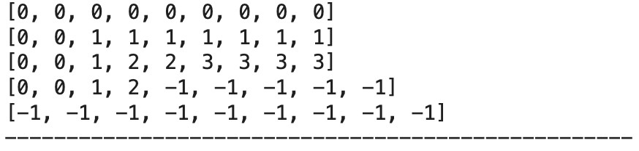
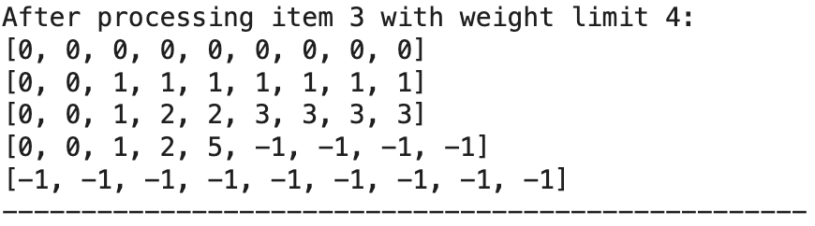
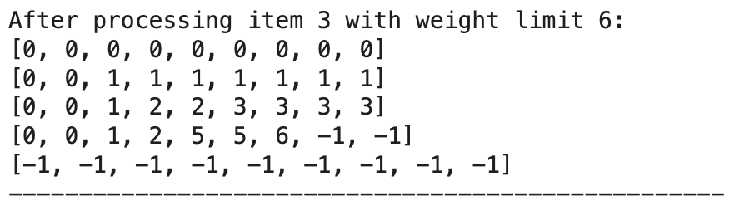
0/1 Knapsack

Slide 17
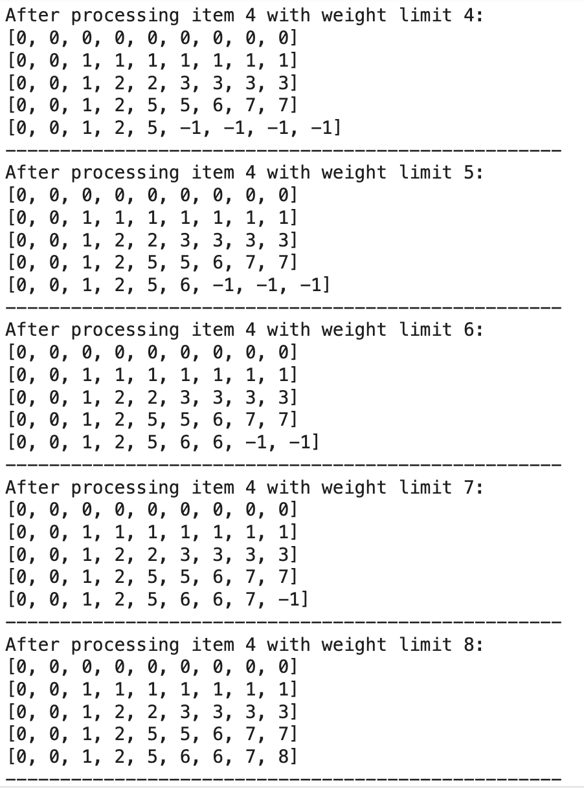
0/1 Knapsack

Slide 18
0/1 Knapsack Problem: Using DP
Maximum bag (knapsack) capacity, m = 15
Number of items, n = 2
 | Item 1 | Item 2
Profit | 5 | 15
Weight | 1 | 15

Slide 19
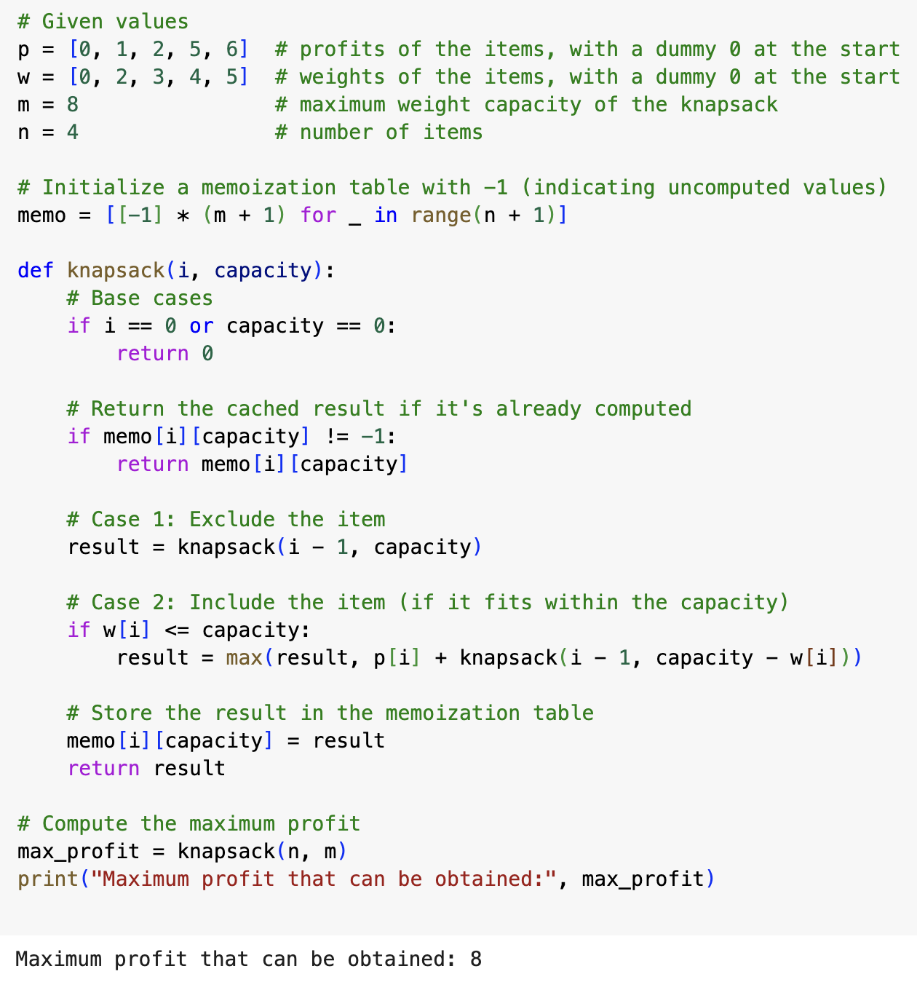
0/1 Knapsack

Slide 20
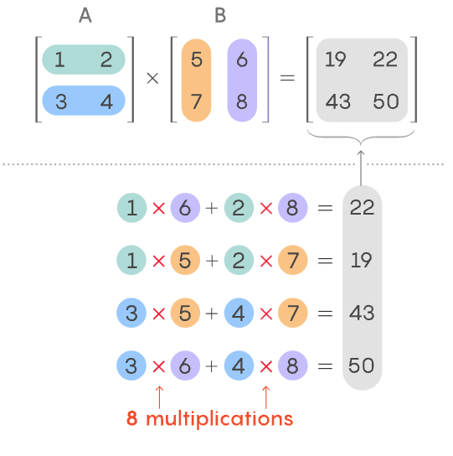
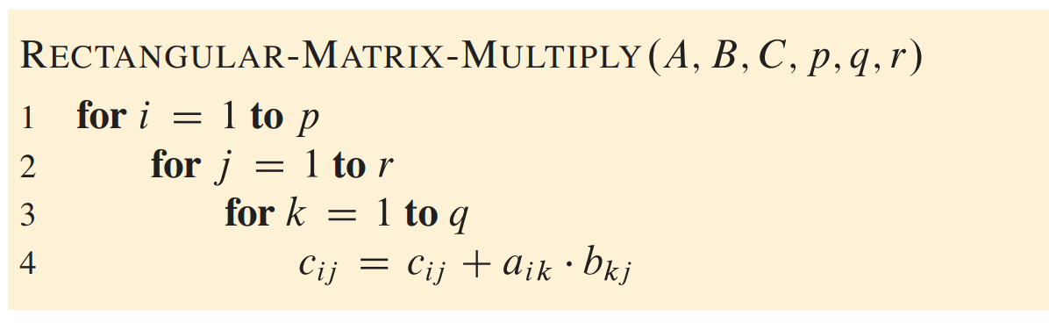
Matrix-chain multiplication

Slide 21
Matrix-chain multiplication
C = A x B
A =
m x n
C =
m x p
B =
n x p
# Scalar multiplications = (m x p) x n

Slide 22
A₁
A₂
A₃
2 x 3
3 x 4
4 x 5
Order matters !!!
2. (A₁ A₂ ) A₃
A₁​ (A₂​ A₃​)
2 x 3 x 4 = 24
3 x 4 x 5 = 60
2 x 4
3 x 5
2 x 4 x 5 = 40
2 x 3 x 5 = 30
2 x 5
2 x 5

Slide 23
A₁
A₂
A₃
A₄
2 x 3
3 x 4
4 x 5
5 x 2
We need to choose the best order !!
A₁​ (A₂​ (A₃​A_{4​}) )
A₁ ( (A₂ A₃) A₄ )
(A₁A₂) (A₃A₄)
(A₁ (A₂ A₃)) A₄
((A₁A₂) A₃) A₄

Slide 24
How to use DP
A₁
A₂
A₃
A₄
1 2 3 4
1
0
 | 0
 |  | 0
 |  |  | 0
2 x 3
3 x 4
4 x 5
5 x 2
2
3
4

Slide 25
A₁
A₂
A₃
A₄
1 2 3 4
1
0
 | 0
 |  | 0
 |  |  | 0
0 | 24
 | 0
 |  | 0
 |  |  | 0
0 | 24
 | 0 | 60
 |  | 0
 |  |  | 0
3 x 4
4 x 5
5 x 2
0 | 24
 | 0 | 60
 |  | 0 | 40
 |  |  | 0
2 x 3
2
3
4
A₁ x
A₃
A₃
A₂
A₂ x
A₄
2 x 3
3 x 4
3 x 4
4 x 5
4 x 5
5 x 2

Slide 26
1 2 3 4
A₁
A₂
A₃
A₄
1
0 | 24
 | 0 | 60
 |  | 0 | 40
 |  |  | 0
0 | 24 | 64
 | 0 | 60
 |  | 0 | 40
 |  |  | 0
2 x 3
3 x 4
4 x 5
5 x 2
2
3
4
A₁​ (A₂​ A₃​)
A₃
A₁ x x
A₂
= min
2. (A₁ A₂ ) A₃

Slide 27
1 2 3 4
A₁
A₂
A₃
A₄
1
0 | 24 | 64
 | 0 | 60
 |  | 0 | 40
 |  |  | 0
0 | 24 | 64
 | 0 | 60 | 64
 |  | 0 | 40
 |  |  | 0
2 x 3
3 x 4
4 x 5
5 x 2
2
3
4
A₂​ (A₃​ A₄​)
A₄
A₂ x x
A₃
= min
2. (A₂ A₃ ) A₄

Slide 28
1 2 3 4
A₁
A₂
A₃
A₄
1
0 | 24 | 64
 | 0 | 60
 |  | 0 | 40
 |  |  | 0
0 | 24 | 64
 | 0 | 60 | 64
 |  | 0 | 40
 |  |  | 0
2
2 x 3
3 x 4
4 x 5
5 x 2
3
4
A₁​ (A₂​ (A₃​A_{4​}) )
A₁ ( (A₂ A₃) A₄ )
(A₁A₂) (A₃A₄)
(A₁ (A₂ A₃)) A₄
((A₁A₂) A₃) A₄
A₃
A₁ x x x = min
A₂
A₄

Slide 29
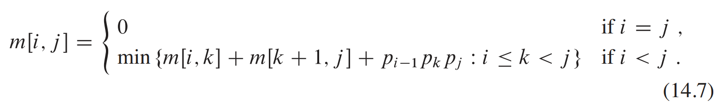
Matrix-chain multiplication
m [i, j] denotes the scalar multiplication cost for multiplying the matrices from A_{i} to A_{j​}.

Slide 30
1 2 3 4
1
0 | 24 | 64
 | 0 | 60
 |  | 0 | 40
 |  |  | 0
0 | 24 | 64
 | 0 | 60 | 64
 |  | 0 | 40
 |  |  | 0
A₁
A₂
A₃
A₄
2
3
2 x 3
3 x 4
4 x 5
5 x 2
4
d₀
d₁
d₂
d₃
d₅
P
2
3
4
5
2

Slide 31
A₁
A₂
A₃
A₄
A₁
A₂
A₃
A₄
2 x 3
3 x 4
4 x 5
5 x 2
x
2 x 3
3 x 4
4 x 5
5 x 2
d₀
d₁
d₂
d₃
d₅
m(1, 2) = 24
m(3, 4) = 40
P
2
3
4
5
2
2 x 4
4 x 2
0 1 2 3 4
2 x 4 x 2 = 16
Total cost = m(1,2) + m(3,4) + 16 = 80

Slide 32
A₁
A₂
A₃
A₄
If i = 1, k = 2 and j = 4
x
2 x 3
3 x 4
4 x 5
5 x 2
m(1, 2) = m (i, k)
m(3, 4) = 40
m(3, 4) = m (k+1, j)
m(1, 2) = 24
2 x 4 x 2 = p[i-1] x p[k] x p[j]
2 x 4
4 x 2
2 x 4 x 2 = 16
p
2
3
4
5
2
0 1 2 3 4

Slide 33
A₁​ (A₂​ A₃​)
1 2 3 4
i = 1, k = 1 and j = 3
1
0 | 24 | 90
 | 0 | 60
 |  | 0 | 40
 |  |  | 0
0 | 24 | ??
 | 0 | 60
 |  | 0 | 40
 |  |  | 0
p
2
3
4
5
2
2
0 1 2 3 4
3
4
m(i, j) = m (i, k) + m (k+1, j) + p[i-1] p[k] p[j]
m(1, 3) = m (1, 1) + m (2, 3) + p[0] p[1] p[3]
m(1, 3) = 0 + 60 + 2*3*5 = 90

Slide 34
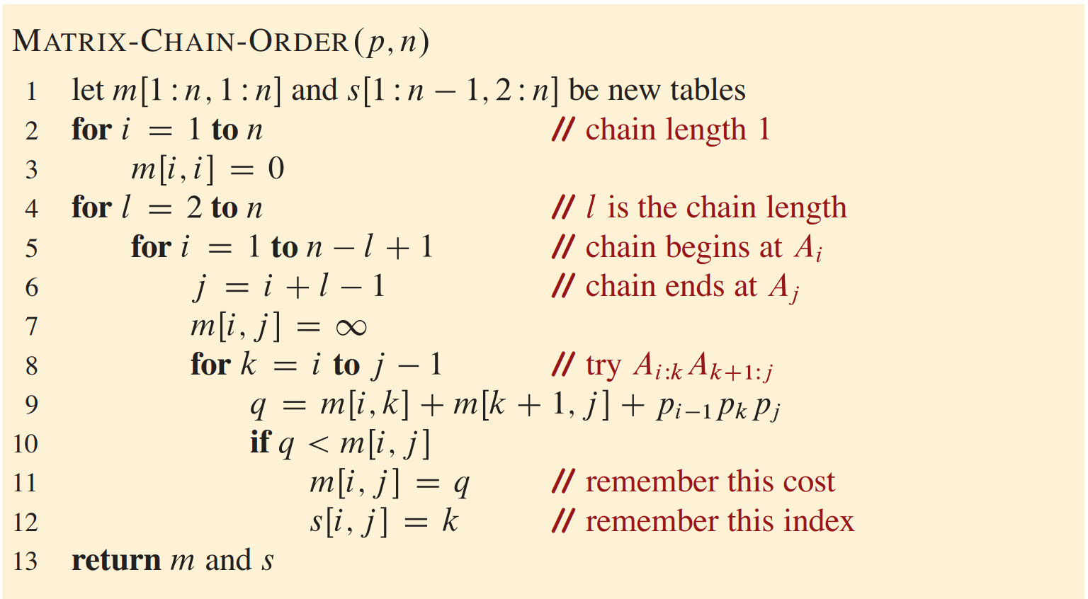
Matrix-chain multiplication

Slide 35
m (1, 2) = A₁ x A₂ = Chain length 2
1 2 3 4
m (1, 3) = A₁ x A₂ x A₃ = Chain length 3
1
0 | 24 | 64
 | 0 | 60
 |  | 0 | 40
 |  |  | 0
0 | 24 | 64
 | 0 | 60 | 64
 |  | 0 | 40
 |  |  | 0
2
m (1, 4) = A₁ x A₂ x A₃ x A₄ = Chain length 4
3
4

Slide 36
m (1, 3) = A₁ x A₂ x A₃ = l = 3
l = 3
i = 1, 2
when i = 1 (A₁ x A₂) x A₃
when i = 2 A₁ x (A₂ x A₃ )
i = 2
j = i +l -1

Slide 37
Time complexity ?
Space Complexity ?

Slide 38
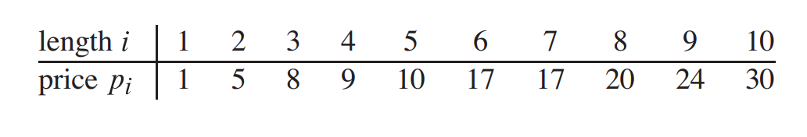
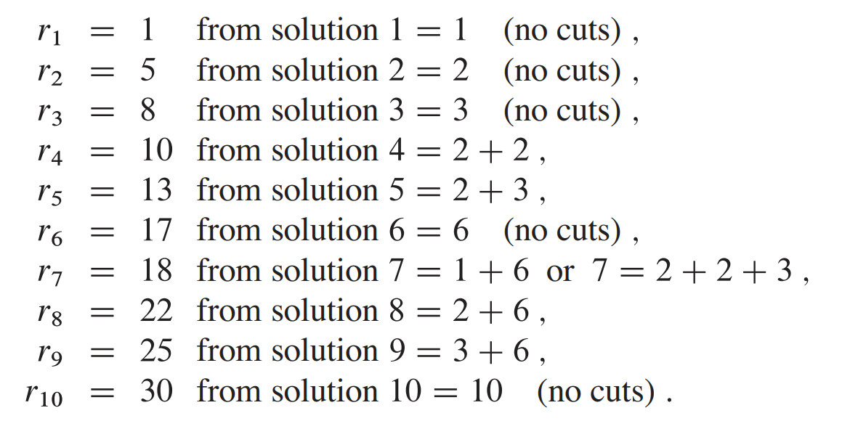
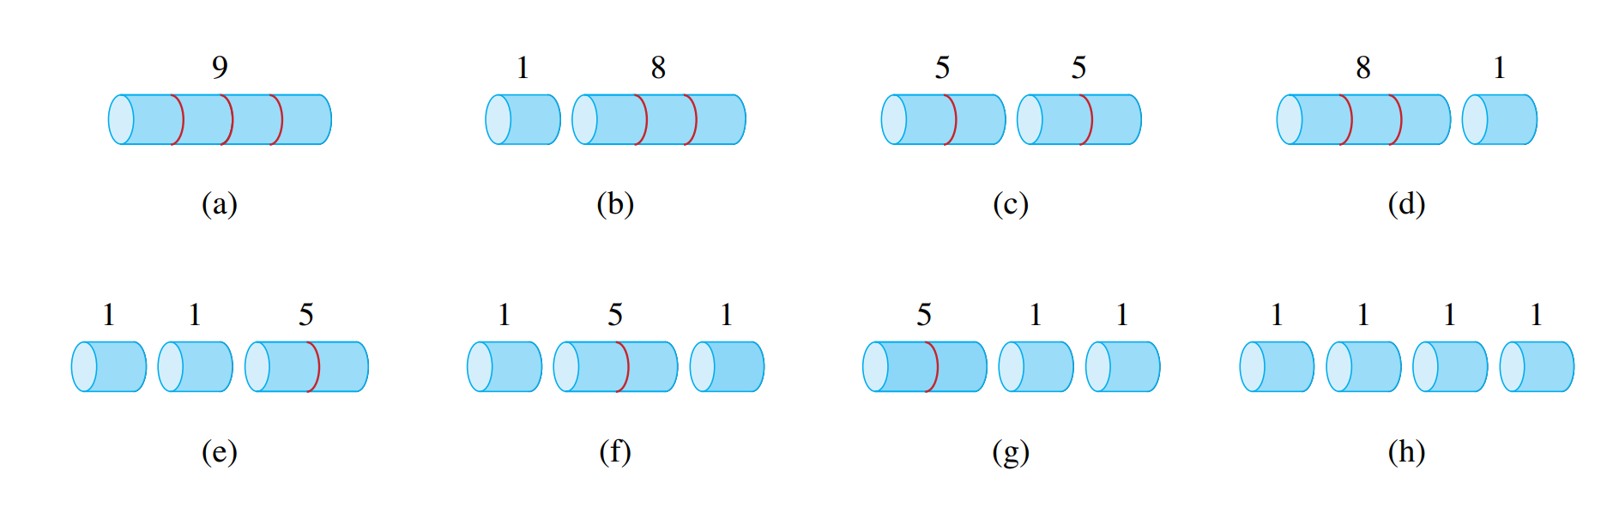
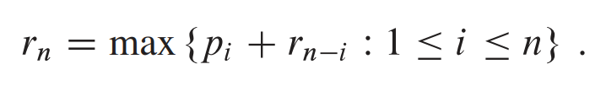
Rod cutting Problem

Slide 39
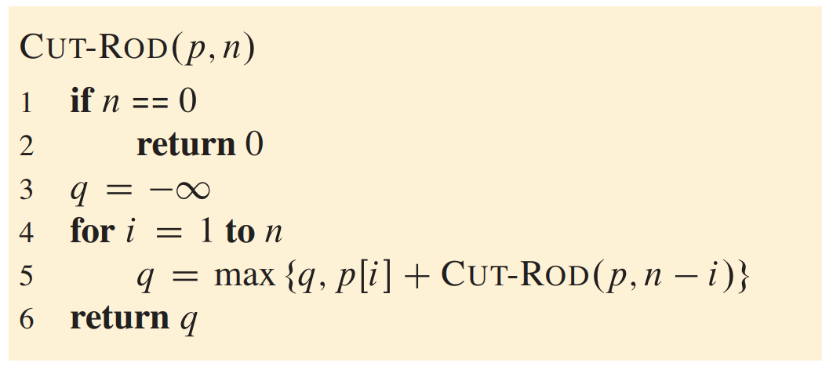
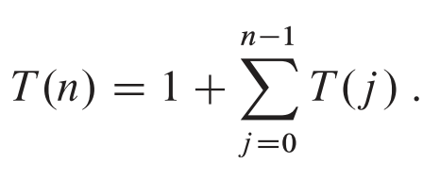

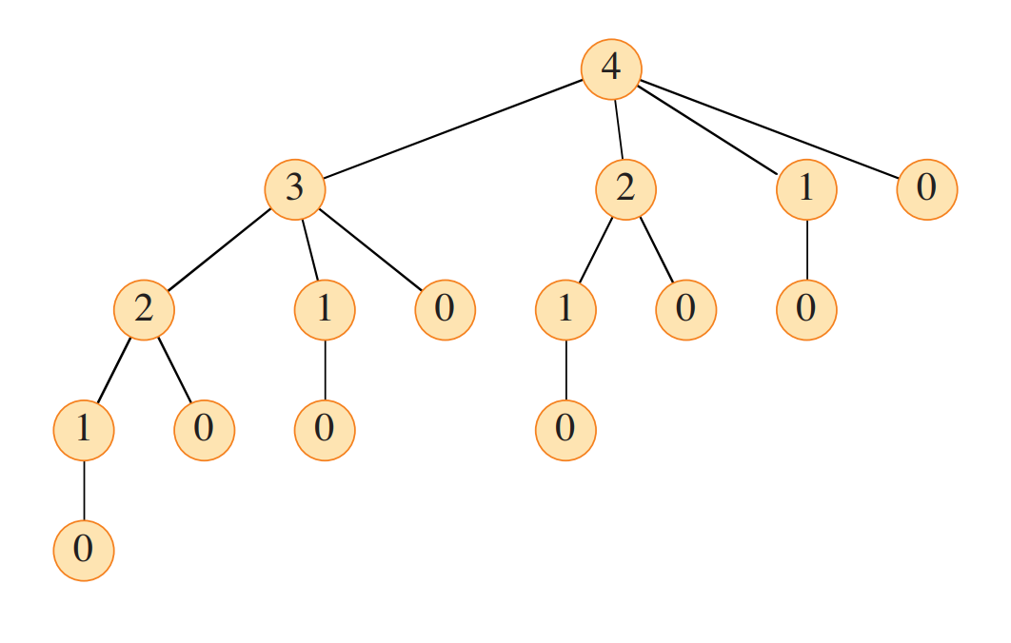
Rod cutting Problem

Slide 40
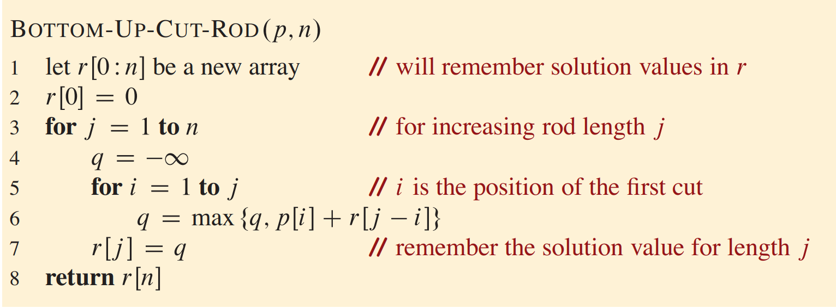
Rod cutting Problem

Slide 41
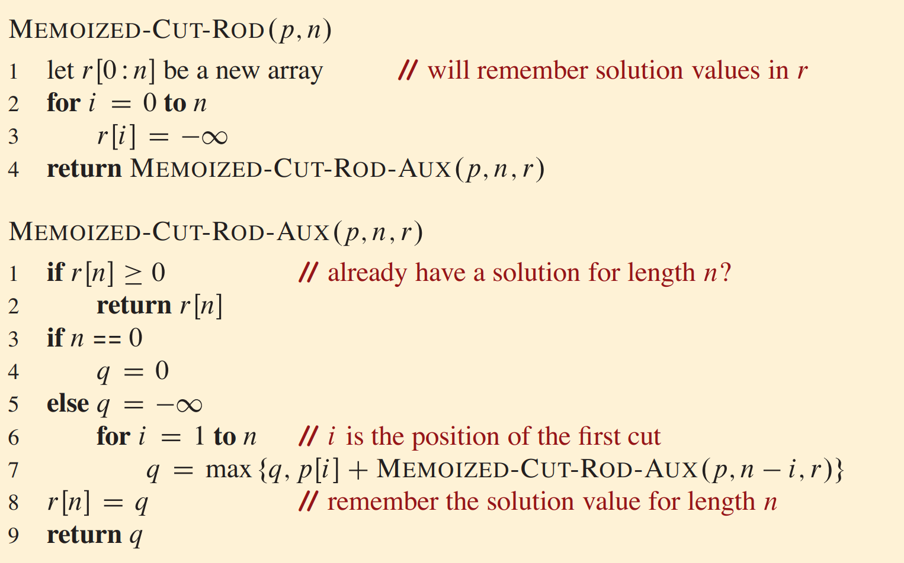
Rod cutting Problem

