Slide 1

Design & Analysis of Algorithms
Dr. Alakesh Kalita
Mathematics and Computing
IIT ISM Dhanbad

Slide 2
Introduction to Recursion
and
Divide and Conquer Approach

Slide 3
Function
What is a function?
Reusable block of code that performs a specific task, takes input, processes it, and may return an output
Why functions are used
Code reusability (write once, use many times)
Modularity (break a large problem into smaller parts)
Readability (program becomes easier to understand)
Maintainability (easy to debug and modify)
def function(arguments):
Steps
Return

Slide 4
Recursive function
What is a Recursive function?
A function that calls itself.
Key Features:
Base case(s): To terminate recursion.
Recursive case(s): To break the problem into smaller instances.
Applications:
Solving problems like factorial computation, Fibonacci sequence, tree traversals, etc.
def recursive_function(parameters):
if base_case_condition:
return result
else:
Return recursive_function(smaller_problem)

Slide 5
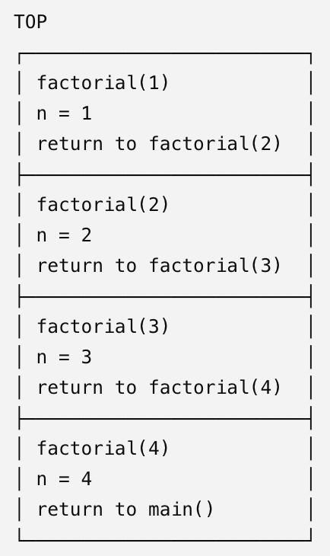
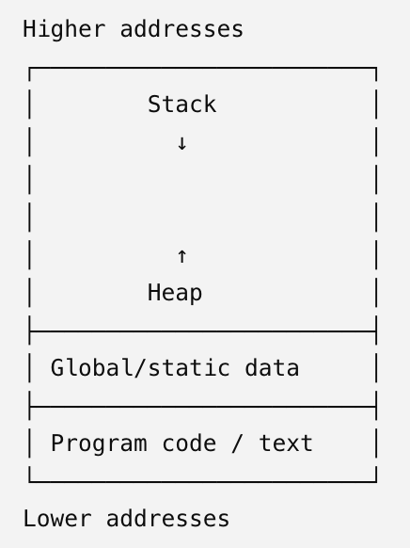
Example: Recursive Function
fact(5)
def fact(n):
if n < = 1:
return 1
else:
return n * fact(n-1)
5
*
fact(4)
4
*
fact(3)
3
*
fact(2)
2
*
fact(1)
1

Slide 6
Time complexity: Recursive function
fact(5)
T(5); for n time is T(n)
5
*
fact(4)
T(n-1)+ c
4
*
fact(3)
T(n-2)+ c + c
3
*
fact(2)
2
*
fact(1)
T(1)+ … + c + c + c
1

Slide 7
Recurrence
1; when n ≤ 1
T(n) =
Solving recurrences
T(n-1) + 1; when n > 1
Substitution Method
Recursion-tree method
Master Method
Akra-Bazzi method

Slide 8
Substitution Method
T(n) = T (n-1) + c
Say, n- k = 1
k = n - 1
= T(n-2) + c + c
= T(n-3) + c + c + c
As T(1) = 1; so, total time is: nc = O(n)
= T(n-k) + kc

Slide 9
Exercises
Solve using substitution method.
1; when n ≤ 1
T(n) =
T(n-1) + n; when n > 1
1; when n ≤ 1
T(n) =
T(n-1) + log n; when n > 1

Slide 10
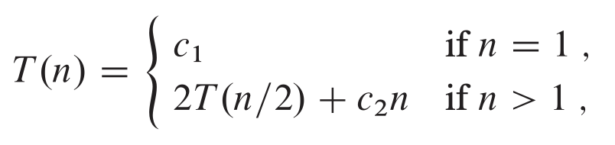
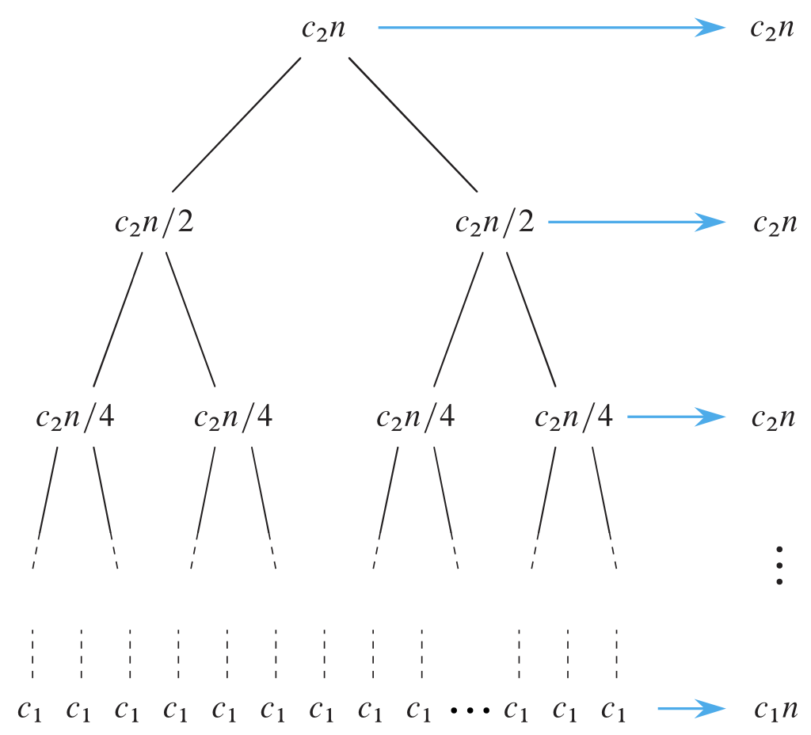
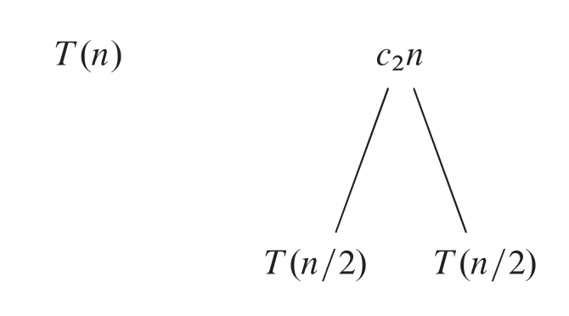
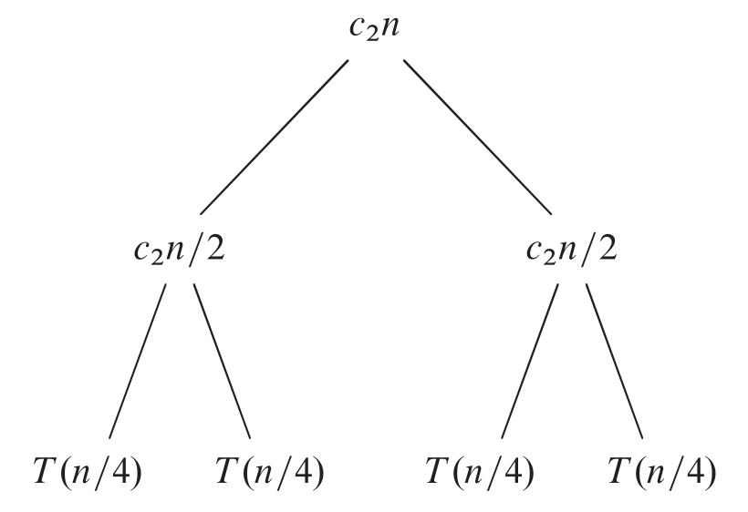


Recursion-tree method
log n

Slide 11

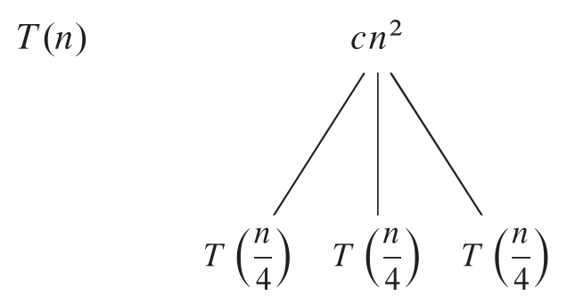
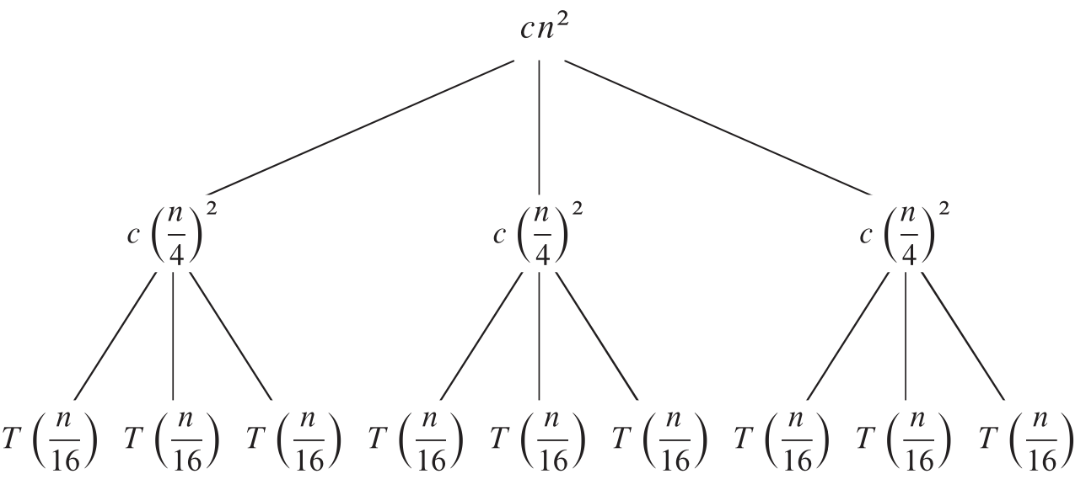
Recursion-tree method

Slide 12

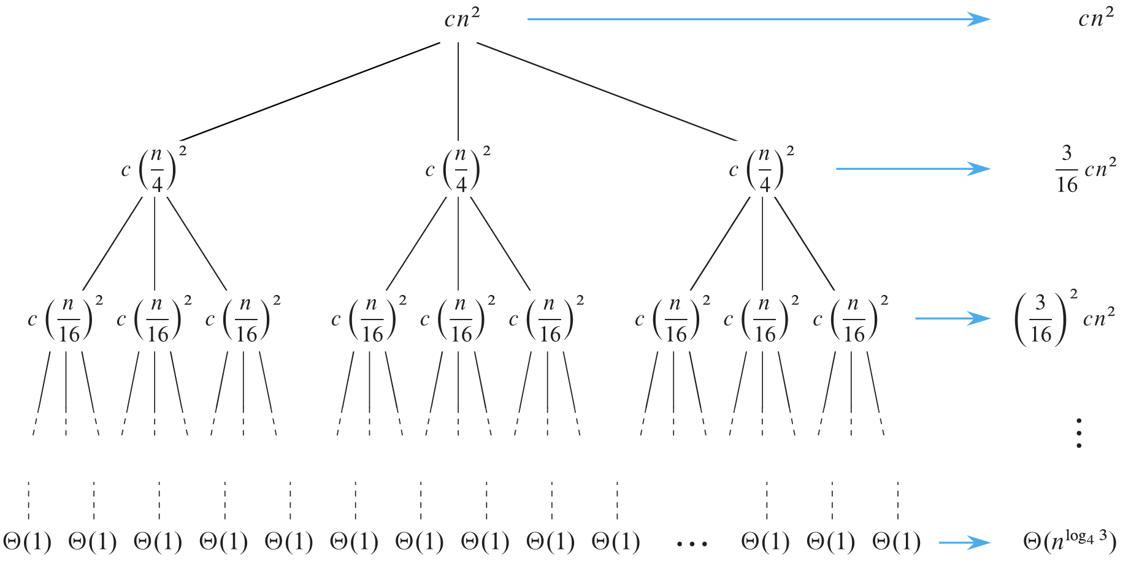
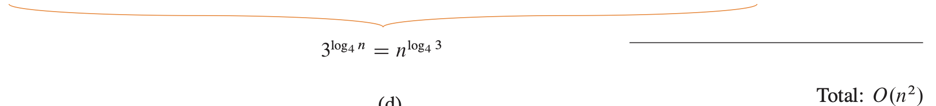
Recursion-tree method

Slide 13
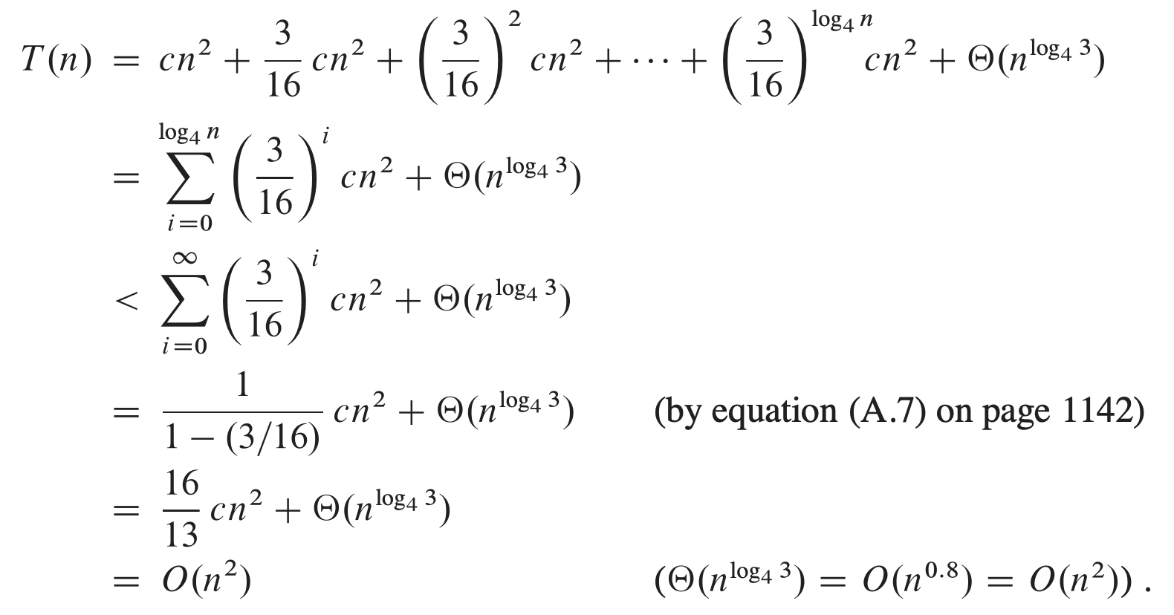
Recursion-tree method

Slide 14

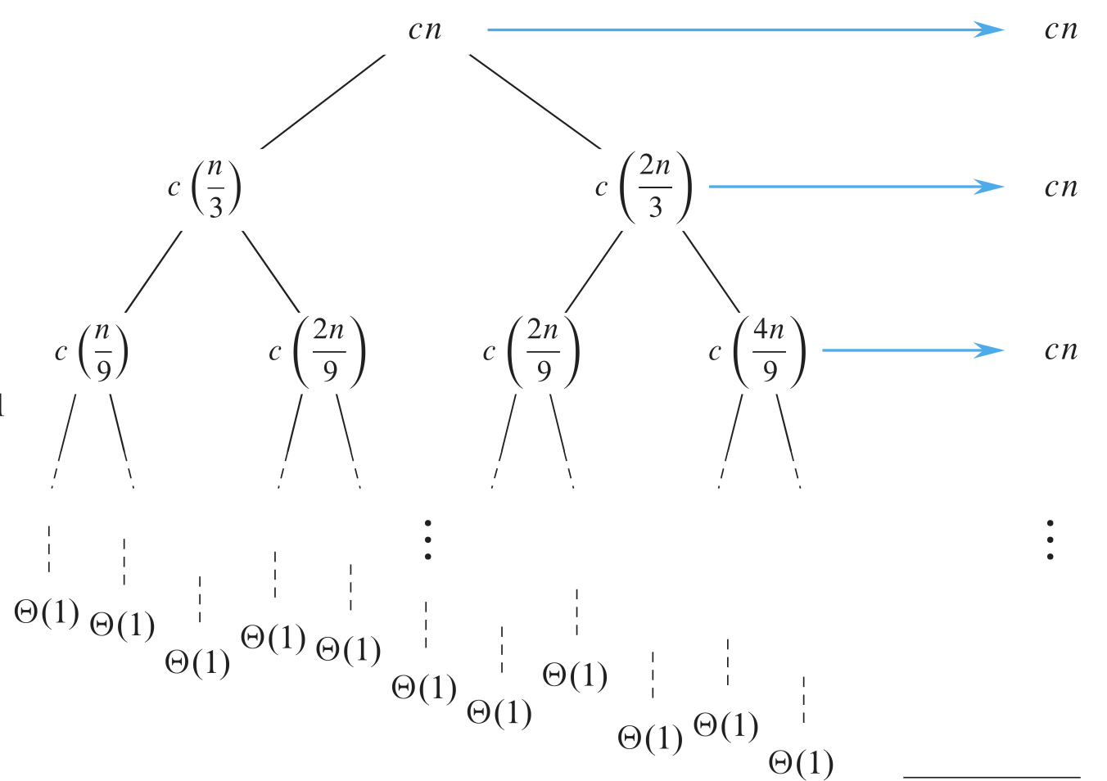


Recursion-tree method
log _{3/2} n

Slide 15
Recursion-tree method
Write the recurrence relation for the Fibonacci series and solve it using the recursion tree method

Slide 16
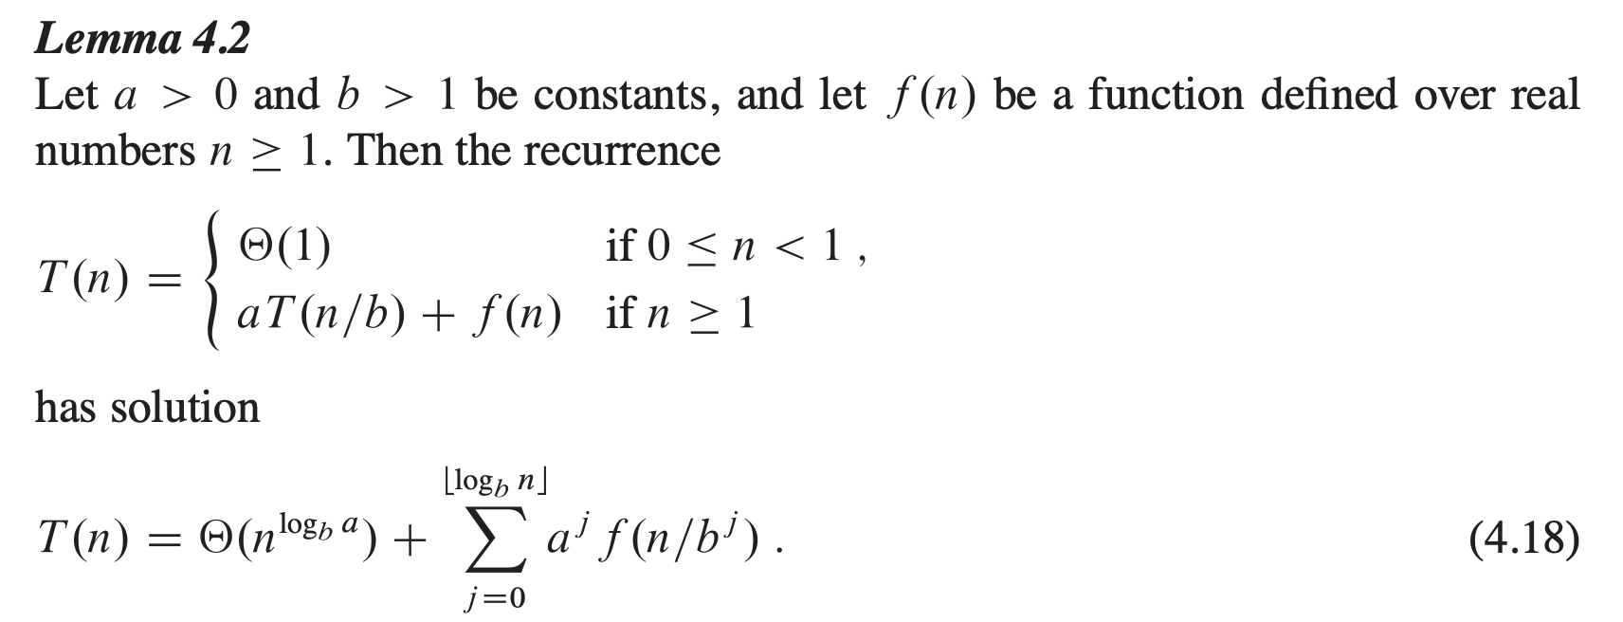
Recursion-tree method

Slide 17

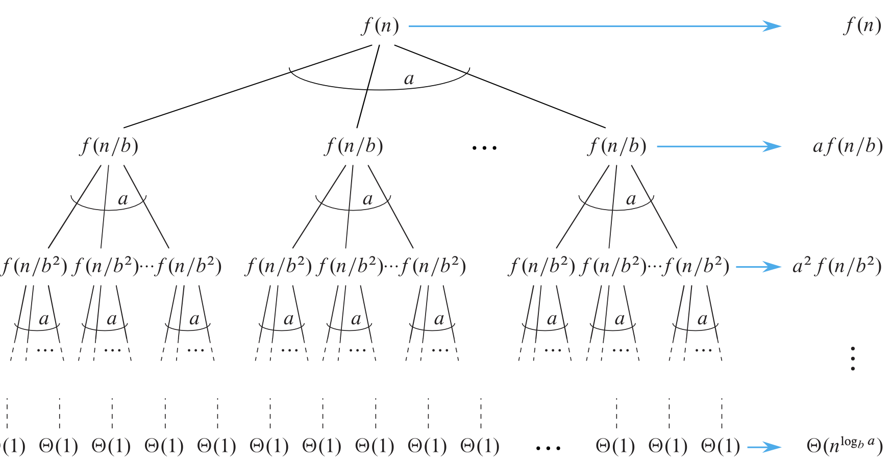
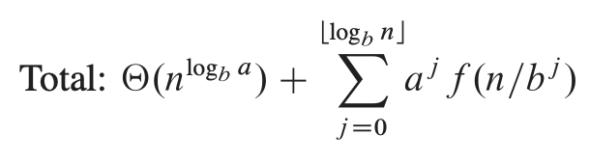
Recursion-tree method
log _{b} n
# leaves = n^{log}bª

Slide 18
Master Theorem
Recursive functions

Slide 19
Case 1
Compare f (n) with n^{log}bª:
f (n) = O(n^{log}b^{a – ε}) for some constant ε > 0.
f (n) grows polynomially slower than n^{log}bª
(by an n^{ε} factor).
Solution: T(n) = Θ(n^{log}bª) .

Slide 20
Case 2
Compare f (n) with n^{log}bª:
f (n) = Θ(n^{log}bª lg^{k}n) for some constant k ≥ 0.
f (n) and n^{log}bª grow at similar rates.
Solution: T(n) = Θ(n^{logba} lg^{k+1}n) .

Slide 21
Case 3
Compare f (n) with n^{log}bª:
f (n) = Ω(n^{log}b^{a + ε}) for some constant ε > 0.
f (n) grows polynomially faster than n^{log}bª (by an n^{ε} factor),
and f (n) satisfies the regularity condition that
a f (n/b) ≤ c f (n) for some constant c < 1.
Solution: T(n) = Θ( f (n) ) .

Slide 22
Examples
Ex. T(n) = 4T(n/2) + n
a = 4, b = 2 ⇒ n^{log}bª = n²; f (n) = n.
Case 1: f (n) = O(n^{2 – ε}) for ε = 1.
∴ T(n) = Θ(n²).
Ex. T(n) = 4T(n/2) + n²
a = 4, b = 2 ⇒ n^{log}bª = n²; f (n) = n².
Case 2: f (n) = Θ(n²lg⁰n), that is, k = 0.
∴ T(n) = Θ(n²lg n).

Slide 23
Examples
Ex. T(n) = 4T(n/2) + n³
a = 4, b = 2 ⇒ n^{log}bª = n²; f (n) = n³.
Case 3: f (n) = Ω(n^{2 + ε}) for ε = 1
and 4(n/2)³ ≤ cn³ (reg. cond.) for c = 1/2.
∴ T(n) = Θ(n³).
Ex. T(n) = 4T(n/2) + n²/lg n
a = 4, b = 2 ⇒ n^{log}bª = n²; f (n) = n²/lg n. Master method does not apply. In particular, for every constant ε > 0, we have n^{ε} = ω(lg n).

Slide 24
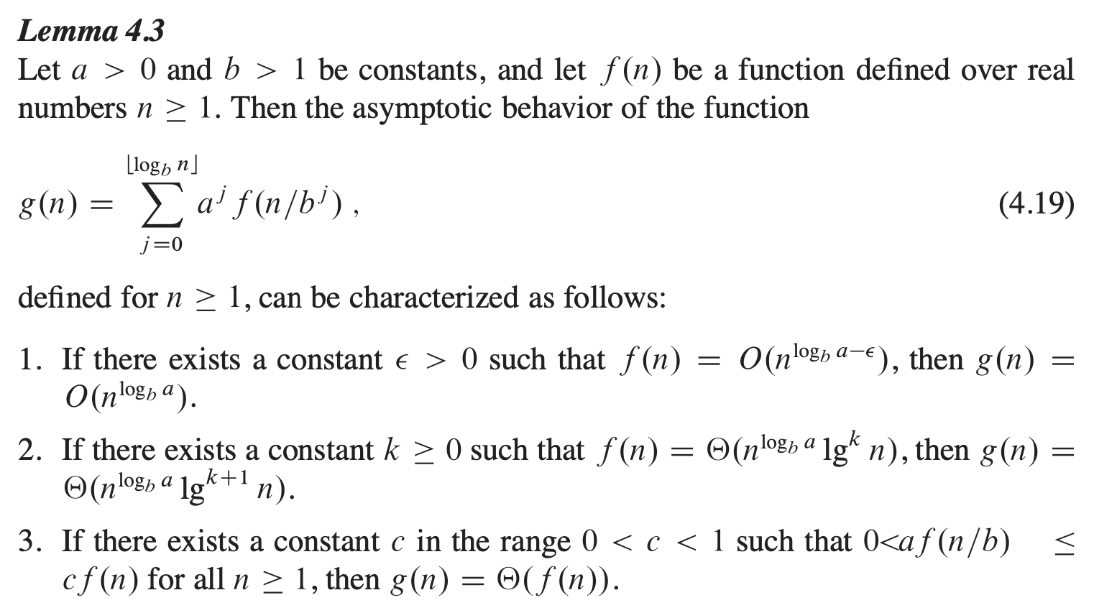
Recursion-tree method

Slide 25
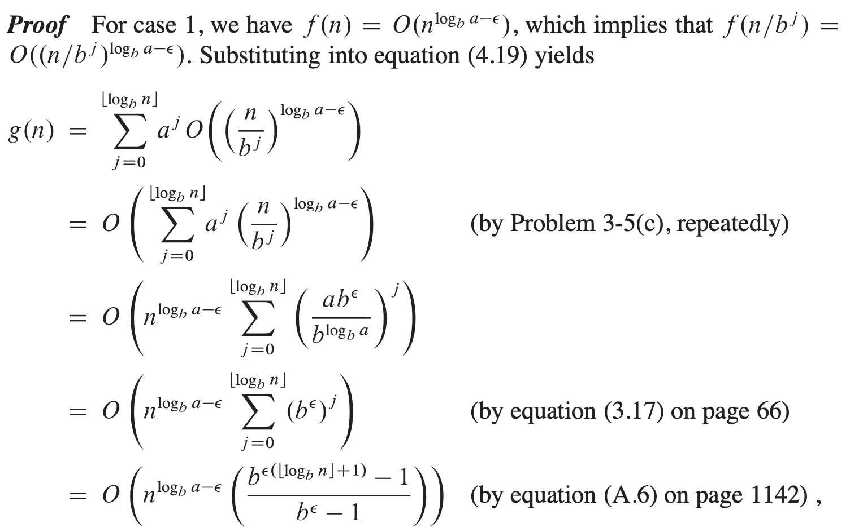
Recursion-tree method
Cormen Book
PP 111-112

Slide 26
Master Theorem for decreasing functions
General form of decreasing function is:
T(n) = a T(n-b) + f(n)
Where a > 0, b > 0 and f(n) = O(n^{k}), k ≥ 0
If a = 1:
O(n^{k+1}) or O(n * f(n))
If a > 1:
O(a^{n/b} n^{k}) or O(a^{n/b} * f(n))
Examples:
T(n) = T(n-1) + 1
T(n) = T(n-1) + n
T(n) = T(n-1) + logn
T(n) = 2T(n-1) + 1
T(n) = 3T(n-1) + 1
T(n) = 2T(n-1) + n
O(n)
O(n²)
O(n logn)
If a < 1:
O(n^{k}) or O(f(n))
O(2^{n})
O(3^{n})
O(n 2^{n})

Slide 27
Question
Find the complexity of the program for fibonacci series using master theorem
T(n) = 2T(n-1) + 1
O(2^{n})
If a > 1:
O(a^{n/b} n^{k}) or O(a^{n/b} * f(n))

Slide 28
Master Theorem for dividing functions
General form of dividing function is:
T(n) = aT(n/b) + f(n)
Where a ≥ 1 , b > 0 and f(n) = Θ(n^{k} log ^{p} n), k ≥ 0
Step 1. Need to determine log_{b}a and k
If log_{b}a > k:
Θ (n^{log}bª)
If log_{b}a = k:
If p > -1 : Θ (n^{k} log ^{p+1}n)
If p = -1 : Θ (n^{k} log log n)
If p < -1 : Θ (n^{k})
Examples:
T(n) = 2T(n/2) + O(n)
O(n logn)
If log_{b}a < k:
If p ≥ 0 : Θ (n^{k} log^{p}n)
If p < 0 : O(n^{k})

Slide 29
Iterative Binary Search
BinarySearch(array, key):
1. Set low = 0
2. Set high = length(array) - 1
3. While low <= high:
a. Set mid = low + (high - low) // 2
b. if array[mid] == key:
return mid
c. Else If array[mid] < key:
Set low = mid + 1
d. Else:
Set high = mid - 1
4. return -1 // Target not found

Slide 30
Recursive Binary Search
def binary_search_recursive(arr, low, high, target):
# Base case: If the range is invalid, the target is not found
if low > high:
return -1
mid = (low + high) // 2
if arr[mid] == target:
return mid
elif target < arr[mid]:
return binary_search_recursive(arr, low, mid - 1, target)
else:
return binary_search_recursive(arr, mid + 1, high, target)

Slide 31
Recursion Problems
Fibonacci Sequence
Sum of ‘n’ Natural Numbers
Reverse a String
Check if a String is Palindrome
Count Digits in a Number
Print All Elements of an Array

Slide 32
Divide and Conquer Approach
Breaking Down Problems for Efficient Solutions

Slide 33
What is Divide and Conquer?
Definition:
A strategy to solve problems by
breaking them into smaller subproblems,
solving these subproblems recursively, and
combining their solutions.
Steps:
Divide: Split the problem into smaller, independent subproblems.
Conquer: Solve the subproblems recursively.
Combine: Merge the solutions of subproblems to get the solution to the original problem.

Slide 34
Characteristics of Divide and Conquer
Problems must exhibit:
Subproblem Optimality: Subproblems are simpler versions of the original.
Independent Subproblems: Subproblems can be solved separately.
Merge Step: A way to combine the solutions effectively.
Examples: Binary Search, Merge Sort, Quick Sort.

Slide 35
General Algorithmic Template
Pseudocode:
def divide_and_conquer(problem):
if base_case(problem):
return base_solution(problem)
subproblems = divide(problem)
subresults = [divide_and_conquer(sub) for sub in subproblems]
return combine(subresults)

Slide 36
Binary Search Example
Problem: Search for an element in a sorted array.
Steps:
Divide: Split the array into two halves.
Conquer: Recursively search in the relevant half.
Combine: No explicit combination is needed; the result is returned directly.

Slide 37
Advantages of Divide and Conquer
Efficiency:
Reduces problem size logarithmically.
Takes advantage of parallelism.
Simplicity:
Clear structure for problem-solving.
Examples in Algorithms:
Sorting: Merge Sort, Quick Sort.
Searching: Binary Search.
Matrix Multiplication: Strassen’s Algorithm.

Slide 38
Disadvantages of Divide and Conquer
Overhead:
Recursive calls use extra stack memory.
Combine Step Complexity:
The merging process can sometimes be inefficient.
Not Always Ideal:
For problems without optimal substructure or overlapping subproblems.

