Slide 1

Design & Analysis of Algorithms
Dr. Alakesh Kalita
Mathematics and Computing
IIT ISM Dhanbad

Slide 2
Graph Data Structure

Slide 3
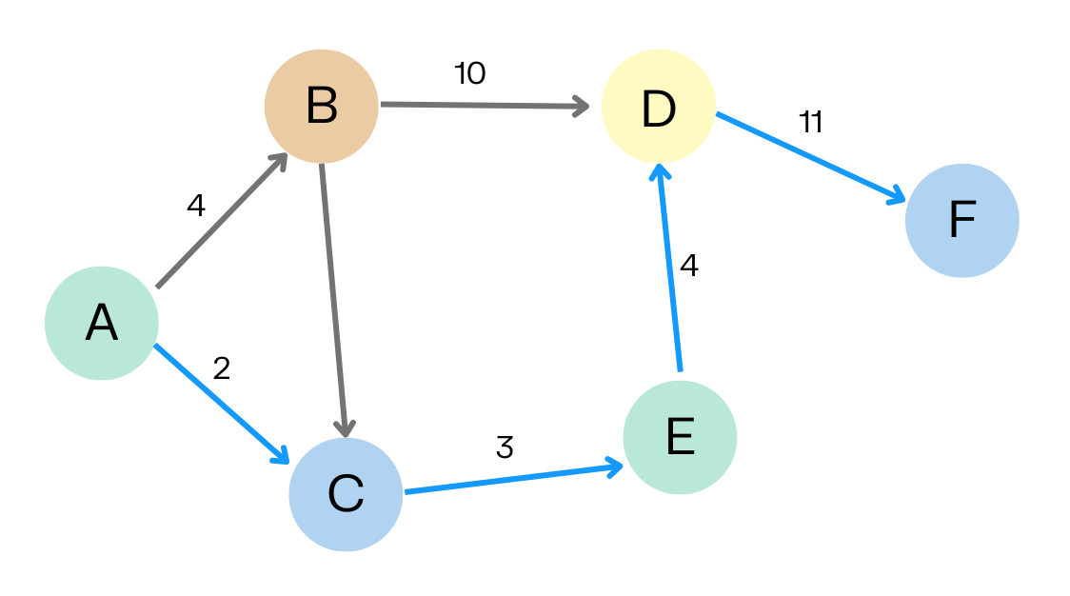
Introduction to Graphs
Definition: A graph G=(V,E) consists of:
V (Vertices or Nodes): The set of points.
E (Edges or Links): The set of connections between nodes.
Examples: (i) Webpages as vertices, connected web pages (hyperlinks) as edges
(ii) Cities as vertices, roads as edges
(iii) In social network like facebook, persons as vertices, connections (friends) as edges
(iv) ER diagram, entities as vertices and relations as edges

Slide 4
Types of graphs
Directed vs. Undirected
A
B
A
B
Directed
One way road
A is source, B is destination
B is adjacent node of A
A is NOT an adjacent node of B
Undirected
Single line railway track
B is an adjacent node of A and vice versa

Slide 5
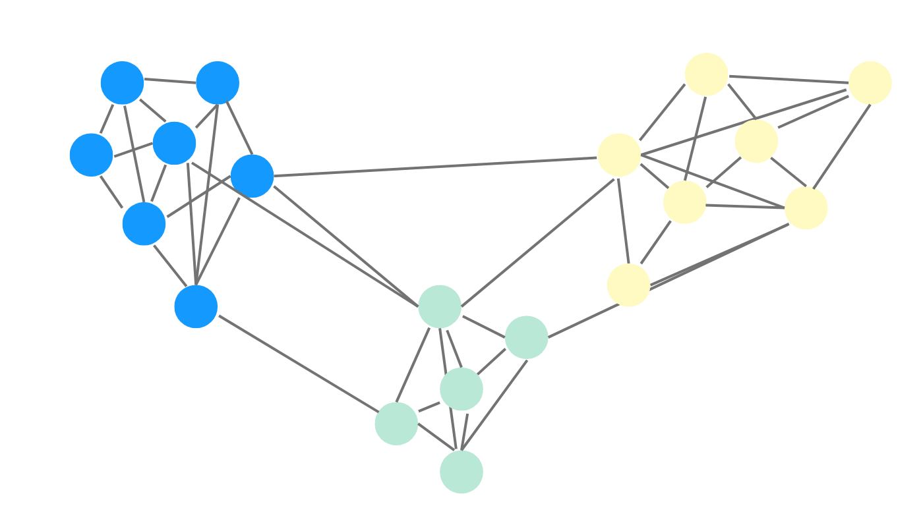
Types of Graphs
Types of graphs:
Directed vs. Undirected
Weighted vs. Unweighted
Sparse vs. Dense
Directed and Weighted
Undirected and unweighted

Slide 6
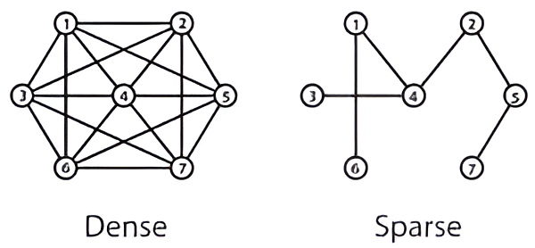
Sparse and Dense Graphs
Definition
A Sparse Graph has few edges relative to the number of vertices.
A Dense Graph has many edges, close to the maximum possible.
Mathematical Representation
Sparse: E < V², O(V) E -> No. of edges, V -> No. of Vertices
Dense: E ~ V², O(V²)

Slide 7
Degree of a vertex
The degree of a vertex in a graph is the number of edges incident to (connected to) that vertex.
Types of Degrees:
In an Undirected Graph:
  The degree of a vertex v, denoted as deg⁡(v), is simply the count of edges connected to v.
2. In a Directed Graph:
  In-degree: The number of incoming edges to v.
  Out-degree: The number of outgoing edges from v.
  Total degree: The sum of in-degree and out-degree.

Slide 8
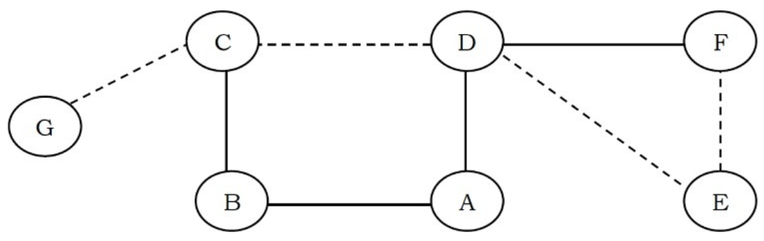
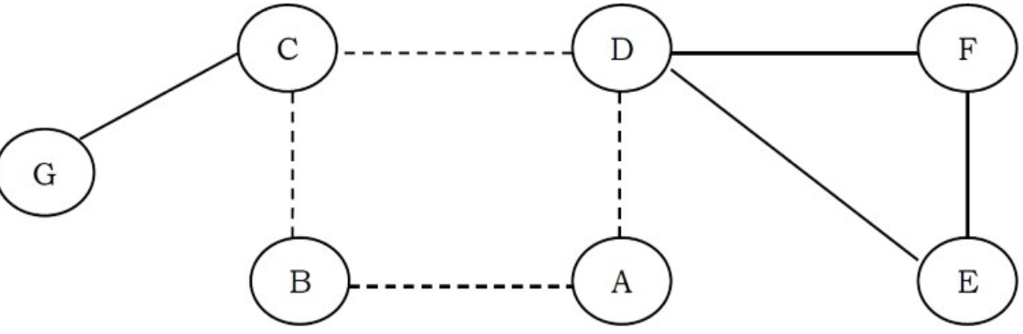
Graphs: Terminologies
A self loop is an edge that connects a vertex to itself
A
A path in a graph is a sequence of adjacent vertices. In the graph, the dotted lines represent a path from G to E
A cycle is a path where the first and last vertices are the same.

Slide 9
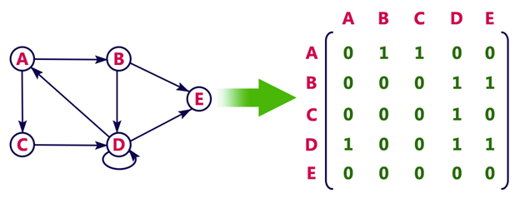
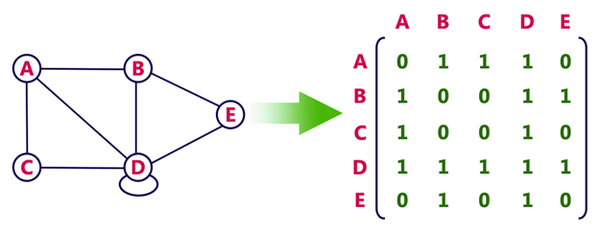
Graphs Representation
How to store these graphs in computer memory by preserving
relation of the vertices ?
Most popular representation of graphs are:
Adjacency Matrix (2D Array)
Adjacency List (Linked List)
Directed Graph Representation
Definition: A ∣V∣×∣V∣ matrix where:
A[i][j]= 1 if there is an edge between vertex
A[i][j]= w (weight) for weighted graphs.
A[i][j]= 0; Otherwise
Undirected Graph Representation

Slide 10
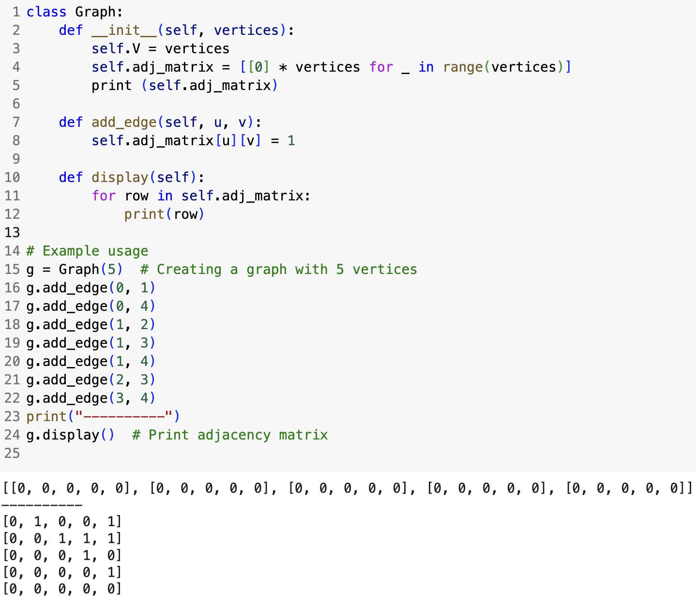
Graphs Representation
0
1
4
2
3
Pros:
  Fast edge lookup O(1) (indices are known)
Cons:
  Takes O(V²) space.

Slide 11
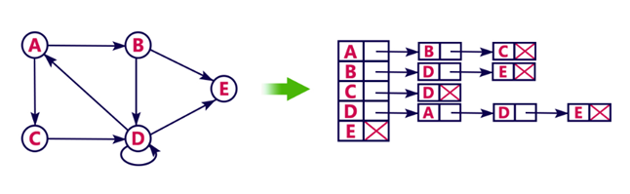
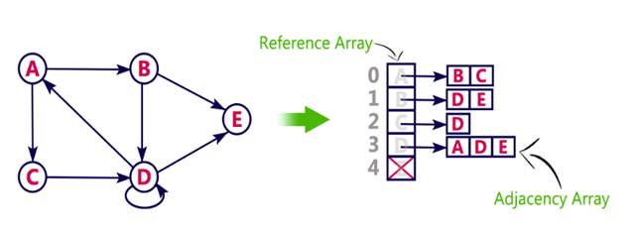
Graphs Representation
Adjacency List:
A list where each node stores its adjacent nodes.
Directed Graph Representation (linked list)
Directed Graph Representation (array)

Slide 12
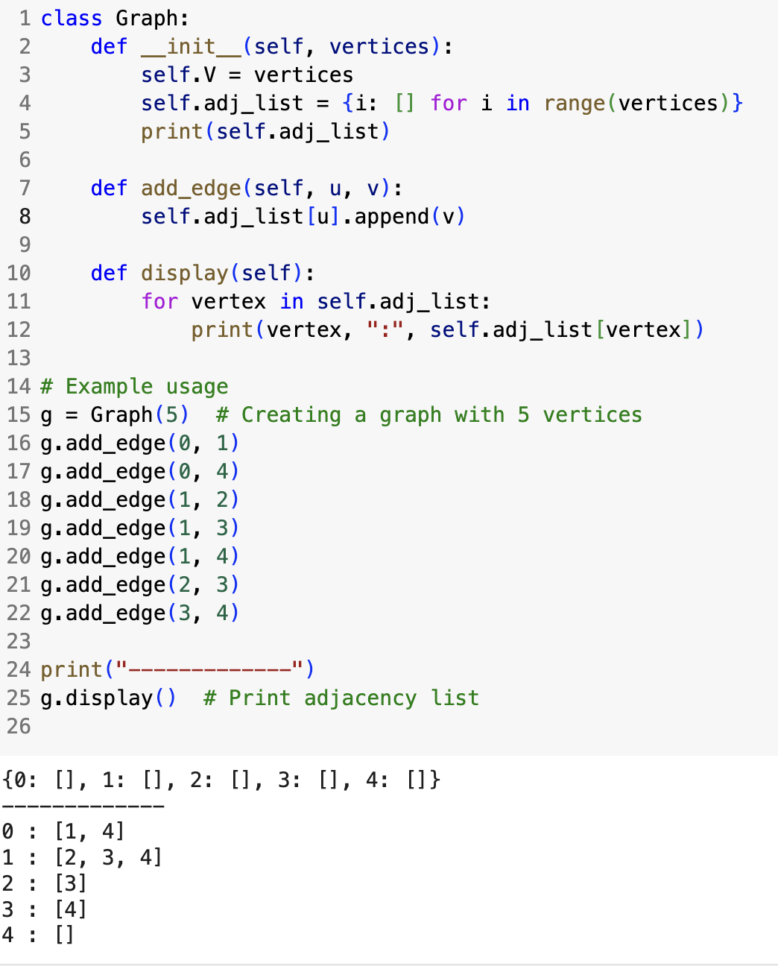
Graphs Representation
0
1
4
2
3
Pros:
Space-efficient for sparse graphs O(V+E).
Cons:
Edge lookup in O(V) worst case.

Slide 13
Adjacency Matrix Vs Adjacency List
Representation | Space Complexity | Edge Lookup | Best for?
Adjacency Matrix | O(V²) | O(1) | Dense Graphs
Adjacency List | O(V+E) | O(V) (worst) | Sparse Graphs

Slide 14
Questions
What is the size of the adjacency list in directed graphs in terms of edges, E?
What is the size of the adjacency list in undirected graphs in terms of edges?
E
2E; asymptotically O(E)

Slide 15
Why Graphs?
We already have the tree data structure, so why do we need graphs?
Graphs can have cycles – Trees do not allow cycles, but many real-world problems involve cycles (e.g., road networks, computer networks).
Graphs allow multiple paths between nodes – In a tree, there is only one path between any two nodes, whereas a graph can have multiple paths, making it useful for shortest path problems.
Graphs support bidirectional relationships – Trees follow a parent-child relationship, while graphs can model mutual relationships like friendships in a social network.
Graphs represent many-to-many relationships – Trees have a strict hierarchy, but graphs allow multiple parents and connections (e.g., course prerequisites).

Slide 16
Graph Traversing
What is Graph Traversal?
  process of visiting all vertices in a graph systematically.
Two main types:
  Breadth-First Search (BFS)
  Depth-First Search (DFS)
Applications of Graph Traversal:
  Pathfinding (Google Maps, AI in games)
  Web Crawling
  Social Network Analysis
  Network Routing

Slide 17
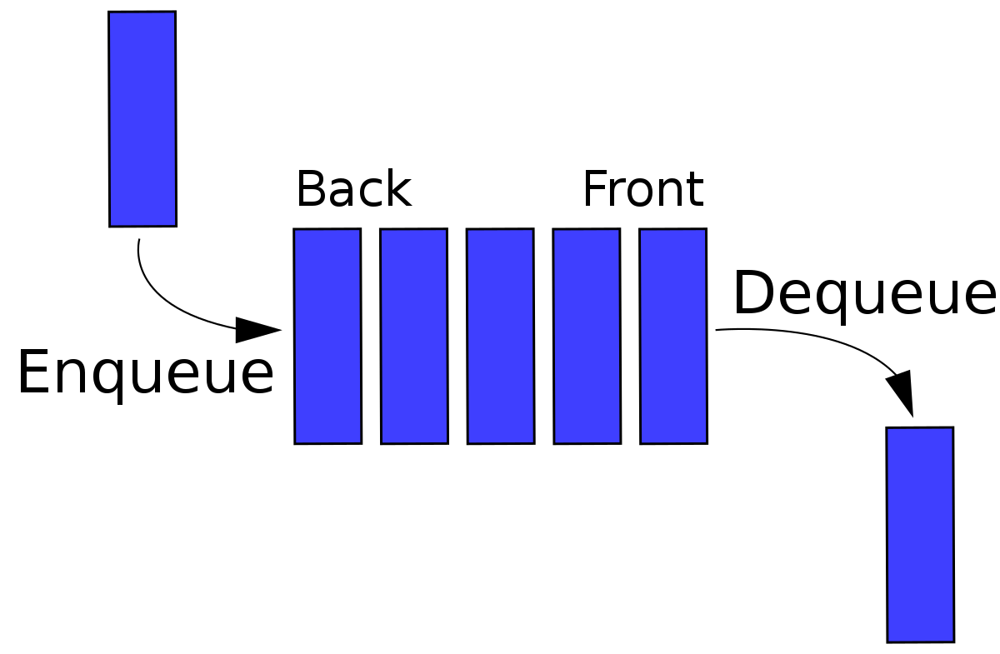
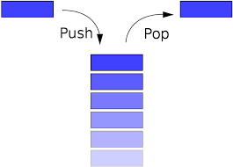
Graph Traversing
Visited (Discovered): The vertex has been seen
Explored: All the child node(s) of the vertex have been seen
Visited:
0
0
0
0
0
0
0
0
Two main types:
  Breadth-First Search (BFS)
  Depth-First Search (DFS)
1
2
3
4
5
6

Slide 18
BFS
BFS Algorithm:
Enqueue the starting node and mark it as visited.
Dequeue a node, process it, and enqueue all its unvisited neighbors and mark them.
Repeat (steps 2-3) until the queue is empty.
Visited:
1
1
1
0
0
0
0
0
1
1
1
0
1
0
start
0
BFS
Sequence
0
1
6
3
2
3
4
5
1
2
Queue
4
5
0
3
6
1
2
4
5
6

Slide 19
BFS: Analysis
What is the size of visited array?
Visited:
0
0
0
0
0
0
0
Space Complexity: O(V) for the visited array. What about the Queue?
start
Space Complexity: O(V-1) in worst case for the Queue.
0
So, space Complexity of BFS is O(V).
What about time complexity?
1
2
3
4
5
6

Slide 20
BFS: Time complexity
Visited:
0
0
0
0
0
0
0
Adjacency list
Time requires to initialize this array?
O(V)
0
1
2
3
0
1
4
Enqueue the starting node and mark it as visited.
Dequeue a node, process it, and enqueue all its unvisited neighbors and mark them.
Repeat (steps 2-3) until the queue is empty.
What about Adj.
Matrix?
2
4
5
1
2
3
3
5
4
6
4
5
5
6
Enqueue all its unvisited neighbors: O(E)
6
6
Time complexity: O(V + E)

Slide 21
BFS: Application
How BFS can be used for mutual friend recommendation in social media like Facebook?
Can BFS find the minimum number of edges between the start vertex and any arbitrary vertex?
1
2
U
5
4
3
6

Slide 22
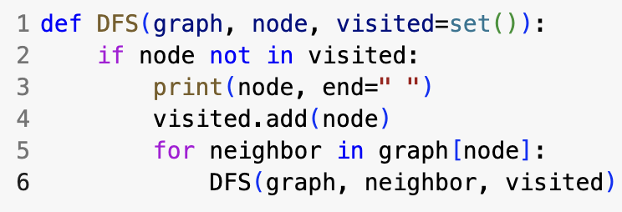
DFS
DFS Algorithm:
Start from a node, mark it visited.
Recursively visit unvisited neighbors.
Backtrack when no more neighbors (unvisited) exist.
start
0
6
3
1
2
Visited:
0
1
1
1
1
1
1
1
4
5
1
4
5
2
DFS
Sequence
3
0
1
4
6
2
5
3
0
Stack
6

Slide 23
DFS: Analysis
What is the size of visited array?
Space Complexity: O(V) for the visited array. What about the Stack?
Space Complexity: O(V-1) in worst case for the Stack.
0
So, space complexity of DFS is O(V).
6
3
Time complexity using adj. list = O(V+E)
Time complexity using adj. matrix = O(V²)
1
2
4
5
1
4
5
2
3
0
Stack
6

Slide 24
BFS Vs DFS
Feature | BFS (Breadth-First) | DFS (Depth-First)
Approach | Level-by-level (wide first) | Deep first, then backtrack
Data Structure | Queue (FIFO) | Stack (LIFO) / Recursion
Time Complexity | O(V+E) | O(V+E)
Space Complexity | O(V) | O(V)(recursive calls)
Use Cases | Shortest path | Maze solving, cycle detection

Slide 25
Topological sort
if G contains an edge E (u,v), then u appears before v in the topological ordering.
(linear ordering of the vertices )
When is it applicable?
Only for Directed graphs
Graph must be Acyclic (no cycle
Insert the popped element in front of a linked list
start
Topological
Ordering
0
0
3
2
5
1
4
6
6
1
2
3
Visited:
0
1
1
1
1
1
1
1
4
5
1
2
DFS
Sequence
3
4
5
0
1
4
6
2
5
3
0
Stack
6

Slide 26
Topological sort
Prerequisite courses
↓
Course scheduling
Task dependencies
↓
Project scheduling
Source files
↓
Compilation/build order
Software packages
↓
Dependency installation
Programming → Data Structures → Algorithms
↓
Advanced DSA

Slide 27
Topological sort (Homework)
Kahn's Algorithm using indegree and Queue data structure

Slide 28
Cycle Detection using DFS (Directed Graphs)
start
0
1
is already visited and present in the stack and its’ parent is ; not
2
0
2
5
0
5
6
1
2
3
So, G contains a cycle
4
1
1
4
5
6
DFS
Sequence
0
1
4
6
5
2
0
Stack
4
6

Slide 29
Homework
Q1. Write an algorithm to find out whether a given undirected graph has a cycle or not.

Slide 30
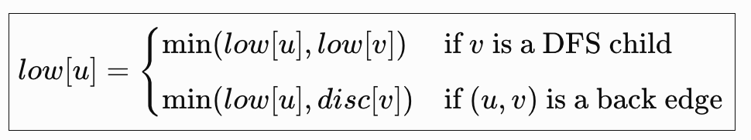
Articulation point detection: DFS
An articulation point (or cut vertex) in a graph is a vertex that, when removed, increases the number of connected components (divides into multiple graphs).
Can a child node in the DFS tree reach one of its’ earliest ancestors without going through its parent?
1
1
Discovery
time
1
6
3
2
4
5
1
2
3
4
5
6
4
2
4
Lowest
Discovery
time
3
1
1
1
1
3
3
3
1
2
3
4
5
6
5
6
5
2
Edge e(u, v); u is parent, v is child
if L[v] ≥ d[u] ; the u is an articulation point; u cannot be root
6
Back edge
Edge connects to ancestor

Slide 31
Articulation point (aka cut vertex)
Lowest discovery time that can be reached from node u, either through its descendants in the DFS tree or through a back edge to an ancestor
Low[v] = min(low[v],disc[u])
If low[v] < disc[u], it means there is another path (a back edge) connecting v (or its subtree) to an ancestor of u. In that case, u is not an articulation point because removing it won't disconnect v.
But if low[v] ≥ disc[u], no such back edge exists, meaning u is the only bridge keeping v connected to the rest of the graph—making u an articulation point!

Slide 32
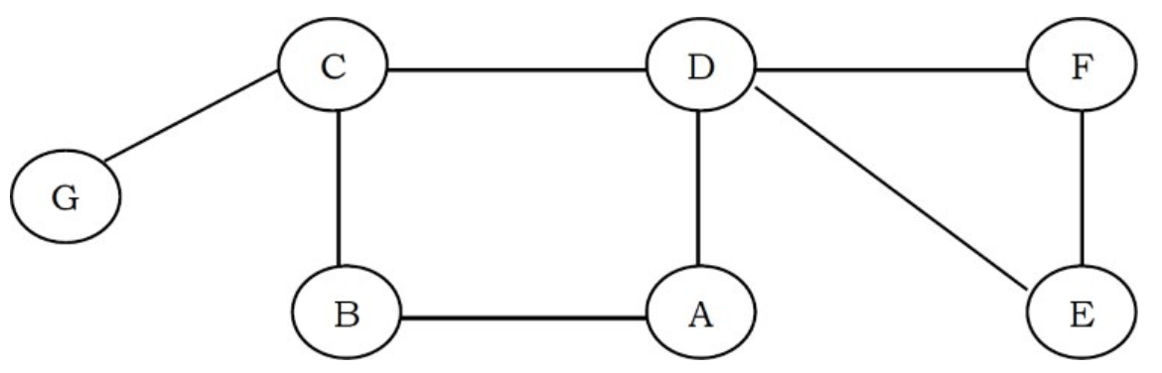
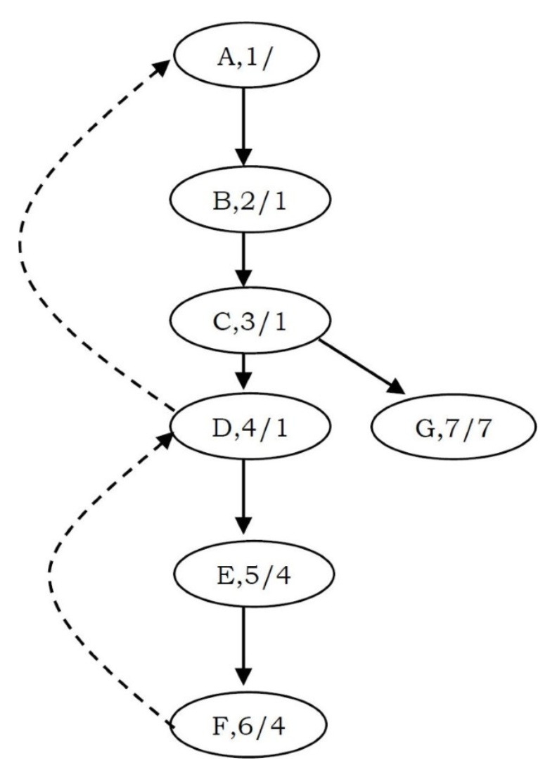
Contd…
Find articulation points of the below graph
Start

Slide 33
Contd…
Let G be a connected graph of order n. What is the maximum number of cut vertices that G can contain?
Ans: n-2

Slide 34

Questions
Apply the DFS(a) algorithm, and find the DFA correct sequences
a b e g h f
a b f e h g
a b f h g e
a f g h b e
a
e
b
f
h
g

Slide 35
Questions
If you use DFS, what could be the maximum stack length?
19
14
13
7
6
18
15
12
8
5
2
1
17
16
11
10
9
4
3

Slide 36
Questions
Q. Which undirected graph representation is most appropriate for determining whether or not a vertex is isolated (is not connected to any other vertex)?
Ans: If we use the adjacency matrix, then we need to check the complete row to determine whether that vertex has edges or not. By using the adjacency list, it is very easy to check, and it can be done just by checking whether that vertex has NULL for next pointer or not [NULL indicates that the vertex is not connected to any other vertex].
Q. Count the number of connected components of Graph G which is represented in the adjacent matrix using DFS.
Ans: Same as BFS. Time Complexity: Same as that of DFS and it depends on implementation. With adjacency matrix the complexity is O(|E| + |V|) and with adjacency matrix the complexity is O(|V|²).

Slide 37
Questions
Q. Detect strongly connected components in graph using DFS?
Kosaraju's Algorithm
Tarjan's Algorithm

Slide 38
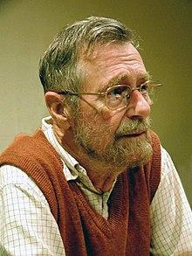
Shortest path algorithms (Weighted graphs)
Can we use BFS algorithm to find the shortest path from source ( ) to destination ( ) for the below graphs?
S
D
S
S
1
1
7
5
M
N
M
N
Dijkstra’s
1
2
1
1
D
D
Note: BFS cannot guarantee that the front vertex of the queue is the closest to the source

Slide 39
Shortest path algorithms (Unweighted graph)
Use BFS vs DFS:
Why BFS?
BFS explores level by level (or layer by layer) from the source node.
The first time BFS reaches a node, it guarantees the shortest path to that node because BFS always takes the smallest number of edges to reach a node.
Why not DFS?
DFS explores depth-first without considering the shortest path.
It may take a long detour before finding the target.
DFS does not work for shortest paths in general graphs.

