Slide 1

Kuant&Min Corporation
Bitcoin Trading
System
肖坤然
张敏觉

Slide 2



Bitcoin Trading System
System
Frame
Data
Mode
Back-
End
Front-
End
Data Mode
Back-End
Front-End

Slide 3



Cloud+Mysql+CPP+Python+JS
Load data into DB
Tencent Cloud(Linux)
Terminal Address: HongKong
MySql
Python
Package: CCXT
Read data
Back-end
WebSocket
Front-end
Local
Backtest
（C++）
Backtest Params
Front page
(JS/html/css)
Backtest
results
Live trading
（C++）
Live trading data
System
Frame
Data
Mode
Back-End
Front-End

Slide 4
Bitcoin Trading System
System
Frame
Data
Mode
Back-
End
Front-
End

Slide 5


Compare different database
Database Choose
Average time to insert data
time(s) | 1 row | 10 rows | 100 rows | …
mysql | 0.278513877 | 2.784136772 | 27.62212780 | …
PostgreSQL | 0.272163891 | 2.716496070 | 26.97019375 | …
Average time to select data
time(s) | 1 row | 10 rows | 100 rows | …
mysql | 0.000277579 | 0.001202503 | 0.009862539 | …
PostgreSQL | 0.000115829 | 0.000267737 | 0.001757550 | …
Almost 10 times faster
System
Frame
Data
Mode
Back-End
Front-End

Slide 6
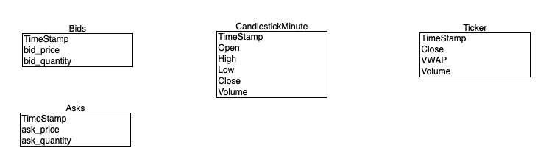
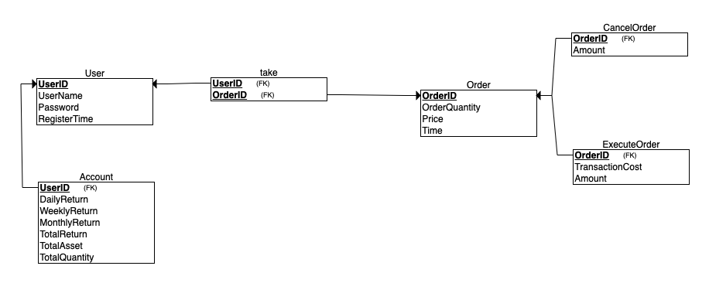
Relational Schemas
Market_Info
(Freq: 2s)
User_Info
System
Frame
Data
Mode
Back-End
Front-End

Slide 7
Bitcoin Trading System
System
Frame
Data
Mode
Back-
End
Front-
End
Backtest
Strategy
Live trading
Websocket

Slide 8
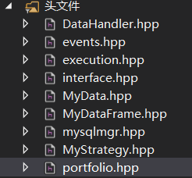
Backtest: Event-driven framework
Header File
Description
MyDataFrame.hpp
Design custom data structure.
MyData.hpp
Used to store and operate market data.
DataHandler.hpp
Define data loading and processing function.
events.hpp
Define signal, order, fill events.
execution.hpp
Used to execute orders.
portfolio.hpp
Define portfolio to store account info.
mysqlmgr.hpp
Used to connect to MySQL in cloud.
MyStrategy.hpp
Used to define your strategy.
interface.hpp
Integrate all parts to run event-driven loop.
System
Frame
Data
Mode
Back-End
Front-End

Slide 9
Backtest: Event-driven framework
Initialization
Get Events
Market Event
Signal Event
Order Event
Fill Event
Calculate Signals
Generate Order
Calculate Trading Cost
Update Account Info
System
Frame
Data
Mode
Back-End
Front-End

Slide 10
Strategy: Double average lines and BOLL
Price
MA20
MA10
BOLL
Risk Management:
Limit our total holdings of bitcoin to 20% of current total assets.
Data: 2s Ticker Price
Buy
Sell
Buy
Sell
System
Frame
Data
Mode
Back-End
Front-End

Slide 11
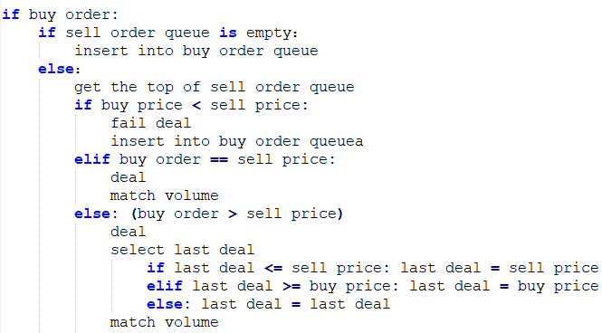
Paper & Live Trading
Match the orders
pseudocode
Utilize the event-driven framework to run the paper & live trading process
System
Frame
Data
Mode
Back-End
Front-End

Slide 12
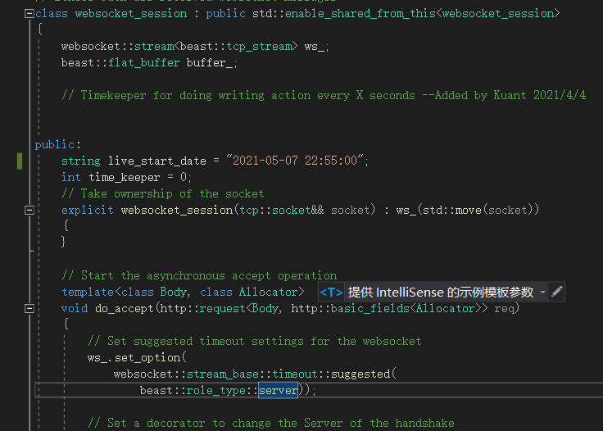
Websocket
Client
Server
Handshake Request
Handshake Response
Data
……
……
Data
System
Frame
Data
Mode
Back-End
Front-End

Slide 13
Bitcoin Trading System
System
Frame
Data
Mode
Back-
End
Front-
End

Slide 14
Web Design
Back Test
From
to
START
Total
Return
Annual Return
MaxDD
Volatility
Calmar
Shape
Total Asset
Pnl
Total return
Position
Cash
System
Frame
Data
Mode
Back-End
Front-End

Slide 15
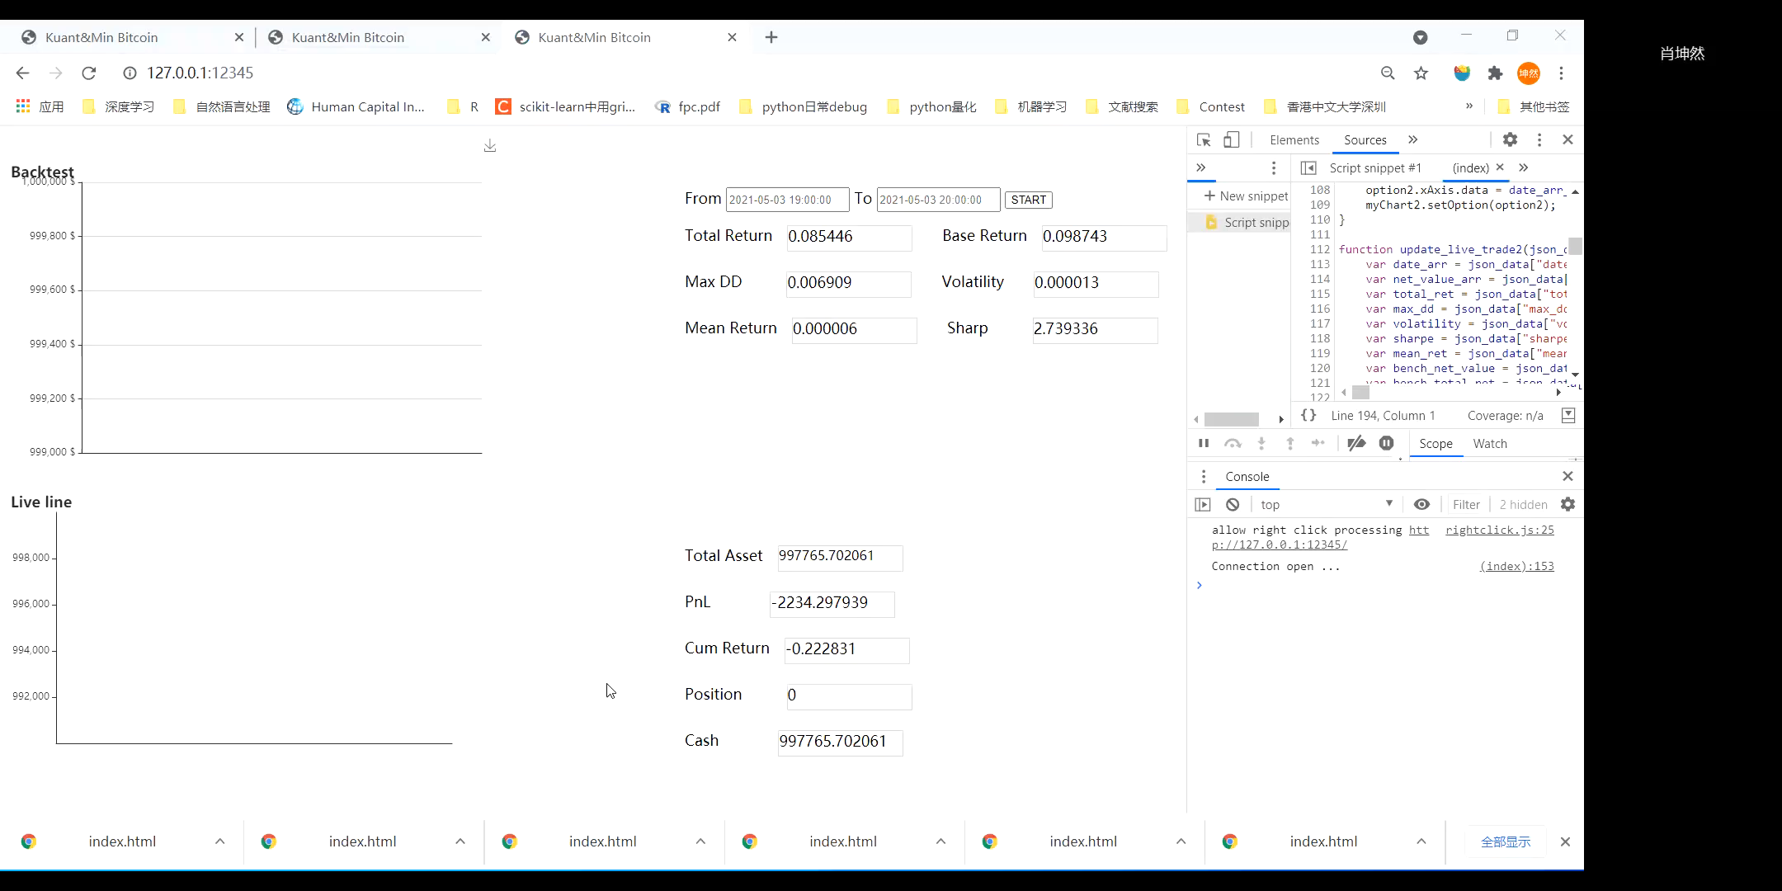
Demo
System
Frame
Data
Mode
Back-End
Front-End

Slide 16
Thank You For Listening

