Slide 1
Team6
文皓平 220040079 王冰220040082
邓伟杰 220040053 谢迅220040088
2021.5
Notes:
更多素材资源- B-lue-D-ragonfly- DESIGN

Slide 2

PART 01
Main Parts of our system

Slide 3
1. Craw
This module is a separate module. There are two folders, craw and craw_sql. Mostlty, they are the same. The programme in craw_sql can save the data in MySQL database directly. But for convenience and data-sharing with teammates, we can also save in Json form and write it into txt with the programme in craw.
Function
When saving the data, we have two ways. One way is writing to table name 'data' and 'data_all' in MySQL database. We can also write it into data.txt and data_all.txt. The table 'data_all' is the complete transaction data that includes details of each transaction, and the 'data' is open,close,high,low and volume of trading price in a certain period as mentioned above. In our craw module, the 'data.txt' and 'data_all.txt' have been saved. The MySQL data are saved in folder 'Dump20210507'. In our later work, we will read the 'data' in our main function to start our whole backtesting system..
Data Storage
双均线策略

Slide 4
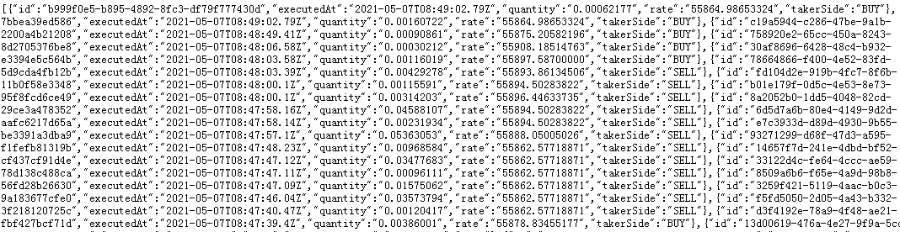
1.Craw
Running this 'craw.py/craw_sql.py', we will use an API from bittrex to get realtime bitcoin trading order. The 'to_dataframe.py/read_sql.py' performs the function that resamples the order flow to dataframe, which shows open,close,high,low and volume of trading price in a certain period (in this programme we just set it about 2-3mins as default, you can change it into a higher frequency). The folder craw_sql also has a programme named 'history_sql.py'. It can help you to get minutes, 5minutes and 1hour history data from bittrex exchange.
Api: https://api.bittrex.com/v3/markets/BTC-USDT/trades
Notes:
由回测结果可知，双均线策略相比于标的指数，波动率较小，在2012年初、2018年末等阶段，避免了较大的回撤，但在标的指数具有较大波动时，收益率较低。在2015年之前均线策略收益率高于沪深300指数，但在2015年之后经常出现落后于沪深300指数的情况
由此可见，双均线策略在2015年之前的表现差强人意，但在其后几年在A股市场表现的非常不理想，故需要提出更新的策略来满足投资者的需求。

Slide 5
2. Feed
This module is to transfer the transaction data to our system, connecting data and further analysis modules.
Function
craw -> data -> Feed -> Strategy -> Portfolio -> Execution -> Backtesting
Chain of our system

Slide 6
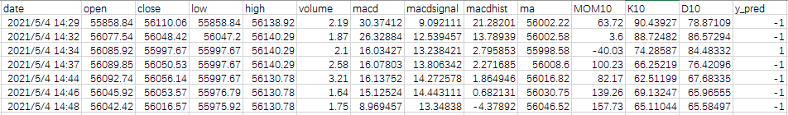
3. Strategy
This module is used to analyze the transaction data to predict the trend of price. Firstly it receives the transaction data from the Feed module. Secondly, it will analyze the transaction data through functions in Strategy module. Thirdly, it will make prediction (-1 or 1) based on analysis, and send such signals to Portfolio and Execution modules.
Example:
1. Basic data
2. Analyze technical indices based on basic data, as features of prediction model.
3. Giving prediction in signal form.
1:buy; -1:sell
Notes:
海龟交易策略跑出了一定的超额收益，同时，相比于基准，它的波动率也更小，更稳定。
由于加入了动态止损的机制，使得策略即使在2014和2015年的熊市中，亏损也也相对较小。同时，也没有错过2015年底和2016年的牛市。从收益曲线中可以看出，海龟策略在面对快速的连续的暴涨暴跌时，表现不是很好，不能及时作出反应，发生收益回吐的现象，所以在使用唐奇安通道和计算ATR时，应该适当缩短回看时间，以使得策略可以更为及时的对行情的变化做出反应。

Slide 7
4. Portfolio
This module is used to manage position. Although we have judged the buying and selling trend, we need to limit the position. For example, we can set a limiting that the proportion of the position must less than 0.5. So, this module plays a limiting role. Then, the opening and selling signals will be sent to the next one--Execution module.
Function
Parameters:
buy_amount and sell_amount: It is a fixed rate to trade (In our setting, we start with principal 1 million, and we set this parameter to 50000)
trade_signal: It is a trading signal. The ‘sell’ is for sale. The ‘buy’ is for purchase. The ‘None’ is for inaction. In the subsequent code, that is a judgment basis.
judge_position: To calculate the proportion of the value of coins in our current portfolio.

Slide 8
5. Execution
This module is used to execute an order to simulate the real situation about trading. And it will eventually return a total profit and loss. There are the meaning of some parameters: tip: Handling fee. buy_flap: The slippage of buying. sell_flap: The slippage of selling. buy_last_price and sell_last_price: the last price of trading. Each transection will both print in the console and save in record.txt.
Function
Example of output:

Slide 9
6. Backtesting
This module firstly draw the backtesting line of our strategy and the market price of Bitcoin, then calculate total return, maximum drawback, alpha, beta and Sharpe ratio of our strategy.
Function
That’s the whole structure of our system.
Chai of our system
craw -> Feed -> Strategy -> Portfolio -> Execution -> Backtesting

Slide 10
PART 02
Back Testing

Slide 11
Our Strategy
Our model: XGBoost
Features | Abstact
volume | Traded volume
ma | Moving average(10-period)
macd | MACD with fastperiod=12, slowperiod=26, signalperiod=9
macdsignal
macdhist
MOM10 | 10-period Momentum index
K10 | K and D of Stochastic Oscillator
D10
XGBoost is an optimized distributed gradient boosting algorithm designed to be highly efficient, flexible and portable. It implements machine learning algorithms under the Gradient Boosting framework. XGBoost provides a parallel tree boosting (also known as GBDT, GBM) that solve many data science problems in a fast and accurate way.

Slide 12
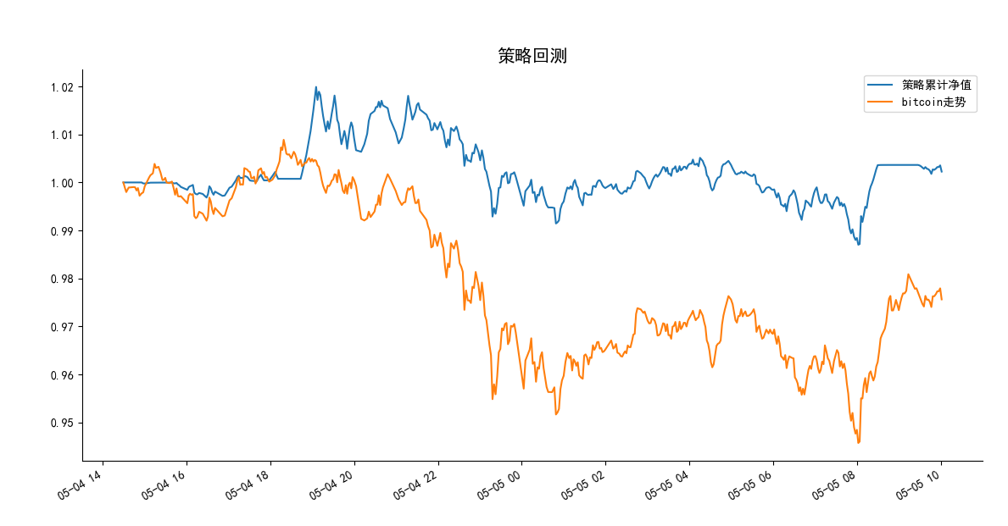
Back testing

Slide 13
Back testing
Back testing period: May 4th 10am to May 5th 10am
(Data from May 4th 10am to 14:30pm is served as training set and thus not reflected in backtesting line and performance.)
Strategy Performance:
Total return： Strategy 0.23%, Market -2.44%
Maximum drawback： Strategy 3.22%, Market 6.26%
Alpha： 0.01, Beta：0.46，Sharpe Ratio：0.93
Last portfolio:
coin_number:10.021545527042575 principal:453647.7368489761

Slide 14
THANKS
Notes:
更多素材资源- B-lue-D-ragonfly- DESIGN

