Slide 1

ALGORITHM TRADING
GROUP 1
汇报人：Yunqing Tian, Yongxing Luo, Yuanyu Zhou, Yushu He, Qian Wu, Yuchen Pang

Slide 2

CONTENTS
DATABASE
STRATEGY
TRADING
OUTCOMES

Slide 3

DATABASE
01
Supporting text here.
When you copy & paste, choose "keep text only" option.

Slide 4
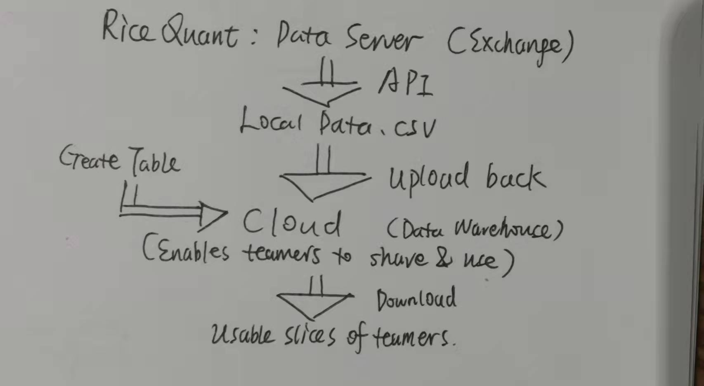
DATABASE

Slide 5
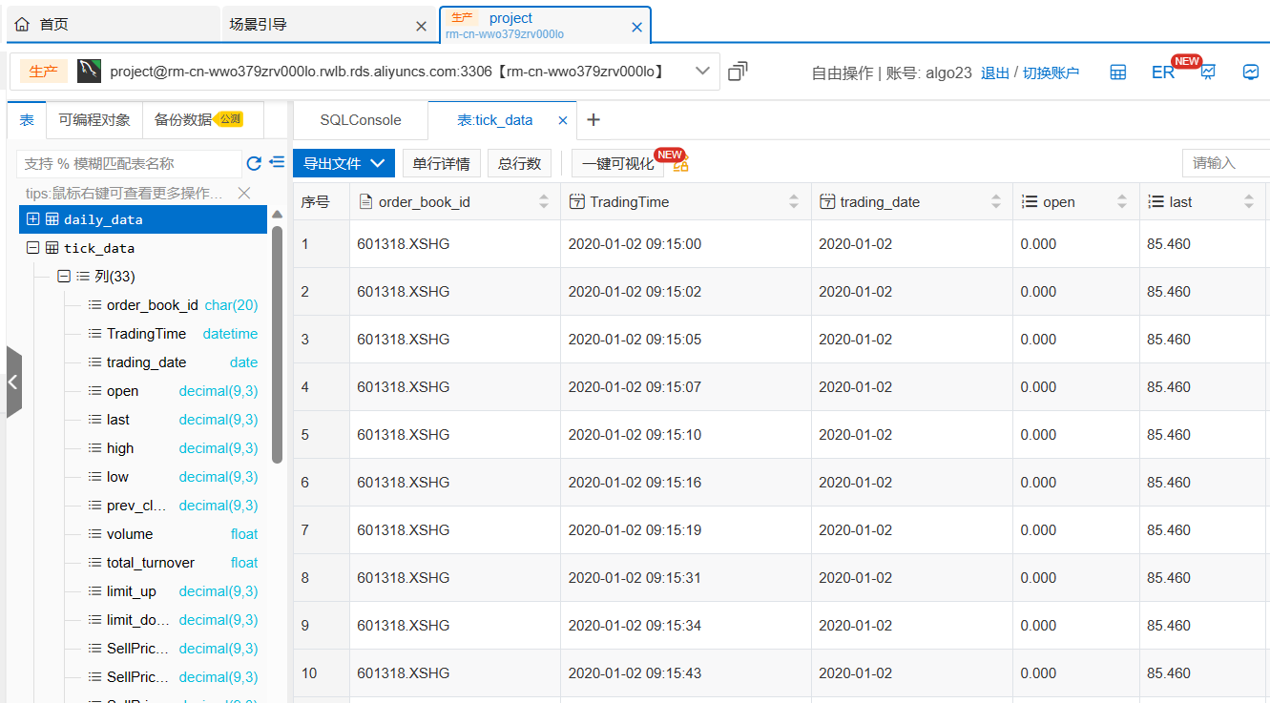
A Corner of Cloud Database

Slide 6
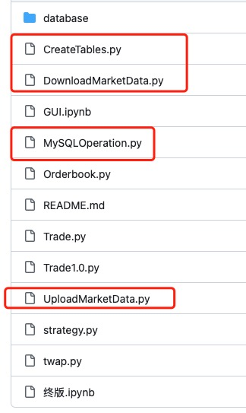
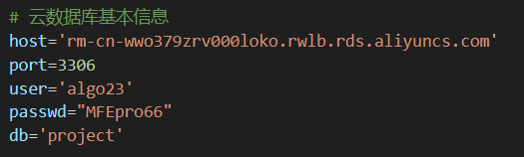
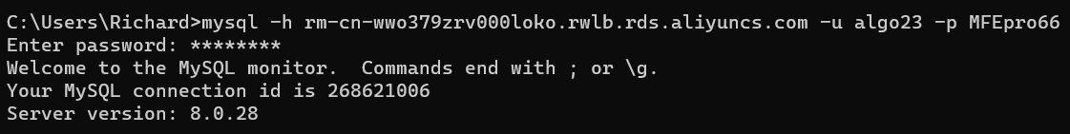
Successful connections!

Slide 7
DATA:
underlying: 金山办公 688111.SZ
Frequency: 1 minute level k-line
Time period: 2 years 1-min
Data2: order-book data in 3 seconds

Slide 8
STRATEGY: SLOPE RSRS(阻力支撑相对强度)
02
Supporting text here.
When you copy & paste, choose "keep text only" option.

Slide 9
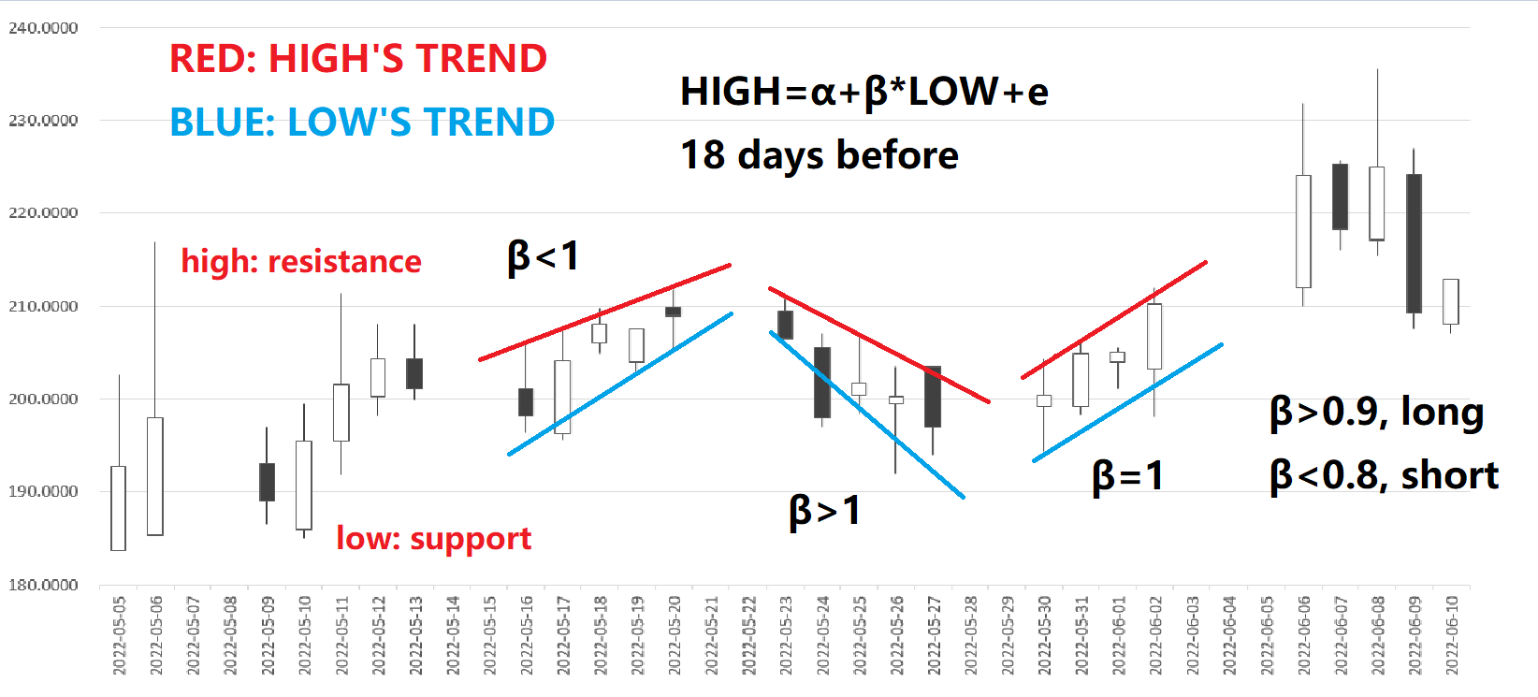
WHAT IS SLOPE RSRS?

Slide 10
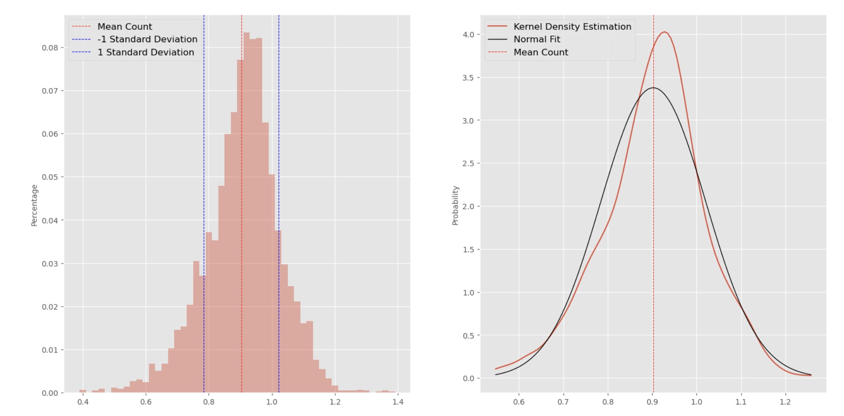
During period, β’s distributions
Beta of 18 days before is calculated as flags for each period: determine buy/sell decisions

Slide 11
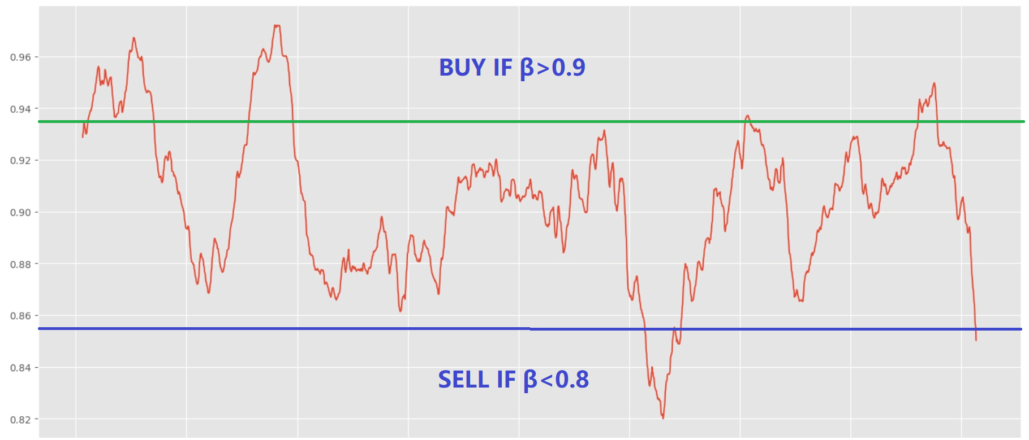
HOW β is connected with trade decision signals?

Slide 12
TRADE
03
Supporting text here.
When you copy & paste, choose "keep text only" option.

Slide 13
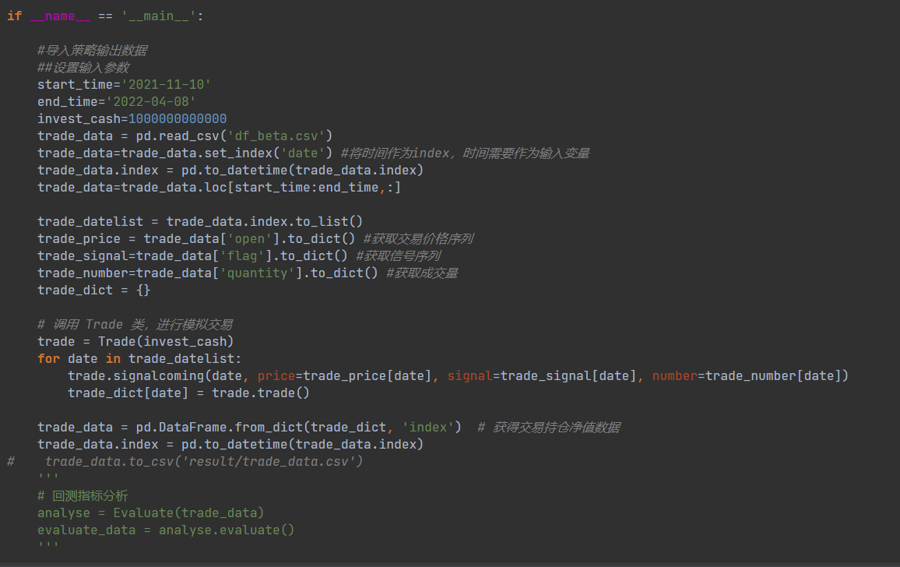
HOW WE PROGRAMMED

Slide 14
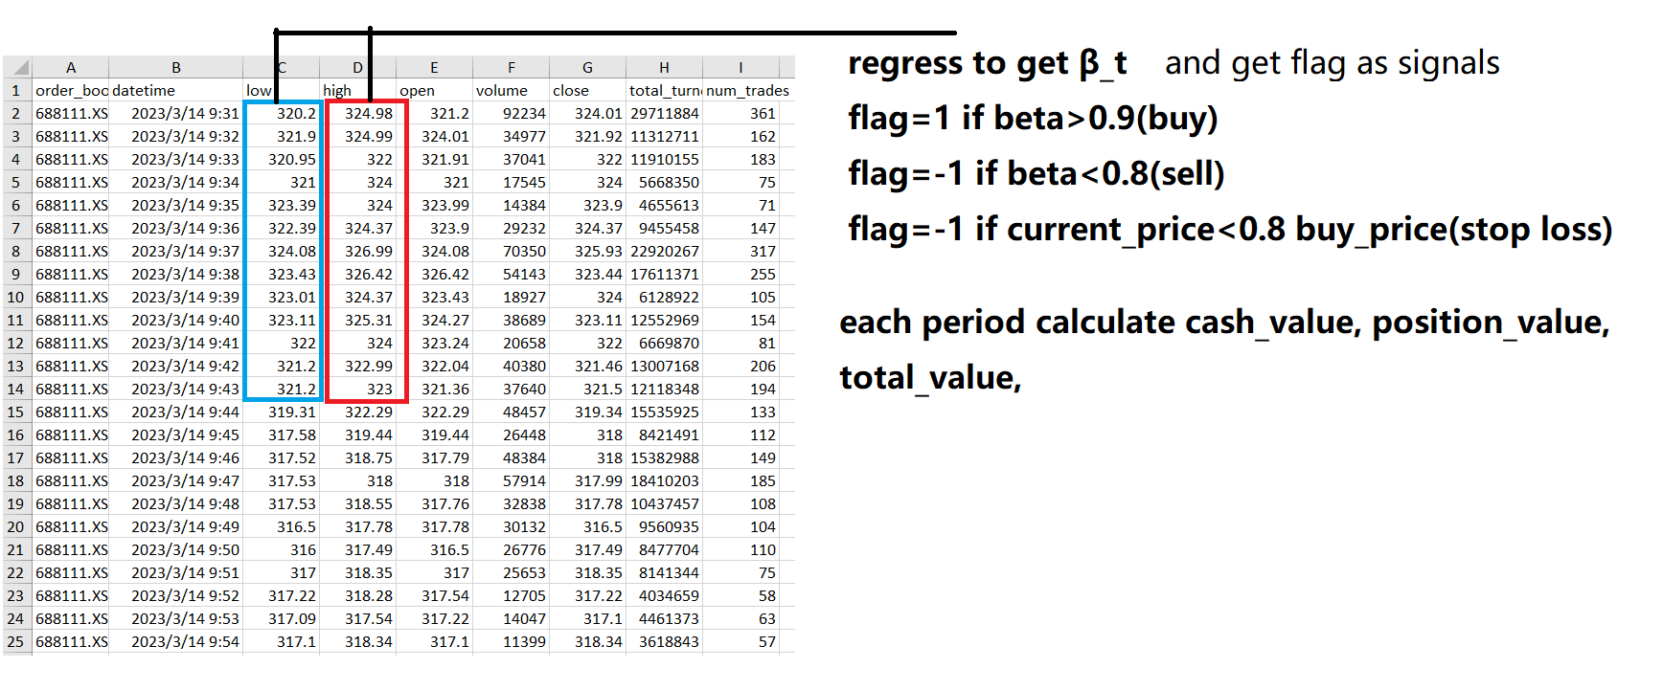
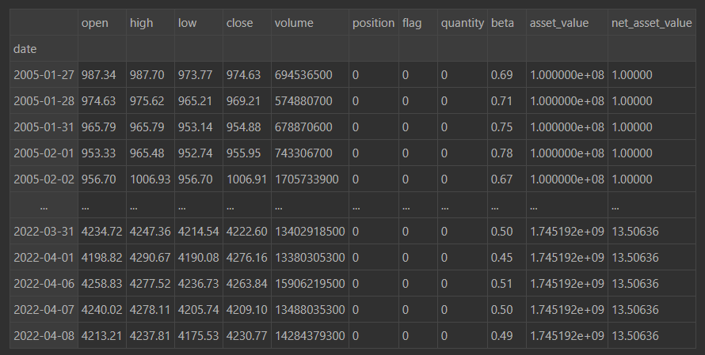
1-min frequency data

Slide 15
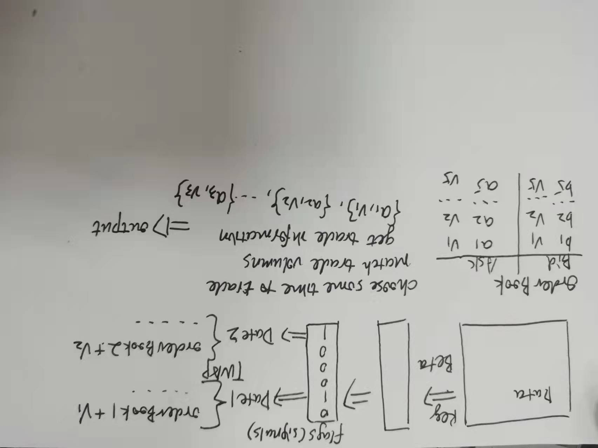
Order book

Slide 16
成果展示
04
Supporting text here.
When you copy & paste, choose "keep text only" option.

Slide 17
How does our strategy run?
See our GUI!
(VIDEO and speaking)

Slide 18
And Your Slogan Here.

