Slide 1
pip install fairness a fairness-aware classification toolkit
Sorelle Friedler • Carlos Scheidegger • Suresh Venkatasubramanian
Haverford College • University of Arizona • University of Utah

Slide 2
Evaluating fairness-aware algorithms
Which algorithm is the best?
... on which dataset?
… how was it preprocessed?
… under which measure?
… with which training / test split?
… what are the right hyperparameter settings?
… what if there are multiple sensitive attributes?

Slide 3
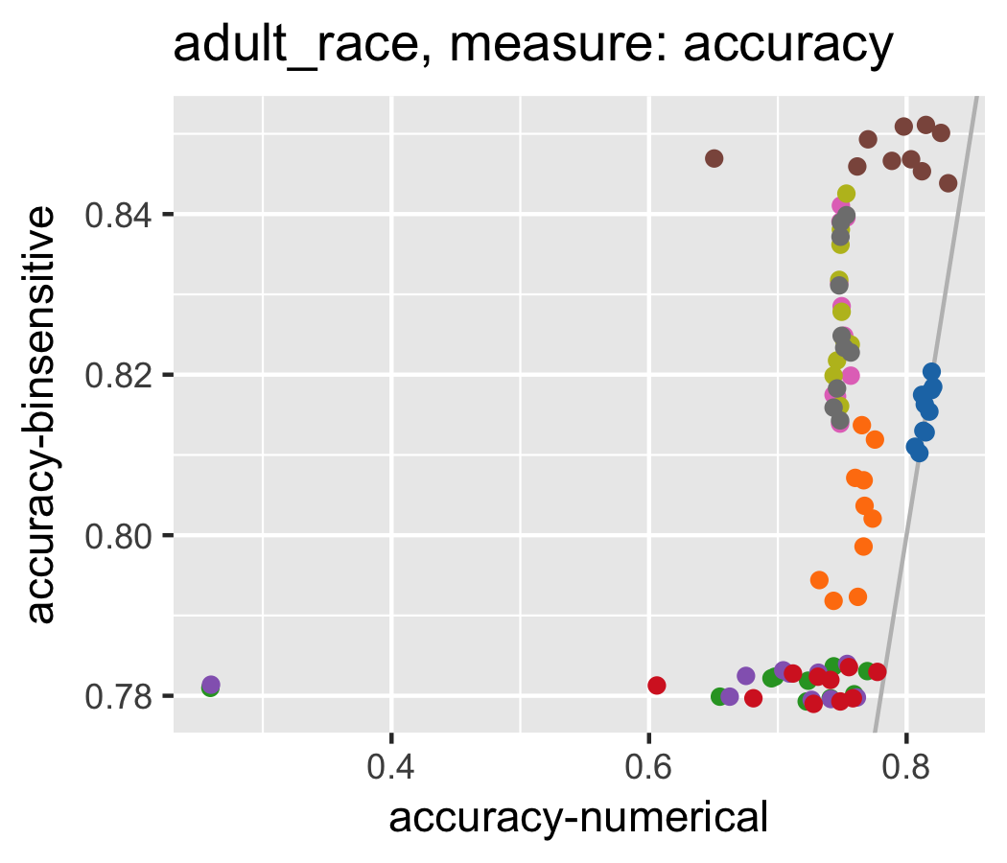
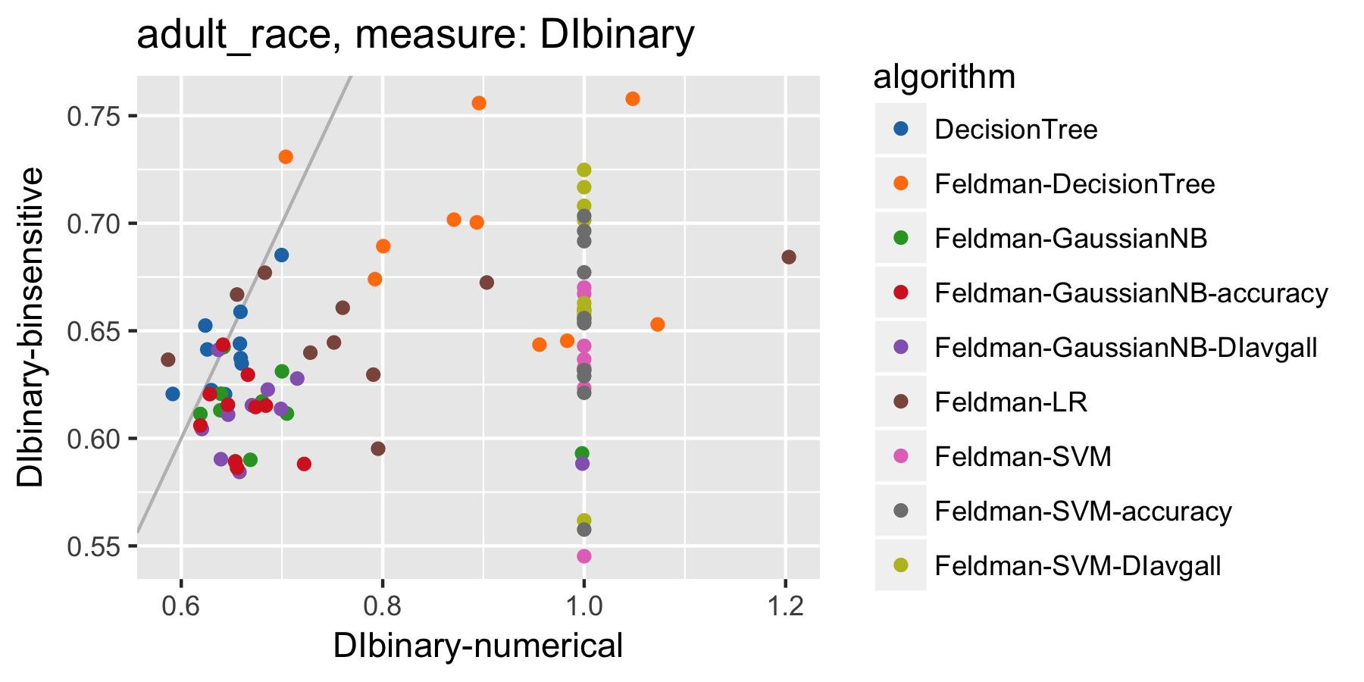
Preprocessing choices make a difference
Feldman et al. is more accurate and less fair when the sensitive variables are made binary.

Slide 4
Preprocessing choices make a difference
Evaluate algorithms against each other using the same preprocessing method.
Try multiple preprocessing methods for your algorithm (if possible).
Examine how the preprocessing method you choose can itself be a fairness/accuracy trade-off.

Slide 5
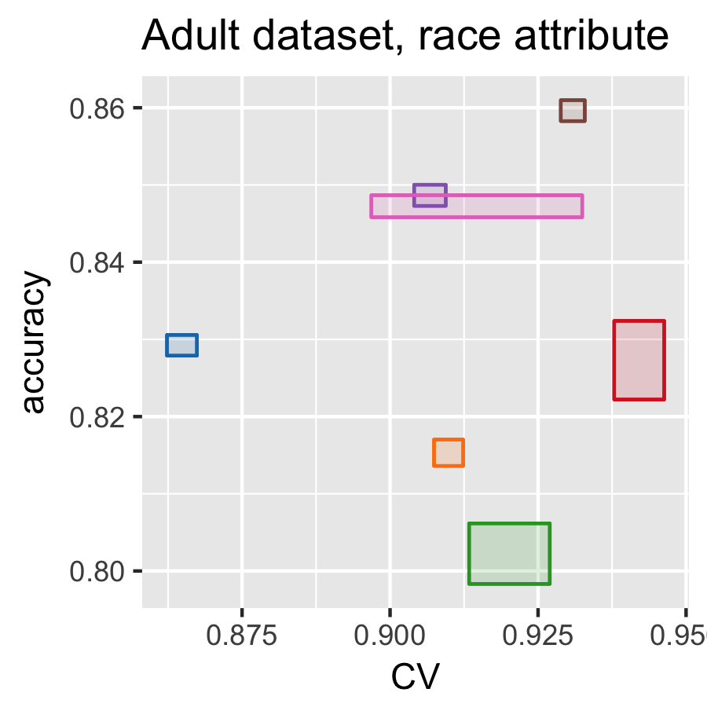
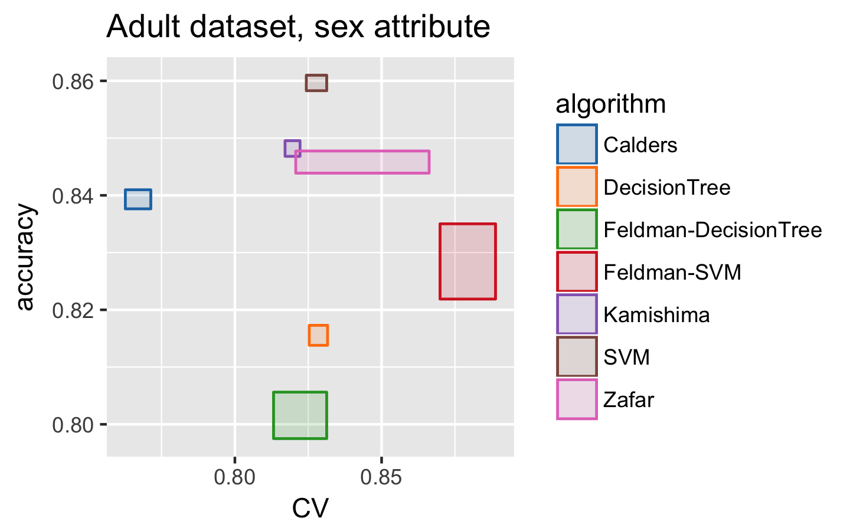
Consider per-algorithm training variability
Feldman et al. varies in accuracy over splits while Zafar et al. varies in fairness.

Slide 6
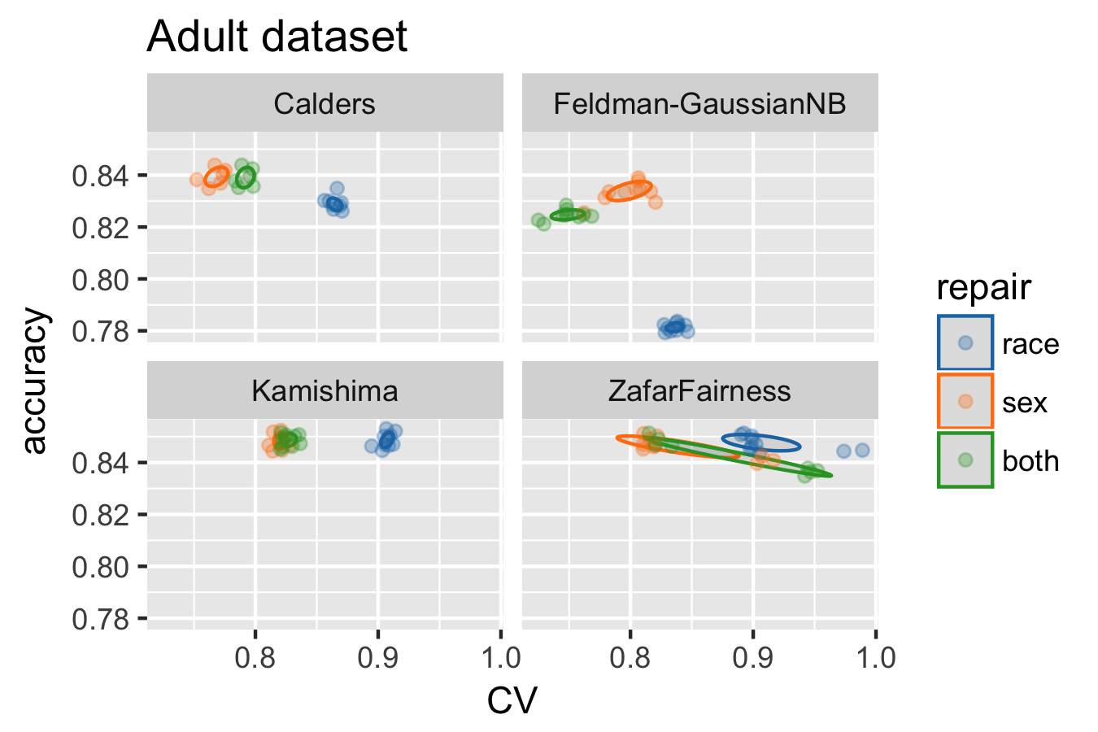
Consider multiple sensitive attributes
Algorithms can handle
multiple sensitive attributes naively by making combined attributes:
Race-Sex
White-Man
White-Woman
etc.

Slide 7
What we’ll do today!
Data
get preprocessed data
add a dataset!
Metrics
add a metric
Algorithms
add an algorithm

Slide 8
https://algofairness.github.io/ fatconference-2019-toolkit-tutorial/

