Slide 1

102. Binary Tree Level Order Traversal
2021-06-06
이해니

Slide 2
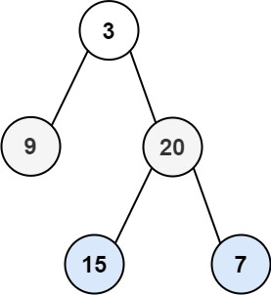
문제
구분 | Input | Output
구조 | TreeNode | List<List<Integer>>
답 | [3,9,20,null,null,15,7] | [[3],[9,20],[15,7]]

Slide 3
문제
구분 | Input | Output
구조 | TreeNode | List<List<Integer>>
답 | [3,9,20,null,null,15,7] | [[3],[9,20],[15,7]]
1 | [3,9,20,null,null,15,7] | [[3]]

Slide 4
문제
구분 | Input | Output
구조 | TreeNode | List<List<Integer>>
답 | [3,9,20,null,null,15,7] | [[3],[9,20],[15,7]]
1 | [3,9,20,null,null,15,7] | [[3]]
2-1 | [3,9,20,null,null,15,7] | [9]
2-2 | [3,9,20,null,null,15,7] | [9, 20]
2 | [3,9,20,null,null,15,7] | [[3],[9,20]]

Slide 5
문제
구분 | Input | Output
구조 | TreeNode | List<List<Integer>>
답 | [3,9,20,null,null,15,7] | [[3],[9,20],[15,7]]
1 | [3,9,20,null,null,15,7] | [[3]]
2 | [3,9,20,null,null,15,7] | [[3],[9,20]]
3-1 | [3,9,20,null,null,15,7] | [15]
3-2 | [3,9,20,null,null,15,7] | [15,7]
3 | [3,9,20,null,null,15,7] | [[3],[9,20],[15,7]]

