Slide 1

OPENFUND PROP — INVESTOR PRESENTATION
A transparent proprietary-trading platform,
built for the hybrid evaluation era
Pre-Seed · USD 50–100K under evaluation · Canada establishment planned
November 2026 — Confidential

Slide 2
INVESTMENT THESIS
Rising global demand for trader evaluation,
and a market that rewards transparency
$850M
12M
$24.5K
Industry revenue 2026 (analyst est., +45% YoY)
Challenge purchases per year, industry-wide
Peak cash need to reach profitability (Base)
Openfund Prop couples a published, honestly-labelled challenge catalog with a working, repository-verified trading terminal — then adds a selective live-capital layer that converts proven evaluation skill into proprietary risk, not customer risk.
The pre-seed ask funds commercial activation of an MVP that already executes, values and reports simulated trades with server-authoritative accounting.

Slide 3
MARKET PROBLEM
Fragmented tools, opaque rules, and broken trust
Fragmented workflow
Charts, feeds, account portals and journals live in different products; traders cannot reconcile performance.
Opaque evaluation terms
Buried drawdown rules and payout conditions; industry incidents (CFTC v. MyForexFunds, 2023) punished simulated-performance mislabelling.
Platform dependency
MetaQuotes withdrew MT4/MT5 from US-facing prop firms (Feb 2024); firms without own terminals lost their storefront.
Sources: CFTC (2023); FinanceMagnates (2024); repo documentation discipline.

Slide 4
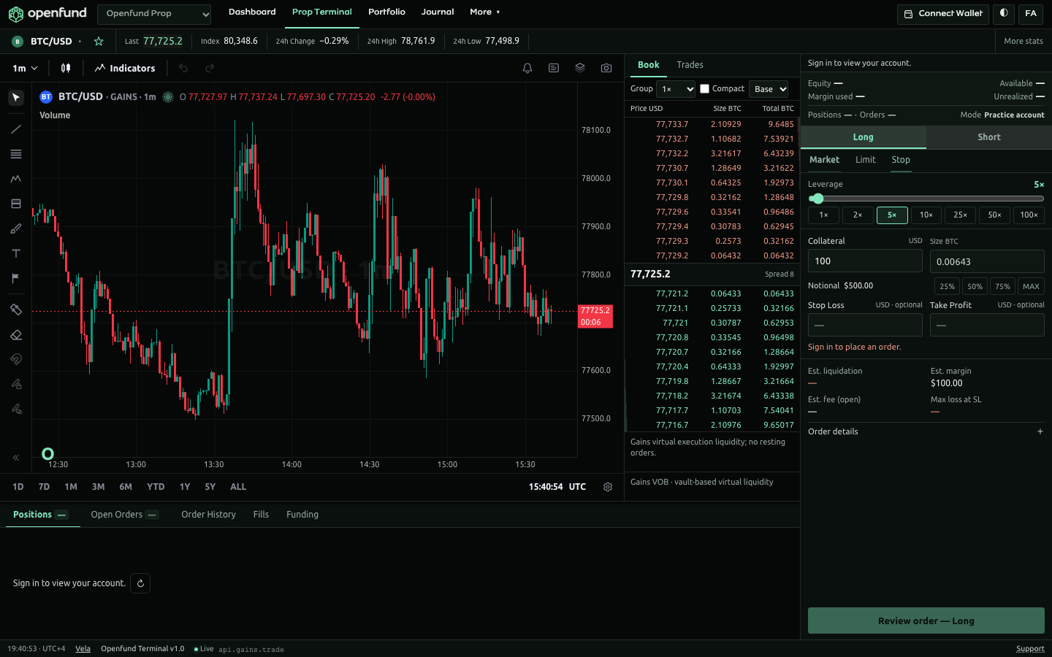
THE SOLUTION
One connected workspace with honest product boundaries
• Published challenge catalog — one source of truth rendered across landing, comparison, FAQ and Rulebook
• Server-authoritative simulated execution: orders, SL/TP, partial closes, liquidation, Decimal valuation, persistent ledger
• Explicit simulation status everywhere — purchase activation and payouts are plainly labelled as not-yet-operational
• Bilingual from day one: English + Persian with full RTL layouts
• Private trader journal: notes, tags, search, import/export in the same account context
Live product screenshot from the repository (docs/assets/screenshots).

Slide 5
PRODUCT & MVP STATUS
Working platform today; commercial activation is the funded step
COMPLETED — repository-verified
PLANNED — funded by this round
✓ React shell, EN/FA + RTL
✓ Shared Vela terminal
✓ Simulated execution engine
✓ Persistent ledger (PostgreSQL)
✓ SIWE wallet sessions
✓ Portfolio & analytics
✓ Private journal
✓ CMS & challenge catalog
✓ CI + Render blueprint
○ Paid challenge activation
○ Evaluation rule enforcement
○ Funded accounts & rewards
○ Payout processing
○ Free-trial provisioning
○ Live trading component (hybrid)
Status per the repository's canonical capability register (reviewed 2026-11-02). Nothing here overstates readiness.

Slide 6
HYBRID PROP TRADING MODEL
Simulated evaluation first; real capital only for the proven few
1
2
3
4
Challenge purchase
Simulated evaluation
Funded stage
Selective live capital
One-time fee; published terms
Targets, daily/total loss limits
Contractual rewards, bi-weekly cycles
Top performers, capped pool
Simulated performance, contractual rewards and real trading P&L are separated in accounting and in product copy. The live-execution component is a proposed architecture subject to technical, operational and legal validation — allocated capital is an asset deployment, never an expense; trading volume is never revenue.

Slide 7
MARKET OPPORTUNITY
A young industry compounding at ~40%+ per year
~120–150
active firms 2026 (down from 220+ peak — consolidation favours credible entrants)
40–50%
of purchases are affiliate-driven — Openfund's bilingual segment is under-served
SOM logic
0.1–0.3% share of purchase volume ≈ the Base-case revenue trajectory
Industry revenue series: Track360 analyst estimates (July 2026); no authoritative TAM exists — figures are third-party estimates, presented as such.

Slide 8
COMPETITIVE LANDSCAPE
Openfund prices at/below the 100K median
Firm | 2-Step 100K | 1-Step 100K | Model | Est. scale
FTMO | €540 | €499 | 2-phase + split | $180–210M rev
FundedNext | $550 | $570 | Multi-format | $110–140M rev
The5ers | $405 | $329 | Instant + scaling | $65–85M rev
FundingPips | $652 | $666 | Eval + Zero instant | —
Topstep | $99/mo | — | Futures subscription | $45–60M rev
OPENFUND (published) | $652 | $666 / $444 | Hybrid + own terminal | Pre-seed
Fees: Pipster database (verified 2026-09-28); scale: Track360 estimates; Topstep is futures (different class). Median 100K: $538 2-step / $509 1-step.

Slide 9
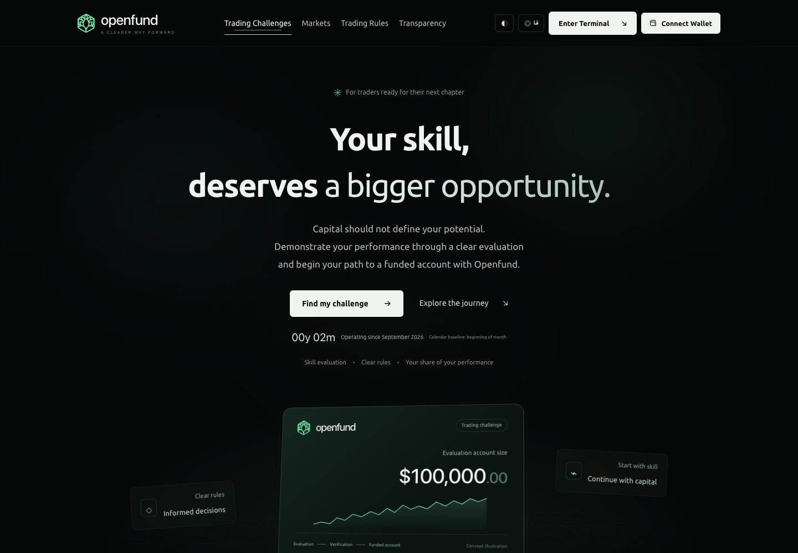
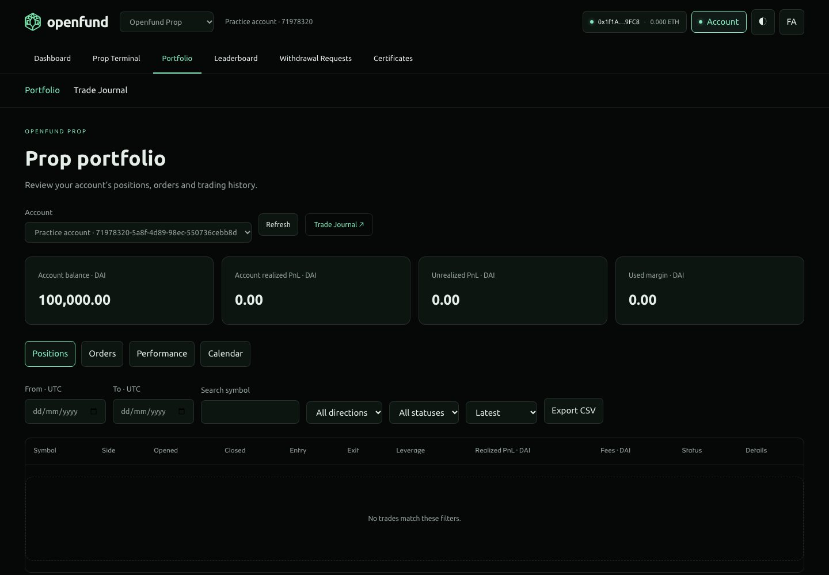
COMPETITIVE DIFFERENTIATION
Own terminal, honest labels, bilingual reach
Own terminal, platform-independent
The shared Vela workspace removes MetaTrader dependency — the Feb-2024 lesson the industry paid for.
Radical status transparency
Unbuilt capabilities are labelled unbuilt — in checkout, FAQ and Rulebook. Trust is the product.
Bilingual EN/FA from day one
A materially under-served trader segment; UI, catalog and journal all support Persian + RTL.
Cost discipline by design
$24.5K peak cash need (Base) — simulated operations carry no customer-capital risk.

Slide 10
REVENUE & BUSINESS MODEL
Published catalog — one-time fees, contractual splits
Program | Sizes | Fee range | Phases | Split
Standard | 5K–100K | $44–$652 | 2 | 80% bi-wk / 100% mo
One-phase | 5K–100K | $74–$666 | 1 | 80% bi-wk / 100% mo
Instant | 5K–200K | $60–$888 | 0 | 95% / 14 days
Free Trial | 5K–100K | free | 2 | — (lead instrument)
Revenue architecture: challenge fees (net of promos, refunds, chargebacks) are the primary line. Trader rewards are a cohort-driven liability (active funded pool × participation × average payment), with payout-to-revenue as an output control. Repeat purchases (30–40% of failed buyers repurchase within 90 days) compound the fee base.

Slide 11
GO-TO-MARKET STRATEGY
Affiliate-led, bilingual-first, trial-funnelled
Phase 1 — Community & content
Bilingual content and trader education; 14-day free trial as a lead instrument (no reward, no conversion — by design).
Phase 2 — Affiliate program
10% revenue share at launch, scaling with volume; industry CPA benchmarks $40–80 — Openfund starts lean.
Phase 3 — Regional depth
Persian-speaking markets under-served by credible, regulated-adjacent firms; expansion by language, not geography.
Free trial terms: published, provisioning not yet operational — activates with commercial launch.

Slide 12
FINANCIAL OUTLOOK — BASE SCENARIO
Profitable from Year 1; 60-month model, formula-verified
Scenario | 5y revenue | 5y EBITDA | $50K ask
Conservative | $0.58M | -$0.28M | Insufficient
Base | $3.32M | +$0.16M | Sufficient
Optimistic | $20.96M | +$3.80M | Sufficient
Payout/revenue (5y)
48%
LTV / CAC
8.6x
Funded accounts, Y5
1,025
All figures from Openfund_Prop_Financial_Model.xlsx (single source of truth): 29 sheets, 6,749 live formulas, 0 errors; scenario switch recalculates the whole package.

Slide 13
CANADIAN ESTABLISHMENT STRATEGY
Planned federal incorporation — clearly not yet incorporated
Federal incorporation (CBCA)
$200 online, 1 business day; annual return $12 — verified Corporations Canada fees
Tax posture
CCPC small-business rate 9% federal + 2.2% Ontario (combined ~11.2% on first $500K) — verified CRA
Compliance budget
≈$3,950 one-off establishment; ≈$2,312/yr compliance (accounting, filings, address)
Regulatory approach
Simulated evaluations + contractual rewards require professional Canadian securities advice before launch; honest labelling mitigates the MyForexFunds pattern
Start-up Visa Program: closed to new applications since 2025-12-31 (2025-commitment exception to 2026-06-30); successor pilot announced, not launched (IRCC, 2025-12-19). Immigration eligibility is separate from business viability.

Slide 14
FUNDING REQUIREMENTS & USE OF FUNDS
USD 50–100K pre-seed — three launch scenarios
Product & engineering — 30%
Lean — $50K
Challenge engine, evaluation enforcement, payout processing
Sufficient in Base scenario; trough $24.5K incl. reserve
Marketing & acquisition — 25%
Affiliate program, bilingual content, paid tests
Operations & support — 18%
Base — $75K
Customer support, tooling
Buffered runway; earlier affiliate ramp-up
Compliance & establishment — 12%
Canadian incorporation, legal, KYC
Live-trading pilot pool — 10%
Accelerated — $100K
Capped capital for selected traders
Funds faster product cadence + live-trading pilot
Contingency — 5%
Reserve
Use-of-funds shares are recommendations tied to the model's Use of Funds sheet; funding verdicts recompute with the scenario selector.

Slide 15
ROADMAP & MILESTONES
Acceptance-gated delivery, not promised dates
Q1 2027
Q2 2027
2028
2029+
Canadian incorporation; KYC + payout rail selection (owner decisions from repo backlog)
Commercial launch: paid activation, evaluation enforcement, funded accounts, payouts
Affiliate scale-up; scenario 'Base' trajectory; operational monitoring & transparency dashboards
Hybrid live-capital pilot (subject to legal validation); product family expansion
Pre-seed ask: USD 50–100K · Contact: Openfund founding group (details confidential at this stage)

