Slide 1
Foundational Text-to-SQL Pipeline: Modular Design and Inference Benchmarking
Transparent baseline for modular, validatable, and locally deployable Text-to-SQL Eric Julianto · Dian Alhusari · Safrizal Ardana Ardiyansa · Vitri Tundjungsari · Tino Saputra

Slide 2
Modular Design and Inference Benchmarking
Paper focus
Transparent baseline for enterprise-oriented Text-to-SQL
Modular pipeline with controllable validation points
Benchmarking Zero-shot, Few-shot, and Chain-of-Thought on Spider
DeepSeek-R1-8B, local deployment, reproducible baseline

Slide 3
Why This Problem Matters
Text-to-SQL is attractive because it lets non-technical users query relational databases in natural language. In practice, production adoption is still constrained by three recurring failure modes:
Schema hallucination
Invalid SQL syntax
Opaque reasoning that is hard to audit
For enterprise use, raw fluency is not enough. The system must be grounded in the schema, validatable before execution, and easy to improve component by component.

Slide 4
Research Goal and Contributions
Goal
Build a foundational Text-to-SQL pipeline that is simple, transparent, and suitable for controlled benchmarking.
Main contributions
A modular pipeline separating intent handling, prompt construction, and validation
A comparison of three prompting strategies using DeepSeek-R1-8B on Spider
An error-oriented analysis showing where failures still concentrate

Slide 5
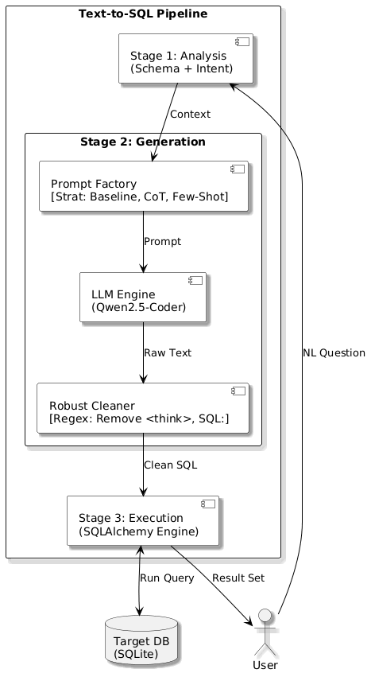
Pipeline Overview
Three-Stage Flow
Intent analysis and schema selection
Prompt construction and SQL generation
Execution-oriented validation
Design Goal
keep the system modular
expose validation checkpoints
make failure sources easier to diagnose

Slide 6
Stage Breakdown
Stage 1
Intent Analysis and Schema Selection
Filter non-query inputs
Rank relevant tables with TF-IDF
Reduce prompt noise before generation
Stage 2
Prompt Factory
Zero-shot baseline
Static few-shot with generic examples
Chain-of-Thought with explicit reasoning structure

Slide 7
Prompting Strategies Compared
Strategy | Core idea | Tradeoff
Zero-shot | Direct schema + question to SQL | Simple and efficient, but limited reasoning support
Few-shot (k=3) | Add static Question-SQL examples | Can help formatting, but may inject domain mismatch
CoT | Ask model to reason before SQL generation | Better planning, but higher token cost

Slide 8
The benchmark asks a narrow practical question: which prompt format works best in a local, resource-constrained setup?

Slide 9
Experimental Setup
Model and Environment
Model: DeepSeek-R1-8B
Inference: Ollama
Deployment: local 8-bit
GPU: NVIDIA RTX 4060, 8GB VRAM
RAM: 64GB DDR5
Evaluation Design
Dataset: Spider
Sample size: 150 queries
Difficulty coverage:
Simple: 52
Intermediate: 64
Complex: 34
Metrics: Execution Accuracy, Validity, Average Tokens

Slide 10
Why Spider and Why Modular?
Spider remains a strong cross-domain benchmark for cross-domain semantic parsing
Multi-table queries expose join planning and grounding failures clearly
A modular design helps isolate whether errors come from retrieval, prompt design, or validation
This is why the paper emphasizes diagnostic value over leaderboard chasing.

Slide 11
Main Results
Strategy | EX (%) | Valid (%) | Avg. Tokens
Baseline | 63.3 | 71.3 | 842
Few-shot (k=3) | 58.0 | 67.3 | 1,437
CoT | 70.7 | 78.7 | 1,185

Slide 12
Takeaway
CoT is the strongest strategy in this benchmark slice
Static few-shot underperforms, likely due to domain-mismatch noise
Better structure can matter more than simply adding examples

Slide 13
Results by Query Complexity
Complexity | Count | Base | Few | CoT
Simple | 52 | 82.7 | 75.0 | 86.5
Intermediate | 64 | 59.4 | 54.7 | 67.2
Complex | 34 | 41.2 | 35.3 | 52.9

Slide 14
The relative advantage of CoT becomes clearer as the SQL problem becomes more compositional.

Slide 15
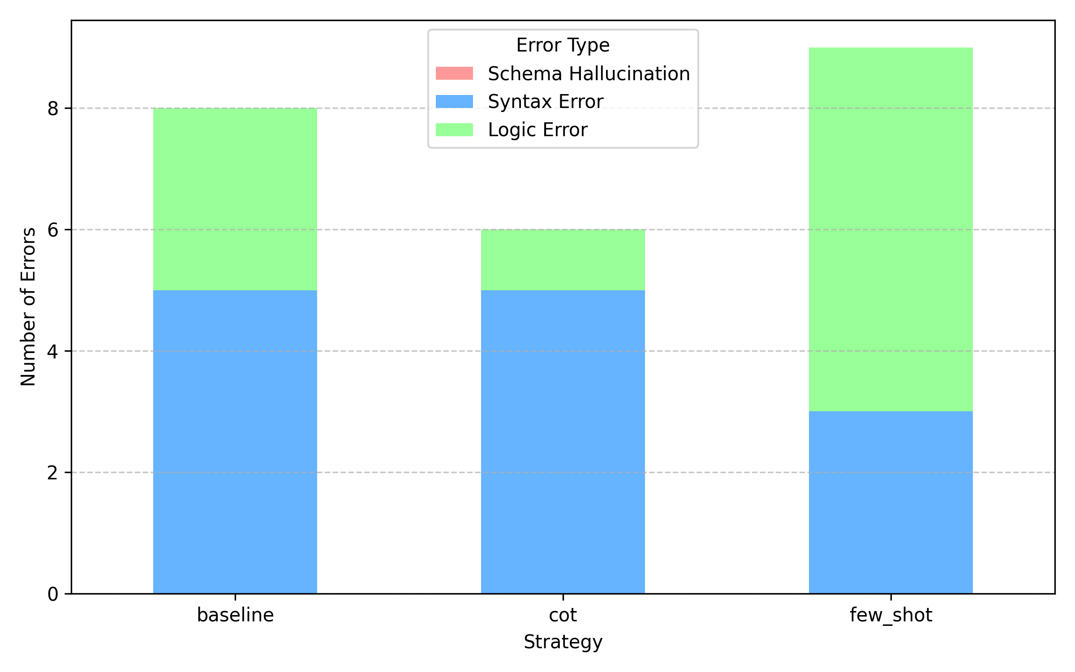
Error Distribution

Slide 16
Key interpretation:
Schema hallucination remains the dominant failure mode
CoT reduces syntax errors by forcing explicit planning
Reliability gains are real, but grounding is still the bottleneck

Slide 17
Qualitative Case Study
In the “Concert” database example, the baseline model hallucinated the column Highest when answering a question about average and maximum stadium capacity.
CoT handled the same case better because it first reasoned about:
relevant table selection
aggregation targets
the valid Capacity column
This is consistent with the broader quantitative pattern: explicit reasoning mainly helps avoid structurally avoidable failures.

Slide 18
What This Benchmark Really Shows
The paper is not claiming a state-of-the-art Text-to-SQL system.
It shows that, under a practical local deployment setup:
prompt design materially changes execution accuracy
static few-shot examples can hurt when they are poorly aligned
validation helps expose where the system still fails
That makes the pipeline useful as both an evaluation scaffold and an engineering baseline.

Slide 19
Limitations and Future Work
Current limits
Only 150 sampled Spider queries
Single quantized 8-bit model
No dynamic retrieval or repair loop yet
Next steps
Dynamic context retrieval
self-correction / repair loops
more agentic execution workflows
broader benchmark coverage beyond the current slice

Slide 20
Conclusion
Bottom line
Chain-of-Thought provides the strongest overall performance in this foundational benchmark, especially on harder queries, but schema grounding remains the core unresolved challenge.
The practical contribution is a modular and auditable Text-to-SQL baseline that can be improved incrementally without turning the whole system into a black box.

Slide 21
Thank You

