Slide 1
GA-Driven Recurrent Modeling for Indonesian Banking Stocks Forecasting
LSTM and Bi-LSTM with Explainable AI and Statistical Validation Eric Julianto · Safrizal Ardana Ardiyansa · Dian Alhusari

Slide 2
GA-Driven Recurrent Modeling

Slide 3
Indonesian Banking Stocks Forecasting
Paper focus
Reproducible benchmark for Indonesian banking stock forecasting
Controlled ablation over architecture, macro features, and optimization
Statistical validation plus SHAP-based explainability
7 banks · 8 cases per bank · 5 seeds per case

Slide 4
Why This Problem Matters
Forecasting banking stocks is difficult because the series are non-stationary, regime-dependent, and affected by both price-side dynamics and external macroeconomic signals.
In practice, many forecasting papers still have three weaknesses:
shallow ablation design
weak statistical validation
limited interpretability of the final model behavior
This work builds a stronger baseline before moving to more advanced architectures.

Slide 5
Research Goal and Contributions
Goal
Test whether macroeconomic feature engineering and budgeted optimization produce reliable gains for LSTM-based forecasting of Indonesian banking stocks.
Main contributions
Structured ablation over LSTM vs BiLSTM, Without_Macro vs With_Macro, and default vs GA
Multi-bank, multi-seed evaluation protocol for robust comparison
Wilcoxon and Diebold-Mariano significance tests
SHAP layer for feature-level explanation and plausibility analysis

Slide 6
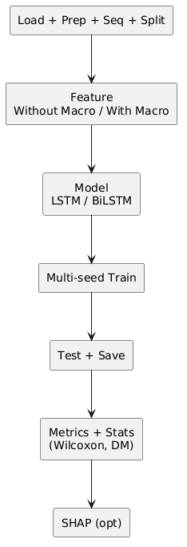
Pipeline Overview
Five-Stage Flow
Data loading and scaling
Sequence generation
Model training
Out-of-sample forecasting
SHAP interpretation
Design Goal
isolate source of performance gains
compare model, feature, and tuning effects fairly
keep the benchmark reproducible

Slide 7
Experimental Setup
Scope
7 banking stocks: BBCA, BBNI, BBRI, BBTN, BDMN, BMRI, BNGA
target: next-day closing price
forecasting horizon: 1 day
Evaluation Design
5 seeds: 42, 52, 62, 72, 82
metrics: RMSE, MAE, MAPE, MSE
fair comparison: same splits, same seeds, same training budget

Slide 8
Ablation Matrix
Factor | Options
Model family | LSTM, BiLSTM
Feature regime | Without_Macro, With_Macro
Optimization | default, GA

Slide 9
This yields:
$$2×2×2=8$$
cases per bank.
Important question
Do macro variables really help, or do they only work in selected issuer-specific regimes?

Slide 10
Model and Optimization Design
Sequence Models
single-layer LSTM
single-layer BiLSTM
dropout 0.2
linear prediction head
Default Setup
hidden size 64
learning rate 1e-3
sequence length 20
Budgeted GA Search
optimize hidden size, learning rate, sequence length
population size 8
generations 5
total budget 40 configurations per case
GA is treated as an optimization-effort ablation, not as the central novelty claim.

Slide 11
Main Results
Bank | Best case | RMSE | MAE | MAPE (%)
BBCA | bilstm_without_macro | 1881.53 ± 199.49 | 1721.55 | 18.36
BBNI | bilstm_without_macro | 335.85 ± 57.51 | 252.66 | 4.90
BBRI | bilstm_without_macro | 525.70 ± 123.24 | 435.44 | 8.34
BBTN | bilstm_without_macro_ga | 51.44 ± 16.04 | 43.48 | 3.23
BDMN | lstm_without_macro | 120.72 ± 21.92 | 98.32 | 3.74
BMRI | bilstm_with_macro_ga | 1388.71 ± 257.96 | 1165.79 | 19.09
BNGA | bilstm_without_macro | 244.14 ± 28.12 | 192.77 | 11.23

Slide 12
Takeaway
BiLSTM dominates in 6 of 7 banks, usually under Without_Macro.

Slide 13
Statistical Validation
Bank | Improve (%) | Wilcoxon p | DM p
BBCA | 8.76 | 0.4375 | 2.28 × 10^-13
BBNI | 10.47 | 0.0625 | 4.84 × 10^-11
BBRI | 28.23 | 0.3125 | < 10^-16
BBTN | 35.66 | 0.3125 | 2.22 × 10^-16
BMRI | 11.18 | 0.4375 | 2.23 × 10^-11
BNGA | 4.91 | 0.3125 | 4.78 × 10^-5
Baseline: lstm_without_macro

Slide 14
Key interpretation:
DM strongly supports lower forecast error in most winning cases
Wilcoxon is weaker because seed count is only n = 5

Slide 15
Does Macro Help?
Bank | LSTM delta (%) | BiLSTM delta (%)
BBCA | +20.34 | +27.87
BBNI | +30.70 | +39.21
BBRI | -1.27 | +23.19
BBTN | -5.04 | -17.72
BDMN | +202.86 | +126.82
BMRI | -1.76 | -4.85
BNGA | +13.25 | +15.45
Mean | +37.01 | +29.99

Slide 16
Interpretation:
Positive delta = degradation
macro features are not universally beneficial
improvements only appear in selected banks and regimes

Slide 17
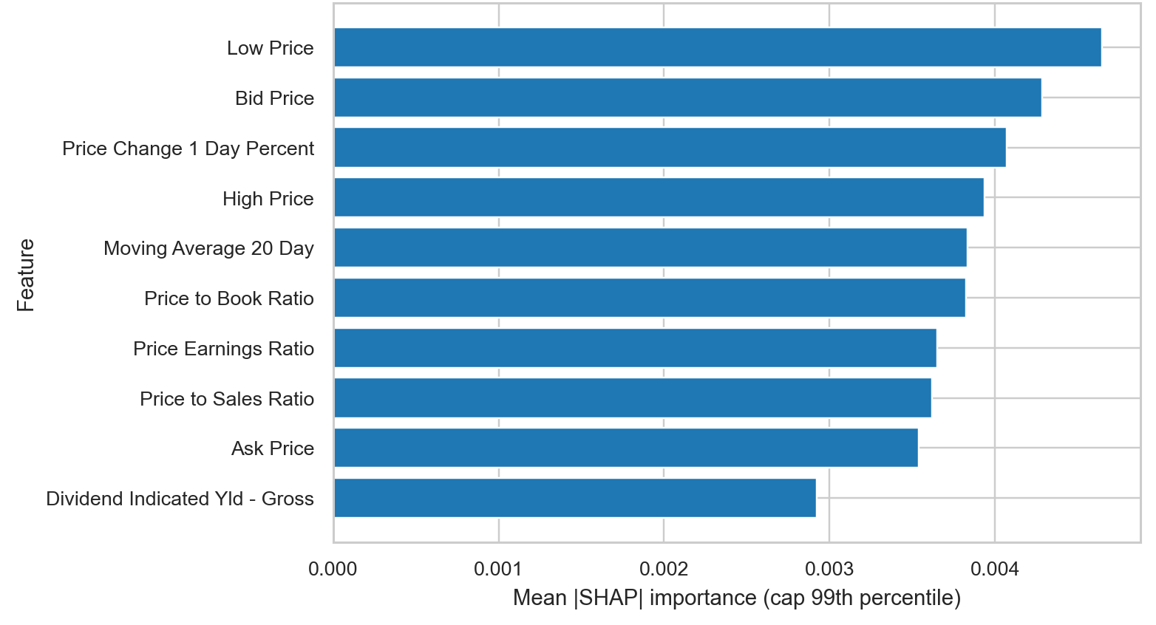
XAI Insight
Global SHAP Ranking
Most frequent dominant drivers:
Low Price (39)
Bid Price (31)
Price Change 1 Day Percent (28)
Price to Sales Ratio (28)
Short-horizon market microstructure features dominate more often than macro variables.

Slide 18
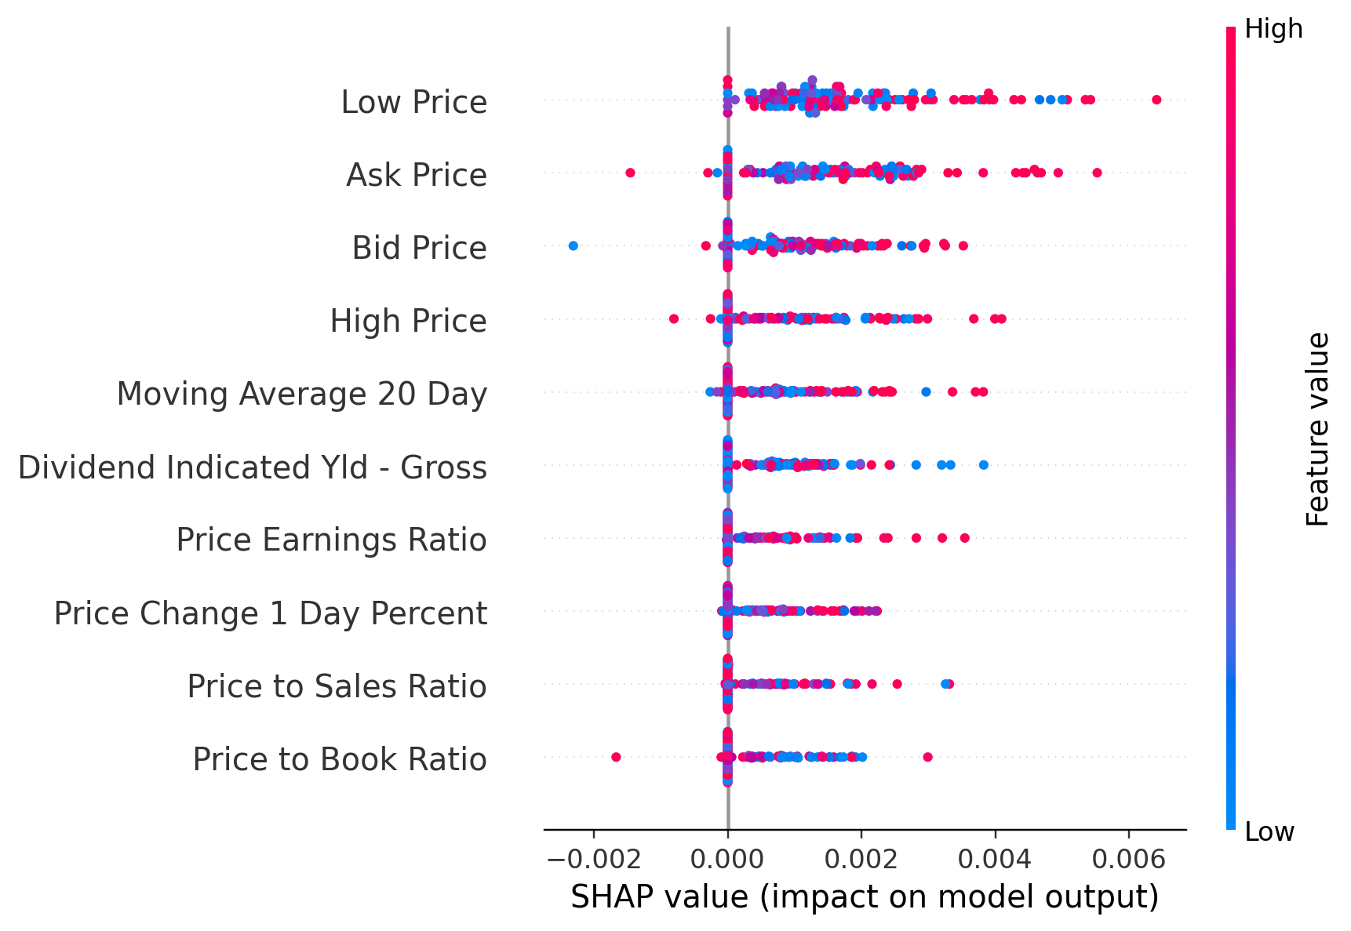
Local Explanation Example
Best Checkpoint Pattern
strongest local attribution view comes from the best-performing checkpoint
explanation patterns remain bank- and regime-specific
macro variables appear as top contributors only in a subset of runs

Slide 19
What This Benchmark Really Shows
The paper is not only about beating a baseline metric.
It shows that:
benchmark rigor materially changes the credibility of forecasting claims
BiLSTM is generally stronger than LSTM in this setup
GA helps in selected cases but not uniformly
macro variables require better relevance and alignment, not blind feature expansion

Slide 20
Conclusion
Bottom line
This study provides a reproducible and statistically grounded forecasting baseline for Indonesian banking stocks.
The strongest practical message is:
BiLSTM usually wins
macroeconomic variables do not help consistently
explanation and significance testing are necessary to judge whether gains are real

Slide 21
Thank You

