Slide 1
Group 2 technical status presentation
Alex Gorinson
Christopher Regan
Garrett Partenza
Temi Owoeye
Thiri Hsu Myat Aung

Slide 2
Project background
A wealthy philanthropist and other nature lovers have formed a committee with the goal of re-igniting public interest in our local and state national parks.
The committee has identified that the current online presence for the parks are outdated and confusing.
Our group is to help with a complete revamping of the national and state websites.

Slide 3
Project background Cont.
The initial goals set for the group by the committee include:
A single centralized website for all national and state parks featuring background information, pictures, and videos.
Supports online donations & ticketing.
Integrate with popular social media platforms.
Provide some type of “gaming” that appeals to teen/young adults which allow users to track parks visited.

Slide 4

Platform and Database
For development it was decided that ReactJS and SQLite with Django would be used chosen as our platform and database.
We chose ReactJS for our platform due to its easy to learn modules and that it was written in JavaScript which many of the team members knew.
We chose SQLite and Django for the database due to how powerful the software is and that our group members had the most knowledge with these two frameworks.

Slide 5

Hosting
So far the group has not made a final decision on which hosting company to use, but we are currently looking at GoDaddy and bluehost.
Once the website has been completed a final decision will be made on which service to use.

Slide 6
Requirements
The key functional requirements for the website include:
Allowing users to narrow their search by state or city, then presenting a list of location specific parks. This is a key function as we expect that this will be vital to connecting users to the parks around them.
Support online donations and ticket sales. Another key feature since it will make both activities that are vital to the continuation of the parks much easier.
Key non-functional requirements for the website include:
Hosting the single centralized site on a cloud service, which will allow stability improvements due to the cloud infrastructure.
The donation and ticketing page will have encryption (HTTPS) to ensure that the users are protected on it. If we did not implement the encryption then we could very well lose our users trust and take monetary damage if they are attacked.

Slide 7

Repo
One of the easier parts of the project since all that was needed was the creation of the repo.
We chose to use GitHub as our repo due to how well known it is and the fact that it is easy to use as well as set up.

Slide 8
Use cases
Our use cases were rather broad and “high level” so to speak in the way that we did not delve deep enough into them. We are in the process of re-writing them to make sure the use cases go to a deep enough level.

Slide 9
Class/Component diagram
For the class/component diagram we displayed so basic methods that a user will typically interact with on the website which include:
getName
getPayment
getLocation
We also included some methods for an administrative user like:
viewUsers
viewDonations
viewShares
We did this to make sure we had a rounded view of the possible interactions a user might have.

Slide 10
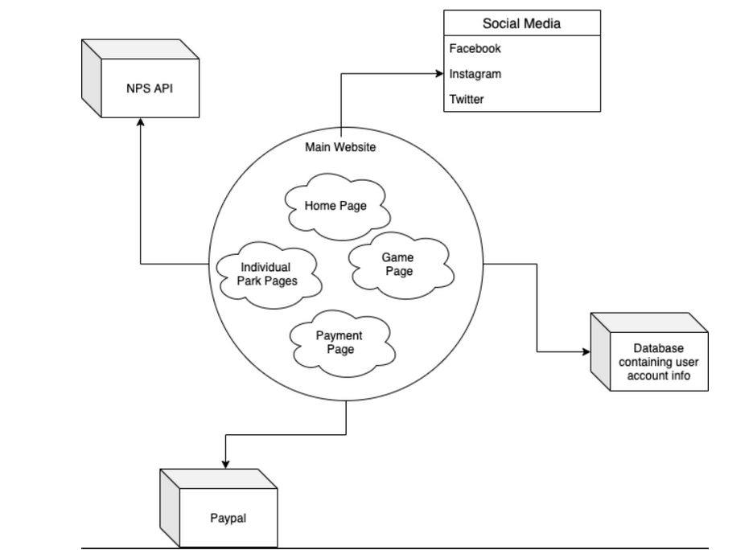
HLA
In our high level architecture diagram we showed the various services and outside calls that the website will have. The purpose of the graph is also to show how all services do connect to each other and to be easy to view from a non-technical user.

Slide 11
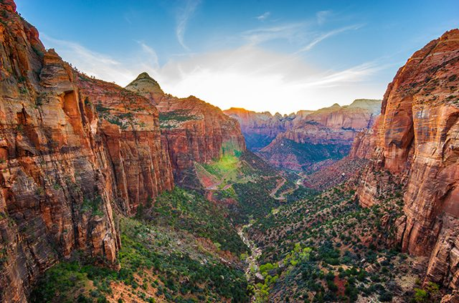
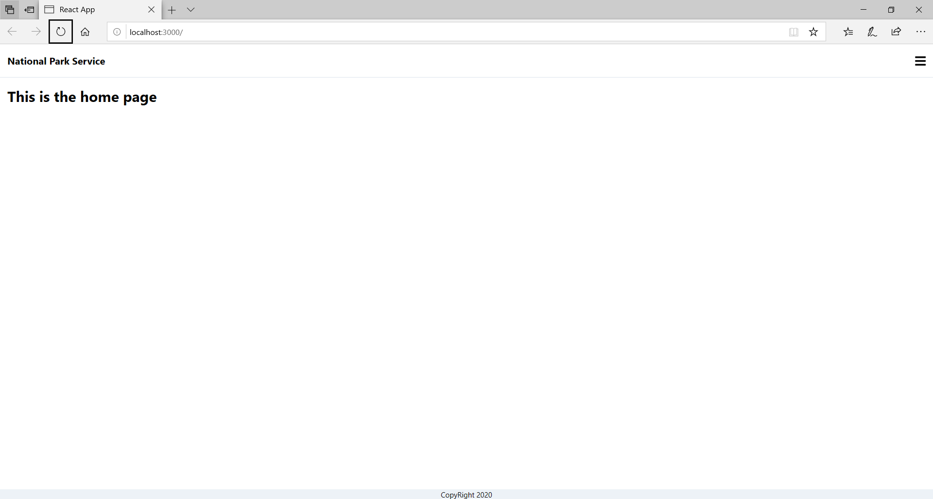
Interface
Here in our diagram we included how our interface is supposed to look. Since it was early in the development the final design is subject to change but a minimalist type design will likely be employed to help stress the pictures and videos from the beautiful parks.
(Test home page and type of picture that will be used)

Slide 12
Alex’s role
Alex is the official contact for the group and turns in the assignments for all members.
Alex maintains a schedule of group activities/assignments that is then shared with the group.
Alex’s main task is the construction of the homepage that will link to all other pages and serve as an “introduction” to the website for new visitors.
Alex is creator of the GitHub repo for the project.

Slide 13
Chris’s role
Integrated drop down menu of all the parks from the home screen and integrated the parks page to display the park selected from said list
Formated parks page to display information from NPS API in a more readable way

Slide 14
Garrett’s role
Garret created a ReactJS multipage structured webapp for the group members to implement their pages in.
Connected the multipage app with the NSP API using a ReactJS package called axios.
Garrett’s major focus is the integration of the API into the website to ensure that it runs as it is supposed to.

Slide 15
Temi’s role
Temi’s responsibility is to create the login and payment page for the website.
She did some self teaching to learn the basics of ReactJS and Django, learning all she needed to know in a short amount of time.
Temi did hours of research on login page templates and tips in order to make an effective and easy to use UI.
Researched and learned how to integrate a payment page into a website safely and securely.

Slide 16
Thiri’s role
Created a Trivia game which includes a front end user interface using ReactJS and a backend API which includes SQLite and Django RESTful framework.
Created a project structure for backend Django and frontend ReactJS projects on the groups GitHub.
Helped preform vital project activities like making a recommended project workflow, README, .gitignore for ReactJS and Django, and ready-to-install python 3 requirements.txt.

Slide 17
Citations
“React.png.” React, www.ssa-frontend.com/media/1164/react.png.
Godaddy Logo, purepng.com/public/uploads/medium/purepng.com-godaddy-logogodaddy-logofonttypeface2018new-21529675406tx1oa.png.
Github Logo, miro.medium.com/max/2560/1*JLYlSLSK8-AZo8gt9UdYqA.jpeg.
Zion National Park, magazine.northeast.aaa.com/wp-content/uploads/2018/04/zion-national-park-guide-2-640x423.jpg.

