Slide 1

Machine Learning Classifier
to Predict
Liver and Pancreatic Carcinoma
Aparajita Choudhury (ac5901)
Anirudhan J Rajagopalan (ajr619)

Slide 2
Learning Problem and Motivation
Predict Hepatocellular Carcinoma (HCC) and Pancreatic Adenocarcinoma (PAAD) using DNA methylation and protein expression.
DNA methylation profile and protein expression are known to be different between cancer and normal cells.
Potential to be used as effective biomarker indicators for gene targeted treatment.

Slide 3
Existing Research
Existing work:
DNA methylation profile individually
Gene expression individually
Comparison between DNA methylation and gene expression
Not much has been done using protein expression in comparison to other biomarkers as an indicator of cancer.

Slide 4
Dataset
Data from TCGA for HCC and PAAD:
DNA methylation (Processed data: ~4GB)
485577 features for both HCC and PAAD
430 samples for HCC
195 samples for PAAD
Protein expression (Processed data: ~1MB)
205 overall features for HCC and PAAD
184 samples for HCC
123 samples for PAAD

Slide 5
Pipeline
Imputation and normalization of data
K-Means - with 2 and 4 centroid
Models
AdaBoost - on reduced dimension
Linear and Gaussian SVM – on reduced dimension
Gaussian Naïve Bayes – on full feature set and reduced dimension
Logistic Regression – on full feature set and reduced dimension

Slide 6
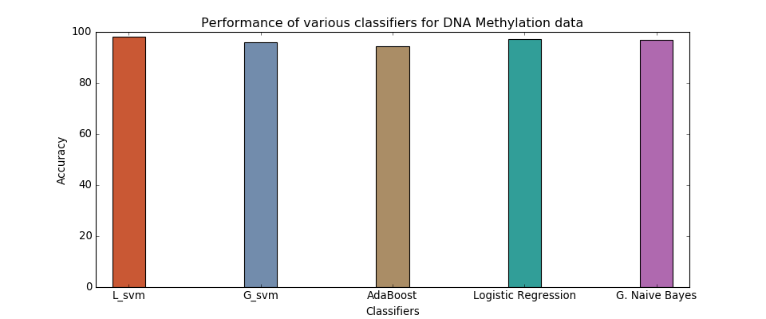
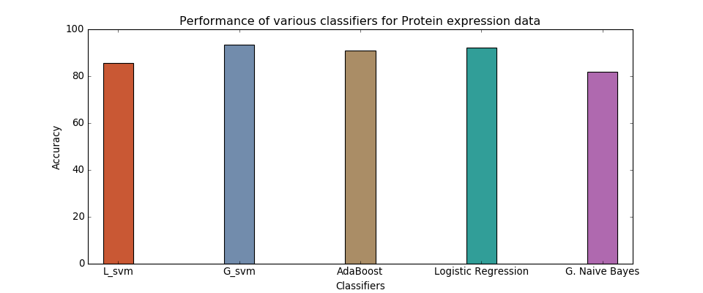
Comparison of models

Slide 7
Conclusion
DNA methylation – best model: Linear SVM with 98.09% accuracy
Protein expression – best model: Gaussian SVM with 93.51% accuracy
Tradeoff: Accuracy vs Resource Utilization
DNA methylation: Higher accuracy – Running Time of ~4 hours – Requires ~4GB data
Protein expression: Relatively lower accuracy – Running Time of ~15 minutes – Requires ~1MB data

Slide 8
References
John Hayward, Sergio A. Alvarez, Carolina Ruiz, Mary Sullivan, Jennifer Tseng, Giles Whalen – “Machine learning of clinical performance in a pancreatic cancer database”, Artificial Intelligence in Medicine 49 (2010) 187–195
Krzysztof Pawlowski, Frederic Pio, Zhi-Liang Chu, John C. Reed and Adam Godzik – “PAAD – a new protein domain associated with apoptosis, cancer and autoimmune diseases”, TRENDS in Biochemical Sciences Vol.26 No.2 February 2001
PeiWei Zhang, Lei Chen, Tao Huang , Ning Zhang , XiangYin Kong , YuDong Cai – “Classifying Ten Types of Major Cancers Based on Reverse Phase Protein Array Profiles”, Published: March 30, 2015 DOI: 10.1371/journal.pone.0123147
Vivek Jain, Weizhuang Zhou, Yifei Men – “Machine Learning Classification of Kidney and Lung Cancer Types”, Stanford University
Scikit-learn: Machine Learning in Python, Pedregosa et al., JMLR 12, pp. 2825-2830, 2011
Yuan Yuan et al. – “Assessing the clinical utility of cancer genomic and proteomic data across tumor types”, Nature Biotechnology 32, 644–652 (2014) doi:10.1038/nbt.2940
Data: TCGA: https://tcga-data.nci.nih.gov/tcga/dataAccessMatrix.htm

