Slide 1
Shortest Paths
Algorithm Design and Analysis
Bibliography:
[CLRS] – chap 24
[CLRS] – chap 25

Slide 2

(Shortest) paths in weighted graphs
G = ( V, E ), edge weight function w : E → R
Weight of a path p = v₁ → v₂ → … → v_{k} is
The shortest path weight from u to v is δ(u,v).
A shortest path from u to v is any path such that w(p) = δ(u, v).
δ(u,v)= min{w(p) : u v}; if there is a path from u to v,
∞ otherwise.

Slide 3
What are the weights ?
Weights may represents different attributes of a relationship
In different problems, weights may have both positive and negative values -> see example problems

Slide 4
Example Problem 1
The ticket prices for traveling by bus between pairs of cities are known. Implement a travel planner for planning a journey from a source city to a destination city, using buses such that the total cost of the journey is minimum.
Find a shortest path from source to destination,
taking into account that edge weights are positive!

Slide 5
Weighted graph – positive weights
t
x
2
8
s
1
3
1
y
z
Shortest path from s to t is s-> y-> z -> x -> t

Slide 6
Example Problem 2
The prices for traveling by bus between pairs of cities are known. For certain roads, however, the local tourist office offers promotion vouchers that may be even bigger than the cost of the corresponding bus ticket. Implement a travel planner for planning a journey from a source city to a destination city, using buses such that the total cost of the journey is minimum.
Find a shortest path from source to destination,
taking into account that edge weights can be negative!

Slide 7
Weighted graph – negative weights
t
x
-8
6
s
5
7
1
y
z
Shortest path from s to t is s-> y-> z -> x -> t

Slide 8
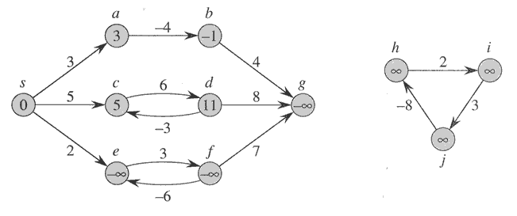
Negative weights cycles
Negative edge weights are no problem, as long as no negative-weight cycles are reachable from the source
If there is a negative weight cycle, the shorthest path is not defined: we can just keep going around the cycle, and finally get w(s, v) = −∞ for all v on the cycle.
[CLRS – Fig 24.1]

Slide 9
Example Problem 3
For the bus tickets and vouchers problem described above, determine if there is any circuit (a path starting from a city and ending back in the same city) that could be done by a tourist such that, at the end, he actually gains money by traveling that particular circuit (the vouchers gained on that circuit are worth more than the sum of the bus tickets). Print out the cities composing the circuit.
Find if the graph has a negative-weight cycle
and print the vertices on that cycle !

Slide 10
Shortest path problem - Variants
Single-pair: Find shortest path from a vertex u to another vertex v.
Single-source: Find shortest paths from a given source vertex s to every other vertex in the graph.
  Actually there are no ways known to solve the single-pair version that’s better in worst case than solving single-source.
All-pairs: Find shortest path from u to v for all u and v some vertices V .
  If you need shortest paths between all pairs, try to do it better than just applying n times the single source algorithm

Slide 11
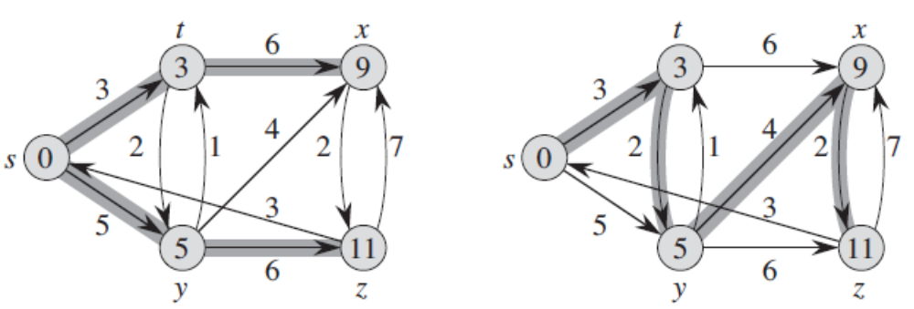
Shortest-path trees from source s
A shortest-path tree from source s is not necessarily unique !
[CLRS – Fig 24.2]

Slide 12
Properties of Shortest paths
The optimal substructure property: Any subpath of a shortest path is a shortest path
Shortest paths can’t contain cycles

Slide 13
Properties of shortest paths:
1. Optimal Substructure Property
Theorem: Subpaths of shortest paths are also shortest paths
Let P_{1k} = <v₁, ... ,v_{k} > be a shortest path from v₁ to v_{k}
Let P_{ij} = <v_{i}, ... ,v_{j} > be subpath of P_{1k} from v_{i} to v_{j}
for any i, j
Then P_{ij} is a shortest path from v_{i} to v_{j}

Slide 14
Optimal Substructure Property – proof (cont)
Proof: By cut and paste
If some subpath P_{ij} = <v_{i}, ... ,v_{j} > were not a shortest path from v_{i} to v_{j,} then we could substitute it by the shorter subpath to create a shorter total path
Hence, the original path would not be shortest path
v₁
v_{i}
v_{j}
v_{k}

Slide 15
Properties of shortest paths:
2. No cycles
Property: shortest paths cannot contain cycles
Sketch of proof:
  Already ruled out negative-weight cycles.
  Positive-weight cycles: we can get a shorter path by omitting the cycle.
  Zero-weight cycles: no reason to use them - assume that our solutions won’t use them.

Slide 16
Designing shortest path algorithms
The starting point is the optimal substructure property: Subpaths of shortest paths are also shortest paths
If we know the shortest paths composed of maximum k vertices, we can build shortest paths of maximum k+1 vertices by adding a new vertex to one of the paths

Slide 17
Single-source shortest paths
Case 1: if all the edges have positive weights (Dijkstra’s algorithm)

Slide 18
Dijkstra’s algorithm – The Idea
Consider all the vertices in the order of their shortest paths from the source vertex s
  Initially, we check all outgoing edges of s. Let (s, x) be the minimum edge outgoing from s. Because all edges are positive, it is also the shortest path from s to x.
  Next step: find the shortest path from s to one more vertex. The only paths to consider are other edges from s or a path formed by (s, x) and an outgoing edge from x

Slide 19
Output of single-source shortest paths algorithms
For each vertex v in V, attributes v.d and v.p are calculated:
v.d= the shortest path estimate
  Initially, v.d=infinity
  v.d is reduced as algorithms progress. But always maintain v.d>=δ(s,v)
  v.d is called a shortest-path estimate.
v.p = predecessor of v on a shortest path from s.
  If no predecessor, v.p = NIL.
  induces a tree—shortest-path tree.

Slide 20
Principle of single-source shortest paths algorithms
Goal: determine shortest paths with source vertex s
Initialization: for all vertices v<>s, initialize v.d=infinity and v.p=NIL. Initialize s.d=0.
Repeatedly try to improve the shortest-path estimates of every vertex v.d by replacing it with a path following the shortest path to u and the edge (u,v) (The “Relaxation” operation)

Slide 21
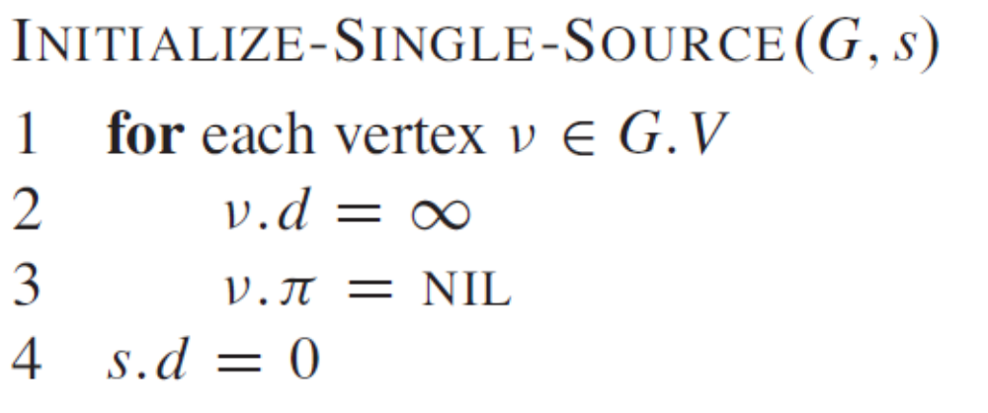
Initialization of shortest paths estimates

Slide 22
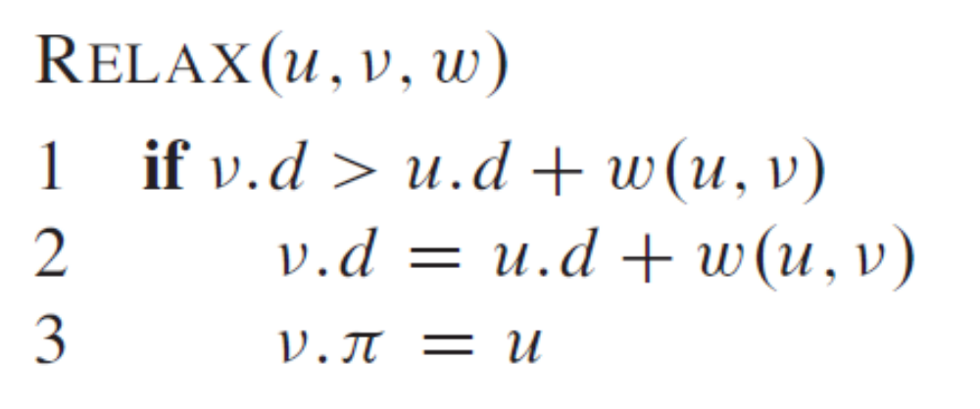
Relaxation
Relaxing an edge (u, v) = testing whether we can improve the shortest path to v found so far by going through u

Slide 23
Dijkstra’s algorithm
Precondition: No negative-weight edges !
Uses a priority queue where keys are shortest-path weights ( v.d).
Have two sets of vertices:
  S = vertices whose final shortest-path weights are determined,
  Q = priority queue = V - S.

Slide 24
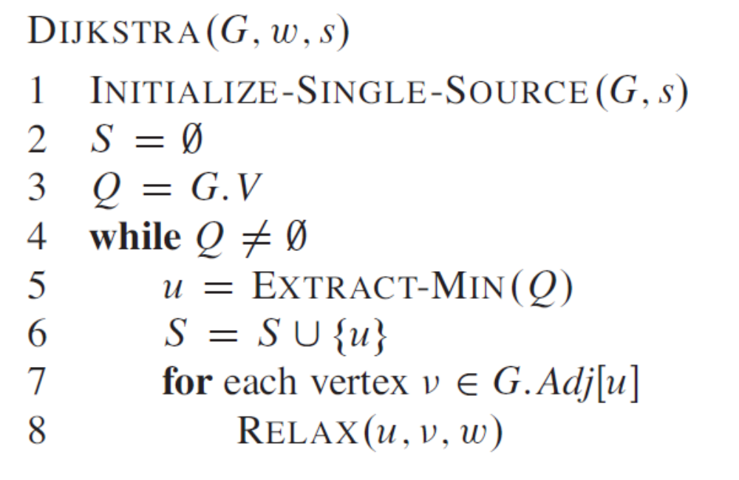
// RELAX performs also
a DECREASE-KEY !
[CLRS]

Slide 25
Example – Dijkstra
t
x
1
10
9
s
7
2
3
4
6
5
2
y
z
Apply Dijkstra’s algorithm in order to determine the shortest paths from s

Slide 26
Example – Dijkstra (step 0)
t
x
1
∞
∞
10
9
s
0
7
2
3
4
6
5
∞
∞
2
y
z

Slide 27
Example – Dijkstra (step 1)
t
x
1
10
∞
10
9
s
0
7
2
3
4
6
5
5
∞
2
y
z
Notations: The shortest-path estimates appear within the vertices, and shaded edges indicate predecessor values. Black vertices are in the set S, and white vertices are in the min-priority queue. The shaded vertex has the minimum d value and is chosen as vertex u in line 5.

Slide 28
Example – Dijkstra (step 2)
t
x
1
8
14
10
9
s
0
7
2
3
4
6
5
5
7
2
y
z
Notations: The shortest-path estimates appear within the vertices, and shaded edges indicate predecessor values. Black vertices are in the set S, and white vertices are in the min-priority queue. The shaded vertex has the minimum d value and is chosen as vertex u in line 5.

Slide 29
Example – Dijkstra (step 3)
t
x
1
8
13
10
9
s
0
7
2
3
4
6
5
5
7
2
y
z
Notations: The shortest-path estimates appear within the vertices, and shaded edges indicate predecessor values. Black vertices are in the set S, and white vertices are in the min-priority queue. The shaded vertex has the minimum d value and is chosen as vertex u in line 5.

Slide 30
Example – Dijkstra (step 4)
t
x
1
8
9
10
9
s
0
7
2
3
4
6
5
5
7
2
y
z
Notations: The shortest-path estimates appear within the vertices, and shaded edges indicate predecessor values. Black vertices are in the set S, and white vertices are in the min-priority queue. The shaded vertex has the minimum d value and is chosen as vertex u in line 5.

Slide 31
Example – Dijkstra (step 5)
t
x
1
8
9
10
9
s
0
7
2
3
4
6
5
5
7
2
y
z

Slide 32
Dijkstra- Correctness
Loop invariant: At the start of each iteration of the while loop, v.d= δ(s, v) for all v in S.
  Initialization: Initially, S =0 so trivially true.
  Termination: At end, Q=0 => S = V, v.d = δ(s, v) for all v in V .
  Maintenance: Need to show that u.d = δ(s, u) when u is added to S in each iteration.

Slide 33
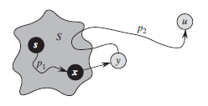
Dijkstra - Proof
  We need to prove that u.d = δ(s, u) when u is added to S in each iteration.
[CLRS] – Fig 24.7

Slide 34
Dijkstra - Analysis
V times
E times
Suppose that Q is implemented using:
Arrays: DECREASE-KEY O(1), EXTRACT-MIN O(V) => algo is O(V*V)
Heaps: DECREASE-KEY O(log V), EXTRACT-MIN O(log V) => algo is O((V+E)*log V)

Slide 35
Comparison
What is the difference between:
  Dijkstra’s algorithm for shortest paths
  Prim’s algorithm for MST

Slide 36
Single-source shortest paths
Case 2: some edges may have negative weights (Bellman-Ford algorithm)

Slide 37
Graph with negative edge weights
5
t
x
-2
6
-3
s
8
7
2
-4
7
9
y
z
Try to apply Dijkstra’s algorithm.
Why is it not working ?

Slide 38
Graphs with negative weights
Dijkstra’s algorithm is not working on graphs having negative weight edges because the assumption that when a vertex u is added to S in each iteration, its value u.d is its final shortest path, is wrong in this case !
If there are negative weight edges, we have no set S of already finished vertices, we must continue inspecting all the vertices !

Slide 39
The Bellman-Ford algorithm
Single-source shortest paths
Allows negative-weight edges
Computes v.d and v.p for all v in V
Returns TRUE if no negative-weight cycles reachable from s, FALSE otherwise.

Slide 40
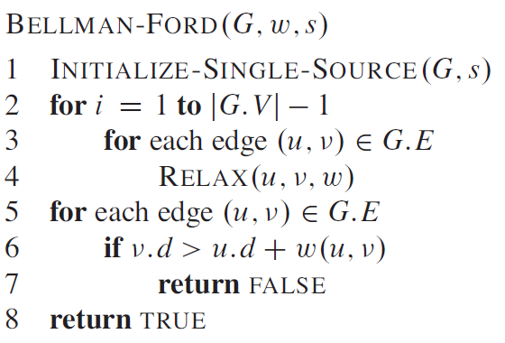
[CLRS]

Slide 41
performs |V|-1 relaxation passes; relax every edge at each pass
checks the existence of a negative-weight cycle reachable from s

Slide 42
Complexity
O(V*E)

Slide 43
Example – Bellman Ford
5
t
x
-2
6
-3
s
8
7
2
-4
7
9
y
z

Slide 44
Example – Bellman Ford
5
t
x
∞
∞
-2
6
-3
s
0
8
2
7
-4
7
∞
∞
9
y
z
INIT-SINGLE-SOURCE(0)
Each pass relaxes the edges in the order:
(t; x); (t; y); (t; z); (x; t); (y; x); (y; z); (z; x); (z; s); (s; t); (s; y)

Slide 45
Example – Bellman Ford
5
t
x
6
∞
-2
6
-3
s
0
8
2
7
-4
7
7
∞
9
y
z
Each pass relaxes the edges in the order:
(t; x); (t; y); (t; z); (x; t); (y; x); (y; z); (z; x); (z; s); (s; t); (s; y)

Slide 46
Example – Bellman Ford
5
t
x
6
4
-2
6
-3
s
0
8
2
7
-4
7
7
2
9
y
z

Slide 47
Example – Bellman Ford
5
t
x
2
4
-2
6
-3
s
0
8
2
7
-4
7
7
2
9
y
z

Slide 48
Example – Bellman Ford
5
t
x
2
4
-2
6
-3
s
0
8
2
7
-4
7
7
-2
9
y
z

Slide 49
Example – Bellman Ford
5
t
x
2
4
-2
6
-3
s
0
8
2
7
-4
7
7
-2
9
y
z

Slide 50
[CLRS]

Slide 51
Bellman-Ford Proof (Claim1)
Claim 1: assuming that G contains no negative-weight cycles that are reachable from s, then, after the |V|- 1 iterations of the for loop of lines 2–4 of BELLMAN-FORD, we have v.d= δ(s, v) for all vertices v that are reachable from s.

Slide 52
Bellman-Ford Proof Claim 1
Loop Invariant (Induction hypothesis)
At each iteration i of the outer for loop:
  If u.d is not infinity, it represents the length of some path from s to u
  If there is a path from s to u with at most i edges, then u.d is the length of the shortest path from s to u with at most i edges
  Note: a shortest path from s to u with at most i edges is not the shortest path from s to u in the graph which is δ(s, u) !

Slide 53
Bellman-Ford Proof Claim 1
Initialization (Base case): i=0
  For the source vertex s, s.d=0, while any other u<>s has u.d=infinity. This is correct because there is no path from s to u<>s with 0 edges

Slide 54
Bellman-Ford Proof Claim 1
Maintenance (Inductive step): assume that it is true for i-1, prove for i
  For a vertex v, consider the shortest path from s to v with at most i edges. Let u be the last vertex before v on this path. Then, the part of the path from s to u is the shortest path from s to u with i-1 edges. By inductive assumption, u.d is the length of this path with i-1 edges.
  v.d=u.d+weight(u,v) is the length of the shortest path from s to v that uses i edges

Slide 55
Bellman-Ford Proof Claim 1
Termination:
Loop finishes when i=|V|-1
  For all vertices u, if there is a path from s to u with at most i edges, then u.d is the length of the shortest path from s to u with at most i=|V|-1 edges => u.d is the length of the shortest path from s to u in the graph

Slide 56
Bellman-Ford Proof (Claim 2)
Claim 2: assuming that G contains no negative-weight cycles that are reachable from s, then the BELLMAN-FORD algorithm returns TRUE, otherwise it returns FALSE
  Formal proof: see [CLRS] –chap 24.1
  In principle, if v.d is still getting smaller after it should have converged to shortest path values, then there must be a negative weight cycle that continues to decrement the path.

Slide 57
All-pair shortest paths
Given a directed graph G =(V;E), having n vertices and an edge weight function w.
Goal: create an n x n matrix D of shortest-path distances, so that D[i][j] is the shortest distance from i to j, for all pairs i, j
Could run BELLMAN-FORD once from each vertex: O(V ^2*E) = O(V ^4) if the graph dense
If no negative-weights, could run DIJKSTRA once from each vertex: O(V*E* lg V) with binary heap = O (V^3 * lg V) if graph dense
Can we do better than this ?

Slide 58
Floyd-Warshall
A different dynamic-programming approach:
  Optimal substructure: subpaths of shortest paths are shortest paths
  Overlapping subproblems: a shortest path to one vertex may be extended to reach further vertexes

Slide 59
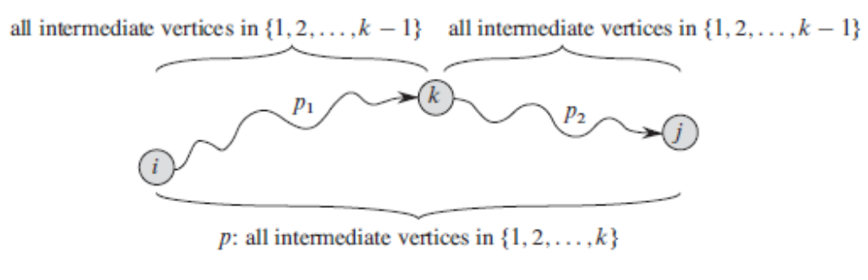
Defining Subproblems (i,j,k)
[CLRS] – Fig 25.3

Slide 60
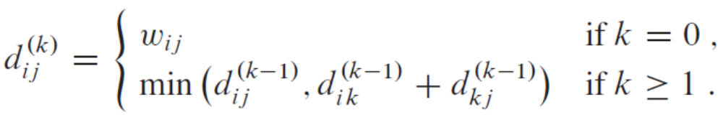
Recursive Formulation
d_{ij}^{(k)}=the weight of a shortest path from i to j
for which all intermediate vertices are in the set {1;2; … ;k}

Slide 61
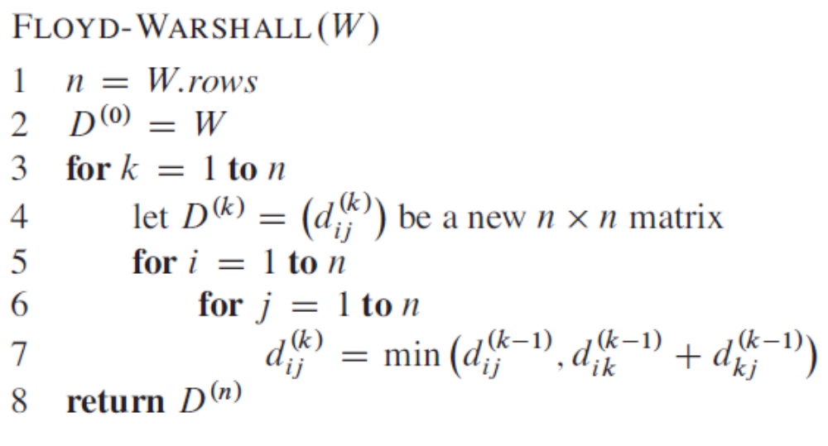
Floyd-Warshall – Version 1
[CLRS]

Slide 62
Floyd-Warshall Improvement
Can we drop the superscripts (k) ?
If, having dropped the superscripts, we were to compute and store d_{ik} or d_{kj} before using these values to compute d_{ij}
If we use d^{(k)}_{ik} , rather than d^{(k-1)}_{ik} in the computation, then we are using a subpath from i to k with all intermediate vertices in 1; 2; … ; k. But k cannot be an intermediate vertex on a shortest path from i to k, since otherwise there would be a cycle on this shortest path. Thus, d^{(k)}_{ik} =d^{(k-1)}_{ik}
Similar d^{(k)}_{kj} =d^{(k-1)}_{kj}
We can drop the superscripts without any loss !

Slide 63
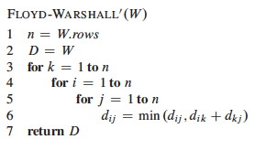
The Floyd-Warshall Algorithm
O(V^3)

Slide 64
Example Problem 4
Consider a system with several user accounts. Each user has by default a security permission to access his or her own account. Users may want to cooperate and give one another permission to use their account. However, if A has permission to use B's account, and B has permission to use C's account, then A may be able to use C's account as well. Identify for each user all the other users with permission (either directly or indirectly) to use his account.
Find the Transitive Closure !

Slide 65
Transitive Closure
The transitive closure of a graph G=(V, E) is a graph G*, G* = (V, E*) of G, where (u, v) ∈ E* if there exists a path from u to v in G.
We can use Floyd-Warshall to compute shortest paths for all pairs
If we are interested only if a path exists from i to j, and not its length, we can modify Floyd-Warshall to use boolean OR rather than min and AND rather than addition.

