Slide 1
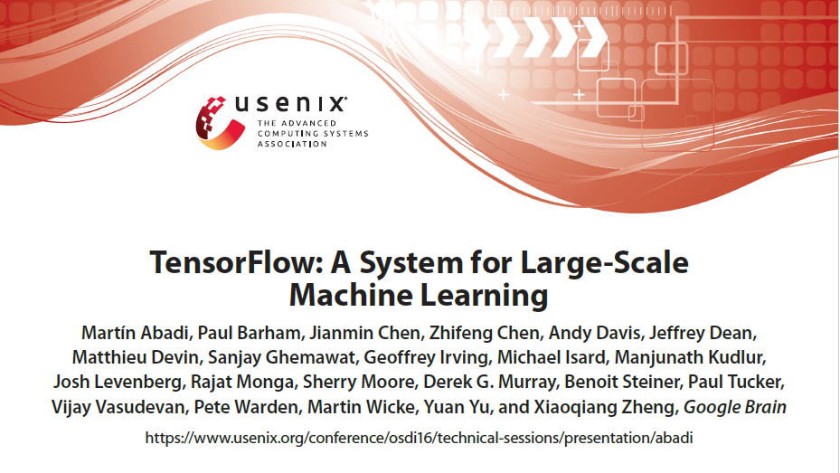

Slide 2
Motivation
In recent years, machine learning as driven advances in many different fields
Successes can be attributed to:
Invention of more sophisticated machine learning models
Availability of large datasets for tackling problems in these fields
Development of software platforms that facilitate the use of large amounts of computational resources for training

Slide 3
State of the art
TF is the successor to DistBelief
DistBelief: distributed system for training neural networks (large-scale)
Used by Google since 2011
In “parameter server” designs like DistBelief, the management of shared state is built into the system
Impossible to handle novel optimizations and training algorithms without advanced systems expertise

Slide 4
Previous system: diSTBELIEF psa
In the parameter server architecture, a job comprises two disjoint sets of processes:
Stateless worker processes – perform the bulk of the computations when training a model
Stateful parameter server processes – maintain the current version of the model parameters
The user defines a neural network as a DAG of layers that terminates with a loss function
A layer is a composition of mathematical operators (input * W + b)
Learner updates W to minimize the value of the loss function (via backpropagation)
Problem: Graph vertices (operations) represented as functional computations on immutable data

Slide 5
Distbelief - Limitations
Python-based scripting interface for composing pre-defined layers was adequate for users with simple requirements, but more advanced users sought three further kinds of flexibility:
Defining new layers: DistBelief layers are implemented as C++ classes, which is a barrier for ML researchers who seek to experiment with new layer architectures
Refining training algorithm: many NNs are trained using SGD to iteratively refine the parameters of the network (max –Vloss function).
Experimenting with new optimization methods in DistBelief involves modifying the parameter server implementation

Slide 6
Distbelief – Limitations …
Defining new training algorithms:
DistBelief workers follow a fixed execution pattern:
Read a batch of input data and the current parameter values
Compute the loss function (a forward pass through the network)
Compute gradients for each of the parameters (a backward pass)
Write the gradients back to the PS
Works well for simple feed-forward neural networks
Fails for more advanced models, such as Reinforcement Learning models (loss function is computed by some agent in a separate system, e.g. a video game emulator)

Slide 7
Distbelief – Limitations …
Also, DistBelief was designed with a single platform in mind: a large distributed cluster of multicore servers
Even after adding support for GPU acceleration, DistBelief remains a heavyweight system that is geared for training deep NNs on huge datasets
Difficult to scale down to other environments (e.g. mobile devices for inference)
Therefore, it was necessary to create separate systems that satisfy the different performance and resource requirements of various platforms
TF provides a single programming model and runtime system for all of these environments

Slide 8
Introduction
TensorFlow (TF) system developed for:
Experimenting with new models
Training on large datasets
Enhanced portability on various devices (large and small scale)
TensorFlow (TF) uses dataflow graphs to represent computations, shared state, and the operations that mutate that state (mutable)
Maps the nodes of a dataflow graph across many machines in a cluster, and within a machine (multicore CPUs, general-purpose GPUs, and TPUs)

Slide 9
Introduction …
TF supports a variety of applications, with a focus on training and inference on deep neural networks
Inspired from high-level programming models of dataflow systems and low-level efficiency of parameter servers
This paper focuses on neural networks training as a challenging systems problem, and highlights two representative applications from this space: image classification and language modeling

Slide 10
Abstraction: heterogeneous accelerators
In addition to general-purpose devices such as multicore CPUs and GPUs, special-purpose accelerators for deep learning
Achieve significant performance improvements and power savings
Google built the Tensor Processing Unit (TPU) specifically for machine learning
TPUs yield an order of magnitude improvement in performance-per-watt compared to alternative state-of-the-art technology

Slide 11
Abstraction: heterogeneous accelerators …
To support these accelerators in TF, a common abstraction is defined for devices
At a minimum a device must implement methods for:
Issuing a kernel for execution
Allocating memory for inputs and outputs
Transferring buffers to and from host memory
Each operator can have multiple specialized implementations for different devices
TF uses tensors of primitive values as a common interchange format that all devices understand
At the lowest level, all tensors in TF are dense, ensuring that the lowest levels of the system have simple implementations for memory allocation and serialization, thus reducing the framework overhead

Slide 12
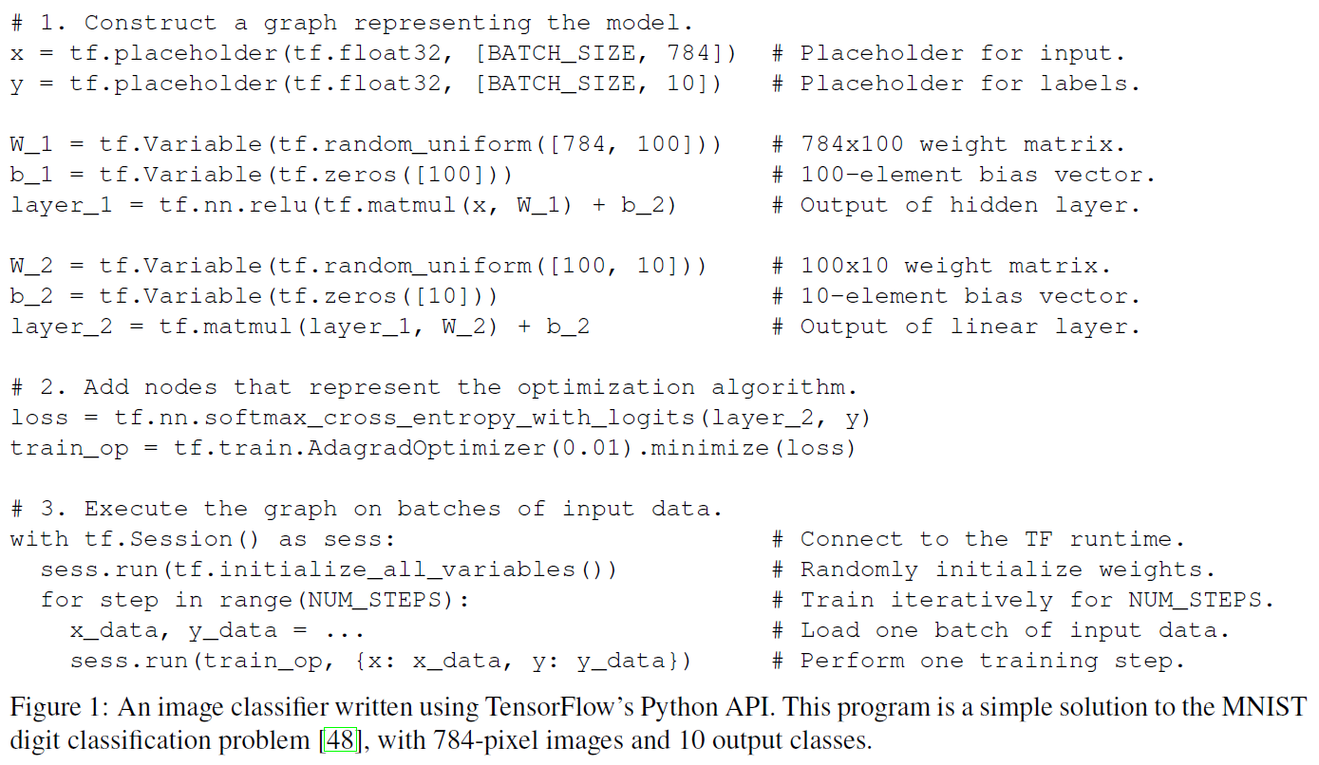
TF Design Principles
TF provides a simple programming abstraction
A high-level scripting interface wraps the construction of dataflow graphs
Enables users to experiment with different model architectures and optimization algorithms without modifying the core system

Slide 13
Dataflow graphs of primitive operators
TF model represents individual mathematical operators as nodes in the dataflow graph
Many optimization algorithms require each layer to have defined gradients (SGD)
Building layers out of simple operators makes it easy to experiment with different update rules

Slide 14
Tf execution model
TF uses a single dataflow graph to represent all computation and state in a machine learning algorithm
Individual mathematical operations
Parameters and their update rules
Input preprocessing
The dataflow graph expresses the communication between sub-computations explicitly
Execute independent computations in parallel
Partition computations across multiple devices

Slide 15
Dataflow Graph elements
In a TensorFlow graph, each vertex represents a unit of local computation, and each edge represents the output from, or input to, a vertex
Operations: computations at vertices
Tensors: values that flow along edges

Slide 16
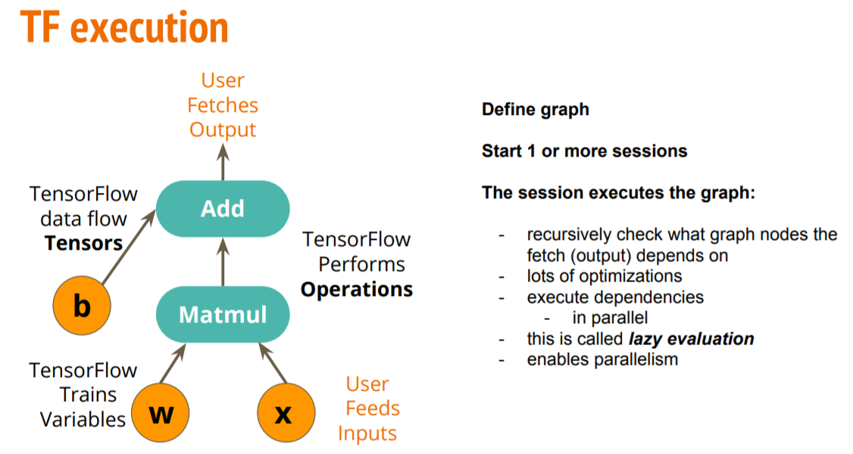
Tensors as Multidimensional arrays
All data modeled as tensors with elements having primitive type: int32, float32, or string (binary)
Edges carry tensors between nodes
An operation takes m tensors as input and produces n tensors as output

Slide 17
Stateful operations
Stateful operations: variables
An operation can contain mutable state that is read and/or written each time it executes
A Variable operation owns a mutable buffer that may be used to store the shared parameters of a model as it is trained
A Variable has no inputs, and produces a reference handle, which acts as a typed capability for reading and writing the buffer
A Read operation takes a reference handle r as input, and outputs the value of the variable (State[r]) as a dense tensor
An AssignAdd takes r and a tensor value x, and when executed performs the update
State’[r] ← State[r] + x subsequent Read(r) operations produce the value State’[r]

Slide 18
Stateful operations …
Stateful operations: queues
TF includes several queue implementations, which support more advanced forms of coordination.
The simplest queue is the FIFOQUEUE, which contains an internal queue of tensors, and allows concurrent access in first-in-first-out order (also, random and priority dequeuing)
Like a Variable, the FIFOQUEUE operation produces a reference handle that can be consumed by one of the standard queue operations (enqueue/dequeue)

Slide 19
Partial and concurrent execution
The API for executing a graph allows the client to specify the subgraph that should be executed
Client selects zero or more edges to feed input tensors into the dataflow, and one or more edges to fetch output tensors from the dataflow
Runtime then prunes the graph to contain the necessary set of operations
Each invocation of the API is called a step, and TF supports multiple concurrent steps on the same graph
Stateful operations allow steps to share data and synchronize when necessary

Slide 20
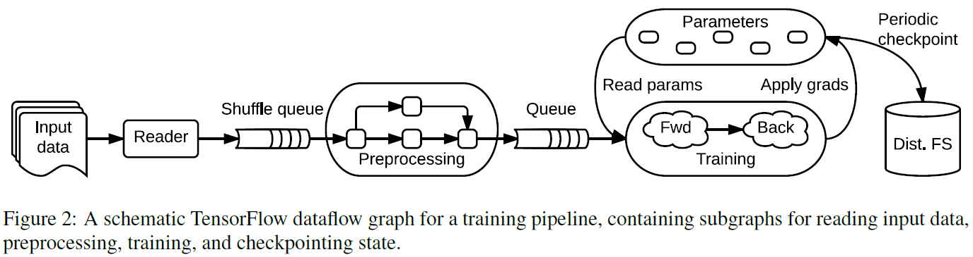
Partial and concurrent execution … typical training application
Multiple subgraphs execute concurrently and interact through shared variables and queues
The core training subgraph depends on a set of model parameters and on input batches from a queue
Many concurrent steps of the training subgraph update the model based on different input batches, to implement data-parallel training
To fill the input queue, concurrent preprocessing steps transform individual input records (e.g. decoding images and applying random distortions)
A separate I/O subgraph reads records from a distributed file system
A checkpointing subgraph runs periodically for fault tolerance

Slide 21
Partial and concurrent execution … maximizing flexibility
Partial and concurrent execution is responsible for much of TensorFlow’s flexibility
Adding mutable state and coordination via queues makes it possible to specify a wide variety of model architectures in user-level code
Enables advanced users to experiment without modifying the internals of the TensorFlow runtime

Slide 22
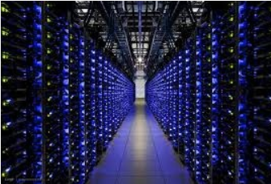
Fault tolerance
Training a model can take several hours or days
Often need to train a model using non-dedicated resources, e.g. using the Borg cluster manager
Does not guarantee availability of the same resources for the duration of the training process
Thus, a long-running TF job is likely to experience failure or pre-emption, so some form of fault tolerance is required

Slide 23
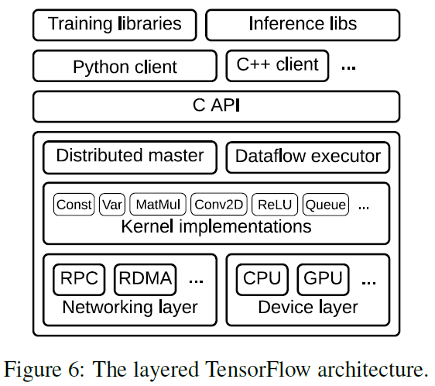
Implementation
The TensorFlow runtime is a cross-platform library
Architecture: a C API separates user-level code in different languages from the core runtime
The core TF library is implemented in C++ for portability and performance: runs on several OS including Linux, Mac OS X, Windows, Android, iOS…
Multiple client languages supported, Python and C++ prioritized
Notes:
Distributed Master translates user requests into execution across a set of tasks
Dataflow Executor in each task handles requests from the master, and schedules the execution of the kernels that comprise a local subgraph

Slide 24
Evaluation
- Experiments run on a shared production cluster
- Figures plot median values with error bars showing the 10th and 90th percentiles

Slide 25
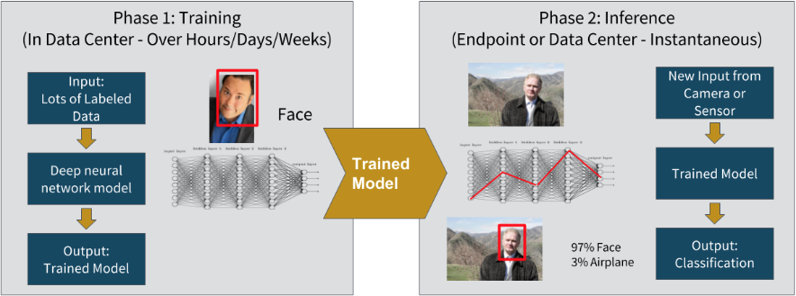
Image classification
Deep NNs have achieved breakthrough performance on computer vision tasks
Facial recognition
Training a network to high accuracy requires a large amount of computation
Scaled out across a cluster of GPU-enabled servers

Slide 26
Image classification …
In these experiments, we focus on Google’s Inception-v3 model, which achieves 78.8% accuracy in the ILSVRC 2012 image classification challenge
We investigate the scalability of training Inception-v3 using multiple replicas
Configured TensorFlow with 7 PS tasks, and vary the number of worker tasks using two different clusters
Notes:
Large Scale Visual Recognition Challenge == ILSVRC

Slide 27
Image classification … first experiment: Inception-v3
Compared the performance training Inception using asynchronous SGD on TensorFlow and MXNet, a contemporary system using a parameter server architecture
Used Google Compute Engine virtual machines running on Intel Xeon E5 servers with NVIDIA K80 GPUs, configured with 8 vCPUs, 16 Gbps of network bandwidth, and one GPU per VM
Both systems use 7 PS tasks running on separate VMs with no GPU

Slide 28
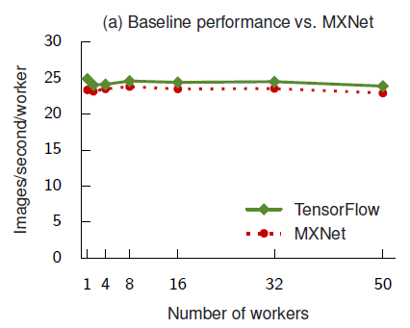
Image classification … first experiment
TensorFlow achieves slightly better throughput that MXNet
The results are largely determined by single-GPU performance
Both systems use cuDNN (CUDA Deep NN library)
Access the same optimized GPU kernels

Slide 29
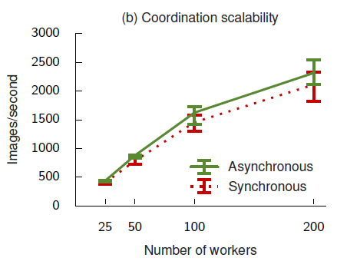
Image classification … second experiment
Using a larger internal cluster, investigate the effect of coordination on training performance
NVIDIA K40 GPUs and a shared datacenter network
Ideally, with efficient synchronous training:
Inception-v3 will train in fewer steps, and
converge to a higher accuracy than with asynchronous training
Synchronous steps are longer than asynchronous steps
Workers must wait for the slowest worker to catch up before starting the next step
Notes:
Training throughput improves to 2,300 images per second as we increase the number of workers to 200, but with diminishing returns
As we add more workers, the step time increases due to more contention on the PS tasks

Slide 30
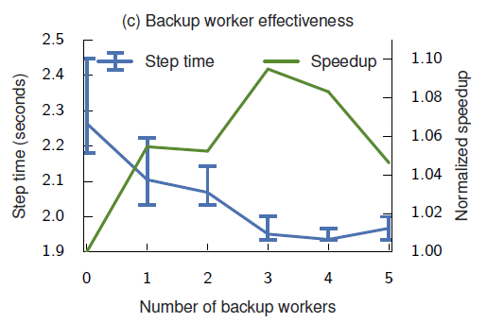
Image classification … Third experiment
Above the 90th percentile the synchronous performance degrades sharply, because stragglers disproportionately impact tail latency
To mitigate tail latency, add backup workers so that a step completes when the first m of n tasks produce gradients
Until fourth worker, probability of a straggler affecting step time decreases
Notes:
Degrades due to contention of PS tasks

Slide 31
Conclusion
TensorFlow’s dataflow representation subsumes existing work on parameter server systems
Offers a set of uniform abstractions that allow users to harness large-scale heterogeneous systems, both for production tasks and for experimenting with new approaches
FURTHER RESEARCH:
Some users have complained about the limitations of a static dataflow graph, especially for Deep Reinforcement Learning
A next step would be to provide a system that transparently and efficiently uses distributed resources, even when the structure of the computation unfolds dynamically

