Slide 1
Introduction

Slide 2
Introduction
Applications of Optimization
Physics
Business
Biology
Engineering
Objectives to Optimize
Efficiency
Safety
Accuracy
Constraints
Cost
Weight
Structural Integrity
Challenges
High-Dimensional Search Spaces
Multiple Competing Objectives
Model Uncertainty

Slide 3
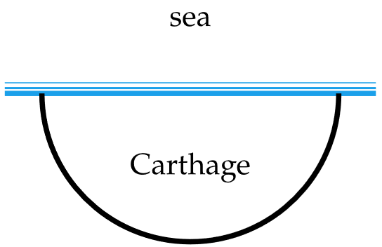
A History
Queen Dido’s Optimization Problem

Slide 4
A History
Calculus
Numerical Algorithms
Artificial Intelligence

Slide 5
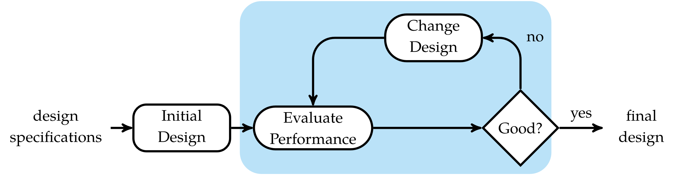
Optimization Process

Slide 6

Basic Optimization Problem
Design Point
Design Variables
Objective Function
Feasible Set
Minimizer

Slide 7
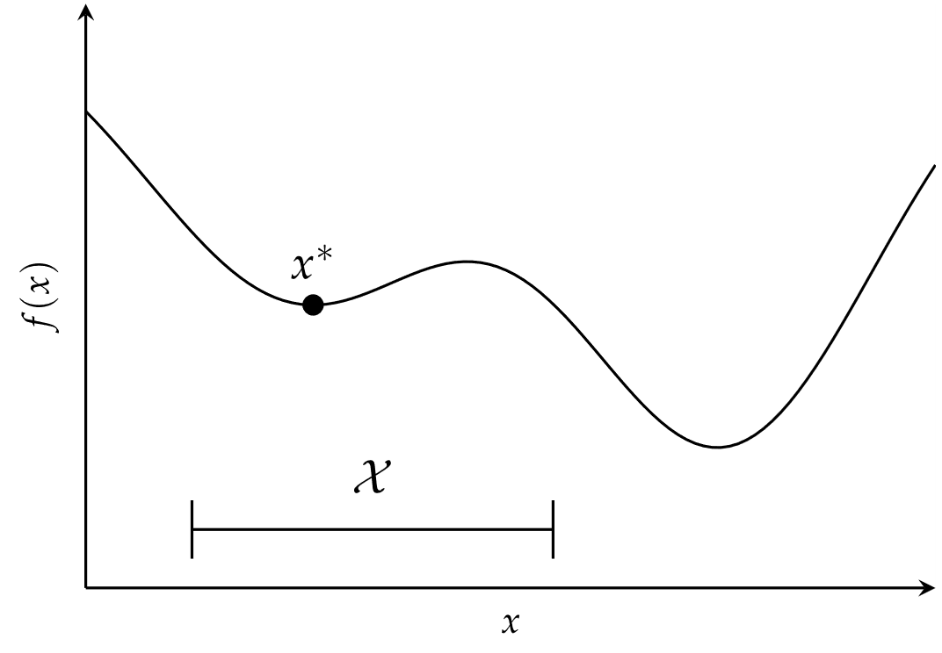
Basic Optimization Problem

Slide 8
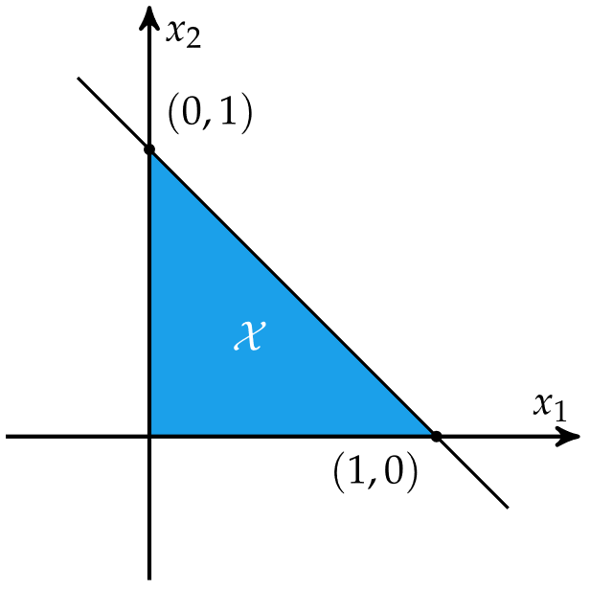

Constraints

Slide 9
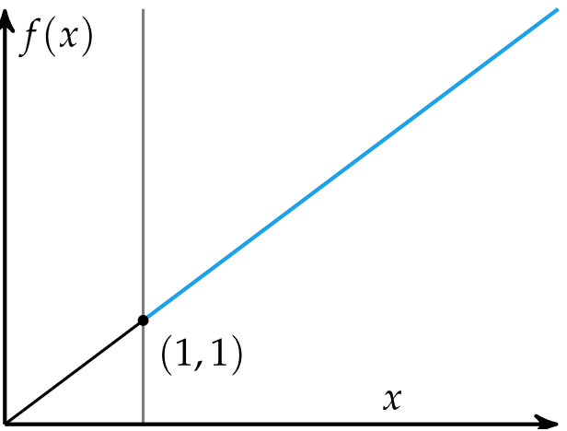
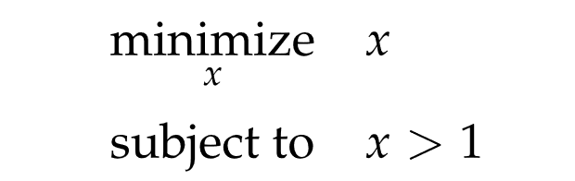
Constraints

Slide 10
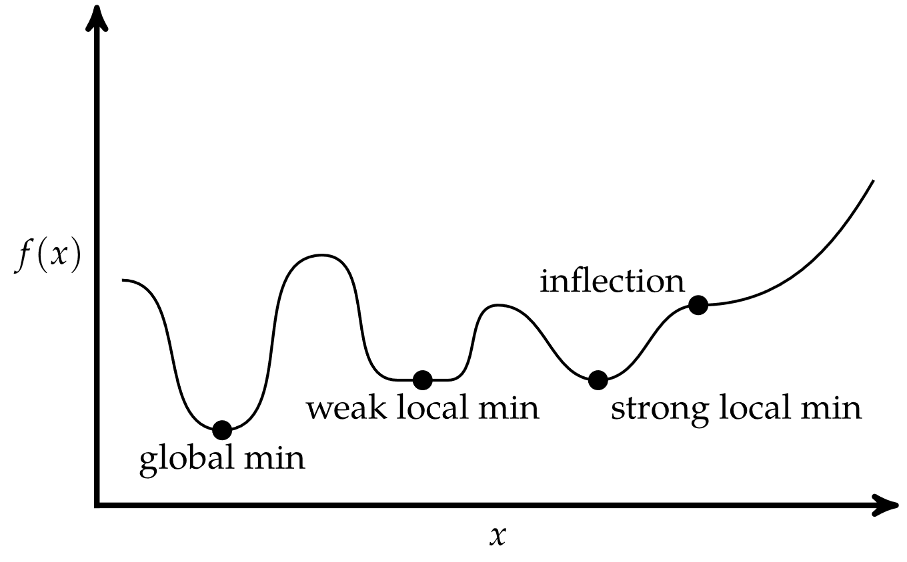
Critical Points
Univariate Function

Slide 11
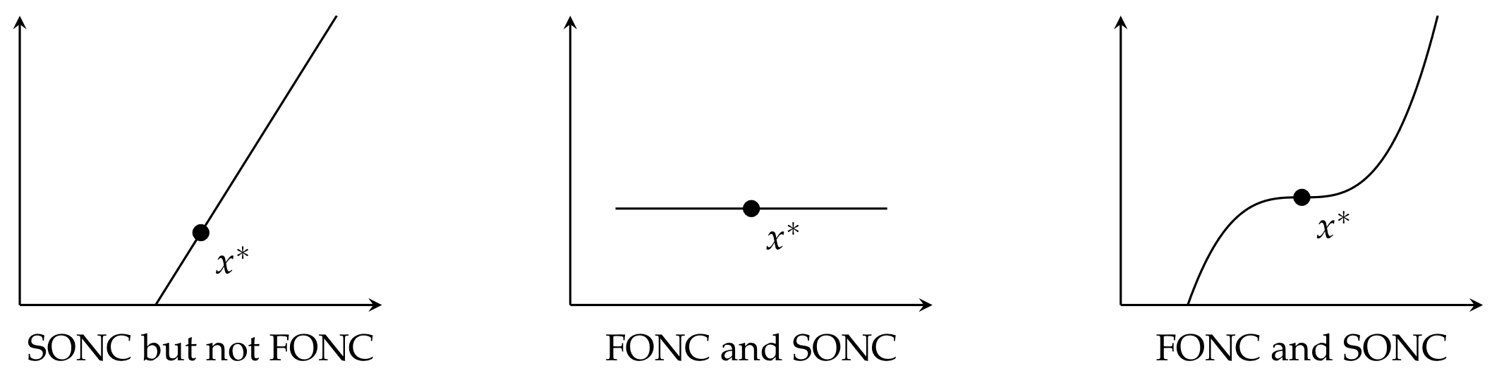

Conditions for Local Minima
Univariate Function
$=0,$ the first-order necessary condition (FONC)
$,$ the second-order necessary condition (SONC)

Slide 12

Conditions for Local Minima
Multivariate Functions
$=0,$ the first-order necessary condition (FONC)
$≥0,$ the second-order necessary condition (SONC)

Slide 13
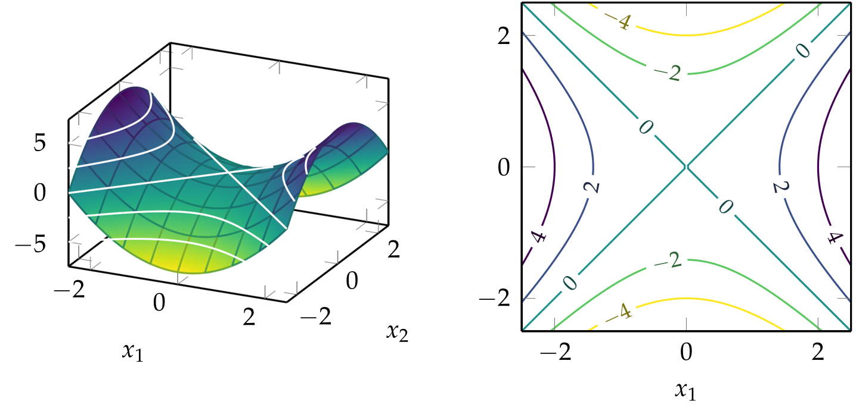

Contour Plots
$f\left(x_{1},x_{2}\right)={x_{1}}^{2}−{x_{2}}^{2}$

Slide 14
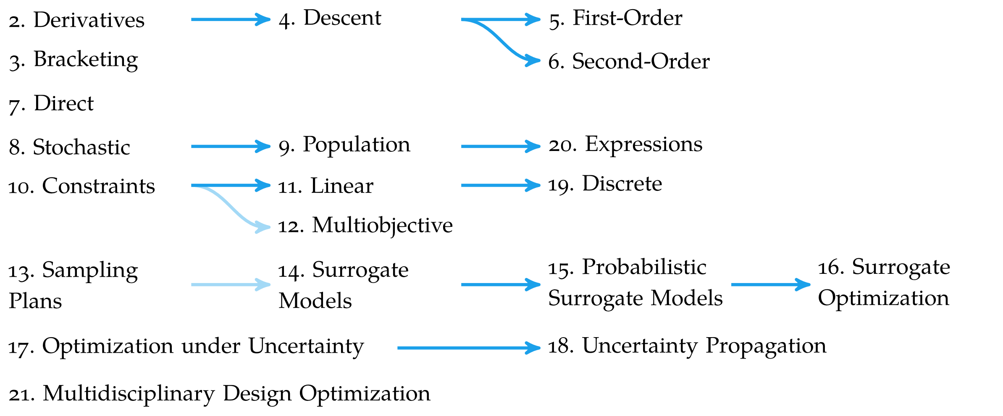
Overview

Slide 15
Summary
Optimization in engineering is the process of finding the best system design subject to a set of constraints
Optimization is concerned with finding global minima of a function
Minima can occur where the gradient is zero, but zero-gradient does not imply optimality

