Slide 1
Linear Constrained Optimization

Slide 2
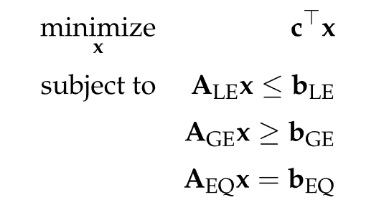
Problem Formulation
If an optimization problem has a linear objective and constraints, it is called a linear program
The general form of a linear program is

Slide 3
Example

Slide 4

Problem Formulation
Every general form linear program can be rewritten more compactly in standard form

Slide 5
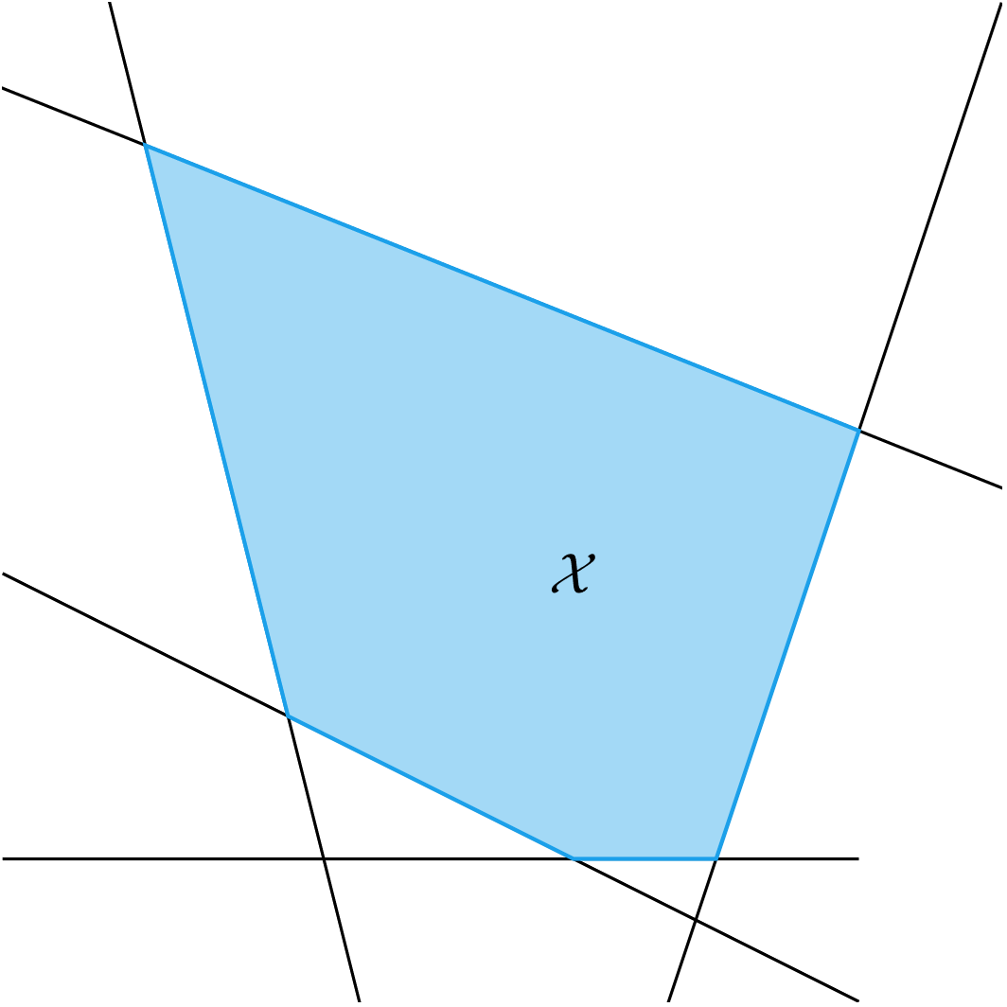
Problem Formulation
Each inequality constraint defines a planar boundary of the feasible set called a half-space
The set of inequality constraints define the intersection of multiple half-spaces forming a convex set

Slide 6
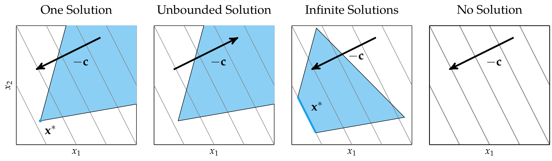
Problem Formulation
How many solutions are there?

Slide 7
Problem Formulation
No unique solution exists if the problem is unbounded, there are infinite solutions, or it is over-constrained

Slide 8

Problem Formulation
Linear programs are often solved in equality form
The feasible sets lie on hyperplanes

Slide 9
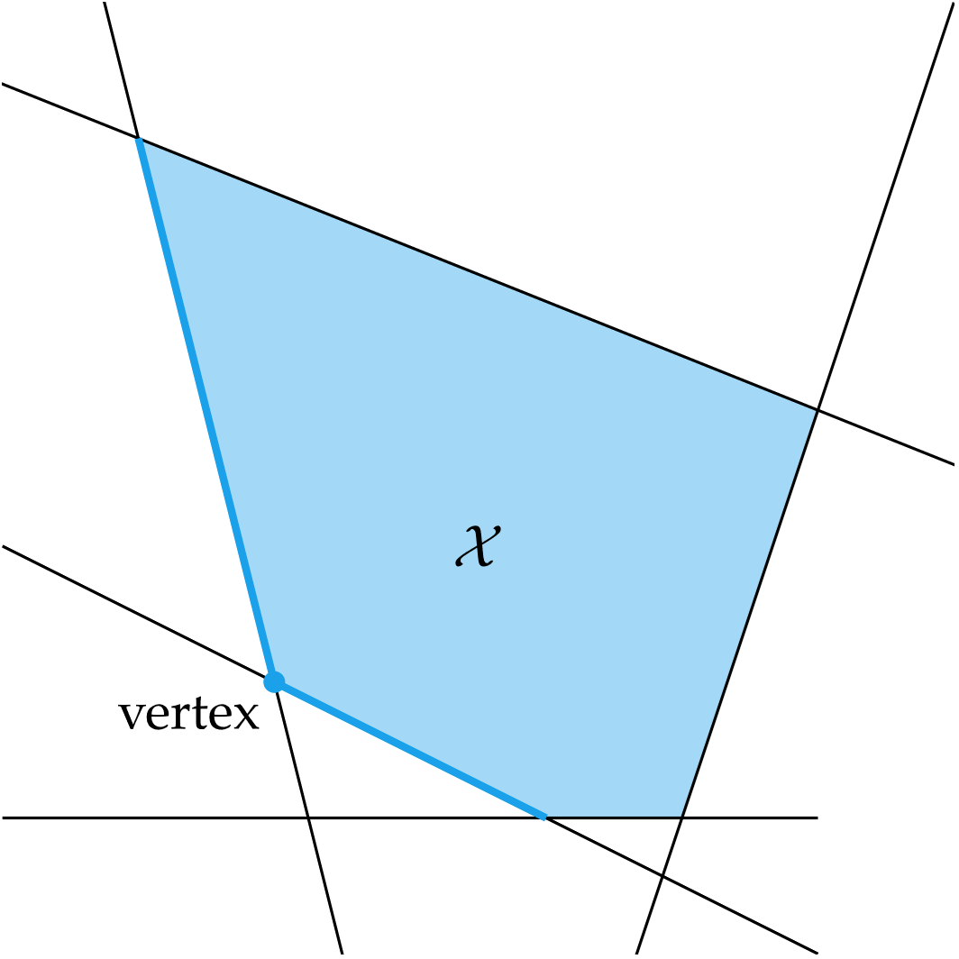
Simplex Algorithm
Guaranteed to solve any feasible and bounded linear program
The feasible set of a linear program forms a polytope
The simplex algorithm moves between vertices of the polytope until it finds an optimal vertex

Slide 10
Simplex Algorithm
Two phases of the algorithm
Initialization Phase: finding a feasible starting vertex
Optimization Phase: finding the optimal vertex

Slide 11
Simplex Algorithm: FONCs
Conditions for Optimality: FONCs for linear programs
feasibility: Ax = b, x ≥ 0
dual feasibility: µ ≥ 0
complementary slackness: µ ⨀ x = 0
stationarity: A⊺λ + µ = c

Slide 12
Simplex Algorithm: FONCs
Conditions for Optimality: FONCs for linear programs
feasibility: Ax = b, x ≥ 0
dual feasibility: µ ≥ 0
complementary slackness: µ ⨀ x = 0
stationarity: A⊺λ + µ = c

Slide 13
Simplex Algorithm
Two phases of the algorithm
Initialization Phase: finding a feasible starting vertex
Optimization Phase: finding the optimal vertex
Conditions for Optimality: FONCs for linear programs
feasibility: Ax = b, x ≥ 0
dual feasibility: µ ≥ 0
complementary slackness: µ ⨀ x = 0
stationarity: A⊺λ + µ = c

Slide 14
Simplex Algorithm: Optimization Phase

Slide 15
Simplex Algorithm: Optimization Phase

Slide 16
Simplex Algorithm: Optimization Phase
Several possible heuristics to search for optimal vertex (choose next q)
Greedy heuristic: maximally reduces objective at each step
Dantzig’s rule: choose most negative entry in µ; easy to calculate
Bland’s rule: chooses first vertex found with negative µ; useful for preventing or breaking out of cycles

Slide 17
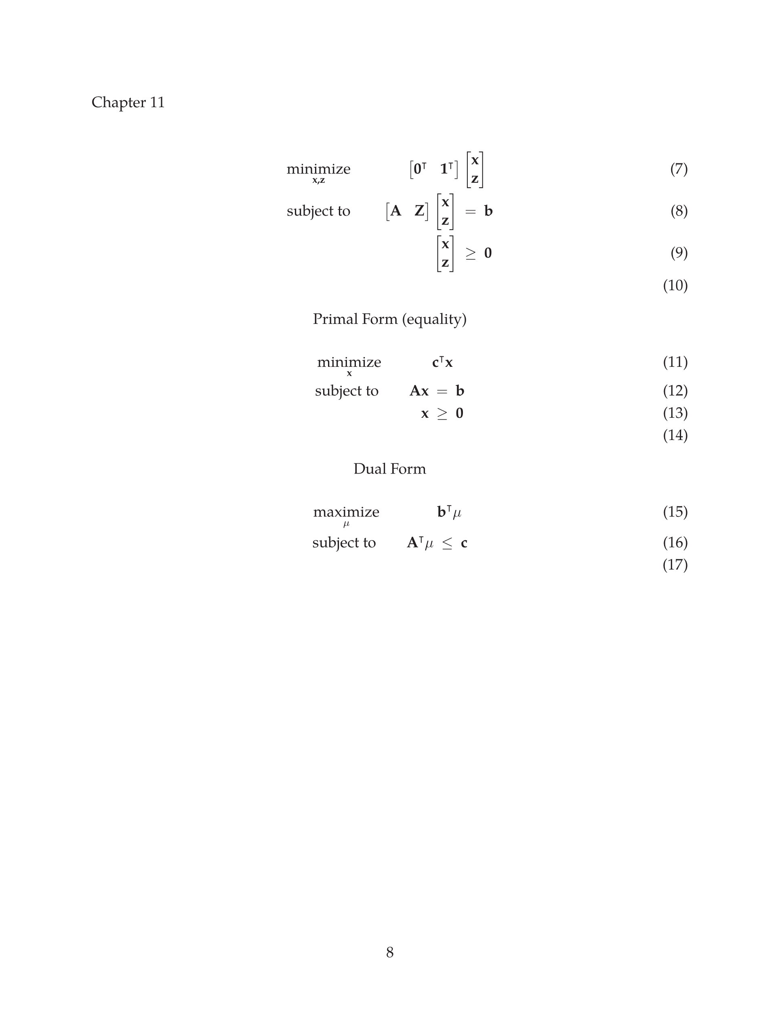
Simplex Algorithm: Initialization Phase
The starting vertex of the optimization phase is found by solving an additional auxiliary linear program that has a known feasible starting vertex
The solution is a feasible vertex in the original linear program

Slide 18
Dual Certificates
Verification that the solution returned by the algorithm is actually the correct solution
Recall that the solution to the dual problem, d* provides a lower bound to the solution of the primal problem, p*
If d* = p* then p* is guaranteed to be the unique optimizer because the duality gap is zero

Slide 19
Dual Certificates

Slide 20
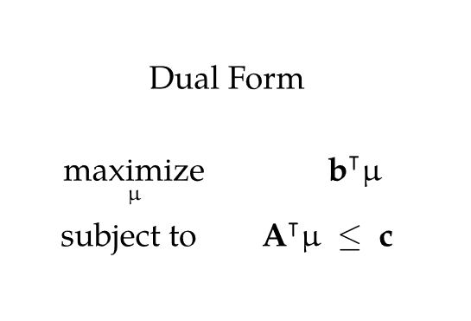
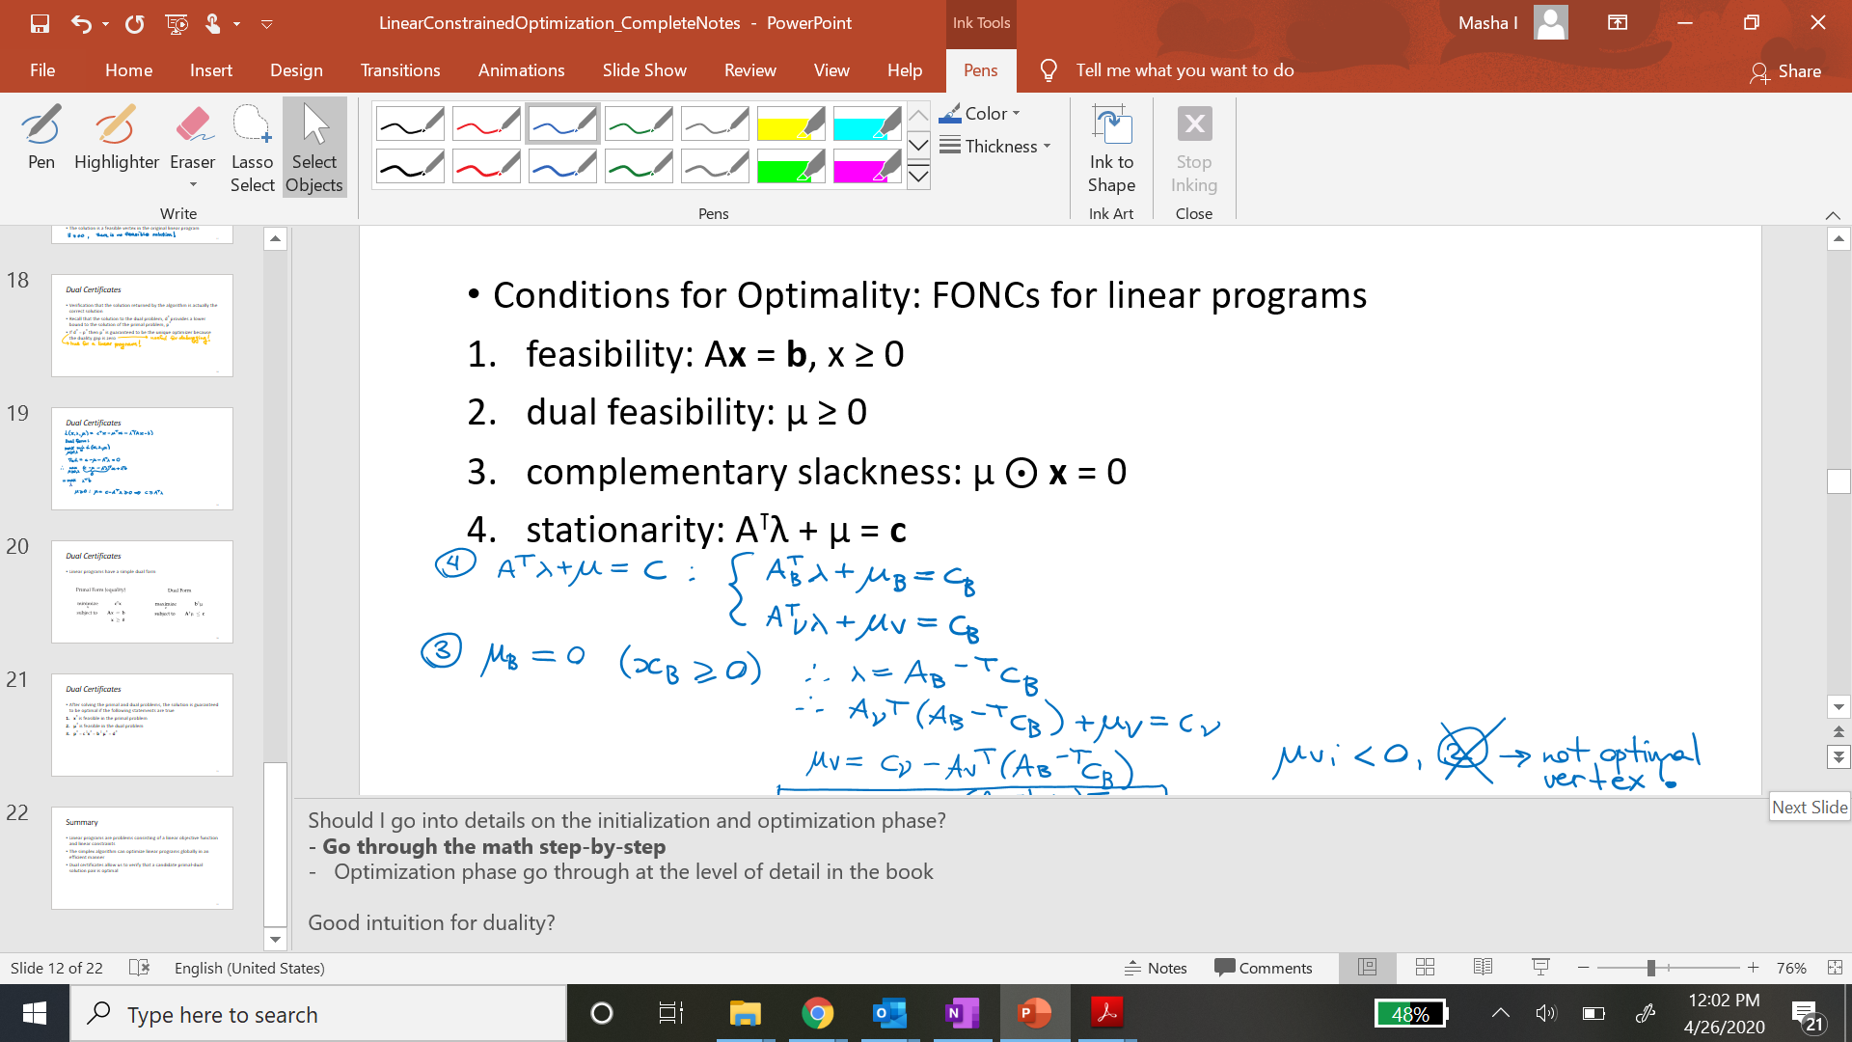
Dual Certificates
Linear programs have a simple dual form

Slide 21
Dual Certificates
After solving the primal and dual problems, the solution is guaranteed to be optimal if the following statements are true
x* is feasible in the primal problem
λ* is feasible in the dual problem
p* = c ⊺x* = b ⊺ λ* = d*

Slide 22
Summary
Linear programs are problems consisting of a linear objective function and linear constraints
The simplex algorithm can optimize linear programs globally in an efficient manner
Dual certificates allow us to verify that a candidate primal-dual solution pair is optimal

