Slide 1
Multiobjective Optimization

Slide 2
Multiobjective Optimization
Some optimization problems have multiple objectives that required tradeoff decisions

Slide 3
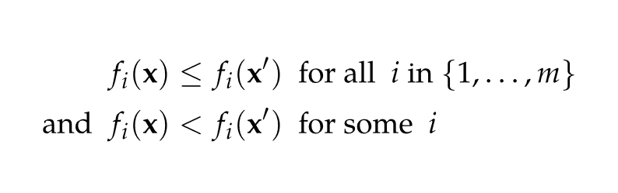
Pareto Optimality
At a Pareto optimal point, increasing one objective value decreases another
In multiobjective optimization, one point dominates another if

Slide 4
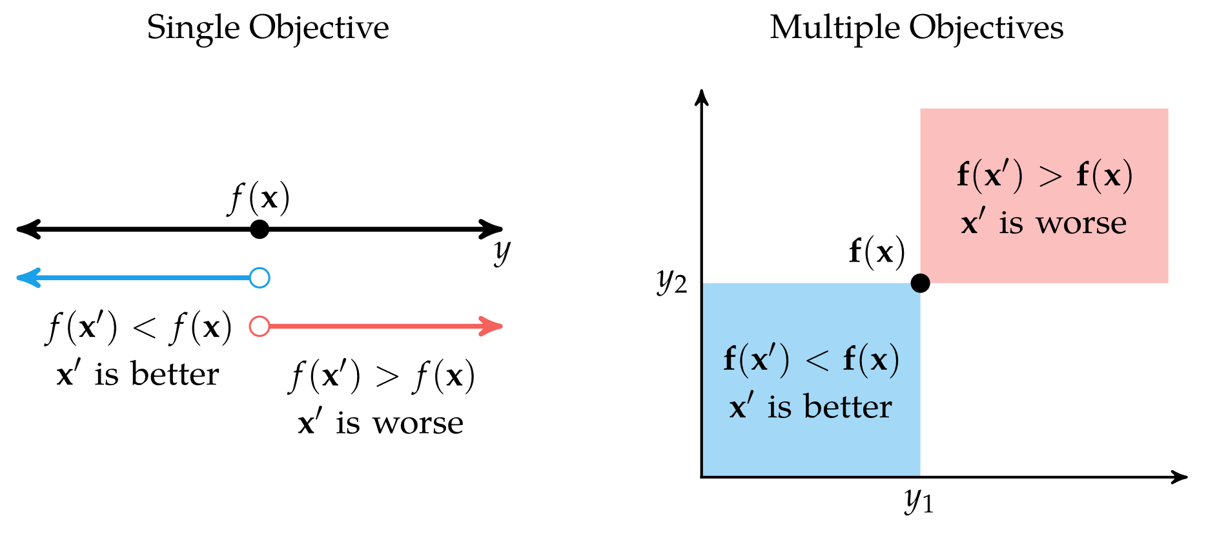
Pareto Optimality

Slide 5
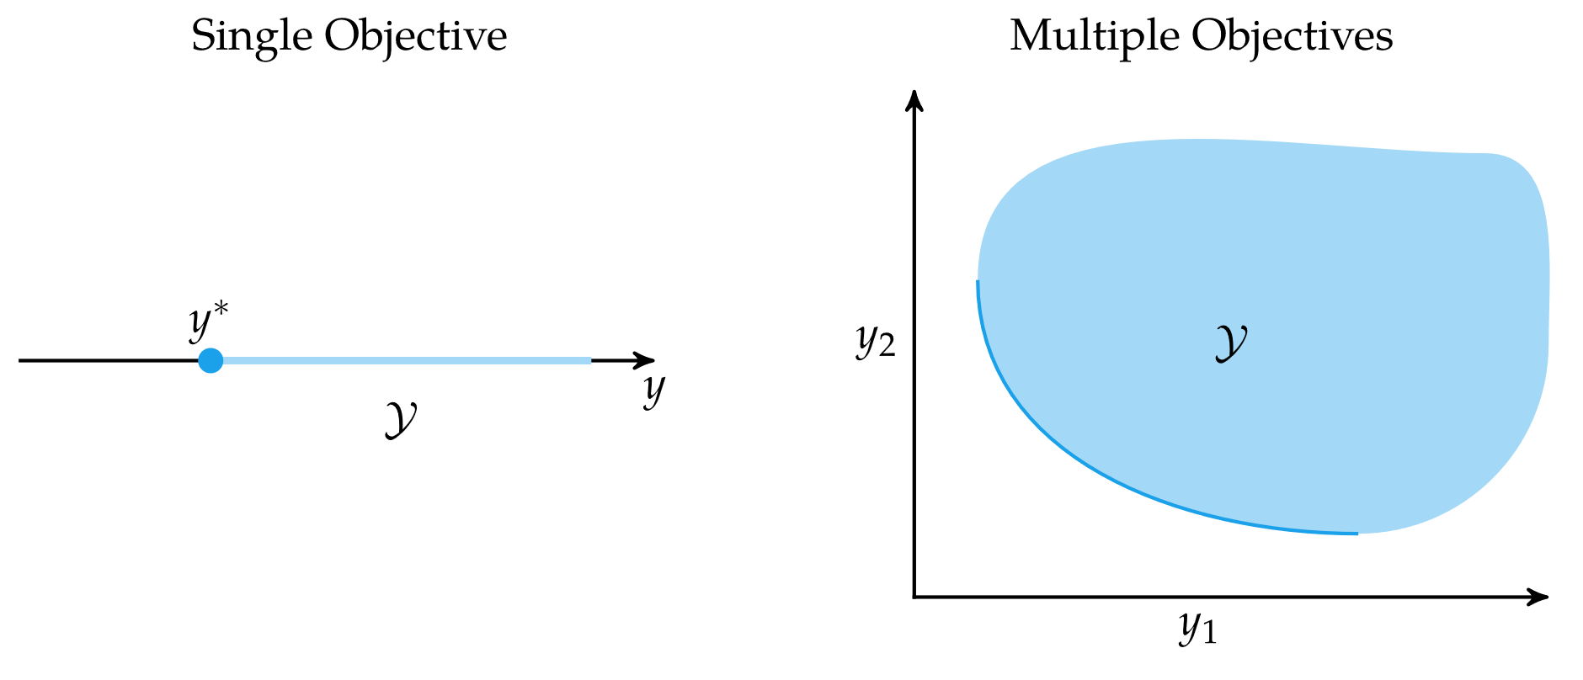
Pareto Optimality: Pareto Frontier
A criterion space is a set of all outputs possible given a space of inputs
In a multidimensional optimization problem, the criterion space is m-dimensional.
In m-dimensional space, it is possible for there to be no clearly optimal point

Slide 6
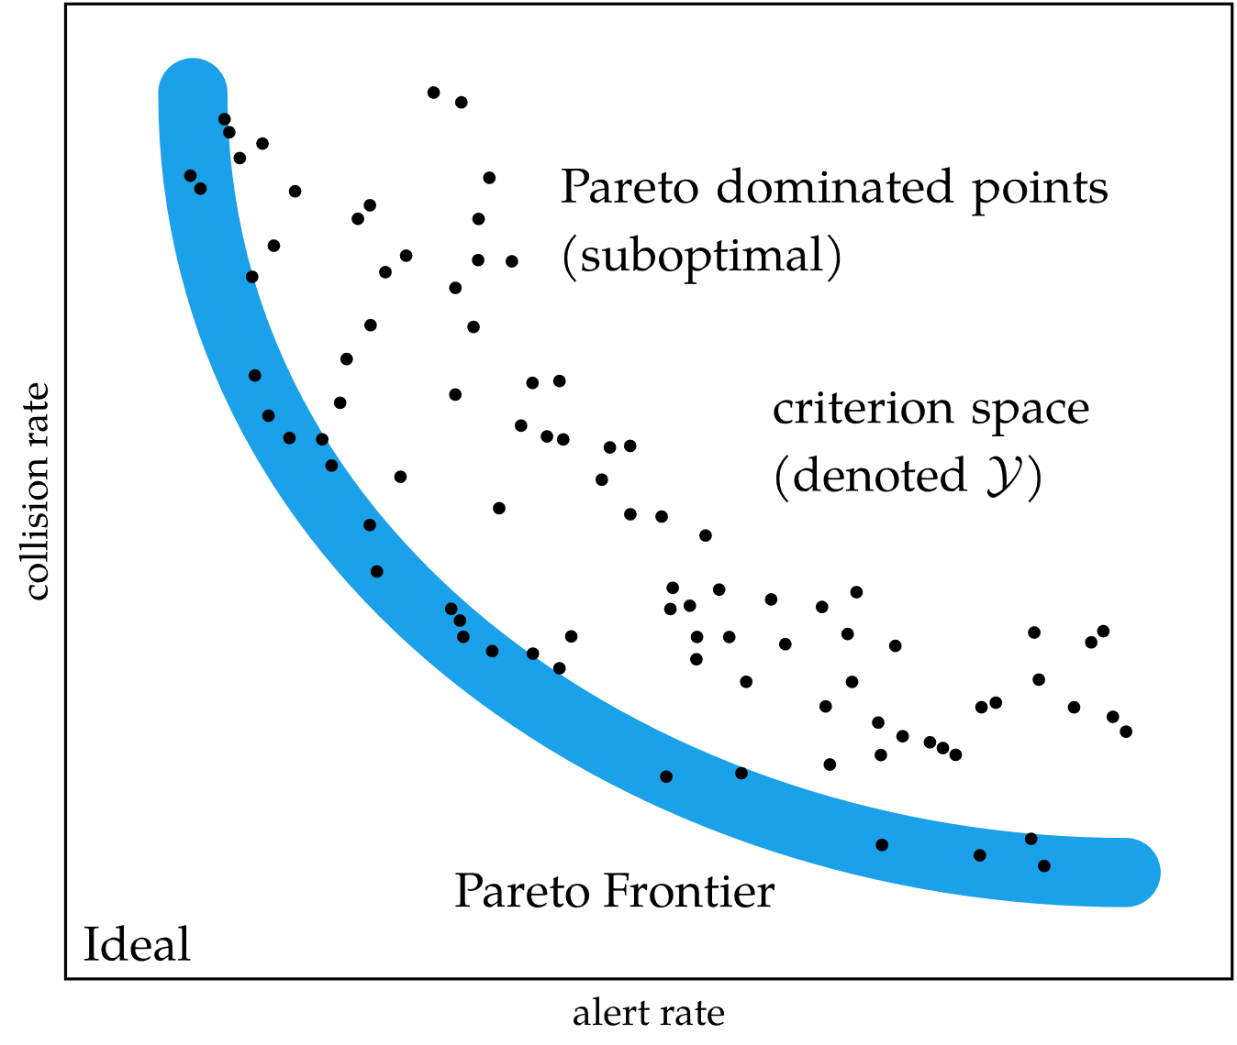
Pareto Optimality: Pareto Frontier
A design point is considered Pareto-optimal if no other point in the criterion space dominates it
The set of all Pareto-optimal points forms the Pareto frontier

Slide 7
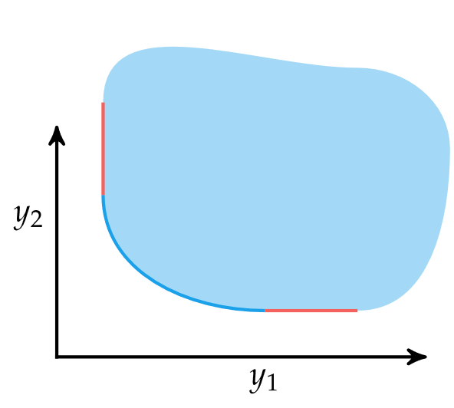
Pareto Optimality: Pareto Frontier
The utopia point is the component-wise optimal point. It may not be in the actual criterion space
Weakly Pareto-optimal points are those on the Pareto frontier that cannot be improved simultaneously in all objectives

Slide 8
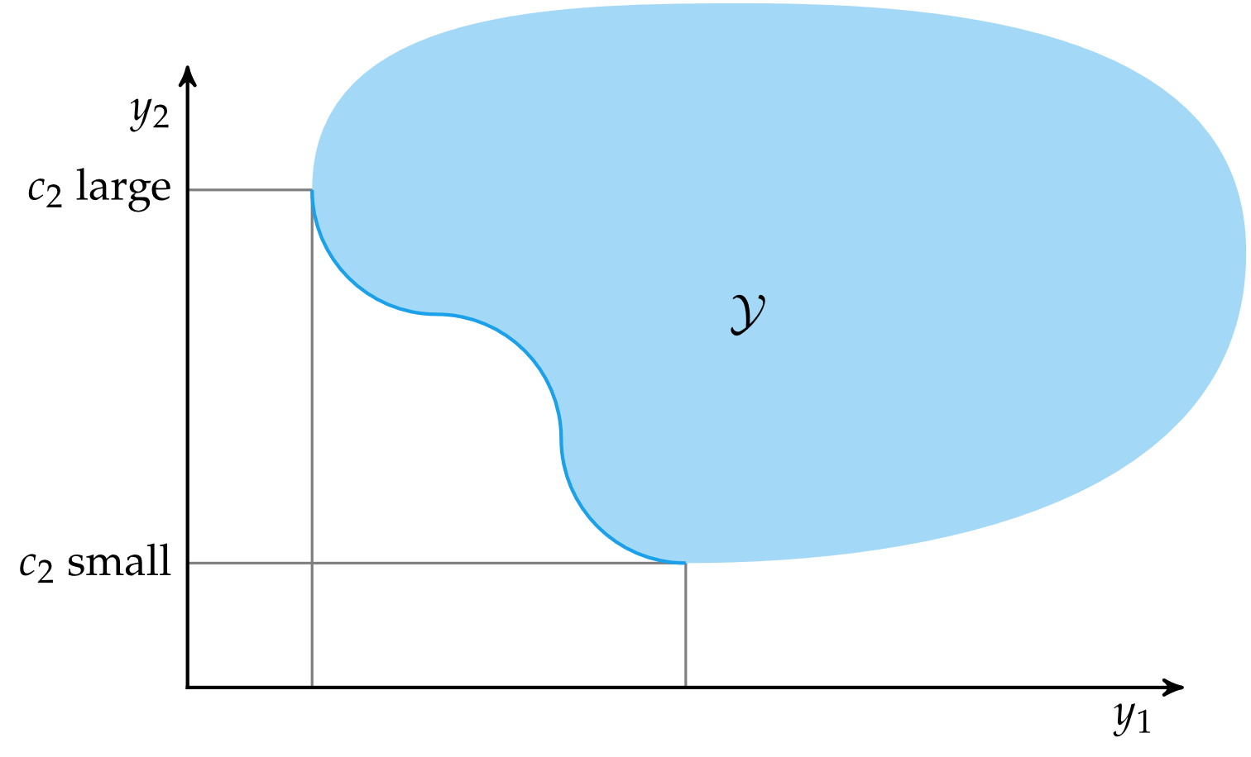
Constraint Methods
There are various methods for generating the Pareto frontier
The constraint method constrains all but one of the objectives to produce a unique optimal point in the criterion space
The constraints are then modified to trace out the Pareto frontier

Slide 9
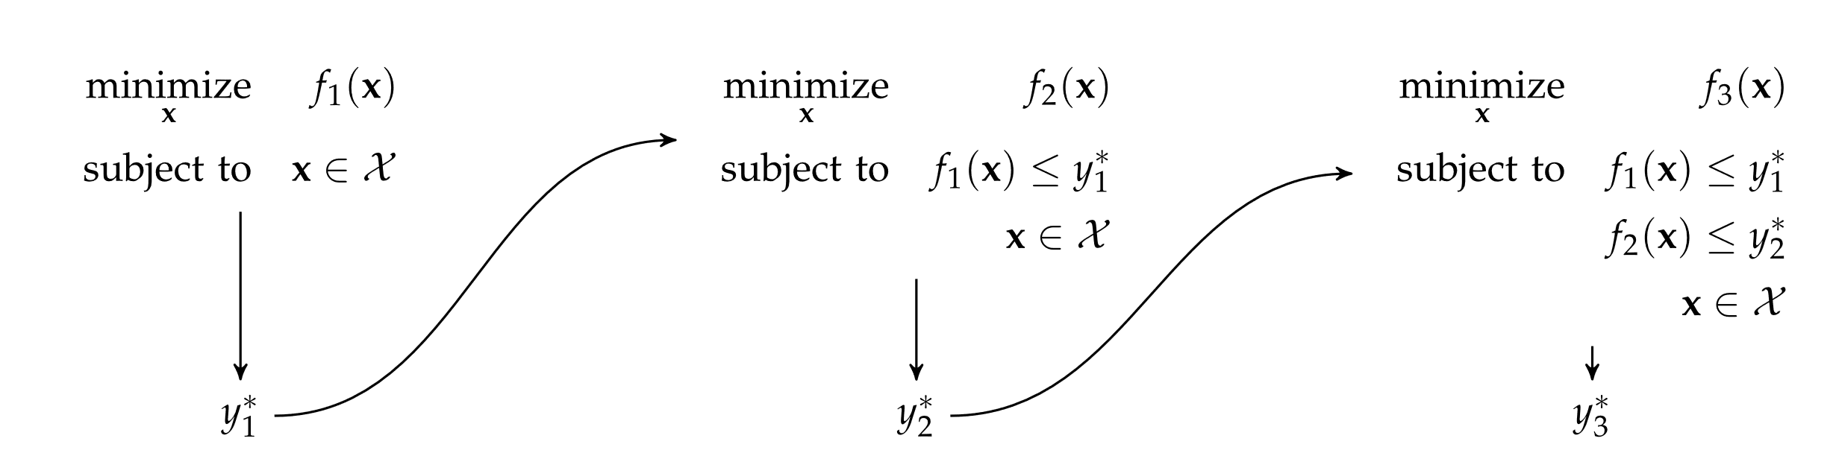
Constraint Methods
The lexicographic method ranks the objectives in order of importance and performs a series of single-objective optimizations in order of importance
Each optimization problem includes constraints to preserve the optimality of the previously optimized objectives

Slide 10
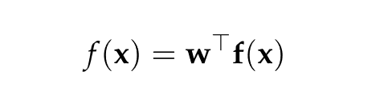
Weight Methods
A designer can encode preferences over the objectives as a vector of weights
The pareto frontier can be generated by sweeping over the space of possible weights
The weighted sum method combines multiple objective functions into one using a constant vector inner product

Slide 11
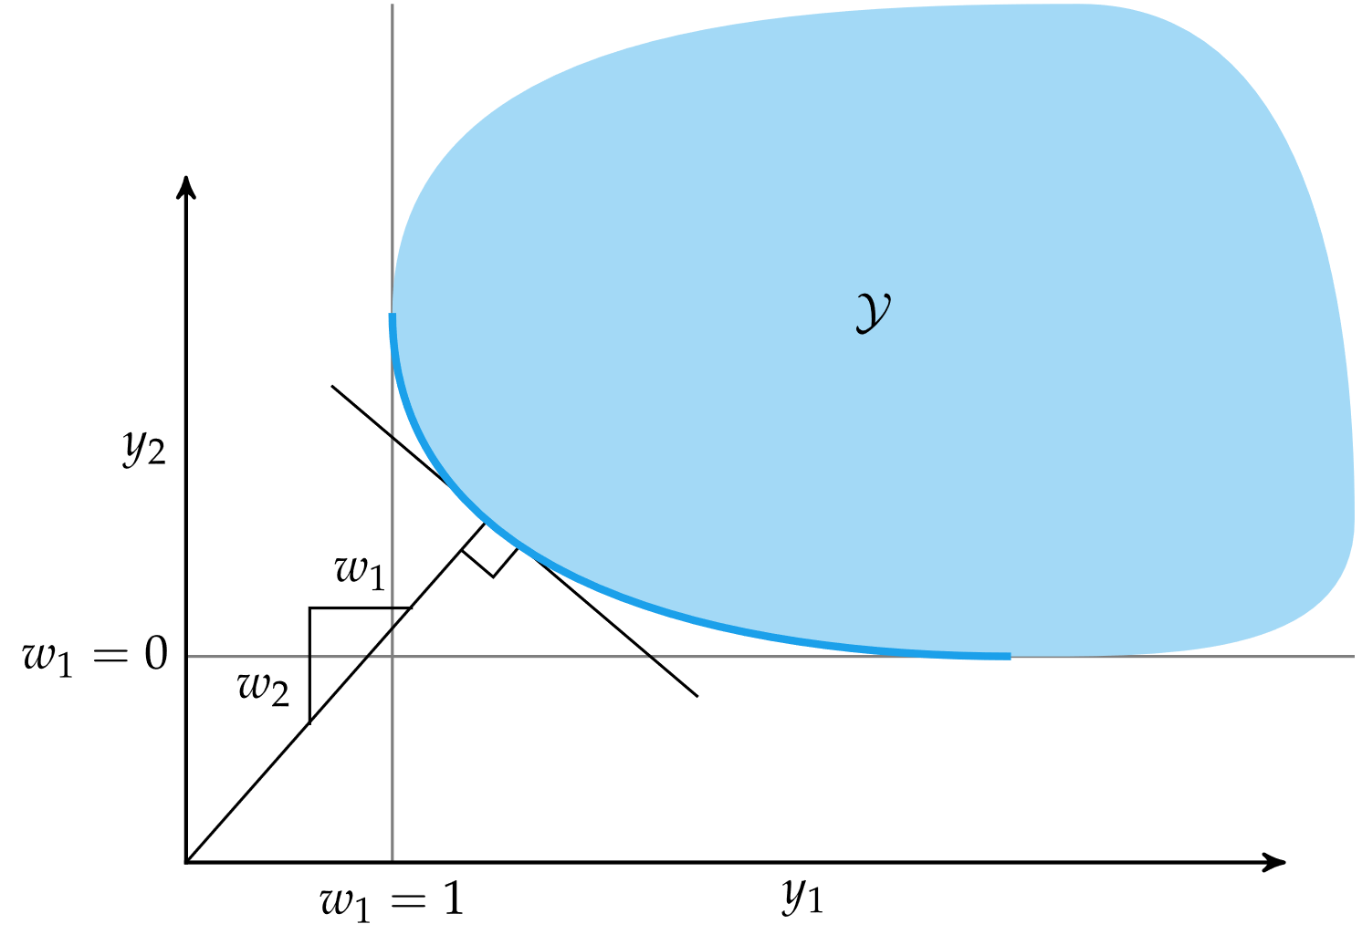
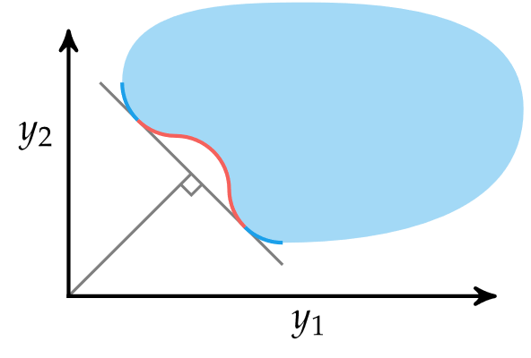
Weight Methods
Note: weighted sum methods cannot obtain points in red

Slide 12
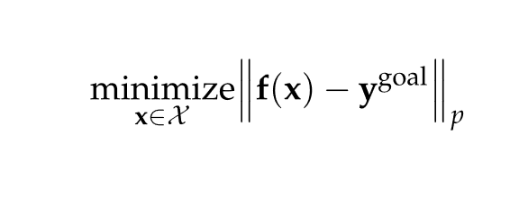
Weight Methods
Goal programming converts multiple objectives into a single objective using a norm between f(x) and a goal point
Typically, the goal point is the utopia point

Slide 13
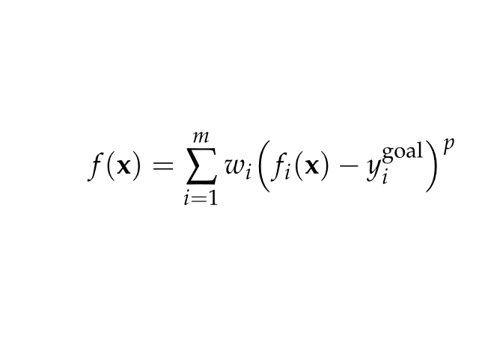
Weight Methods
Weighted exponential sum combines goal programming and the weighted sum method
Here, w is a vector of weights that sum to 1 and p ≥ 1

Slide 14
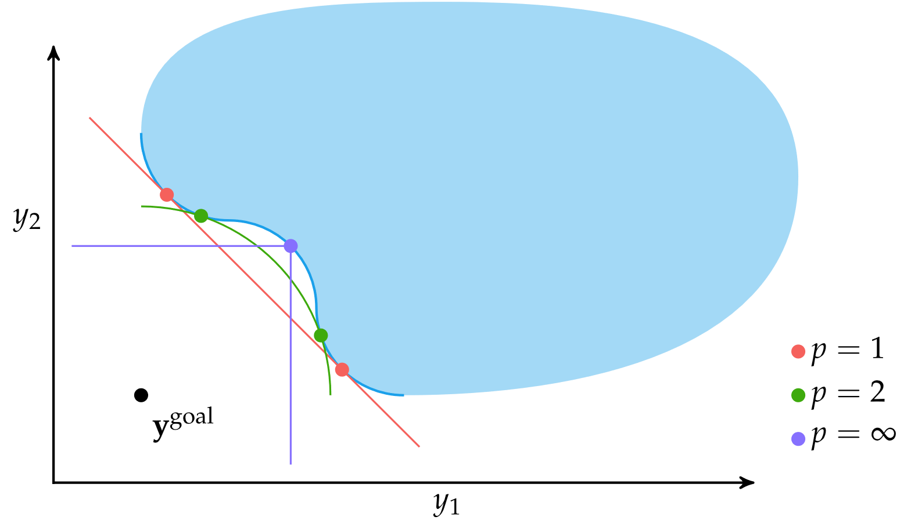
Weight Methods
Weighted exponential sum for different values of p

Slide 15
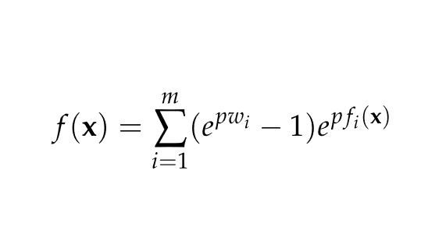
Weight Methods
Previous methods cannot obtain points in nonconvex portions of the Pareto frontier
The exponential weighted criterion can provide Pareto-optimal points in nonconvex regions
Note: High values of p can lead to numerical overflow

Slide 16
Multiobjective Population Methods
A population is partitioned into several subpopulations
Each subpopulation is optimized with respect to a different objective

Slide 17
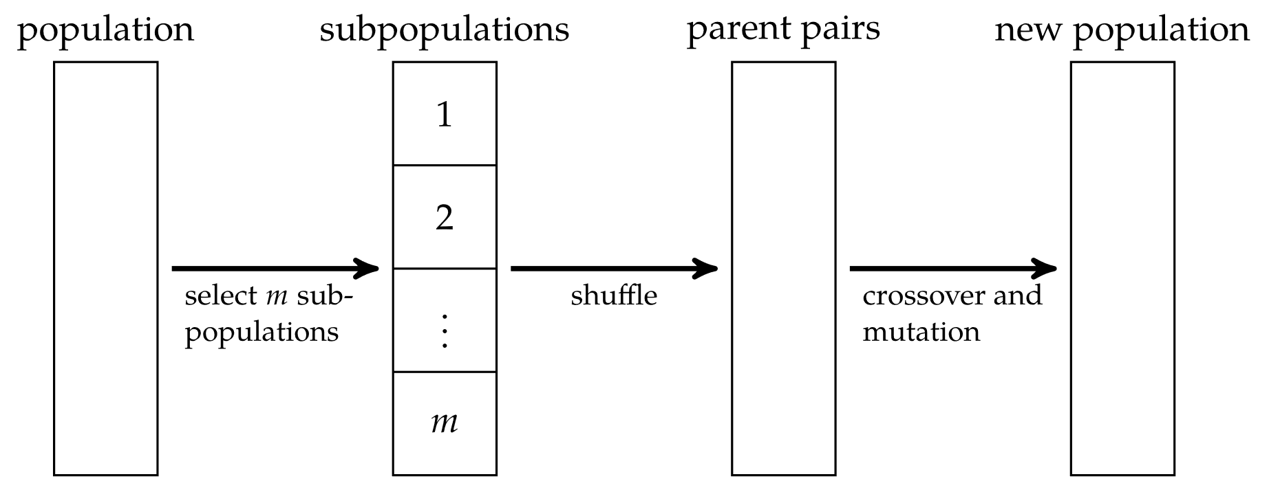
Multiobjective Population Methods
The vector evaluated genetic algorithm randomly partitions subpopulations at each generation

Slide 18
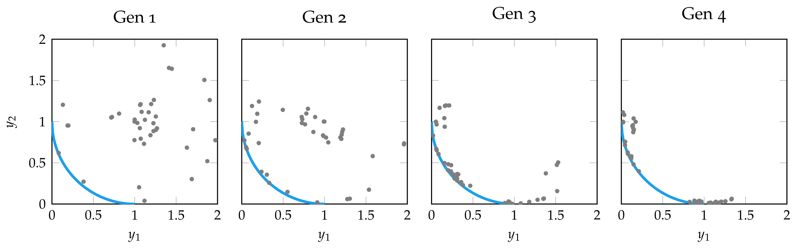
Multiobjective Population Methods

Slide 19
Multiobjective Population Methods
Nondomination ranking is used to rank individuals in the population
Nondominated individuals (Pareto-frontier)
Nondominated by any except those in (1)
Nondominated by and except those in (1) or (2)
…

Slide 20
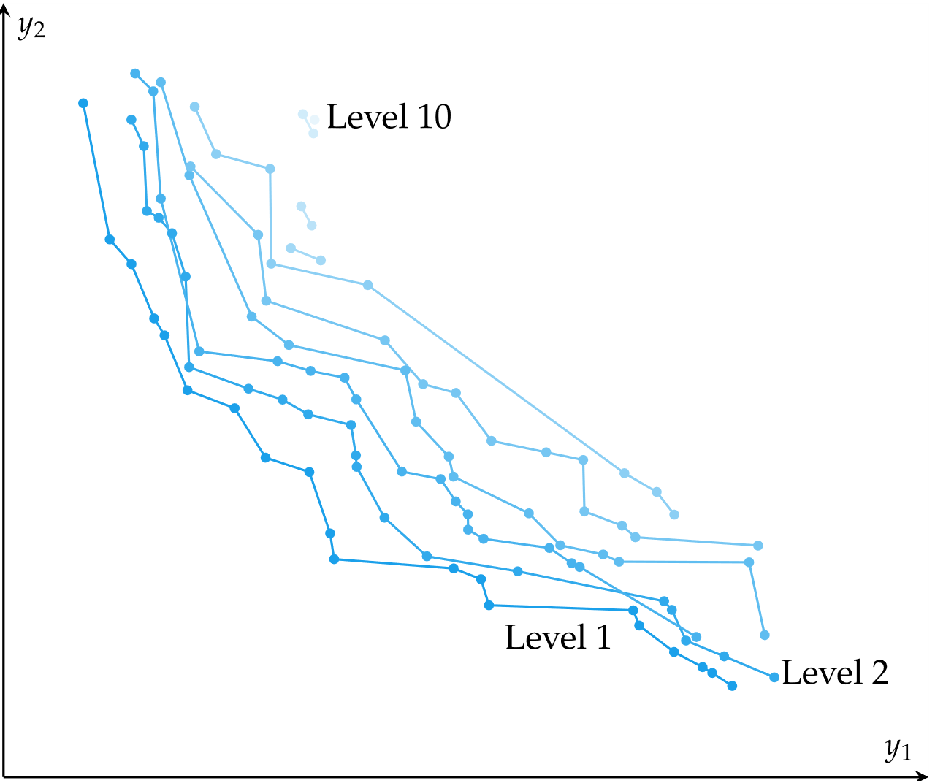
Multiobjective Population Methods

Slide 21
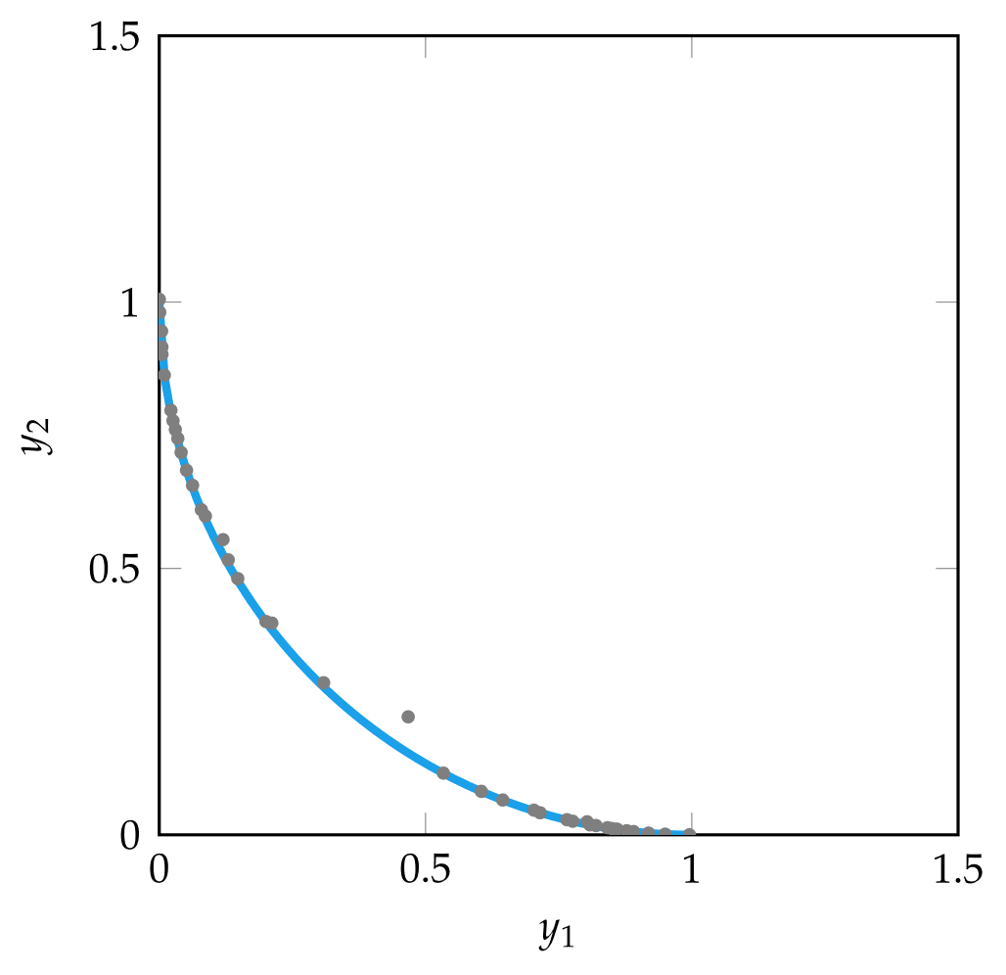
Multiobjective Population Methods
In multiobjective population methods, a population that approximates the Pareto frontier is called a Pareto filter
At every generation, dominant individuals are retained and dominated individuals are removed

Slide 22
Multiobjective Population Methods
A niche is a focused cluster of points, typically in the criterion space
Niche techniques help encourage an even spread of points across the Pareto frontier
In fitness sharing, the individual objective values are penalized if neighboring points are too close
In equivalence class sharing, when two individuals are compared, their nondomination ranking is considered first, then fitness sharing is used to as a tie-breaker

Slide 23

Multiobjective Population Methods
Improved coverage of Pareto frontier using fitness sharing

Slide 24
Preference Elicitation
If using a weighted sum method, how should the weights be determined?
Preference elicitation involves inferring a scalar-valued objective function from the preferences of experts about objective tradeoffs
A common approach is asking experts to choose preference between the optimized results of two weight distributions w_{a} and w_{b}. These distributions are continually adjusted until w aligns with user preferences

Slide 25
Preference Elicitation
The process of choosing w_{a} and w_{b} such that at each iteration, the expert response is the most informative
If the weight vector is length n, then the space of possible weights forms a subspace in n-dimensional space W, from which both w_{a} and w_{b} must be chosen
Q-Eval: a greedy heuristic strategy that bisects W and chooses w_{a} and w_{b} from either side
Polyhedral method: reduces uncertainty and balances breadth by approximating W with a bounding ellipsoid

Slide 26
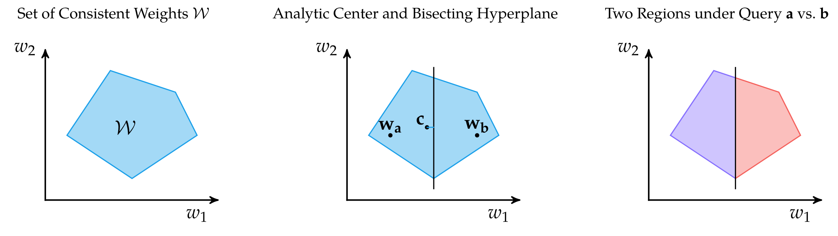
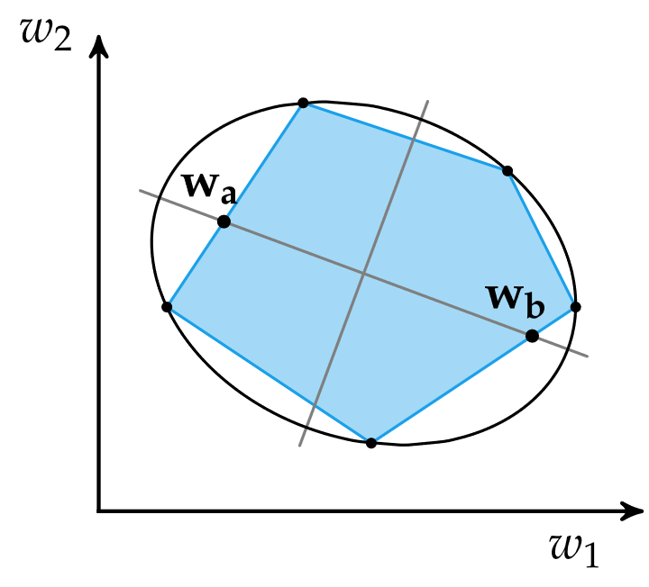
12.5 Preference Elicitation
Q-Eval
Polyhedral

Slide 27
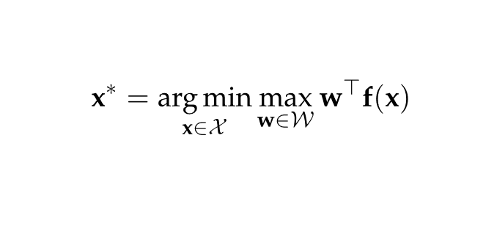
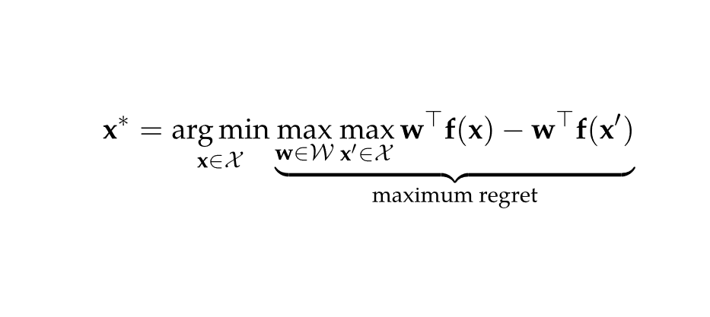
Preference Elicitation
Although query methods reduce the search space efficiently, the last step of selecting a final design is called design selection
Decision quality improvement method is a minimax method that minimizes the worst-case objective value cost
Minimax regret minimizes the maximum possible regret

Slide 28
Summary
Design problems with multiple objectives often involve trading performance between different objectives
The Pareto frontier represents the set of potentially optimal solutions
Vector-valued objective functions can be converted to scalar-valued objective functions using constraint-based or weight-based methods

Slide 29
Summary
Population methods can be extended to produce individuals that span the Pareto frontier
Knowing the preferences of experts between pairs of points in the criterion space can help guide the inference of a scalar-valued objective function

