Slide 1
Surrogate Models

Slide 2
Surrogate Models
A surrogate model of a function is an approximation of the function that is less costly to evaluate
The surrogate model can then be used to help direct the search for the optimum of the real objective function

Slide 3
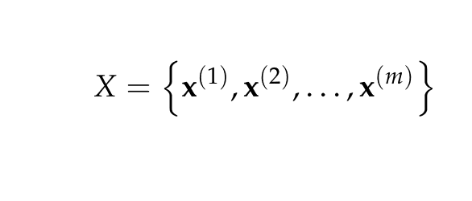
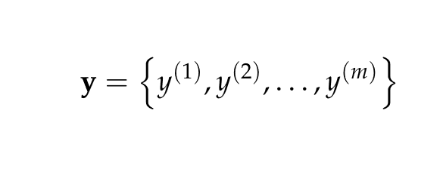

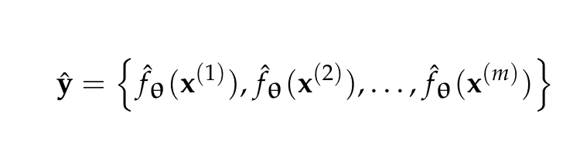
Fitting Surrogate Models
Given a set of design points and function evaluations,
Find the model parameters which minimize error
This optimization problem is called regression

Slide 4
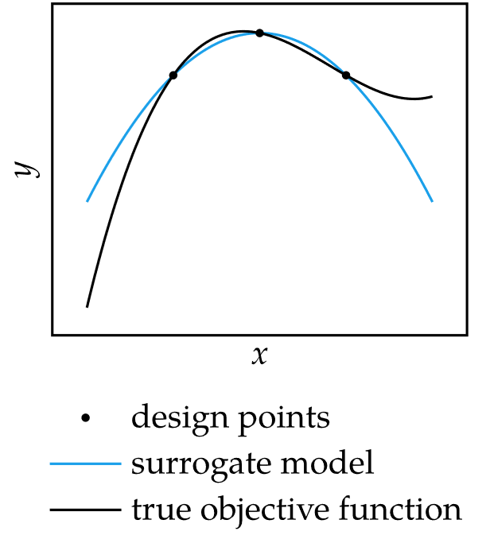

Fitting Surrogate Models
Example: approximating $f$ with a quadratic function

Slide 5


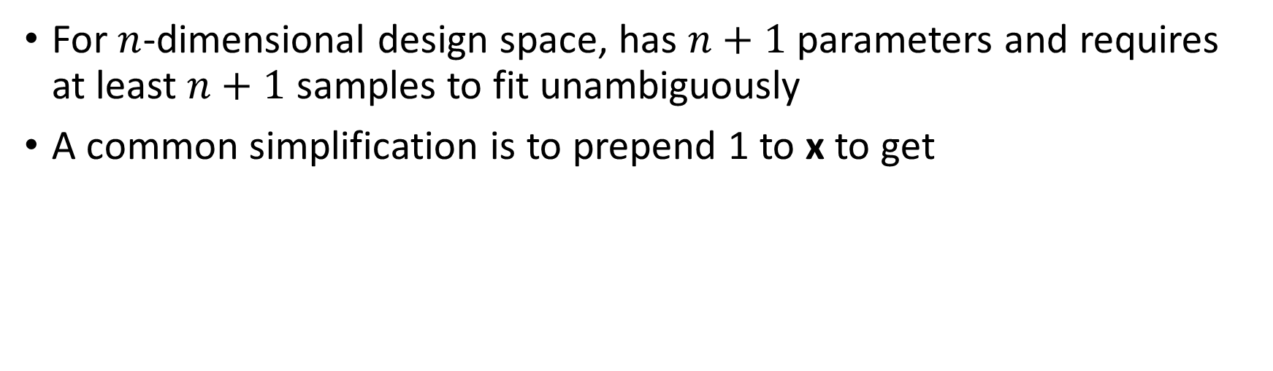
Linear Models
For $n$-dimensional design space, has $n+1$ parameters and requires at least $n+1$ samples to fit unambiguously
A common simplification is to prepend 1 to x to get

Slide 6


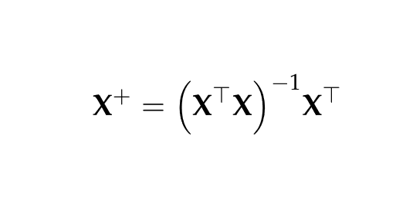
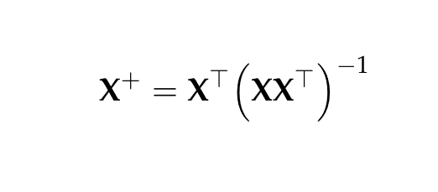
Linear Models
Fitting a linear model is called linear regression
Solution can be found analytically
If X⊤X is invertible,
If X X⊤ is invertible,

Slide 7
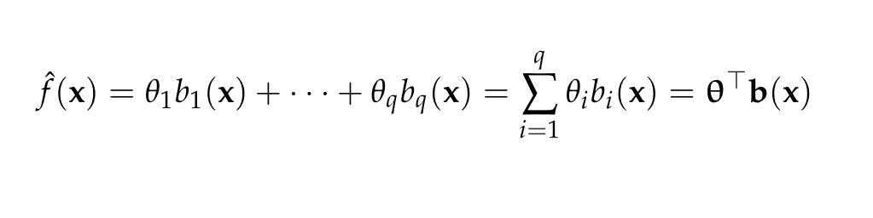
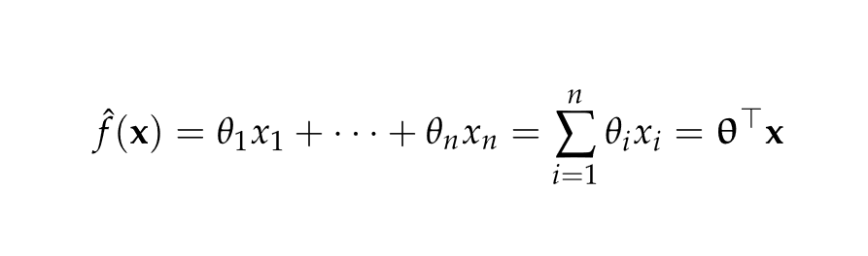
Basis Functions
More general surrogate models can be constructed as linear combinations of basis functions evaluated at the design point
For linear models, the basis function is the design point

Slide 8


Basis Functions
Any surrogate model represented as a linear combination of basis functions can be fit using regression

Slide 9
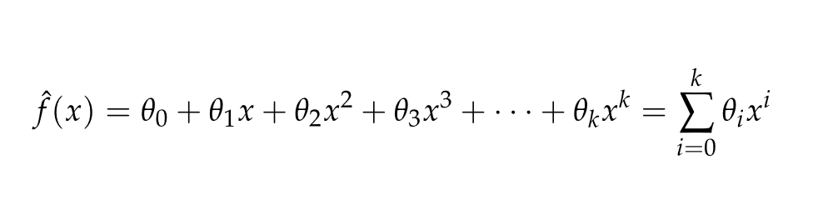


Basis Functions: Polynomials
A simple 1-D polynomial model of degree $k$ has the form
In 2-D, the basis function has the form

Slide 10
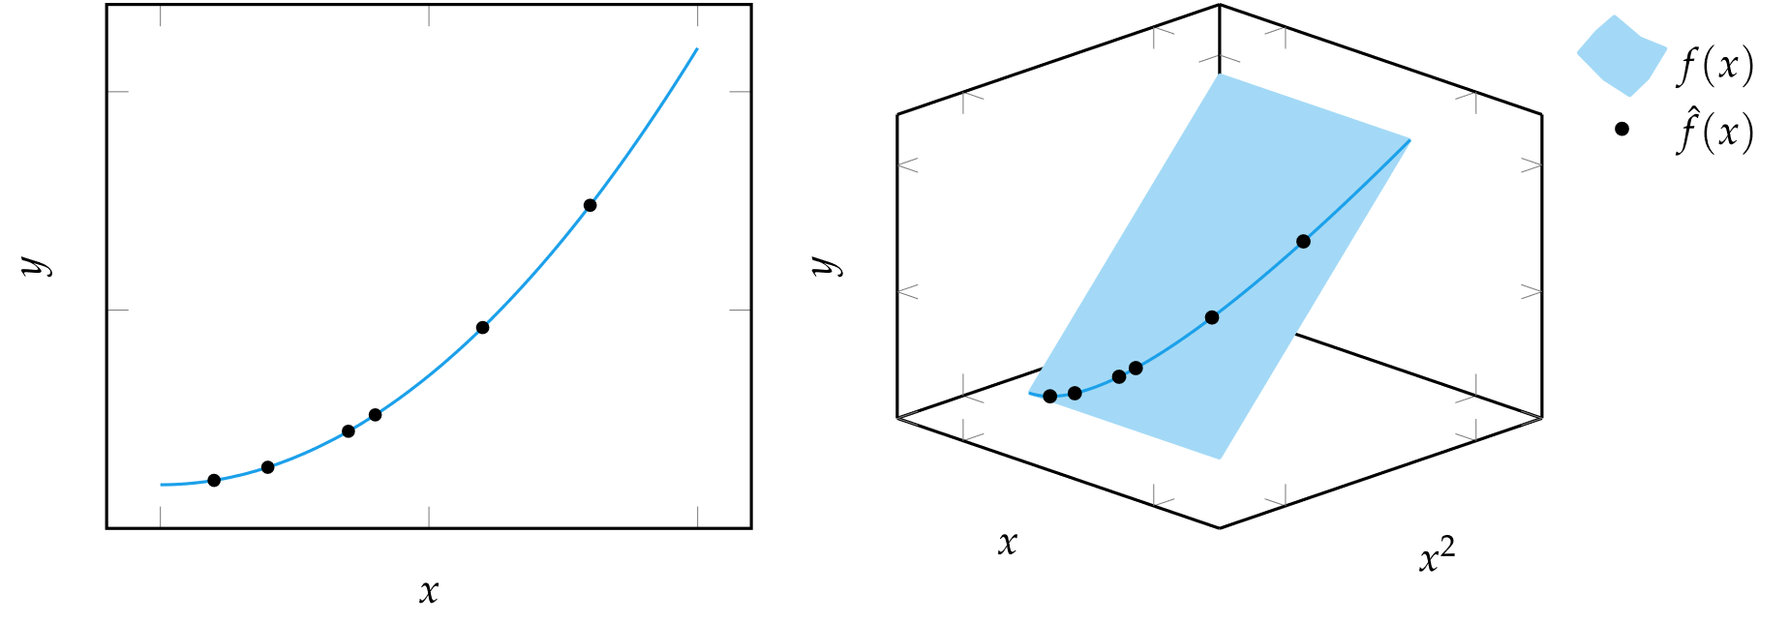
Basis Functions: Polynomials
Polynomial surrogate models are fit with linear regression, so in a sufficiently high-dimensional space, each polynomial model is always linear

Slide 11
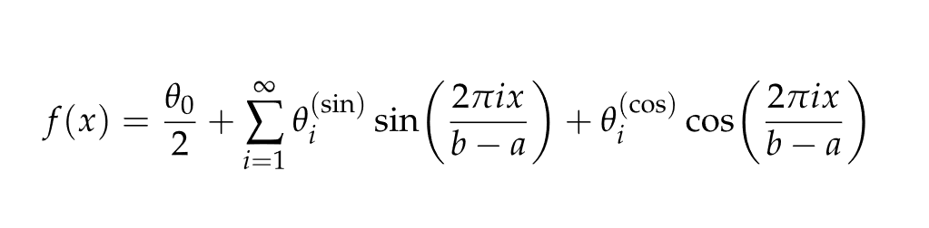
Basis Functions: Sinusoidal
Any continuous function over a finite domain can be represented using an infinite set of sinusoidal basis functions
If the function is univariate and integrable, it can be described using a Fourier series according to the summation

Slide 12
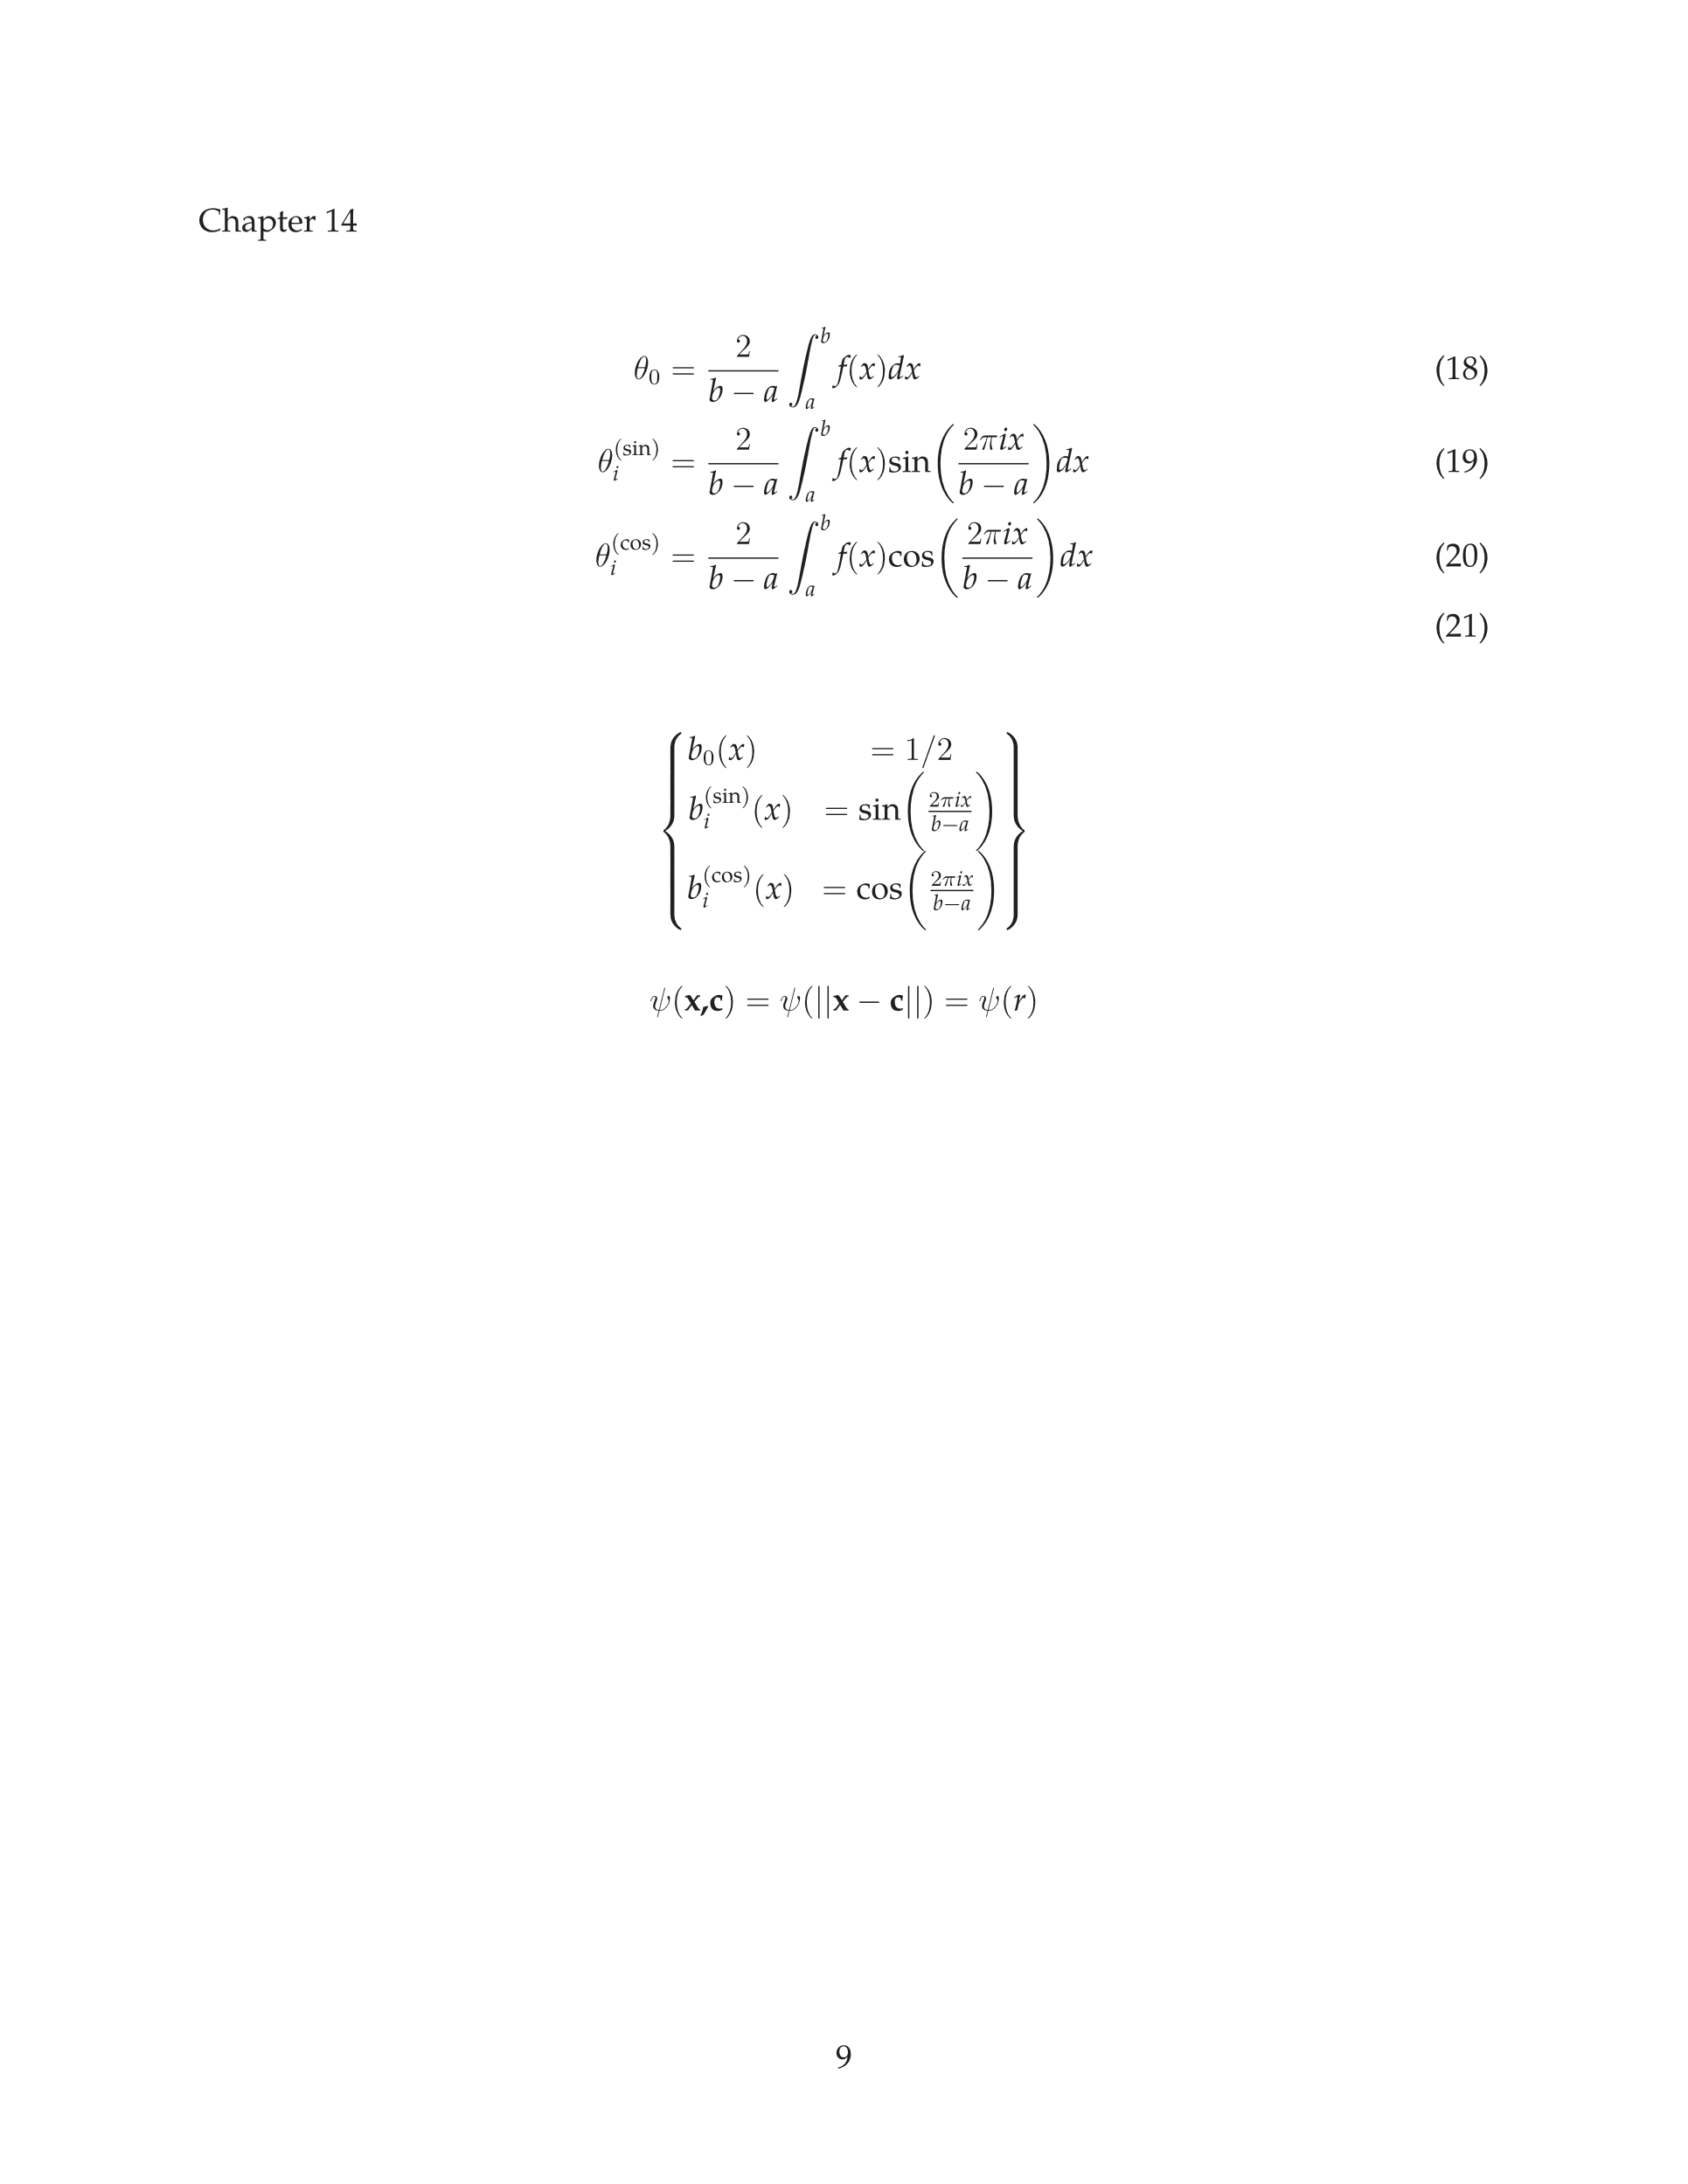
Basis Functions: Sinusoidal
The formula for sinusoidal coefficients are

Slide 13
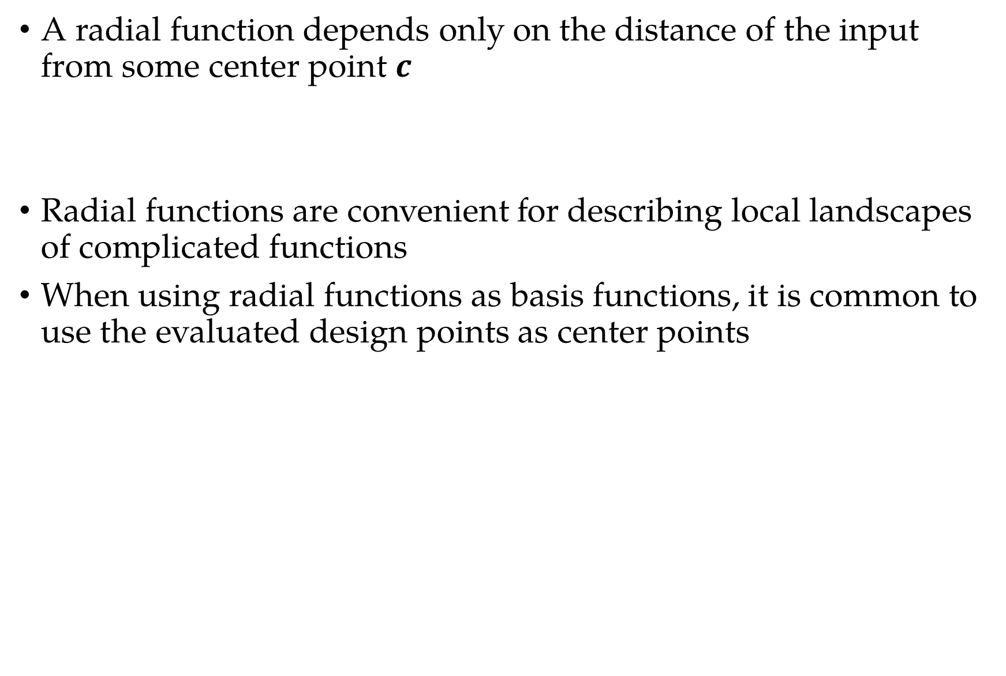
Basis Functions: Radial
A radial function depends only on the distance of the input from some center point $c$
Radial functions are convenient for describing local landscapes of complicated functions
When using radial functions as basis functions, it is common to use the evaluated design points as center points

Slide 14
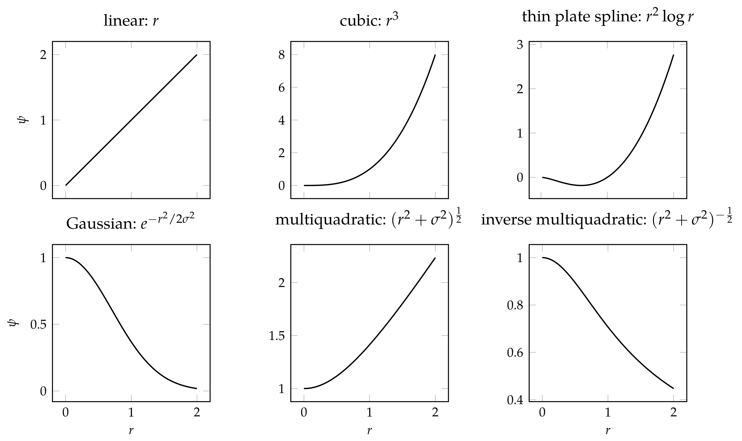
Basis Functions: Radial

Slide 15
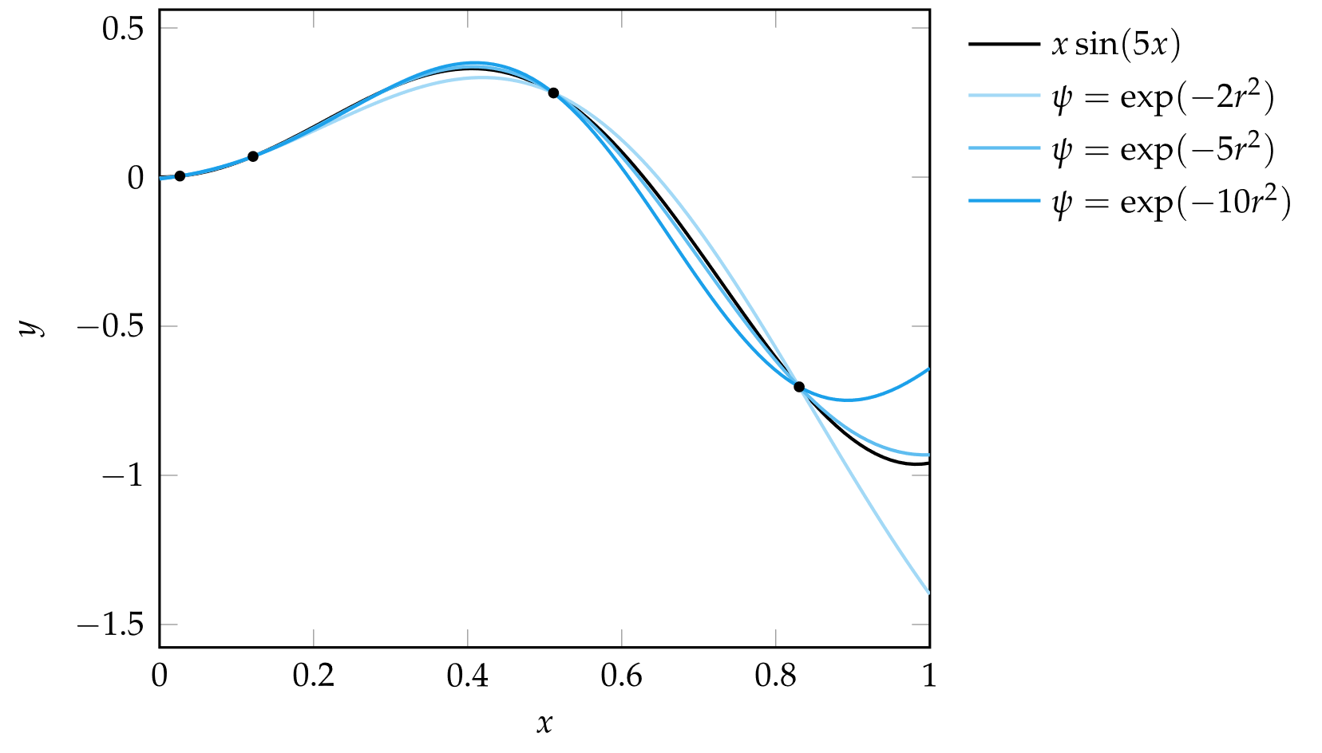
Basis Functions: Radial

Slide 16
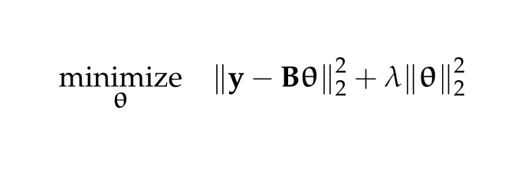
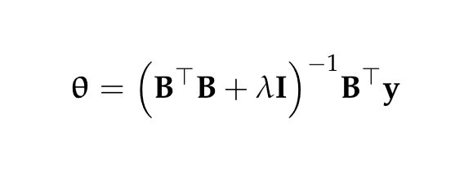
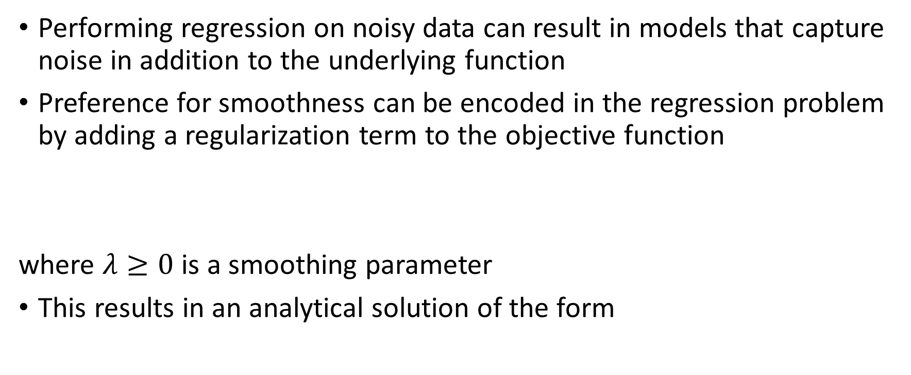
Fitting Noisy Objective Functions
Performing regression on noisy data can result in models that capture noise in addition to the underlying function
Preference for smoothness can be encoded in the regression problem by adding a regularization term to the objective function
where $λ≥0$ is a smoothing parameter
This results in an analytical solution of the form

Slide 17
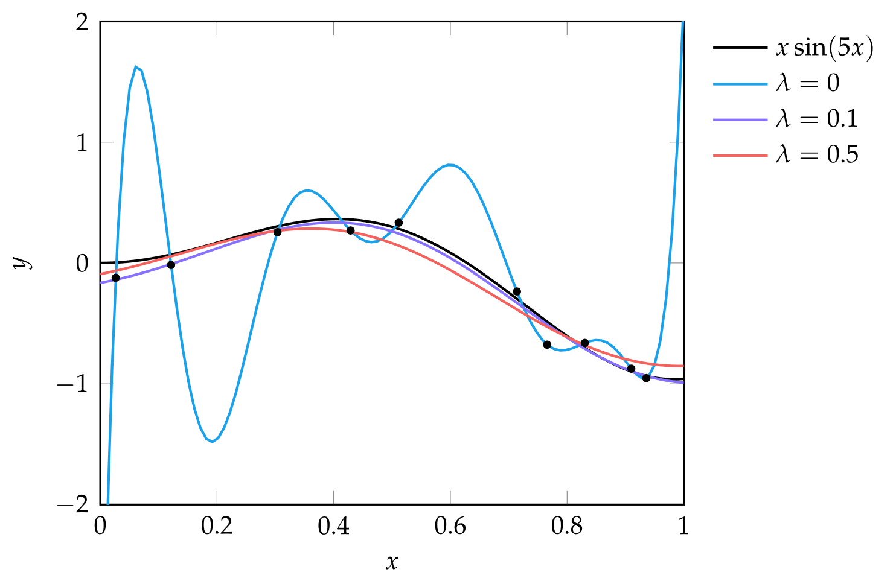
Fitting Noisy Objective Functions

Slide 18
Model Selection
After a model is fit to data, its quality still must be evaluated
Data used to fit a model is called training data
Models are compared based on generalization error which is the predictive error on data not in the training set

Slide 19
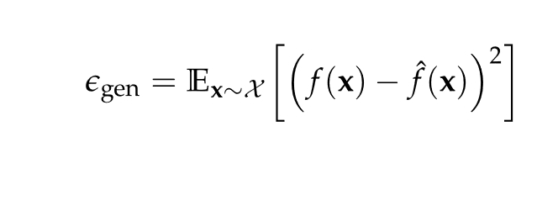
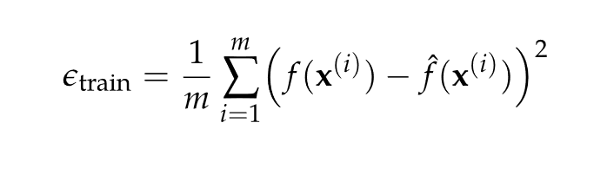
Model Selection
One way to quantify generalization error is as the expected squared error of predictions
Since this requires knowledge of the original function value at unknown points, it can be tempting to estimate generalization error using training error, which is the mean squared error (MSE) of the model compared to the training data
Models with low training error can still perform poorly outside of the regions containing training data

Slide 20
Model Selection: Holdout
The holdout method estimates generalization error by partitioning available data into a test set and a training set
Data from the training set is used to fit the model, and data from the test set is used to estimate generalization error
The model designer must decide how to partition the data into these two sets:
If training set is too small, the model will be poor
If training set is too large, the generalization error estimate will be poor
In random subsampling, the holdout method is applied multiple times with randomly selected test-train partitions, with the generalization error averaged over all runs

Slide 21
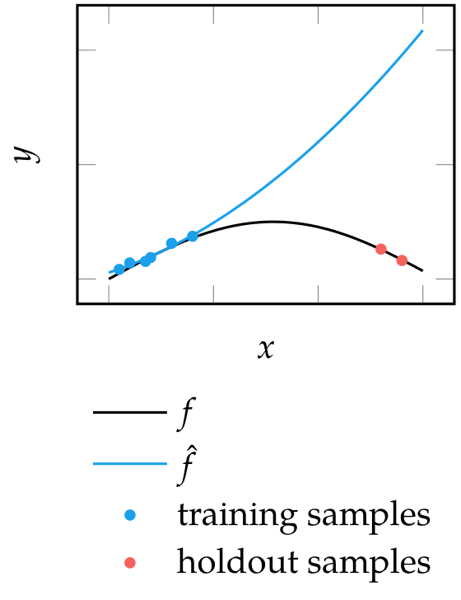
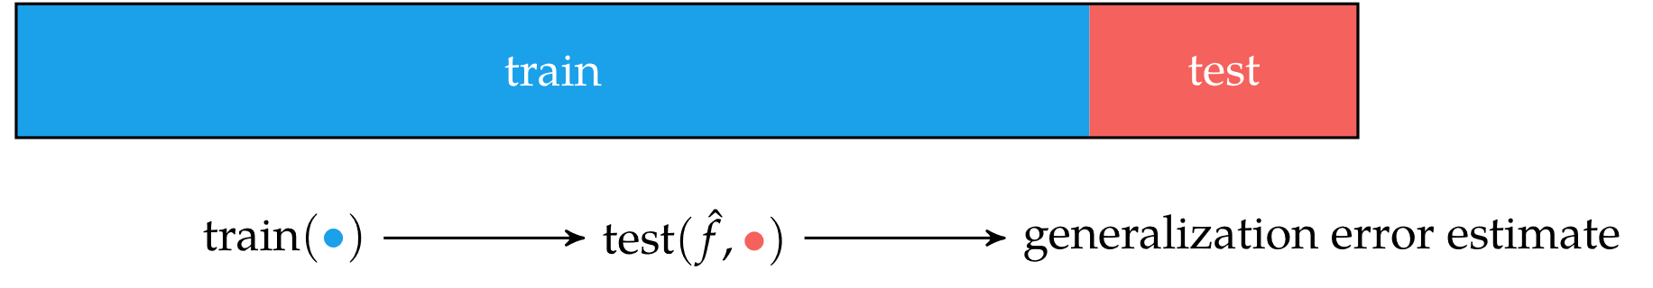
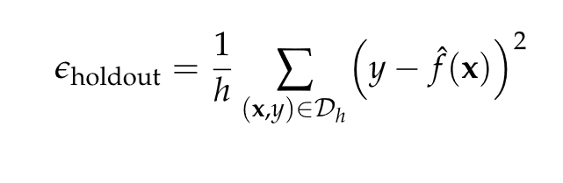
Model Selection: Holdout

Slide 22
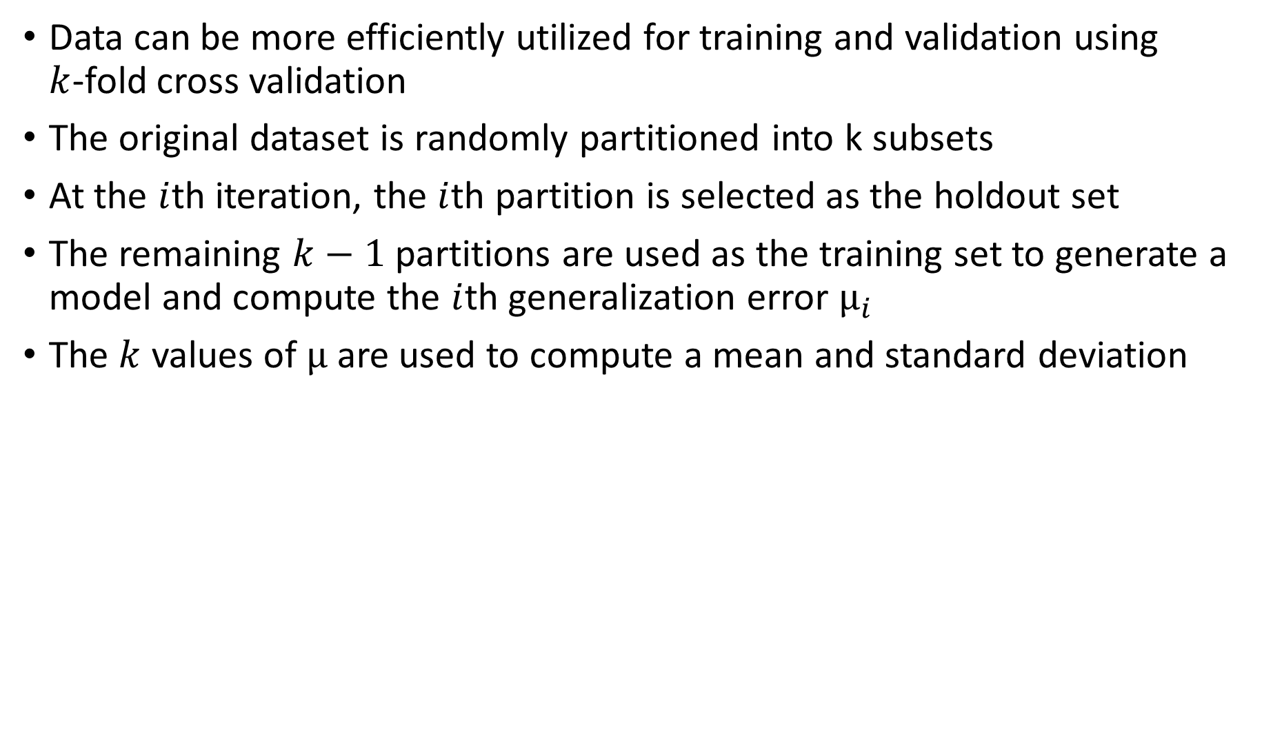
Model Selection: Cross Validation
Data can be more efficiently utilized for training and validation using $k$-fold cross validation
The original dataset is randomly partitioned into k subsets
At the $i$th iteration, the $i$th partition is selected as the holdout set
The remaining $k−1$ partitions are used as the training set to generate a model and compute the $i$th generalization error $μ_{i}$
The $k$ values of $μ$are used to compute a mean and standard deviation

Slide 23
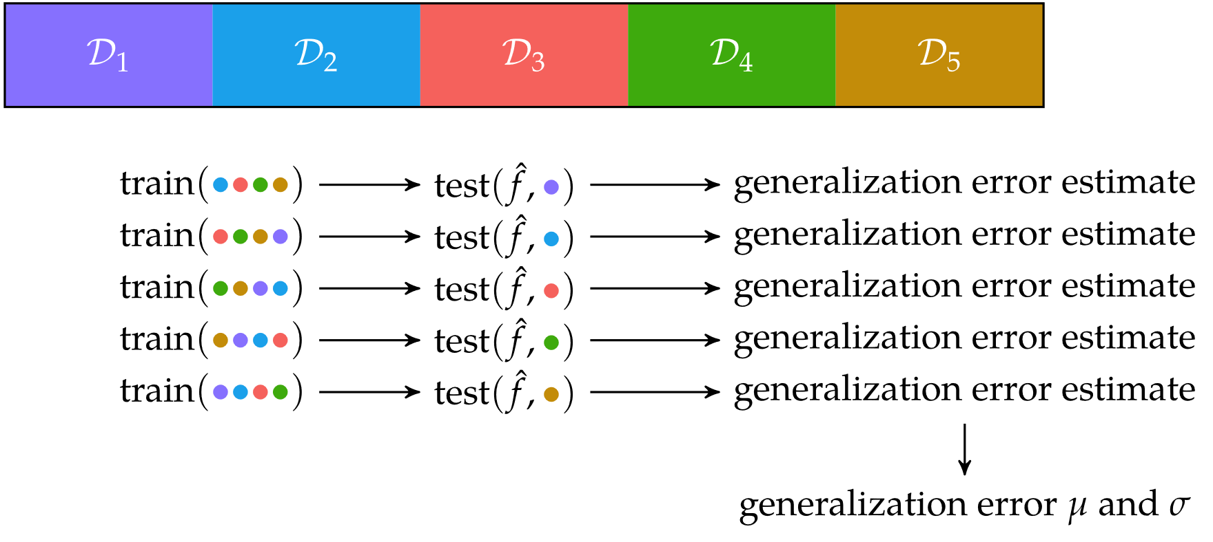
Model Selection: Cross Validation

Slide 24
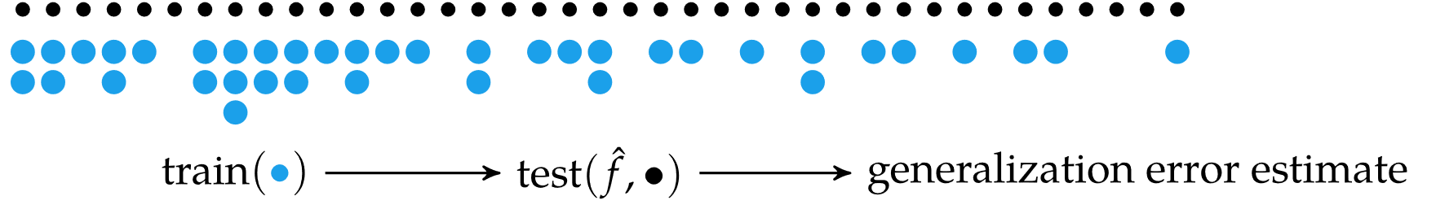

Model Selection: Bootstrap
The bootstrap method averages the generalization error by training on $b$ bootstrap samples evaluated on the entire training set
Each bootstrap sample is generated by randomly selecting $m$ data points with replacement from a dataset of size $m$, meaning some data points can be selected multiple times in the same bootstrap sample

Slide 25
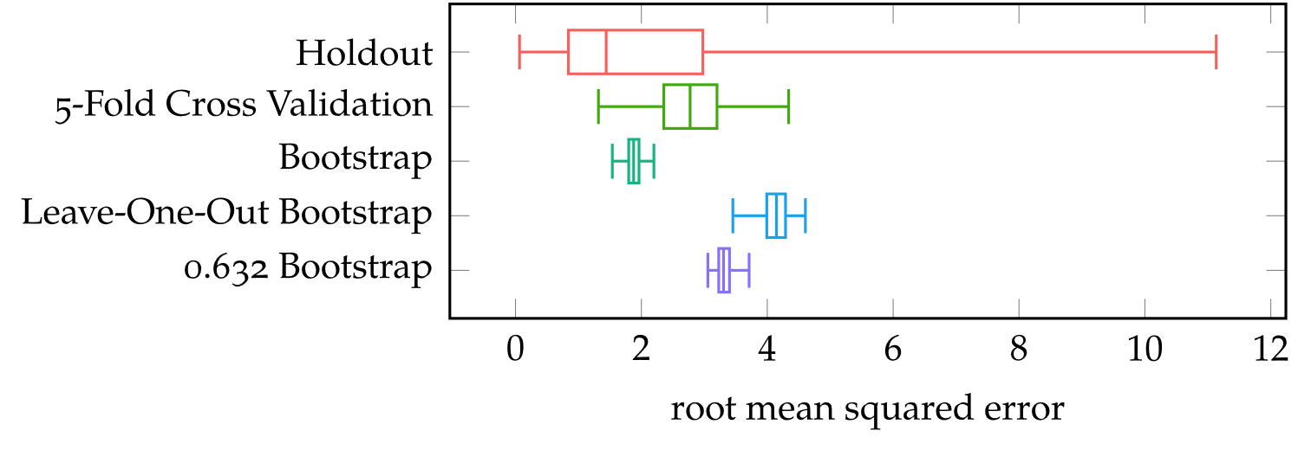
Model Selection: Bootstrap
To remove bias, the leave-one-out bootstrap estimate only computes generalization error using samples not included in a particular bootstrap sample
This introduces a new bias since the test sets have different sizes, so the 0.632 bootstrap estimate normalizes the result to remove this bias

Slide 26
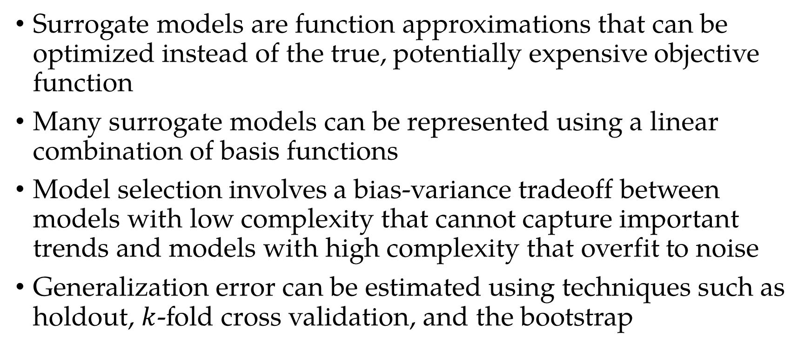
Summary
Surrogate models are function approximations that can be optimized instead of the true, potentially expensive objective function
Many surrogate models can be represented using a linear combination of basis functions
Model selection involves a bias-variance tradeoff between models with low complexity that cannot capture important trends and models with high complexity that overfit to noise
Generalization error can be estimated using techniques such as holdout, $k$-fold cross validation, and the bootstrap

