Slide 1
Probabilistic Surrogate Models

Slide 2
Probabilistic Surrogate Models
It is often useful to quantify confidence in a surrogate model
One approach is to use a probabilistic model that quantifies our confidence
A common probabilistic model is the Gaussian process

Slide 3
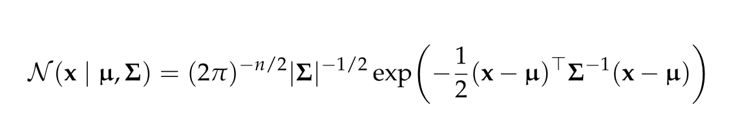
Gaussian Distribution
Also called normal distribution
Univariate Gaussian distribution is parameterized by mean µ and variance σ²
Multivariate Gaussian distribution is parameterized by mean vector µ and covariance matrix ∑
Probability density at x is given by

Slide 4

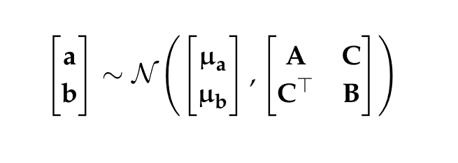

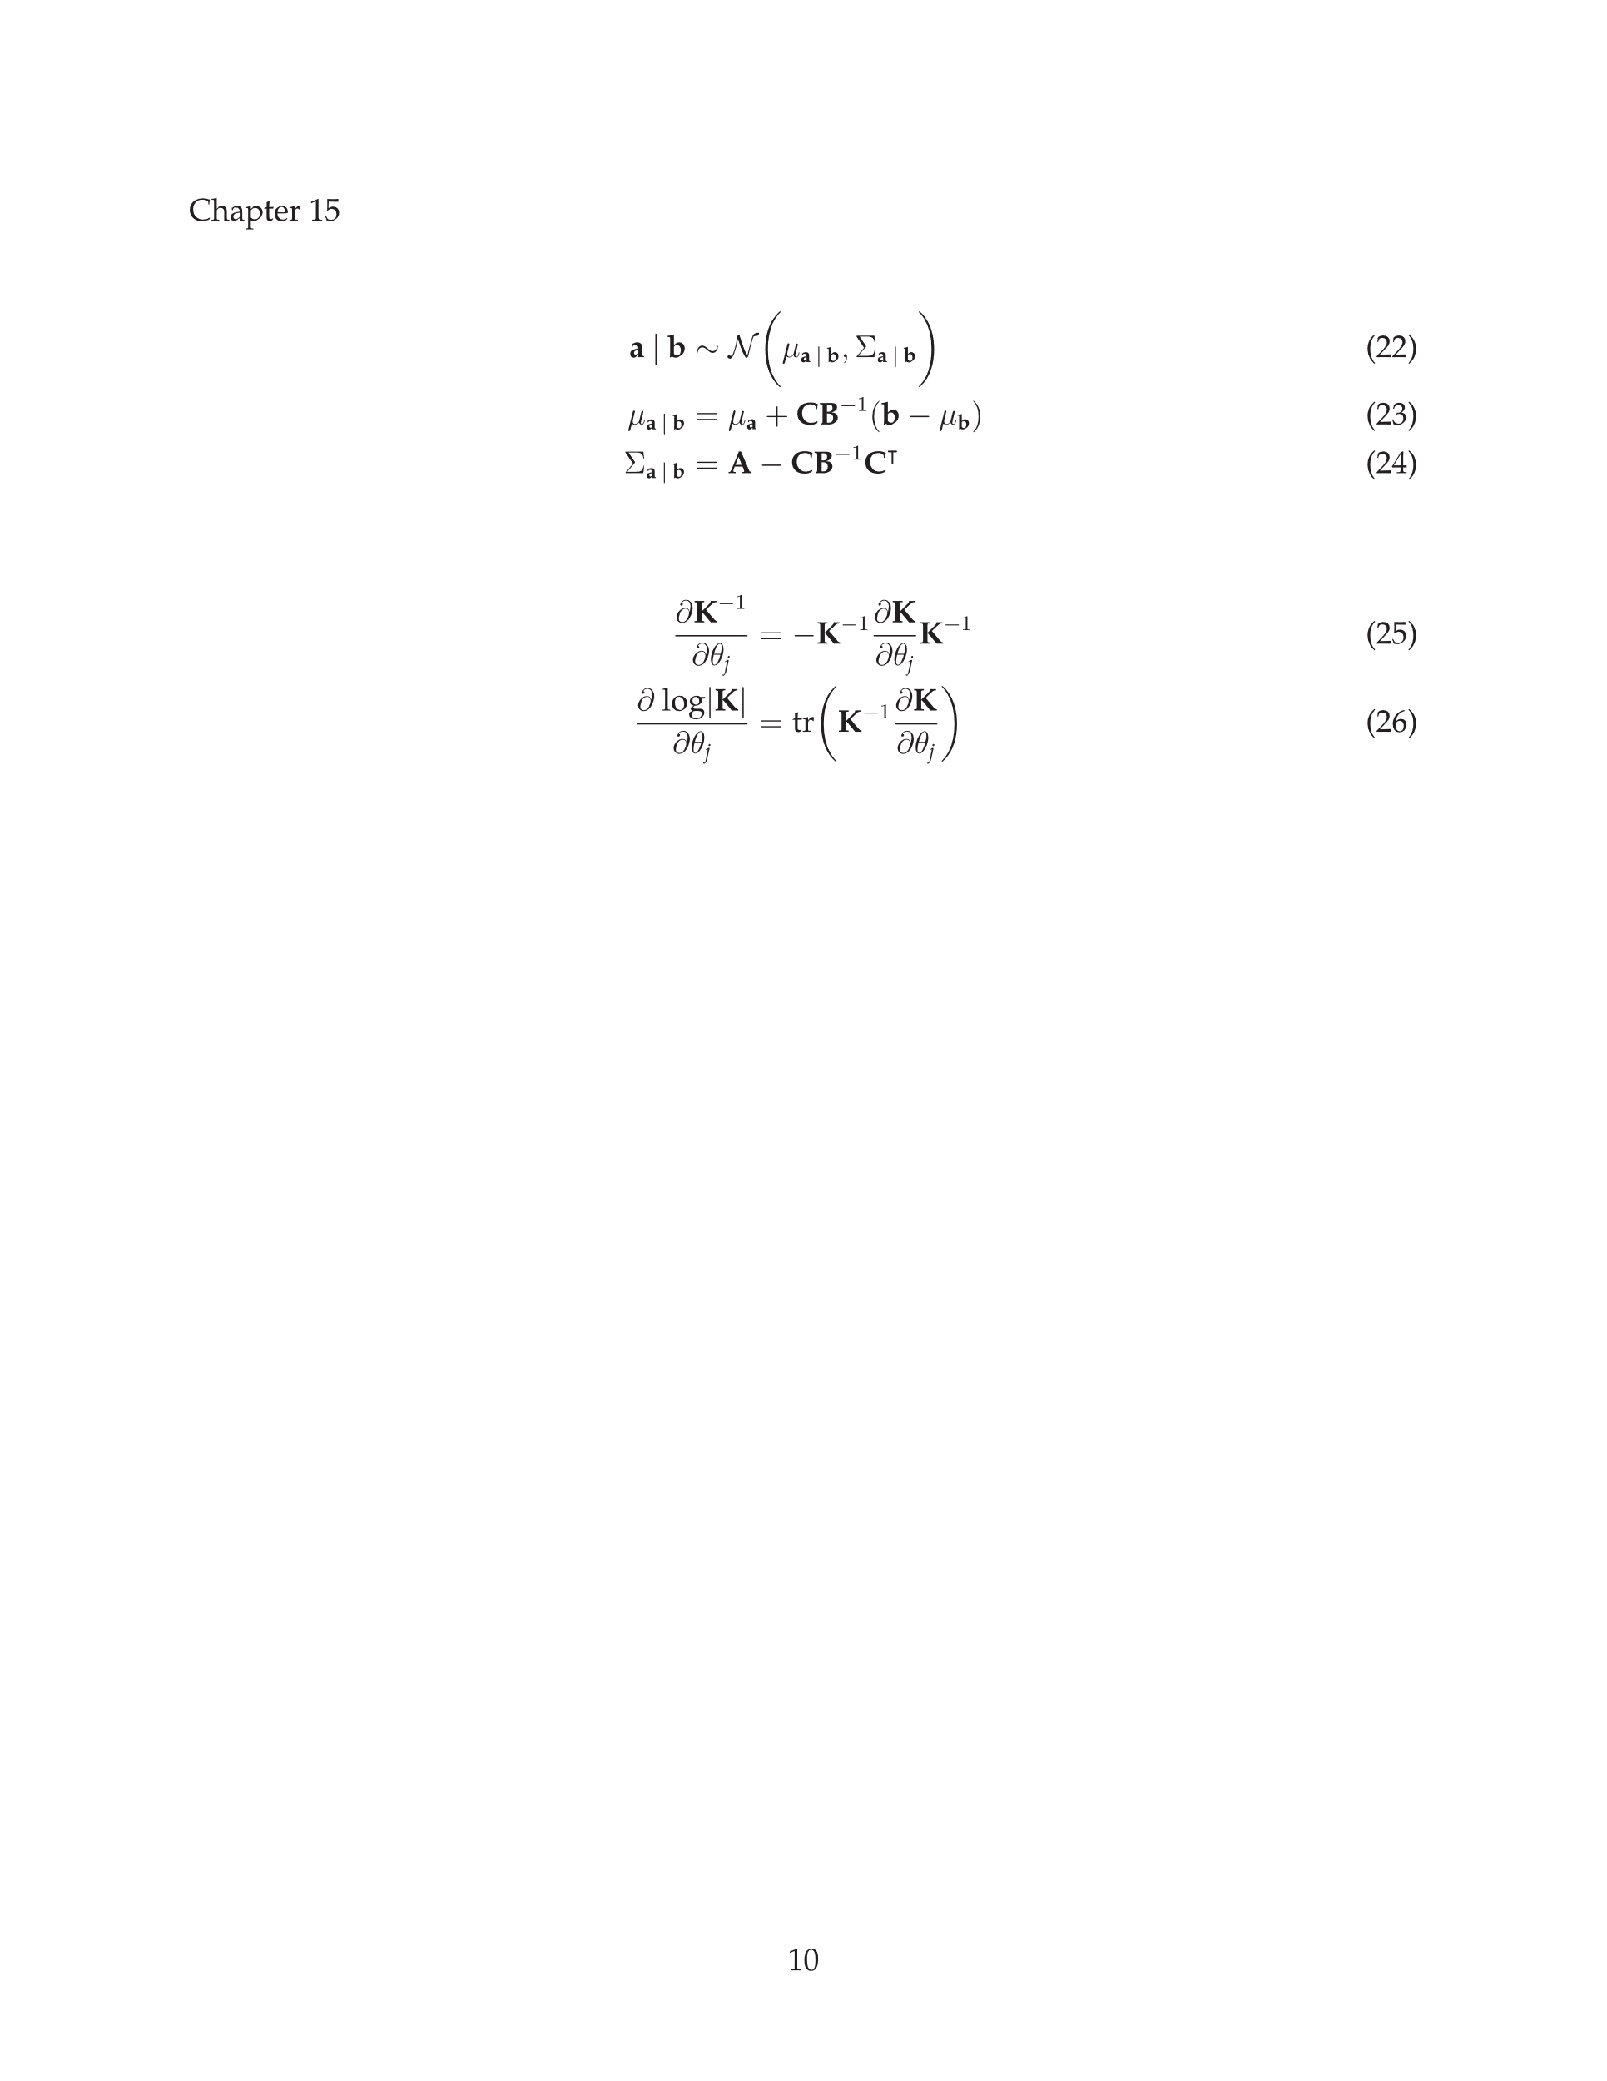
Gaussian Distribution
Sampling a value from a Gaussian is written as
Two jointly Gaussian random variables a and b are written as
Each variable’s marginal distribution is written as
A variable’s conditional distribution is written as

Slide 5
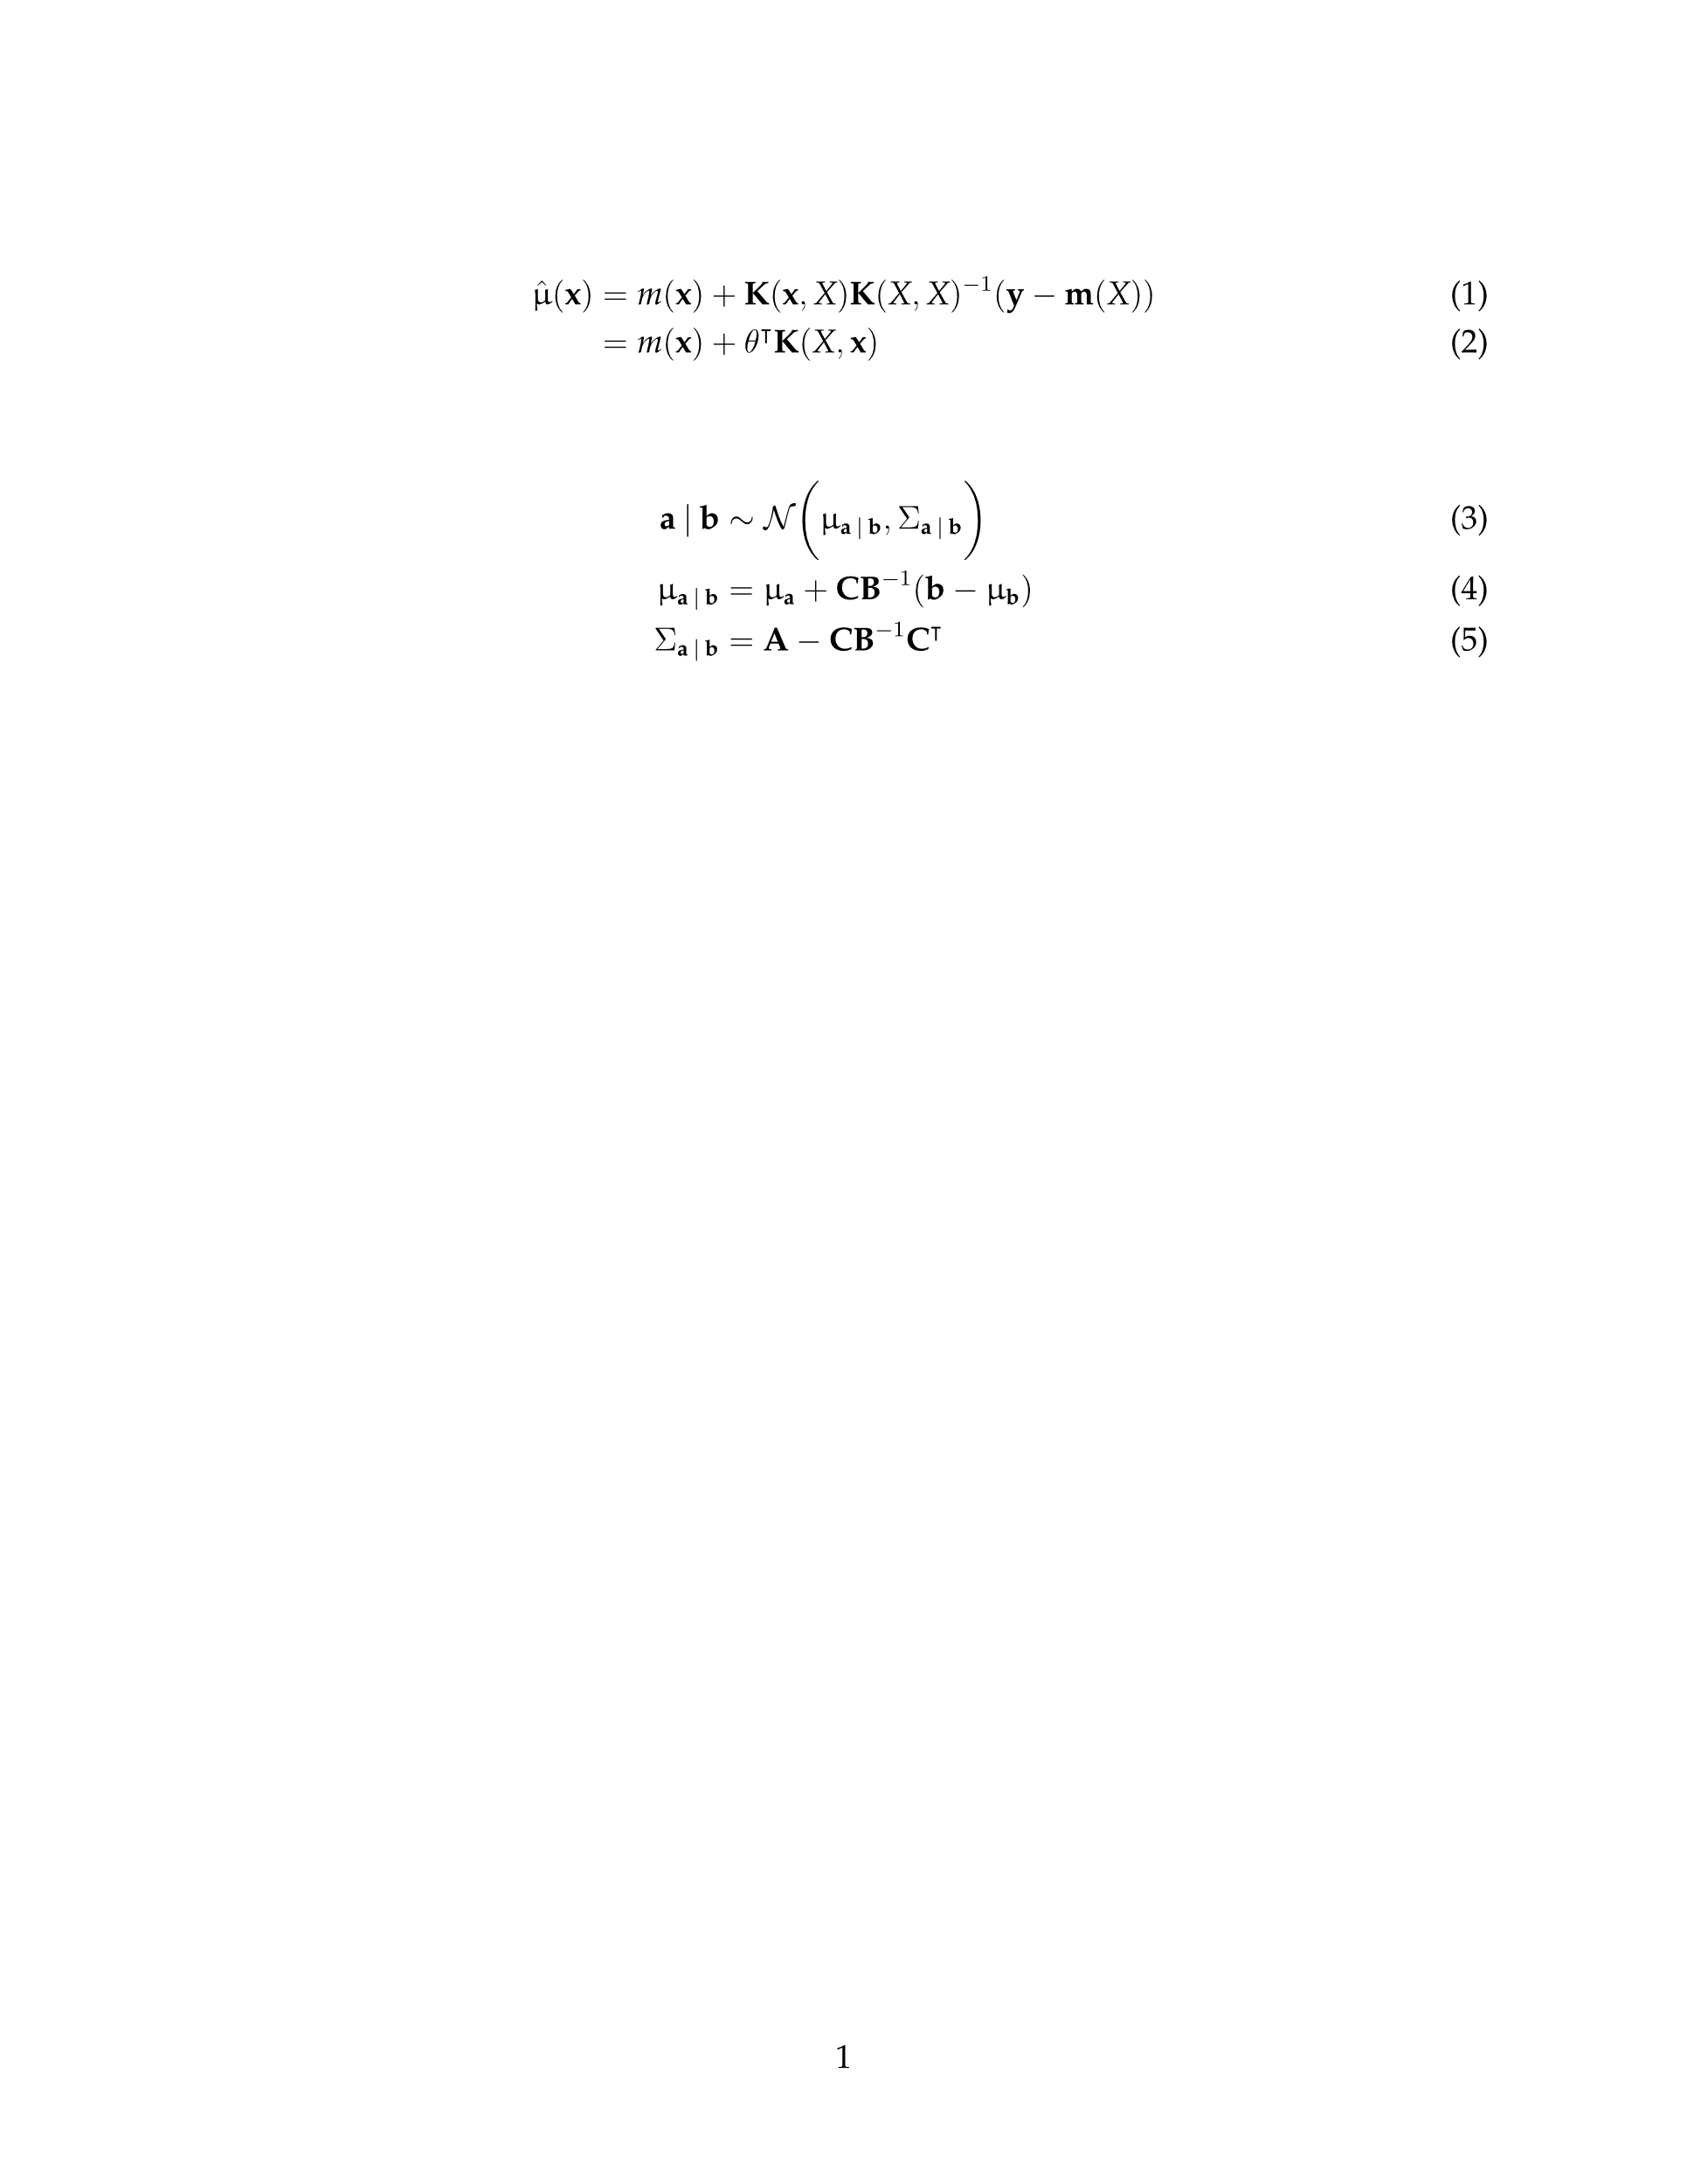
Gaussian Distribution
Given the full set of parameters µ and ∑, the parameters for conditional distributions can be easily computed

Slide 6
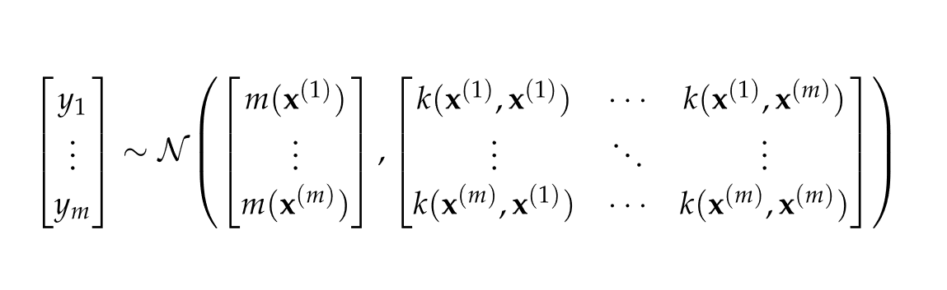
Gaussian Processes
A Gaussian Process extends the idea of Gaussian distributions to functions
For any finite set of points, the distribution over the function evaluations at those points is written as
Here, m(x) is the mean function and k(x, x’) is the covariance function or kernel

Slide 7
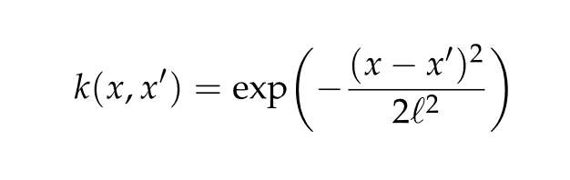
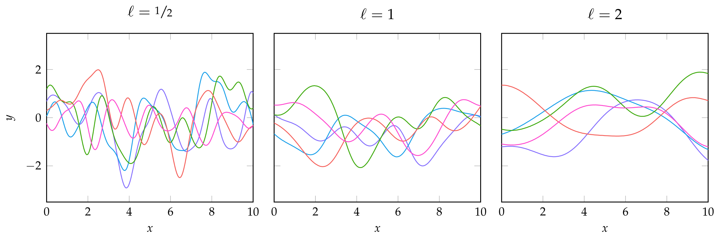
Gaussian Processes
A common kernel function is the squared exponential kernel
where ℓ is the characteristic length-scale, which is the distance required for the function to change significantly

Slide 8
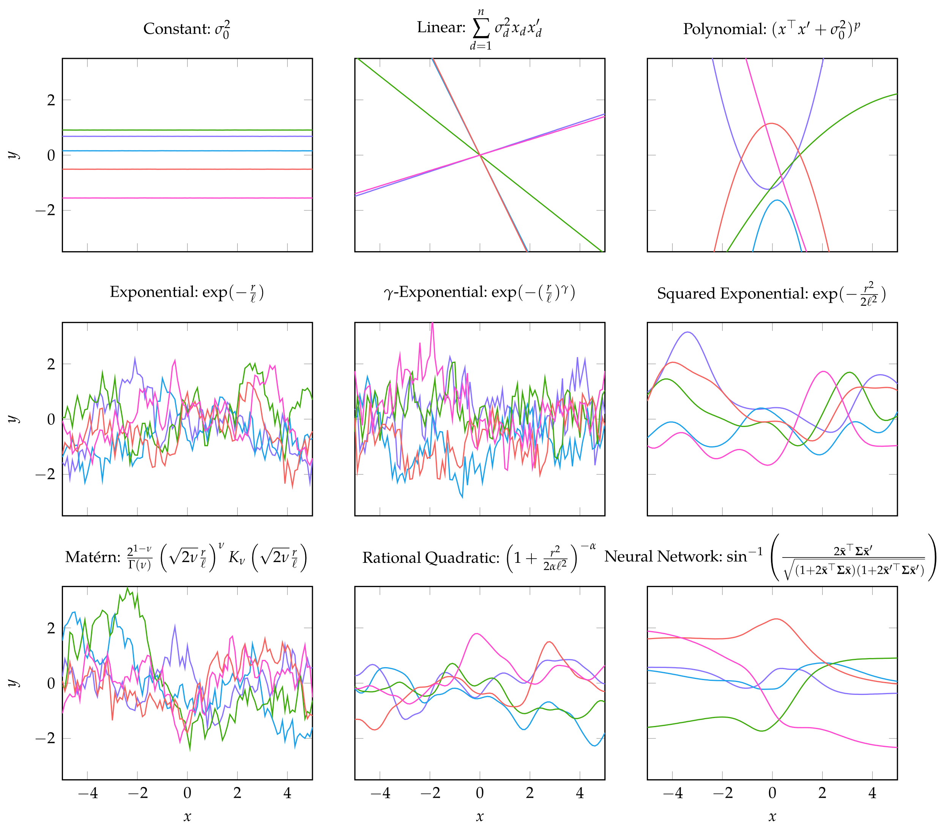
Gaussian Processes
Examples of the same Gaussian process with different kernel functions

Slide 9
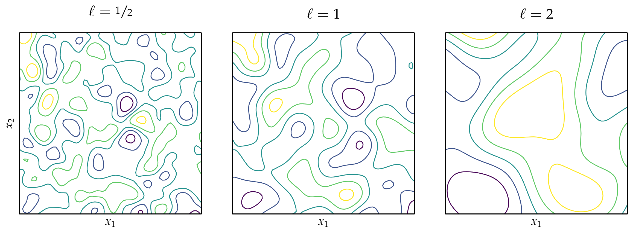
Gaussian Processes
Example of multivariate Gaussian with squared-exponential kernel at different length scales

Slide 10
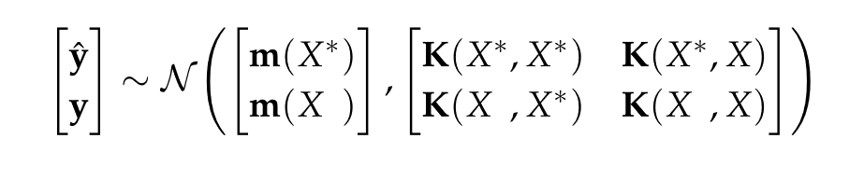
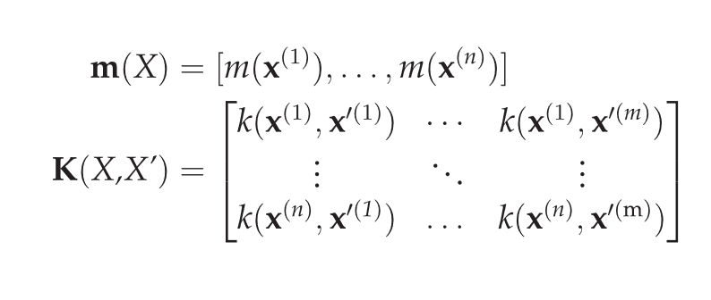

Prediction
Given a set of function evaluations $y$ evaluated at points $x$ and model parameters µ and ∑, a Gaussian process can be used to predict the function evaluations $\hat{y}$ at new points $x^{∗}$. This can be written as where

Slide 11
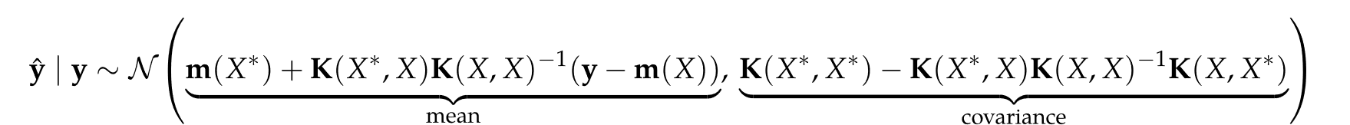


Prediction
The predicted values can be found using the conditional distribution
using the conditional distribution formulas previously presented
The predicted mean and variance of $\hat{y}$ is

Slide 12
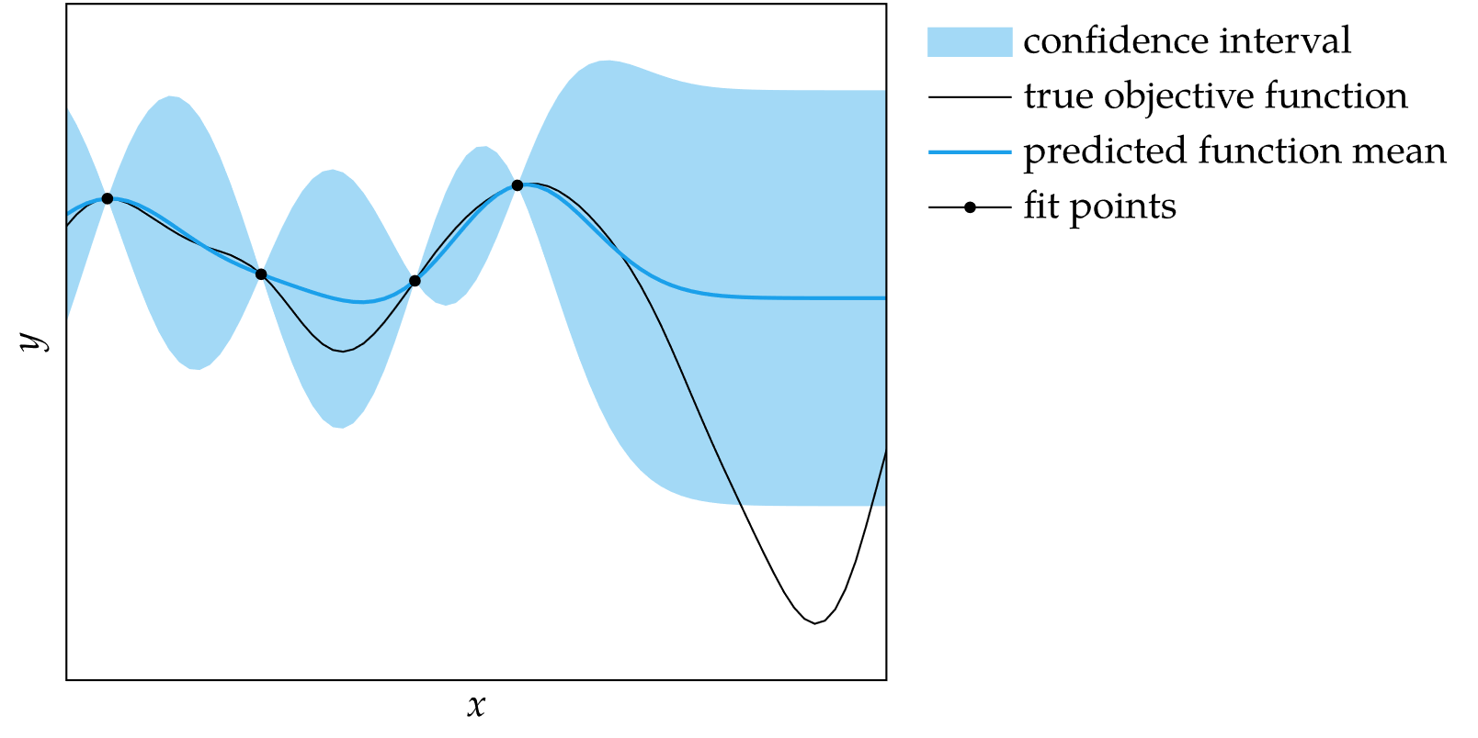
Prediction
Using variance to compute standard deviation, the predicted mean and standard deviation can be computed at any point
This enables calculation of the 95% confidence region

Slide 13
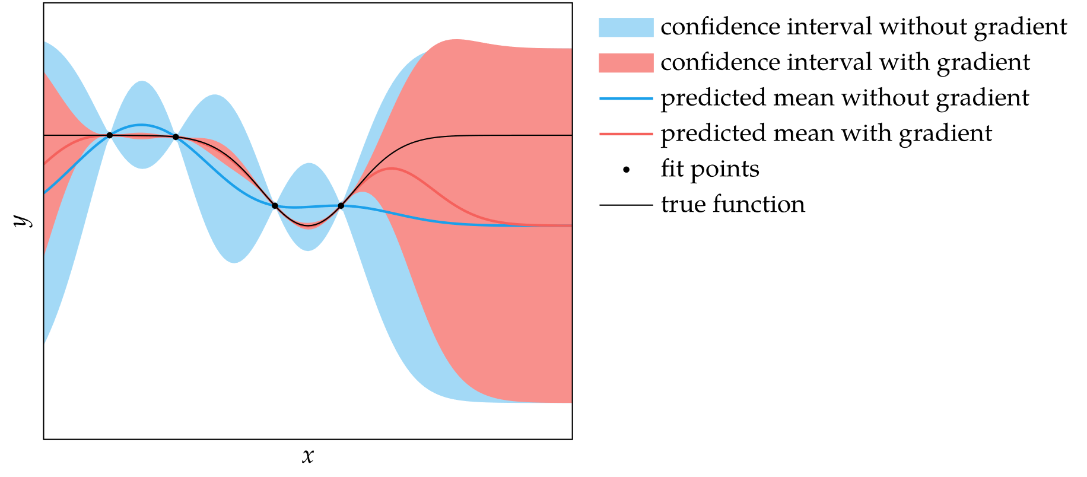
Gradient Measurements
If function gradient evaluations can be made as well, the process can be extended to include gradient predictions for higher prediction fidelity

Slide 14
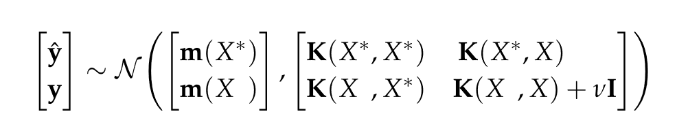
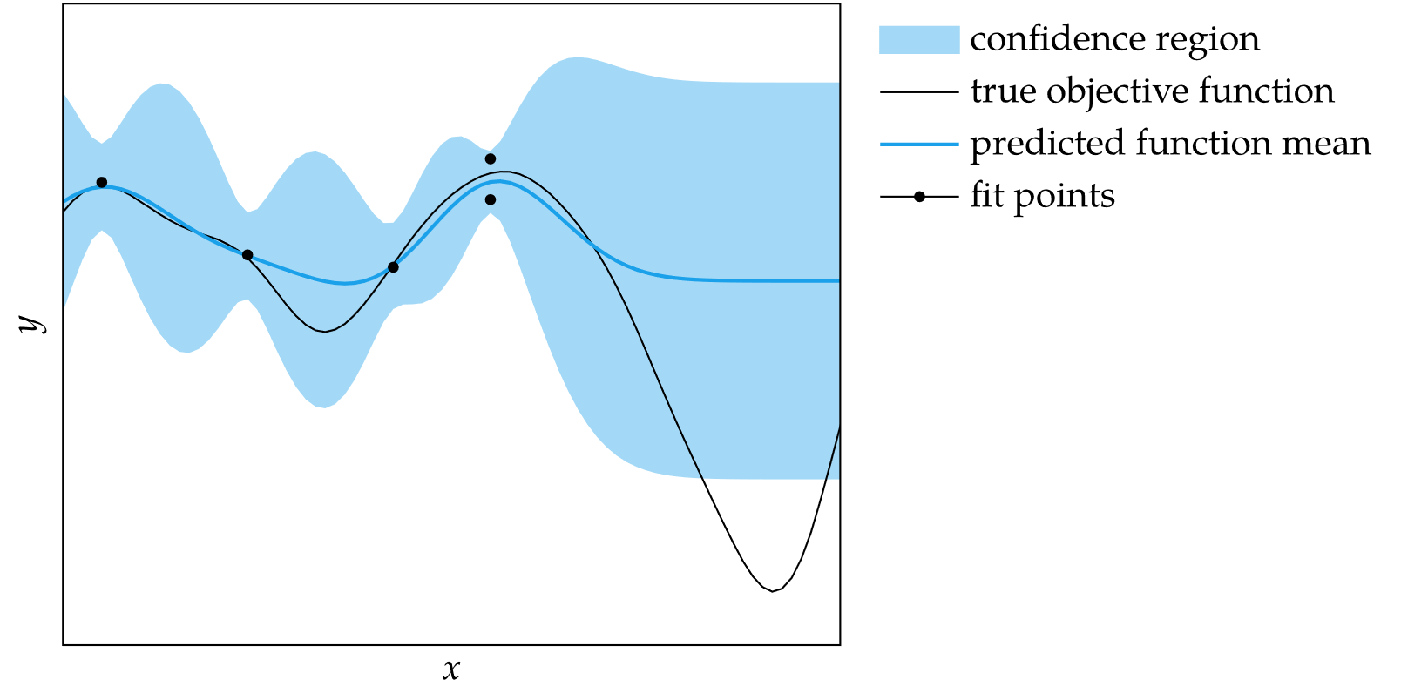
Noisy Measurements
If function evaluations are affected by zero-mean noise, then the joint distribution can be augmented and solved the same way

Slide 15
Fitting Gaussian Processes
The choice of kernel and parameters can be found using cross validation methods
Instead of minimizing squared error, we maximize the likelihood of the data
To avoid working with numbers of greatly disparate orders of magnitude, the log-likelihood is maximized in practice

Slide 16
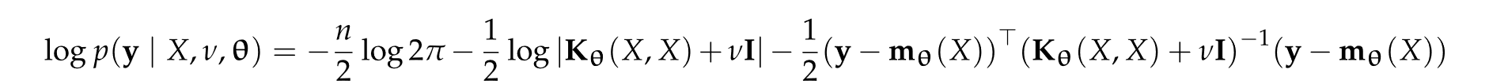
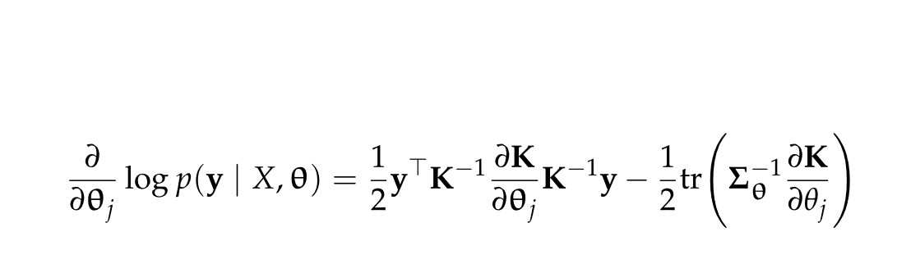
Fitting Gaussian Processes
The log-likelihood formula for a Gaussian process with zero-mean noise
Can be maximized using gradient ascent
Gradient formula for log-likelihood is
where

Slide 17
Summary
Gaussian processes are probability distributions over functions
The choice of kernel affects the smoothness of the functions sampled from a Gaussian process
The multivariate normal distribution has analytic conditional and marginal distributions
We can compute the mean and standard deviation of our prediction of an objective function at a particular design point given a set of past evaluations

Slide 18
Summary
We can incorporate gradient observations to improve our predictions of the objective value and its gradient
We can incorporate measurement noise into a Gaussian process
We can fit the parameters of a Gaussian process using maximum likelihood

