Slide 1
Uncertainty Propagation

Slide 2
Uncertainty Propagation
We have covered how probability distributions can model the inputs to the objective function
This chapter covers how these uncertainties can be propagated to estimate the quantities associated with the output distribution, such as the mean and variance of the objective function

Slide 3
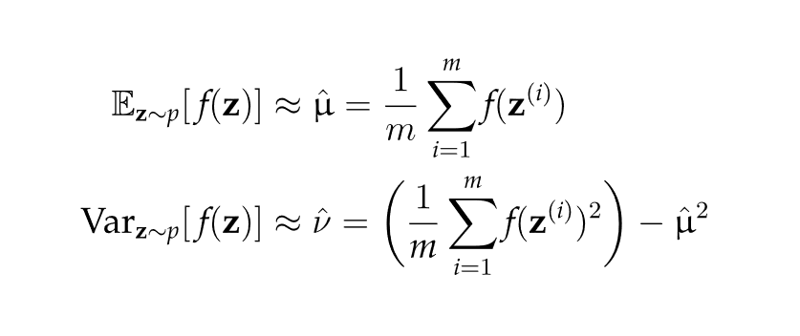
Sampling Methods
If the objective function can be computed as a random variable, then parameters such as its mean and variance can be approximated by Monte Carlo integration
Does not require any prior knowledge of p
May require many samples to compute mean and variance

Slide 4
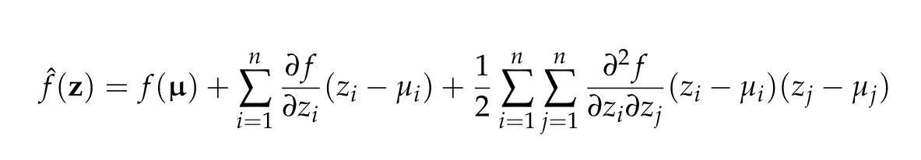

Taylor Approximation
Estimate mean and variance by Taylor series approximation of f at a fixed design point x.
For uncorrelated components of z, if the mean of the distribution over z is µ and the variances of the individual components of z are ν, then the second-order Taylor series approximation of f(z) at z = µ is
Neglecting higher-order terms, the mean and variance are

Slide 5

Polynomial Chaos
A polynomial is fit to evaluations of f(z) and the resulting surrogate model is used to compute the mean and variance
Univariate case
Very computationally efficient to compute mean and variance
Coefficients can be fit using linear regression

Slide 6
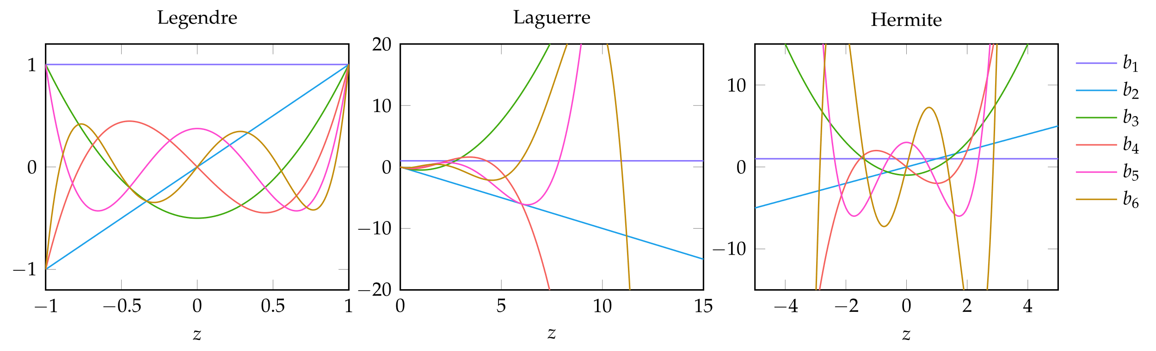
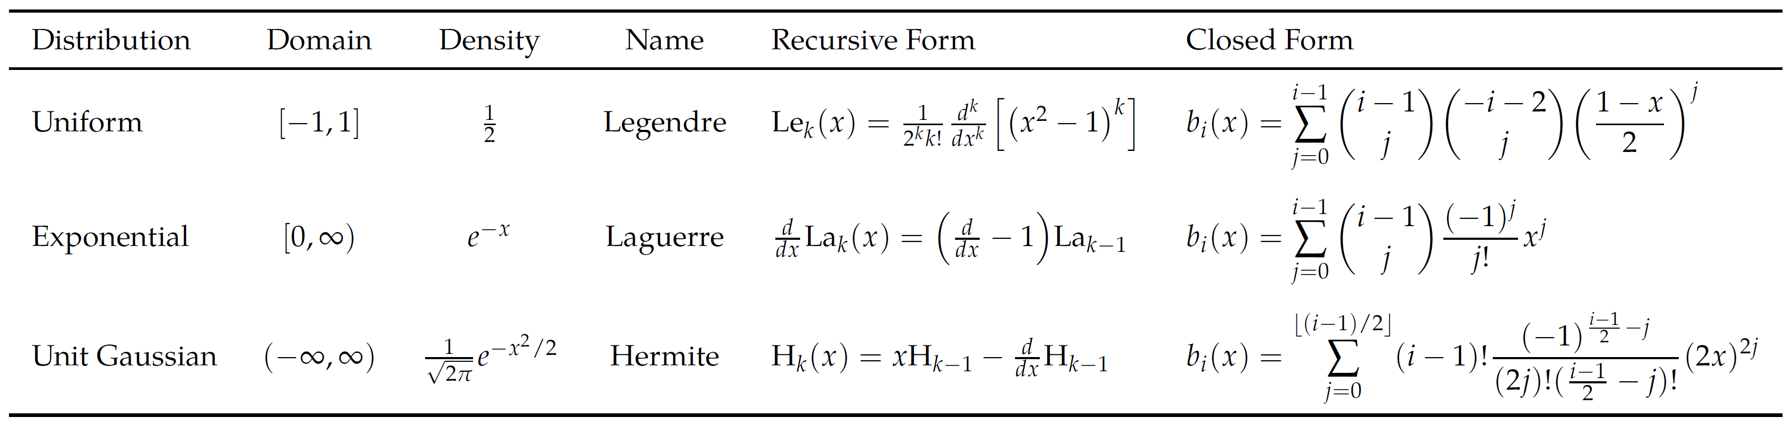
Polynomial Chaos

Slide 7
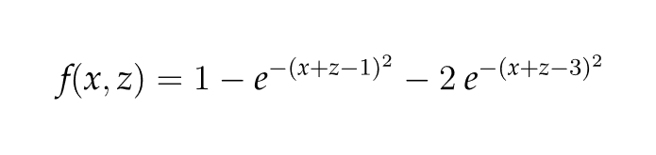
Polynomial Chaos
Consider optimizing the (unknown) objective function
with z drawn from zero-mean unit-Gaussian distribution.
The estimated expected value can be computed using third-order Hermite polynomials

Slide 8
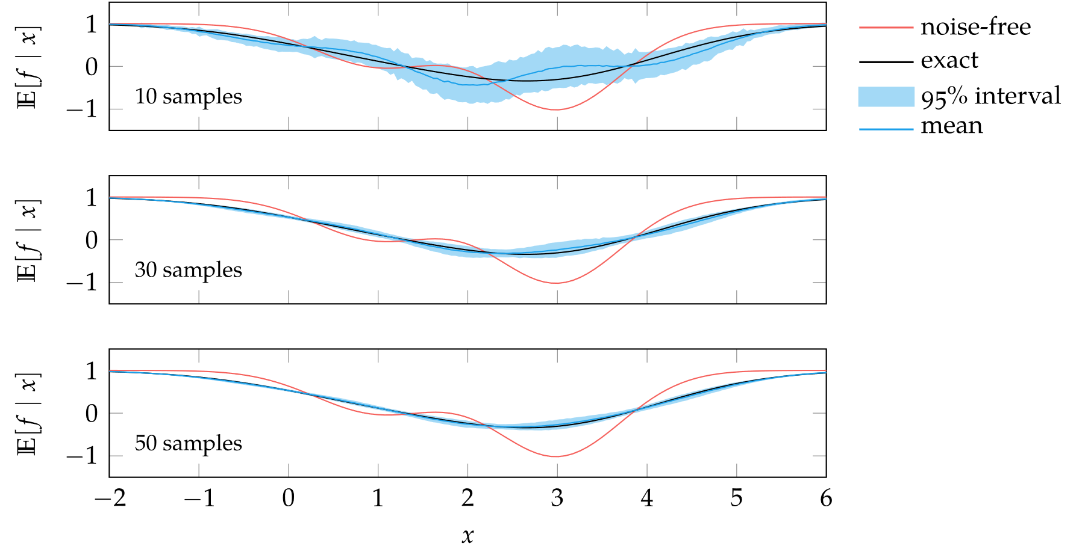
Polynomial Chaos

Slide 9
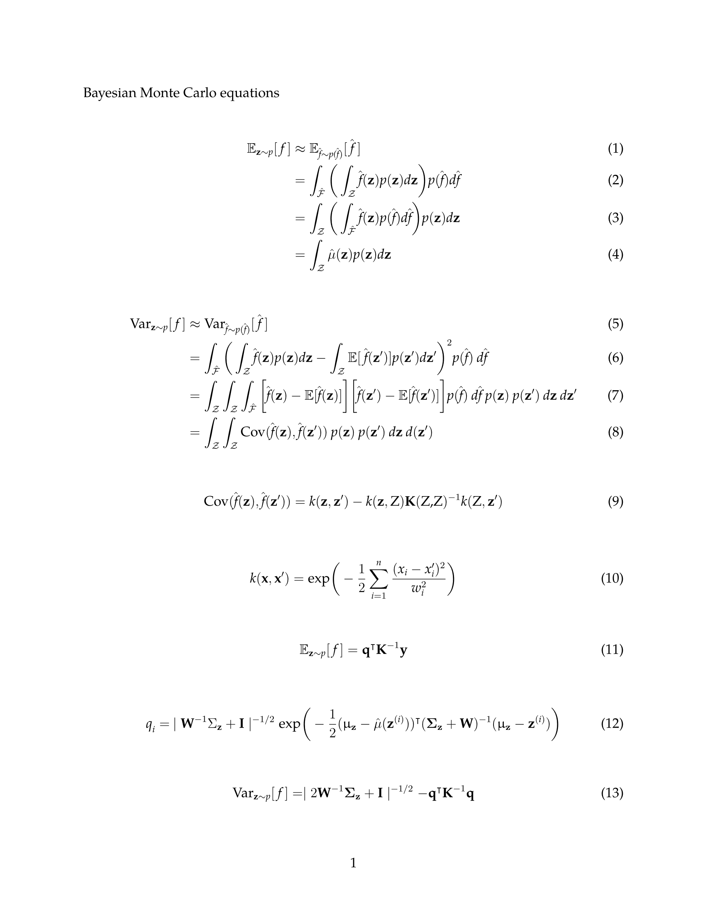
Bayesian Monte Carlo
Idea is to fit a Gaussian process to samples

Slide 10
Bayesian Monte Carlo
Now considering the variance
where

Slide 11
Summary
The expected value and variance of the objective function are useful when optimizing problems involving uncertainty, but computing these quantities reliably can be challenging.
One of the simplest approaches is to estimate the moments using sampling in a process known as Monte Carlo integration.
Other approaches, such as the Taylor approximation, use knowledge of the objective function’s partial derivatives.
Polynomial chaos is a powerful uncertainty propagation technique based on orthogonal polynomials.
Bayesian Monte Carlo uses Gaussian processes to efficiently arrive at the moments with analytic results for Gaussian kernels.

