Slide 1
Discrete Optimization

Slide 2
Outline
What is discrete optimization?
Problem formulation for linear programs
Approximate solution techniques
Exaction solution techniques
Dynamic programming
Ant-Colony optimization

Slide 3
Discrete Optimization
Solving problems with variables that are discrete instead of continuous
Examples?
The set of possible discrete values can be finite or infinite

Slide 4
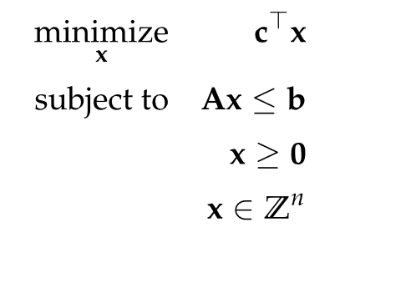
Integer Programs
A linear program with integral constraints
A mixed integer program contains both continuous and integral constraints
Can be solved exactly with the simplex algorithm under strict conditions on A, b, and c

Slide 5
Rounding
A common approach is to relax the discrete value constraint, solve the problem in the continuous domain, then round the continuous result to the nearest discrete value
Known as solving the "relaxed" LP

Slide 6
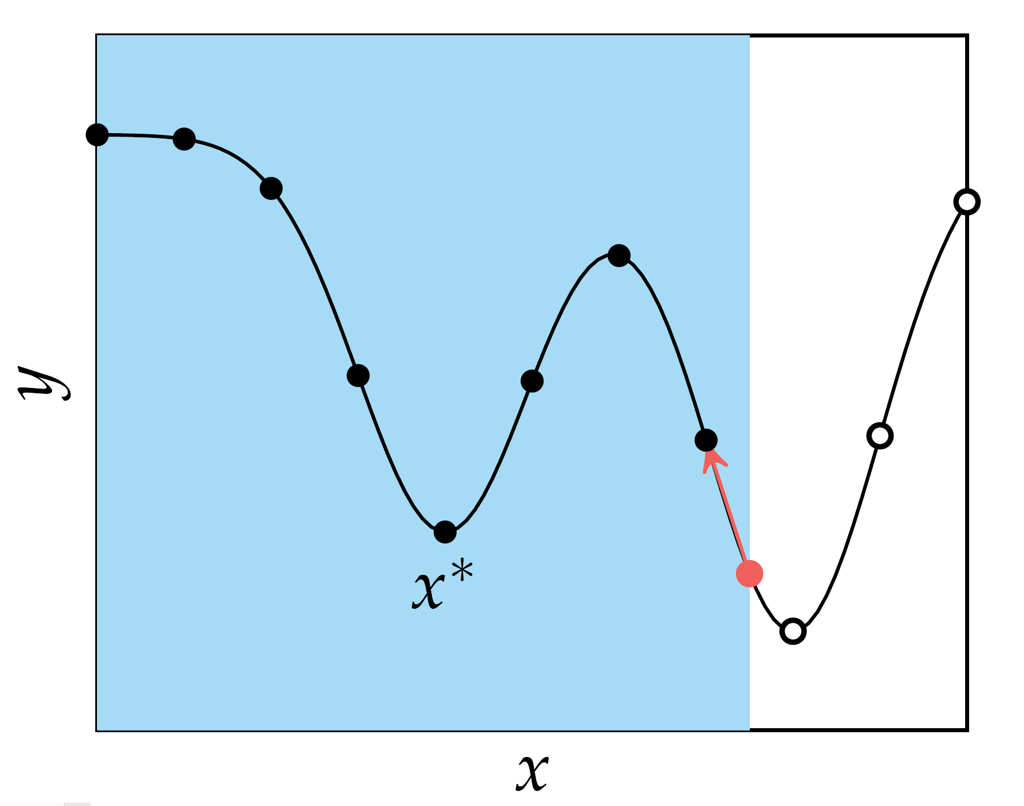
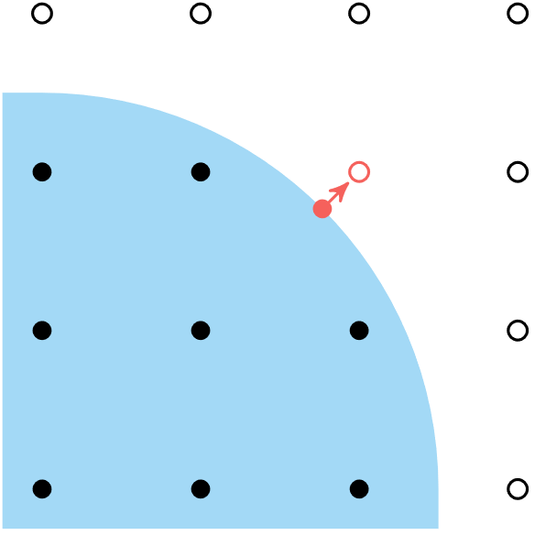
Rounding
Rounding to infeasible point
Rounding to suboptimal point
If A is integral, the error of a rounded solution can be bounded

Slide 7
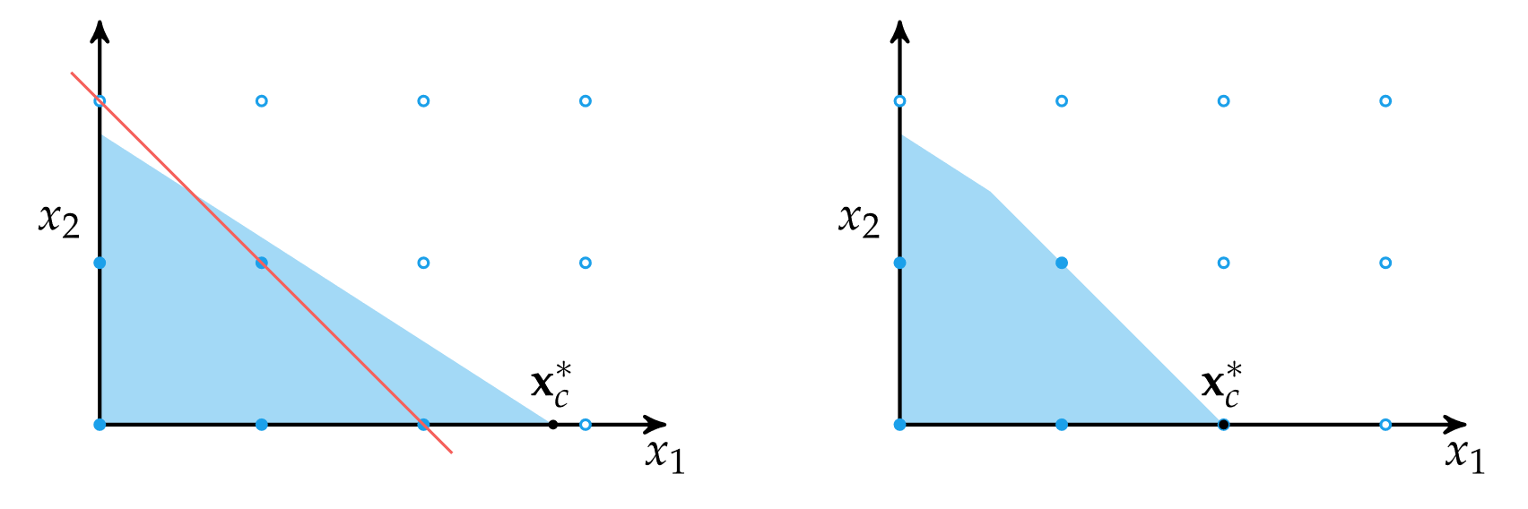
Cutting Planes
The cutting plane method solves the relaxed LP, adds linear constraints, then repeats until the solution is exact
Solves mixed integer programs exactly
The linear constraints are chosen such that all discrete points are still feasible, but the relaxed solution is not

Slide 8



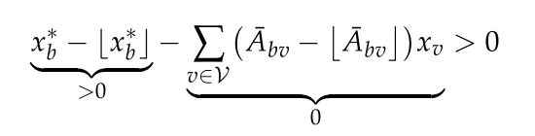
Cutting Planes
Recall that we can partition a vertex as
Using the method of Gomory's cut, we can add an additional inequality constraint for each nonintegral dimension
This "cuts out" the relaxed solution
with

Slide 9
Branch and Bound
Algorithm for efficiently searching the very large set of solution possibilities
“Branching” is dividing the domain into sections
“Bounding” is keeping track of the best solution so far and rejecting regions that cannot improve upon it
In the worst case, the algorithm has to search all possibilities but in practice it works very well. Combined with cutting planes, this approach forms the basis of many commercial MIP solvers.

Slide 10
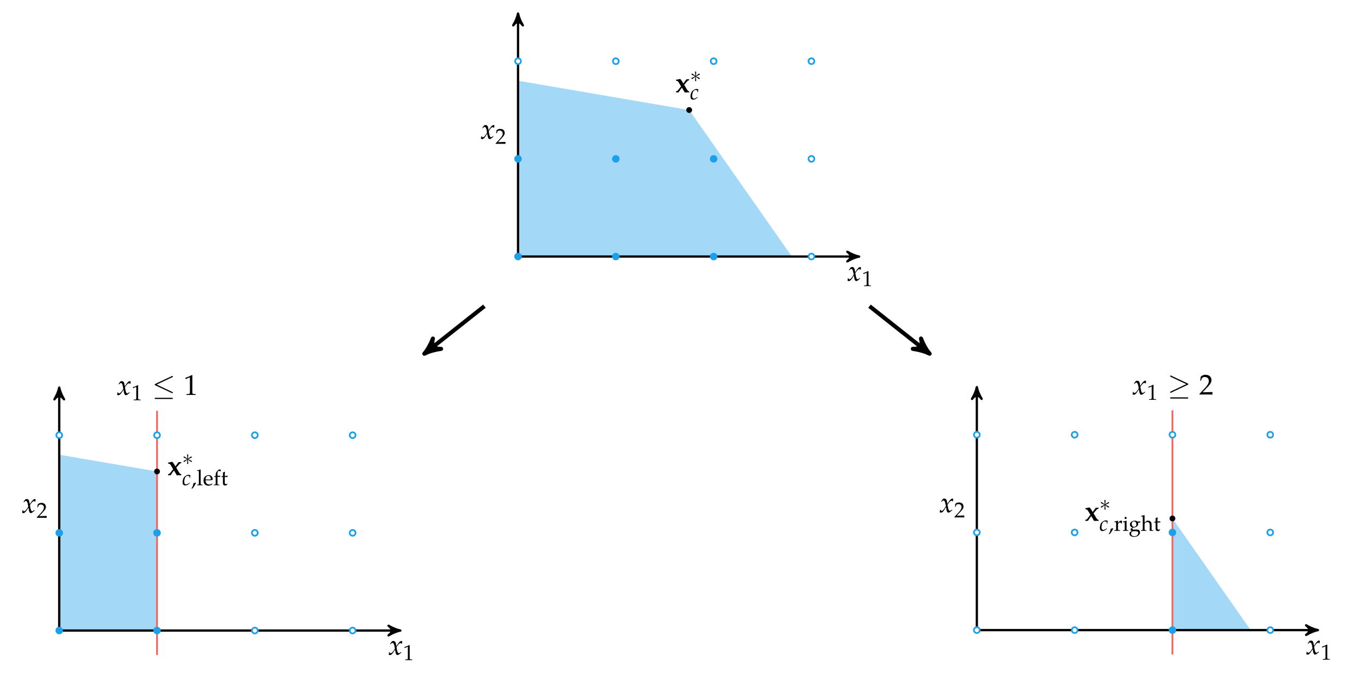

Branching

Slide 11
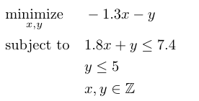
Bounding

Slide 12








Bounding
LP-1
LP-2
LP-3
Infeasible
LP-4
LP-5

Slide 13
Dynamic Programming
Applied to problems with optimal substructure and overlapping subproblems
Optimal substructure means an optimal solution can be constructed from optimal solutions to its subproblems
Overlapping subproblems means solving each subproblem separately requires repeating certain operations
Dynamic programming begins with desired problem and recurses down to smaller and smaller subproblems, retrieving the value of previously solved problems as necessary

Slide 14
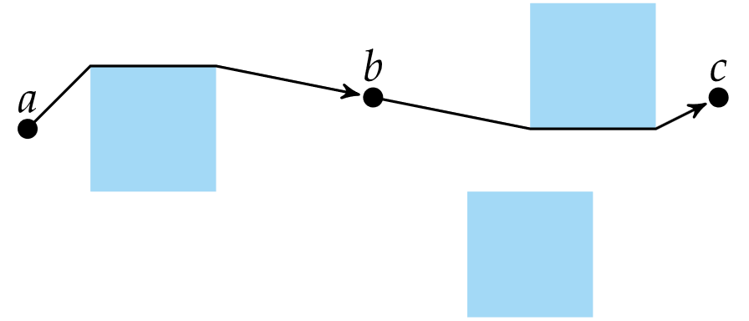
Dynamic Programming
Example – Optimal path
Others?

Slide 15
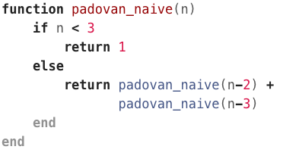
Example 1: Padovan Sequence

Slide 16
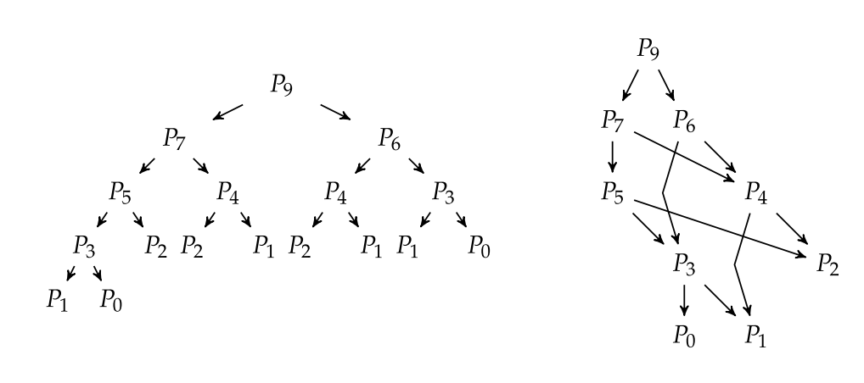
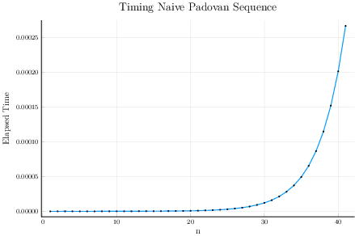
Example 1: Padovan Sequence

Slide 17
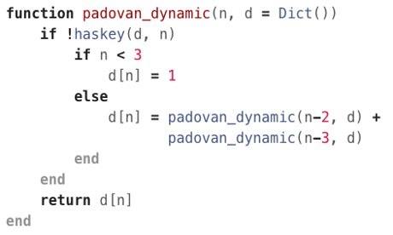
Example 1: Padovan Sequence

Slide 18





Example 2: Knapsack Problem
Trying to pack some number of items into a backpack
Limited space in the backpack
Each item has a specified value and size
What is the best subset of items to include?

Slide 19
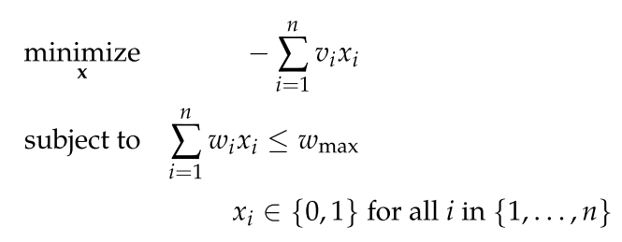
Example 2: Knapsack Problem

Slide 20


Example 2: Knapsack Problem
Consider the ith item. You can either use it or not.
If you use it, then the value of your knapsack will be
If you don't use it then the value of your knapsack will be

Slide 21
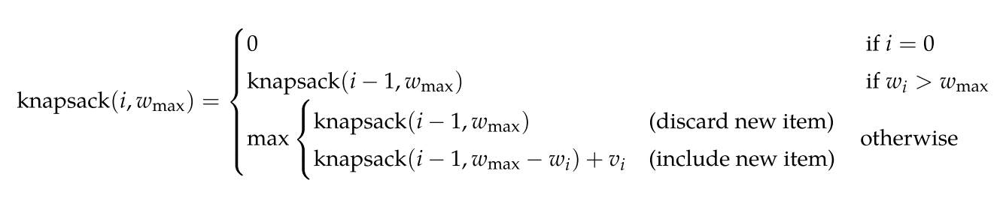
Example 2: Knapsack Problem

Slide 22
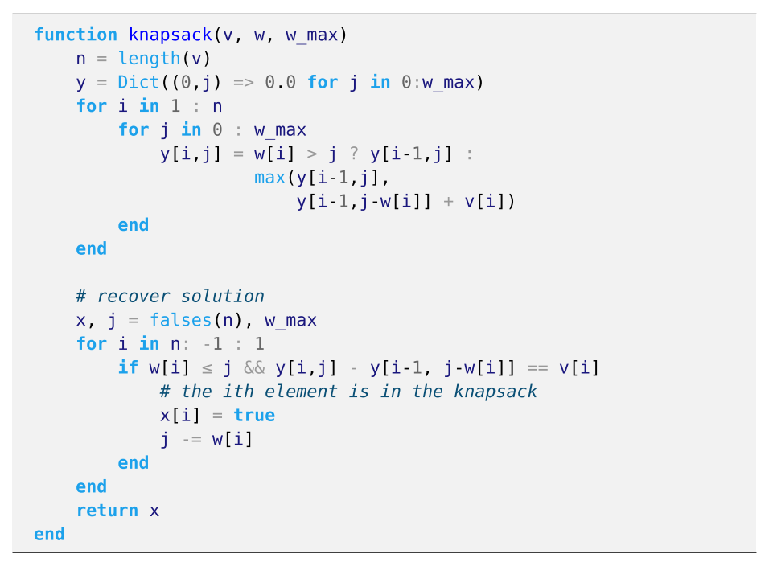
Example 2: Knapsack Problem

Slide 23
Ant Colony Optimization
A stochastic method for optimizing paths through graphs
Named after ant behavior of leaving pheromone trails
If a wandering ant successfully arrives at the destination, their pheromone gets added to the path they took
Successful paths are reinforced, while unpopular trails fade over time
When expressed mathematically, ant colony optimization has been used to find near-optimal solutions to hard problems such as the traveling salesman problem

Slide 24

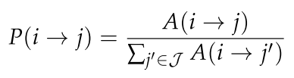
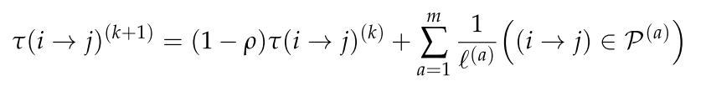
Ant Colony Optimization
Edge attractiveness
Probability of edge transition
Ants deposit pheromones after finding a successful path. The amount of pheromone deposited depends on value of path found

Slide 25
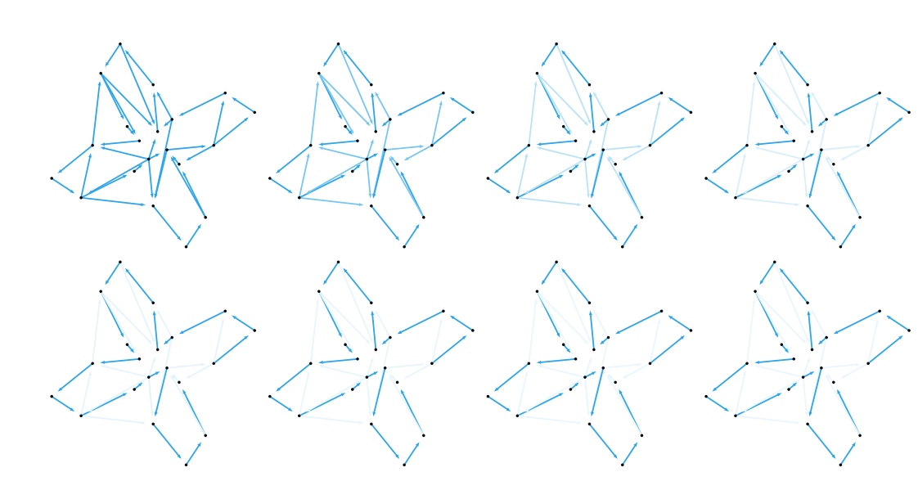
Ant Colony Optimization

Slide 26
Summary
Discrete optimization problems require that the design variables be chosen from discrete sets.
Relaxation, in which the continuous version of the discrete problem is solved, is by itself an unreliable technique for finding an optimal discrete solution but is central to more sophisticated algorithms.
Many combinatorial optimization problems can be framed as an integer program, which is a linear program with integer constraints.

Slide 27
Summary
Both the cutting plane and branch and bound methods can be used to solve integer programs efficiently and exactly. The branch and bound method is quite general and can be applied to a wide variety of discrete optimization problems.
Dynamic programming is a powerful technique that exploits optimal overlapping substructure in some problems.
Ant colony optimization is a nature-inspired algorithm that can be used for optimizing paths in graphs.

