Slide 1
Derivatives and Gradients

Slide 2
Derivatives
Derivatives tell us which direction to search for a solution

Slide 3
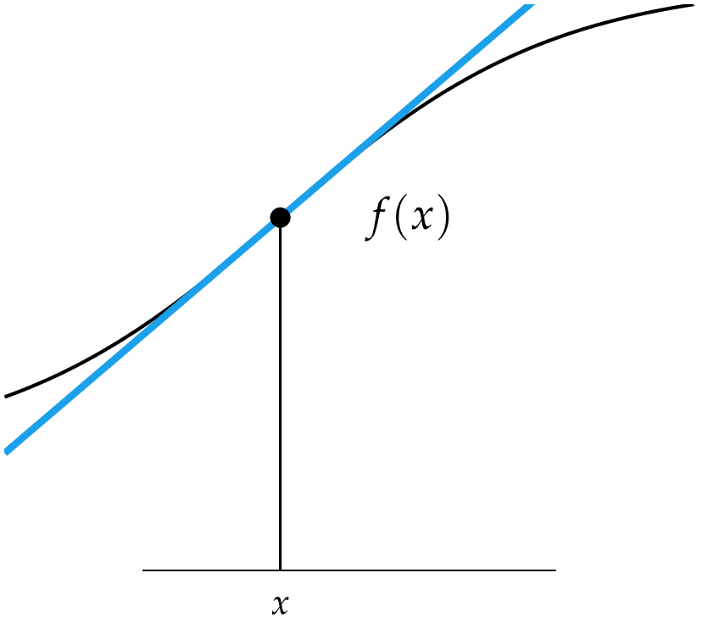
Derivatives
Slope of Tangent Line

Slide 4
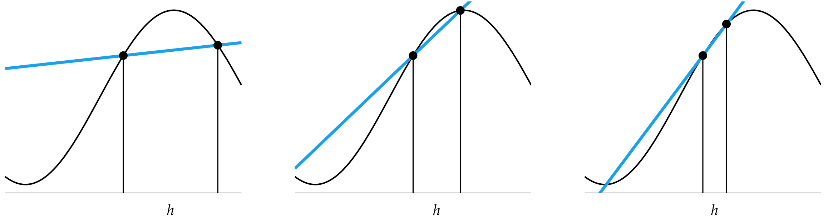
Derivatives

Slide 5
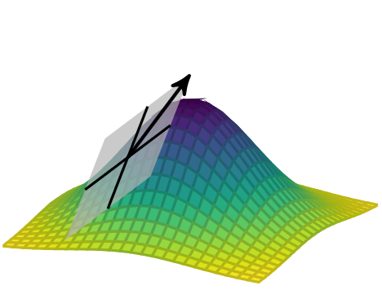

Derivatives in Multiple Dimensions
Gradient Vector
Hessian Matrix

Slide 6

Derivatives in Multiple Dimensions
Directional Derivative

Slide 7
Numerical Differentiation
Finite Difference Methods
Complex Step Method

Slide 8
Numerical Differentiation: Finite Difference
Derivation from Taylor series expansion

Slide 9
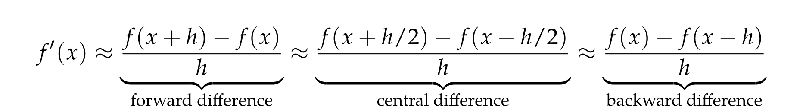
Numerical Differentiation: Finite Difference
Neighboring points are used to approximate the derivative
h too small causes numerical cancellation errors

Slide 10
Numerical Differentiation: Finite Difference
Error Analysis
Forward Difference: O(h)
Central Difference: O(h²)

Slide 11
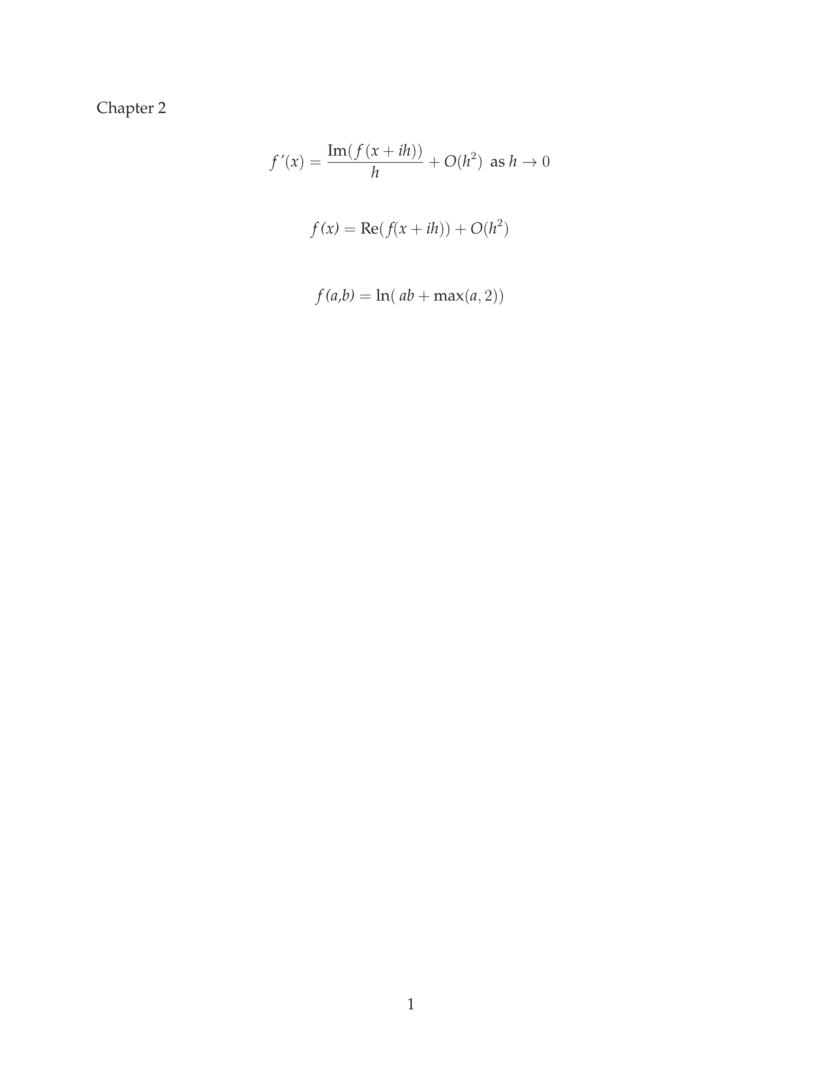
Numerical Differentiation: Complex Step
Taylor series expansion using imaginary step

Slide 12
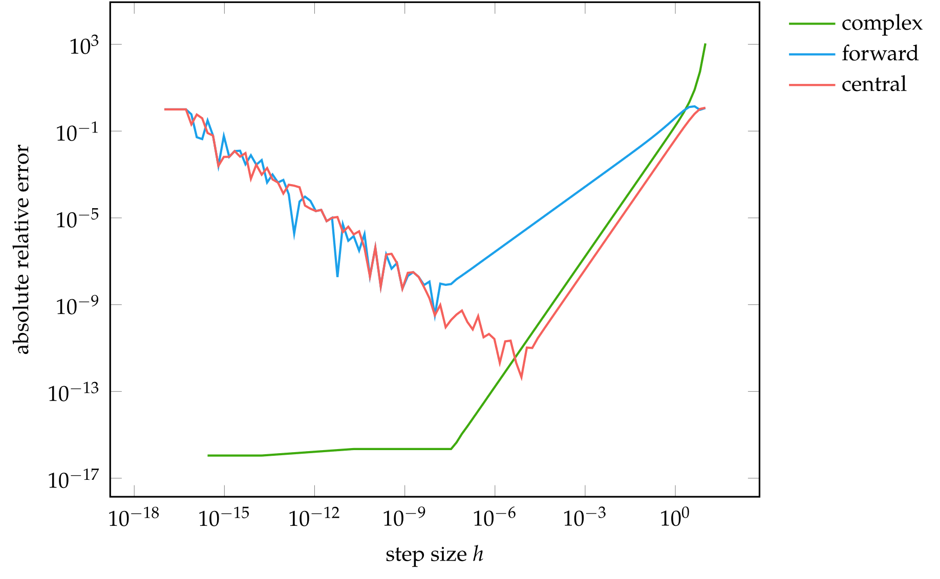
Numerical Differentiation Error Comparison

Slide 13
Automatic Differentiation
Evaluate a function and compute partial derivatives simultaneously using the chain rule of differentiation

Slide 14
Automatic Differentiation
Forward Accumulation is equivalent to expanding a function using the chain rule and computing the derivatives inside-out
Requires n-passes to compute n-dimensional gradient
Example

Slide 15
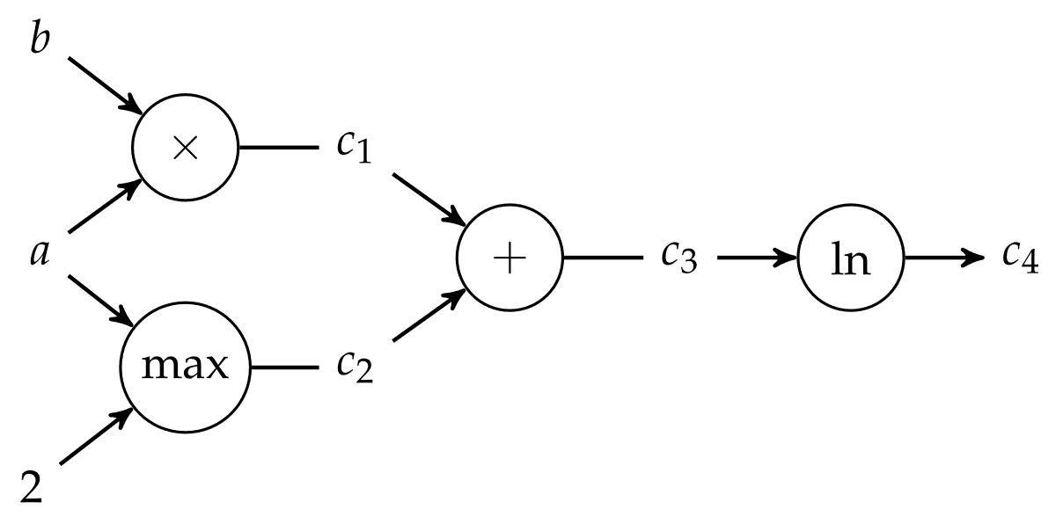
Automatic Differentiation
Forward Accumulation

Slide 16
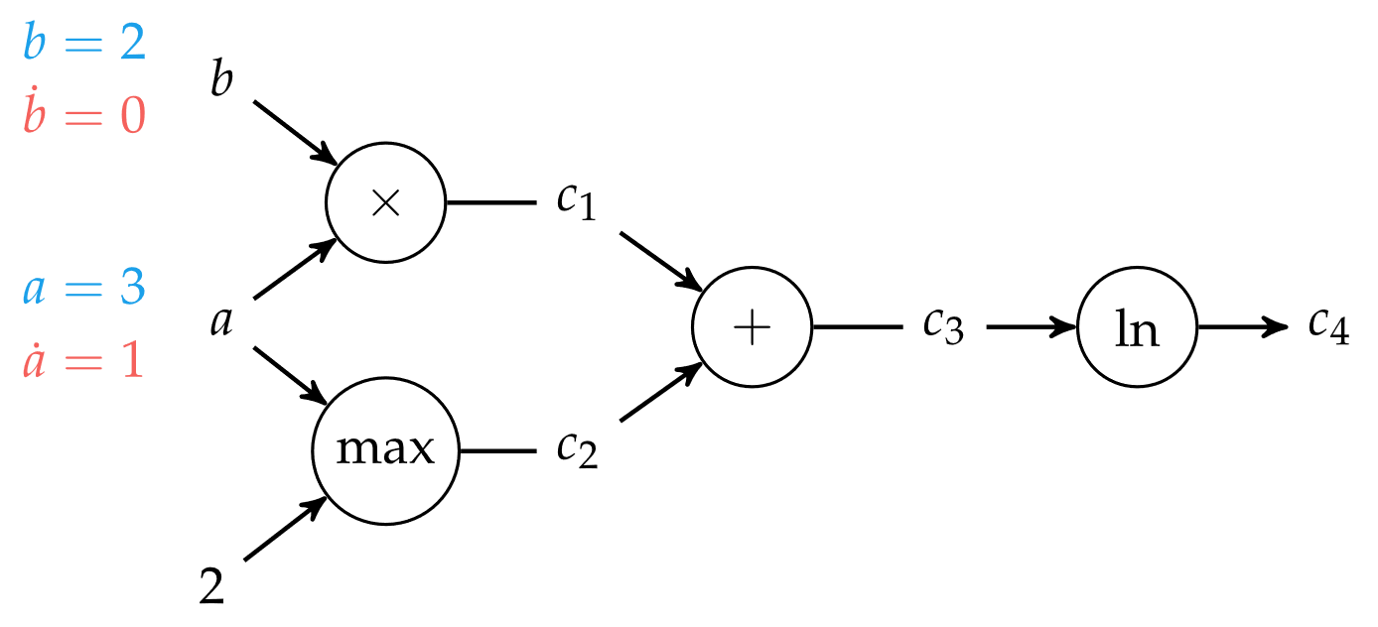
Automatic Differentiation
Forward Accumulation

Slide 17
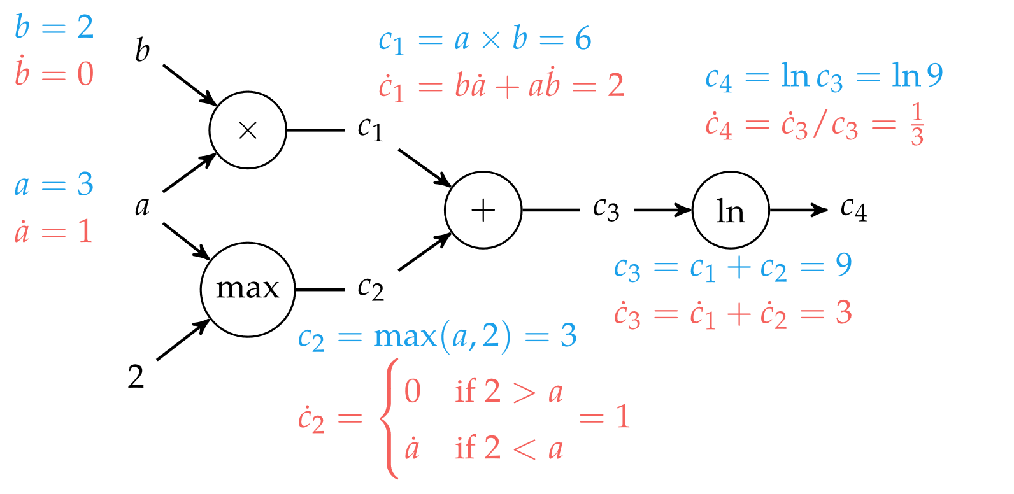
Automatic Differentiation
Forward Accumulation

Slide 18
Automatic Differentiation
Reverse accumulation is performed in single run using two passes over an n-dimensional function (forward and back)
Note: this is central to the backpropagation algorithm used to train neural networks
Many open-source software implementations are available

Slide 19
Summary
Derivatives are useful in optimization because they provide information about how to change a given point in order to improve the objective function
For multivariate functions, various derivative-based concepts are useful for directing the search for an optimum, including the gradient, the Hessian, and the directional derivative
One approach to numerical differentiation includes finite difference approximations

Slide 20
Summary
Complex step method can eliminate the effect of subtractive cancellation error when taking small steps
Analytic differentiation methods include forward and reverse accumulation on computational graphs

