Slide 1
Expression Optimization

Slide 2
Expression Optimization
In some problems, the number of variables is unknown
Finding optimal solutions of problems with unknown parameters requires optimizing over the set of expressions

Slide 3
Grammars
Expressions can be represented by a tree of symbols
Grammars constrain the space of possible expressions
A grammar is represented by a set of production rules
Production rules involve symbols and types
Types are defined sets of expression trees
Production rules are used to form expression trees by expanding types into new expressions with more types and symbols
If a type is expanded into just symbols, preventing further expansion, then it is called a terminal

Slide 4
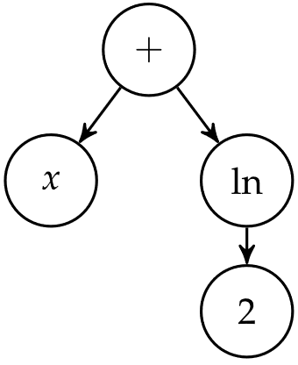
Grammars
Representing the expression x + ln 2 as a tree

Slide 5
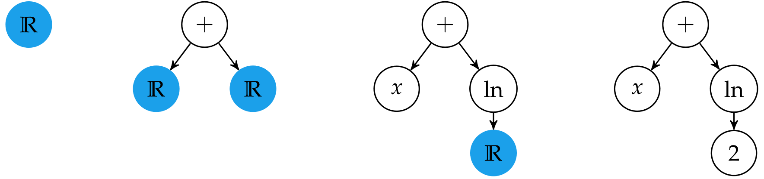

Grammars
Constructing the expression tree using a grammar
$ℝ$ ↦ $ℝ$ + $ℝ$
$ℝ \text{↦}$ x
$ℝ$ $\text{↦}$ ln($ℝ$)
$ℝ$ $\text{↦}$ 2

Slide 6
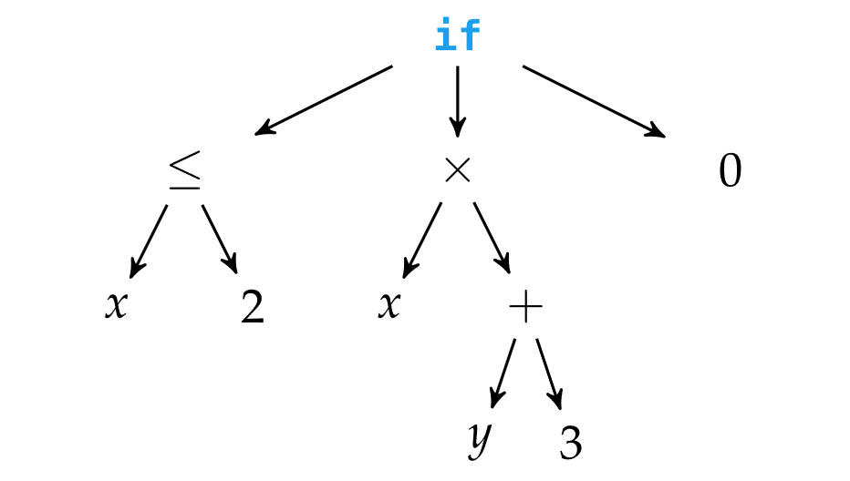
Genetic Programming
Genetic programming represents individuals as trees and optimizes over them using mutation and tree crossover

Slide 7
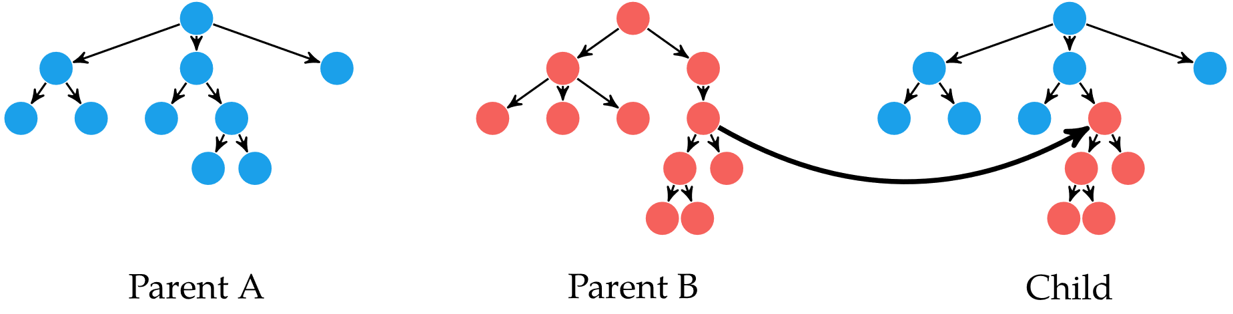
Genetic Programming
Tree crossover combines two parent trees into a child tree
Over many generations, tree crossover tends to increase tree depth and overall complexity
It is common to introduce a bias for parsimony, or simplicity in the solution based on the tree’s depth

Slide 8
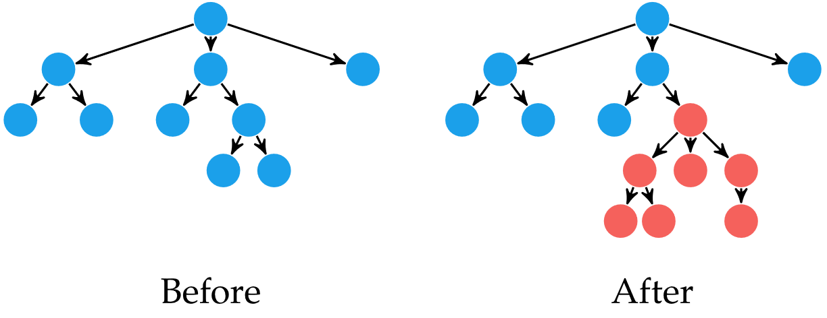
Genetic Programming
Random variation can be added in multiple ways
Tree mutation is when a random tree is generated and its root replaces a random node in the tree

Slide 9
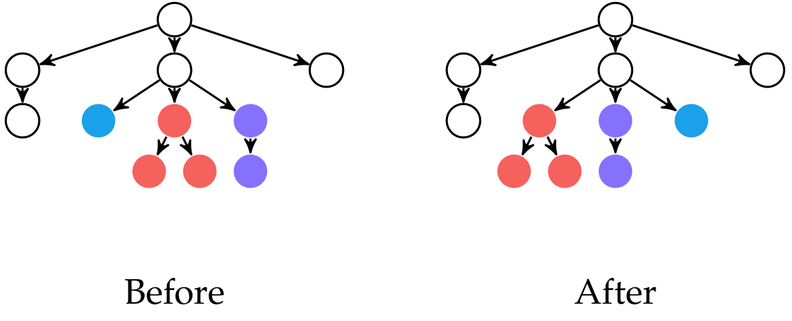
Genetic Programming
Tree permutation is when randomly chosen nodes are permuted
Often combined with tree mutation

Slide 10
Grammatical Evolution
Instead of encoding expressions as trees, they are encoded as integer arrays, allowing application of traditional genetic algorithm techniques
Unlike genetic algorithms, expressions are encoded based on a grammar

Slide 11


Grammatical Evolution
Example design point: [ 205 , 52 , 4 , 27 , 10 , 59 , 6 ]
Starting symbol: $ℝ$
Example grammar
$ℝ$ ↦$𝔻 𝔻$’$ℙ𝔼$
$𝔻$’ ↦$𝔻 𝔻\text{’}$ | $ε$
$ℙ \text{↦}$ $𝔻 𝔻\text{’}$ | $ε$
$𝔼 \text{↦}$E $𝕊 𝔻 𝔻\text{’}$ | $ε$
$𝕊 \text{↦}$+ | - | $ε$
$𝔻 \text{↦}$0 | 1 | 2 | 3 | 4 | 5 | 6 | 7 | 8 | 9
$ℝ$ is a real value
$𝔻$ is a terminal decimal
$𝔻\text{’}$ is a nonterminal decimal
$ℙ$ is the decimal part
$𝔼$ is the exponent
$𝕊$ is the sign
$ε$ produces an empty string

Slide 12

Grammatical Evolution
Example design point: [ 205 , 52 , 4 , 27 , 10 , 59 , 6 ]
Starting symbol: $ℝ$
Example grammar
$ℝ$ ↦$𝔻 𝔻$’$ℙ𝔼$
$𝔻$’ ↦$𝔻 𝔻\text{’}$ | $ε$
$ℙ \text{↦}$ $𝔻 𝔻\text{’}$ | $ε$
$𝔼 \text{↦}$E $𝕊 𝔻 𝔻\text{’}$ | $ε$
$𝕊 \text{↦}$+ | - | $ε$
$𝔻 \text{↦}$0 | 1 | 2 | 3 | 4 | 5 | 6 | 7 | 8 | 9
Make substitution using first rule
$ℝ$ ↦$𝔻 𝔻$’$ℙ𝔼$

Slide 13
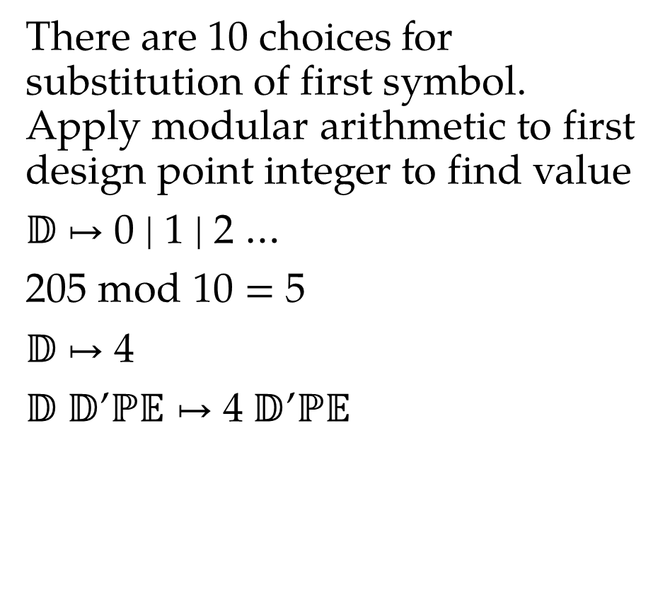
Grammatical Evolution
Example design point: [ 205 , 52 , 4 , 27 , 10 , 59 , 6 ]
Starting symbol: $ℝ$
Example grammar
$ℝ$ ↦$𝔻 𝔻$’$ℙ𝔼$
$𝔻$’ ↦$𝔻 𝔻\text{’}$ | $ε$
$ℙ \text{↦}$ $𝔻 𝔻\text{’}$ | $ε$
$𝔼 \text{↦}$E $𝕊 𝔻 𝔻\text{’}$ | $ε$
$𝕊 \text{↦}$+ | - | $ε$
$𝔻 \text{↦}$0 | 1 | 2 | 3 | 4 | 5 | 6 | 7 | 8 | 9
There are 10 choices for substitution of first symbol. Apply modular arithmetic to first design point integer to find value
$𝔻 \text{↦}$0 | 1 | 2 …
205 mod 10 = 5
$𝔻 \text{↦}$4
$𝔻 𝔻$’$ℙ𝔼$ $\text{↦}$4 $𝔻$’$ℙ𝔼$

Slide 14
Grammatical Evolution
Example design point: [ 205 , 52 , 4 , 27 , 10 , 59 , 6 ]
Starting symbol: $ℝ$
Example grammar
$ℝ$ ↦$𝔻 𝔻$’$ℙ𝔼$
$𝔻$’ ↦$𝔻 𝔻\text{’}$ | $ε$
$ℙ \text{↦}$ $𝔻 𝔻\text{’}$ | $ε$
$𝔼 \text{↦}$E $𝕊 𝔻 𝔻\text{’}$ | $ε$
$𝕊 \text{↦}$+ | - | $ε$
$𝔻 \text{↦}$0 | 1 | 2 | 3 | 4 | 5 | 6 | 7 | 8 | 9
Continuing similarly until a terminal symbol is encountered produces the expression
4e+8
Changing the 52 to 51 produces the expression
43950.950e+8

Slide 15
Grammatical Evolution
Grammatical evolution uses two additional genetic operators
Gene duplication selects a random section of the string and appends a duplicate to the end of the array
Unlike genetic algorithms, when a design point is evaluated in grammatical evolution, if a terminal symbol is reached before the entire string is evaluated, the remainder of the string is ignored
If crossover is performed in an inactive region it provides no benefit
Pruning is when some or all of inactive regions are truncated

Slide 16
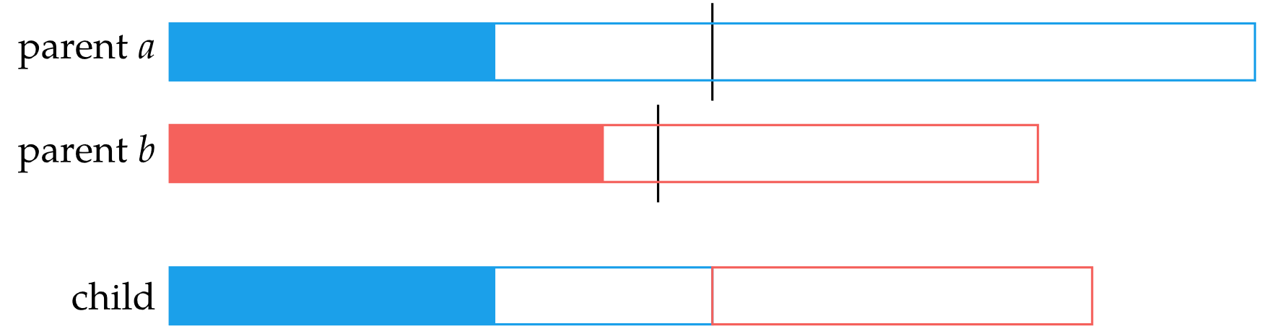
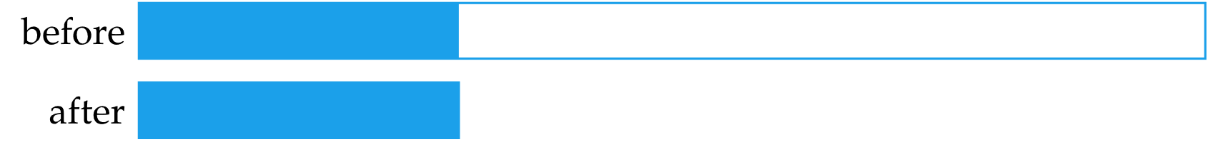
Grammatical Evolution
If the white sections are inactive, crossover can be ineffective
Pruning randomly removes inactive regions of some chromosomes

Slide 17
Probabilistic Grammars
Rather than strictly applying grammar rules, each rule can have a weight assigned to it and is applied randomly with a probability proportional to its weight
When applied to a number of design points, the highest performing elite samples can be used to adjust the weights according to how well the rule’s application correlated to performance or other factors

Slide 18
Probabilistic Prototype Trees
Expressions are represented as trees with a probability vector assigned to each node
The probability vector represents a categorical distribution over the grammar’s production rules
Expressions and rules are sampled based on the probability distributions at each node
After each generation, probability vectors are updated to increase population performance

Slide 19
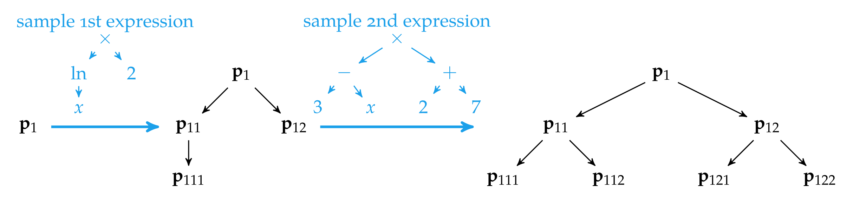
Probabilistic Prototype Trees

Slide 20
Summary
Expression optimization allows for optimizing tree structures that, under a grammar, can express sophisticated programs, structures, and other designs lacking a fixed size.
Grammars define the rules used to construct expressions.
Genetic programming adapts genetic algorithms to perform mutation and crossover on expression trees.
Grammatical evolution operates on an integer array that can be decoded into an expression tree.
Probabilistic grammars learn which rules are best to generate, and probabilistic prototype trees learn probabilities for every iteration of the expression rule generation process.

