Slide 1
Multidisciplinary Optimization

Slide 2
Multidisciplinary Optimization
Multidisciplinary Optimization (MDO) focuses on solving optimization problems spanning across multiple interacting disciplines

Slide 3
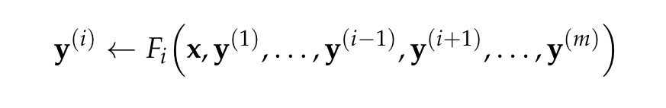
Disciplinary Analyses
As with all previous optimization problems, we optimize a design point, but for each discipline, a disciplinary analysis is performed on that design point to generate a set of outputs called response variables for each disciplinary analysis
where x is the design point, y is a vector of response variables, m is the number of disciplines, and F is some function used to compute the ith response variable vector
Note the coupling of response variables between disciplines

Slide 4

Disciplinary Analyses
An assignment is an association of a set of variable names with corresponding values related to the problem
A disciplinary analysis can be thought of as a way of updating the response variables for the discipline using an assignment
An assignment can be represented in code as a dictionary or associative array data structure
Using these structures, variables are not restricted to numbers, but can be any object such as a vector

Slide 5

Interdisciplinary Compatibility
Interdisciplinary compatibility means response variables are compatible with all disciplinary analysis
Interdisciplinary compatibility holds for a particular assignment if the assignment is unchanged under all disciplinary analyses
Finding an assignment that satisfies interdisciplinary compatibility is called a multidisciplinary analysis

Slide 6
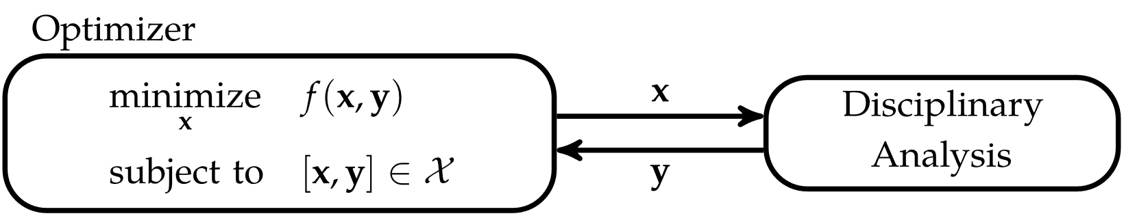
Interdisciplinary Compatibility
System optimization for a single discipline requires an optimizer to select design variables and query the disciplinary analysis in order to evaluate the constraints and objective function
Only one discipline, so no coupling between disciplines

Slide 7
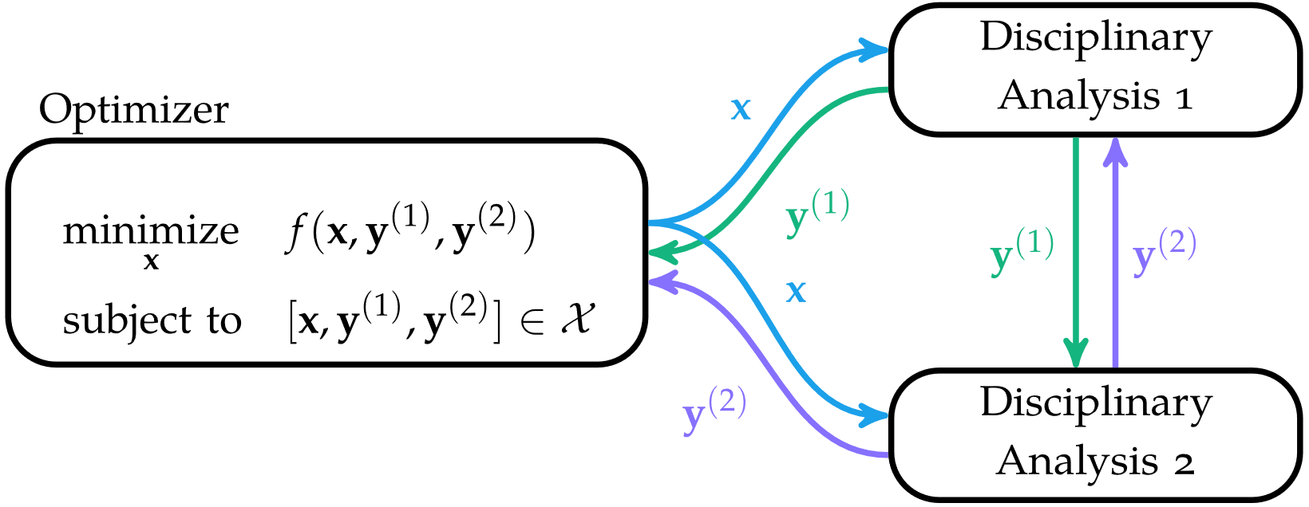
Interdisciplinary Compatibility
If there are multiple disciplines, then dependencies have to be considered

Slide 8
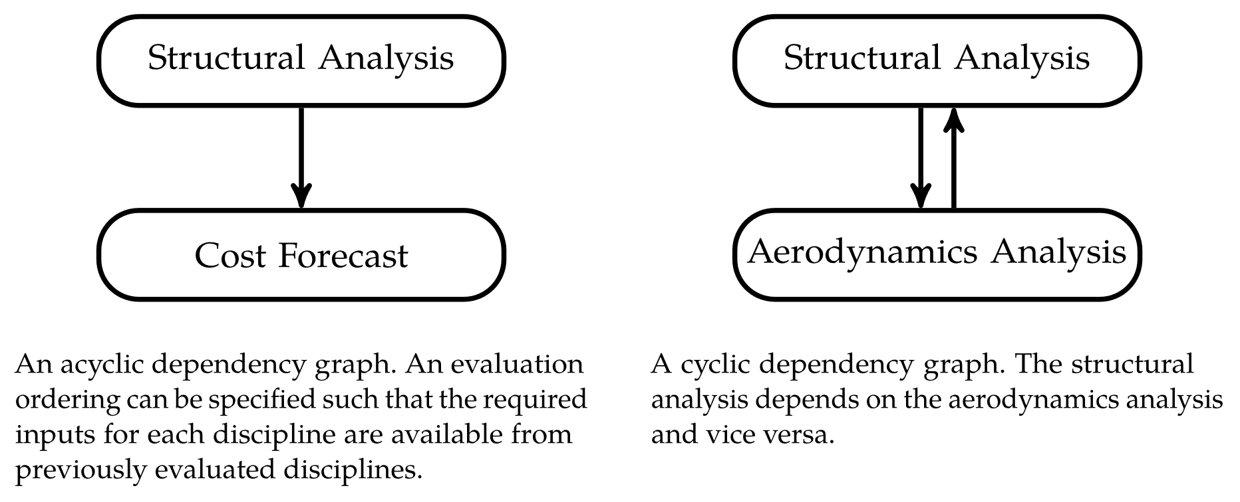
Interdisciplinary Compatibility
Dependencies can be mapped to form a dependency graph
If disciplines are mutually dependent on each other, then they have a dependency cycle

Slide 9
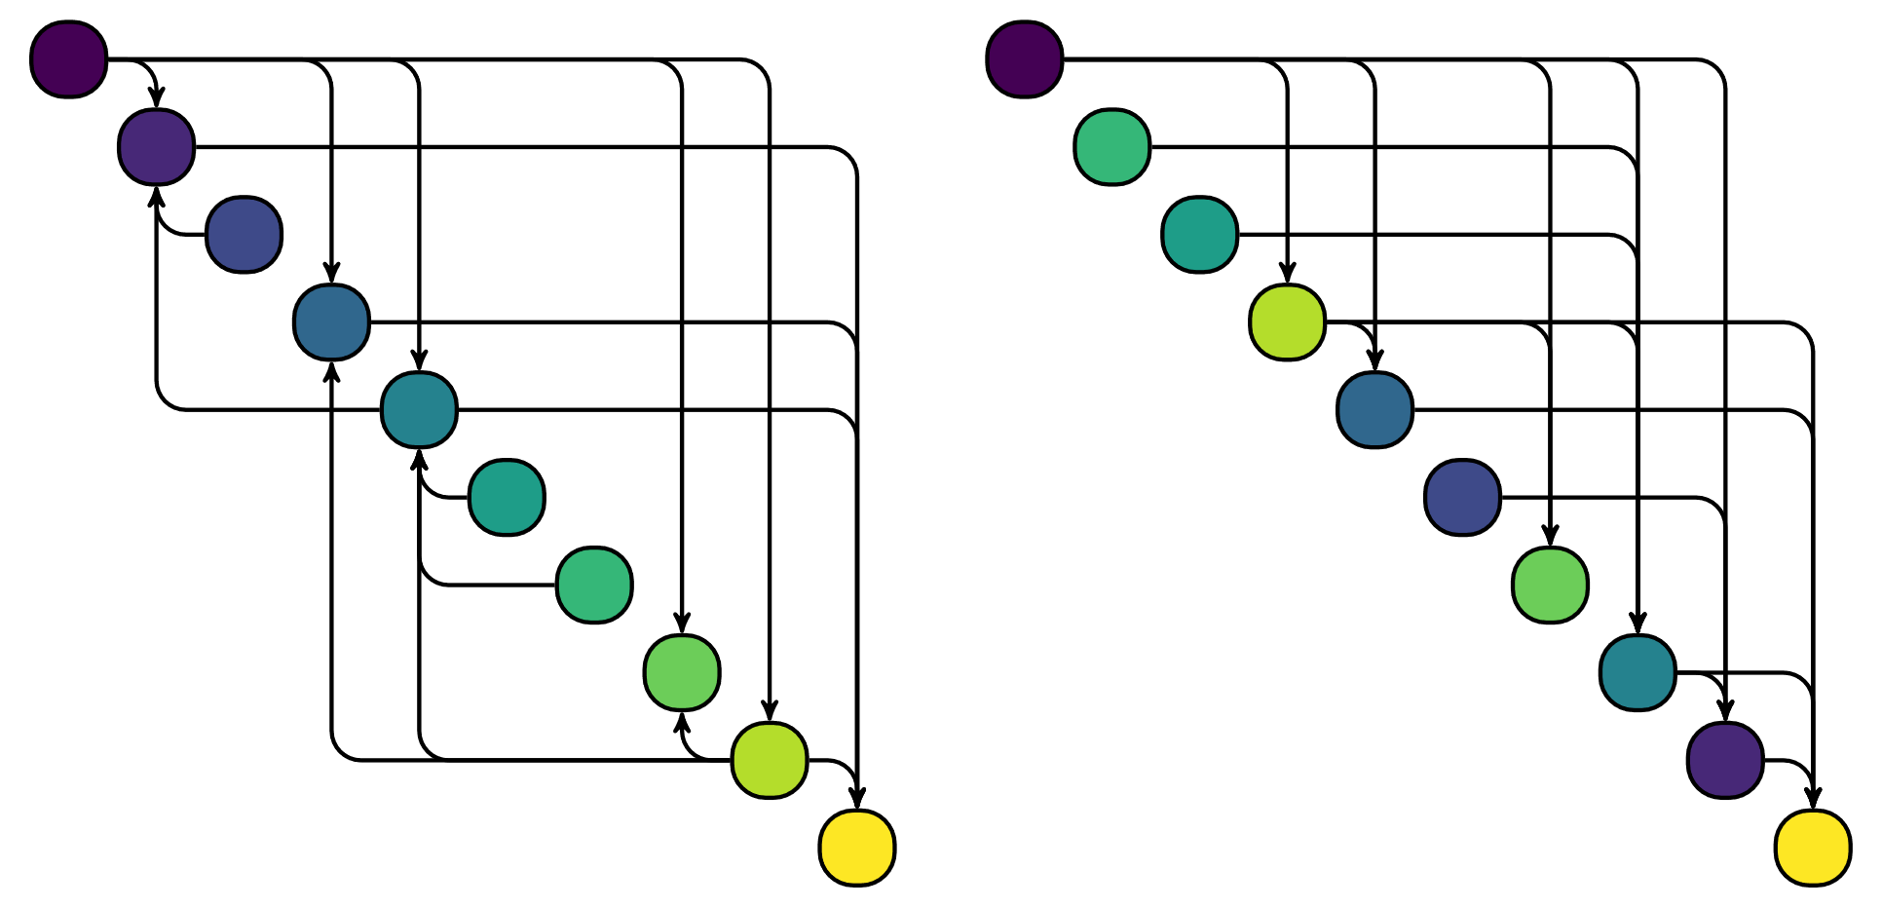
Interdisciplinary Compatibility
If a dependency graph has no cycles, then there always exists an evaluation ordering such that dependencies are satisfied called a topological ordering
Kahn’s algorithm can find such orderings

Slide 10
Interdisciplinary Compatibility
If there are dependency cycles, then no topological ordering exists
A general approach is iterative techniques such as the Gauss-Seidel method
Depending on the nature of the problem,
iterative methods can converge slowly

Slide 11
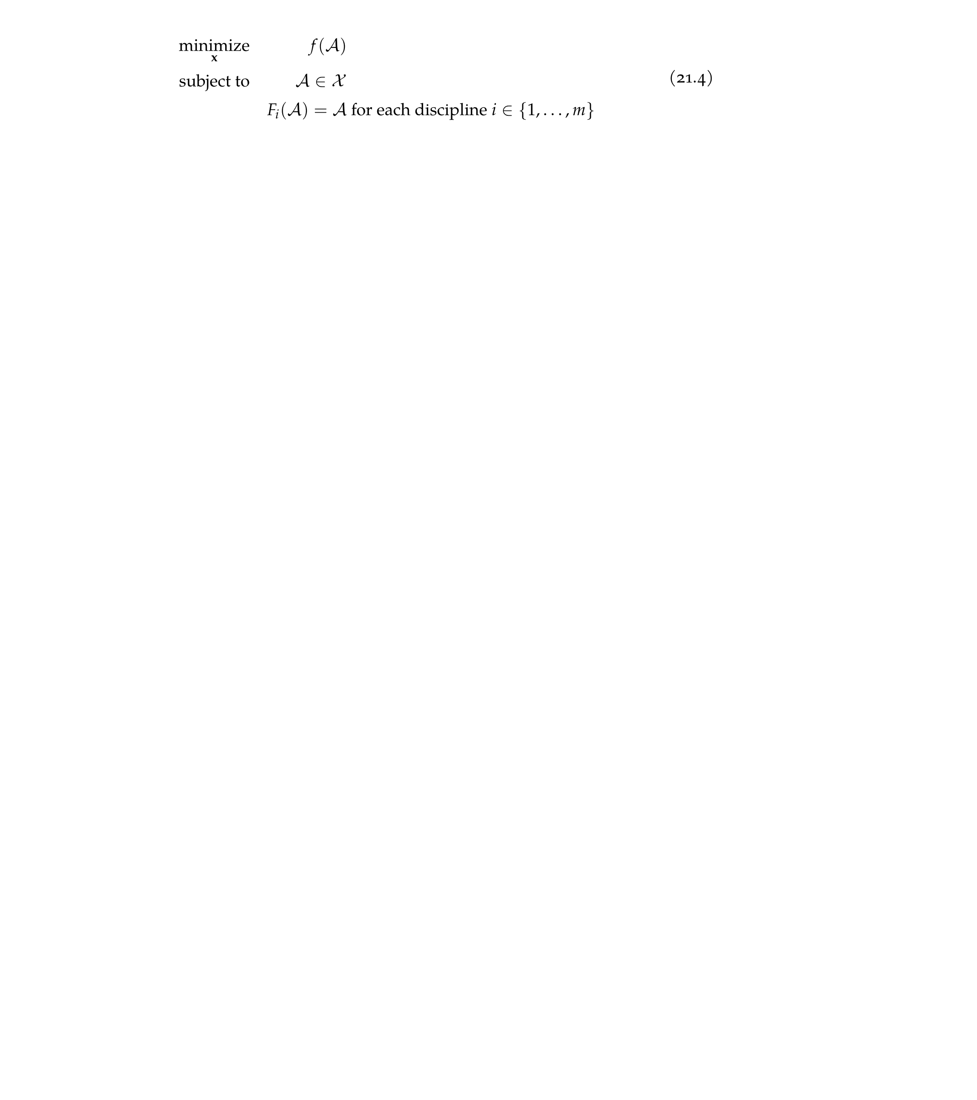
Architectures
General MDO problem formulation
where f and depend on both the design and response variables

Slide 12
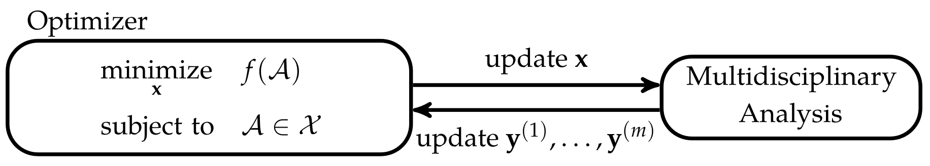
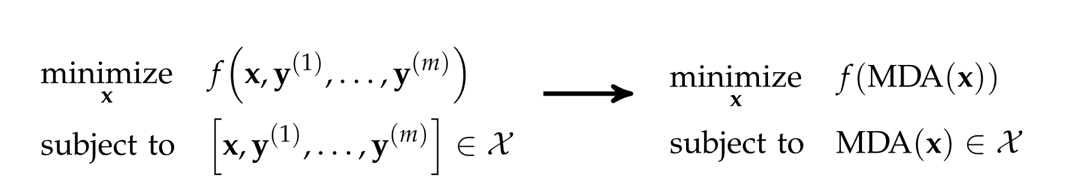
Multidisciplinary Design Feasible
The multidisciplinary design feasible architecture structures the MDO problem such that standard optimization algorithms can be directly applied to optimize the design variables

Slide 13
Multidisciplinary Design Feasible
Primary advantage of the multidisciplinary design feasible architecture is that the procedure is simple
The primary disadvantage is that it can be expensive, requiring multiple discipline analyses
Problems with complex dependencies may not converge

Slide 14
Sequential Optimization
The sequential optimization architecture attempts to optimize the overall MDO problem by optimizing over multiple subproblems
A subproblem is an optimization procedure performed over a subset of the design variables while focusing on a particular discipline
The system-level optimizer takes the results from each subproblem and optimizes over the remaining variables
This architecture often leads to suboptimal solutions and is often used as a baseline against which other optimization architectures are measured

Slide 15
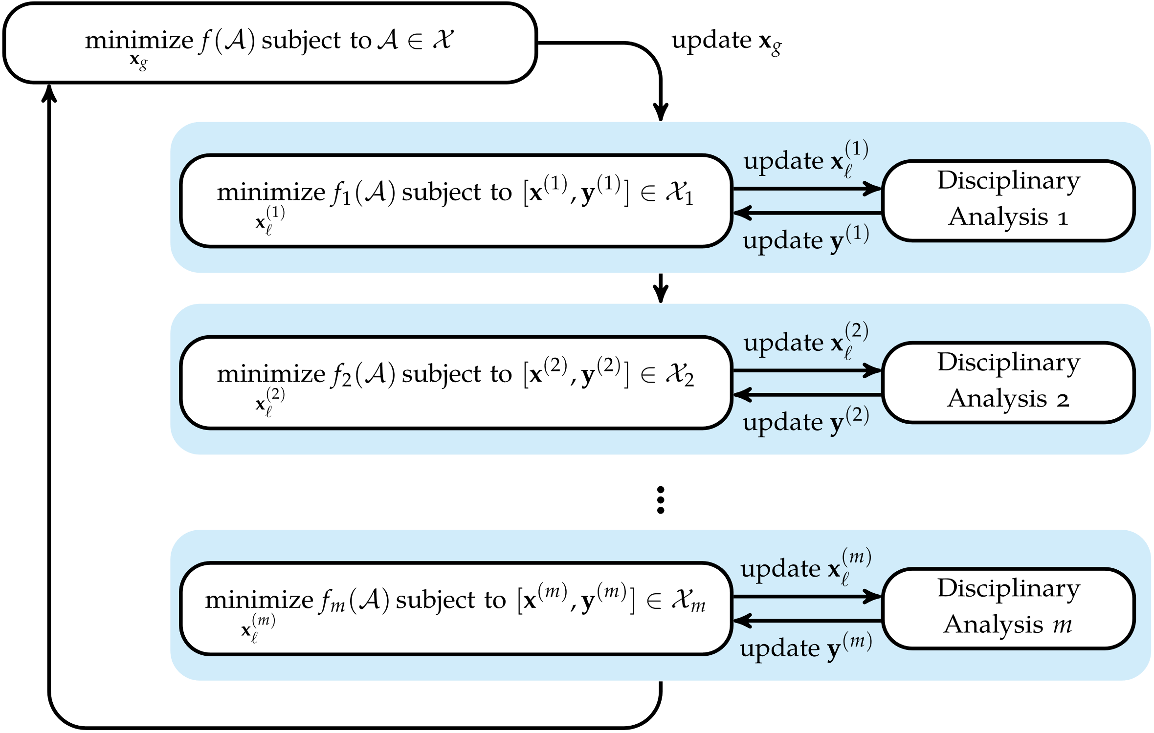
Sequential Optimization

Slide 16
Individual Discipline Feasible
The Individual Discipline Feasible architecture allows disciplinary analyses to be conducted in parallel
A set of coupling variables c are introduced which serve as proxies for the response variables
The optimizer modifies the design point at each iteration until c has converged to a feasible equivalent to y

Slide 17
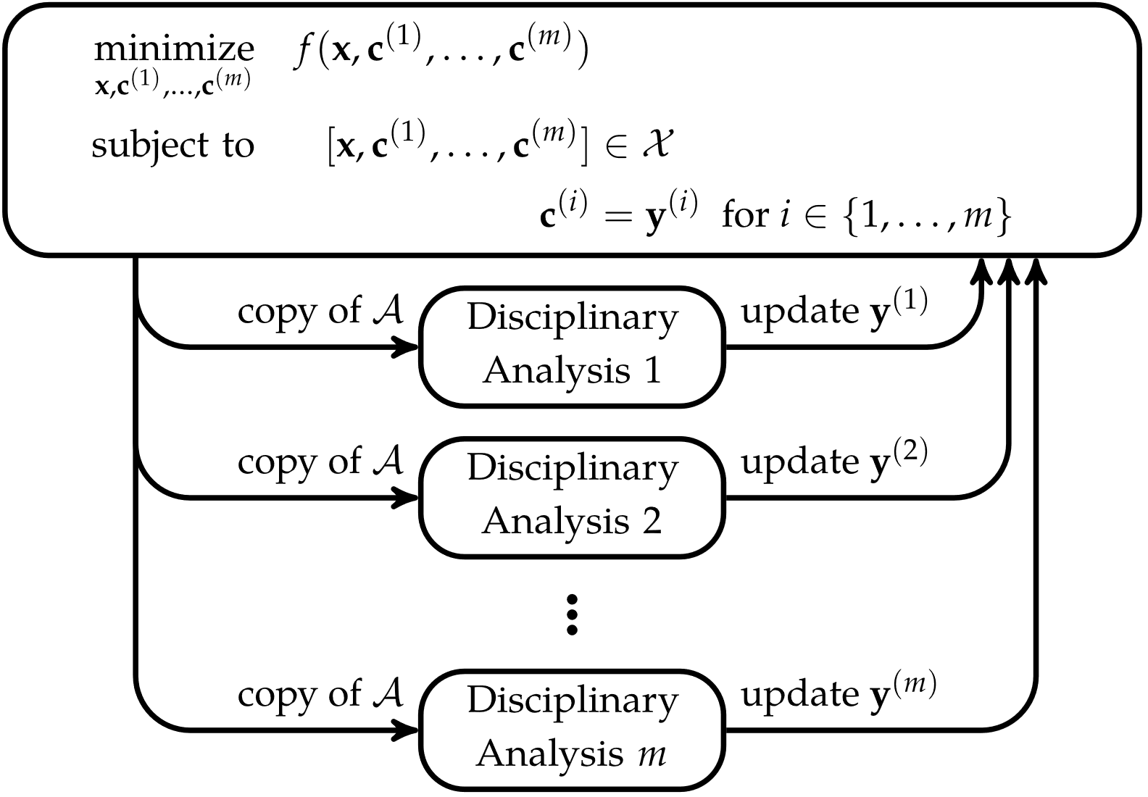
Individual Discipline Feasible

Slide 18
Collaborative Optimization
The Collaborative Optimization architecture breaks down a problem into disciplinary subproblems that have full control over local design variables and discipline-specific constraints and can be analyzed in parallel
Coupling variables are defined to enable iterative convergence to a feasible optimal solution
Collaborative Optimization is an example of a distributed architecture

Slide 19
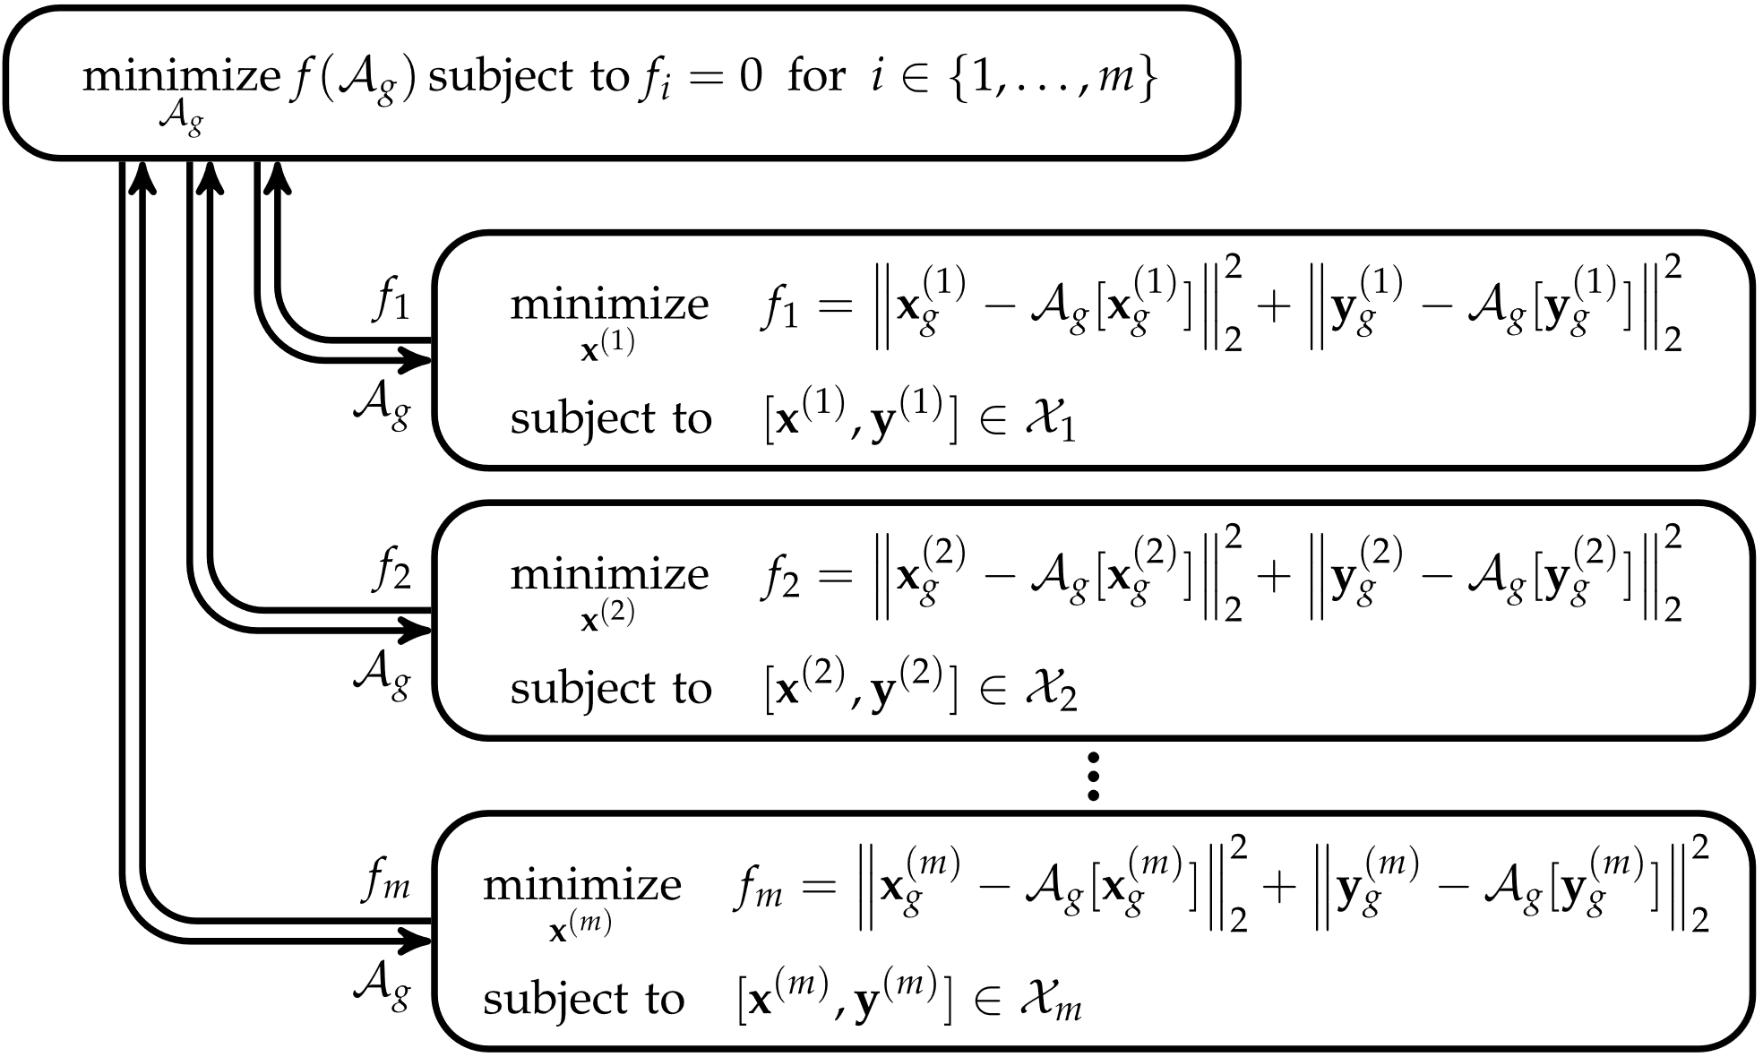
Collaborative Optimization

Slide 20

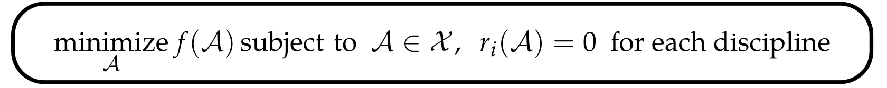
Simultaneous Analysis and Design
The simultaneous analysis and design (SAND) architecture avoids coordinating between multiple design analyses and combines the entire optimization process into a single optimizer
Any disciplinary analysis can be transformed into residual form
The MDO problem can then be stated simply as

Slide 21
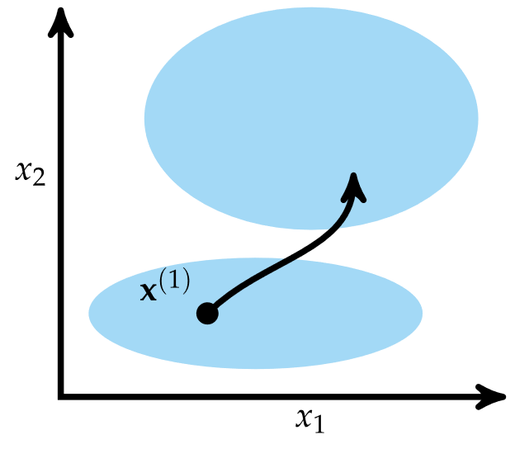
Simultaneous Analysis and Design
An advantage of SAND is that the solution process is simpler, provided the problem supports transformation into residual form
SAND can also traverse infeasible regions of the search space to find an optimal, feasible solution
A disadvantage is that not
all problems support transformation to
residual form

Slide 22
Summary
Multidisciplinary design optimization requires reasoning about multiple disciplines and achieving agreement between coupled variables
Disciplinary analyses can often be ordered to minimize dependency cycles
Multidisciplinary design problems can be structured in different architectures that take advantage of problem features to improve the optimization process
The multidisciplinary design feasible architecture maintains feasibility and compatibility through the use of slow and potentially nonconvergent multidisciplinary design analyses

Slide 23
Summary
Sequential optimization allows each discipline to optimize its discipline-specific variables but does not always yield optimal designs
The individual discipline feasible architecture allows parallel execution of analyses at the expense of adding coupling variables to the global optimizer
Collaborative optimization incorporates suboptimizers that can leverage domain specialization to optimize some variables locally

Slide 24
Summary
The simultaneous analysis and design architecture replaces design analyses with residuals, allowing the optimizer to find compatible solutions but cannot directly use disciplinary solution techniques

