Slide 1
Local Descent

Slide 2

Descent Direction Iteration
Descent Direction Methods use a local model to incrementally improve design point until some convergence criteria is met
Check termination conditions at x^{(k)}; if not met, continue.
Decide descent direction d^{(k)} using local information
Decide step size α^{(k)}
Compute next design point x^{(k+1)}

Slide 3

Line Search
Used to compute α
Using the techniques discussed in Chapter 3,
Often this is computed approximately to reduce cost

Slide 4

Line Search: Alternatives
Fixed α called learning rate
Decaying step factor
Decaying step factor is often required in convergence proofs

Slide 5
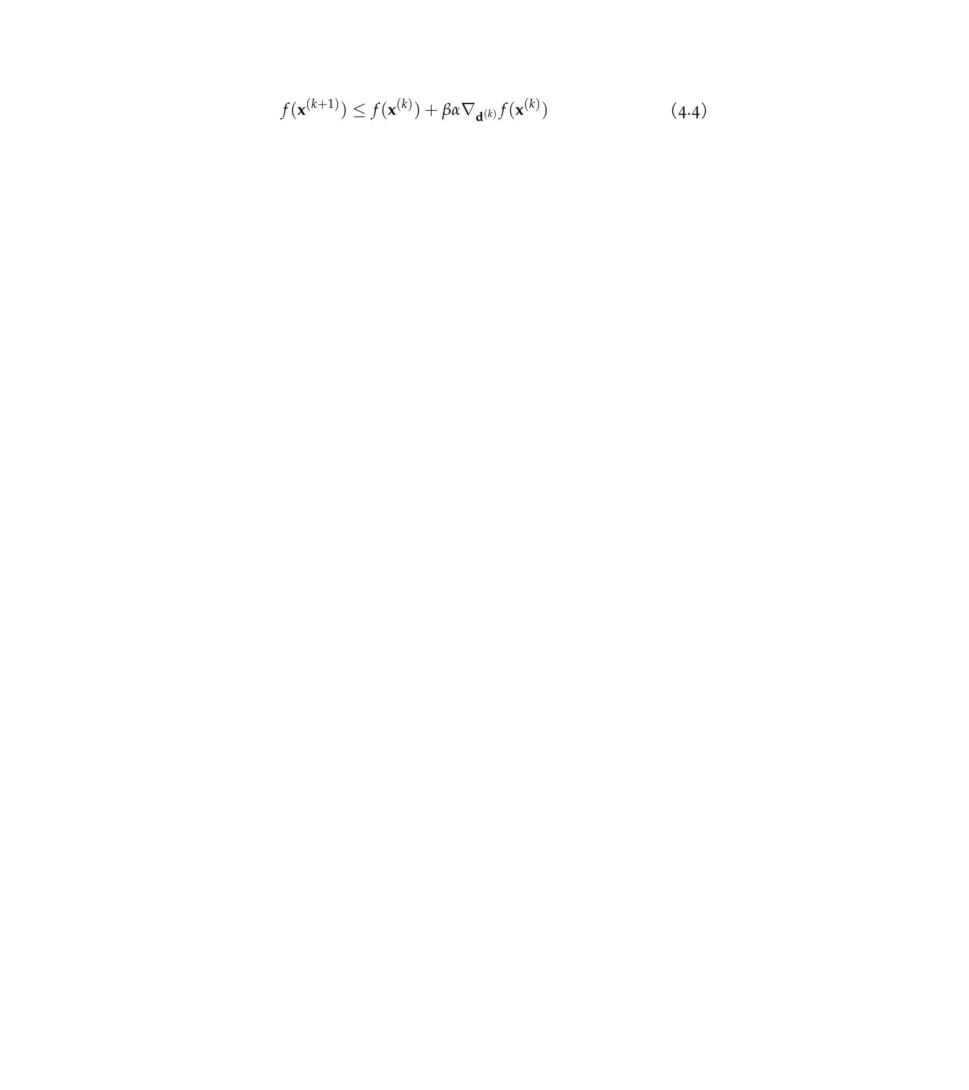
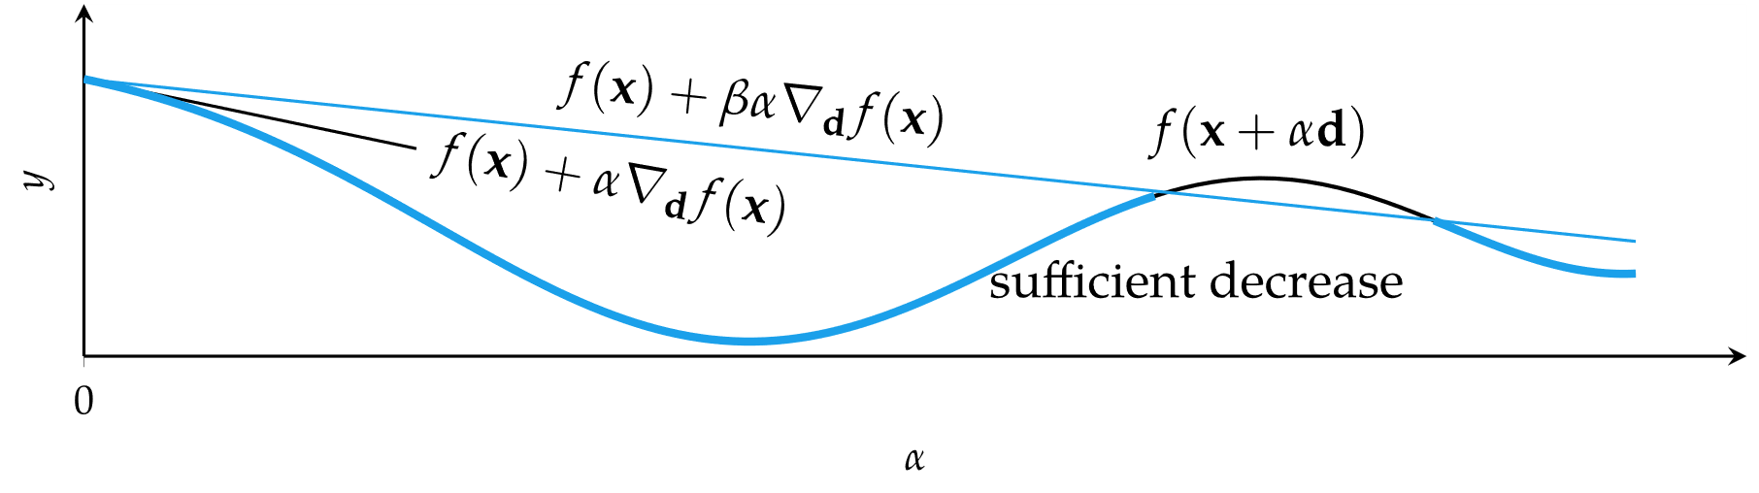

Approximate Line Search
If function calls are expensive, rather than finding the minimum along a search direction, find a point of sufficient decrease
β∊[0,1], usually β=1$×$10⁻⁴
Backtracking line search starts with a large step and then backs off

Slide 6
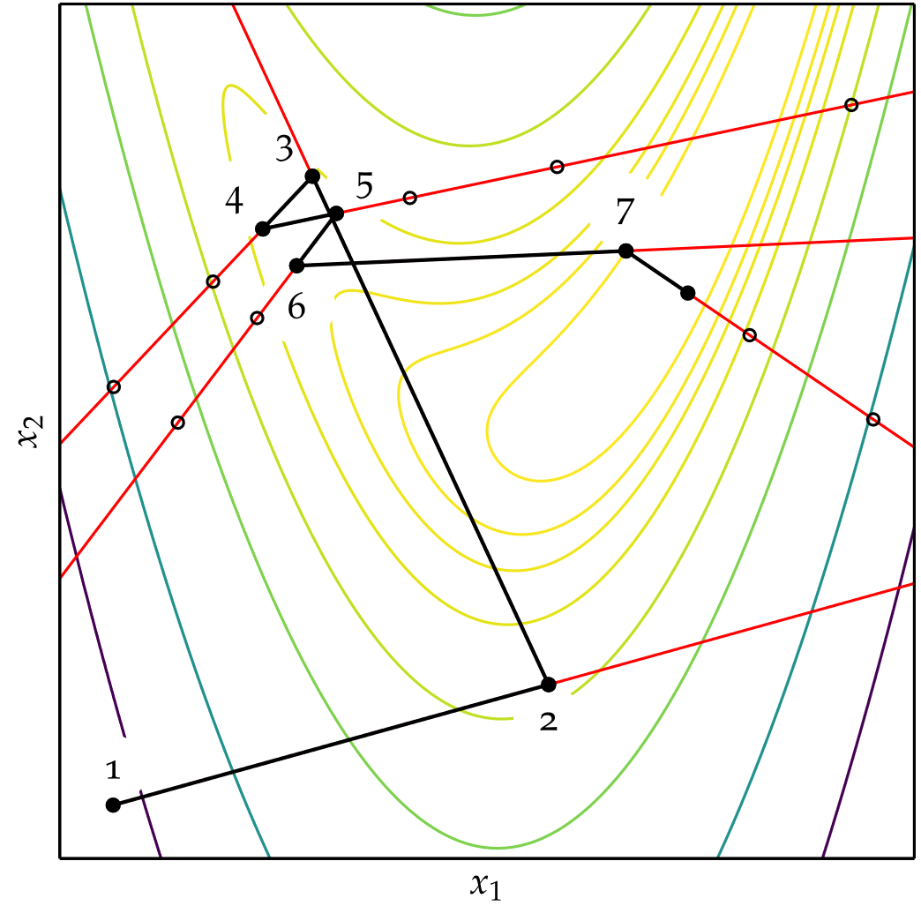
Approximate Line Search
Backtracking line search
on Rosenbrock function

Slide 7
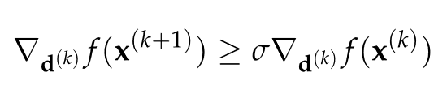
Approximate Line Search
Building on backtracking line search are the Wolfe Conditions
First Wolfe Condition: Sufficient Decrease
Second Wolfe Condition: Curvature Condition

Slide 8
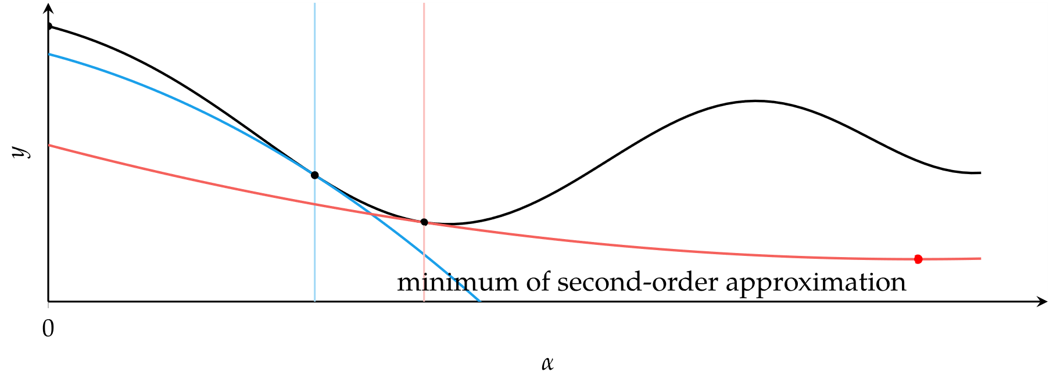
Approximate Line Search
The curvature condition ensures the second-order function approximations have positive curvature

Slide 9
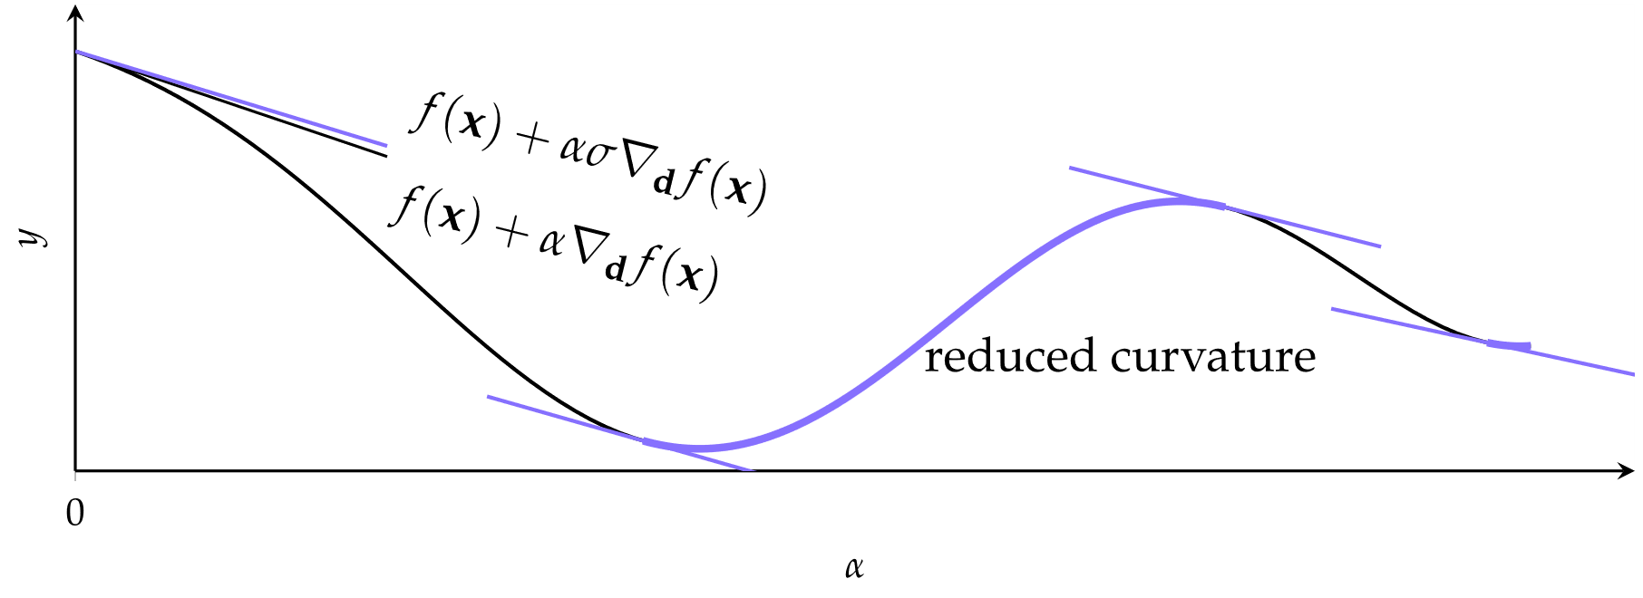
Approximate Line Search
Regions satisfying the curvature condition

Slide 10
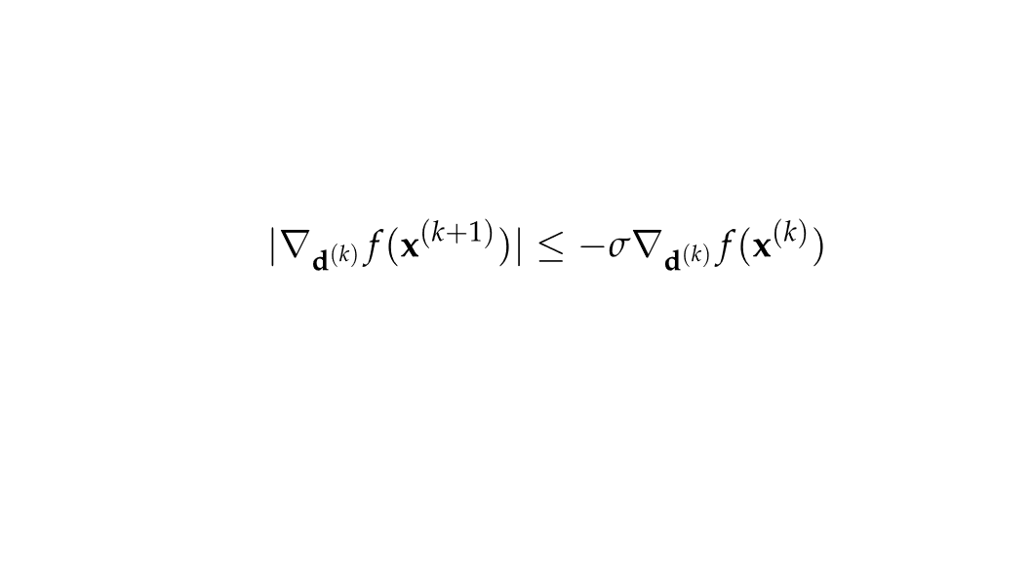
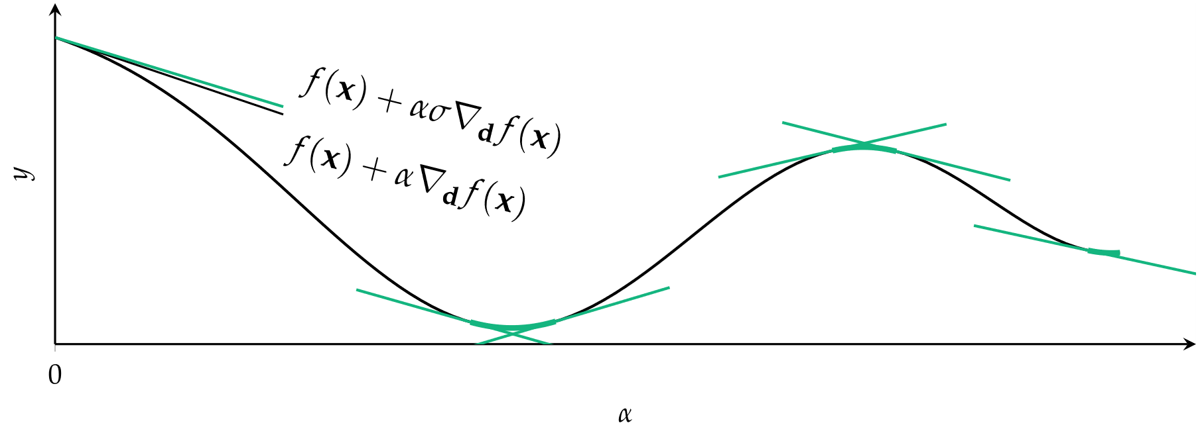
Approximate Line Search
Regions where the strong curvature condition is satisfied

Slide 11
Approximate Line Search
Bracketing Phase: test successively larger step sizes to find interval guaranteed to contain step lengths satisfying Wolfe conditions
Zoom Phase: shrink the interval using bisection to find point satisfying Wolfe conditions

Slide 12
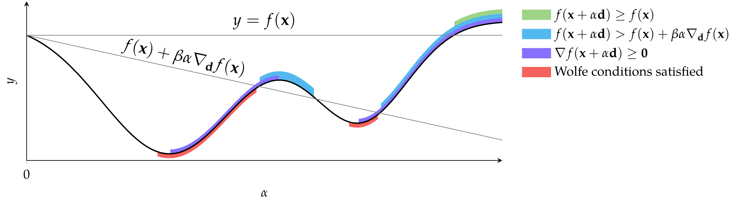
Approximate Line Search
Bracketing Phase:

Slide 13
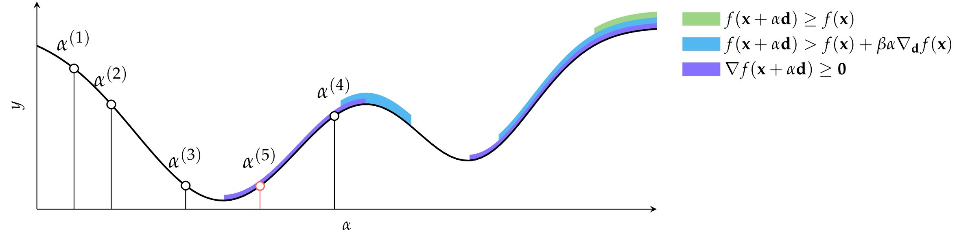
Approximate Line Search
Zoom Phase:

Slide 14
Trust Region Methods
Descent methods can place too much trust in their first and second order information
Trust region methods, or restricted step methods, limit the step size to ensure local approximation error is minimized

Slide 15
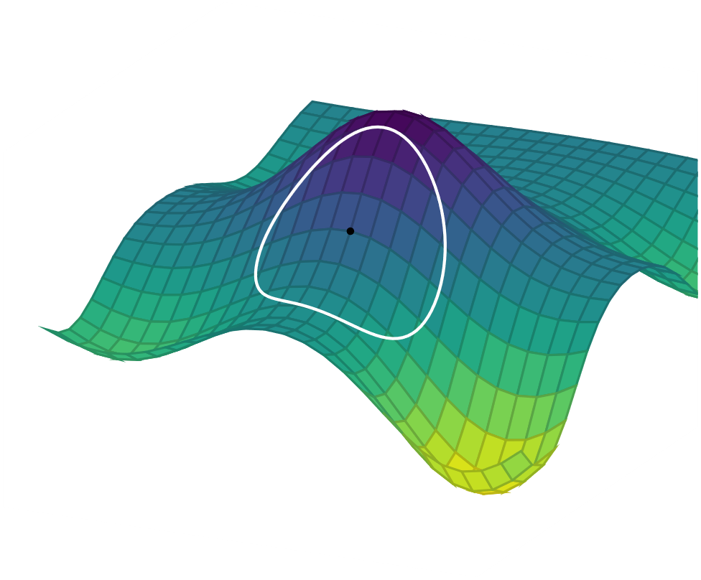
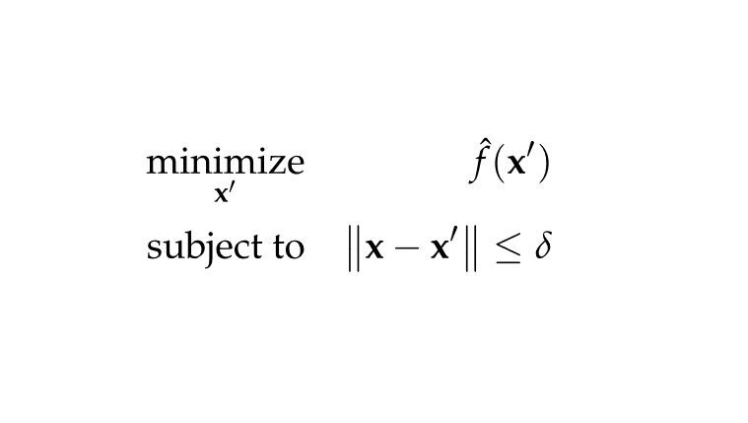

Trust Region Methods
$\hat{f}(x^{′})$ is local function approximation at new design point
$δ$ is trust region radius
$x^{′}$ is new design point

Slide 16


Trust Region Methods
$δ$ can be expanded or contracted based on performance

Slide 17
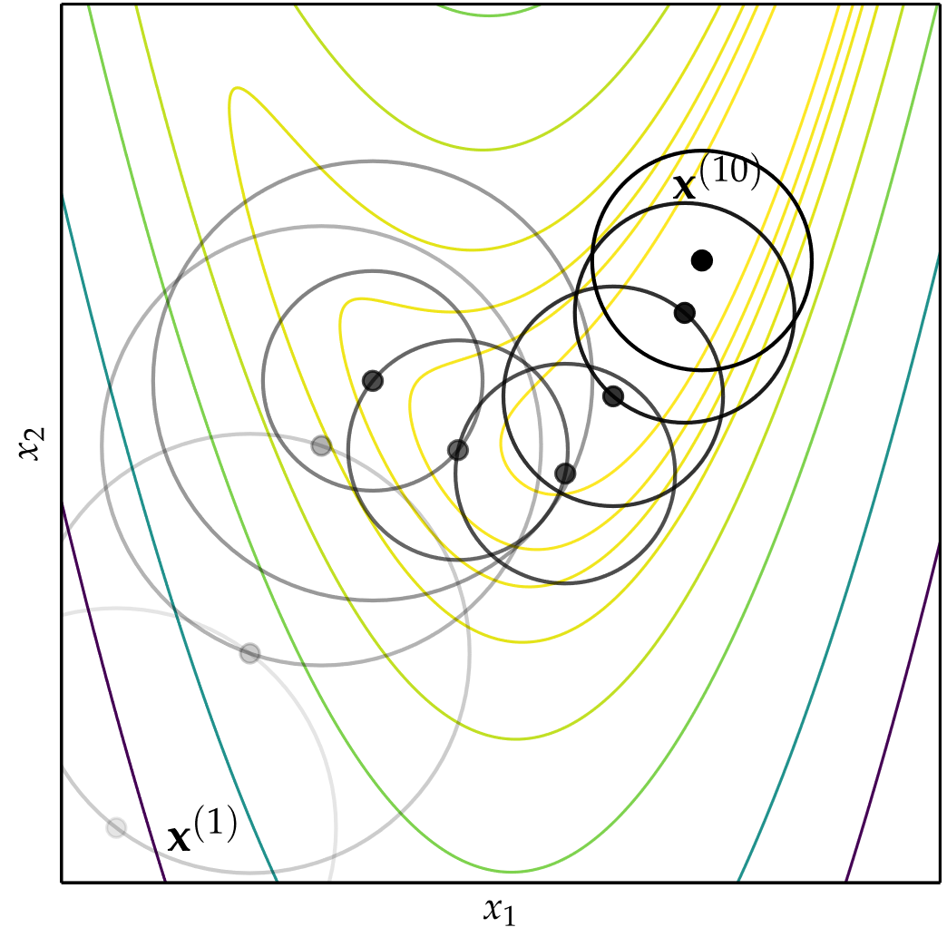
Trust Region Methods
Trust region optimization
of Rosenbrock Function

Slide 18


Termination Conditions
Maximum Iterations
Absolute Improvement

Slide 19
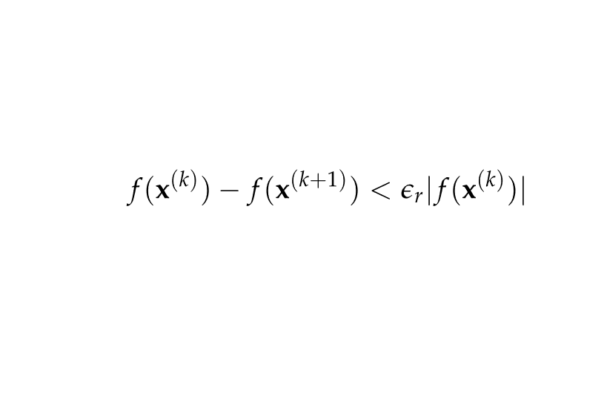

Termination Conditions
Relative Improvement
Gradient Magnitude

Slide 20
Summary
Descent direction methods incrementally descend toward a local optimum.
Univariate optimization can be applied during line search.
Approximate line search can be used to identify appropriate descent step sizes.
Trust region methods constrain the step to lie within a local region that expands or contracts based on predictive accuracy.
Termination conditions for descent methods can be based on criteria such as the change in the objective function value or magnitude of the gradient.

