Slide 1
First-Order Methods

Slide 2
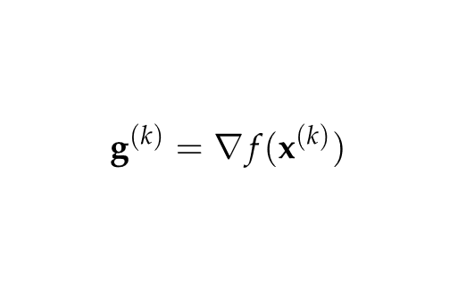

Gradient Descent
Search in direction of steepest descent

Slide 3
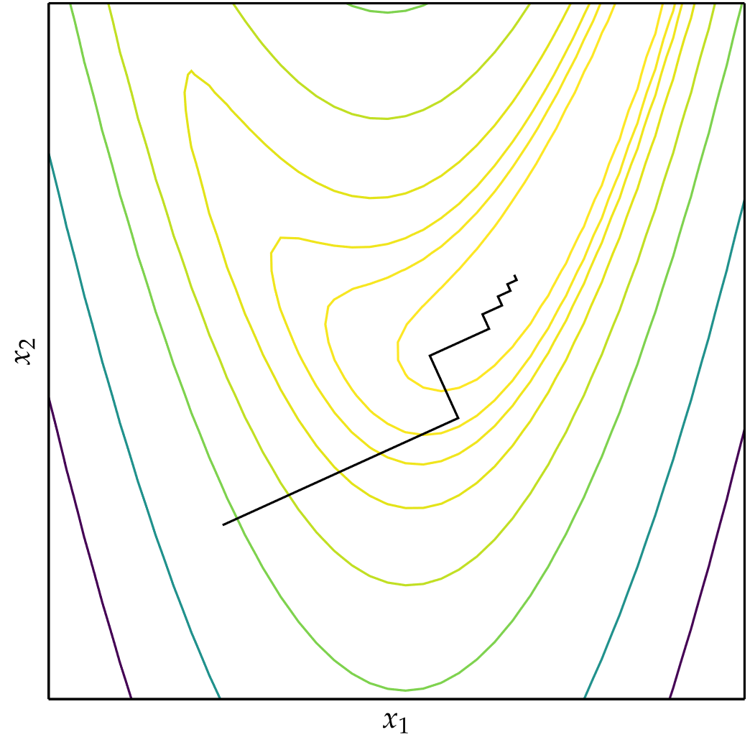
Gradient Descent
Applying gradient descent
and line search on Rosenbrock
function

Slide 4
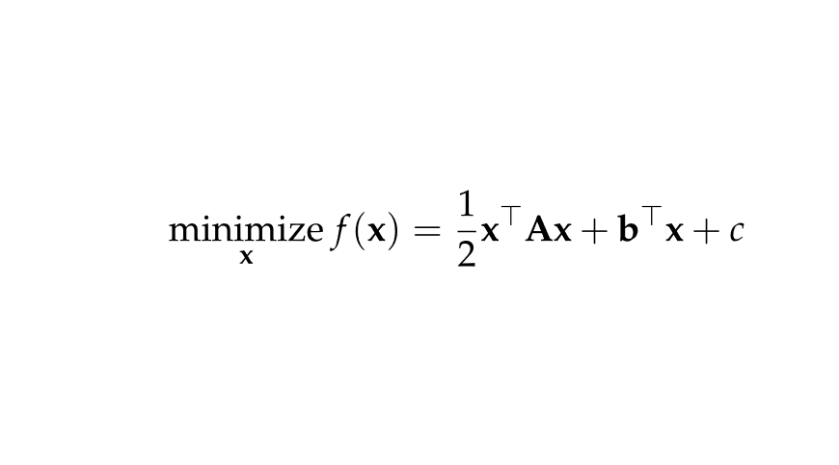
Conjugate Gradient
Inspired by methods for optimizing quadratic functions
Assumes problem takes the quadratic form
where A is positive-definite matrix
All search directions are mutually conjugate with respect to A
For n-dimensional problem, converges in n steps
Can be used when function is locally approximated as quadratic

Slide 5
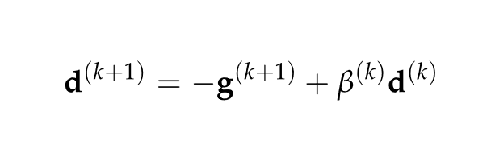
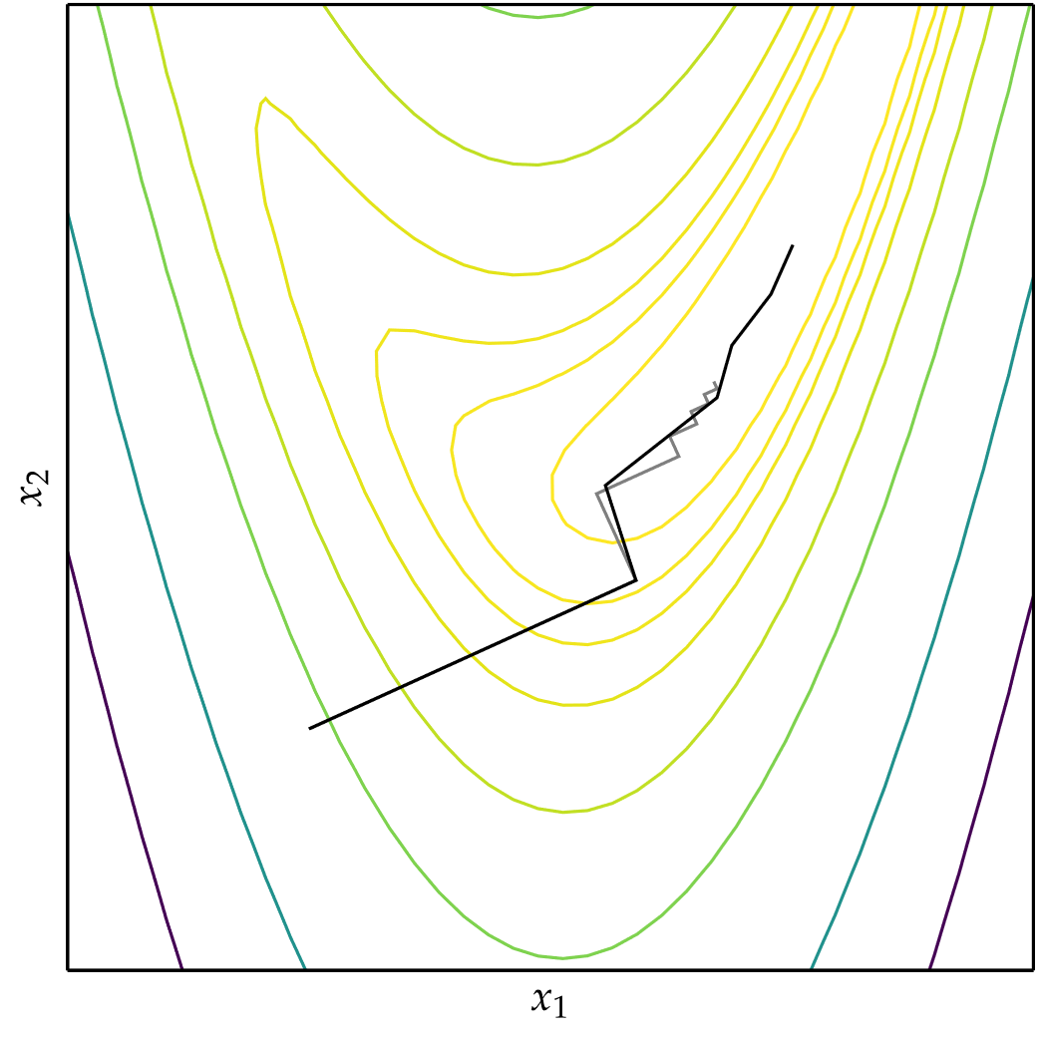
Conjugate Gradient
Using Fletcher-Reeves or Polak-Ribière equations for β^{(k)}, a function can be locally approximated as quadratic and minimized using Conjugate Gradient

Slide 6
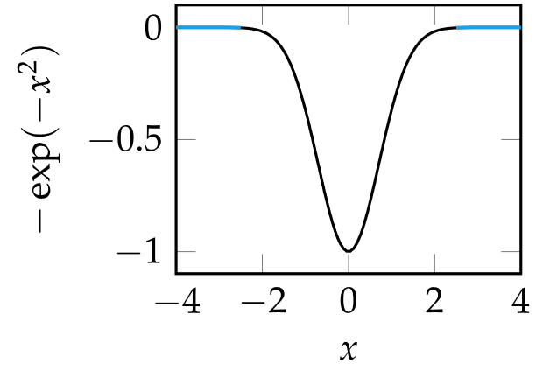
Momentum
Addresses common convergence issues
Some functions have regions with very small gradients

Slide 7
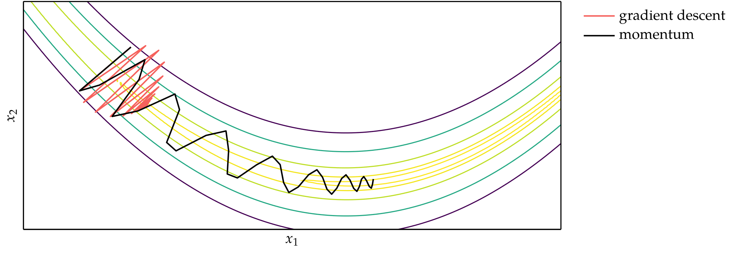
Momentum
Some functions cause gradient descent to get stuck
Momentum overcomes these issues by replicating the effect of physical momentum

Slide 8
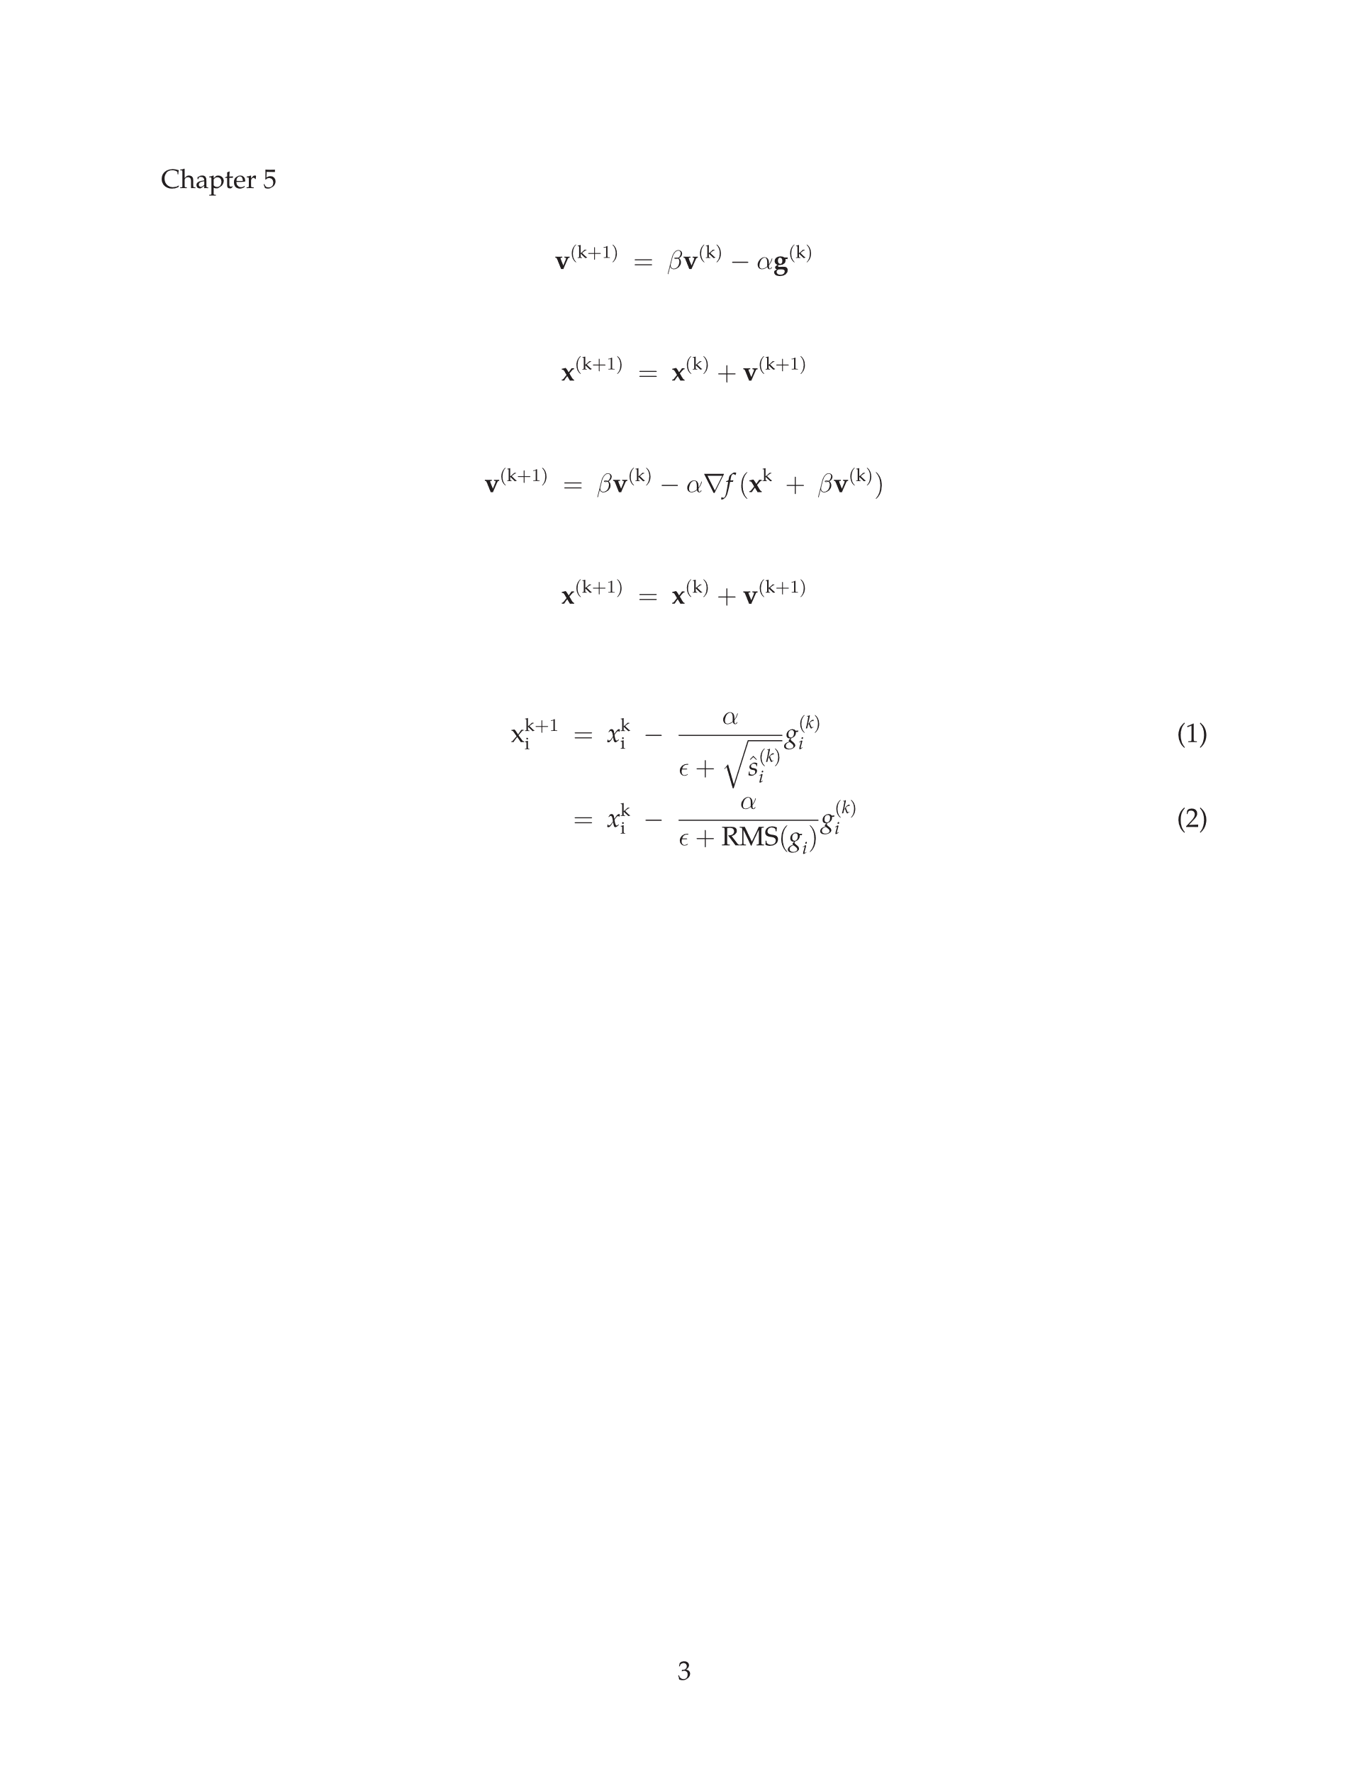
Momentum
Momentum update equations

Slide 9
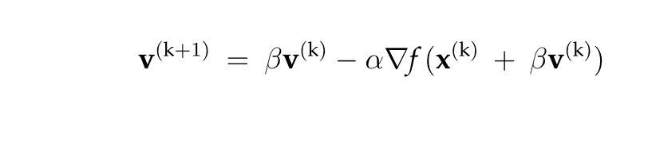
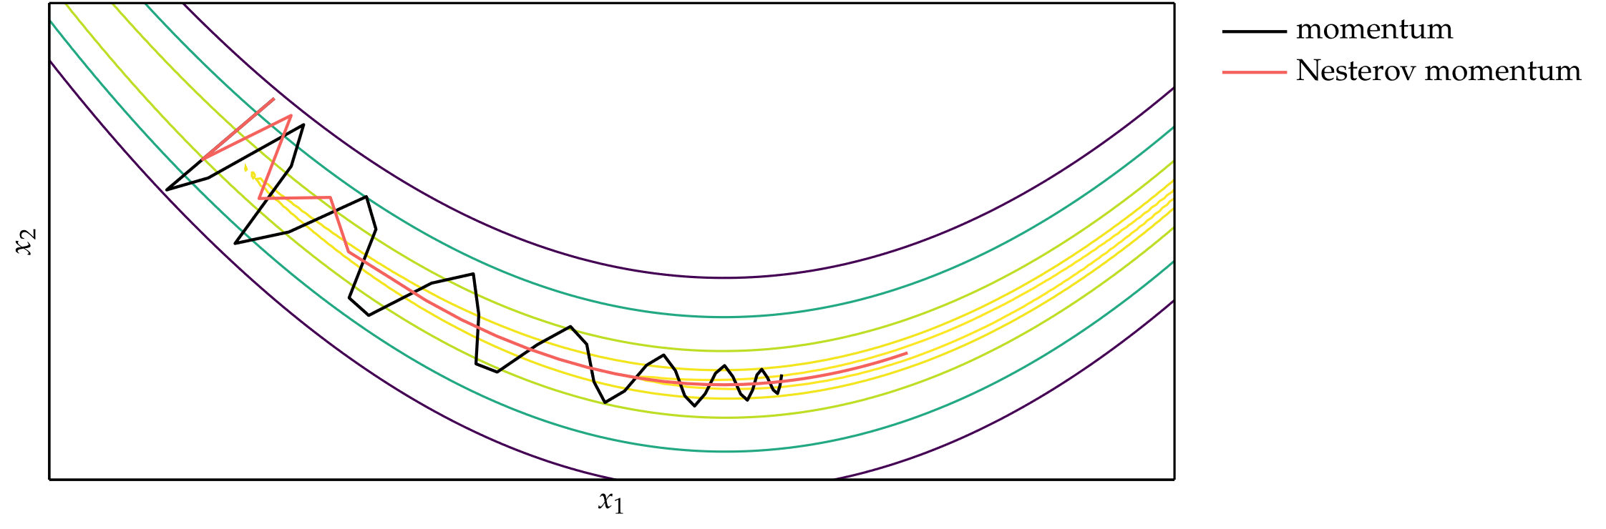
Nesterov Momentum

Slide 10
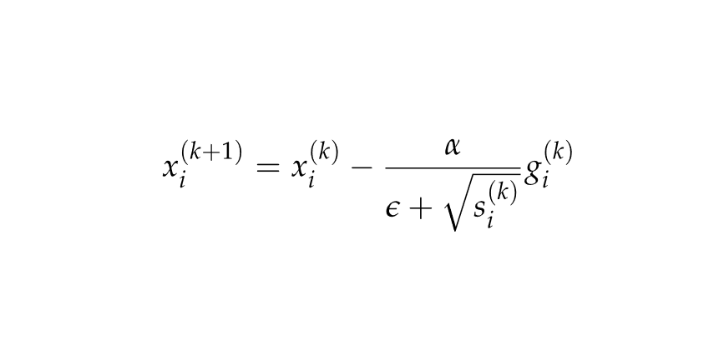
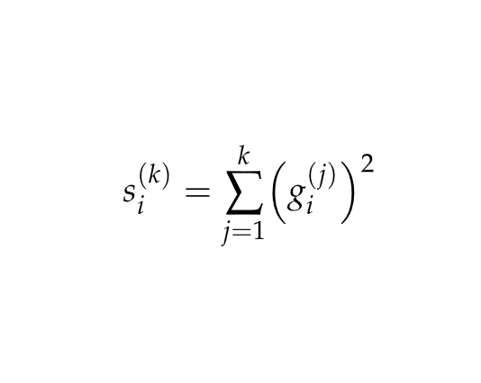

Adagrad
Instead of using the same learning rate for all components of x, Adaptive Subgradient method (Adagrad) adapts the learning rate for each component of x.
For each component of x, the update equation is
where
$$ϵ≈1×{10}^{−8}$$

Slide 11
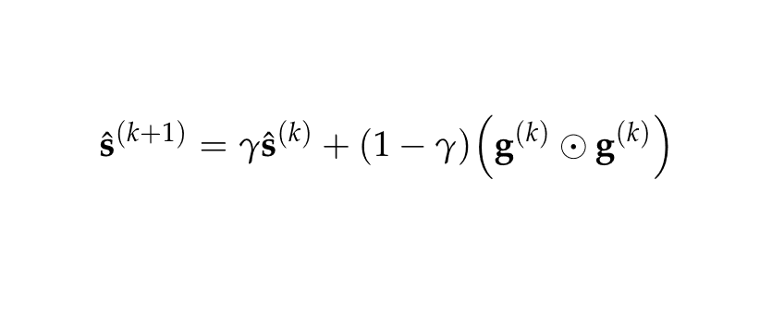
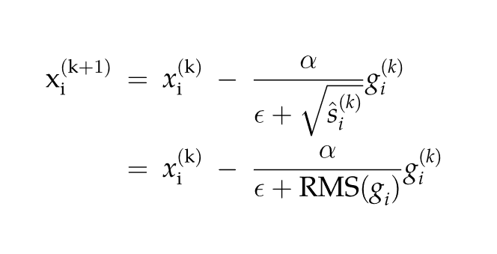
RMSProp
Extends Adagrad to avoid monotonically decreasing learning rate by maintaining a decaying average of squared gradients
Update Equation

Slide 12
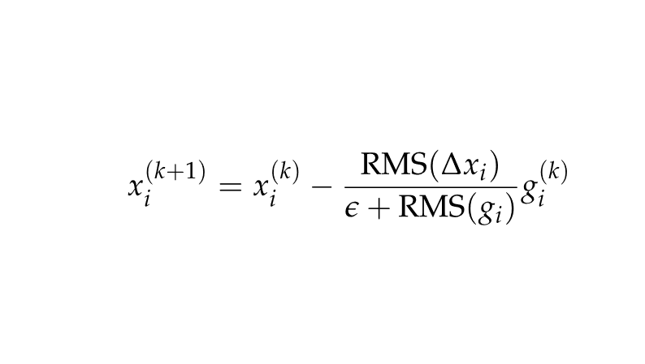
Adadelta
Modifies RMSProp to eliminate learning rate parameter entirely

Slide 13
Adam
Incorporates ideas from momentum and RMSProp
The adaptive moment estimation method (Adam), adapts the learning rate to each parameter.
At each iteration, a sequence of values are computed
Biased decaying momentum
Biased decaying squared gradient
Corrected decaying momentum
Corrected decaying squared gradient
Next iterate x^{(k+1)}

Slide 14
Hypergradient Descent
Many accelerated descent methods are highly sensitive to hyperparameters such as learning rate.
Applying gradient descent to a hyperparameter of an underlying descent method is called hypergradient descent
Requires computing the partial derivative of the objective function with respect to the hyperparameter

Slide 15
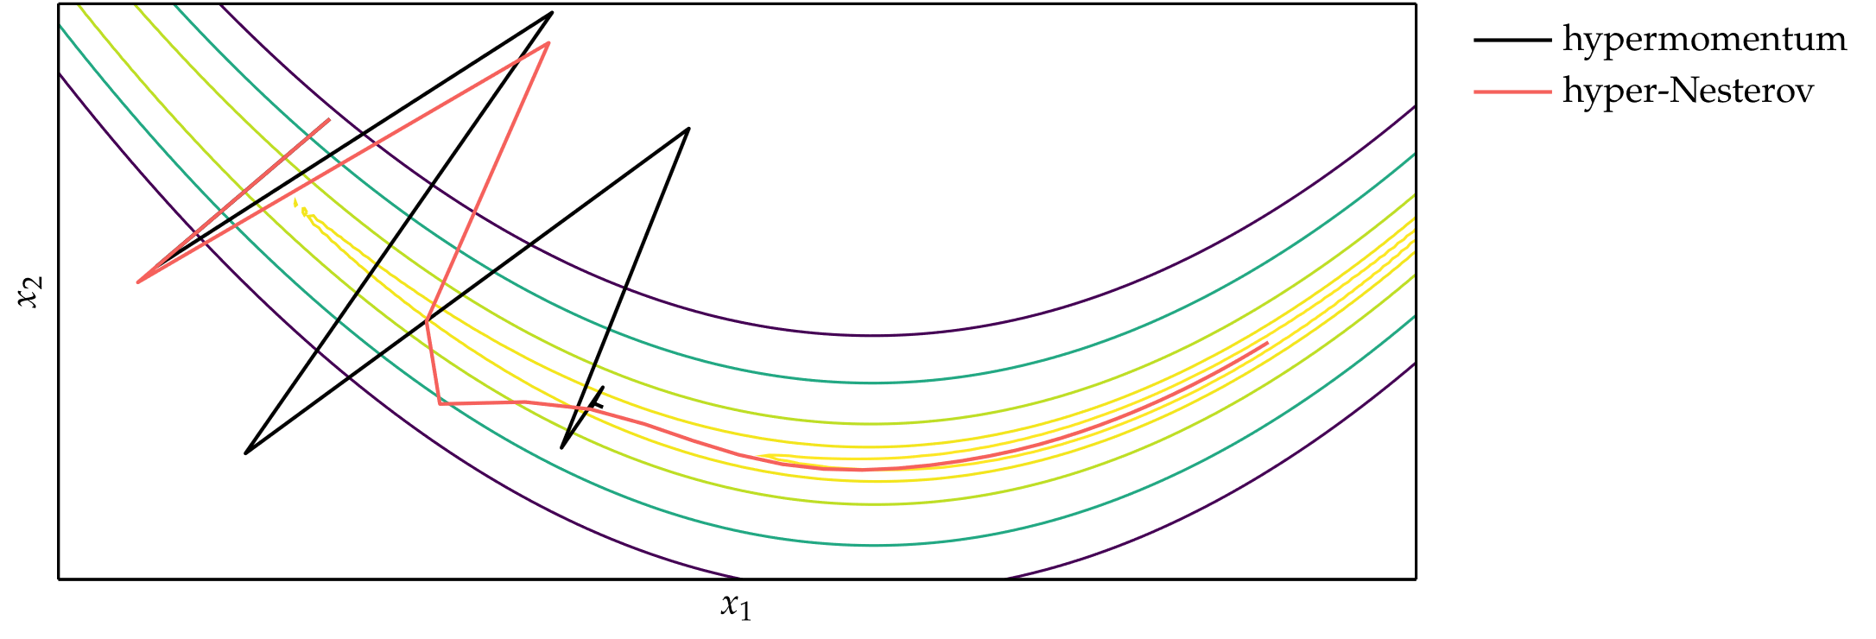
Hypergradient Descent

Slide 16
Summary
Gradient descent follows the direction of steepest descent.
The conjugate gradient method can automatically adjust to local valleys.
Descent methods with momentum build up progress in favorable directions.
A wide variety of accelerated descent methods use special techniques to speed up descent.
Hypergradient descent applies gradient descent to the learning rate of an underlying descent method.

