Slide 1
Second-Order Methods

Slide 2
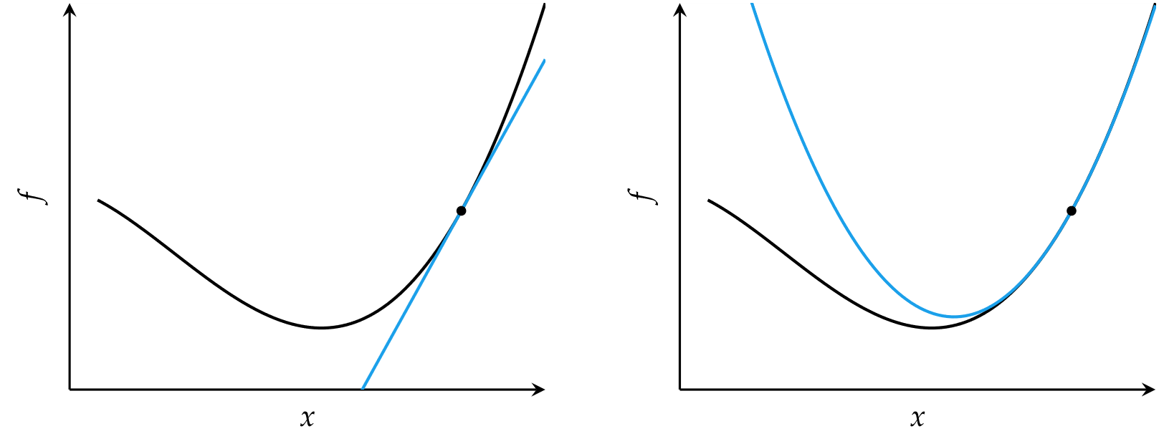
Second-Order Methods
Locally approximate function as quadratic
Comparison of first-order and second order approximations

Slide 3


Newton’s Method
Approximate a function using second-order Taylor series expansion
Univariate function

Slide 4


Newton’s Method
Multivariate function
Multivariate update rule
H is the Hessian matrix

Slide 5
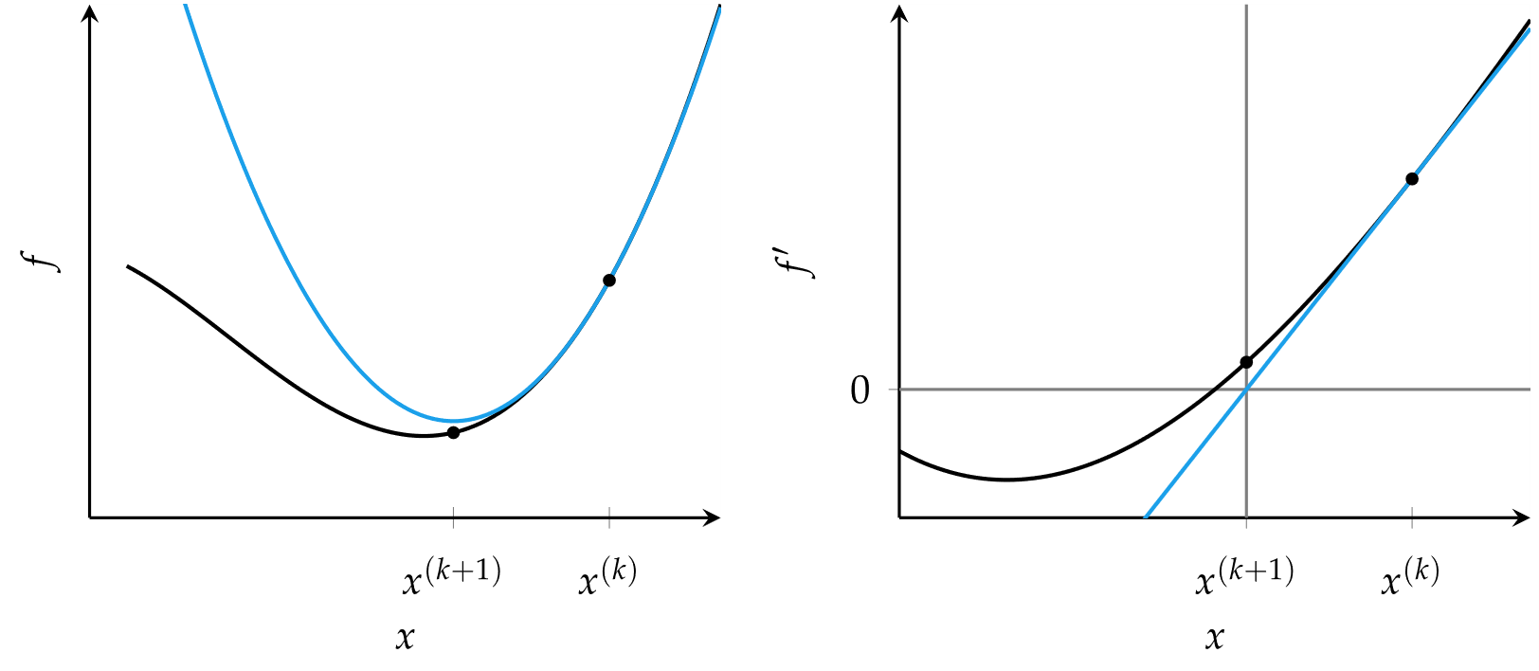
Newton’s Method
Newton’s method for optimization is equivalent to finding the roots of the derivative function

Slide 6
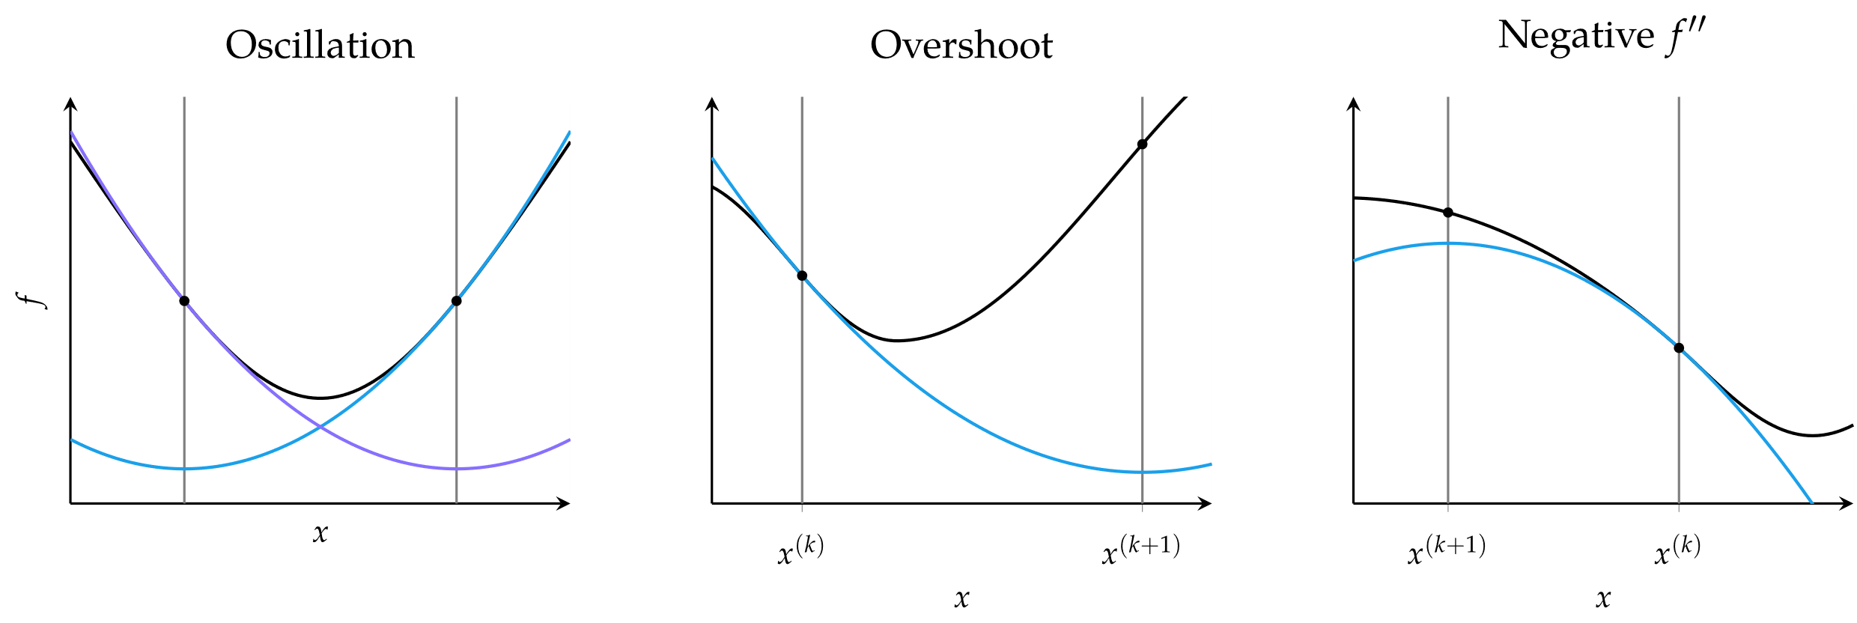
Newton’s Method
Common causes of error in Newton’s method

Slide 7


Secant Method
For univariate functions, if the second derivative is unknown, it can be approximated using the secant method
Update equation

Slide 8
Quasi-Newton Methods
For multivariate functions, the inverse Hessian may not be available or infeasible to compute, so can be approximated using a variety of Quasi-Newton methods, each appropriate in different circumstances
Davidon-Fletcher-Powell (DFP) method
Broyden-Fletcher-Goldfarb-Shanno (BFGS) method
Limited-memory BFGS (L-BFGS) method

Slide 9
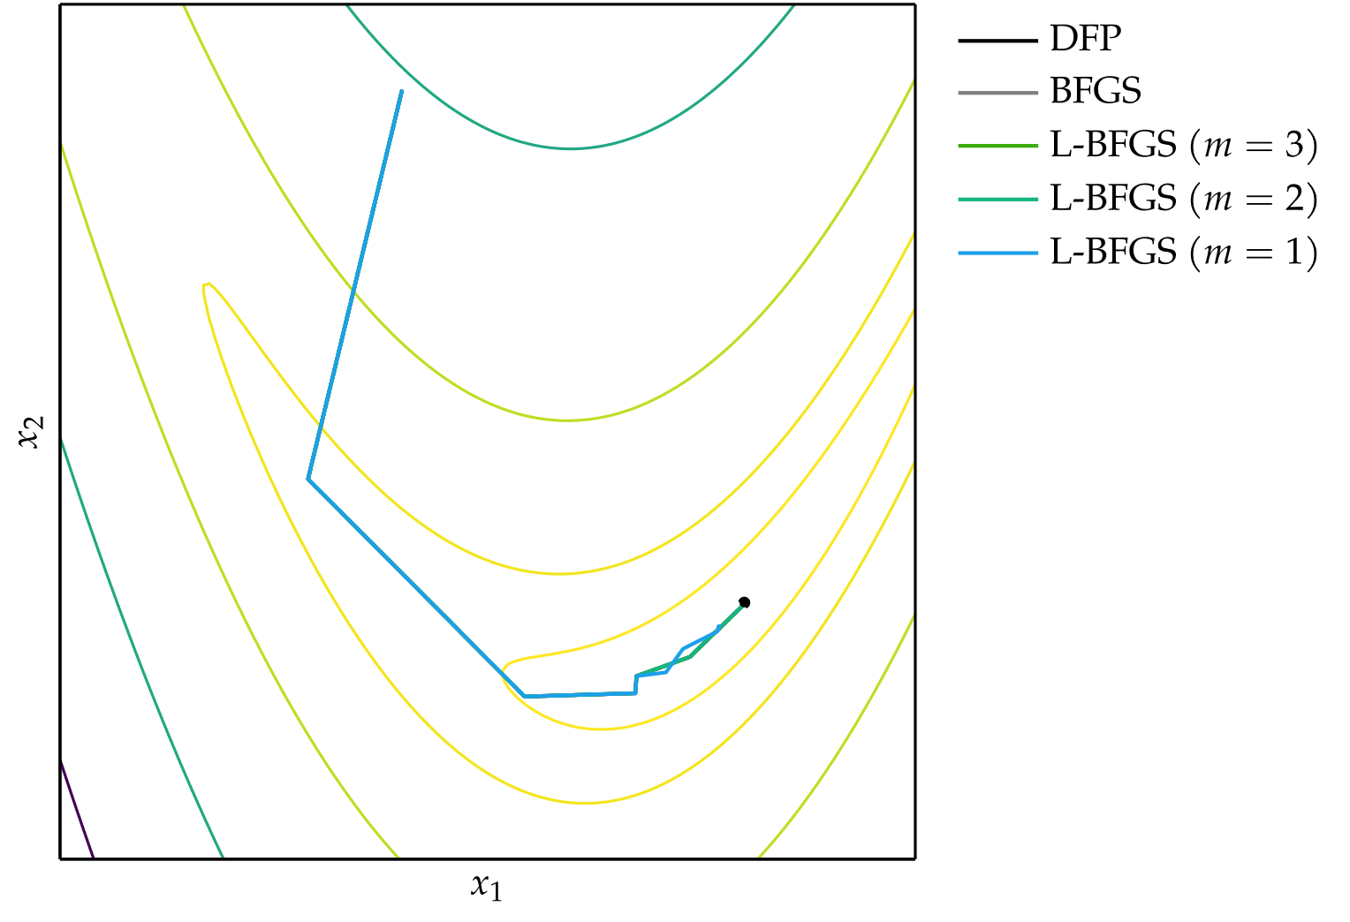
Quasi-Newton Methods

Slide 10
Summary
Incorporating second-order information in descent methods often speeds convergence.
Newton’s method is a root-finding method that leverages second-order information to quickly descend to a local minimum.
The secant method and quasi-Newton methods approximate Newton’s method when the second-order information is not directly available.

