Slide 1
Portfolio Health Advisor
Two AI agents that turn a confusing portfolio into clear, honest advice.
ACM Student Chapter Hackathon · Agentic AI

Slide 2
The problem
Retail investors hold stocks across sectors but can't see the big picture.
Three questions nobody answers easily: How much did I really gain? How concentrated is my risk? What should I do about it?
Our answer: automate that reasoning with a two-agent AI pipeline.

Slide 3
Solution: sequential agent pipeline
Agent 1 — Analyst: reads the CSV, runs math tools. Worth 27110.7 (+2180.4 / +8.75%), top sector Technology 53.71%. Facts only.
Agent 1b — Risk: flags HIGH risk (score 80/100), estimates tax, and adds health, rebalance, stress and harvest analysis. Rule-based, instant.
Agent 2 — Advisor: a free-tier LLM reasons over the findings and writes a 120-word plain-English summary with 1–2 actions. Offline rule engine as fallback.
Then: multi-turn Q&A over the same findings ('why is my risk high?').

Slide 4
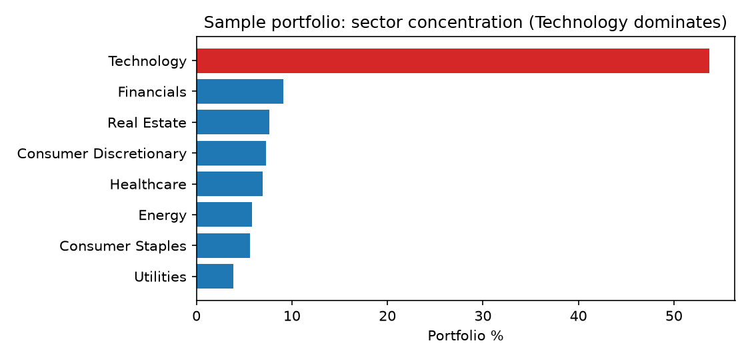
Live results on the sample portfolio
Value 27110.7 on cost 24930.3 → +2180.4 (+8.75%). 7 winners, 3 losers (worst: CLDW −11.1%).
Health 29.4/100 (Grade D) — Technology at 53.71% is the core problem (HHI 3207.72).
Rebalance plan frees ~5072.41 by trimming TCHX, CLDW, SEMI.
Stress: If Technology fell 20%, the portfolio would drop 10.74% to ~24198.6. Hypothetical.
Red ≥ 50% · Orange ≥ 30%

Slide 5
Creative features (beyond the brief)
Health score 0–100 + grade with penalty breakdown — one number anyone gets.
One-click rebalance plan — exact SELL quantities, BUY amounts (frees ~5072.41).
Growth projector + SIP goal planner — 'SIP for 100000 in 5 years?' answered live.
Stress-test lab — crash any sector by any % and see the damage.
Tax estimators — gains tax + tax-loss harvest pairs (CLDW offsets TCHX, saves ~77.4).
Report export + advice cache (repeat runs in ~0.2s) + full-screen mouse-driven TUI.

Slide 6
Scale: 10 → 200 holdings
Generator builds reproducible datasets (seeded): 200-holding portfolio ≈ 3.85M value.
Same pipeline, no code changes — CSV in, dashboard out.
Large portfolio correctly reads as diversified (top sector ≈ 12%) vs the concentrated sample.
200 holdings compute in well under 2 seconds (vectorized pandas).

Slide 7
Accuracy you can audit
Exact math: totals computed from unrounded values, reconciled to the cent on both datasets.
Sector percentages largest-remainder normalized — always sum to exactly 100.00%.
HHI concentration index from exact weights, not rounded ones.
Validation: friendly errors for missing columns, bad tickers, bad percentages.
Tested: tools + agents (LLM stubbed) + real mouse-click TUI tests — all green.

Slide 8
Interfaces for every judge
Full-screen TUI (Textual): sidebar, tables, What-If lab, live Q&A chat, one-click export.
Classic Rich menu + plain CLI (--auto, --non-interactive, --question) for scripts.
./run.sh — one command from clone to dashboard, with or without an API key.
Markdown report in outputs/ — the whole analysis as a shareable file.

Slide 9
Demo plan (3 minutes)
1. ./run.sh → dashboard: health gauge, red concentration bar, advice panel.
2. Rebalance view: exact trim/buy list. Stress lab: crash Technology 20%.
3. Ask: 'SIP for 100000 in 5 years?' → exact monthly number.
4. Export report → open outputs/*.md. Show --auto + cache speed on rerun.

Slide 10
Thank you — questions?
Not financial advice. Educational demo on static sample data.
github.com/algospider/AGENTIC-AI · ./run.sh to try it live

