Slide 1
CONSILIUM
One platform for who decides, what the rules are, and what happens when something goes wrong
Forums
Policy
Escalation
Who decides
What the rules are
When things go wrong
G-1…19
P-1…26
E-1…19
Shared Core
one data model · one permission model · one audit trail
What we built, what the evidence shows, and what it takes to reach production
Offline install · Windows and Linux · PostgreSQL · no per-seat licence
Leadership briefing · 18 September 2026
Pre-read for decision. Release 1.0.0: every figure measured on the final build.
Notes:
Purpose of this session: take a decision on the path to production for Consilium. The deck follows the answer-first structure: the executive summary and the decisions come first; sections A to F are the supporting evidence; the appendix holds the detail. Every number carries its source in the footnote. All figures are final: they were measured on release 1.0.0 after the last build wave.

Slide 2
Consilium is built and credibly tested; reaching production now depends on rehearsal in the target environment and five leadership decisions
1
We built one governance platform on infrastructure the organisation already runs.
Forums, policy and escalation share one Core: 144 entities over 378 tables. Installs with no internet access on Windows and Linux, on PostgreSQL. Open-source framework, no per-seat licence, not forked.
RECOMMENDATION
Approve the move to target-environment rehearsal, gated on evidence:
Rebase onto framework v16 before go-live
Provide the target environment and name its infrastructure owners
Confirm the single sign-on protocol
Name business owners for rules and reference data
Approve an AI endpoint and data boundary, or leave AI off: nothing depends on it
Go-live is conditional on the exit criteria on slide 40, not on a date.
2
Coverage is measured, not asserted, and the final build closed most of the gaps.
All 64 mandatory requirements re-measured on release 1.0.0: 49 fully reachable, 9 partly, 6 missing a mandatory clause. On 17 Sep it was 22 / 24 / 18. Of 191 backlog stories, 151 are done and none is in progress.
3
Quality evidence is strong, and realistic data made it stronger.
1453 of 1453 automated tests pass on a clean site. 302/302 interface checks and 11/11 browser journeys pass. A realistic demonstration organisation exposed 9 defects, including a publication-approval bypass. All are fixed, with 21 regression tests.
4
What remains before go-live is mainly environment work, not design.
Install, migration and upgrade are rehearsed air-gapped on Rocky Linux 9 (verify 14/14). Still open: the target itself, certificates, sign-on, SMTP, load and a real Windows run. The framework version we use (v15) treats PostgreSQL as second-class.
Sources: docs/delivery/REQUIREMENTS-COVERAGE.md §1–2 (final measurement, 18 Sep 2026); docs/delivery/EPICS.md; docs/delivery/DEPLOYMENT-READINESS.md; HANDOVER.md §4, §7.
Consilium | 2
Notes:
Answer first. Four points, each supported later in the deck. One: we built one platform on infrastructure the organisation already runs, with no per-seat licence. Two: we measured coverage honestly, requirement by requirement; the first measurement exposed real gaps, the final build closed most of them, and the six that remain are named. Three: the quality evidence is strong, and it became stronger when we loaded a realistic organisation and found nine real defects, including a control bypass on policy publication, which is fixed. Four: installation, migration and upgrade are rehearsed offline on a stand-in server; what is left is mainly environment work on the real target — certificates, sign-on, SMTP, load, a real Windows run — plus the framework-version decision. The recommendation is on the right.

Slide 3
We ask for five decisions today; each one removes a named blocker on the path to production
# | Decision | Why it is needed now | Recommendation | Proposed owner
1 | Framework version: rebase onto v16 before go-live | In v15 the framework calls its PostgreSQL support limited and says fixes for earlier versions will not be added. Our porting work carries over to v16 unchanged. | Approve the rebase before target rehearsal | Executive sponsor, with engineering lead
2 | Target environment: provide it and name its infrastructure owners | Migration, upgrade and load can only be rehearsed on the target. Certificates, ports, service accounts, the mail route (SMTP relay or Microsoft Graph app registration), write-once storage and backup ownership are all undecided. | Approve access; name one infrastructure owner | Infrastructure lead
3 | Single sign-on: confirm the protocol | LDAP and OIDC are configuration. SAML does not exist in the framework, so it would be a separate build with its own estimate. | Confirm LDAP or OIDC if possible | Information security
4 | Business rules: name owners for rules and reference data | The engines are built but run on data nobody has supplied yet: major/minor classification rules, real taxonomy values, escalation closure criteria, and a regulatory-change file sample. | Name owners in the governance and policy offices | Business sponsors
5 | AI position: approve an endpoint, or leave it off | Tested end to end with an OpenAI-compatible provider. Every analysis also works with AI off. Production needs an approved endpoint, an outbound path and a data boundary. | Approve an endpoint and ceiling, or keep AI off | Executive sponsor, with security
Sources: HANDOVER.md §7–8; docs/product/07-assumptions-and-gaps.md A-1–A-4, B-1, B-4–B-6; docs/product/01-requirements-baseline.md App. A; docs/delivery/DEPLOYMENT-READINESS.md. Owners are a proposal for confirmation.
Consilium | 3
Notes:
These are the asks. Each one is tied to a specific blocker. Decision 1, the framework version, is an architecture call the handover explicitly reserved for people rather than engineers. Decision 2 matters most for the schedule: nothing can be rehearsed until the target environment exists and someone owns certificates, service accounts, write-once storage and backups. Decision 3 matters because LDAP and OIDC are configuration, while SAML is a separate build. Decision 4: the engines exist, but the business rules they run on do not yet. Decision 5 keeps AI from becoming a go-live dependency.

Slide 4
A
Why this exists
Three governance questions, and the evidence they must produce
A Why this exists
B What we built
C How it works
D Evidence
E What is not done
F Road to production
Consilium | 4
Notes:
Section A sets out the problem: what the organisation must be able to prove, and why one platform answers it better than three separate systems.

Slide 5
A · WHY THIS EXISTS
Governance comes down to three questions. Consilium answers each one in a single place, on a shared Core
Who decides?
What are the rules?
What happens when something goes wrong?
Governance forums
19 mandatory requirements · G-1 … G-19
Policy
26 mandatory requirements · P-1 … P-26
Escalation
19 mandatory requirements · E-1 … E-19
Inventory of boards, committees, councils, working groups
Formation requests evaluated and approved
Membership, meetings, motions and votes
Compliance standing, annual attestation, disbandment
Frameworks, policies, standards, procedures
Intake, drafting, review, approval, publication
Applicability, exemptions, monitoring, violations
Periodic review, attestation, retirement
Intake against configurable templates
Severity and routing from an approved matrix
Action plans, risk acceptances, time limits
Closure with evidence, or handed off externally
Shared Core, built once: taxonomy, identity and delegation, attestation, classification rules, versioning and revert, retention, import and export, notification, service levels. 64 mandatory + 7 supplementary requirements
Source: docs/product/01-requirements-baseline.md §3 and Appendices A–B (64 mandatory requirements, all marked Mandatory in the source; 7 supplementary O-1…O-7 brought into scope); HANDOVER.md §0.
Consilium | 5
Notes:
The programme's 64 mandatory requirements reduce to three questions. Who decides is the forum inventory: committees, councils and working groups, and how they are formed, composed, reviewed and disbanded. What the rules are is the governing-document lifecycle. What happens when something goes wrong is escalation. The key design choice was to treat these as three modules of one product rather than three systems to integrate.

Slide 6
A · WHY THIS EXISTS
The requirements set a high bar for evidence: every decision, approval and refusal must be provable after the fact
What must be provable | What the requirements demand | Requirements | Why it is hard
Who did what, and when | Every change and user action logged with timestamp and actor. Prior versions retained, and an authorised user can revert. | G-9, P-9, E-12 | Revert is not a framework feature. It is built forward-only, so history is never rewritten.
Nothing published without approval | Every approval required for the change's classification is complete before publication. No bypass without a documented exception. | P-25, P-16 | The gate must hold on every route, not just the intended one (see the defect on slide 30).
Challenge happened | Second-line review and challenge, with service levels, before escalation to executives or forums. | E-9 | Needs time limits per step, not just per matter.
People confirmed the facts | Annual first-quarter attestation of the forum inventory; annual policy attestation. | G-10, P-8 | Three attestation events share one engine.
Restricted means restricted | Confidential documents and sensitive escalations limited to authorised users for view, download, print and share. | P-1, P-13, E-16 | Must hold on list, form, report, search, export and API.
Records cannot be altered | Data and documents retained per policy, in write-once, read-many form for the period. | G-16, P-18, E-18 | Moved from an external hook to in-platform: the largest single scope increase.
Source: docs/product/01-requirements-baseline.md §3 (requirement statements, paraphrased). All 64 requirements are Mandatory in the source documents.
Consilium | 6
Notes:
This slide explains why the platform is built the way it is. Read down the left column: these are the things an auditor or supervisor will test. Each maps to specific mandatory requirements. They drive most of the build effort: revert, write-once retention and enforcement on every read path are not framework features. They had to be built.

Slide 7
A · WHY THIS EXISTS
Stakeholder decisions turned three separately scoped systems and four live connectors into one platform, reshaping 37 of the 64 requirements
FROM
TO
Effect of stakeholder decisions on the 64 mandatory requirements
Three separately scoped systems
One platform, three modules, shared Core
S-1
Live connectors to the risk register, risk appetite system, GRC platform and regulatory-change feed
One governed file import and export pipeline, with mapping, validation and a full audit trail
S-2
Retention handed off to an external records system
Retention classes, legal hold and a hash-chained archive, built in the platform
S-3
Collaborative editing built here
External editor. We hold the authoritative document body and its version chain, with revert
S-4, S-5
So what: the largest unknown (four undiscovered external interfaces) was removed. The largest scope increase (in-platform retention) was accepted.
Periodic escalation submissions compiled by hand
Reports generated directly, with quarterly tracking and nil returns
E-11
Source: docs/product/01-requirements-baseline.md §2 (decisions S-1…S-11), §4 and requirement tables (Δ markers; the tables are authoritative per 07 'Known inconsistencies' — the 06 summary states 15 and 26); E-11 statement.
Consilium | 7
Notes:
The source requirements described three separately scoped systems with live connectors to four external systems nobody had specified. Eleven stakeholder decisions reshaped that into something deliverable. Fourteen requirements changed materially and twenty-three were clarified. The biggest trade: live connectors became one governed file import pipeline, which keeps the control and loses only timeliness. Retention moved in-house, which is the largest single scope increase.

Slide 8
A · WHY THIS EXISTS
Consilium puts all three lines of defence on the same record, so challenge and assurance happen where the work is done
1st line
Own and manage
2nd line
Oversee and challenge
3rd line
Independent assurance
Policy Owner — drafts and maintains governing documents
Escalation Owner — raises and works matters, action plans, closures
Committee Secretary / Forum Owner — meetings, motions, votes, membership
Risk Governance Office — evaluates formation requests
Compliance Reviewer — records forum compliance decisions
Escalation Reviewer — challenges and reviews matters
Enterprise Policy Office — approves, publishes, retires
Consilium Audit — reads everything, changes nothing
Governance Refusal Log — every refused action, with reason
Field-level change history on every governed record
Segregation of duties is enforced on the server and tested by attempting forbidden actions:
✓ A reviewer cannot create a document
✓ A policy owner cannot delete a document
✓ An auditor may read but not write
✓ A viewer cannot create a forum
Sources: docs/guides/08-your-first-day.md (roles); docs/product/05-glossary.md §B–C; docs/delivery/REQUIREMENTS-COVERAGE.md P-13 (permission tests). The mapping of roles to lines of defence is illustrative.
Consilium | 8
Notes:
The same record carries first-line ownership, second-line challenge and third-line assurance. Segregation of duties is enforced on the server, not by hiding buttons. Tests attempt each forbidden action as the wrong role. The audit role reads everything and changes nothing. Every refusal is logged, so assurance can see attempted breaches as well as completed actions.

Slide 9
B
What we built
The capability, the design choices behind it, and the platform it runs on
A Why this exists
B What we built
C How it works
D Evidence
E What is not done
F Road to production
Consilium | 9
Notes:
Section B covers what exists: the capability map, the four design principles, why we chose this platform, the constraints it meets, the architecture, the data model, the redesigned portal and the integrations screen.

Slide 10
B · WHAT WE BUILT
One platform, three modules and a shared Core: the engines every module needs are built once and reused
Governance
24 entities
Policy
38 entities
Escalation
18 entities
144
Forum inventory and hierarchy
Committee formation and evaluation
Compliance lifecycle and watched fields
Membership with history, delegation, quorum
Meetings, motions, votes, minutes
Disbandment
Repository, lineage, applicability
Lifecycle, approval routing, gates
Intake and major/minor classification
Versions, publication, exemptions
Horizon scanning, monitoring, violations
Glossary
Matters with three configurable templates
Matrix-driven severity and routing
Action plans, risk acceptances
Time limits and breach escalation
Closure criteria and evidence
Analysis and periodic returns
entities across Core and three modules
378
PostgreSQL tables on one site
1
Consilium Core
64 entities · built once, used by all three modules
data model, permission model and audit trail
Taxonomy (17 lists)
Identity & delegation
Attestation engine
Classification rules
Version chain & revert
Retention & legal hold
No module keeps its own copy of a shared list: every tag links to the Core taxonomies.
Import & export
Notification templates
Service levels & reminders
Approval decisions
AI guard & provenance
Navigation & integrations
Sources: entity and table counts measured on the demonstration site, 18 Sep 2026 (a scratch record type excluded); docs/delivery/SESSION-SUMMARY.md; docs/product/02-data-model.md §2.1.
Consilium | 10
Notes:
This is the capability map. Across the top are the three business modules with their entity counts. Underneath is the Core: the services all three need. Attestation, notification, versioning, retention and service-level timing appear in all three modules' requirements with slightly different wording. Building them three times is the most likely way a programme like this becomes inconsistent. We built each one once.

Slide 11
B · WHAT WE BUILT
Four design principles make the platform auditable and cheap to change
1
States are configuration; flags are logic
2
Nothing is deleted; history reads as at any date
Code never compares a workflow state's name. It reads flags (editable, active, requires review) that each state sets.
Why it matters: Renaming a state, or inserting an approval step, is configuration, not a release.
Evidence: A checker over 82 state names fails the build. Proven live: a new approval stage added with no release (slide 32).
Seats are ended, forums disbanded, documents retired, values made inactive. Membership is a dated record of its own.
Why it matters: The composition of any forum on any past date is a query, not a reconstruction.
Evidence: Revert writes a new version; prior versions still exist afterwards (tested).
3
Every refusal is recorded
4
One engine per concern
When a control stops an action, the reason is written to the Governance Refusal Log, even if the action is rolled back.
Why it matters: Assurance sees attempted breaches, not only completed actions.
Evidence: Every refusal message names the rule that refused it.
Attestation, notification, versioning, retention, service levels and classification are built once, in Core.
Why it matters: One consistent answer instead of three subtly different ones.
Evidence: Three annual attestation events, one engine.
Sources: docs/OPERATIONS.md §A–B; docs/delivery/SESSION-SUMMARY.md; docs/product/02-data-model.md §2.3 (M-1, M-4); docs/delivery/REQUIREMENTS-COVERAGE.md G-6, G-9.
Consilium | 11
Notes:
These four principles are why the platform should stay cheap to run. One: the code never reads a workflow state's name. It reads flags, so adding a Legal Review step is configuration, not a release, and a checker enforces this. Two: nothing is deleted, so we can reconstruct any date. Three: every refusal is logged, which gives assurance the attempted breaches too. Four: one engine per concern. For example, three annual attestation events run on one engine.

Slide 12
B · WHAT WE BUILT
An open-source framework gave us the governance building blocks without a per-seat licence, and we have not forked it
Framework building block | What Consilium uses it for
Workflow (states, transitions, role gates) | Policy approvals and exceptions, sign-off chains
Workflow action record | Immutable record of who approved what, and when
Assignment rule | Escalation routing
Role, permission, user permission | Committee membership, segregation of duties
Version (audit trail) | Automatic field-level change history
Notification | Alerts on state change or time-limit breach
Record type definition | A new record type without writing a migration
Report, dashboard, web form | Management reporting and intake forms
No per-seat licence
The objective set at the outset: run the platform on infrastructure the organisation already runs, with no per-seat licence of a commercial GRC product.
Not forked
The framework source stays untouched. 8 runtime patches are applied at start-up, each doing nothing on Linux, so upstream updates keep applying.
Portable by evidence
A static code audit of the whole framework found 10 Windows blockers, 6 of them in test code. The rest are patched and tested.
Source: HANDOVER.md §1 (framework primitives and uses; objective of no per-seat licensing), §3 (not forked; 8 runtime patches; AST audit), §8; docs/product/04-architecture.md §1.
Consilium | 12
Notes:
The platform choice is an open-source, metadata-driven framework. It ships the building blocks you would otherwise buy a commercial GRC product for: configurable workflow, immutable approval records, field-level history, role and row permissions, notifications, a report builder and an API. The critical discipline is that we have not forked it. Every change is a runtime patch that does nothing on Linux, so upstream security fixes still apply. The moment we fork, we own the framework's security patching forever.

Slide 13
B · WHAT WE BUILT
The platform meets five hard enterprise constraints that the framework's standard installation cannot
Constraint | Why the standard path fails | What we built | Evidence
Installs with no internet | Assumes git clone from GitHub; the framework is not on the public package index | One self-verifying bundle: wheels, framework, application, prebuilt assets, installer | Air-gapped Rocky Linux 9: no route to the internet, 0 network lines in pip's log; verify.sh 14/14, health 17/17
No compiler | Some dependencies publish no wheel | Wheels built when the bundle is made, on a connected machine | Runtime set: 139 wheels + 6 pure-Python sdists; the builder refuses anything that needs a compiler
No package manager for the front end | Front-end build needs node and yarn | Prebuilt asset bundle committed; libraries vendored and checksummed | Verified with node absent from the path
Windows and Linux from one tree | Standard tooling (bench, supervisor, nginx, gunicorn) is POSIX-only | Cross-platform launcher of about 800 lines; pure-Python web server; fork-free worker | 22 simulated-Windows tests pass. Not yet run on real Windows hardware
PostgreSQL only | MariaDB-first | PostgreSQL 16; no MariaDB-specific SQL | About 190 framework tests run on PostgreSQL: 3 failures, none ours
Sources: HANDOVER.md §2–4; README.md ('Current state', 'Requirements'); docs/delivery/DEPLOYMENT-READINESS.md §1–3; CLAUDE.md non-negotiable rules 1–7.
Consilium | 13
Notes:
The framework's standard install assumes Linux, internet access, a git clone from GitHub, MariaDB and several POSIX-only tools. None of that works in a locked-down enterprise network. This slide shows each constraint, what we did about it, and the evidence. The honest caveat is in the Windows row. The Windows code paths are covered by tests that simulate Windows, but the product has never run on an actual Windows machine. That is a Phase 2 exit criterion.

Slide 14
B · WHAT WE BUILT
A conventional tiered architecture with no outbound network dependency in the delivered configuration
SECURE ZONE — air-gapped Linux server (production) or Windows workstation (development)
OUTSIDE THE TRUST BOUNDARY
Client
AI service (optional)
OpenAI-compatible; every request logged before it is sent
Portal screens (daily work)
Workspace (administration)
Web
Doc AI and horizon scanning
Browser hand-offs, identifiers only; logged
Pure-Python web server
Static assets served in-process
Mail: SMTP or Microsoft Graph
Outbound notifications only
Application
Permission check on every request
Document engine
Workflow engine
Core services
Module logic
REST API
Identity provider
OIDC or LDAP, authentication only
Background
Job queues
Workers
Scheduler: exactly one
Import / export drop
Nothing commits without human review
Data
PostgreSQL 16
Redis cache and queues
Private file storage
No requirement among the 64 depends on anything outside the zone.
Source: docs/product/04-architecture.md §2.1–2.3 (components), §4.2 (AI boundary rules), §9.2 (boundary table), §9.3 (exactly one scheduler); docs/guides/07-help-and-ai.md; docs/guides/09-administration.md §9.14 (Integrations).
Consilium | 14
Notes:
The left box is everything inside the secure zone: a browser-only client, a pure-Python web tier, one application codebase, background workers and a single scheduler, and PostgreSQL, Redis and private file storage. Permission evaluation happens on the server for every path, so a custom screen cannot widen access. On the right is everything outside the trust boundary: the AI service, the document editor and horizon-scanning hand-offs, mail by SMTP or Microsoft Graph, the identity provider and the file drop. Each is optional and connected from one administrator screen, and none of the 64 requirements depends on any of them. The one operational rule to remember: exactly one scheduler process, or every job runs twice.

Slide 15
B · WHAT WE BUILT
The data model marks every element as specified, decided or inferred, so reviewers know exactly what to challenge
Specified
Named in a source requirement document.
e.g. Committee formation request, charter, horizon scan
Implemented entities by module
S
D
Decided
Settled by a stakeholder decision. Binding.
e.g. Membership as its own dated record; one attestation engine; document version chain
I
Inferred
In no source and not decided. Every item is a review point.
e.g. Shared regulatory-requirement library (C-1); what restricted handling must block (C-3)
114
144
378
Four structural decisions: membership is its own dated record · we hold the document body and version chain · four tagging dimensions are multi-valued · nothing keys off a state name
logical entities in the model
entities implemented
database tables
Sources: docs/product/02-data-model.md §1.1 (provenance marks), §2.2 (114 logical entities: 78 standalone + 36 child), §2.3 (M-1…M-4); docs/product/07-assumptions-and-gaps.md §4 (C-1…C-5); implemented counts measured on the demonstration site, 18 Sep 2026.
Consilium | 15
Notes:
Every entity and field in the data model carries a provenance mark. S means specified in a source document. D means decided by a stakeholder after the fact, and binding. I means inferred: we needed it to satisfy a requirement, but nobody asked for it. Every I item is a review point and is listed with its consequences in the assumptions document. On the right: the logical model defines 114 entities, and the implementation has 144 across the four modules. Four structural decisions shape everything else.

Slide 16
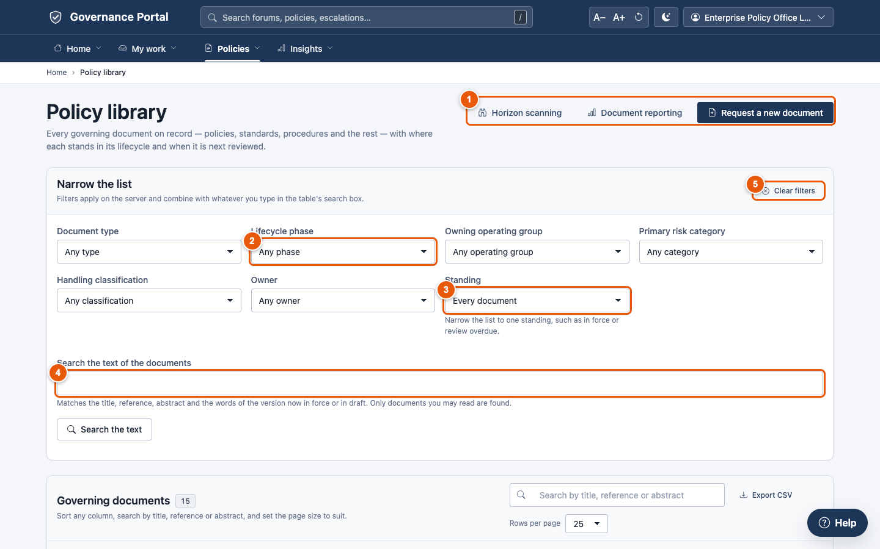
B · WHAT WE BUILT
Daily work happens in purpose-built portal screens and administration in the workspace, with one permission model behind both
Portal — for daily work
Menus by area — Home, My work, Governance, Policies, Escalations, Insights — and search from any page
Every table pages, sorts and searches in the database, and exports to CSV
Light and dark themes; text-size control; a Help assistant on every page
Workspace — for administration
Roles, reference data, workflow and rule configuration, report builder, audit views
Made to look like the organisation's own
Framework name removed from the interface
Name, logo, colours, typeface and banner set by an administrator, with no release
Out-of-scope framework features hidden
Hiding is presentation; the server's refusal is the control.
Sources: docs/product/04-architecture.md §3; docs/guides/01-finding-your-way.md; docs/guides/09-administration.md §9.5 (branding); delivery-team change log 18 Sep 2026 (framework name removed; out-of-scope features hidden).
Consilium | 16
Notes:
The interface is hybrid. People doing daily work use the portal. Administrators use the framework's workspace for roles, reference data, workflow configuration and the report builder, because rebuilding those screens is expensive and is where audit findings come from. Both call the same permission-checked API. The product is now white-labelled: the framework's name is gone from the interface, and an administrator sets the organisation's name, logo, colours and typeface in one record with no deployment. Out-of-scope framework features are hidden.

Slide 17
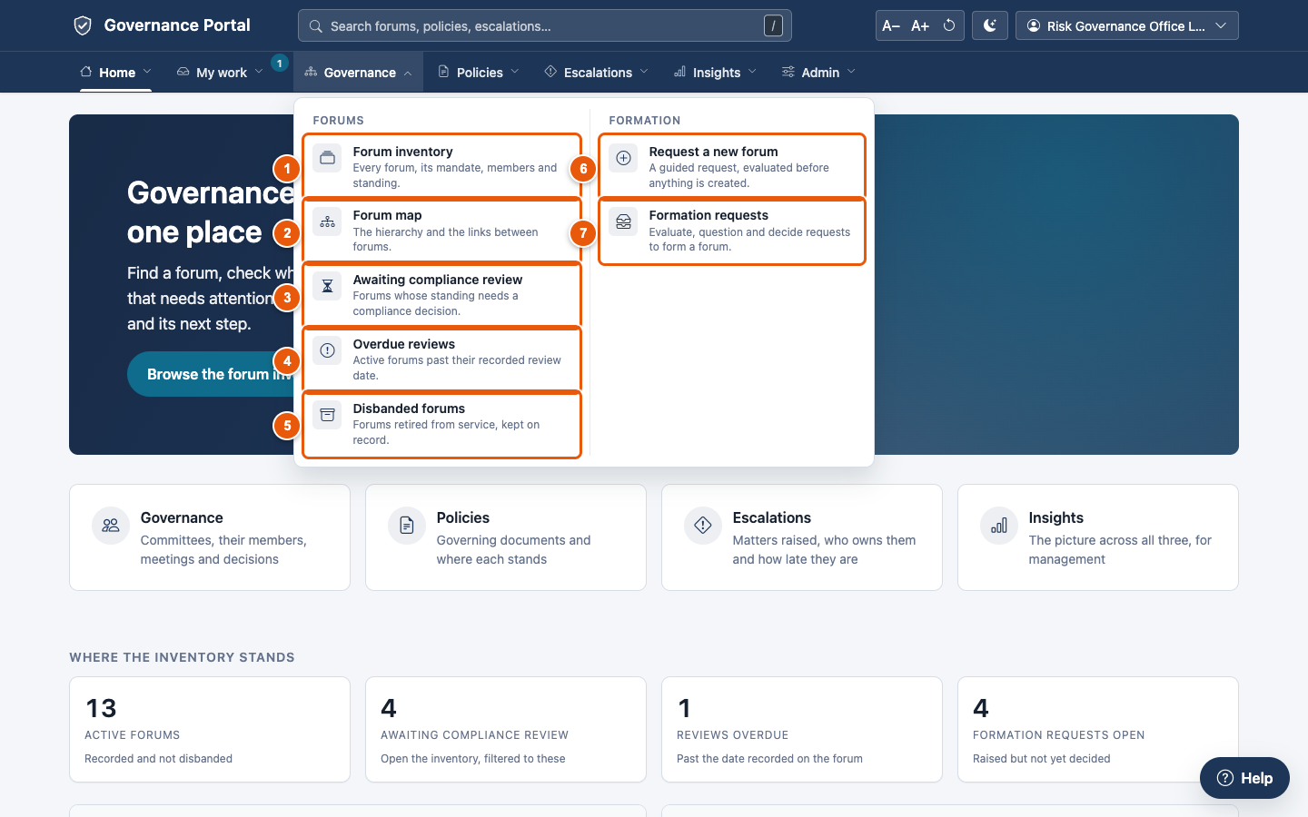
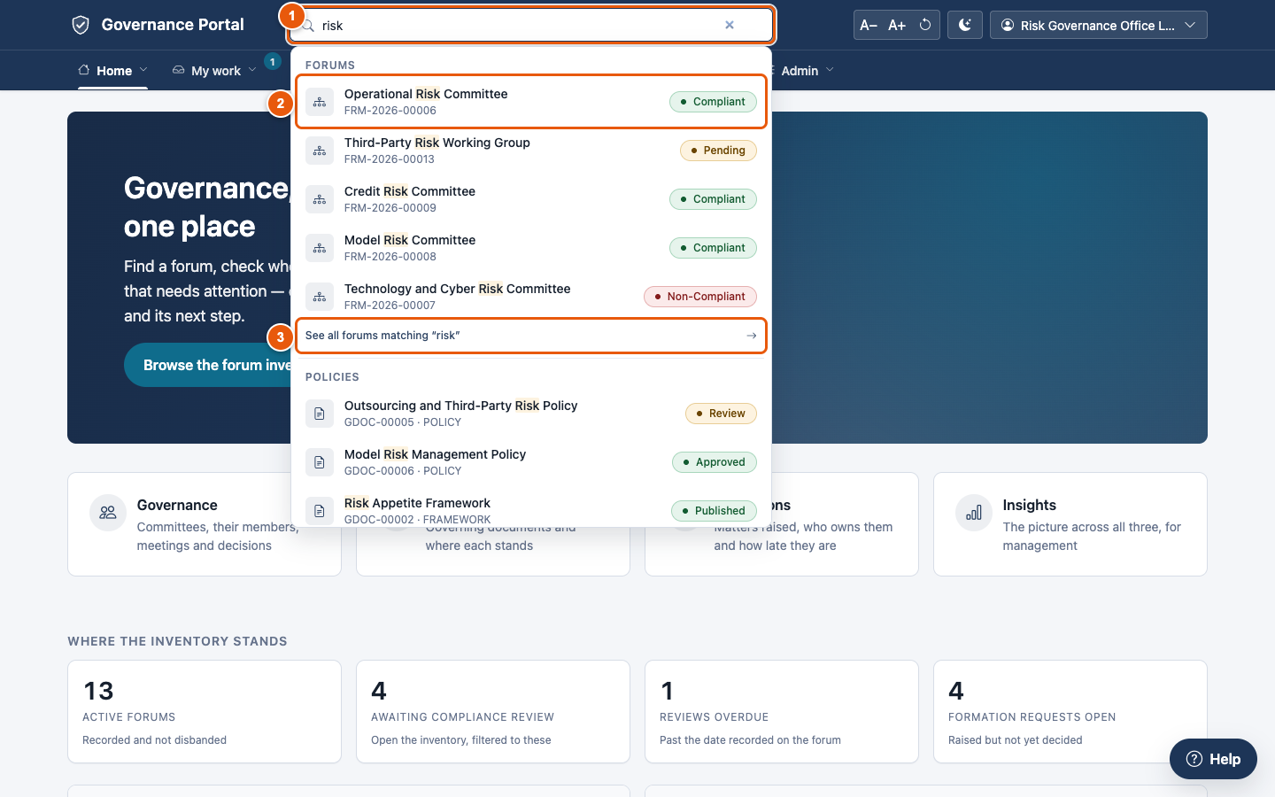
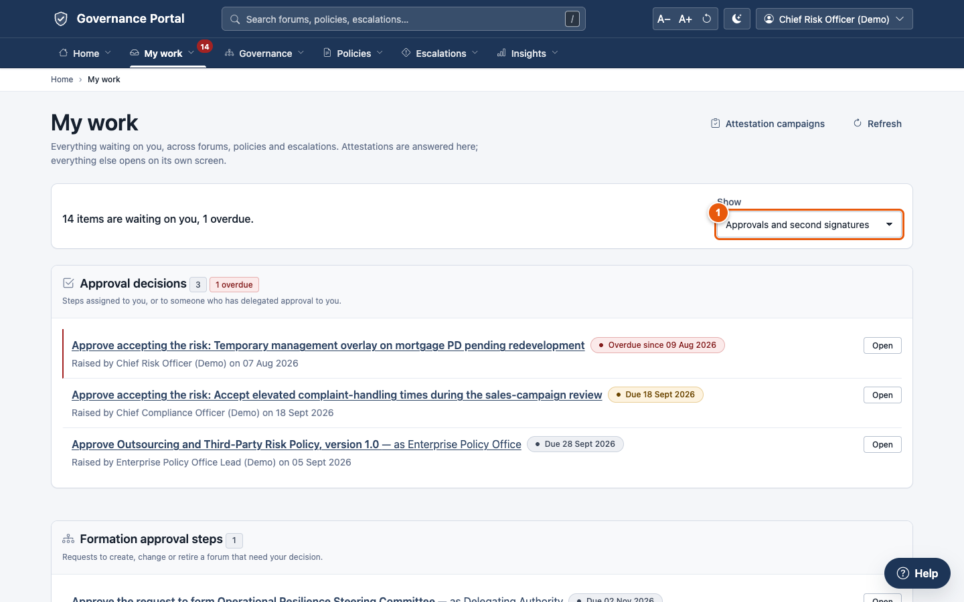
B · WHAT WE BUILT
The portal was redesigned around how people work: one header, menus shaped by role, and search from any page
A menu opens a panel of pages and ready-made views, each explained
Search from any page, grouped by forums, policies and escalations
My work: approvals described in words, not codes
Menus by role
Home, My work, Governance, Policies, Escalations, Insights, Admin; nobody is offered a dead end
Search is safe
"/" or Ctrl/Cmd+K; results come only from records the viewer may read
Lists that work
Filter, sort, search and Export CSV on every list; empty states say what to do next
Keyboard, phone, clarity
Menus by keyboard; slide-out on phones; times show their zone; plain names
Sources: consilium_core/navigation.py (cns_nav), consilium_core/search.py, templates/base_portal.html; consilium_core/tests/test_navigation.py (11), test_global_search.py (9); scripts/browser_journeys.py (11/11); docs/delivery/EPICS.md E35.
Consilium | 17
Notes:
After the product owner's review, the header was rebuilt. The top row holds the brand, one search box, text size, theme and the user menu. The second row holds seven menus: Home, My work, Governance, Policies, Escalations, Insights and Admin. Each opens a panel of pages and ready-made filtered views, each with a line saying what it is for. Menus are filtered by role and read permission, so nobody is offered a dead end. Search reaches forums, policies and escalations from any page, through the same permission checks as the lists, so a confidential document or sensitive matter never appears to someone not cleared. Lists export to CSV, empty states say what to do next, and the menus work from the keyboard and on a phone.

Slide 18
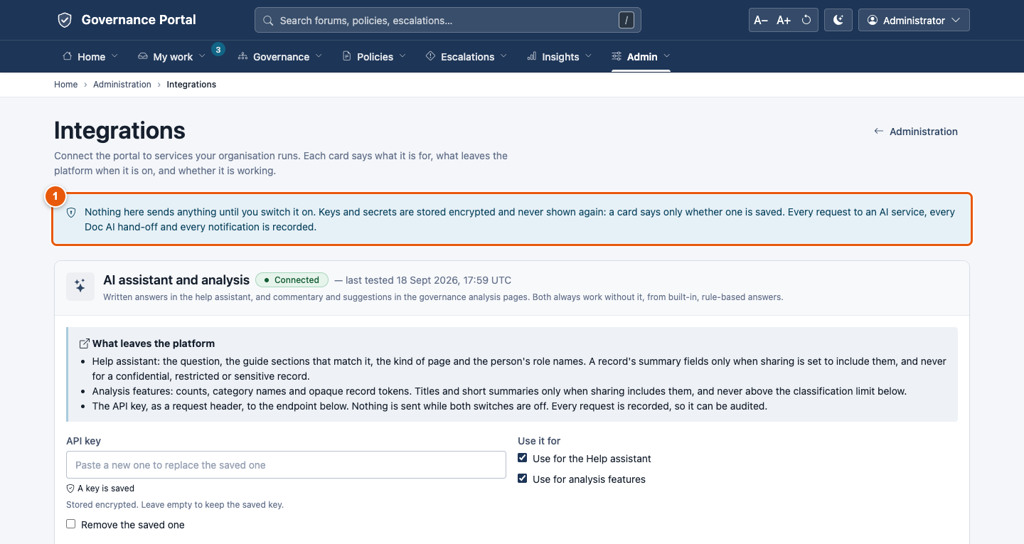
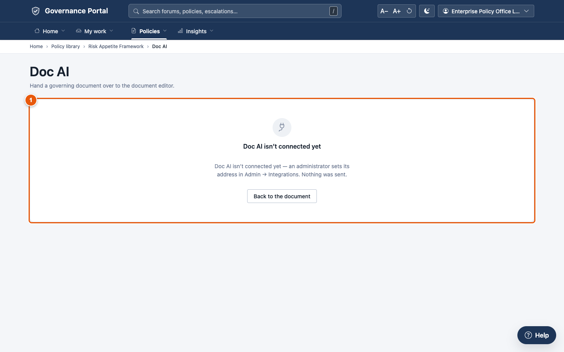
B · WHAT WE BUILT
One administrator screen connects the organisation's own systems: AI, the document editor, horizon scanning, mail and sign-on
AI
OpenAI-compatible endpoint; write-only key; Test connection; every call logged
Doc AI
Open a policy in the document editor; access-checked, logged, identifiers only
Horizon scanning
A link to the external platform; label and roles configurable
Mail
SMTP, or Microsoft Graph with app-only credentials; send a test to me
Sign-on
Shows the redirect URI to register; OIDC or LDAP set at install
Sources: consilium_core/integrations/ (admin.py, external_tools.py, graph_mail.py); www/integrations, www/doc-ai, www/horizon-scanning; consilium_core/tests/test_integrations.py (31), test_graph_mail.py (20); docs/delivery/DEPLOYMENT-READINESS.md 'What the organisation provides'; docs/delivery/EPICS.md E36.
Consilium | 18
Notes:
Everything that connects to another system is on one screen, Admin, Integrations, for administrators only. The AI card takes an OpenAI-compatible endpoint and a key that is never shown back, and tests the connection through the same audited client the product uses. Doc AI is the organisation's document editor: Open in Doc AI checks access, logs the hand-off and sends only identifiers, never the file; until an address is set it explains that it is not connected yet. Horizon scanning is a link to the external platform with a configurable label. Mail goes by SMTP or, where servers may not speak SMTP, by Microsoft Graph with application credentials. Single sign-on shows the redirect address to give the identity team. Nothing here needs a code change.

Slide 19
C
How it works
A day in the life, from forming a committee to proving a year later what happened
A Why this exists
B What we built
C How it works
D Evidence
E What is not done
F Road to production
Consilium | 19
Notes:
Section C walks through one journey using the demonstration organisation. Every record reference on these slides exists in the demonstration database.

Slide 20
C · HOW IT WORKS
One journey, from forming a committee to proving a year later what happened, runs on one set of records
1 Form a forum
2 Review compliance
3 Run the policy lifecycle
4 Escalate an issue
5 Close with evidence
6 Audit as at any date
WHAT HAPPENS
WHAT HAPPENS
WHAT HAPPENS
WHAT HAPPENS
WHAT HAPPENS
WHAT HAPPENS
Request evaluated on five criteria, approval steps from a configured route; approval creates a draft forum
Compliance reviewer records a decision; a change to a watched field reopens review
Draft → Review → Approved → Published → Implemented → Retired
Matrix sets severity and pathway; time limits run
Closure record plus completed response template
Membership, votes, versions and refusals, as at any date
DEMO RECORD
DEMO RECORD
DEMO RECORD
DEMO RECORD
DEMO RECORD
DEMO RECORD
CFR-2026-00001 → FRM-2026-00014 Data Governance Council
Operational Risk Committee: watched-field change → review FCR-2026-00006
Risk Appetite Framework published after 2 approval decisions
ESC-2026-00007: severity High, breached 31 Jul 2026, raised
ESC-2026-00006 closed, tracked externally
67 meetings, 38 minute versions, 17 charter versions
CONTROL
CONTROL
CONTROL
CONTROL
CONTROL
CONTROL
Approve stays disabled until nothing blocks it
A review is its own record and cannot be edited
Gates on every route, including the one we found open
Sensitive matters invisible to anyone not cleared
Refused until both are done
Nothing is deleted
Source: docs/delivery/REQUIREMENTS-COVERAGE.md §3 (demonstration records on the rebuilt demo site, queried 18 Sep 2026); docs/guides/ chapters 3–5.
Consilium | 20
Notes:
This is the storyline for the walkthrough. Six steps, each with the control that makes it defensible and a demonstration record you can open in the product. The next five slides take them in turn. The point to land is continuity: the forum formed in step one approves the policy in step three and receives the escalation in step four. In the audit step, all of that can be read back as it stood on any date.

Slide 21
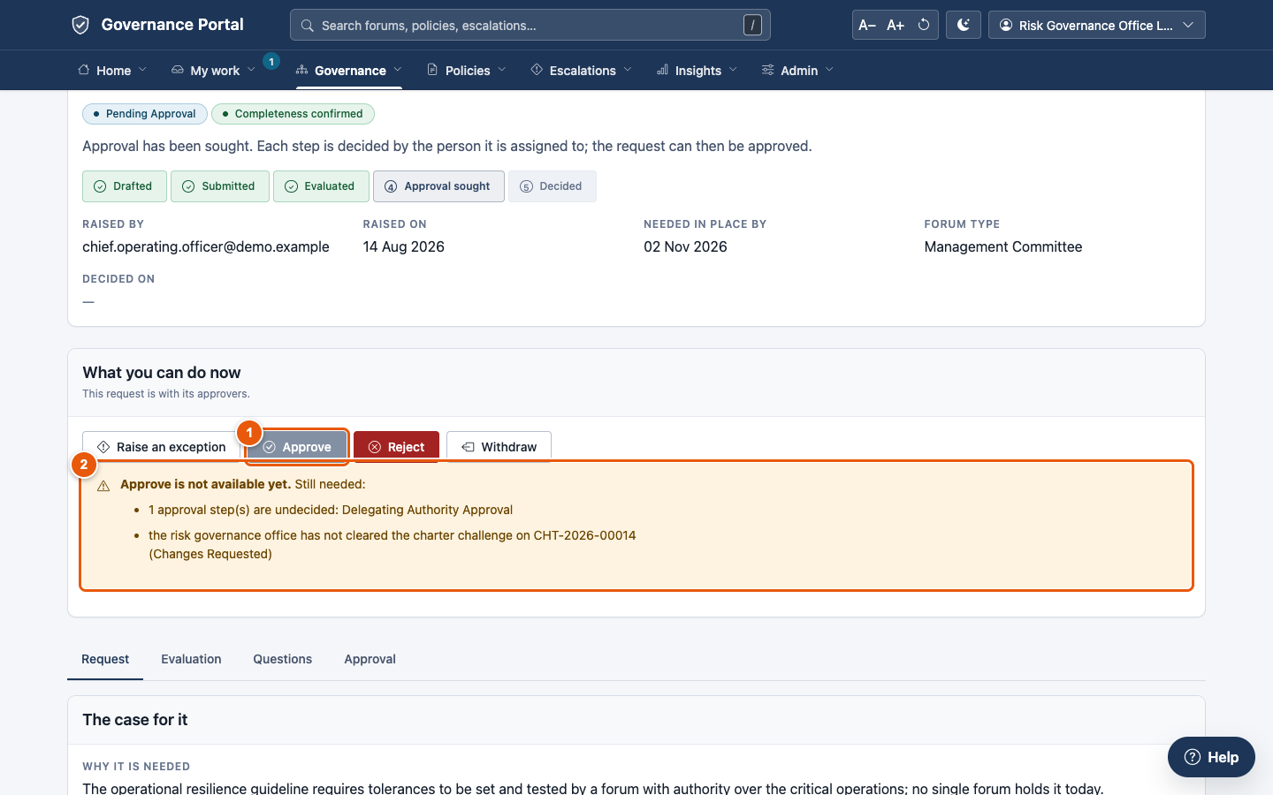
C · HOW IT WORKS
Forming a committee is evaluated against five criteria, and approval stays disabled while anything is outstanding
1
Guided request: required fields, guidance and draft save. The governance office confirms the request is complete.
2
Five criteria assessed: coverage gap, duplication, escalation pathway, framework alignment, resource feasibility.
3
Approval steps come from a configured route, sequential order enforced, role queues, changed without a release.
4
A bypass needs a recorded authorisation, waives only its own step, and never by the step's own holder.
EVIDENCE
62 formation tests (27 engine, 35 portal).
Demo requests at every stage, draft to approved.
A charter challenge blocks approval (G-7).
Sources: docs/guides/03-governance.md §3.4–3.5; docs/delivery/REQUIREMENTS-COVERAGE.md G-5, G-7, G-8, G-17 (tests and demo records).
Consilium | 21
Notes:
Step one. A requester fills in the guided form. The governance office checks completeness, runs the overlap check against the existing inventory, and assesses the five criteria. Approval steps are raised from a configured route. The Approve button stays disabled, and lists what is outstanding, until every criterion is assessed and every step decided. A bypass needs a recorded exception authorised by the Head of Risk Governance. Approval creates the forum in Draft. An open charter challenge now blocks approval, and steps are decided in order. The honest gap that remains: the route cannot yet vary by forum type or materiality (G-8).

Slide 22
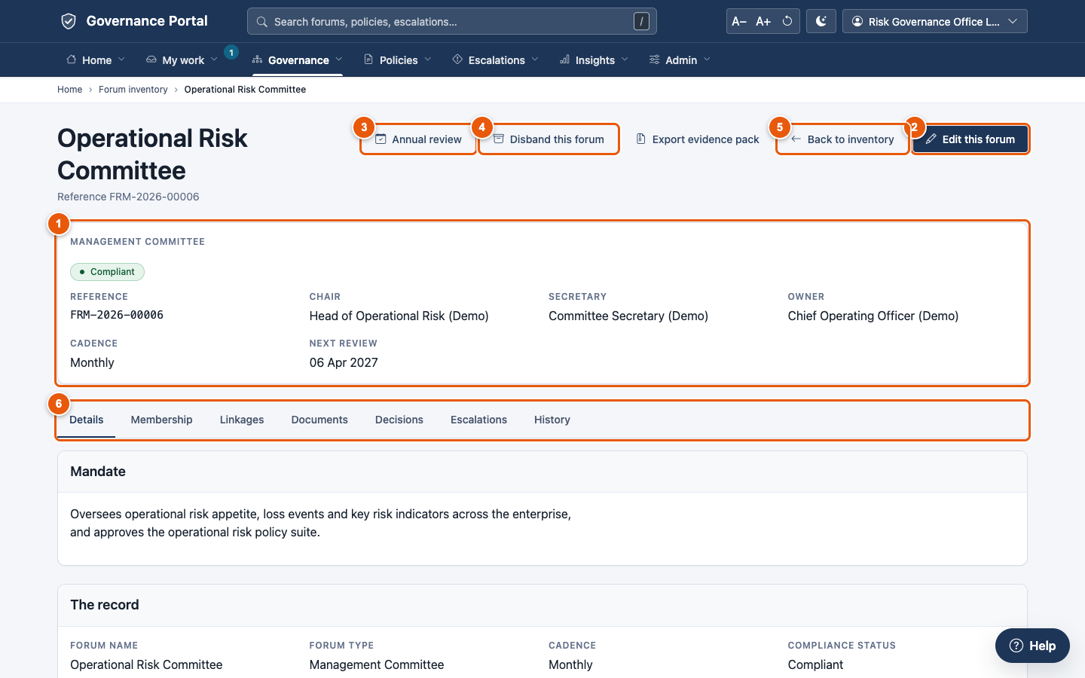
C · HOW IT WORKS
A forum's compliance standing stays current: changing a watched field sends it back for review automatically
1
Compliance decision recorded: Compliant, Non-Compliant (reasons required), Not Applicable, or returned to its creator.
2
The review is its own record and cannot be edited afterwards.
3
Watched fields are configuration: a change to, say, the mandate moves the forum back to pending and notifies compliance.
4
Forum page shows everything in one place: seats, charter, meetings, motions, decisions, approved documents and the connections diagram.
EVIDENCE
FRM-2026-00006: watched-field change → review FCR-2026-00006.
FRM-2026-00007 recorded Non-Compliant.
43 membership and voting tests.
Sources: docs/guides/03-governance.md §3.1–3.3, §3.6; docs/delivery/REQUIREMENTS-COVERAGE.md G-4, G-6, G-11, G-13, §1.1 (screen map).
Consilium | 22
Notes:
Step two. The Compliance Reviewer records a decision on the forum. Each decision is its own record and cannot be edited later. The important behaviour is the watched fields. When someone changes a designated field, such as the mandate, the forum drops back to Pending and compliance is notified. The list of watched fields is configuration, so compliance can change it without a release. The forum page also shows how the forum connects to its parent and child committees.

Slide 23
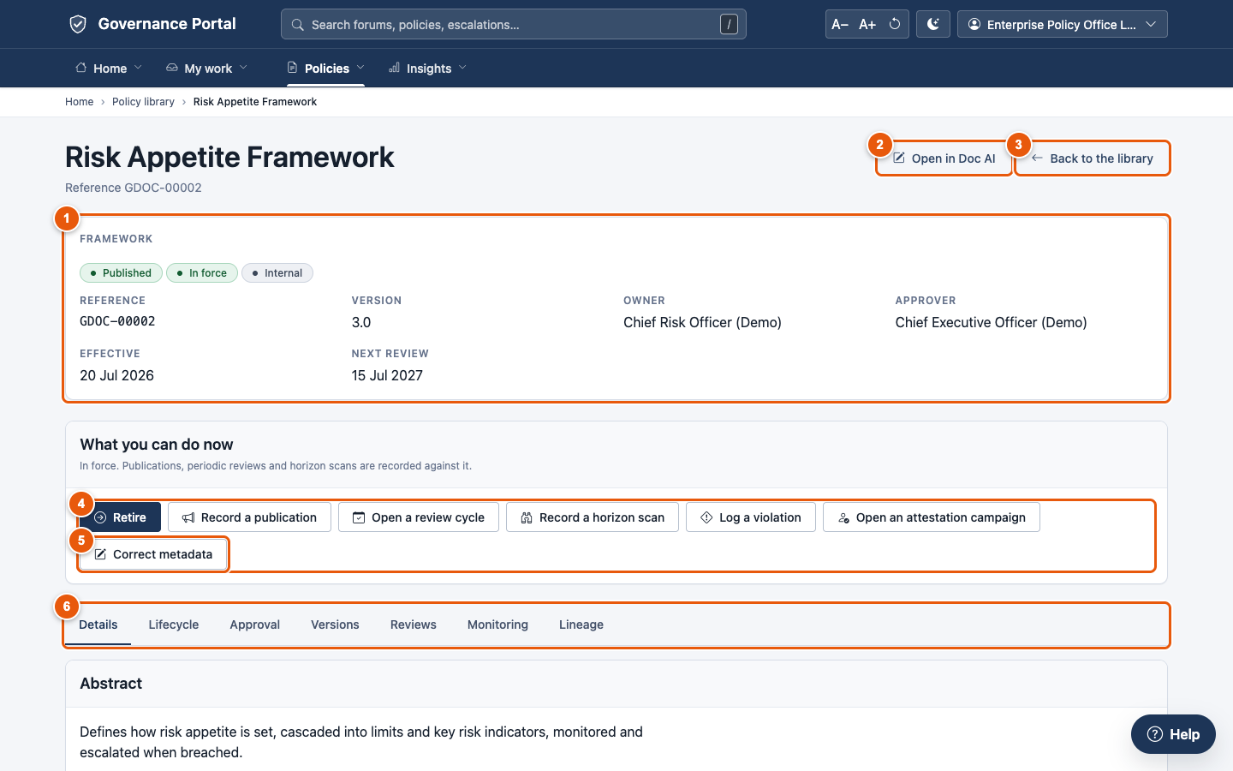
C · HOW IT WORKS
A policy moves through a gated lifecycle and cannot be published without its complete approval set, on any route
1
Six phases, each move limited to its role: policy owner submits; the policy office approves, publishes and retires.
2
Gates checked on every phase change: complete approval chain, current version, applicability. A written exception is the only bypass.
3
Reopened documents start a fresh approval cycle. The previous cycle's approvals no longer count (fixed).
4
Version chain held here: each upload is a new immutable version. Revert writes a new version.
EVIDENCE
10 publication-gate tests, including menu and direct-write refusal.
GDOC-00002 Risk Appetite Framework published after 2 decisions.
68 portal-action tests, incl. 15 on the approval chain.
Sources: docs/guides/04-policies.md; docs/delivery/REQUIREMENTS-COVERAGE.md P-9, P-25 (TestPublicationRefusal ×7, TestGatesOnEveryRoute ×3); policy/tests/test_portal_actions.py.
Consilium | 23
Notes:
Step three. The policy lifecycle runs from Draft to Retired, and each move is limited to the role responsible for it. The important control is P-25, no publication without the full approval set. Lifecycle gates are configuration. Since the fix described in section D, they run on every phase change, whatever route it comes from. Reopened documents cannot reuse the previous cycle's approvals; that was a real defect we found and fixed. Every one of these actions is now on the policy page itself, POST-only, with the failing gate named before you act. A gate exception is approved by the policy office, never by the person asking.

Slide 24
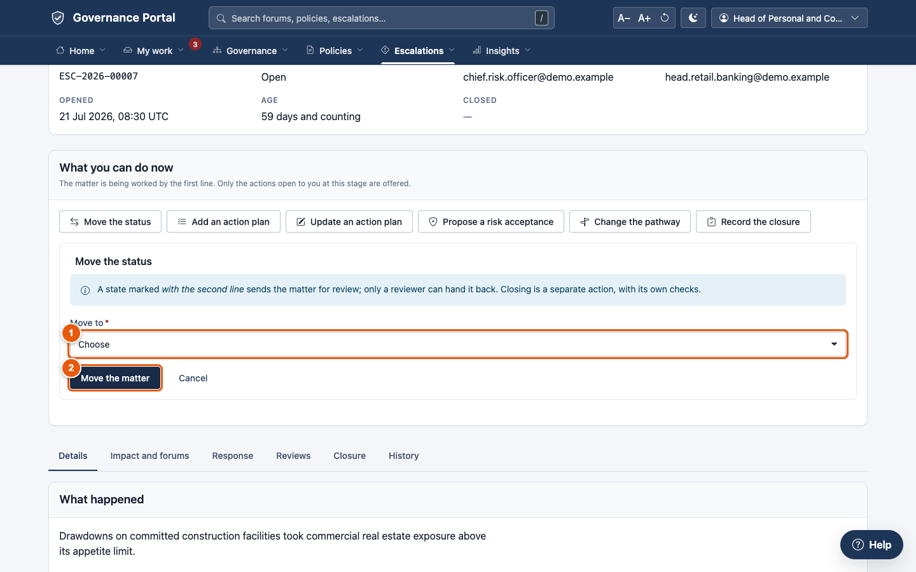
C · HOW IT WORKS
Escalations are routed by an approved matrix, timed against limits, and invisible to anyone not cleared for sensitive matters
1
Matrix-driven severity and pathway. The rule that fired is recorded; a manual override is visible as such.
2
Time limits run on a business calendar. A breach raises severity and notifies, once.
3
Sensitive matters are hidden from lists, counts, search, reports and the API. A link reads like a record that does not exist.
4
No closure without its outcome: a closure record and the completed response template are both required.
EVIDENCE
19 routing and closure tests; 12 sensitivity tests.
ESC-2026-00007 breached 31 Jul 2026 → raised.
Portal actions: 43 tests (raise, work, approve, close); time in each status measured against targets.
Sources: docs/guides/05-escalations.md; docs/delivery/REQUIREMENTS-COVERAGE.md E-4, E-10, E-13, E-16 (tests, demo records); escalation/tests/test_portal_actions.py.
Consilium | 24
Notes:
Steps four and five together. The escalation matrix sets severity and the forum pathway from the facts of the matter, and records which rule fired. Clocks run against configured time limits. A breach raises the matter and notifies once. A defect that re-breached every day was found and fixed. Sensitive escalations are not just hidden on screen. They are excluded from every read path, including counts and the API. Closure needs both the closure record and the completed response template, and a confirmation. Matters are raised, worked, taken from a role or group queue, and closed on the portal; forums and matters can be reverted with a reason.

Slide 25
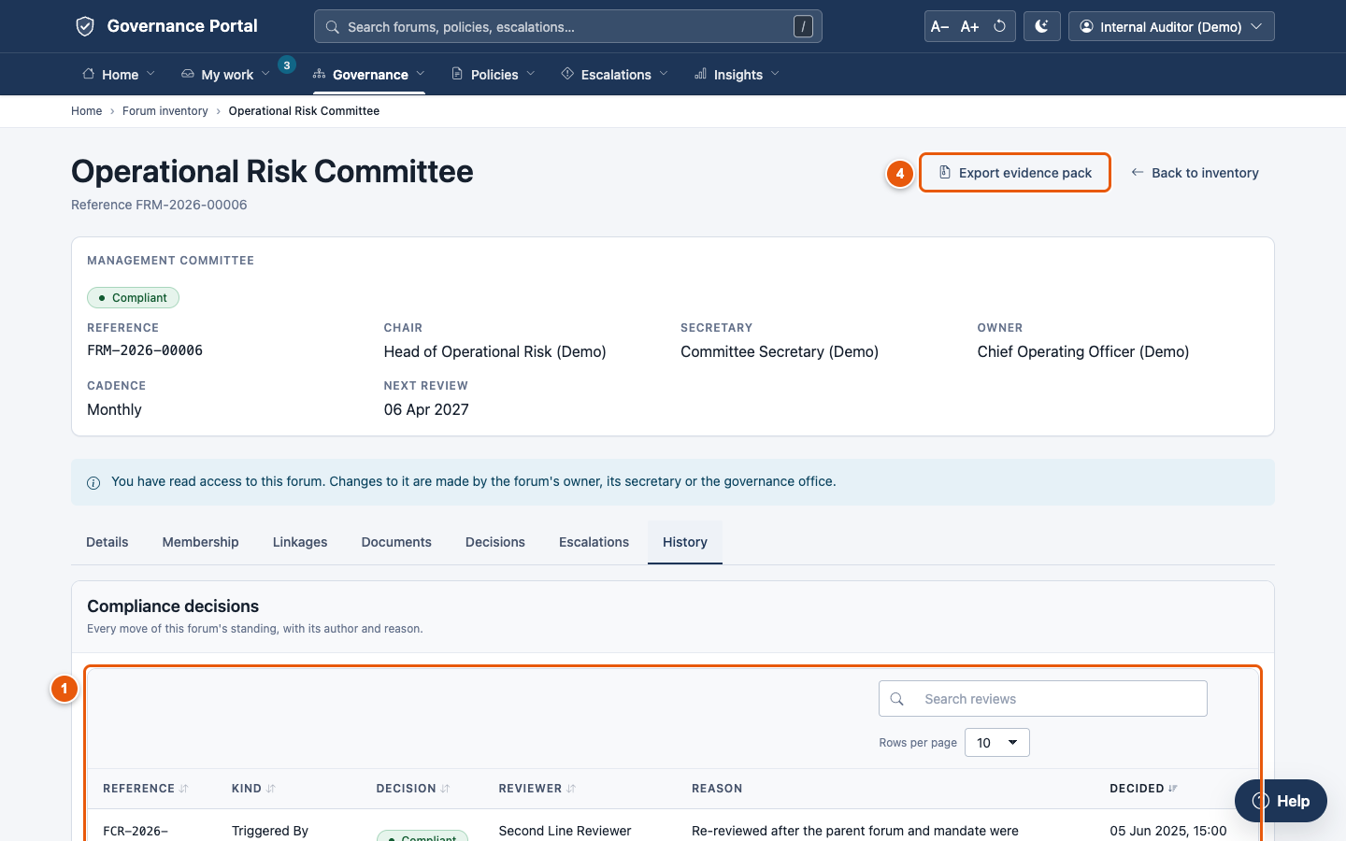
C · HOW IT WORKS
A year later, the record shows who sat, who voted, what was approved and what was refused, as at any date
Who sat on the forum?
Membership is a dated record; seats can be held by position; delegations carry validity windows.
Composition on any past date is a query
Who voted, and was there quorum?
One vote row per entitled voter; quorum calculated and stored when the decision is taken.
Later membership changes do not rewrite it
What did the document say?
Immutable version chain with content hash. Revert writes a new version and is itself audited.
38 minute versions; 17 charter versions
What was refused, and why?
Governance Refusal Log; field-level change history; exception authorisations for any bypass.
Refusals logged even when rolled back
Not yet proven end to end: the retention and legal-hold engine is built (19 tests pass) and a daily job flags records due for disposal, but no demo record is under retention, carrying out an approved disposal and releasing a hold have no screen, and write-once storage is an open infrastructure decision. Until that decision, describe the control as tamper-evident with restricted write access, not write-once. Every record now exports as an evidence pack with a SHA-256 manifest.
Sources: docs/product/02-data-model.md §2.3 (M-1, M-2); docs/product/05-glossary.md §D; docs/OPERATIONS.md §A; docs/delivery/REQUIREMENTS-COVERAGE.md G-9, G-13, G-15, G-16 (demo counts, tests).
Consilium | 25
Notes:
Step six is the reason the system exists: a year later, someone asks what happened. Membership is a dated record, so the forum as it stood on the day is a query. Votes are recorded per entitled voter, with quorum stored at the time. Document bodies are immutable versions with a hash. Refusals are logged. Be clear about what is not yet proven. The retention engine is built and tested, and a daily job flags records due for disposal, but no record on the demo site is under retention yet, and an approved disposal cannot yet be carried out from a screen.

Slide 26
D
Evidence
Measured coverage, test results, defects found and fixed, and the controls we attacked directly
A Why this exists
B What we built
C How it works
D Evidence
E What is not done
F Road to production
Consilium | 26
Notes:
Section D is the evidence. Coverage is measured, not asserted. The tests are real runs. The defects and fixes are documented with regression tests.

Slide 27
D · EVIDENCE
All 64 mandatory requirements re-measured on the final build: 49 fully reachable, 9 partly, and 6 missing one mandatory clause
What the measurement says
Policy closed its gap: 22 of 26 now in class a or b; every policy action is on the portal.
Class c (9): mostly two missing screens: carrying out a disposal, and outbound export.
64 of 64 have a direct, passing test; for 11 the tests cover only part of the requirement.
A passing test proves only what it exercises: the missing clauses of class d are untested by definition.
17 SEPTEMBER BASELINE (BEFORE THE FINAL WAVE)
a 19 · b 3 · c 24 · d 18
Same method, same classes: 22 fully reachable then, 49 now
Mandatory total: a 43 · b 6 · c 9 · d 6 = 64
Source: docs/delivery/REQUIREMENTS-COVERAGE.md §1.2 (classes), §2 (summary), final measurement 18 Sep 2026 against release 1.0.0 and the rebuilt demo site; the 17 Sep baseline is the same method before the final wave. Classes: a = portal screen; b = workspace, configuration or job by design; c = partly reachable; d = not implemented in whole or in a mandatory clause.
Consilium | 27
Notes:
This is the final measurement, with the same method and classes as the 17 September baseline shown in the box. A requirement counts as fully reachable only if a user can reach it through a screen, or through configuration where that is the design. Policy moved most: from 3 fully reachable to 22 of 26, because every policy action is now on the portal and every notice is templated. The six class-d rows each miss one clause, named on the next slide. Several were re-graded downward on a stricter reading, not because code regressed.

Slide 28
D · EVIDENCE
Requirement by requirement, what remains is narrow: routing depth, two missing notices, disposal and outbound export
Governance
19 requirements
G-
1
G-
2
G-
3
G-
4
G-
5
G-
6
G-
7
G-
8
G-
9
G-
10
G-
11
G-
12
G-
13
G-
14
G-
15
G-
16
G-
17
G-
18
G-
19
Policy
26 requirements
P-
1
P-
2
P-
3
P-
4
P-
5
P-
6
P-
7
P-
8
P-
9
P-
10
P-
11
P-
12
P-
13
P-
14
P-
15
P-
16
P-
17
P-
18
P-
19
P-
20
P-
21
P-
22
P-
23
P-
24
P-
25
P-
26
Escalation
19 requirements
E-
1
E-
2
E-
3
E-
4
E-
5
E-
6
E-
7
E-
8
E-
9
E-
10
E-
11
E-
12
E-
13
E-
14
E-
15
E-
16
E-
17
E-
18
E-
19
Supplementary
7 requirements
O-
1
O-
2
O-
3
O-
4
O-
5
O-
6
O-
7
a Portal screen
b Workspace / config by design
c Partly reachable: a step has no screen
d Not implemented in whole or a mandatory clause
Reading the tiles: d = one missing clause each: formation path by forum type (G-8), Q1 attestation rule (G-10), meeting and charter notices (G-14, O-4), approval reminders and group routing (P-8), transitions by type and severity (E-8), risk-acceptance approval chain (E-9), dashboard customisation (O-3). c = disposal execution (G-16, P-18, E-18), outbound export (G-19, P-20, E-19), forum SLA view (G-12), delegate nomination (G-13), external links on a document (P-5).
Source: docs/delivery/REQUIREMENTS-COVERAGE.md §3 (per-requirement 'Reachable' column) and §4 (gaps), final measurement 18 Sep 2026.
Consilium | 28
Notes:
Each tile is one requirement, coloured by its final measured class. The orange tiles each miss one clause. Two concern approval routing depth: the formation path by forum type or materiality (G-8), and policy approval reminders and group routing (P-8). One is the meeting-schedule and charter-review notices (G-14); every other notice now goes through an editable template. The rest are the first-quarter rule for the annual attestation (G-10), escalation transitions by type and severity (E-8), and a configurable approval chain for risk acceptance (E-9). The grey tiles are mostly two missing screens: carrying out an approved disposal, and outbound export.

Slide 29
D · EVIDENCE
Quality evidence is layered, and every figure comes from a run, not an assertion
1453 / 1453
302 / 302
11 / 11
57 / 57
application tests pass on PostgreSQL, on a clean site: 0 failures, 0 errors
interface regression checks: every portal page, signed in and out, with no dead links or missing assets
browser journeys, incl. menus by keyboard, search and the phone layout
toolchain tests, 22 of them simulating Windows, plus the deployment kit
Application test suite at each recorded measurement
Checks that fail the build
Any CDN reference; any package-manager step
Vendored files that do not match their checksums
Any client-identifying content
Any logic branching on a workflow state name
What changed in the final wave
Every portal page has a page-context test, including refusal of a reader without access
Tests run on a separate clean site; the demo site holds no test rows
Sources: docs/delivery/REQUIREMENTS-COVERAGE.md §1 (final run: 1453 tests, OK, 1433 s on a clean site; 1372 before the last round; 780 on 17 Sep); docs/delivery/DEPLOYMENT-READINESS.md (722; verify.sh 14/14); docs/delivery/SESSION-SUMMARY.md; README.md (293, Core only).
Consilium | 29
Notes:
Four layers of evidence. Application tests: 1453 run against a real PostgreSQL database on a clean site, and all pass. During the last round our own state-name checker caught one rule break in new code before release; that is what the checks are for. The interface sweep makes 302 checks across the portal, signed in and out, for dead links, missing assets and leftover framework branding. Eleven browser journeys drive a real browser, including the menus by keyboard, search and the phone layout. The toolchain has 57 tests, 22 of which simulate Windows. The chart shows how the suite grew at each point it was recorded. Every portal page now has its own page-context test.

Slide 30
D · EVIDENCE
Loading a realistic organisation exposed nine defects that the passing test suite had missed. All are fixed and guarded by regression tests
23
role-based personas
Defect found | What could have happened | Type
Workspace workflow menu and direct writes skipped publication gates | A policy published with no approval chain (P-25) | Control
Approvals matched to steps by name only | A reopened policy republished on last cycle's approvals | Control
Role-based step took the first database row | Approval assigned to a disabled account or the built-in administrator | Control
Publication gate used a query PostgreSQL refuses | No document could be marked implemented | Database divergence
Breached matter restarted its clock on save | The same matter breached again every day | Reliability
An unticked box read as 'not given' | A seat could not be made non-voting; vote entitlement wrong | Data integrity
Nothing wrote the meeting's minutes link | Minutes could not be kept against a meeting | Data integrity
'Opened on' took the browser's clock | Dates hours out for users in other time zones | Data integrity
14
forums, board to working group
15
policies in every lifecycle phase
15
escalations in every state
plus attestation campaigns, meetings, motions and votes
So what: 'the tests pass' was true and not enough. Runs with realistic data are now part of how we verify.
Sources: regression-test docstrings in apps/consilium/consilium/{governance,policy,escalation}/tests/test_regressions.py; docs/delivery/REQUIREMENTS-COVERAGE.md §1, P-25; delivery-team summary 18 Sep 2026 (9 defects, 21 regression tests). Selection shown; descriptions paraphrased.
Consilium | 30
Notes:
This is the most important lesson in the deck. Before we loaded realistic data, every test passed. That was true, and it was not enough. Tests exercise what engineers imagine. A realistic organisation exercises what users will actually do. The worst of the nine was a control failure: the workspace's own workflow menu could publish a policy with no approvals. Another reused the previous cycle's approvals. One was a PostgreSQL divergence that stopped any document being marked implemented. All are fixed, each with a regression test, and realistic-data runs are now part of how we verify.

Slide 31
D · EVIDENCE
We tried to break the three controls leadership cares most about. All three now hold on every route
Publication approval
P-25
Sensitive escalations
E-16
Confidential documents
P-1, P-13, P-19
FIXED
HOLDS
FIXED
Found: the workspace's workflow menu and direct writes skipped the gates, so a document could be published with no approval chain.
Now: gates run on every phase change, whatever the route. A written exception still works.
Tested: menu refused, direct write refused, proper route publishes; plus 7 refusal tests.
Control: permission hooks on the matter and its three child records; a dedicated access role.
Holds on: lists, counts, search, reports and the API. A link reads like a record that does not exist.
Tested: 12 sensitivity tests, including the API list and named people seeing their own matters.
Found (17 Sep): the view, download, print and share flags were display-only, so attachments were readable by anyone with read access.
Now: read, list, download, print and share refused per flag on every path, attachments and version bodies included; a view-only in-portal viewer.
Tested: 32 handling tests through the API, plus the viewer page.
How we test a control: by attacking every route to the action, not just the intended one: the workspace menu, a direct API write, the portal action and the file download.
Sources: docs/delivery/REQUIREMENTS-COVERAGE.md P-1, P-13, P-19, P-25, E-16; policy/tests/test_regressions.py (TestGatesOnEveryRoute); policy/tests/test_handling.py; escalation/tests/test_sensitivity.py.
Consilium | 31
Notes:
Three controls. First, publication approval. We found the workspace's workflow menu and direct API writes both skipped the gates. That is fixed: gates now run on every phase change. Three tests attempt each route, and the proper route still works. Second, sensitive escalations. These are excluded on every read path: lists, counts, search, reports and the API. A link to one reads the same as a link to nothing. Third, confidential documents. On 17 September the confidentiality flags were display-only, so anyone with read access could open and download a confidential document. That is now enforced on every path, attachments and version bodies included, with a view-only in-portal viewer. Thirty-two tests attack it through the API.

Slide 32
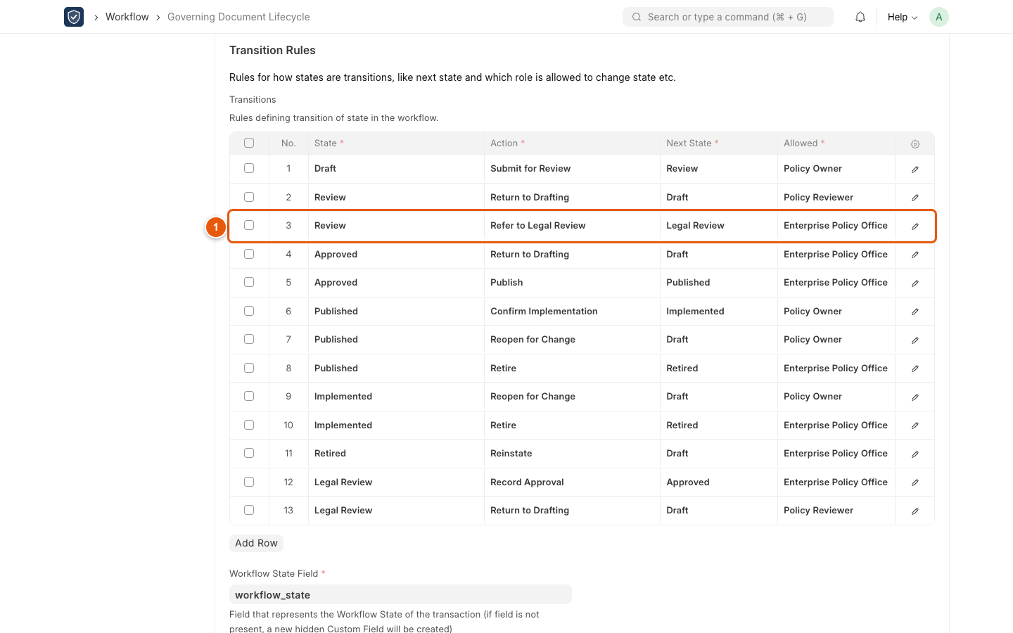
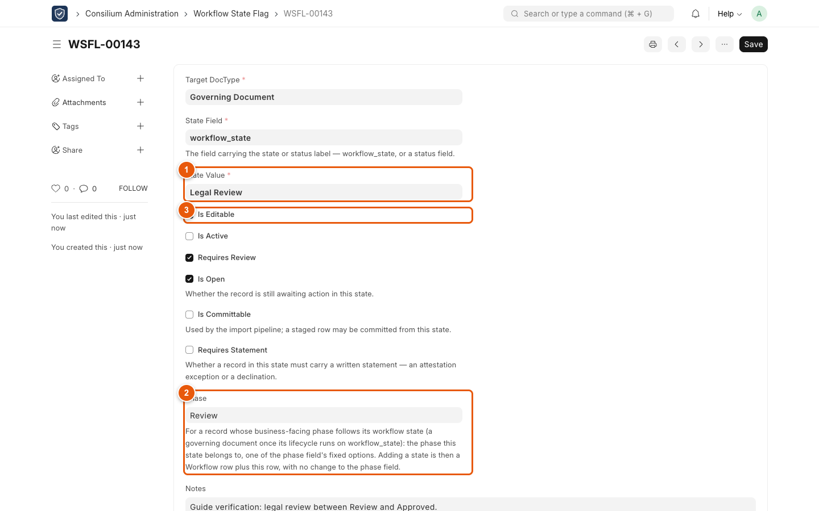
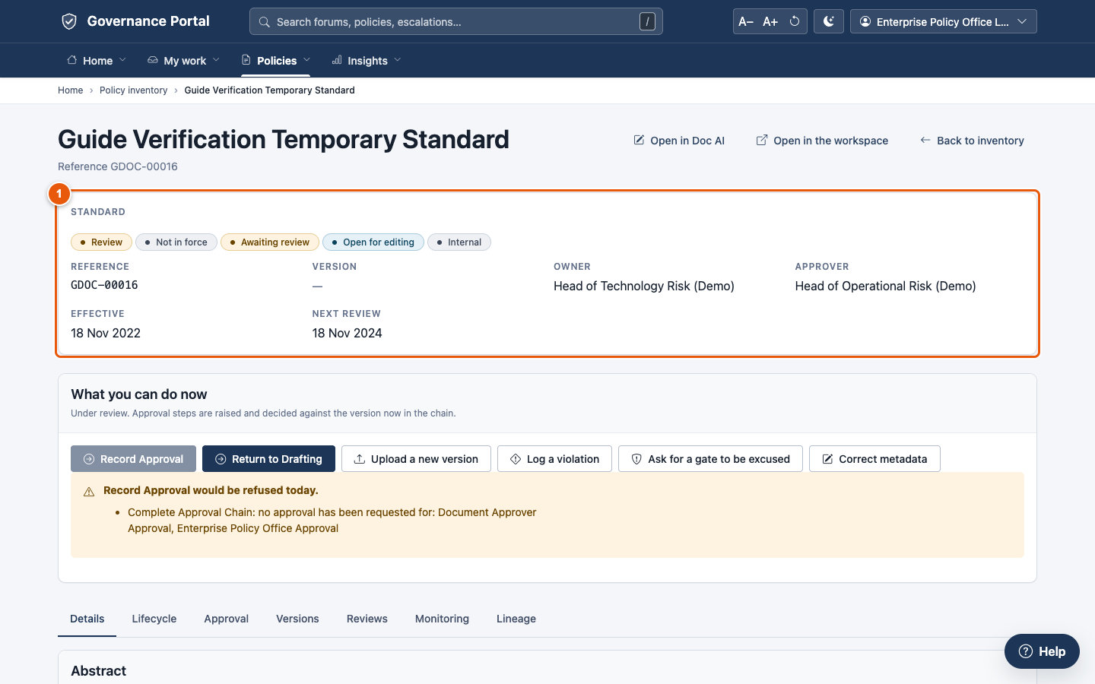
D · EVIDENCE
We tested the claim that a new approval step is configuration, not code: a Legal Review stage was added with no release
1 The Legal Review stage and its transitions are added to the workflow, as configuration
2 One flag row says what the stage means: editable, active, requires review
3 The document moves into Legal Review; the page's actions update themselves
What this proves: renaming a state or inserting an approval step is an administrator's change, made in minutes and recorded in the audit trail. It needs no release.
The safety net: a state with no flag row is refused, not guessed, so a missing configuration shows up at once. Each refusal is written to the Governance Refusal Log.
Source: docs/guides/images/manifest.json and verification screenshots (captured 18 Sep 2026 on the demo site, document GDOC-00016); docs/guides/09-administration.md §9.11 and docs/OPERATIONS.md §B (worked example: adding a workflow state).
Consilium | 32
Notes:
This slide is proof of design principle one. An administrator added a Legal Review stage between Review and Approved on the policy lifecycle, entirely through configuration. First, the stage and its transitions were added in the workflow. Second, one flag row says what the stage means; without it the system refuses to move a document into the stage rather than guessing, and the refusal names the missing row. Third, the document moved into Legal Review, and the page's actions updated themselves. No code changed and nothing was deployed.

Slide 33
E
What is not done
Feature gaps, the AI features, go-live conditions and the assumptions that carry most risk
A Why this exists
B What we built
C How it works
D Evidence
E What is not done
F Road to production
Consilium | 33
Notes:
Section E is the honest list: what is missing, what we have deliberately not built, and what must be true before go-live.

Slide 34
E · WHAT IS NOT DONE
Of 191 backlog stories, 151 are done and none is in progress. Most of what remains is missing tests or work that needs the target environment
151 of 191
stories done: a user can reach it and a passing test covers it
39
partial: mostly missing tests, or rehearsal that needs the target
100 of 127
of the original backlog done; 64 stories were added after it
Deployment-readiness stories were rehearsed on a stand-in server. They close only on the target environment (decision 2).
Source: docs/delivery/EPICS.md 'Status at a glance' (final measurement, 18 Sep 2026, against release 1.0.0, the demo site and the 1453-test run). Done = reachable by a user and covered by a passing test.
Consilium | 34
Notes:
The backlog has been re-measured story by story after the final wave, with a strict definition of done: a user can reach the behaviour, and a passing test covers it. 151 of 191 are done, and nothing is in progress. Of the original 127 stories, 100 are done. The last round added eleven stories for the navigation and integrations work, eight of them done. The 39 partial stories fall into three groups. Deployment-readiness stories need the target environment or a Windows workstation. Some behaviour that exists has no automated test yet: theme, text size, table paging and the report builder. The rest are small product gaps, such as a campaign export or the violation's escalation link on the portal. The one story not started is the Windows workstation run.

Slide 35
E · WHAT IS NOT DONE
All seven workstreams and the third wave are complete. Six mandatory requirements still miss one clause each, and none is a design problem
Workstream | What it closed | Requirements (class at 17 Sep) | Status now
1 · Handling and viewer | Confidential and restricted handling; in-portal document viewer; naming conventions; glossary enforcement | P-1, P-13, P-19, P-15, P-24 (d) | Done · all a or b
2 · Policy actions | Lifecycle buttons, approval steps, version upload and revert, publication, reviews, scans, intake classification | P-8, P-9, P-16, P-21, P-25, P-26 (c) | Done · P-8 now d (reminders)
3 · Escalation actions | Portal write actions; forum-participant notification; revert for forums and escalations | E-5, E-8 (c); E-7, E-12, G-9 (d) | Done · E-8 now d (transitions)
4 · Queues and imports | Task and attestation inbox; campaign administration; import batch review; coverage-gap view | G-10, P-23, G-19, P-20, E-19 (c); O-3 (d) | Done · export still c
5 · Notifications | Email, admin-editable templates, reminders, service-level warnings and time in state, regulatory fan-out | G-14, P-14, E-17, O-4, P-6, P-7, P-10, P-11, E-9, E-11, E-13 (d) | Done · G-14 meeting notices open
6 · Help assistant | Context-aware help, offline by default, optional AI endpoint | O-1 (a); usability | Done · offline
7 · AI features | O-6 and O-7 on the optional, administrator-configured endpoint | O-6, O-7 (d) | Done · rule-based; AI off by default
STILL OPEN: ONE CLAUSE EACH (CLASS D)
Formation route by forum type or materiality (G-8) · Q1 rule for the annual inventory attestation (G-10) · meeting and charter-review notices (G-14) · approval-step reminders and group routing (P-8) · escalation transitions by type and severity (E-8) · risk-acceptance approval chain (E-9)
Sources: docs/delivery/REQUIREMENTS-COVERAGE.md §2 (what moved), §4 (remaining gaps), final measurement 18 Sep 2026; docs/delivery/EPICS.md (E27–E33).
Consilium | 35
Notes:
Each row maps the gaps found on 17 September to the workstream that closed them, with the final class. All seven workstreams and the third wave are complete, and each was measured on the final build. The box at the bottom lists what is still open. Each item is a single clause with a stated fix in the coverage document, and together they are the Phase 1 backlog on the roadmap. Every notice, the approval-step and disbandment notices included, now goes through an editable template.

Slide 36
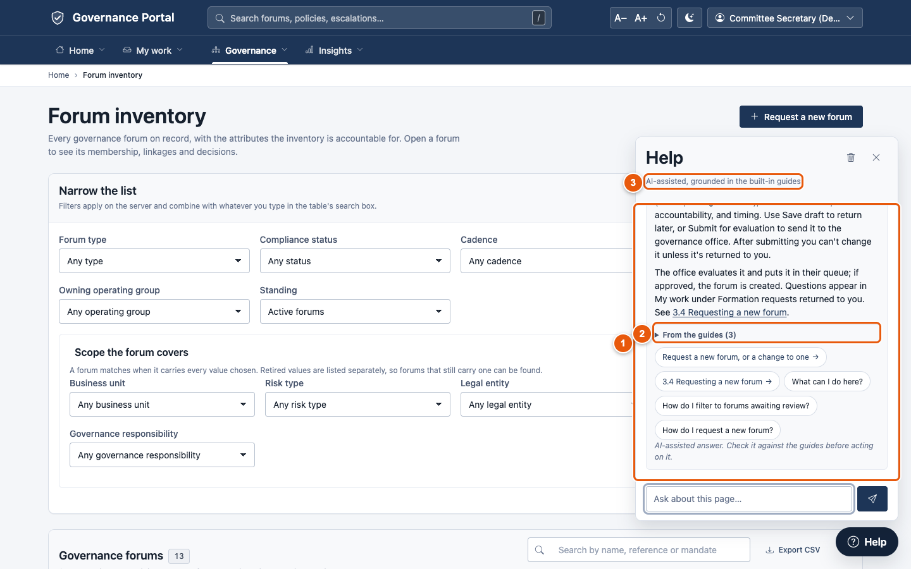
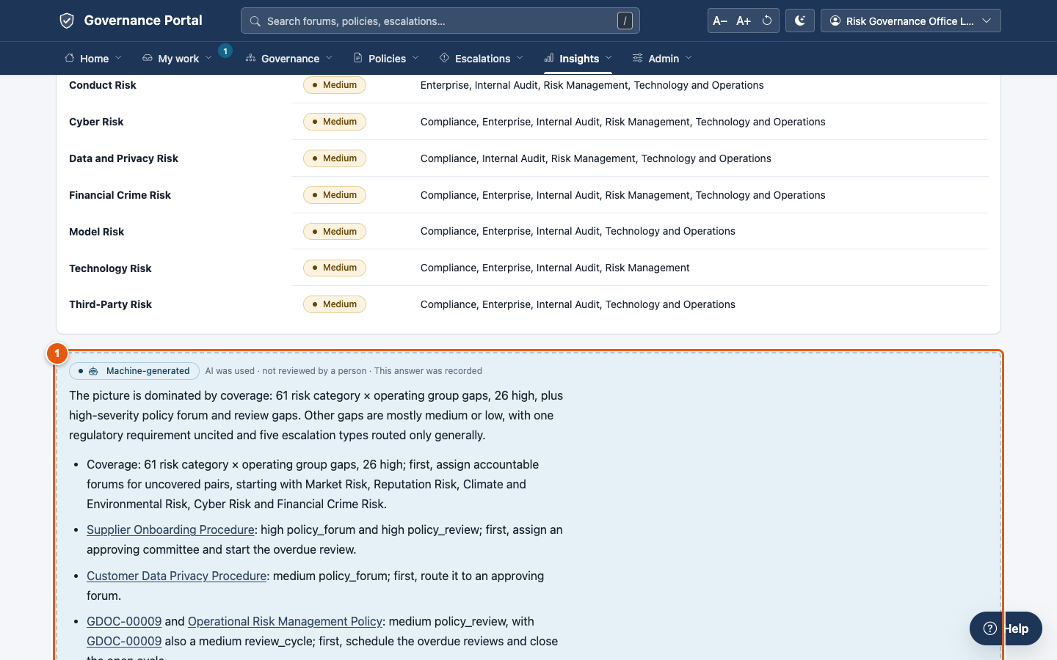
E · WHAT IS NOT DONE
AI is connected and tested with an OpenAI-compatible provider: a Help assistant on every page answers with citations, and every analysis still works with AI off
The Help assistant answering with its sources
Gaps and risk: rule-based findings, with labelled AI commentary
Works today
A Help assistant on every page, answering from the guides with citations; commentary on the analysis pages. 20 logged requests on the demo site, all succeeded.
Controls
Guidance-only by default; a classification ceiling; sensitive and restricted never sent; every call logged first; a person accepts any suggestion.
For production
An approved endpoint, an outbound path and a data-boundary decision, or AI stays off. Every analysis works without it.
Sources: docs/delivery/REQUIREMENTS-COVERAGE.md O-1, O-6, O-7; docs/delivery/EPICS.md E22, E31-S4, E36-S2; consilium_core/ai/ (client, guard), consilium_core/assistant/; AI Service Request log on the demo site (20 requests, all succeeded, all at Internal classification); consilium_core/tests/test_ai_features.py (37), test_assistant.py (36), test_integrations.py (31).
Consilium | 36
Notes:
AI is now connected on the demonstration site, through an OpenAI-compatible provider configured in Admin, Integrations, and it works end to end. The Help assistant sits on every page. It answers from the illustrated guides, the glossary and the page's own description, cites where each answer comes from, and respects the asker's access. The analysis pages add AI commentary to rule-based results that stand on their own. The controls are unchanged: guidance-only by default, a classification ceiling, sensitive and restricted records never sent, and every request logged before it leaves. On the demo site that log shows twenty requests, all succeeded, all at Internal classification. For production the organisation chooses its own approved endpoint, or leaves AI off; nothing depends on it.

Slide 37
E · WHAT IS NOT DONE
Offline install, migration and upgrade are rehearsed on a stand-in server. The conditions left before go-live need the target environment
Proven by running it
✓ Air-gapped install on Rocky Linux 9 in 2 min 23 s; verify.sh 14/14
✓ Demo site migrated with identical row counts
✓ Upgrade from the previous release: no table lost a row
✓ Backup and restore by the kit, verified
✓ systemd units, TLS proxy; one scheduler ran every job once
✓ OIDC sign-in against a mock provider; existing users matched
✓ CI: platform rules, toolchain tests, app tests, health check
Open go-live condition | Status | What closes it
The target's own PostgreSQL | Stand-in only. Largest unknown. | Install and migrate on the target server with representative data
Offline bundle | Must be rebuilt from the final commit | Rebuild (Python 3.11, x86_64); install; verify.sh again
Load | Indicative only (emulated laptop) | Agreed volume; several web processes; record the times
Certificates, IdP, mail route | Documented; decisions open | The organisation's CA, identity provider, and an SMTP relay or a Graph app registration
Other platforms | RHEL 8, Ubuntu 22.04 not run; Python 3.11 only | Rehearse; raise the hiredis and psutil pins for 3.12 or ARM
Real Windows hardware | Never run on a Windows machine | Bootstrap on a managed laptop; RUNBOOK acceptance script
Upgrade rollback | Printed, not exercised | Exercise once before the first production upgrade
Write-once storage; backup owner | Undecided; unassigned | Infrastructure decision; a named owner
Sources: docs/delivery/DEPLOYMENT-READINESS.md ('Where it stands', §1–9, evidence/linux-rehearsal/); docs/delivery/REQUIREMENTS-COVERAGE.md §5 (re-checked 18 Sep 2026); docs/RUNBOOK.md; HANDOVER.md §4.
Consilium | 37
Notes:
Left: what is proven by running it, on an air-gapped Rocky Linux 9 server standing in for the target. Install, migration of the demonstration site, upgrade from the previous release, backup and restore, the service units, the scheduler and single sign-on against a mock provider all ran, and verify.sh passed 14 of 14. Right: what is still open. The largest unknown is the target's own PostgreSQL, because the framework calls its PostgreSQL support second-class in this version. The offline bundle must also be rebuilt from the final commit. None of the open items blocks building. All of them block going live. Most need decisions or access from people outside the engineering team.

Slide 38
E · WHAT IS NOT DONE
Five assumptions carry the most rework risk if they prove wrong, and each needs a business or risk judgement, not engineering
# | Assumption | If it is wrong | Who settles it | Severity
1 | Regulatory citations are chosen from a shared library, not typed as free text (C-1) | 'Notify owners when a regulation changes' cannot be implemented as written | Owner of the regulatory-change process | H
2 | 'Restricted' means blocking download, print and share, not just viewing (C-3) | The difference between configuration and a build that must hold on six separate paths | Owner of the confidential-document standard | H
3 | Tamper-evident storage is acceptable where the requirement says write-once (A-1) | An auditor who edits a file directly will succeed; the hash chain will only record that they did | Risk function, with an infrastructure owner | H
4 | Retention is built in the platform, not handed to an external records system (S-3) | If revisited, a substantial part of Core disappears | Records management | H
5 | Four forum tags (business unit, risk type, legal entity, jurisdiction) are multi-valued (D-5) | Correct, but every filter on them becomes a subquery on the most-used screen | Governance office; confirmed by load test | M
Source: docs/product/07-assumptions-and-gaps.md §7 ('What a reviewer should push back on'), items A-1, C-1, C-3, D-5 and §2 (S-3). Severity: H = rework of a model, schema or delivery mechanism.
Consilium | 38
Notes:
These are the five places where being wrong is expensive, taken from our own assumptions register. Notice that none of them is an engineering question. Whether tamper-evidence is enough where the requirement says write-once is a risk judgement. What restricted handling must prevent is a question for the owner of the confidential-document standard. We would like named people to answer each one in the next few weeks.

Slide 39
F
Road to production
A gated plan, clear ownership, the risks and the framework-version recommendation
A Why this exists
B What we built
C How it works
D Evidence
E What is not done
F Road to production
Consilium | 39
Notes:
Section F is the plan. Phases exit on evidence, not dates. Durations are ranges and will be re-baselined once the target environment exists.

Slide 40
F · ROAD TO PRODUCTION
A three-phase path to production, with each phase exiting on objective evidence rather than a date
W0
W2
W4
W6
W8
W10
W12
W14
W16
W18
W20
P1 Finish the product
Rebuild the offline bundle from the final commit
Remaining class-d clauses and missing tests; re-measure
P2 Target-environment rehearsal
Rebase onto framework v16; re-verify
Provision target: certificates, ports, accounts, storage
Migration, load and upgrade rehearsal
Real Windows run; single sign-on; one scheduler
P3 Pilot and go-live
Business rules, taxonomy, data import
User acceptance with the governance and policy offices
Go-live readiness review, then go-live
P1 exit: Each of the 6 remaining class-d clauses built or accepted by its owner. Full suite, interface sweep and journeys pass on the final bundle.
P2 exit: The same tree runs on the target and on a managed Windows laptop, with 8/8 smoke checks, making no network connections. Migration and load measured. Sign-on and service accounts working.
P3 exit: Business owners accept UAT. Real rules and taxonomy loaded. Backups scheduled with a named owner. Exactly one scheduler running.
Durations are planning estimates from the delivery team, expressed as ranges and not taken from repository documents; re-baseline after Phase 2 starts. Exit criteria: HANDOVER.md §6 (Phases 0–3), docs/delivery/DEPLOYMENT-READINESS.md, docs/delivery/REQUIREMENTS-COVERAGE.md §4–5.
Consilium | 40
Notes:
The plan has three phases. Phase 1 closes the product: the six remaining single-clause gaps and the missing tests, then a final bundle from the final commit. Phase 2 can start as soon as the environment decision is taken and runs partly in parallel. It rebases onto framework v16, then rehearses migration, load and upgrade on the target, runs on real Windows hardware, and settles sign-on, certificates and service accounts. Phase 3 is pilot and go-live with the business owners. The bars show ranges: the solid part is the lower estimate, the lighter part the upper. The total is roughly 12 to 20 weeks from environment access, to be re-baselined after Phase 2 starts.

Slide 41
F · ROAD TO PRODUCTION
Clear ownership: engineering builds, the deploying team runs it, the business owns the rules, and leadership owns the risk calls
Activity | Executive sponsor | Delivery engineering | Infrastructure / deploying team | Information security | Business owners (governance, policy, escalation) | Internal audit
Framework version decision (v15 vs v16) | A | R | C | C | I | I
Rebase onto v16 and full re-verification | I | A/R | C | I | I | I
Target environment, certificates, ports, service accounts | I | C | A/R | C | – | I
Migration, load and upgrade rehearsal | I | R | A | I | I | I
Write-once storage and backup ownership | C | C | R | C | A | C
Single sign-on protocol and configuration | I | R | C | A | I | –
Classification rules, taxonomy, closure criteria | I | C | – | – | A/R | C
User acceptance and go-live acceptance | A | C | C | C | R | C
AI position and any AI endpoint | A | C | C | R | C | I
Proposed allocation for leadership confirmation. Basis: HANDOVER.md §8 (the network request, the hardware run and the v15/v16 decision need people); docs/product/07-assumptions-and-gaps.md 'Settles it' entries. R = responsible, A = accountable, C = consulted, I = informed.
Consilium | 41
Notes:
This is a proposed ownership model. The pattern is simple. Engineering builds and verifies. The infrastructure or deploying team owns the environment and runs the rehearsals with us. Information security owns sign-on and the AI boundary. The business owners, the risk governance office and the enterprise policy office, own the rules the engines run on and accept the product. Leadership is accountable for the two risk calls: the framework version and the AI position. Please challenge any row you disagree with.

Slide 42
F · ROAD TO PRODUCTION
The top risk is the framework's second-class PostgreSQL support in v15; rebasing onto v16 before go-live is the main mitigation
Risk | Severity | Mitigation | Owner
Framework v15 treats PostgreSQL as second-class; fixes will target v16 only | High | Rebase onto v16 before target rehearsal; porting work is version-agnostic | Sponsor / engineering
Unknown database divergences appear under load or during migration (3–4 already found and fixed; stand-in rehearsal clean) | High | Migration and load rehearsal on the target with representative data, not a smoke test | Infrastructure / engineering
Write-once storage undecided: the control is tamper-evident, not write-once | High | Storage decision with a named owner; describe the control accurately until then | Risk function / infrastructure
Never run on real Windows hardware; Windows workers have no crash isolation | Medium | Front-load the managed-laptop run; run several supervised workers; production is Linux | Engineering
SAML mandated: not available in the framework | Medium | Confirm the protocol now; if SAML, estimate a separate component | Information security
Business rules not supplied (classification, taxonomy, closure criteria) | Medium | Engines ship without them; named owners and one working session each | Business owners
Platform pins: Python 3.11 on x86_64 only (hiredis blocks 3.12, psutil blocks ARM) | Medium | Provision Python 3.11 x86_64; raise the pins before any 3.12 or ARM target | Engineering / infrastructure
AI endpoint discloses restricted content | Low | Off by default; 'guidance only' sends no record contents; every request logged | Information security
Sources: HANDOVER.md §7 (risk table); docs/product/07-assumptions-and-gaps.md A-1, A-4, B-1, B-4, B-6; docs/product/04-architecture.md §9.3; docs/guides/07-help-and-ai.md; docs/delivery/DEPLOYMENT-READINESS.md §1 (dependency fork verified by content).
Consilium | 42
Notes:
The risk register, ordered by severity. The first two are really one risk: the framework version we use treats PostgreSQL as second-class, and we have already found divergences between database backends. The mitigation is the rebase plus a proper rehearsal on the target. Write-once storage is high severity because it is a risk judgement nobody has made yet. Windows and the scheduler are medium and have simple mitigations. The dependency-substitution risk from the handover has been mitigated by the bundle builder, which verifies content rather than version strings.

Slide 43
F · ROAD TO PRODUCTION
Recommendation: rebase onto framework v16 before go-live. The porting work carries over, and v15 PostgreSQL fixes are not coming
Option A — stay on v15
Option B — rebase onto v16 (recommended)
For
+ No rebase effort now
Against
– The framework's own notice: PostgreSQL support is limited to v16 and above; fixes for earlier versions will not be added
– 3–4 database divergences already found and fixed by us, with no basis to assume that is all
– Every future PostgreSQL defect is ours to find and fix
For
+ The framework's supported path for PostgreSQL
+ Porting work is version-agnostic: runtime patches, no fork
+ Done before rehearsal, so we rehearse what we ship
Against
– Rebase effort plus full re-verification: test suite, interface sweep, offline bundle rebuild
– v16 still needs the same real-Windows proof
Recommendation: approve the rebase onto v16 now and schedule it at the start of Phase 2, before any target rehearsal. Decision owner: executive sponsor, on the engineering lead's advice.
Sources: HANDOVER.md §7 (quoted framework notice; recommendation to rebase), §8 (an architecture call for people); docs/product/07-assumptions-and-gaps.md A-4; docs/delivery/SESSION-SUMMARY.md; policy/tests/test_regressions.py (TestImplementationGate).
Consilium | 43
Notes:
The framework prints a notice on every new site: PostgreSQL support is limited to v16 and above, and fixes for earlier versions will not be added. We have already found three or four database divergences ourselves, including one among this week's defects. Staying on v15 means every future PostgreSQL issue is ours to fix, without upstream help. Rebasing costs a few weeks of re-verification. Our porting work was written to be version-agnostic, and the rebase should happen before the target rehearsal, so that we rehearse what we will actually ship. The recommendation is to rebase.

Slide 44
Decisions and asks: five approvals today put Consilium on a gated path to production
Rebase onto framework v16 before go-live
OWNER
Executive sponsor
NEEDED BY
Today
1
Provide the target environment and name one infrastructure owner (certificates, ports, service accounts, write-once storage, backups)
OWNER
Infrastructure lead
NEEDED BY
Start of Phase 2
2
Confirm the single sign-on protocol (LDAP or OIDC preferred; SAML is a separate build)
OWNER
Information security
NEEDED BY
Start of Phase 2
3
Name business owners for classification rules, taxonomy values, closure criteria and the regulatory-change file
OWNER
Business sponsors
NEEDED BY
Within two weeks
4
Approve an AI endpoint and its data boundary, or keep AI off for go-live; nothing depends on it
OWNER
Executive sponsor, with security
NEEDED BY
Today
5
In return, the delivery team commits to: re-measuring coverage with the same method at each phase exit; reporting against phase exit criteria; every claim backed by a run.
Sources: slides 3, 37, 40–43. Owners and timing are proposals for confirmation in this meeting.
Consilium | 44
Notes:
Close on the asks. Five decisions, each with an owner and a date by which we need it. If these are taken today, Phase 2 can start as soon as the environment is available. We will report progress against the phase exit criteria, not against dates, and we will re-measure coverage with the same method at each phase exit.

Slide 45
Appendix
A1 Requirement trace summary
A2 Glossary
A3 Test inventory
A4 Demonstration organisation
Consilium | 45
Notes:
Reference material for the pre-read.

Slide 46
APPENDIX
A1 · Requirement trace summary: how each module's requirements are satisfied, changed and covered
Module | Mandatory | Needs a build component | Materially changed (bold Δ) | Clarified (Δ) | Coverage a / b / c / d (final) | ≥1 direct passing test
Governance (G) | 19 | 14 | 3 | 9 | 11 / 1 / 4 / 3 | 19 of 19
Policy (P) | 26 | 24 | 9 | 6 | 19 / 3 / 3 / 1 | 26 of 26
Escalation (E) | 19 | 16 | 2 | 8 | 13 / 2 / 2 / 2 | 19 of 19
Total | 64 | 54 | 14 | 23 | 43 / 6 / 9 / 6 | 64 of 64
Supplementary (O) | 7 | — | — | — | 5 / 0 / 0 / 2 | 7 of 7
Notes. 'Needs a build component' counts requirements whose dominant class includes Build (06 states 55; the 01 tables give 54). Only P-17 is purely native. Every mandatory requirement has a direct passing test; for 10 the tests cover only part of it (G-8, G-10, G-12, G-14, P-5, P-8, P-12, P-17, E-8, E-9).
All 64 mandatory and 7 supplementary requirements trace to at least one entity and one surface (06 §7).
Sources: docs/product/01-requirements-baseline.md §3–4 (dominant class, Δ markers — tables authoritative); docs/product/06-traceability.md §7 (64/64 and 7/7 traced); docs/delivery/REQUIREMENTS-COVERAGE.md §2 (classes and tests, final measurement 18 Sep 2026).
Consilium | 46
Notes:
Summary of the trace. Every requirement has an entity and a surface. Fifty-four of the sixty-four need some application code. The traceability summary says 55, because it was written from an earlier pass; the requirement tables are authoritative. Only P-17 is satisfied purely by a stock feature.

Slide 47
APPENDIX
A2 · Glossary of terms used in this briefing
Term | Meaning
Governance forum | Any standing body (committee, council, oversight body, working group) with a mandate, membership and reporting lines.
Governing document | Framework, Policy, Standard, Procedure or Supporting Document.
Escalation matter / matrix | An issue raised for decision at a defined authority level; the approved mapping from its attributes to severity and pathway.
Effective challenge | Structured questioning of a first-line assessment by the second line before a matter proceeds.
Attestation | Periodic positive confirmation by a named person that stated facts are accurate. Three events, one engine.
Watched field set | Admin-editable list of fields whose change sends a record back for compliance review.
Term | Meaning
Semantic flag | A property such as editable or active that a workflow state sets. Logic reads flags, never state names.
Document version / revert | Immutable snapshot of a document body; revert writes a new version with the old content.
Archive record | Immutable, hash-chained retention artefact; tampering becomes detectable.
Import batch / external reference | The governed file-import pipeline that replaces live connectors; a foreign identifier with its provenance.
Portal / workspace | Purpose-built screens for daily work / the framework's administrative interface.
WORM · SLA · 1LOD/2LOD/3LOD | Write once, read many · tracked time target · first, second, third line of defence.
Source: docs/product/05-glossary.md §A, §B, §D; docs/guides/11-glossary.md.
Consilium | 47
Notes:
Reference glossary.

Slide 48
APPENDIX
A3 · Test inventory: the suites behind the evidence, by area
Core (476) | Tests
AI features (rule-based) | 37
Help assistant | 36
Integrations | 31
Service levels and time in state | 22
Notification templates | 22
Inbox and campaigns | 22
Microsoft Graph mail | 20
Navigation and search | 20
Governance (242) | Tests
Formation portal | 35
Wave-3 screens (charter, disband, map) | 33
Formation engine | 27
Membership | 25
Lifecycle and reviews | 22
Voting screen, queues, bypass | 20
Governance entities | 19
Voting | 18
Policy (328) | Tests
Portal actions | 68
Search, reports, notices | 34
Lifecycle and routing | 33
Confidential handling | 32
Repository | 27
Monitoring and glossary | 24
Horizon scanning | 19
Intake classification | 19
Escalation (149) | Tests
Portal actions | 43
Queues, systemic route, timing | 22
Resolution and closure | 19
Escalation entities | 14
Routing matrix | 12
Sensitive matters | 12
Templates | 8
Pathway participants | 5
Beyond the module suites: 1453 / 1453 full application suite (258 more in record-type test files) · 302/302 interface sweep · 11/11 browser journeys · 57 toolchain tests (22 simulate Windows) · verify.sh 14/14 and health 17/17 on the rehearsal server · 6/6 platform rules · about 190 of the framework's own tests on PostgreSQL (3 failures, none ours).
Source: test files under apps/consilium/consilium/*/tests/ (methods counted from source); docs/delivery/REQUIREMENTS-COVERAGE.md §1 (final run: 1453 tests, OK); HANDOVER.md §4. Largest suites per module; not an exhaustive list.
Consilium | 48
Notes:
The largest test files in each module. The coverage matrix maps every test class to the requirements it proves. The final full run was 1453 tests on a clean site, all passing.

Slide 49
APPENDIX
A4 · The demonstration organisation: realistic enough to find defects, fictitious by design
23
14
15
15
67
92
role-based personas
forums, board to working group
governing documents; 157 versions
escalations, every state
meetings; 24 motions, 137 votes
attestation tasks
Area | What is loaded (examples)
Formation | Requests at every stage, from draft to approved; an approved request created a forum through a recorded bypass exception
Attestation | 2026 forum inventory campaign: 22 attested, 11 pending, 3 declined, 3 with exceptions; policy campaign: 5 attested, 4 pending; 2025 campaign closed
Policy | Lineage from framework to procedures; an authorised exemption; a retired standard superseded, raising a remediation task on its child; 13 glossary terms
Escalation | Matrix-routed and manually overridden matters; action plans; risk acceptances pending, approved and expired; sensitive matters; an external closure
Configuration | Escalation matrix, time limits, approval routes, 5 document templates, 5 retention classes, 6 guide articles
Sources: demonstration site rebuilt from scratch 18 Sep 2026 (deploy/demo_data.py, about 27 s, idempotent); docs/delivery/REQUIREMENTS-COVERAGE.md §3 (records queried 18 Sep 2026); docs/delivery/DEMO-LOGINS.md. All personas use a reserved demo domain.
Consilium | 49
Notes:
The demonstration organisation is fictitious and must never be loaded into production. It is realistic enough to exercise every state of every lifecycle, and that is what found the nine defects. It rebuilds from scratch in about 27 seconds. Personas are created with no password. A demonstrator issues random per-run passwords with deploy/demo_logins.py into a file outside the repository, so no password is ever committed.

