Slide 1

Overview of the project purpose
John King
jk525@student.le.ac.uk

Slide 2
Project Background
IBM Skillsbuild is a free educational platform teaching valuable skills in computing and technology.

Slide 3
The problem we want to solve…
There is no denying that IBM Skillsbuild offers excellent content but:
Progress on IBM Skillsbuild feels invisible, making it hard for learners to stay motivated
There is no clear sense of achievement which limits ongoing engagement
There is little social connection, making the learning experience feel isolated

Slide 4
The solution!
Our gamification project was designed to make the learning experience more engaging, interactive, and rewarding for students through a range of features, including:
. A Global Leaderboard and Friend Leaderboard
. Personal Learning Goals and Progress tracking
. A Credit System with purchasable Avatars
. Unlockable Badges and ranks

Slide 5
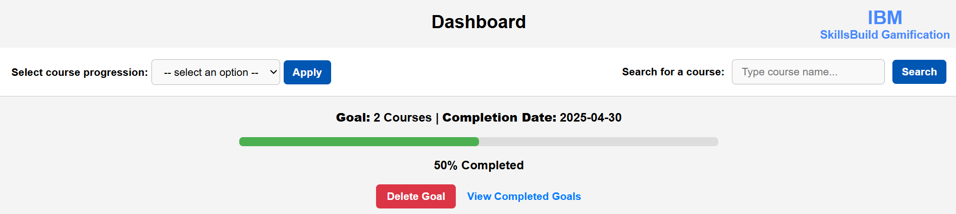
Purpose: Personal Learning goals
Focus and Motivation:
Personal Learning goals gives the student a clear target to work towards.
Sense of Progress:
Progress bars show students how close they are to achieving their goals.

Slide 6
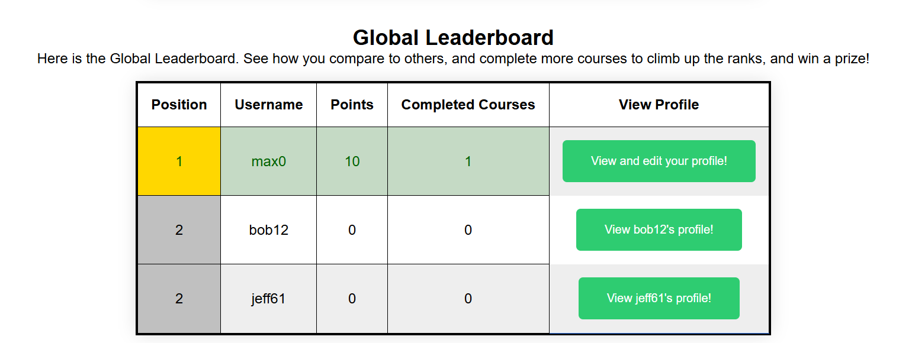
Purpose: Leaderboard
Competition:
Global leaderboard encourages students to push themselves to climb their rank
Social connection:
Friends' leaderboard allows students to compare learning progress in a smaller, more supportive group

Slide 7
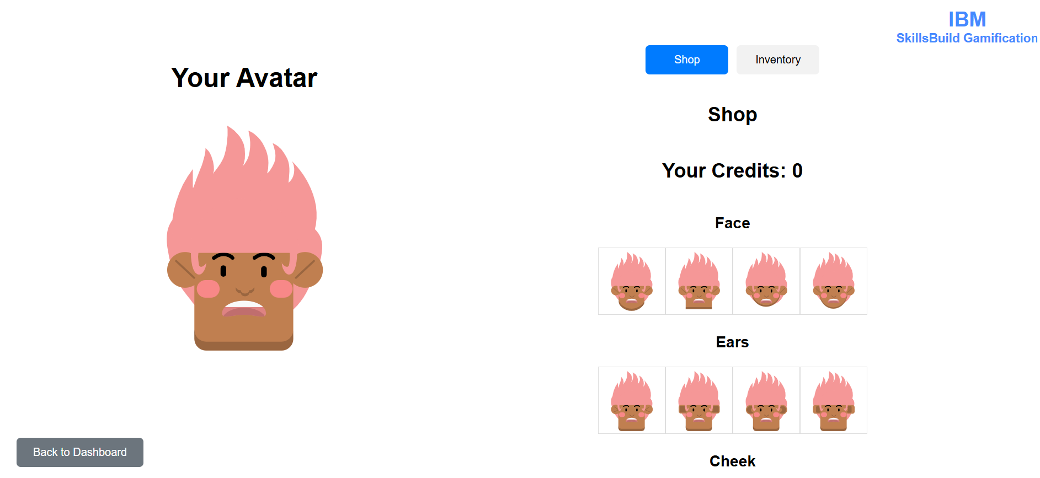
Purpose:
Credits and Avatars
Rewards Progress
Students earn credits for completing courses, turning work into tangible reward
Fun and Engagement
Customizing avatars makes the platform more fun and personal, improving student satisfaction.

Slide 8
Impact on Students
These features:
Make learning more engaging and motivating
Encourages self-paced leaning
Builds competition and social connection
Creates a sense of personal achievement
Overall, elevating the IBM Skillsbuild platform.

Slide 9
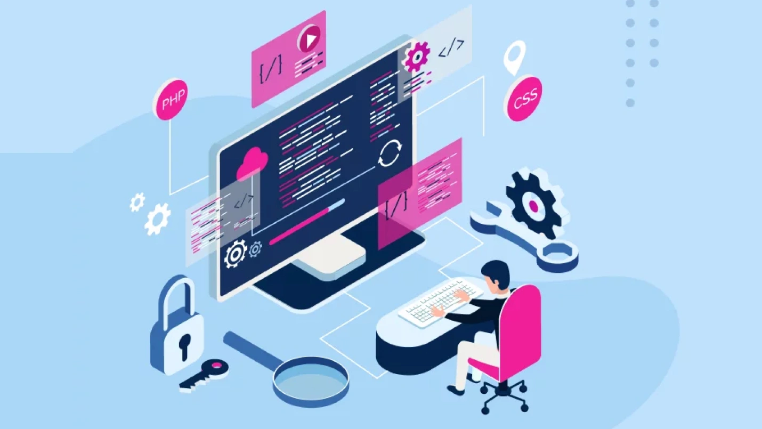

Software Architecture of IBM SkillsBuild Gamification
Alex George ag666@student.le.ac.uk

Slide 10




What we considered when choosing the technology to use
Familiarity
Ease of Use
Documentation available

Slide 11


Backend: Spring and MySQL
Spring Boot / Spring MVC – handling controller endpoints
MySQL for the database
Spring has good controller architecture
Familiar with Spring from previous modules – faster development, can better make progress during the sprint
OOP -> Promotes code reusability e.g. in the student class

Slide 12
Front End: JSP, JS, CSS
JSP:
We chose to use JSP as we were familiar with it from previous modules
It also integrates well with our Java Code, as you can “embed” java code inside the JSP files.
CSS:
Styling was done with CSS
JS:
Some features, such as dynamically changing leaderboard position indicators, or searching for courses, are handled in JS

Slide 13
Improvements that could have been made in the Software Architecture
Next time we could:
Use thyme leaf rather than JSPs for making the pages, as it may help with clean code
Use a CSS Framework to ensure more consistency between web pages

Slide 14

Task
Allocation
IBM SkillsBuild Gamification
Shoaib Irfan
sim20@student.le.ac.uk

Slide 15
How was it done?
Approach taken:
Roles were assigned on voluntary basis
Strengths and familiarity with concepts were key in distribution of workload

Slide 16

How was it done?
All User Stories were assigned to team members on GitLab with appropriate weights upon discussion at the beginning of each Sprint.
Made sure work distribution was equal and satisfactory for all team members to avoid team conflicts.

Slide 17
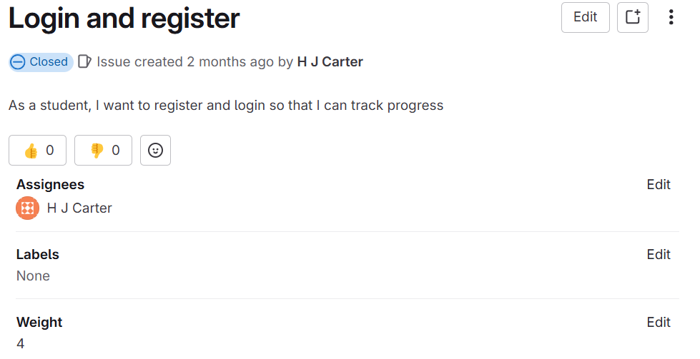
Evidence of Allocation

Slide 18

Evidence of Success
All team member expressed their satisfaction with allocation during all sprint retrospectives, reviews and peer reviews.
All User stories were completed on schedule including all non-technical DoD items like Documentation and Review
Team scored high grades in both checkpoints and the overall check.

Slide 19
Group Involvement in
Scrum Events
Haydn Carter
hjc26@student.le.ac.uk

Slide 20
Scrum Events
Sprint
Sprint Planning
Standup meeting
Sprint Review
Sprint Retrospective

Slide 21

Standup Meetings – Format
Twice a week, with a hard limit of 15 minutes for the entire meeting.
Three questions to answer:
What have you been working on?
What is blocking you right now?
What are you going to be working on?
Notes:
We had two standup meetings a week, one at the beginning, and one at the end.
We had a limit for each standup of 15 minutes, which meant that each member had about 3 minutes to answer the questions. Despite the time limit, we never went over 15 minutes. We also used these three questions as a prompt.

Slide 22
Standup Meetings – Results
team members were kept accountable.
workload was consistent.
no user stories left in the backlog for either sprint.
Notes:
Kept individuals accountable in following internal deadlines – When talking about what they were going to be working on, team members would often set themselves deadlines, especially if other team members were waiting on them before they could begin.
Promoted consistency in workload – People were regularly setting goals for what they were next going to accomplish before the next meeting, so work was done throughout the sprint rather than just at the end.
All user stories complete

Slide 23
Realistic plans to take this project onwards
Maximillian Charles Edwards
me245@student.le.ac.uk

Slide 24
What are potential areas that we could expand upon?
Review system
Avatar system
A completion system of the subjects

Slide 25
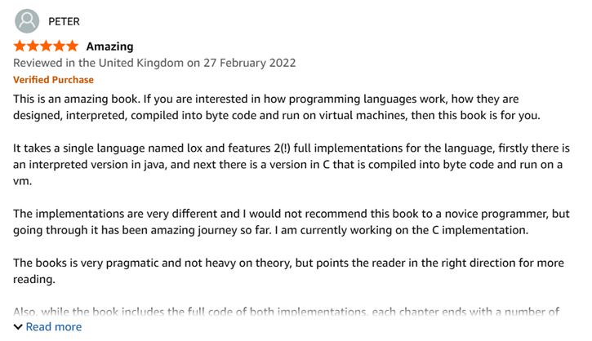

How to expand upon the Review System?
Could be a review history.
Include a star system instead of a number system.
We could include the date of the review.
Allow there to be a report button.

Slide 26
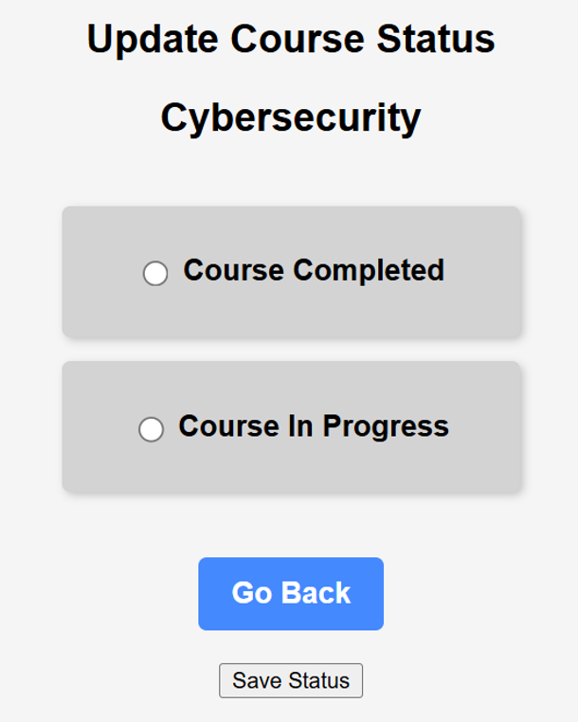
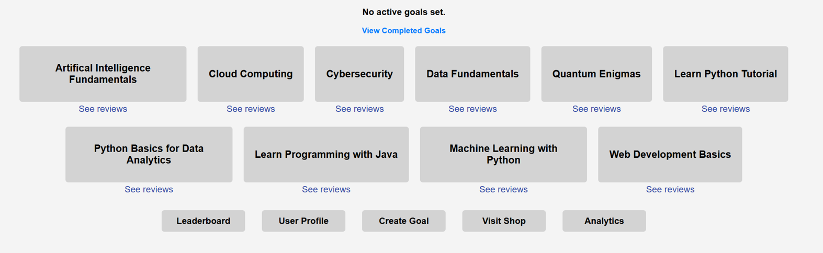
How could we improve upon the asserting if a subject is completed?
We could have a random data set of unique quizzes after clicking course completed?
Perhaps colour code the courses based on if they are in progress or completed?
Perhaps we also have a list on which courses that the user has completed and is currently in progress of doing.

Slide 27
How could we improve upon the avatar system?
Include more additional avatars for users to choose from
Add a wider diversity of cosmetics for users to choose from to customise avatars

