Slide 1
Welcome to…..
Bank Management System

Slide 2
Presented By-
Md Alhaj Hosen
Id:17182103335
Md Ikbal Hosen
Id: 17182103317
Md Sahrial Alam
Id: 17182103334
Supervised By-
Suman Saha
Assistant Professor
Department of Computer Science and Engineering (CSE)
Bangladesh University of Business and Technology (BUBT)
Mirpur, Dhaka.

Slide 3
Contents
Introduction
Motivation
Objectives
Features
H/W and S/W Requirements
Proposed Model
Snapshots of the Project
Limitations & Future Plans
Conclusion

Slide 4
Introduction
The Management system is designed & developed to create account
Relates to many fields.
Feedback & Suggestions
Admin has all the authorization

Slide 5
Motivations
Regular updating all information.
Scope of further improvement.
Customer can contact any time for their emergency need.
Authorized user could give us feedback & opinions.
Breaking & Latest news can be uploaded instantly.

Slide 6
Objectives
Our project will perform and fulfill all the tasks that any customer would desire.
Saving customer time.
Get more informative.
Different features are available on the basis of customer requirement.
Protecting the customer’s account.
Get feedback.

Slide 7
Features
1-Login
2-Main Menu
3- Create New Account
4- Customer info
5-Deposite Balance
6-Withdraw Balance
7- Transaction
8-Money Transfer
9-Loan Details

Slide 8
H/W and S/W Requirements
Hardware Requirement Specifications:
RAM: 1 GB
Processor: Intel Family
Software Requirement Specifications:
Xampp
Visual Studio
MySQL connector

Slide 9
Proposed Model
The BMS is a desktop-based project for maintaining a person's account in a bank.
Have different types of functionality.
A very good search.
Users can collect all the transaction by using printing process.
Users must have to register first to do any kind of bank activities.
Admin have the authorization to approve members.

Slide 10
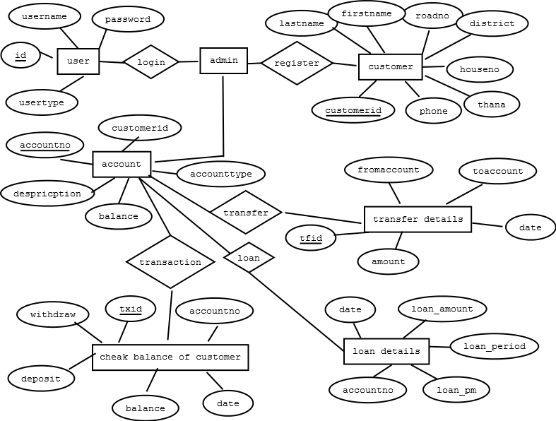
Continue…
ER Diagram:

Slide 11
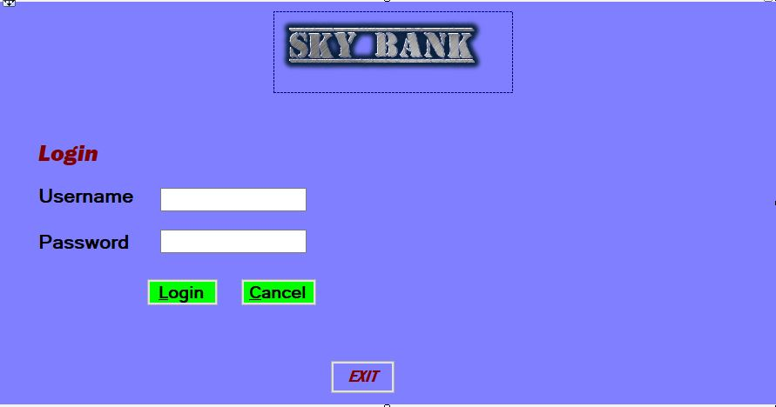
Login Page:
Continue..
Figure 2: Login page

Slide 12
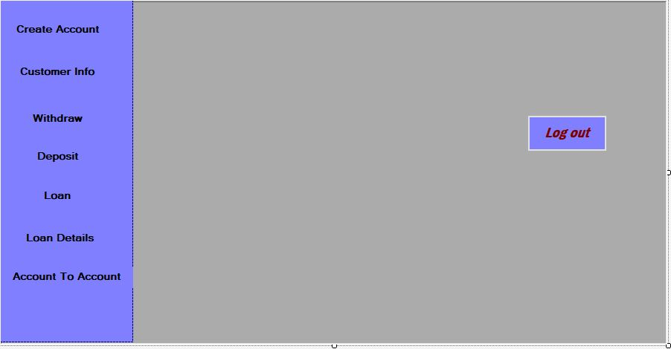
Main page:
Continue..
Figure 3:Main page

Slide 13
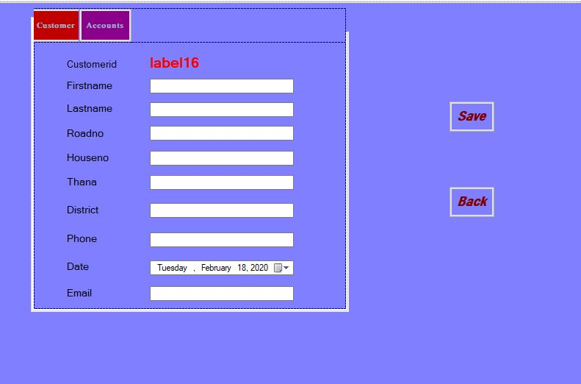
Create account
Continue..
Figure 4: Create account page

Slide 14
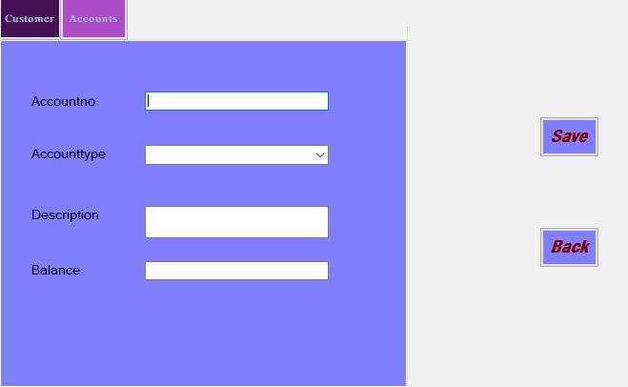
Continue…
Figure 4: Create account page

Slide 15
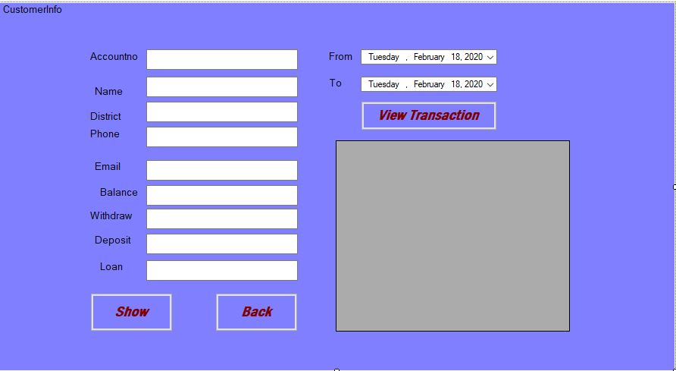
Customer details:
Continue..
Figure 5: Customer details page

Slide 16
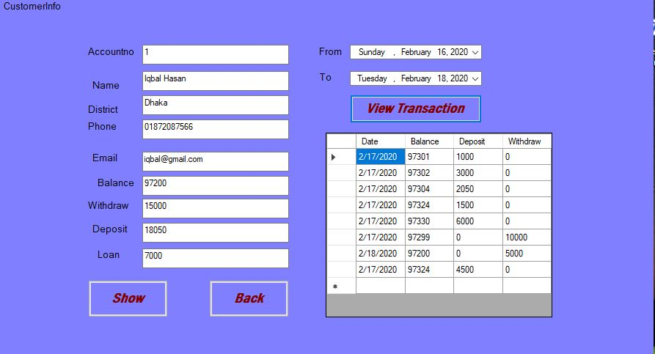
View details:
Continue..
Figure 6: View Account details page

Slide 17
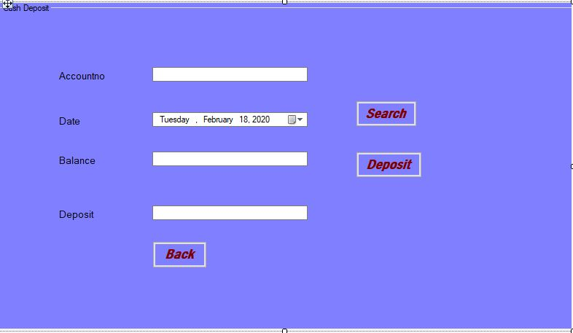
Deposit Page:
Continue..
Figure 7: Deposit page

Slide 18
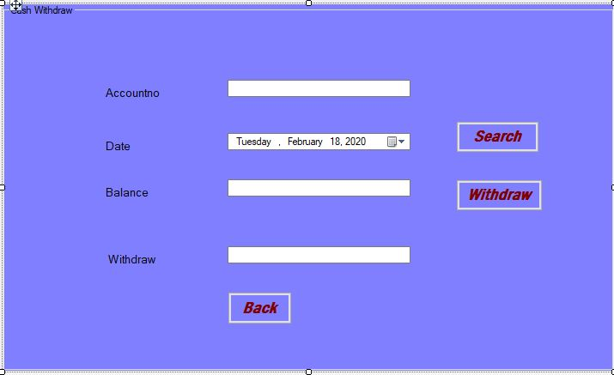
Withdraw Page:
Continue..
Figure 8: Withdraw page

Slide 19
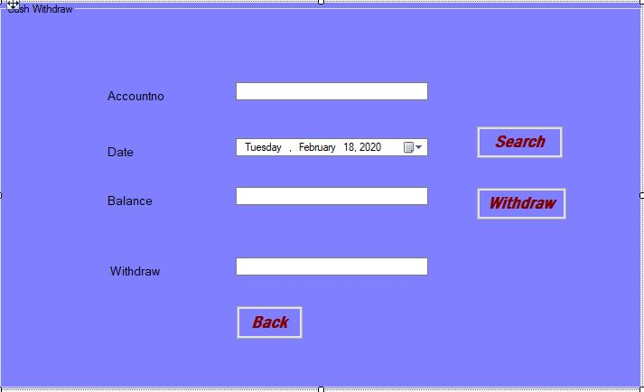
Money Transfer:
Continue..
Figure 10: Money Transfer page

Slide 20
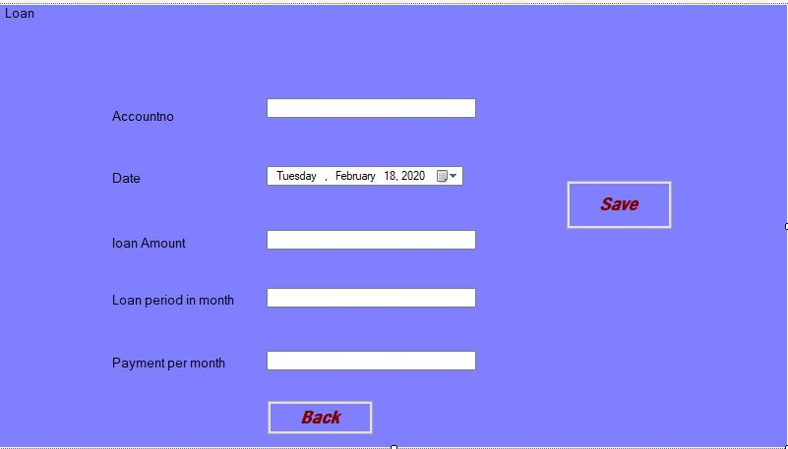
Loan System1:
Continue..
Figure 10: Add Loan page

Slide 21
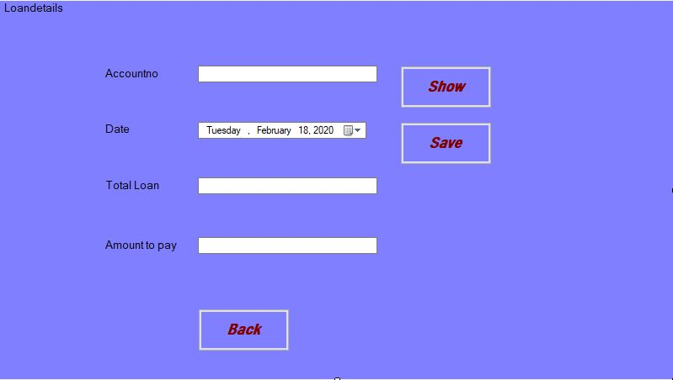
Loan System2:
Continue..
Figure 10: Loan Details page

Slide 22
Limitations & Future Plans
Limitation:
Desktop based only, have no online system.
Always open with the visual studio.
Customer doesn’t access their account.
Plans:
Much more improved search.
Convert it to online application where customer can access to
Open as a software

Slide 23
Conclusion
This project is developed to nurture the needs of a user in a banking sector by embedding all the tasks of transactions taking place in a bank.
Less time consuming to know details.
Is & always will be free to use.
Future version of this database system will still be much enhanced than the current system.

Slide 24

Thank You Everyone
Any Questions

