Slide 1

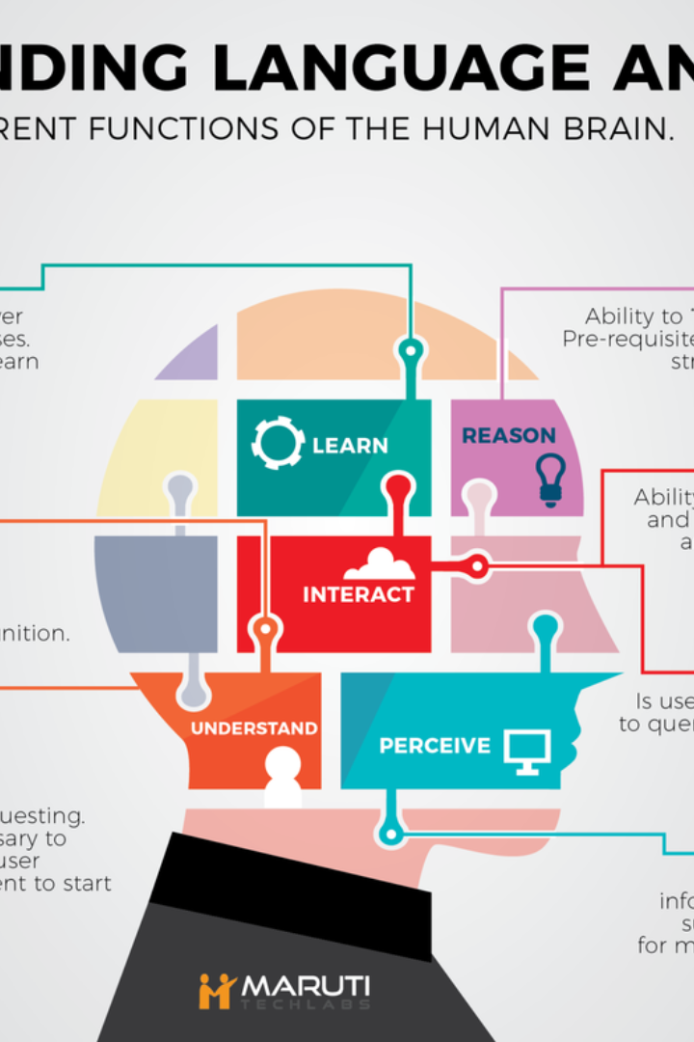
NATURAL LANGUAGE PROCESSING

Slide 2


Slide 3
Introduction
NLP is a subfield of artificial intelligence (AI) dedicated to the interaction between computers and human language.
It involves the development of algorithms and techniques to enable computers to understand, interpret, and generate human language.
NLP has a wide range of applications, including machine translation, sentiment analysis, chatbots, information extraction, and question answering

Slide 4
Language Models
Models understand and generate human-like language.
Trained on data, they assist language tasks
The bag-of-words model
Bag-of-words counts word frequency for representation.
Numerical representation highlights important words in document.
N-gram word model
N-gram word model captures word relationships.
Enhances understanding with local context analysis.

Slide 5
Cont..
N-gram /character-level model
N-gram models extend to character-level analysis.
Used for spelling correction and error detection.

Slide 6
Cont..
Word representations
Word representations are numerical representations of words.
They enable language understanding by clustering similar words

Slide 7
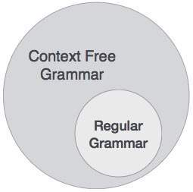
Grammar
Grammar defines rules for sentence construction and understanding.
It aids AI systems in analyzing and generating human-like sentences

Slide 8
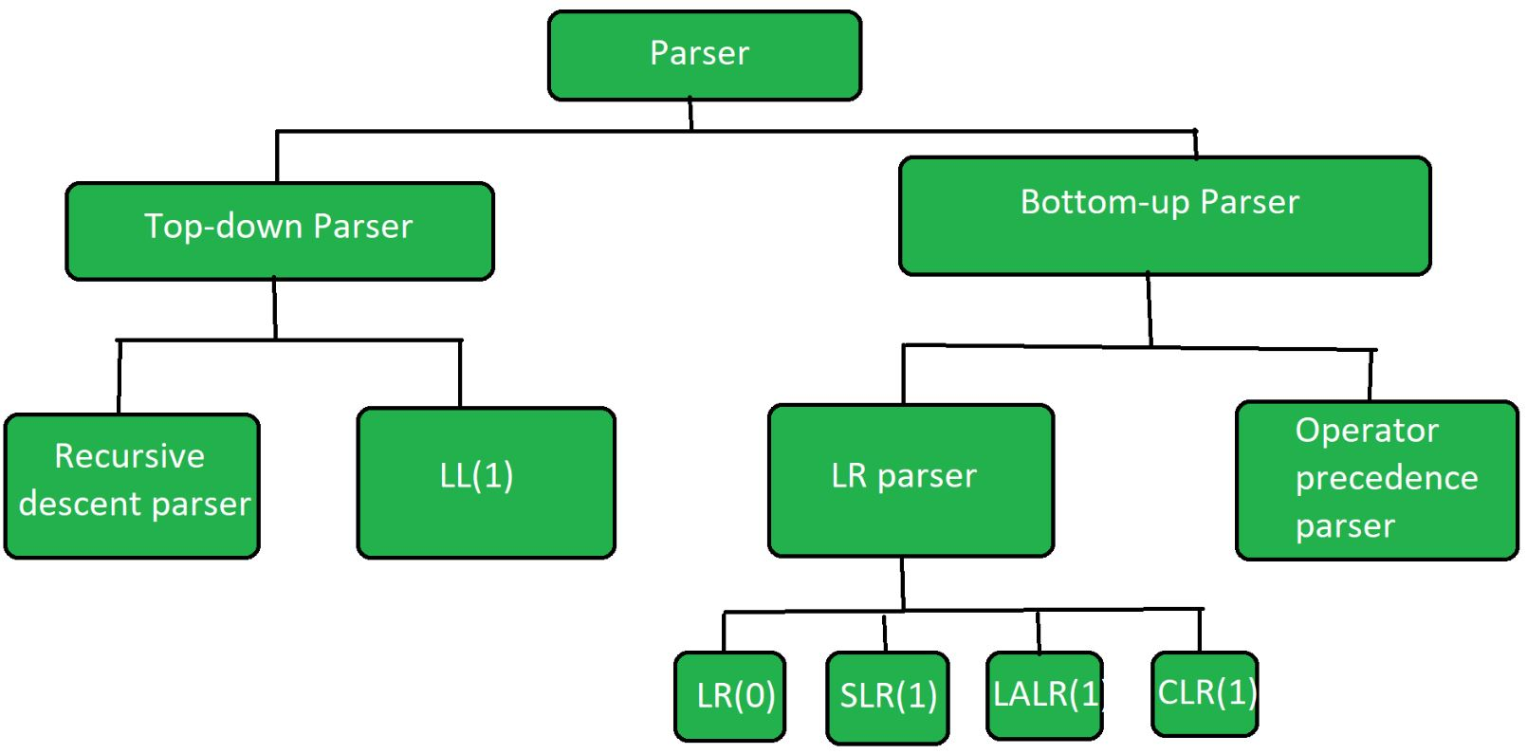
Parsing
Parsing analyzes sentence structure and syntax.
It breaks down the sentence and determines relationships.

Slide 9
Cont...
Dependency parsing
Dependency parsing analyzes word relationships in a sentence.
It identifies syntactic dependencies between words.
Learning a parser from examples
Learning a parser from examples involves training with labeled sentences.
The parser learns grammar patterns and rules

Slide 10
Augmented Grammars
Augmented grammars enhance expressive power of formal grammars.
Additional symbols/rules represent complex language structures.
Semantic interpretation
Semantic interpretation is the process of giving meaning to language elements like words, phrases, or sentences.
Learning semantic grammars
Learning semantic grammars involves understanding grammar rules that encompass the meaning or understanding of a language.

Slide 11
Complications of Real Natural Language
Complications of real natural language refer to the challenges and complexities that arise when dealing with human language in practical applications.
These include:
Quantification
Dealing with the interpretation and meaning of quantifiers such as "all," "some," or "none" within sentences
Pragmatics
Understanding the contextual nuances and implied meaning in language.

Slide 12
Cont...
Long-Distance Dependencies
Handling dependencies between words or phrases that are separated by a significant distance in a sentence, making their interpretation more complex.
Time and Tense
involve accounting for how language expresses temporal information, including past, present, and future events.

Slide 13
Cont...
Ambiguity
Addressing the presence of multiple possible interpretations or meanings of words, phrases, or sentences.
Lexical Ambiguity
Dealing with words that have multiple meanings, requiring disambiguation based on context.
Metaphor
Recognizing and understanding the figurative or non-literal use of language

Slide 14
Natural Language Tasks
processing and understanding of human language using NLP techniques
Some common examples include:
Speech Recognition: Converting spoken language into written text.
Text-to-Speech: Converting written text into spoken language.
Machine Translation: Automatically translating text from one language to another.
Information Extraction: Identifying and extracting specific information or structured data from unstructured text.

Slide 15
Cont..
Information Retrieval: Finding relevant information from a large collection of documents based on a user's query.
Question Answering: Providing accurate and relevant answers to questions posed in natural language.

Slide 16
Conclusion
Natural Language Processing (NLP) enables computers to understand, interpret, and generate human language.
NLP techniques capture the structure, semantics, and context of natural language.
Challenges in NLP include ambiguity, context-dependency, and handling long-distance dependencies.

Slide 17


