Slide 1
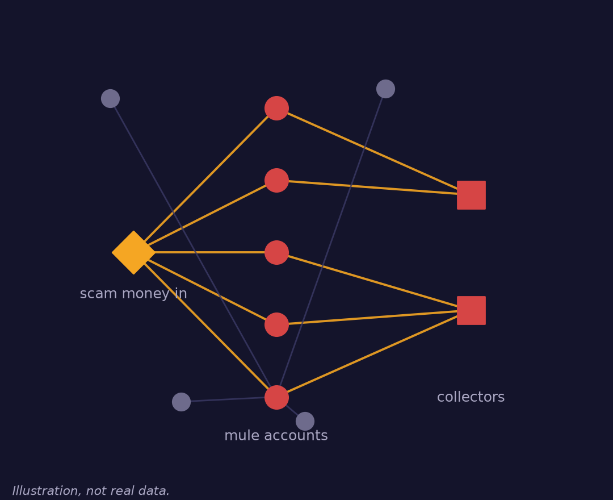
BUILDX HACKATHON 2026 · BANKING, FINANCIAL SERVICES AND FINTECH
MuleCatch
One payment reveals the whole scam ring.
Real-time AI that scores each payment in the context of the account network, groups a mule ring into one explainable case, and flags fraud, not genuine customers. A person always decides.
REAL-TIME SCORING
ONE CASE PER RING
HUMAN DECIDES
SYNTHETIC-DATA RESULTS
How a ring looks in the account graph (illustration)
TEAM [Team name] · [Member 1] · [Member 2] · [Member 3]
Live: mulecatch.vercel.app · [repository link]
Notes:
TIMING 0:30-0:40. Open /live BEFORE this slide: press Start stream at 5 payments/s and let the first 30 seconds play with no slide. Then: 'I'm [name], this is [team]. We built MuleCatch.'
PITCH CUT (about 4.5 min live): slides 1-9. Slides 10-12 are appendix for Q&A.
Fill in team names and the repository link before the event. Wording rules: say 'flags' and 'routes to a human', never 'blocks', 'stops' or 'recovers'. Say 'synthetic data' next to every result. Never claim a bank partnership or 'production-ready'.

Slide 2
THE PROBLEM
SCORES PROBLEM 20%
Scam money leaves through mule rings. Banks review one account at a time.
4.5 lakh
₹11,333 cr
23 banks
A persona, not an interview
A fraud analyst at a small bank gets one alert per account and rebuilds the ring by hand. A genuine customer who paid one flagged account gets frozen.
mule accounts frozen by the Indian Cyber Crime Coordination Centre in about a year
lost to cyber fraud in the first nine months of 2024, as reported
had adopted RBI's MuleHunter.AI by Dec 2025 because static rules gave too many false alarms
Business Standard, Nov 2024
The Wire; other sources differ
MediaNama (RTI reply)
ROOT CAUSE
Alerts are per account, but the fraud is a network. Analysts reconstruct the ring by hand, review the same ring many times, and sometimes freeze genuine customers on the way.
MuleCatch · BuildX Hackathon 2026 · Banking and FinTech
02 / 12
Notes:
TIMING 0:40-1:05. One sentence per number. 4.5 lakh and the Rs 11,333 crore are press reports of government data; say 'as reported'. MuleHunter.AI shows the regulator already treats this as a priority, so we are not selling a problem nobody has.
HONEST: the analyst persona is a hypothesis from public sources. We have not interviewed analysts yet (validation plan in docs/buildx/02).
Likely question: 'is the 90% false-positive figure yours?' No: it is a consultancy figure; we do not show it.

Slide 3
THE SOLUTION
SCORES INNOVATION 25%
One payment in, one ranked ring case out, no innocent bystanders.
1 Score every payment
2 Group the ring
3 A person decides
Each payment is scored against the account network as it arrives. Payments into a ring are flagged for review in about 81 ms (median) on a synthetic window of about 5,000 payments.
Accounts are grouped into rings. A ring becomes a case only when its members carry their own evidence, so a big genuine community is not mistaken for one.
MuleCatch never blocks or freezes. The investigator gives a reason, the decision is hash-chained, and the case exports as a report.
THE CLAIM, KEPT NARROW
Network analytics is not new. What we add is the unit of work: the ring, ranked by how much evidence each member carries, with the number of genuine customers pulled in measured and shown.
MuleCatch · BuildX Hackathon 2026 · Banking and FinTech
03 / 12
Notes:
TIMING 1:05-1:25. Three steps, one breath each. The p50 figure is from docs/buildx/payment_eval_results_v4.json (hardened, 20 held-out datasets, re-run on the current code): about 81 ms median, 169 ms p95, on a development machine. Say 'synthetic'.
Likely question: 'is the graph part novel?' No, and we say so. The novelty is the case ranking and the genuine-customer exposure number.

Slide 4
LIVE DEMO
SCORES DEMO presentation 15%
The 90-second walkthrough: watch a ring form, open its case, record a decision.
0:00
0:15
0:25
0:45
1:15
Press Start
A ring turns red
Check the counter
Open the case
Record a decision
Stream replays synthetic UPI payments at 5 per second. Dots appear as each is scored.
One cluster is flagged. One case opens, not dozens of alerts.
Genuine accounts flagged. It reads 0 on this synthetic data.
Reasons, money path, timeline, and which members carry their own evidence.
Pick an outcome, give a reason. The decision lands in the hash-chained audit log.
BACKUP
Recorded video of the same flow, on the laptop and a USB stick. The replay is seeded, so Replay gives the same ring.
MuleCatch · BuildX Hackathon 2026 · Banking and FinTech
04 / 12
Notes:
TIMING 1:25-2:55 (90 s). The first 30 seconds of the stream already played before slide 1. Now go to /live, press Replay if needed, open the top case.
Say: 'One source, N payments under Rs 50k in H hours, fanned to M accounts, consolidated into K collectors.' Fill N/H/M/K from what is on screen; never quote numbers that are not on screen.
Record the decision with a reason and show the audit entry. All data is synthetic: say it once, clearly.
If anything fails: switch to the recorded video at the same timestamp. Never show fabricated data.

Slide 5
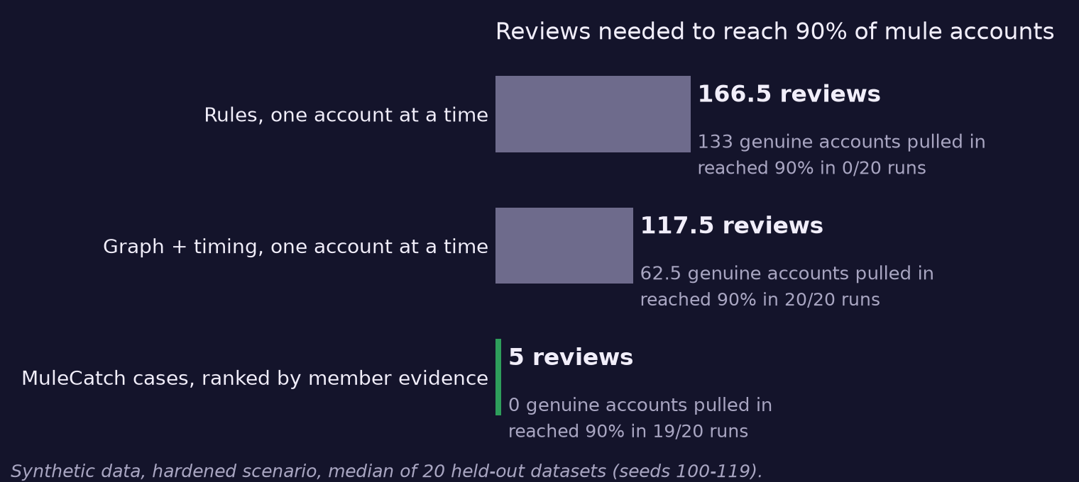
MEASURED RESULT, SYNTHETIC DATA
SCORES FEASIBILITY 20%
Five ranked cases reach 90% of mule accounts. The rules queue never gets there.
99%
of mule payments flagged, per payment, as they arrive
0.0%
of genuine payments flagged in this sample. None seen, not a guarantee.
81 / 169 ms
median / 95th percentile per payment. The p95 is above a 100 ms budget.
READ THIS FIRST
We wrote both the data generator and the detector, so these are upper bounds. 20 held-out datasets, seeds never used for tuning.
MuleCatch · BuildX Hackathon 2026 · Banking and FinTech
05 / 12
Notes:
TIMING 2:55-3:30. Chart: hardened scenario, where account age is equalised so the easy shortcut is gone. Rules reach 90% in 0 of 20 runs (166.5 reviews, 133 genuine accounts pulled in). Case queue ranked by member evidence: 5 reviews, 0 genuine accounts. Re-run on the current code (docs/buildx/evaluation_results_v2.json); the rules baseline is lower than in the first audit because six noisy rules were removed.
Per-payment numbers: docs/buildx/payment_eval_results_v4.json, hardened, test seeds 100-119, 1 in 25 payments replayed live.
Say the p95 problem out loud before a judge does. Sources for every figure: scripts in scripts/evaluation/, results in docs/buildx/.

Slide 6
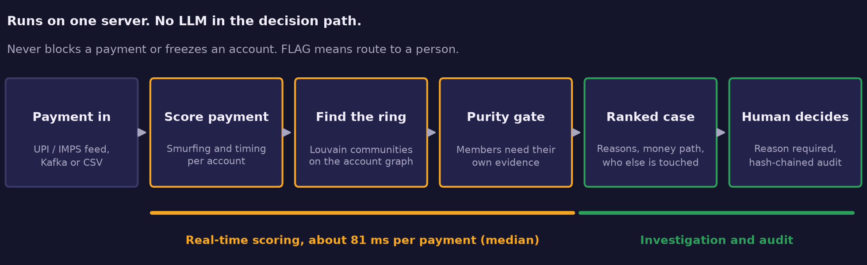
ARCHITECTURE
SCORES FEASIBILITY 20%
Six steps, one server, and a person at the end.
Stack
Explainable by design
Deployable small
FastAPI and React. NetworkX and Louvain find the rings. Kafka, Postgres and Neo4j are optional.
Every flag lists its reasons and which ring members carry their own evidence. No LLM in the decision path.
Runs on one server, on-premise. Read-only pilot data feed. Nothing is sent to a third party.
MuleCatch · BuildX Hackathon 2026 · Banking and FinTech
06 / 12
Notes:
TIMING 3:30-3:40. Do not walk the boxes. Point at the orange lane (real time) and the green lane (investigation and audit). Likely question: 'why not a GNN?' We measured: no gain, and we found and removed a label-leaking feature, so it is off the decision path.

Slide 7
COMPETITION
SCORES INNOVATION 25%
Others find mule accounts. None publish a ring queue that counts genuine customers pulled in.
Scores payments or accounts
Network or link view
Whole ring as one ranked case
Counts genuine customers pulled in
Works from payments alone
MuleHunter.AI (RBIH)
✓
~
✕
✕
✓
Clari5 (Perfios)
✓
✓
~
✕
✓
BioCatch
✓
~
✕
✕
✕
Quantexa
✓
✓
~
✕
✓
MuleCatch
✓
✓
✓
✓
✓
Our claim is narrow: a ring-level queue ranked by member evidence, with genuine-customer exposure measured. We complement MuleHunter.AI, we do not replace it.
From public vendor material, which is self-reported. A cross means not found in public material, not that it does not exist. Tick = yes, tilde = partly. Source: docs/buildx/03-differentiation.md.
MuleCatch · BuildX Hackathon 2026 · Banking and FinTech
07 / 12
Notes:
TIMING 3:40-3:55. Read one row: the last. Honest reading: the vendors are far bigger and have data and device signals we cannot reach (BioCatch). Our edge is the unit of work and the measurement. If a judge names a vendor that does this, say 'then we are in good company; please show us the number'.

Slide 8
WHERE WE STAND
SCORES FEASIBILITY 20%
What runs today, what is next, and where it fails.
Real, live today
In progress
Known limits
• Per-payment scoring API (flag, never block)
• Live stream with ring cases and a genuine-flagged counter
• Case view: reasons, money path, member evidence
• Human decision with reason, hash-chained audit, report export
• Incremental ring updates to bring p95 under 100 ms
• Analyst interviews and a timed case-view study
• Independent validation on a bank's time-split history
• IBM AMLworld (public benchmark): 0% of laundering payments caught. Our rules fit fast smurfing, not multi-day cycles
• Mules who pay many bystanders or move 24x slower evade us: 68% and 62% caught
• Data is synthetic and we wrote the generator
MuleCatch · BuildX Hackathon 2026 · Banking and FinTech
08 / 12
Notes:
TIMING 3:55-4:20. Judges punish polish that exceeds the code, so lead with the left column and then read the red one aloud. AMLworld: docs/buildx/ibm_aml_results.json (mule payment recall 0.0, account evidence AUC 0.68); a later branch tried relay and loop features and did not close the gap. Evasion: docs/buildx/evasion_results_v3.json (dilute 68%, slower 62%). Charts are in the appendix.
Likely question: 'so does it work on real data?' Honest answer: we do not know. That is the pilot.

Slide 9
THE ASK
SCORES IMPACT 20%
A read-only pilot on a small bank's history, to find out if rings beat accounts on real data.
✓
Real-time scoring of each payment, flag only, never block
Who it is for (hypothesis)
✓
One ranked case per ring, with the evidence behind it
Users: fraud and AML analysts. Buyers: heads of fraud risk at small finance, cooperative and payments banks. Pilot: 8 to 12 weeks, read-only, on historical data with time-split labels.
✓
Genuine customers pulled in are counted, not hidden
✓
A person decides, with a reason and a hash-chained audit trail
✓
Honest about limits: synthetic data, independent data still open
NOT A FINISHED PRODUCT
A measured prototype with its failures on the table. Try it: mulecatch.vercel.app (guest login). · [team contact] · [repository link]
MuleCatch · BuildX Hackathon 2026 · Banking and FinTech
09 / 12
Notes:
TIMING 4:20-4:35. Close on the ask, not on features. 'We are not asking you to believe the synthetic numbers; we are asking for the data path to test them.' Total pitch about 4:35 with the 30-second opener, leaving buffer under 5:00.

Slide 10
APPENDIX
Judge Q&A: the answers we have ready.
Why not a GNN?
Better than MuleHunter.AI?
We measured: no gain over graph plus timing, and we found a feature that leaked labels, so it is off the decision path.
Different unit: cases, not account scores. We complement it.
Does it work on real data?
Is it real time?
Unknown. A CSV path is tested on a small sample without labels, so we claim no accuracy. IBM AMLworld shows it does not transfer yet.
Per-payment scoring takes 81 / 169 ms (median / p95) on synthetic data. Louvain still reruns often; incremental updates are next.
Will it freeze genuine customers?
Why is synthetic data enough?
It never freezes anyone. A flag routes to a person who must give a reason.
It is not. It is a regression check and a fair fight against rules. The pilot is the real test.
What is new, given pre-built code?
What if mules adapt?
Organisers allowed prior code. We keep a git log of what was built during the event.
Two tactics still beat us (appendix). We measured and published them.
MuleCatch · BuildX Hackathon 2026 · Banking and FinTech
10 / 12
Notes:
Appendix: use for Q&A only. Keep answers to one sentence; point to the file path when a judge asks where a number came from.

Slide 11
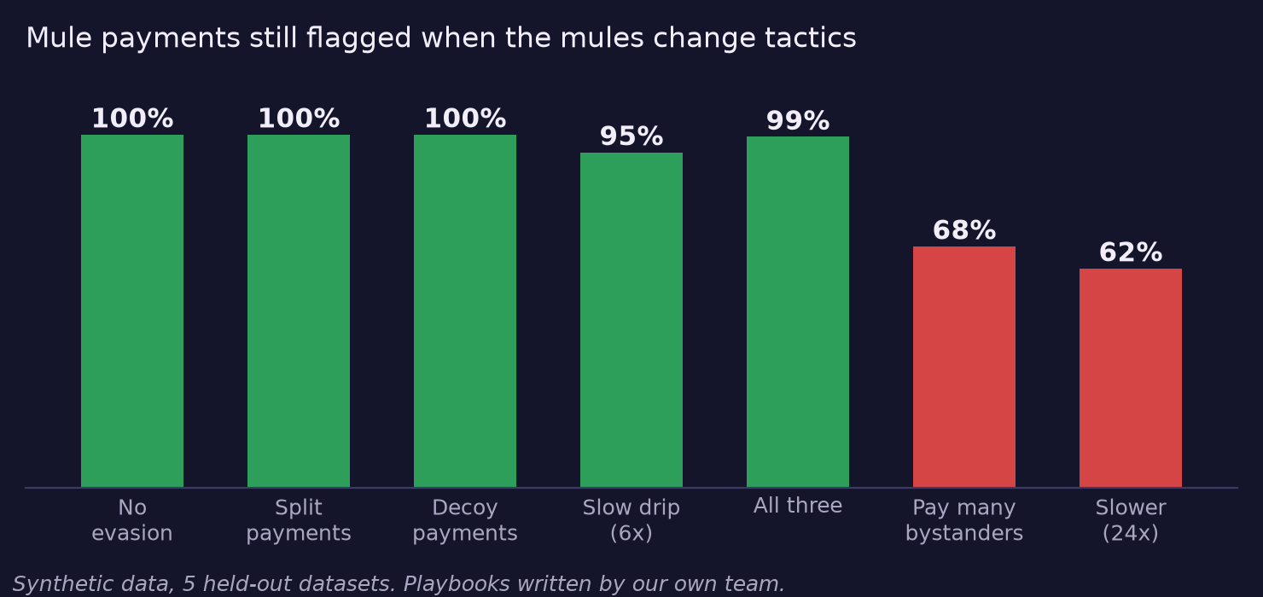
APPENDIX
Where it fails: mules who adapt, and data it was not built for.
IBM AMLworld, public benchmark
20 time slices, about 2,000 payments each. Laundering payments caught: 0%. Genuine payments flagged: 0.04%. Account evidence AUC 0.68. Quiet, but blind to cycles, stacks and scatter-gather.
What we do about it
Say it up front. Decoy-robust ring extraction and longer time windows are the top detection priorities, ahead of new features.
Playbooks were written by the same team that wrote the fixes, so a pass is weak evidence. Source: docs/buildx/evasion_results_v3.json, ibm_aml_results.json.
MuleCatch · BuildX Hackathon 2026 · Banking and FinTech
11 / 12
Notes:
Appendix: show if asked 'what breaks it?'. The two red bars are the honest answer.

Slide 12
APPENDIX
Sources behind every number.
Claim
Source
About 4.5 lakh mule accounts frozen in about a year
Business Standard, 12 Nov 2024; The Wire (press reports of government data)
₹11,333 crore lost to cyber fraud, first nine months of 2024
The Wire. Other sources give different totals and scopes
23 banks implemented MuleHunter.AI by Dec 2025
MediaNama, RTI reply, Dec 2025
Rules reach 90% of mules in 0 of 20 runs; 5 vs 166.5 reviews
docs/buildx/evaluation_results_v2.json (hardened, seeds 100-119)
99% mule, 0.0% genuine payments flagged; 81 / 169 ms
docs/buildx/payment_eval_results_v4.json (hardened)
Mule tactics: 68% and 62% caught
docs/buildx/evasion_results_v3.json
AMLworld: 0% laundering payments caught
docs/buildx/ibm_aml_results.json; Altman et al., NeurIPS 2023
Competitor capabilities
Vendor material, self-reported: docs/buildx/03-differentiation.md
MuleCatch · BuildX Hackathon 2026 · Banking and FinTech
12 / 12
Notes:
Appendix: every figure on the slides traces to a file path here. Figures are generated by docs/pitch/make_figures.py from these result files.

