Slide 1
Predicting Disease Progression in Cirrhosis Using Artificial Neural Networks
The GenG Model to Improve Prognostic Accuracy in Healthcare
Presented by: Alham Hotaki
Date: 16.09.2024

Slide 2
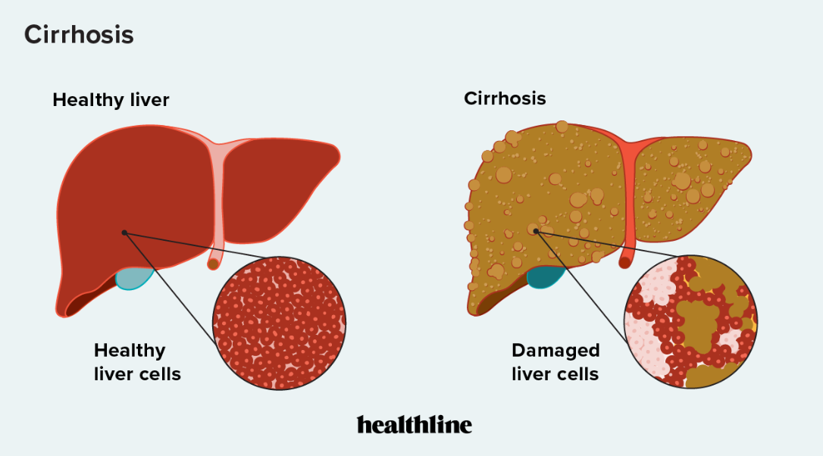
Cirrhosis – A Critical Liver Condition
Cirrhosis is a chronic liver disease that can lead to severe complications, including liver failure and death.
Early prediction is crucial but traditional methods can be limited by human error and difficulty in recognizing patterns in complex data.
Key Question: How can we leverage artificial intelligence, specifically an Artificial Neural Network (ANN), to enhance the accuracy of predicting cirrhosis progression?

Slide 3
Overview of the Dataset
The dataset we used contains detailed clinical information from a study conducted by the Mayo Clinic on 424 cirrhosis patients.
Key Variables:
Demographics: Age, sex, and more.
Clinical observations: Presence of ascites, hepatomegaly, spider angiomas.
Blood tests: Bilirubin, cholesterol, albumin, and others.
Target Variable: The histological stage of cirrhosis, with four stages representing disease progression.

Slide 4
A Brief Exploratory Data Analysis (EDA)

Slide 5
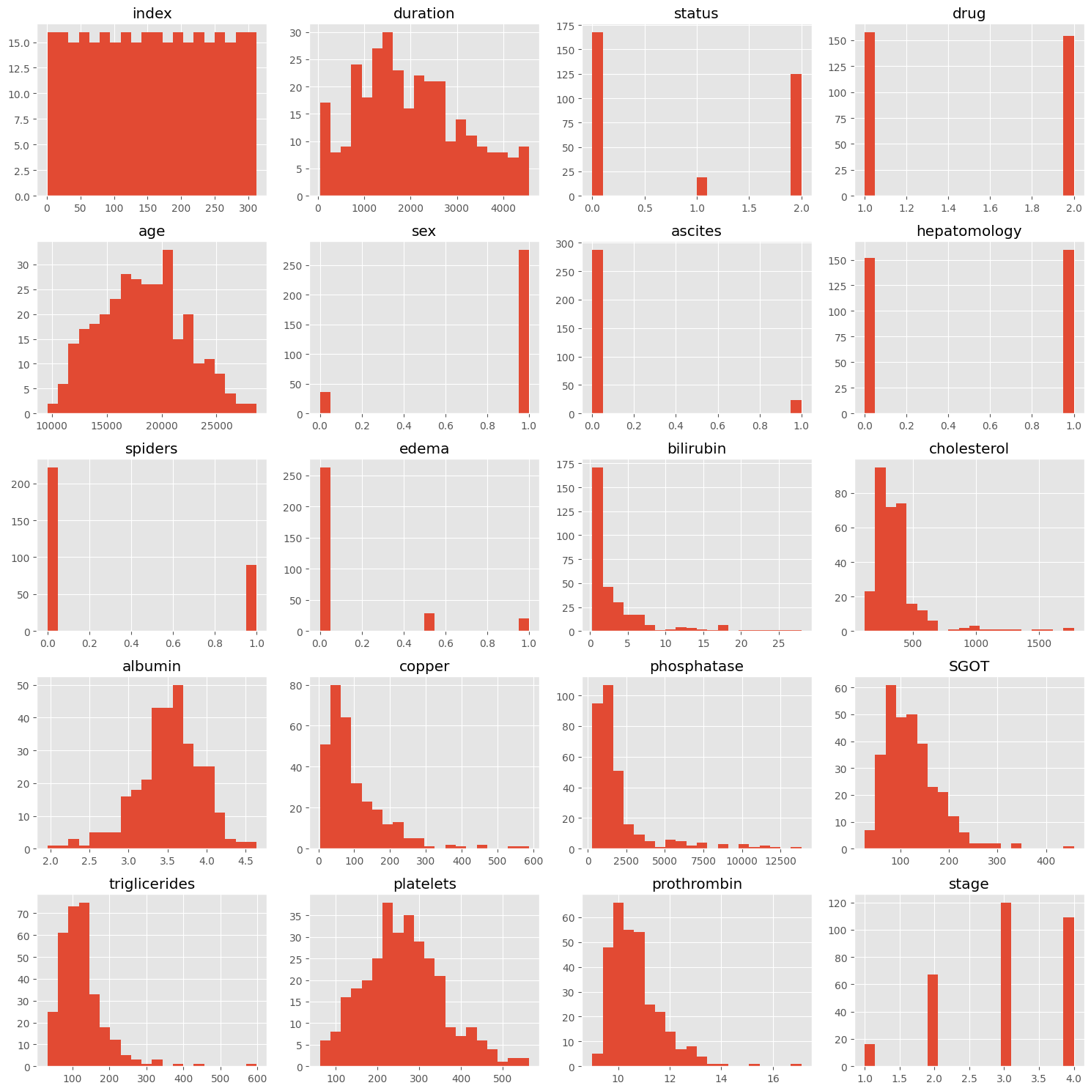
Distribution of Features
Most of the features are skewed and have non-normal distributions, indicating that transformations (such as normalization or log transformations) might be necessary for machine learning models.
The "stage" column, which is the target for prediction, shows a clear multi-class nature with four stages of cirrhosis.

Slide 6
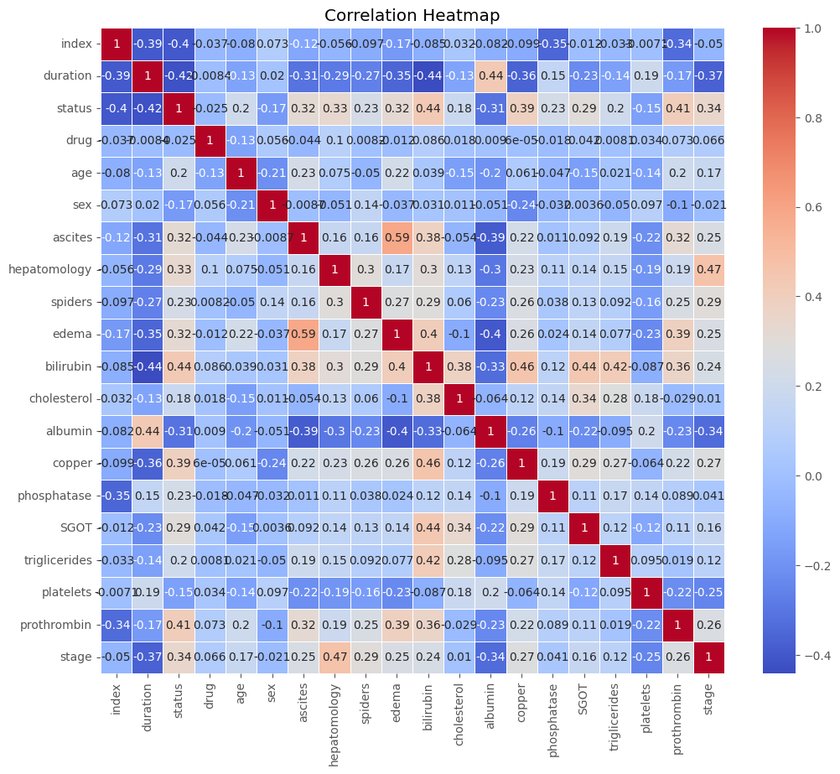
Correlation of Features
Multicollinearity: Some variables like edema and ascites are highly correlated, which might introduce multicollinearity issues if used together in certain machine learning models.
Feature Selection: Variables with stronger correlations to the target (stage), such as hepatomegaly, bilirubin, and albumin, are likely important predictors for the stage of cirrhosis.

Slide 7
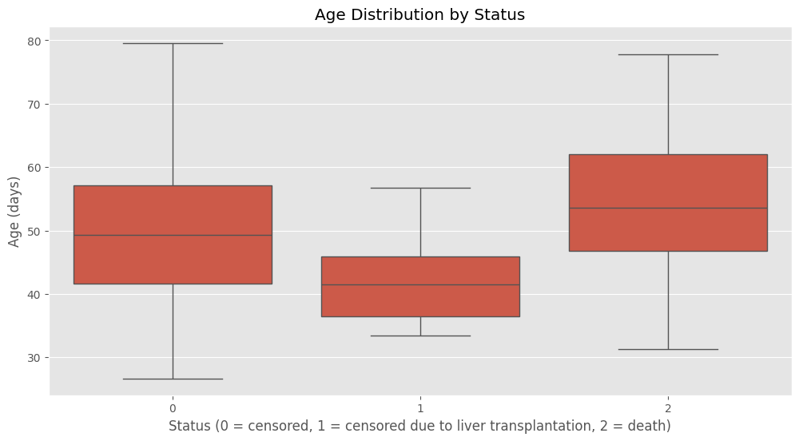
Age and Status
Patients who underwent liver transplants (status 1) are generally younger compared to the other groups.
Patients who are censored or have passed away have similar age distributions, but there is more variability in the "death" group.

Slide 8
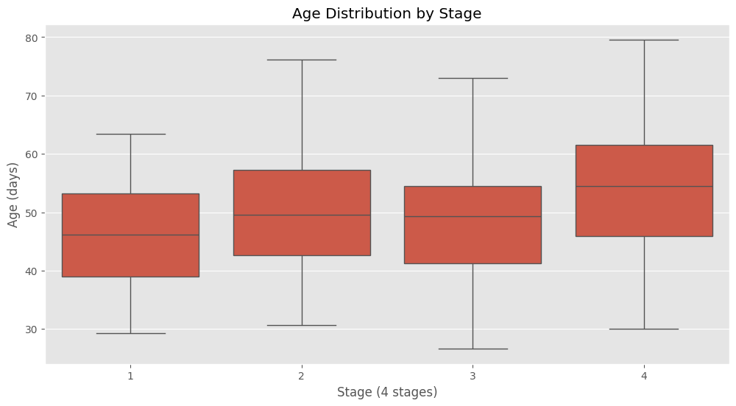
Age and Stage
Across all stages, the median age is relatively consistent (around 45–50 days), but the variability in age increases as the disease progresses to more advanced stages (especially in Stages 3 and 4).
Stage 4 shows the greatest spread in age, suggesting that patients in more advanced stages of cirrhosis span a wide age range, whereas Stage 1 is more concentrated in a specific age group.

Slide 9
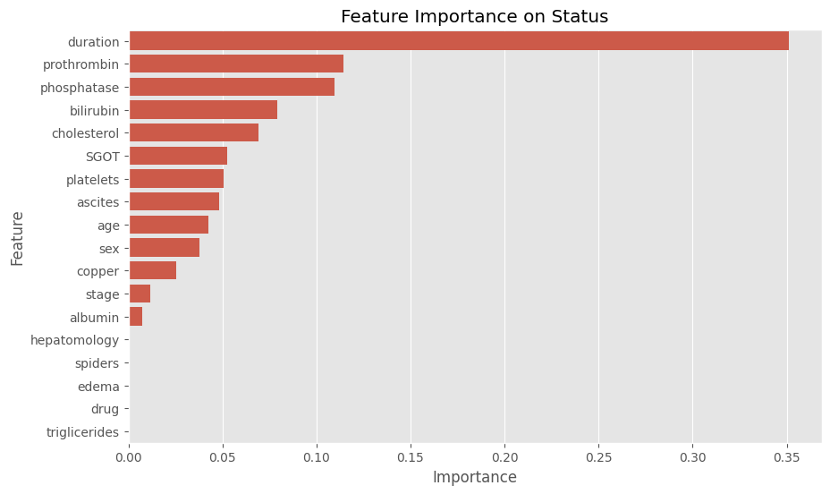
Feature Importance Analysis

Slide 10
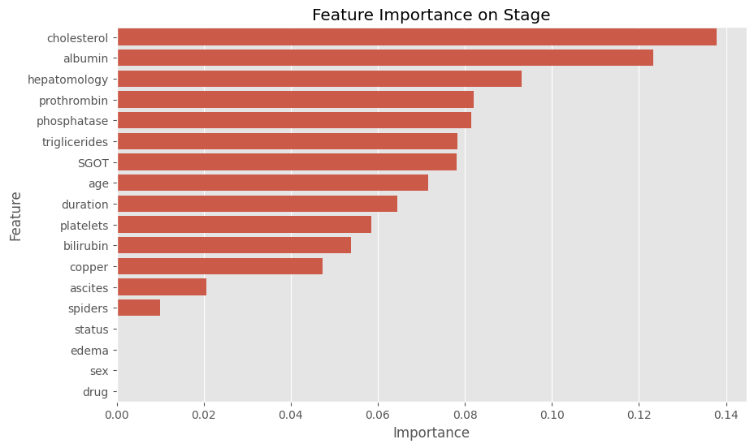
Feature Importance Analysis

Slide 11
Artificial Neural Network (ANN)
Overview

Slide 12
What is ANN?
An Artificial Neural Network mimics the brain’s neurons and connections to identify patterns in data. It’s particularly powerful for nonlinear, complex relationships like those in medical data.
Our Model:
We designed an ANN with 2 hidden layers:
64 neurons in the first layer and 32 neurons in the second layer.
Activation Function: ReLU (Rectified Linear Unit) for the hidden layers to handle non-linearities in the data.
Output Layer: Uses softmax activation for multi-class classification to predict the disease stage (4 stages).

Slide 13
Training the Model
We trained the ANN on features such as bilirubin, albumin, age, prothrombin time, cholesterol, and more, with the goal of predicting the stage of cirrhosis.
Process:
Data was standardized using scaling to ensure all features were on a comparable range.
The model was trained for 10,000 epochs with a learning rate of 0.001 to optimize the prediction accuracy.
Loss function: Cross-entropy was used to penalize incorrect predictions and guide the learning process.
The ANN achieved a strong performance with an overall accuracy of more than 80% on the training set.

Slide 14
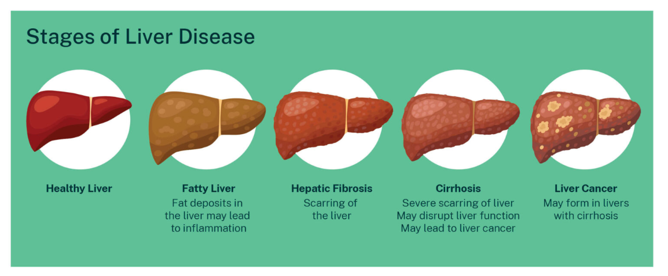
Predicting the Stages of Cirrhosis

Slide 15
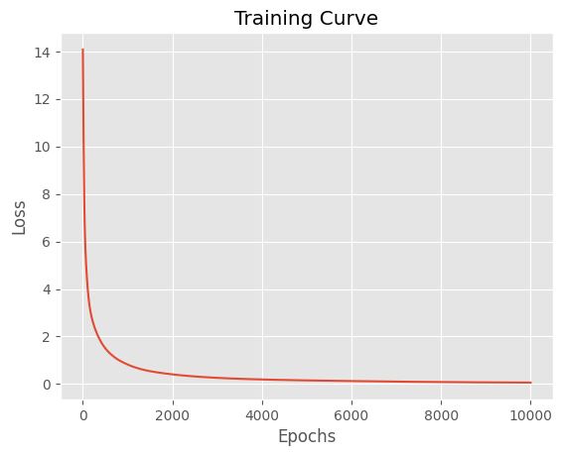
Training Curve

Slide 16
The real world application of the model
For Doctors:
The ANN model can act as a decision support tool, providing an initial stage prediction. The doctor can use this prediction as a starting point and perform a final review to confirm the diagnosis.
This reduces the time spent on diagnosis while still allowing the physician to maintain full control over the final outcome.
For Scientists:
This method blends the strengths of AI in analyzing vast amounts of data with the human insight of experienced healthcare professionals.
Doctors remain integral to the diagnostic process, especially for rare or borderline cases where their expertise can identify nuances the model may miss.

Slide 17
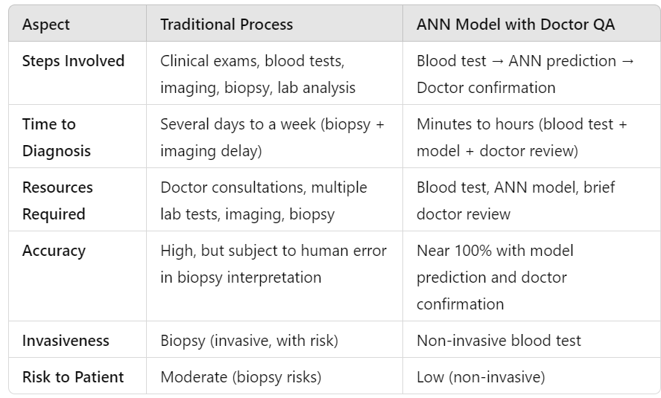
Traditional Clinical Process vs. ANN Model Application

Slide 18
Traditional Clinical Process vs. ANN Model Application
Traditional Approach: Patient A undergoes blood tests, imaging, and a biopsy. Diagnosis takes 5-7 days.
ANN Approach with Doctor QA:
Patient A’s blood test results are fed into the model.
Model Prediction: Within minutes, the model predicts that the patient is in Stage 3 of cirrhosis.
Doctor Confirmation: A doctor reviews the model’s output, confirms that the prediction is accurate based on additional clinical signs or tests.
Total Time: 30 minutes to a few hours (depending on the availability of the doctor for final review).

Slide 19
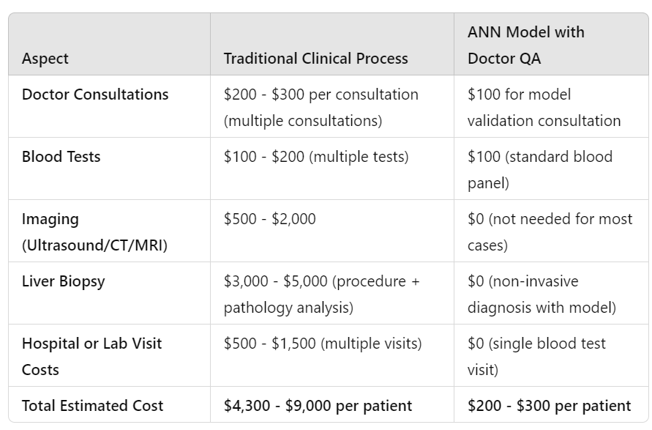
Cost Comparison: Traditional vs. ANN Model

Slide 20
Cost Comparison: Traditional vs. ANN Model
Reduced Procedure Costs: Eliminating invasive and expensive procedures like biopsies saves thousands of dollars per patient.
Less Doctor Time Required: Doctors can focus on reviewing and confirming predictions, which reduces consultation time, ultimately lowering the costs of medical labor.
Faster Results, Fewer Visits: Patients don’t need to return for multiple appointments or lab visits, reducing associated costs of hospital stays or transportation.
Scalability: Once deployed, the model can be used for thousands of patients with minimal additional cost, drastically lowering the per-patient cost for healthcare providers.

Slide 21
ANN Model
Estimated Time Saving per Patient:
5 - 7 days
Estimated Cost Saving per Patient:
USD 4’000 to USD 6’000
Key Benefits

Slide 22
Final Words
Hybrid Approach: The ANN model acts as a rapid initial screening tool, but the final stage diagnosis is always confirmed by a healthcare professional. This ensures the highest level of accuracy while greatly reducing the time and resources needed for diagnosis.
Benefits: By combining AI with human expertise, we:
Reduce diagnostic times from days to minutes.
Maintain 100% confidence in the results through doctor validation.
Improve patient outcomes with faster, more accurate decisions.
This hybrid approach offers the best of both worlds—AI's speed and precision, with the reliability and insight of medical expertise.

Slide 23
Thank You
max growth

