Slide 1
Postal Mail Mobile Notification
SEIS785 – Capstone Project
Abdulrahman Alhamran

Slide 2
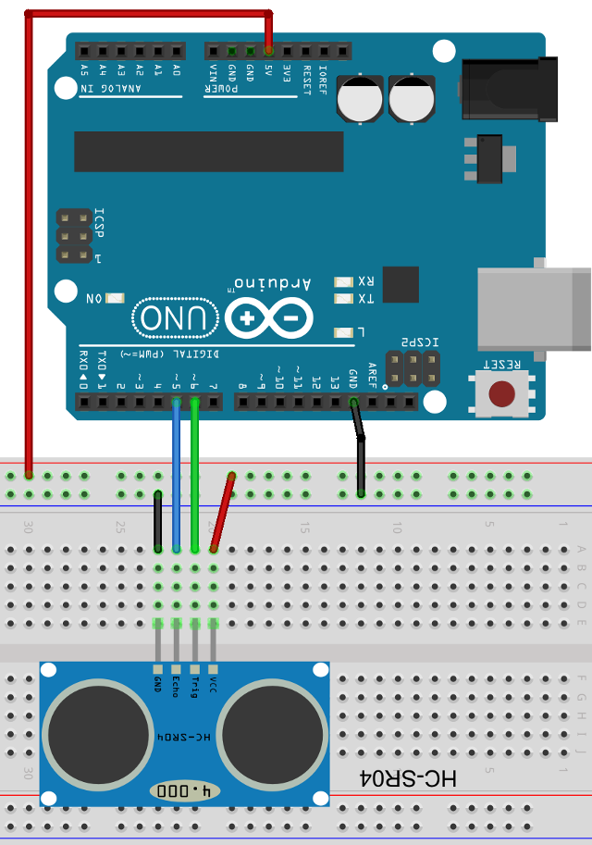
Arduino Board
Arduino board + WIFI Shield
Distance Sensor

Slide 3

Arduino Board
Sense

Slide 4

Arduino Board
Google
Sense
Stream

Slide 5
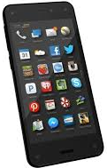
Arduino Board
Google
Sense
Stream
Mail Dropped?
Notify

Slide 6
Lessen learned
Arduino
Google Big Query/APIs
Microsoft Power PI
Temboo/Twilio
Fritzing

