Slide 1

Intelligent Query Processing in SQL Server 2019
09. – 12.12.2019
Frankfurt am Main
Milos Radivojevic
#ittage

Slide 2


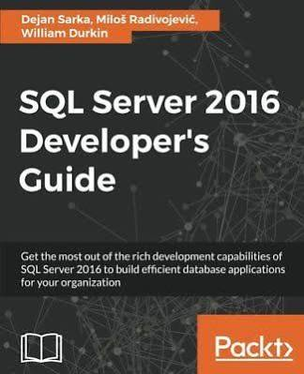
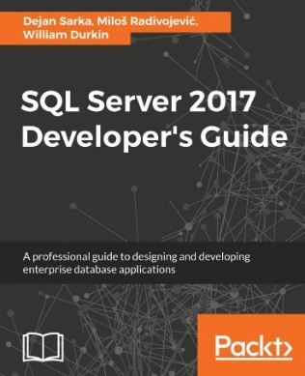


Milos Radivojevic
Data Platform MVP
Principal Database Consultant, bwin GVC Vienna, Austria
Co-Founder: SQL Pass Austria
Conference Speaker, Book Author
Contact:
E: MRadivojevic@gvcgroup.com
W: https://milossql.wordpress.com

Slide 3
Inefficient Execution Plans in SQL Server
Execution plans are sometimes suboptimal
Affected Queries:
Queries using table variables
Queries with scalar user-defined functions
Queries referencing multi-statement table valued functions
Complex queries
Queries with tables with skew data distribution
Issues:
Inapropriate operator choice
Memory Grant under- or overestimation

Slide 4
Query Processing in SQL Server
SQL Server 2016 and prior
After the execution plan is created, it is used in consecutive query executions, without changes (with the same operators and memory grants)
SQL Server 2017 Adaptive Query Processing
Breaking the pipeline between query optimization and execution
Executing a part of the query during the execution plan creation
Updating a part of the cached plan during consecutive query executions
SQL Server 2019 Intelligent Query Processing
Additional improvements, not only adaptive; therefore new name => Intelligent QP

Slide 5
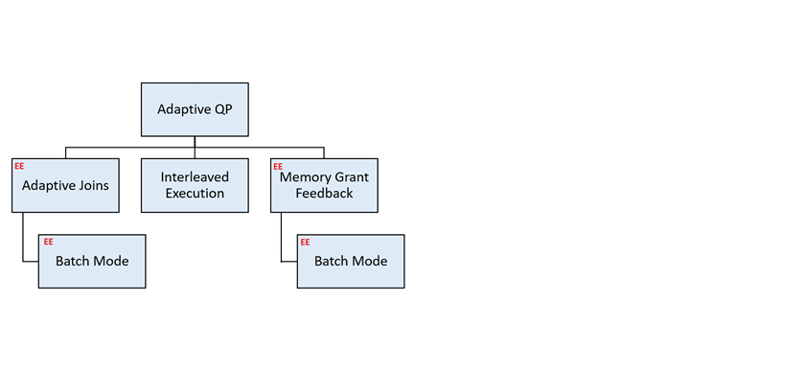
Adaptive Query Processing
SQL Server 2017

Slide 6
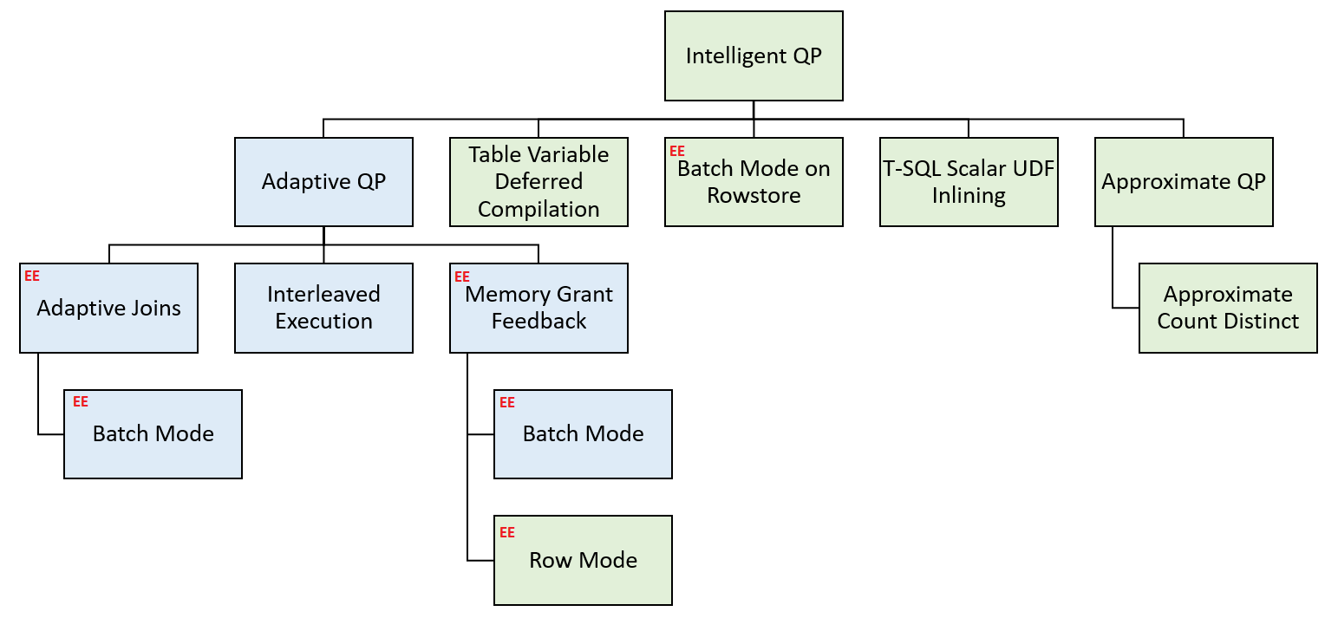
Intelligent Query Processing
SQL Server 2019

Slide 7
BATCH MODE ON
ROWSTORE

Slide 8
What is Batch Mode?
Batch mode allows query operators to work on a batch of rows, instead of just one row at a time
At the CPU level multiple rows processed at once instead of one row
Number of processing instructions restricted
Better CPU cache utilization and increased memory throughput
Can be beneficial for queries that are CPU bound

Slide 9
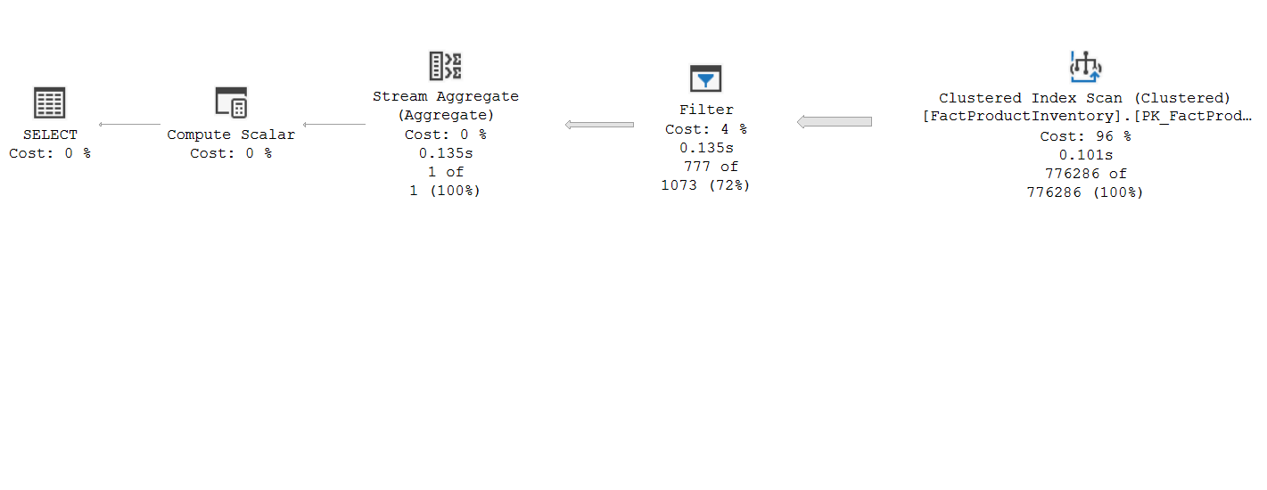

Row Mode
Inefficient; the same instrunctions for every row, overhead of giving control to another operator and taking it back

Slide 10


Batch Mode
batch of rows as working unit: 64 – 912 rows, depends on number and size of columns and CPU L2 cache

Slide 11
Batch Mode on Columnstore/Rowstore
Batch Mode on Columstore introduced in SQL Server 2012
Improvements – up to 20x faster queries!
Batch Mode on Rowstore introduced in SQL Server 2019
Some queries could be significantly faster (900 rows in batch in all my tests)
In my examples 2-6x faster!

Slide 12
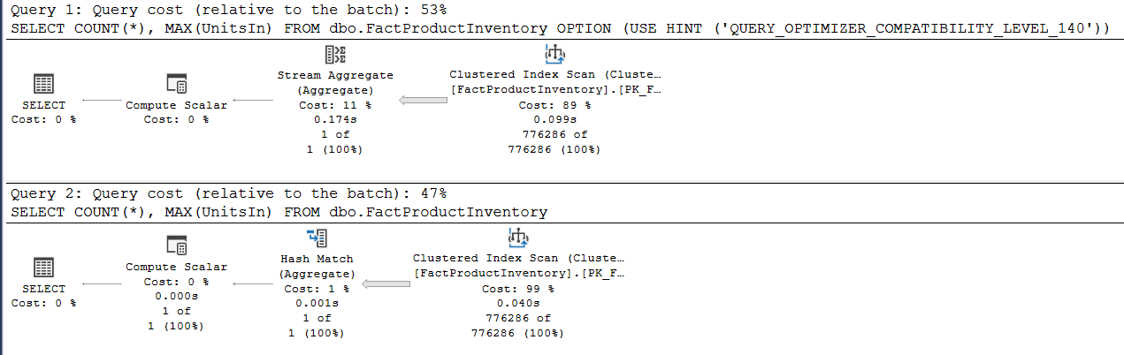



USE AdventureWorksDW2019;
GO
SET NOCOUNT ON SET STATISTICS TIME ON;
GO
SELECT COUNT(*), MAX(UnitsIn) FROM dbo.FactProductInventory OPTION (USE HINT ('QUERY_OPTIMIZER_COMPATIBILITY_LEVEL_140'));
GO
SELECT COUNT(*), MAX(UnitsIn) FROM dbo.FactProductInventory;
GO
SQL Server Execution Times:
CPU time = 219 ms, elapsed time = 210 ms.
SQL Server Execution Times:
CPU time = 46 ms, elapsed time = 50 ms.
4x

Slide 13
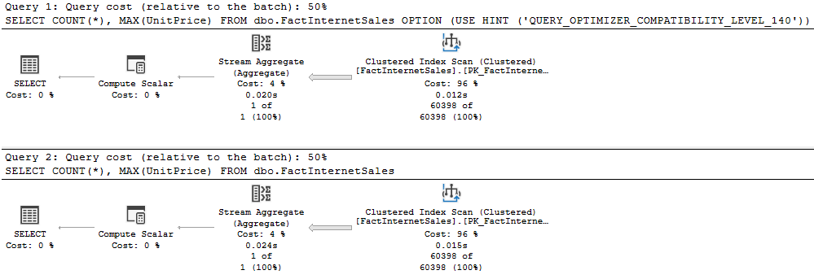
SELECT COUNT(*), MAX(UnitPrice) FROM dbo.FactInternetSales OPTION (USE HINT ('QUERY_OPTIMIZER_COMPATIBILITY_LEVEL_140'));
GO
SELECT COUNT(*), MAX(UnitPrice) FROM dbo.FactInternetSales;
SQL Server Execution Times:
CPU time = 16 ms, elapsed time = 19 ms.
SQL Server Execution Times:
CPU time = 16 ms, elapsed time = 18 ms.
0%
No Batch mode!

Slide 14

Batch Mode on Rowstore
Native support
No tricks with fake columnstore indexes or other optimizer delusions
Initial heuristics considers potential benefits of batch mode for operators
Interesting table (at least 131.072 rows)
Interesting batch operators: join, aggregate or window aggregate
At least one of the batch operator’s input should have not less than 131.072 rows

Slide 15
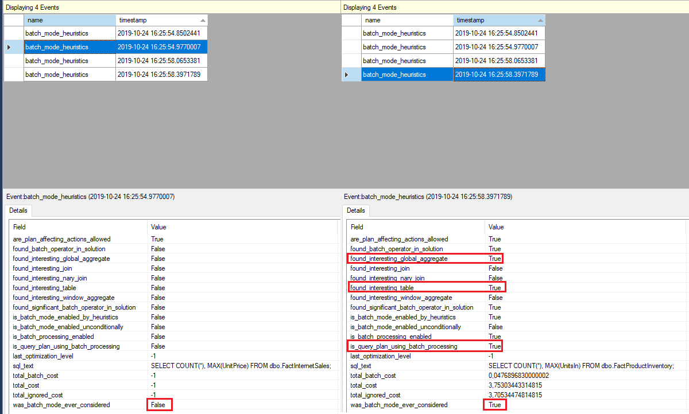
Batch Mode on Rowstore
sqlserver.batch_mode_heuristics Extended Event

Slide 16
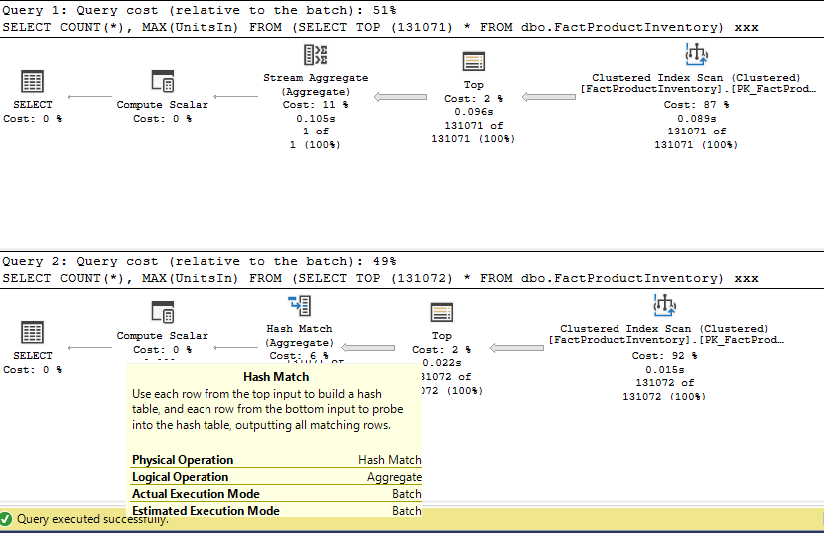
USE AdventureWorksDW2019;
GO
--row mode
SELECT COUNT(*), MAX(UnitsIn) FROM (SELECT TOP (131071) * FROM dbo.FactProductInventory) xxx;
GO
--batch mode
SELECT COUNT(*), MAX(UnitsIn) FROM (SELECT TOP (131072) * FROM dbo.FactProductInventory) xxx;
GO;
row mode
batch mode

Slide 17
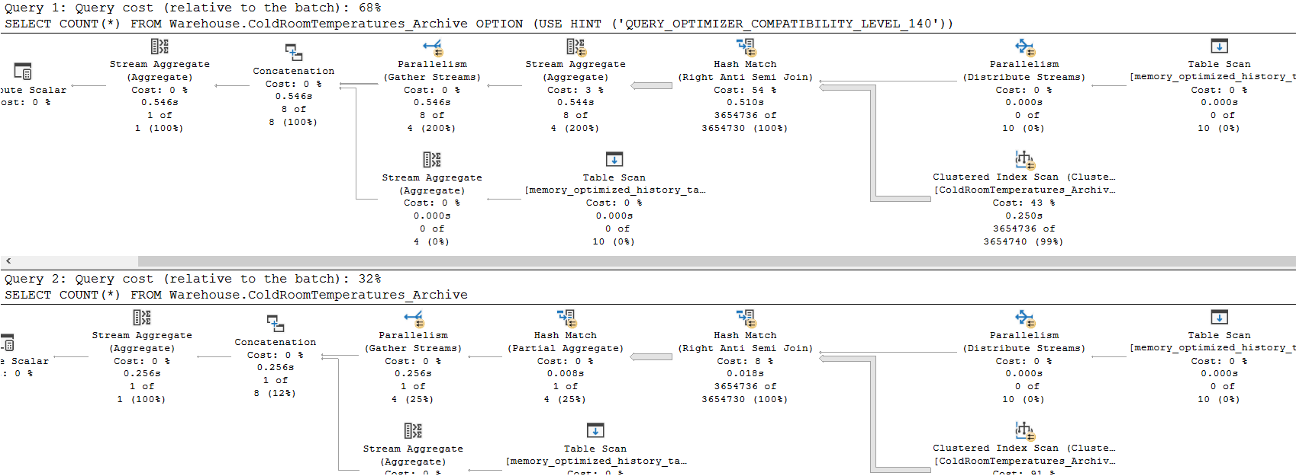
USE WideWorldImporters;
GO
SELECT COUNT(*) FROM Warehouse.ColdRoomTemperatures_Archive OPTION(USE HINT('QUERY_OPTIMIZER_COMPATIBILITY_LEVEL_140'));
GO
SELECT COUNT(*) FROM Warehouse.ColdRoomTemperatures_Archive;
2x
SQL Server Execution Times:
CPU time = 3842 ms, elapsed time = 615 ms.
SQL Server Execution Times:
CPU time = 1642 ms, elapsed time = 306 ms.

Slide 18
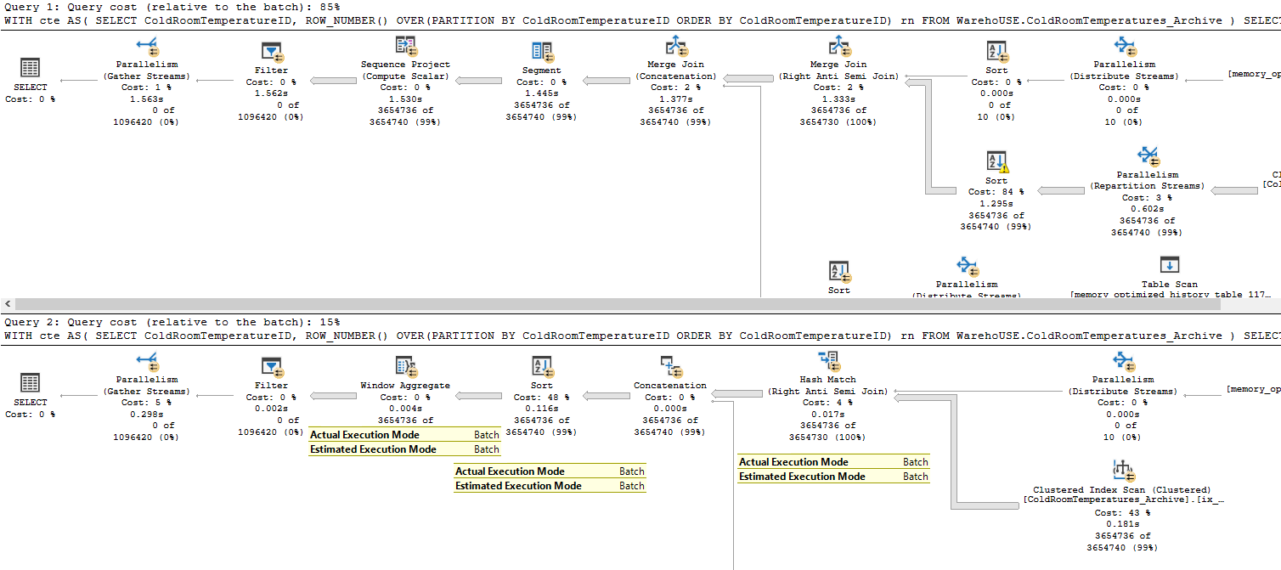
WITH cte AS(
SELECT ColdRoomTemperatureID, ROW_NUMBER() OVER(PARTITION BY ColdRoomTemperatureID ORDER BY ColdRoomTemperatureID) rn
FROM Warehouse.ColdRoomTemperatures_Archive
)
SELECT * FROM cte WHERE rn > 1 OPTION (USE HINT ('QUERY_OPTIMIZER_COMPATIBILITY_LEVEL_140')) ;
GO
WITH cte AS(
SELECT ColdRoomTemperatureID, ROW_NUMBER() OVER(PARTITION BY ColdRoomTemperatureID ORDER BY ColdRoomTemperatureID) rn
FROM Warehouse.ColdRoomTemperatures_Archive
)
SELECT * FROM cte WHERE rn > 1;
SQL Server Execution Times:
CPU time = 8514 ms, elapsed time = 1574 ms.
SQL Server Execution Times:
CPU time = 2061 ms, elapsed time = 333 ms.
5x

Slide 19
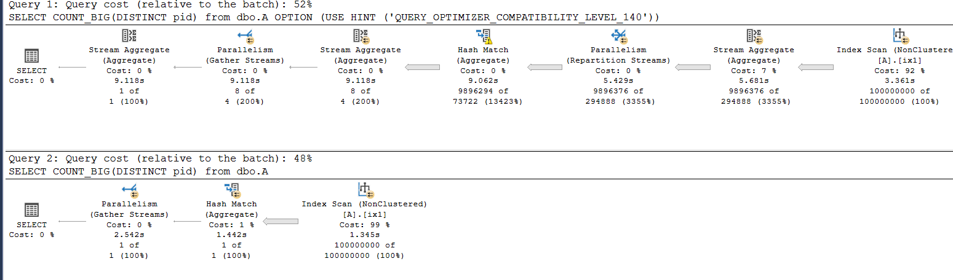
USE Statistik;
GO
ALTER DATABASE Statistik SET COMPATIBILITY_LEVEL = 150;
GO
SELECT COUNT_BIG(DISTINCT pid) from dbo.A OPTION (USE HINT ('QUERY_OPTIMIZER_COMPATIBILITY_LEVEL_140'));
GO
SELECT COUNT_BIG(DISTINCT pid) from dbo.A;
SQL Server Execution Times:
CPU time = 43405 ms, elapsed time = 9136 ms.
SQL Server Execution Times:
CPU time = 17171 ms, elapsed time = 2619 ms.
3,5x

Slide 20
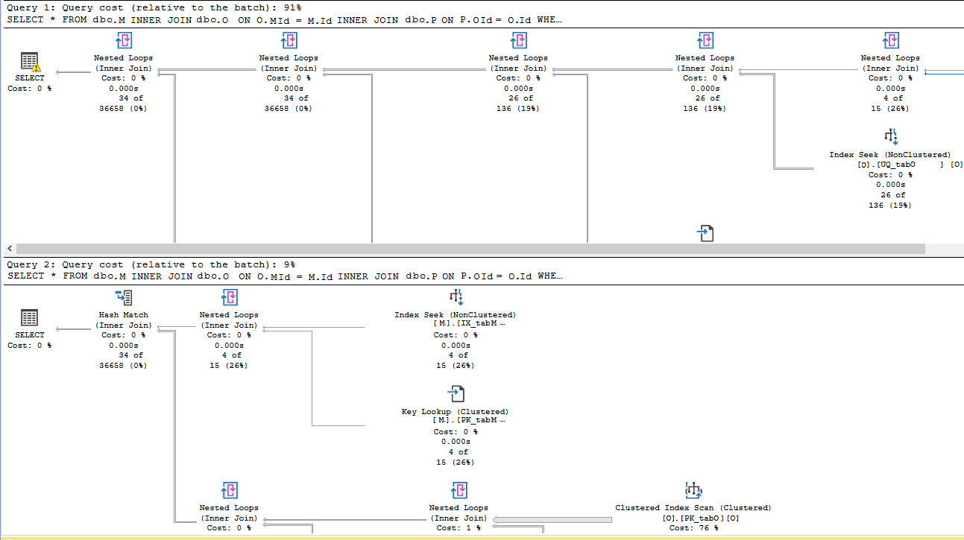
25x
Regressions?
SELECT * FROM dbo.M
INNER JOIN dbo.O ON O.Mid = M.Id
INNER JOIN dbo.P ON P.Oid = O.Id
WHERE M.c1 = 2462782;
SELECT * FROM dbo.M
INNER JOIN dbo.O ON O.Mid = M.Id
INNER JOIN dbo.P ON P.Oid = O.Id
WHERE M.c1 = 2462782 OPTION (USE HINT ('QUERY_OPTIMIZER_COMPATIBILITY_LEVEL_150'));
SQL Server Execution Times:
CPU time = 0 ms, elapsed time = 2 ms.
SQL Server Execution Times:
CPU time = 47 ms, elapsed time = 50 ms.
OPTION (USE HINT('DISALLOW_BATCH_MODE'));

Slide 21
Enabling/Disabling Batch Mode
Enabling
ALTER DATABASE current SET COMPATIBILITY_LEVEL = 150;
ALTER DATABASE SCOPED CONFIGURATION SET BATCH_MODE_ON_ROWSTORE = ON;
OPTION (USE HINT('ALLOW_BATCH_MODE'));
Disabling
ALTER DATABASE SCOPED CONFIGURATION SET BATCH_MODE_ON_ROWSTORE = OFF;
OPTION (USE HINT('DISALLOW_BATCH_MODE'));

Slide 22


Batch Mode on Rowstore – More Info
Extended event batch_mode_heuristics
More info:
Blog: Niko Neugebauer
http://www.nikoport.com/2018/10/07/batch-mode-part-3-basic-heuristics-analysis/
Blog: Dima Pilugin
http://www.queryprocessor.com/batch-mode-on-row-store/

Slide 23
Batch Mode on Rowstore - Conclusion
Very promising feature
Improvements with no efforts
It could be a reason for upgrade for some companies
First version, probably will not optimize some queries that need an optimization
Possible regressions, but you can enable/disable feature at two levels
It brings benefits for queries with large tables and datasets

Slide 24
MEMORY GRANT
FEEDBACK

Slide 25
Memory Grant Feedback
Adjust memory grant parameter in the execution plan AFTER the plan is generated (after a few query executions)
Memory is adjusted for a query when
It used less than 50% of granted memory
Is spilling out to tempdb
In SQL Server 2017 requires a columnstore index on the affected table

Slide 26
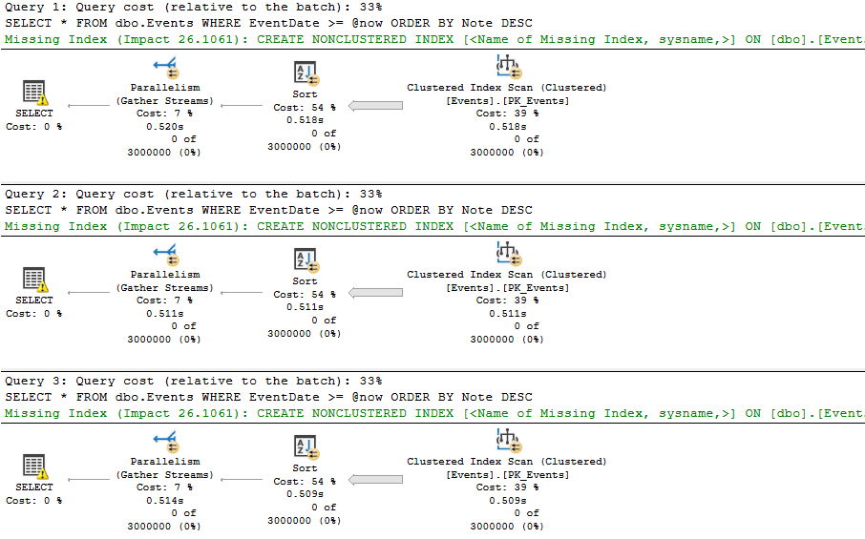
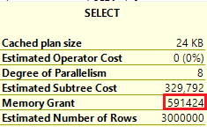
--ensure that the database runs under CL 130 (SQL Server 2016)
ALTER DATABASE TestDb SET COMPATIBILITY_LEVEL = 130;
GO
ALTER DATABASE SCOPED CONFIGURATION CLEAR PROCEDURE_CACHE;
GO
EXEC dbo.GetEvents '20180101';
GO 3
The same memory grant

Slide 27
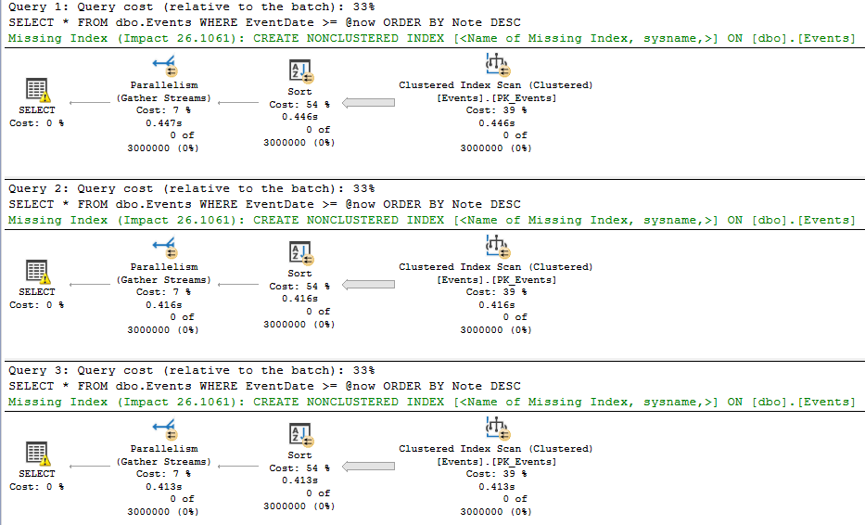
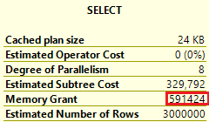
--ensure that the database runs under CL 140 (SQL Server 2017)
ALTER DATABASE TestDb SET COMPATIBILITY_LEVEL = 140;
GO
ALTER DATABASE SCOPED CONFIGURATION CLEAR PROCEDURE_CACHE;
GO
EXEC dbo.GetEvents '20180101';
GO 3
Batch mode Memory Grant
in SQL Server 2017
requires a columnstore index

Slide 28
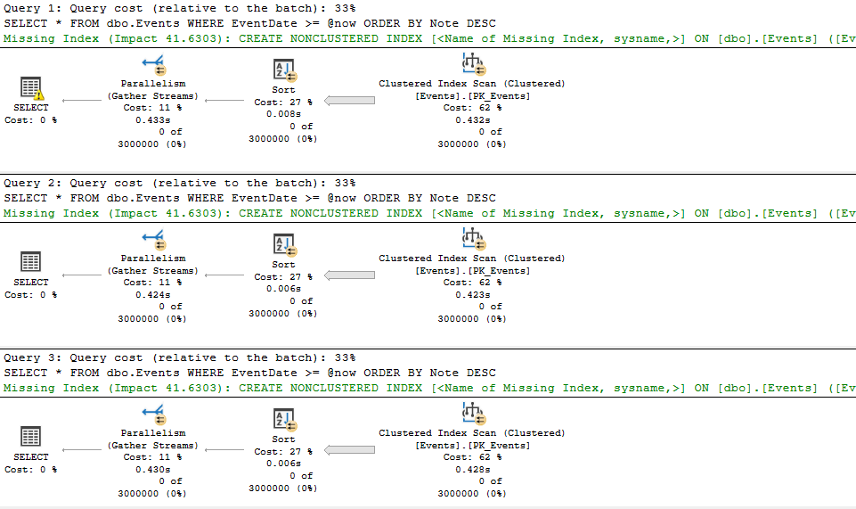
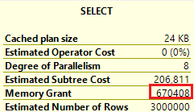
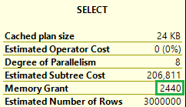
CREATE NONCLUSTERED COLUMNSTORE INDEX ixc ON dbo.Events(id, EventType,EventDate, Note) WHERE id = -4;
GO
ALTER DATABASE SCOPED CONFIGURATION CLEAR PROCEDURE_CACHE;
GO
EXEC dbo.GetEvents '20180101';
GO 3

Slide 29

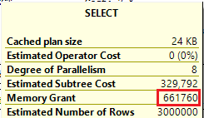
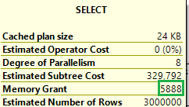
ALTER DATABASE TestDb SET COMPATIBILITY_LEVEL = 150;
GO
--remove the columnstore index
DROP INDEX ixc ON dbo.Events;
GO
ALTER DATABASE SCOPED CONFIGURATION CLEAR PROCEDURE_CACHE;
GO
EXEC dbo.GetEvents '20180101';
GO 3
Row mode Memory Grant
in SQL Server 2019
No columnstore index required

Slide 30
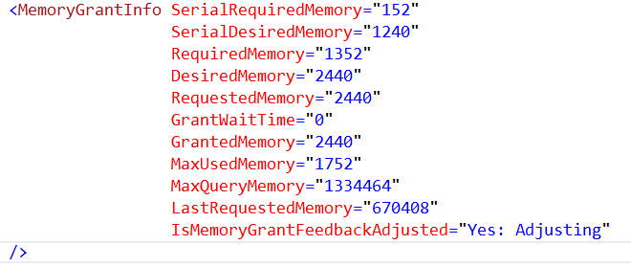
Memory Grant Feedback
New plan attributes in the XML plan
It works with cached plans and memory grants > 1MB
It does not work with OPTION (RECOMPILE)
It is not persisted if the plan is removed from cache
In SQL Server 2019, it works in both Batch and Row Mode
If memory grant memory values oscillate, the feature is disabled

Slide 31
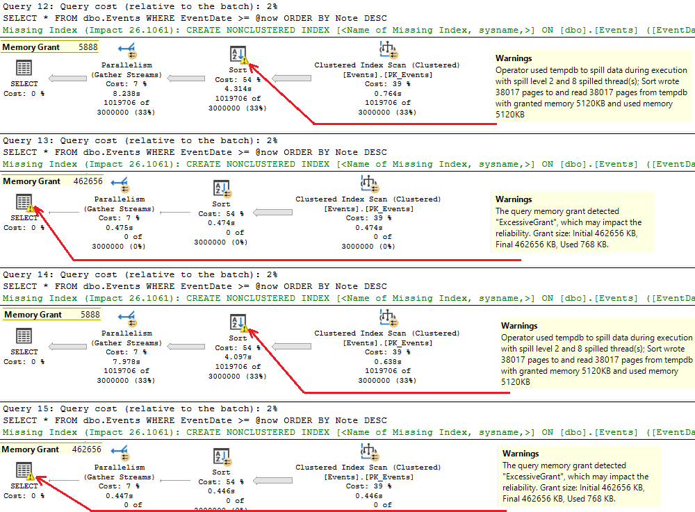
Memory Grant Feedback
EXEC dbo.GetEvents '20180101';
EXEC dbo.GetEvents '20160101';
GO 30

Slide 32
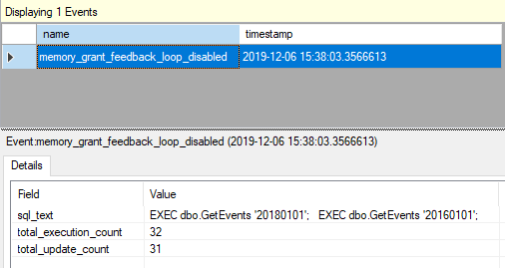
Memory Grant Feedback
If memory grant memory values oscillate, the feature is disabled
EXEC dbo.GetEvents '20180101';
EXEC dbo.GetEvents '20160101';
GO 30

Slide 33
Memory Grant Feedback - Conclusion
Very useful feature
In SQL Server 2019 works in both modes
Will affect ALL queries having an operator that requires memory
Almost no measurable overhead (*)
(*) in all my tests

Slide 34
SCALAR UDF
INLINING

Slide 35
Scalar UDFs in SQL Server
Code reuse, encapsulation and modularity
Complex business rules or computations
Single place change
Written once, invoke from many modules
Reduce network traffic
BUT...

Slide 36
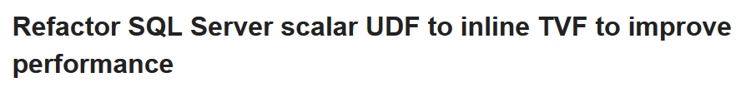


Scalar UDFs in SQL Server

Slide 37
Scalar UDFs in SQL Server
They are very slow
Iterative invocation
Overhead for invoking – once per row
No cross-statement optimization
Only serial execution plans possible

Slide 38
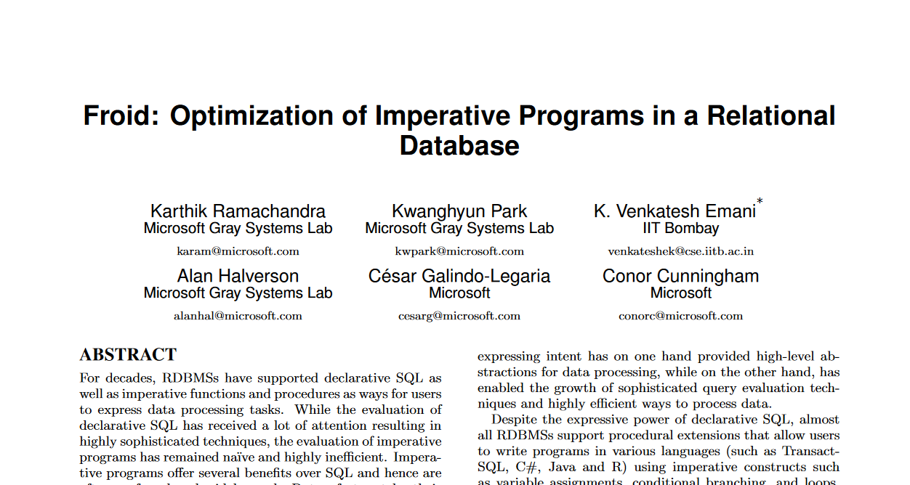
Scalar UDF Inlining
http://www.vldb.org/pvldb/vol11/p432-ramachandra.pdf

Slide 39
Scalar UDF Inlining
Goal – improve queries where scalar UDFs are problem
Scalar UDF Inlining feature (Froid framework):
Transforms scalar UDF into relational expressions or subqueries (IF => CASE WHEN)
Embeds them in the calling query by using APPLY operator
Optimize expressions or subqueries
Result:
Performance improved (more efficient plan)
Execution plan could be parallel

Slide 40
Froid Transformation
SELECT q5.v
FROM
(
(SELECT 2000 AS a) AS q1
OUTER APPLY
(SELECT CASE WHEN q1.a > 1000 THEN 'HIGH' END AS val) AS q2
OUTER APPLY
(SELECT CASE WHEN q1.a > 500 THEN 'HIGH' END AS val) AS q3
OUTER APPLY
(SELECT 'LOW' AS val) AS q4
OUTER APPLY
(SELECT CASE WHEN q2.val IS NOT NULL
THEN q2.val
WHEN q3.val IS NOT NULL
THEN q3.val
ELSE q4.val
END v) AS q5
);
DECLARE @val VARCHAR(10);
DECLARE @a INT = 2000;
IF @a > 1000
SET @val = 'HIGH';
ELSE IF @a > 500
SET @val = 'MEDIUM'
ELSE
SET @val = 'LOW'
SELECT @val;

Slide 41
Froid Transformation
SELECT q5.v
FROM
(
(SELECT 2000 AS a) AS q1
OUTER APPLY
(SELECT CASE WHEN q1.a > 1000 THEN 'HIGH' END AS val) AS q2
OUTER APPLY
(SELECT CASE WHEN q1.a > 500 THEN 'HIGH' END AS val) AS q3
OUTER APPLY
(SELECT 'LOW' AS val) AS q4
OUTER APPLY
(SELECT CASE WHEN q2.val IS NOT NULL
THEN q2.val
WHEN q3.val IS NOT NULL
THEN q3.val
ELSE q4.val
END v) AS q5
);
DECLARE @val VARCHAR(10);
DECLARE @a INT = 2000;
IF @a > 1000
SET @val = 'HIGH';
ELSE IF @a > 500
SET @val = 'MEDIUM'
ELSE
SET @val = 'LOW'
SELECT @val;

Slide 42
Froid Transformation
SELECT q5.v
FROM
(
(SELECT 2000 AS a) AS q1
OUTER APPLY
(SELECT CASE WHEN q1.a > 1000 THEN 'HIGH' END AS val) AS q2
OUTER APPLY
(SELECT CASE WHEN q1.a > 500 THEN 'HIGH' END AS val) AS q3
OUTER APPLY
(SELECT 'LOW' AS val) AS q4
OUTER APPLY
(SELECT CASE WHEN q2.val IS NOT NULL
THEN q2.val
WHEN q3.val IS NOT NULL
THEN q3.val
ELSE q4.val
END v) AS q5
);
DECLARE @val VARCHAR(10);
DECLARE @a INT = 2000;
IF @a > 1000
SET @val = 'HIGH';
ELSE IF @a > 500
SET @val = 'MEDIUM'
ELSE
SET @val = 'LOW'
SELECT @val;

Slide 43
Froid Transformation
SELECT q5.v
FROM
(
(SELECT 2000 AS a) AS q1
OUTER APPLY
(SELECT CASE WHEN q1.a > 1000 THEN 'HIGH' END AS val) AS q2
OUTER APPLY
(SELECT CASE WHEN q1.a > 500 THEN 'HIGH' END AS val) AS q3
OUTER APPLY
(SELECT 'LOW' AS val) AS q4
OUTER APPLY
(SELECT CASE WHEN q2.val IS NOT NULL
THEN q2.val
WHEN q3.val IS NOT NULL
THEN q3.val
ELSE q4.val
END v) AS q5
);
DECLARE @val VARCHAR(10);
DECLARE @a INT = 2000;
IF @a > 1000
SET @val = 'HIGH';
ELSE IF @a > 500
SET @val = 'MEDIUM'
ELSE
SET @val = 'LOW'
SELECT @val;

Slide 44
Froid Transformation
SELECT q5.v
FROM
(
(SELECT 2000 AS a) AS q1
OUTER APPLY
(SELECT CASE WHEN q1.a > 1000 THEN 'HIGH' END AS val) AS q2
OUTER APPLY
(SELECT CASE WHEN q1.a > 500 THEN 'HIGH' END AS val) AS q3
OUTER APPLY
(SELECT 'LOW' AS val) AS q4
OUTER APPLY
(SELECT CASE WHEN q2.val IS NOT NULL
THEN q2.val
WHEN q3.val IS NOT NULL
THEN q3.val
ELSE q4.val
END v) AS q5
);
DECLARE @val VARCHAR(10);
DECLARE @a INT = 2000;
IF @a > 1000
SET @val = 'HIGH';
ELSE IF @a > 500
SET @val = 'MEDIUM'
ELSE
SET @val = 'LOW'
SELECT @val;

Slide 45
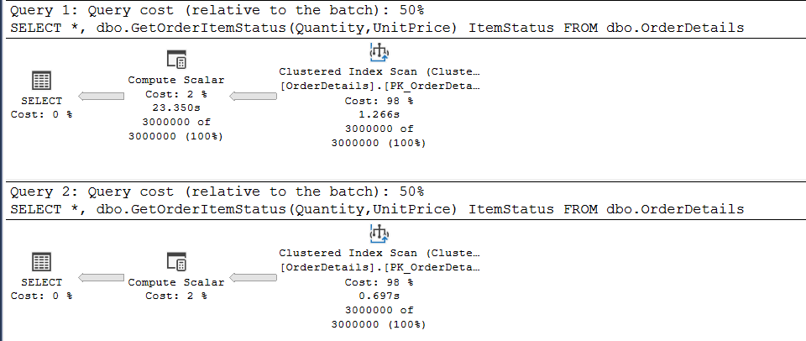
CREATE OR ALTER FUNCTION dbo.GetOrderItemStatus(
@Quantity INT, @UnitPrice DECIMAL(10,2))
RETURNS VARCHAR(20)
AS
BEGIN
DECLARE @Ret VARCHAR(20) = '';
DECLARE @Amount DECIMAL(10,2) =
@Quantity * @UnitPrice;
IF @Amount > 1000
SET @Ret = 'TOP 1000'
ELSE IF @Amount > 500
SET @Ret = 'TOP 500'
RETURN @Ret;
END
12x
SET STATISTICS TIME ON;
GO
ALTER DATABASE TestDb SET COMPATIBILITY_LEVEL = 140;
GO
SELECT *, dbo.GetOrderItemStatus(Quantity,UnitPrice) ItemStatus FROM dbo.OrderDetails;
GO
ALTER DATABASE TestDb SET COMPATIBILITY_LEVEL = 150;
GO
SELECT *, dbo.GetOrderItemStatus(Quantity,UnitPrice) ItemStatus FROM dbo.OrderDetails;
CPU time = 18656 ms, elapsed time = 24306 ms.
CPU time = 2047 ms, elapsed time = 2075 ms.

Slide 46
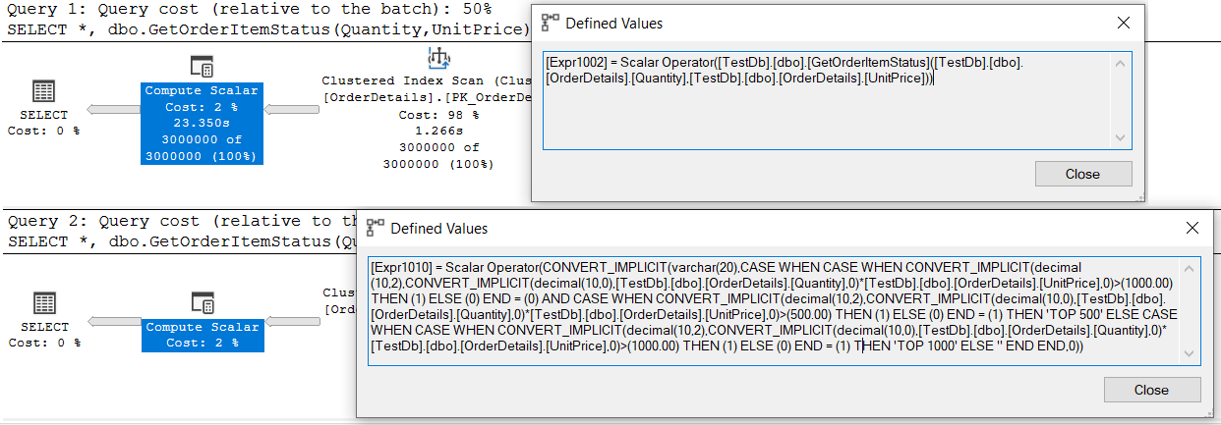
CREATE OR ALTER FUNCTION dbo.GetOrderItemStatus(
@Quantity INT, @UnitPrice DECIMAL(10,2))
RETURNS VARCHAR(20)
AS
BEGIN
DECLARE @Ret VARCHAR(20) = '';
DECLARE @Amount DECIMAL(10,2) =
@Quantity * @UnitPrice;
IF @Amount > 1000
SET @Ret = 'TOP 1000'
ELSE IF @Amount > 500
SET @Ret = 'TOP 500'
RETURN @Ret;
END
SET STATISTICS TIME ON;
GO
ALTER DATABASE TestDb SET COMPATIBILITY_LEVEL = 140;
GO
SELECT *, dbo.GetOrderItemStatus(Quantity,UnitPrice) ItemStatus FROM dbo.OrderDetails;
GO
ALTER DATABASE TestDb SET COMPATIBILITY_LEVEL = 150;
GO
SELECT *, dbo.GetOrderItemStatus(Quantity,UnitPrice) ItemStatus FROM dbo.OrderDetails;

Slide 47
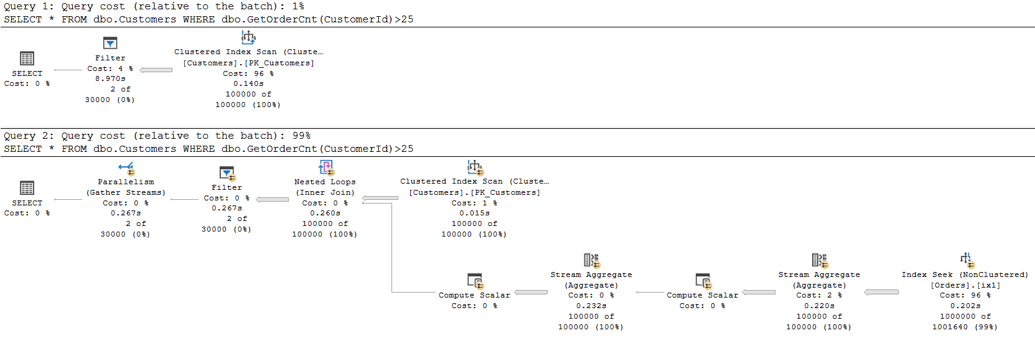
CREATE OR ALTER FUNCTION dbo.GetOrderCnt (@CustomerId INT)
RETURNS INT
AS
BEGIN
DECLARE @Cnt INT;
SELECT @Cnt = COUNT(*) FROM dbo.Orders WHERE CustomerId = @CustomerId;
RETURN @Cnt;
END
33x
ALTER DATABASE TestDb SET COMPATIBILITY_LEVEL = 140;
GO
SELECT * FROM dbo.Customers WHERE dbo.GetOrderCnt(CustomerId) > 25;
GO
ALTER DATABASE TestDb SET COMPATIBILITY_LEVEL = 150;
GO
SELECT * FROM dbo.Customers WHERE dbo.GetOrderCnt(CustomerId) > 25;
CPU time = 8610 ms, elapsed time = 8971 ms.
CPU time = 1860 ms, elapsed time = 271 ms.

Slide 48
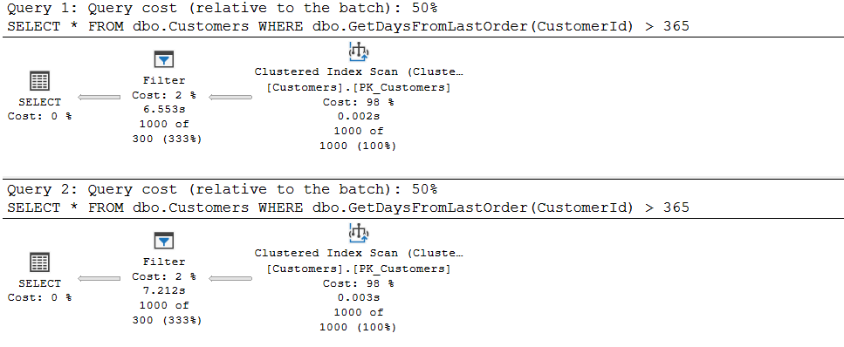
CREATE OR ALTER FUNCTION dbo.GetDaysFromLastOrder(@CustomerId INT)
RETURNS INT
AS
BEGIN
DECLARE @Days INT;
DECLARE @LastOrder DATETIME;
SET @LastOrder = (SELECT TOP (1) OrderDate FROM dbo.Orders WHERE CustomerId = @CustomerId ORDER BY OrderDate DESC);
SELECT @Days = DATEDIFF(day, @LastOrder, GETDATE());
RETURN @Days;
END
0%
Scalar UDF Inline does not work
with GETDATE() function
SELECT * FROM dbo.Customers WHERE dbo.GetDaysFromLastOrder(CustomerId) > 365;
CPU time = 12531 ms, elapsed time = 12648 ms.
CPU time = 12485 ms, elapsed time = 13079 ms.

Slide 49
Scalar UDF Inlining
Not all scalar UDFs can be inlined
Check whether a function can be inlined:
is_inlineable = 1 does not imply that it will always be inlined
Decision is made when the query referencing a scalar UDF is compiled
SELECT CONCAT(SCHEMA_NAME(o.schema_id),'.',o.name), is_inlineable
FROM sys.sql_modules m INNER JOIN sys.objects o ON o.object_id = m.object_id WHERE o.type = 'FN';

Slide 50
Scalar UDF Inlining - Limitations
UDF does not invoke any intrinsic function that is either time-dependent or has side effects such as GETDATE() or NEWSEQUENTIALID
The UDF does not reference table variables, table-valued parameters or user-defined types
UDF is not natively compiled (interop is supported)
UDF is not used in a computed column or a check constraint definition
The UDF is not a partition function
Full list of limitations: https://docs.microsoft.com/en-us/sql/relational-databases/user-defined-functions/scalar-udf-inlining?view=sql-server-ver15

Slide 51
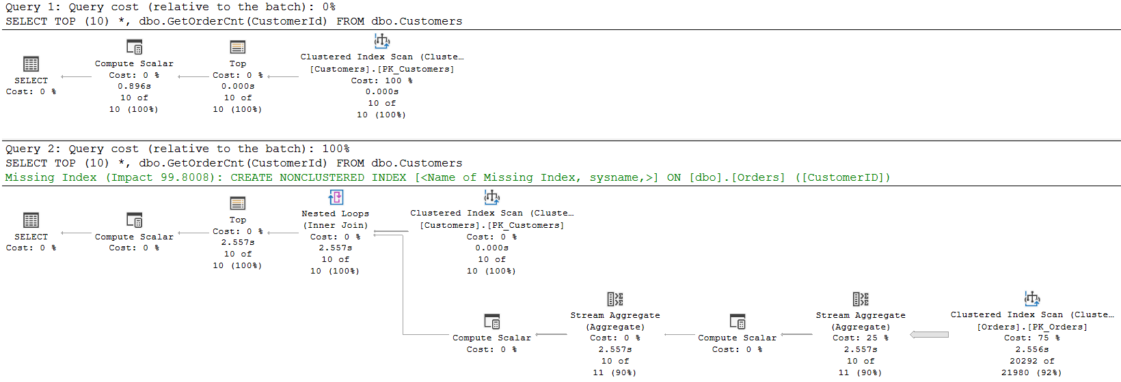
Regressions?
5x
ALTER DATABASE TestDb SET COMPATIBILITY_LEVEL = 140;
GO
SELECT TOP (10) * FROM dbo.Customers WHERE dbo.GetOrderCnt(CustomerId) > 25;
GO
ALTER DATABASE TestDb SET COMPATIBILITY_LEVEL = 150;
GO
SELECT TOP (10) * FROM dbo.Customers WHERE dbo.GetOrderCnt(CustomerId) > 25;
CPU time = 5922 ms, elapsed time = 873 ms.
CPU time = 4735 ms, elapsed time = 4753 ms

Slide 52
Regressions?
ALTER DATABASE TestDb SET COMPATIBILITY_LEVEL = 140;
GO
SELECT TOP (10) * FROM dbo.Customers WHERE dbo.GetOrderCnt(CustomerId) > 25;
GO
ALTER DATABASE TestDb SET COMPATIBILITY_LEVEL = 150;
GO
SELECT TOP (10) * FROM dbo.Customers WHERE dbo.GetOrderCnt(CustomerId) > 25;
Solution
SELECT TOP (10) * FROM dbo.Customers WHERE dbo.GetOrderCnt(CustomerId) > 25
OPTION (USE HINT('DISABLE_TSQL_SCALAR_UDF_INLINING'));

Slide 53
Scalar UDF Inlining
Enable
ALTER DATABASE current SET COMPATIBILITY_LEVEL = 150;
ALTER DATABASE SCOPED CONFIGURATION SET TSQL_SCALAR_UDF_INLINING = ON;
CREATE OR ALTER FUNCTION dbo.getMaxOrderDate(@CustID INT) RETURNS DATETIME WITH INLINE = ON
Disable
ALTER DATABASE SCOPED CONFIGURATION SET TSQL_SCALAR_UDF_INLINING = OFF;
OPTION (USE HINT('DISABLE_TSQL_SCALAR_UDF_INLINING'));
CREATE OR ALTER FUNCTION dbo.getMaxOrderDate(@CustID INT) RETURNS DATETIME WITH INLINE = OFF

Slide 54
Scalar UDF Inlining - Conclusion
Very promising feature
Improvements with no efforts
Part of the Standard Edition
Many limitations (GETDATE(), table variables…)
Very useful for small and medium companies (not enough people to rewrite UDFs) 3rd party tools
it’s a first version

Slide 55
TABLE VARIABLE
DEFERRED COMPILATION

Slide 56
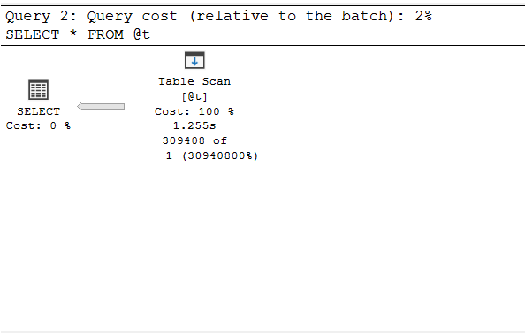
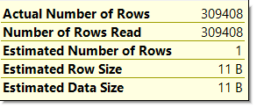
Problems with Table Variables
DECLARE @t TABLE(id INT)
INSERT INTO @t SELECT message_id FROM sys.messages;
SELECT * FROM @t;
Inappropriate operators in the execution plan
Insufficient memory grants
Notes:
Inappropriate operators in the execution plan
mostly Nested Loop Join instead of Hash Join
Insufficient memory grants
Number of processing rows is usually underestimated => less Memory Grant reserved for the query => spills to tempdb

Slide 57


Table Variable Deferred Compilation
DECLARE @T AS TABLE (ProductID INT);
INSERT INTO @T SELECT ProductID
FROM Production.Product
WHERE ProductLine IS NOT NULL;
SELECT * FROM @T t
INNER JOIN Sales.SalesOrderDetail od
ON t.ProductID = od.ProductID
INNER JOIN Sales.SalesOrderHeader h
ON h.SalesOrderID = od.SalesOrderID
ORDER BY od.UnitPrice DESC;
SQL Server 2017 and all previous versions
Content of the table variable unknown at the compile time => cardinality 1
SQL Server 2019
Content of the table variable known at the compile time => cardinality = actual number of rows

Slide 58
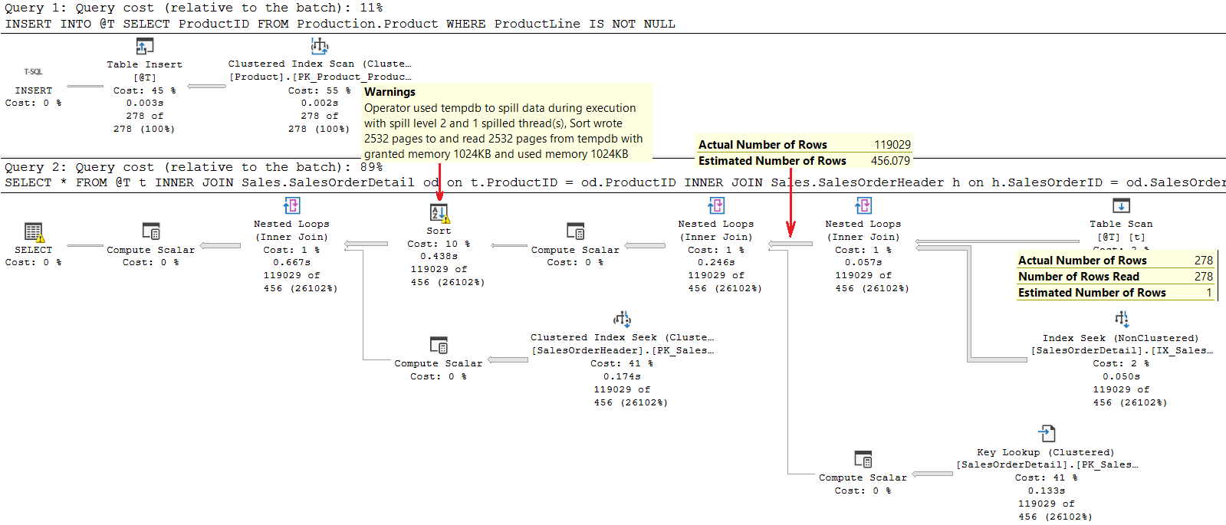
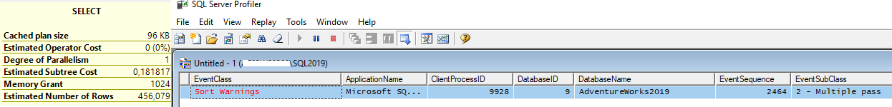
DECLARE @T AS TABLE (ProductID INT);
INSERT INTO @T SELECT ProductID FROM Production.Product WHERE ProductLine IS NOT NULL;
SELECT * FROM @T t
INNER JOIN Sales.SalesOrderDetail od on t.ProductID = od.ProductID
INNER JOIN Sales.SalesOrderHeader h on h.SalesOrderID = od.SalesOrderID
ORDER BY od.UnitPrice DESC;
SQL Server 2017
execution time: 873 ms

Slide 59
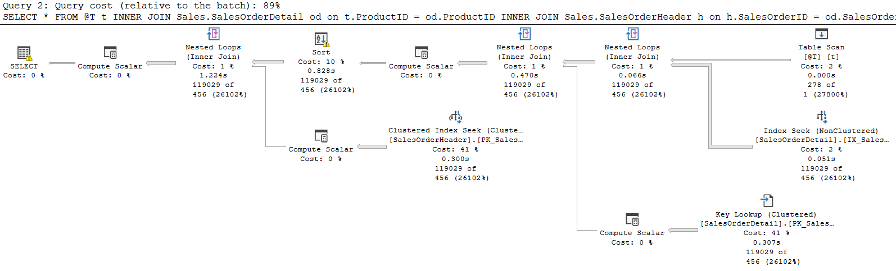





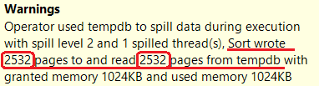
DECLARE @T AS TABLE (ProductID INT);
INSERT INTO @T SELECT ProductID FROM Production.Product WHERE ProductLine IS NOT NULL;
SELECT * FROM @T t
INNER JOIN Sales.SalesOrderDetail od on t.ProductID = od.ProductID
INNER JOIN Sales.SalesOrderHeader h on h.SalesOrderID = od.SalesOrderID
ORDER BY od.UnitPrice DESC;
SQL Server 2017
execution time: 873 ms

Slide 60
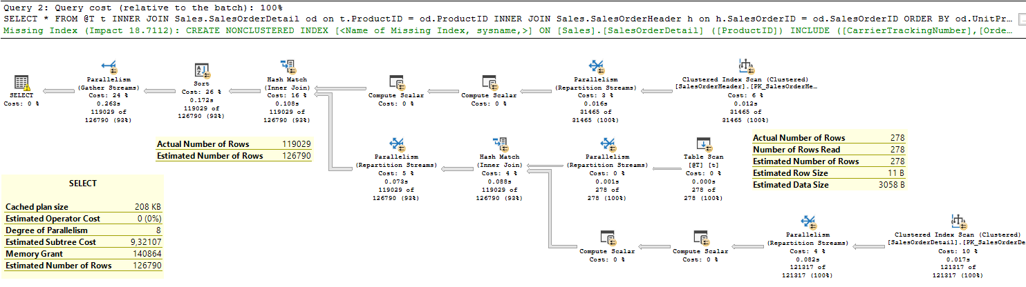
DECLARE @T AS TABLE (ProductID INT);
INSERT INTO @T SELECT ProductID FROM Production.Product WHERE ProductLine IS NOT NULL;
SELECT * FROM @T t
INNER JOIN Sales.SalesOrderDetail od on t.ProductID = od.ProductID
INNER JOIN Sales.SalesOrderHeader h on h.SalesOrderID = od.SalesOrderID
ORDER BY od.UnitPrice DESC;
SQL Server 2019
2x
execution time: 484 ms

Slide 61
Table Variable Deferred Compilation
Improves plan quality and overall performance for queries referencing table variables
Cardinality estimates are based on actual table variable row counts
Prior to SQL Server 2019 it was almost always wrong
Now it is always correct
BUT...

Slide 62

Table Variable Deferred Compilation Side Effects

Slide 63
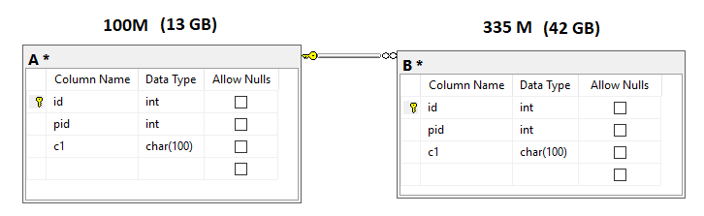
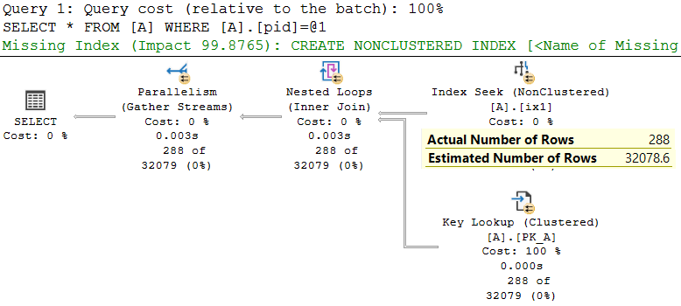
SELECT * FROM A WHERE A.pid = 413032;

Slide 64
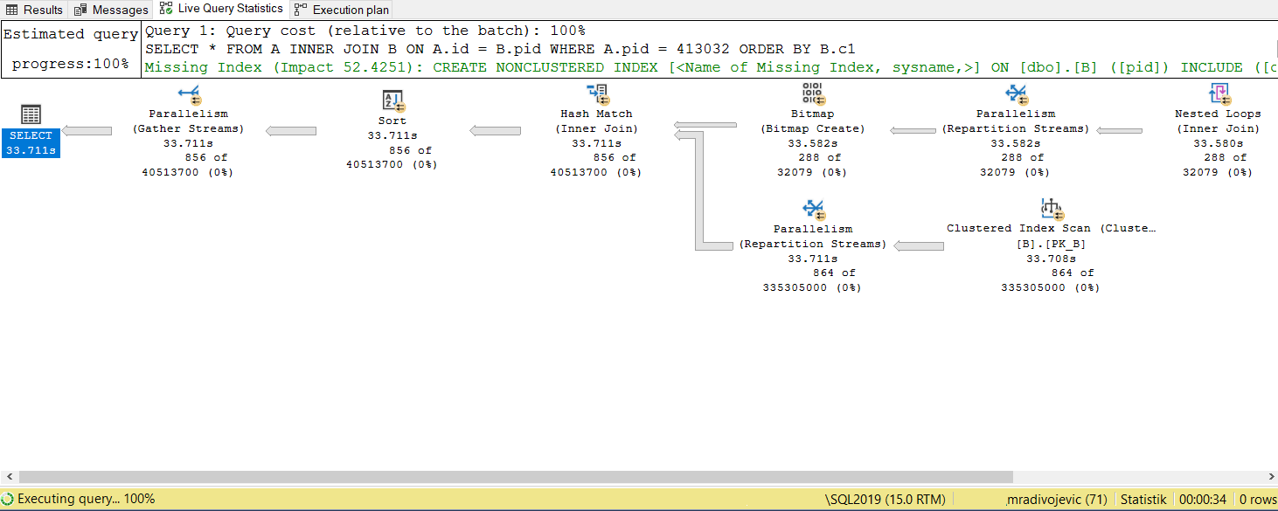
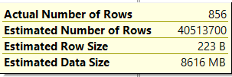
SELECT * FROM A
INNER JOIN B ON A.id = B.pid
WHERE A.pid = 413032 ORDER BY B.c1;
Query returns 856 rows

Slide 65

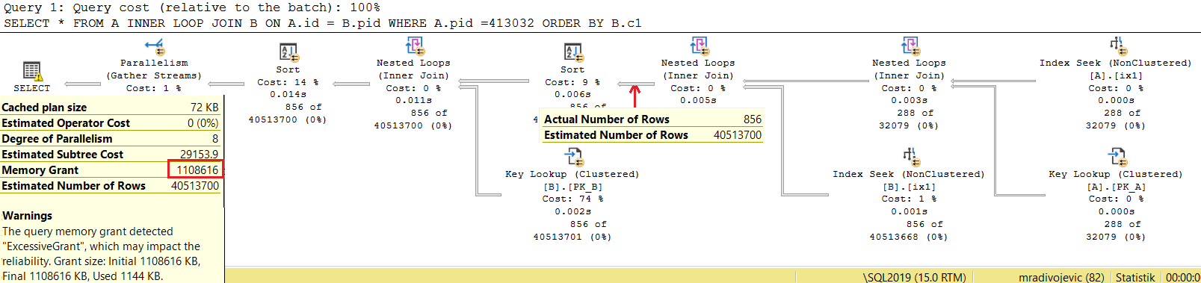

SELECT * FROM A
INNER LOOP JOIN B ON A.id = B.pid
WHERE A.pid = 413032 ORDER BY B.c1;
Query returns 856 rows
DECLARE @t TABLE(id INT PRIMARY KEY, pid INT, c1 CHAR(100));
INSERT INTO @t SELECT * FROM A WHERE A.pid = 413032;
SELECT * FROM @t A
INNER JOIN B ON A.id = B.pid;;

Slide 66
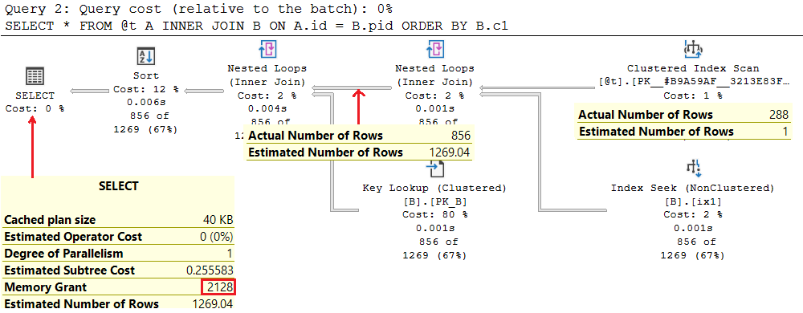
DECLARE @t TABLE(id INT PRIMARY KEY, pid INT, c1 CHAR(100));
INSERT INTO @t SELECT * FROM A WHERE A.pid = 413032;
SELECT * FROM @t A
INNER JOIN B ON A.id = B.pid;
SQL Server 2017

Slide 67
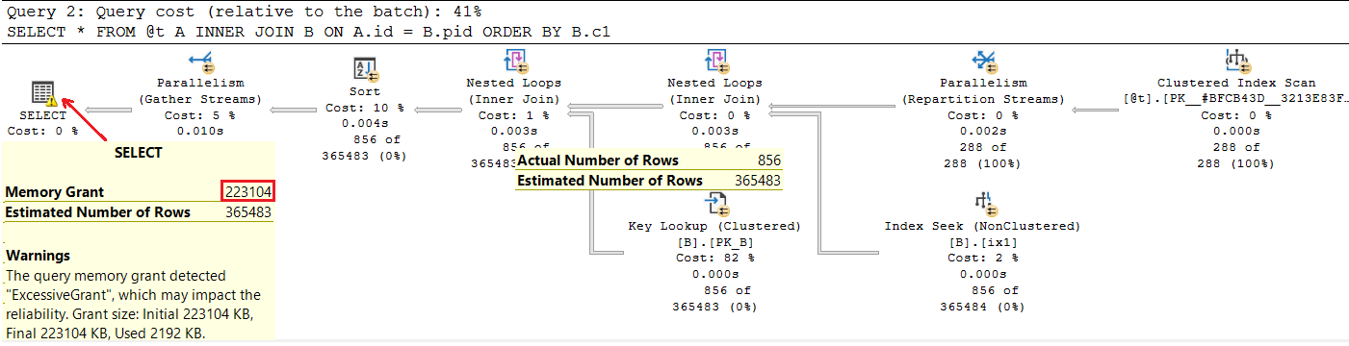
DECLARE @t TABLE(id INT PRIMARY KEY, pid INT, c1 CHAR(100));
INSERT INTO @t SELECT * FROM A WHERE A.pid = 413032;
SELECT * FROM @t A
INNER JOIN B ON A.id = B.pid;
SQL Server 2019
Parallel plan, higher estimations, higher memory grant

Slide 68
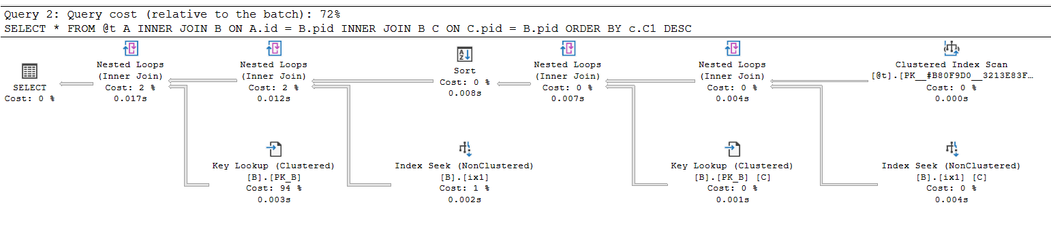
DECLARE @t TABLE(id INT PRIMARY KEY, pid INT, c1 CHAR(100));
INSERT INTO @t SELECT * FROM A WHERE A.pid = 413032;
SELECT * FROM @t A
INNER JOIN B ON A.id = B.pid
INNER JOIN B C ON C.pid = B.pid
ORDER BY C.c1 DESC;
SQL Server 2017
Query returns 3 222 rows
SQL Server Execution Times:
CPU time = 31 ms, elapsed time = 116 ms.

Slide 69
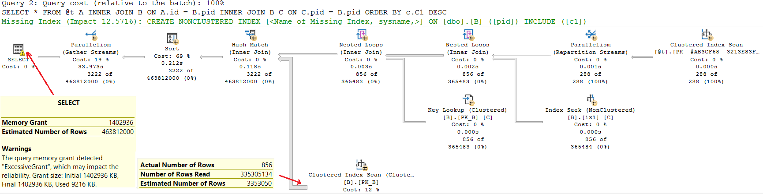
DECLARE @t TABLE(id INT PRIMARY KEY, pid INT, c1 CHAR(100));
INSERT INTO @t SELECT * FROM A WHERE A.pid = 413032;
SELECT * FROM @t A
INNER JOIN B ON A.id = B.pid
INNER JOIN B C ON C.pid = B.pid
ORDER BY C.c1 DESC;
SQL Server 2019
SQL Server Execution Times:
CPU time = 43999 ms, elapsed time = 34482 ms.
300x

Slide 70
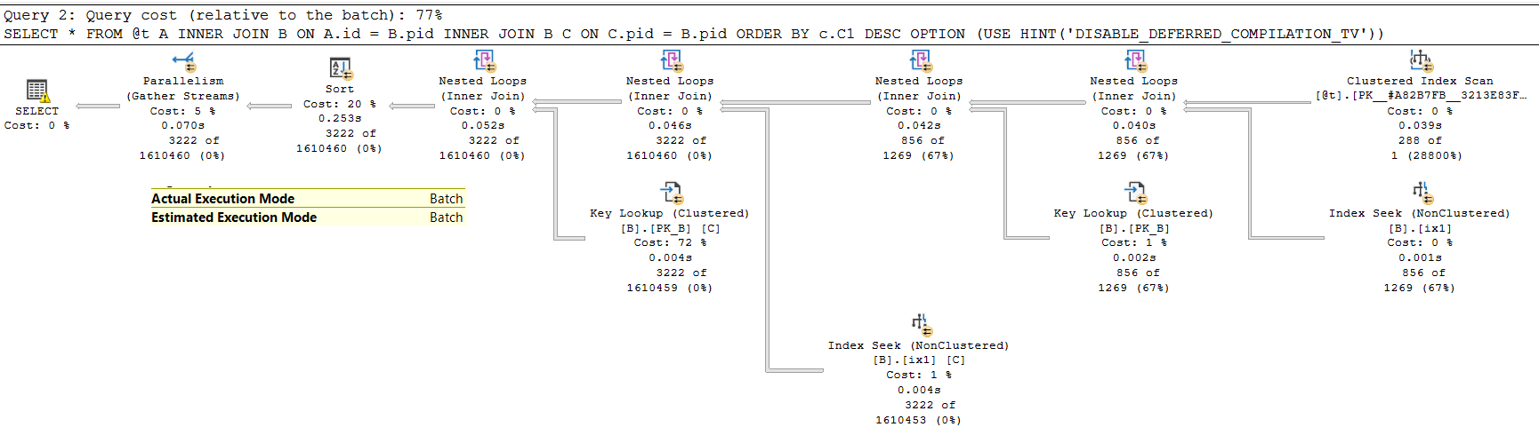
DECLARE @t TABLE(id INT PRIMARY KEY, pid INT, c1 CHAR(100));
INSERT INTO @t SELECT * FROM A WHERE A.pid = 413032;
SELECT * FROM @t A
INNER JOIN B ON A.id = B.pid
INNER JOIN B C ON C.pid = B.pid
ORDER BY c.C1 DESC
OPTION (USE HINT('DISABLE_DEFERRED_COMPILATION_TV'));
SQL Server 2019
SQL Server Execution Times:
CPU time = 416 ms, elapsed time = 109 ms

Slide 71



Table Variable Deferred Compilation - Conclusion
Designed to address cardinality issues caused by fixed estimation:
Nested Loop Joins where Hash Joins are more appropriate
Memory grant underestimation issues
Better estimation for execution plans for new queries
Prone to parameter sniffing
Can break existing workarounds

Slide 72
APROXIMATE
QUERY PROCESSING

Slide 73
APPROX_DISTINCT_COUNT
It uses significantly less memory resources
Error from the precise COUNT DISTINCT equivalent within 2% for most workloads
Great performance for data sets with a high number of distinct values
Implemented HyperLogLog algorithm
It’s more about used resources then about the speed

Slide 74
HyperLogLog Algorithm
It hashes each element to make the data distribution more uniform
After hashing all the elements, it looks for the binary representation of each hashed element
HLL looks number of leading zero bits in the hash value of each element and finds maximum number of leading zero bits
𝑁𝑢𝑚𝑏𝑒𝑟 𝑜𝑓 𝑑𝑖𝑠𝑡𝑖𝑛𝑐𝑡 𝑒𝑙𝑒𝑚𝑒𝑛𝑡𝑠=2^(𝑘+1)
where 𝑘 is maximum number of leading zeros in data set
Documentation: http://algo.inria.fr/flajolet/Publications/FlFuGaMe07.pdf

Slide 75
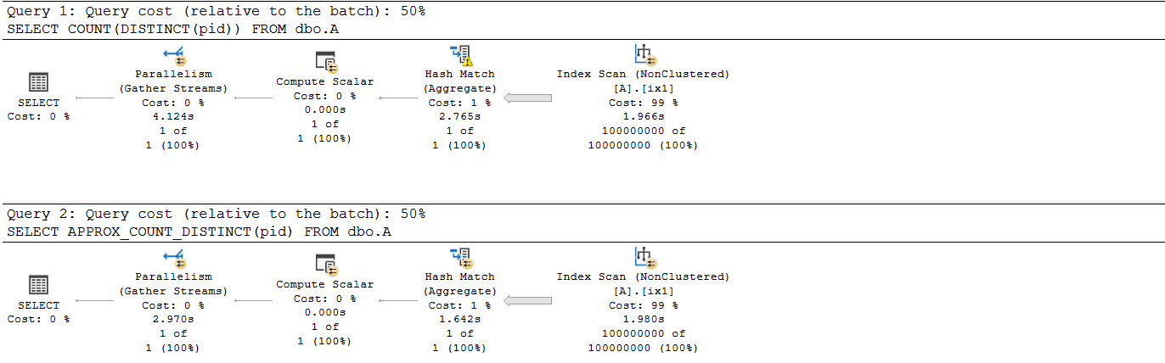


--Table A 100M rows
SELECT COUNT(DISTINCT(pid)) FROM dbo.A;
SELECT APPROX_COUNT_DISTINCT(pid) FROM dbo.A;
SQL Server Execution Times:
CPU time = 15735 ms, elapsed time = 2493 ms.
SQL Server Execution Times:
CPU time = 12360 ms, elapsed time = 1988 ms.

Slide 76
IQP - Conclusion
It will affect OLTP workload, significantly more than SQL Server 2017
Many issues will be solved, but for specific query patterns
Benefits can be even huge, depending on workload
Regressions are possible, but you can easily mitigate them by disabling features at different levels
Expectations for improvement in existing OLTP workloads
HIGH from Batch mode on rowstore and Memory Grant, Scalar UDF Inlining
LOW from Table Variable Deferred Compilation and Adaptive Joins

Slide 77
Bonus (if time permits)

Slide 78
BATCH MODE
ADAPTIVE JOIN

Slide 79
Batch Mode Adaptive Join
New operator - Adaptive Join
Allows to choose between Hash Join and Nested Loop Join at runtime
It starts as Hash Join and if after input scanning
estimated number of rows < threshold => switches to Nested Loop Join
estimated number of rows >= threshold => continues as Hash Join
It will better handle queries with variety of parameters, but it won‘t solve all issues caused by wrongly chosen Join operator
It works only in Batch Mode

Slide 80


Batch Mode Adaptive Join
EXEC dbo.GetOrderDetails 1;
EXEC dbo.GetOrderDetails 112;

Slide 81

Batch Mode Adaptive Join
Q: Is it better with new Adaptive Join operator?
A: Yes!!! Under the CL 150, the query runs 4x faster!

Slide 82

Batch Mode Adaptive Join
Q: Is it better with new Adaptive Join operator?
IT DEPENDS!
A: Actually NO - under the CL 150, the query runs 5x slower!

Slide 83
Batch Mode Adaptive Join - Conclusion
It can bring benefits for some queries
It can also bring regressions
You should test, test and test it with your workload!
Can handle basic parameter sniffing cases
It requires operators in batch mode

Slide 84
INTERLEAVED EXECUTION

Slide 85
Interleaved Execution
Related to queries with multi statement table valued functions (MTVF)
Breaks the optimization process
Executes a part of the query with function call and get actual cardinality
Epilogue: More appropriate plan (correct cardinality instead of 100)
Costs: Increased CPU compile time
Limits: It works with fixed parameters only, prone to param. sniffing

Slide 86


Interleaved Execution
DECLARE @d DATETIME = SYSDATETIME();
SELECT ol.OrderID, ol.UnitPrice, ol.StockItemID FROM Sales.Orderlines olINNER JOIN dbo.SignificantOrders() f1 ON f1.Id = ol.OrderID WHERE PackageTypeID = 7;
PRINT CONCAT('Execution time: ', DATEDIFF(millisecond, @d, SYSDATETIME()), ' ms');
GO 5
dbo.SignificantOrders() cardinality: 74K rows
Compatibility Level 130
Compatibility Level 150
2x
Plan: Nested Loop Join
Plan: Hash Join

