Slide 1
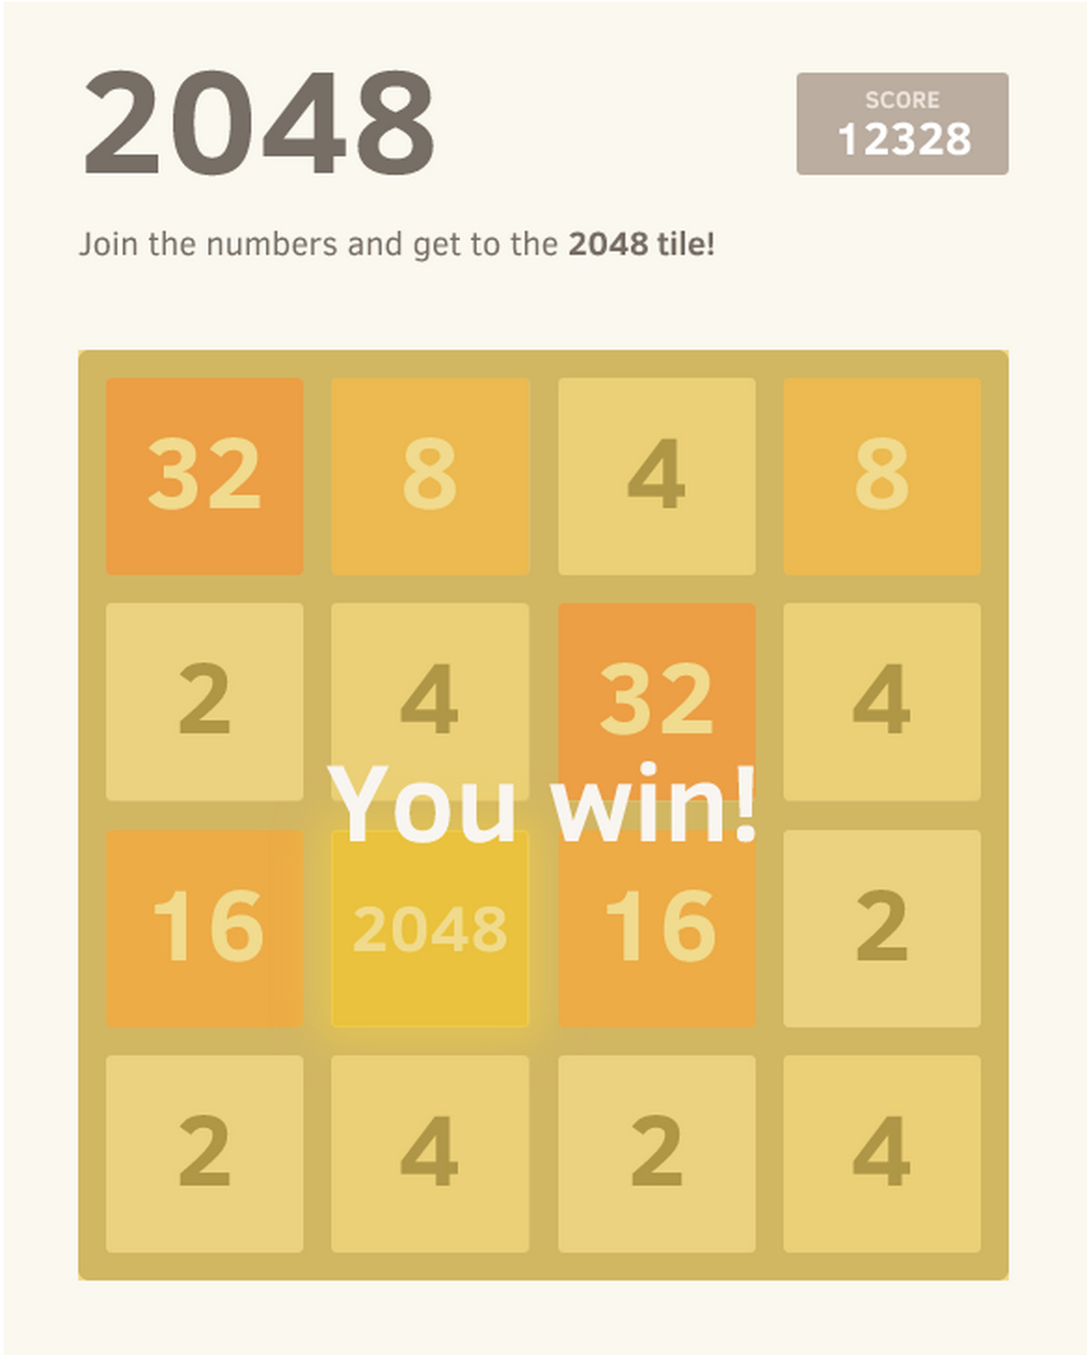
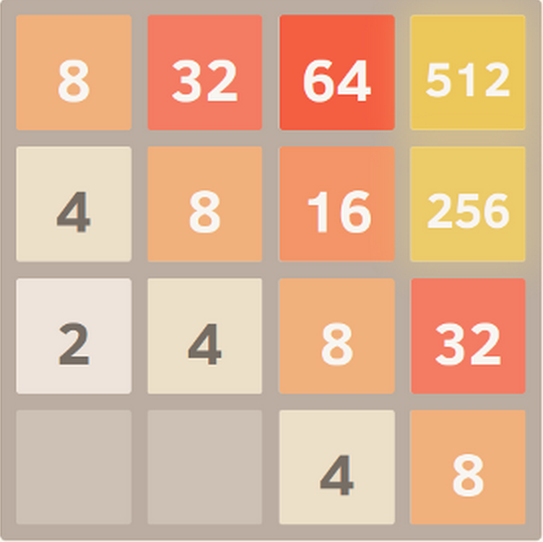
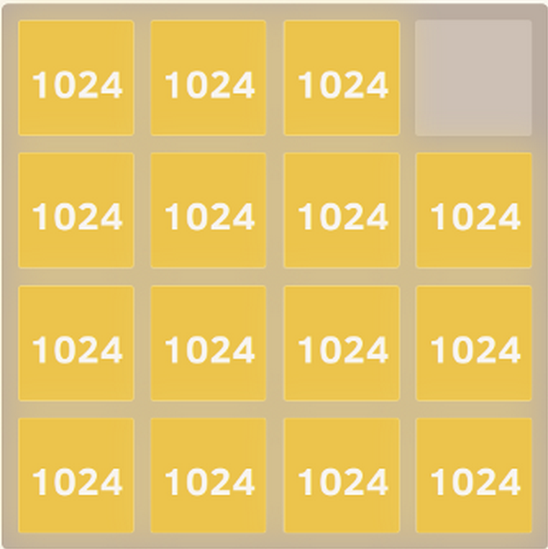

2048: A Gentleman’s Game Played By Robots Alden Hart & Rich Korzelius Computer Science 370
The Game
2048, popularized by Gabriele Cirulli, is a simple puzzle game. The object is to achieve the 2048 tile by combining powers of 2. A robot plays using intelligent search strategies that exploit two key aspects of the game:
After each player move, a tile appears in a random unoccupied space.
This new tile has a 90% chance of being a 2 and a 10% chance of being a 4.
The Search
We employ two different intelligent search strategies to win the game. Before each move, the program simulates all possible moves, then all possible random tile placements for several generations. It then chooses the move that is most likely to turn out well.
A perfectly monotonic board
A perfectly smooth board
The Heuristics
In order to assess the “goodness” of a move, we evaluate the board according to two main heuristics:
Monotonicity: The board is strictly decreasing along its rows and columns.
Smoothness: The board has many possible merges
Minimax Search
This strategy treats the randomly placed tile as an opponent playing against you. It prepares for the worst case scenario by selecting the move that maximizes your score while minimizing the opponent’s effectiveness.
Expectimax Search
oiuhvoiwje
References
Game hosted at https://github.com/gabrielecirulli/2048
Pictures from http://stackoverflow.com/questions/22342854/what-is-the-optimal-algorithm-for-the-game-2048

