Slide 1
Deep Learning Project
Team Members:
Alhasan Gamal
Islam Muhammed
Omar Atef
Alaa Desukey
Faten Ahmad
State Farm Distracted Driver Detection

Slide 2
Table of contents
01
02
03
Dense Model
CNN Model
Data Augmentation
04
05
Visualization
Transfer Learning

Slide 3
Dense Model
A neural network in which every neuron in a certain layer is connected to every neuron the consequent layer.

Slide 4
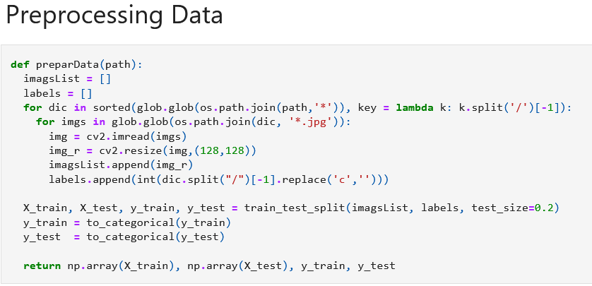
Pre-processing
Done in 3 steps:
Load images using cv2
Resizing images into (128*128) images
Applying one hot encoding to labels using to_categorical
Splitting the data into train and test

Slide 5
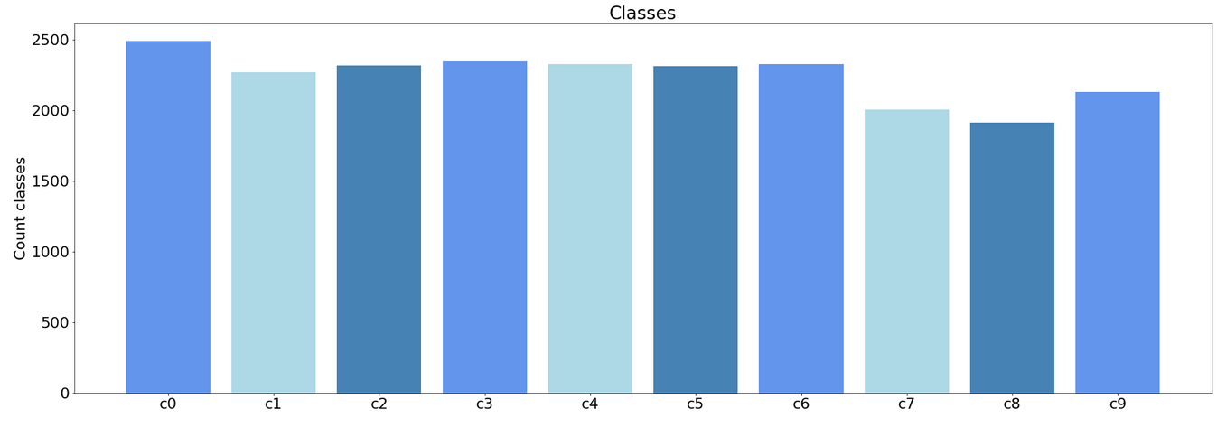
Data Distrbution
By inspection it was found that the data is always balanced

Slide 6
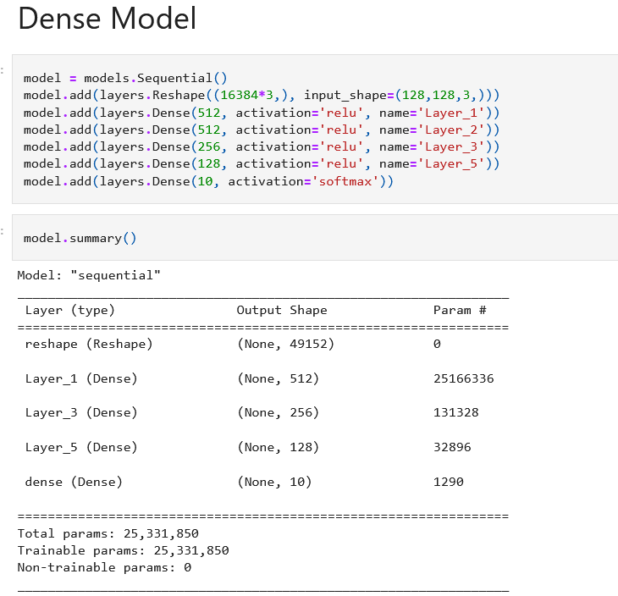
Model Parameters
Since Dense layers are being used, then the input image must be reshaped into 128*128*3 vector
Components:
2 Dense layers with 512 neurons
1 Dense layer with 256 neurons
1 Dense layer with 128 neurons
1 Dense layer with 10 neurons

Slide 7
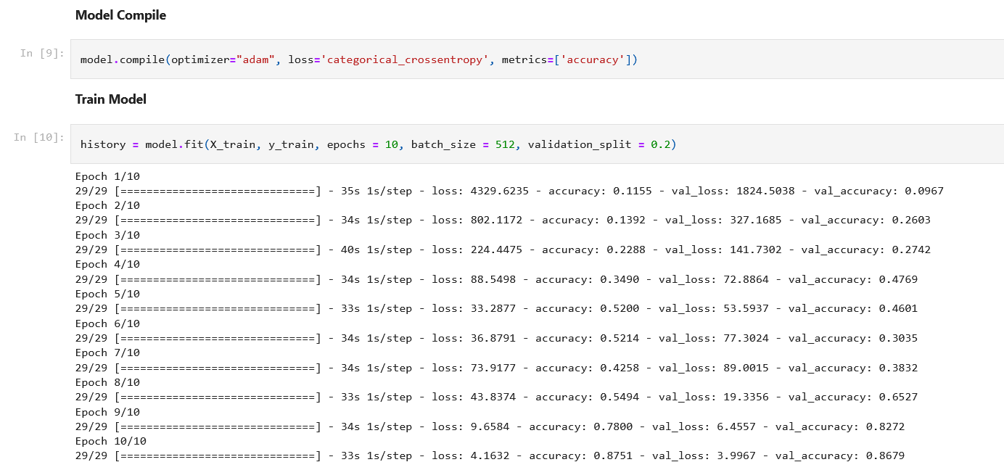
Model Training
The model is compiled using Adam optimizer and categorical cross entropy as the loss function. The accuracy is observed
Training is done with 10 epochs along with a batch size of 512 and validation split of 20%

Slide 8
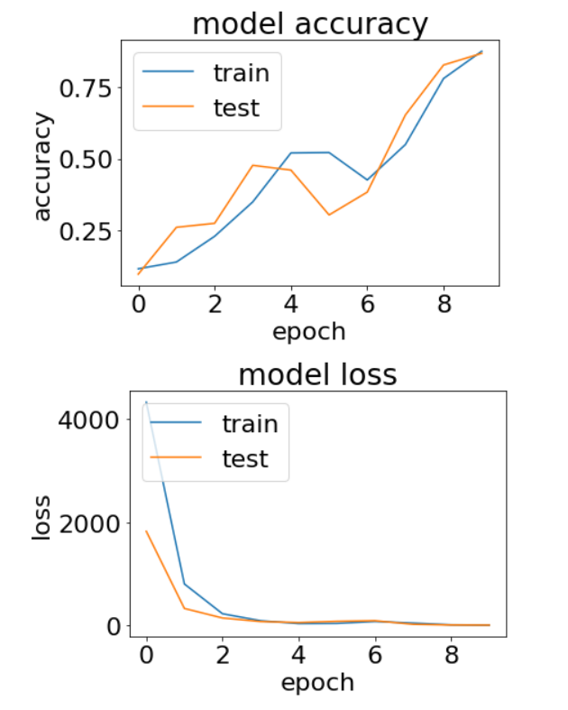
Model Evaluation
After training the model for 10 epochs, the training accuracy settled at 87% and the validation accuracy settled around 86% which indicates that there is no overfitting

Slide 9
ConvNet Model
A neural network that uses convolution operations and filters to extract features of objects.

Slide 10
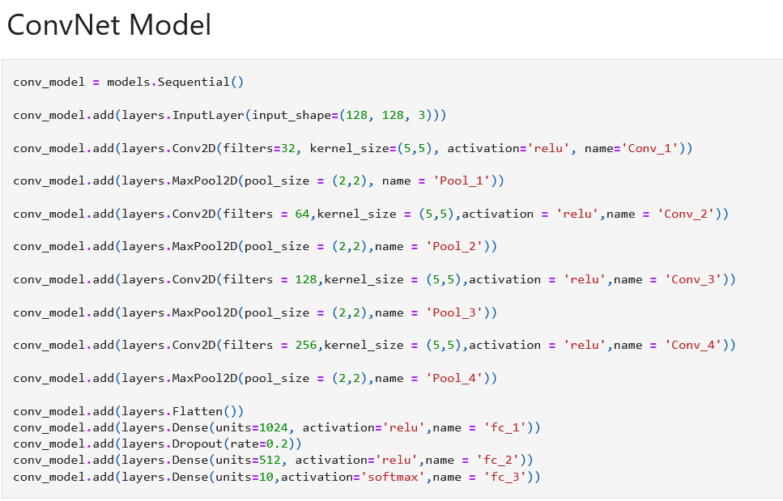
Model Parameters
Since ConvNets use kernels, there is no need to flatten the shape
Components:
4 Convnets with different kernel sizes and
4 maxpooling with pool size of 2*2
The output of last maxpool is flattened and fed into 3 dense layers

Slide 11
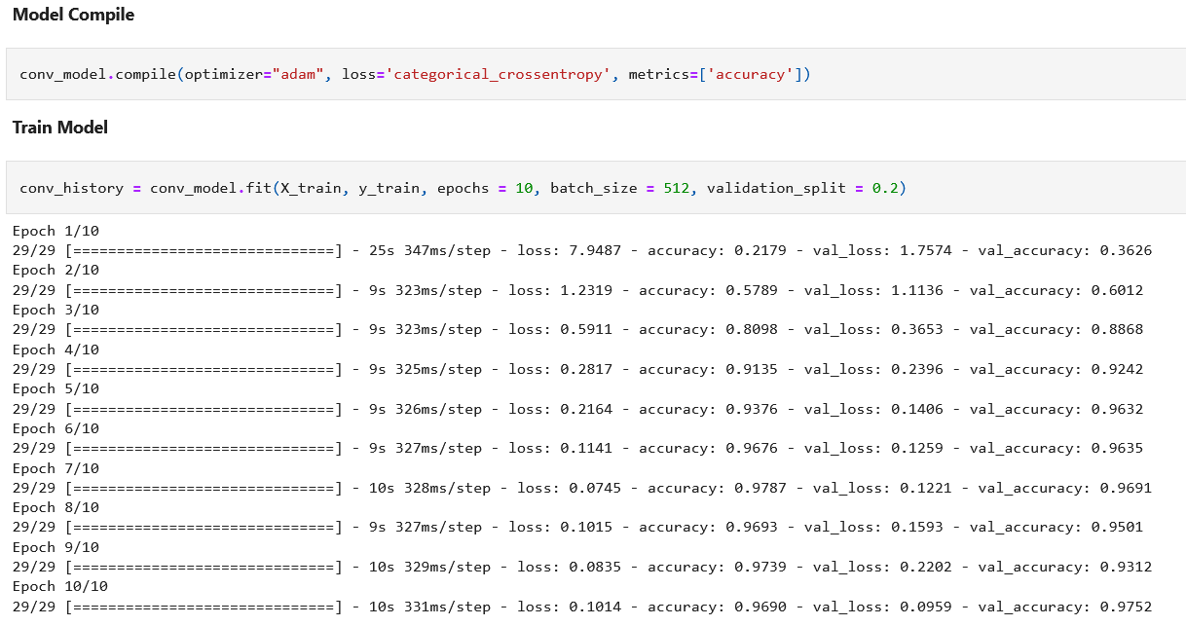
Model Training
The model is compiled using Adam optimizer and categorical cross entropy as the loss function. The accuracy is observed
Training is done with 10 epochs along with a batch size of 512 and validation split of 20%

Slide 12
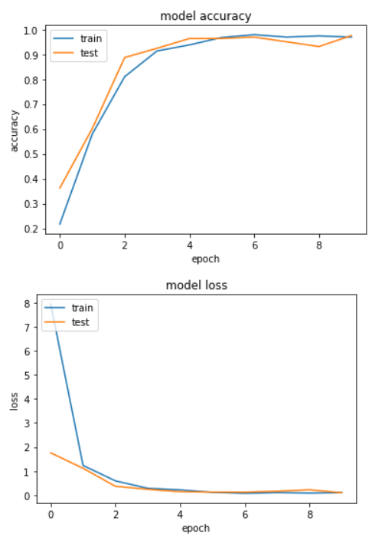
Model Evaluation
After training the model for 10 epochs, the training accuracy settled at 96% and the validation accuracy settled around 97% which is a little higher than training accuracy

Slide 13
Transfer Learning
Using pre-trained neural network vgg16

Slide 14
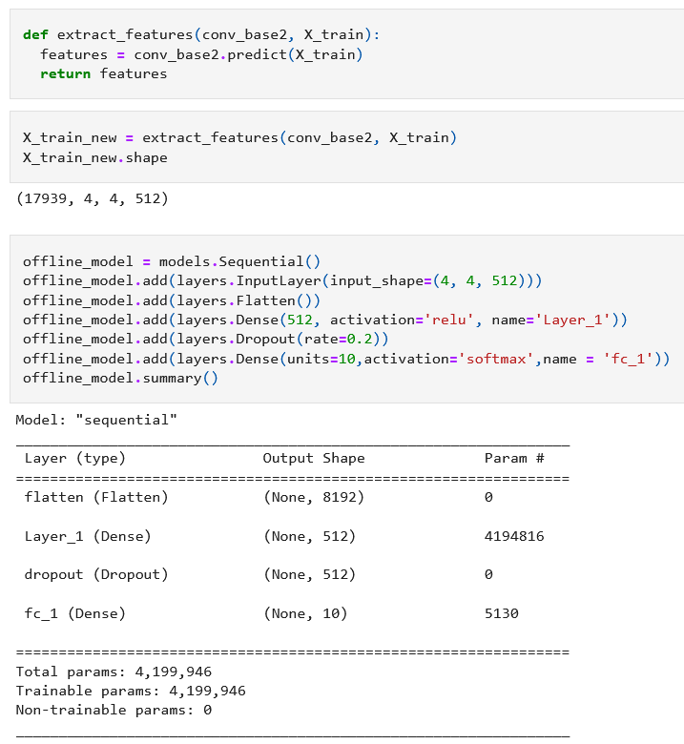
Model
Offline Learning
The VGG16 model is used as it is to extract features then the features is fed into a dense neural network as input
Components:
Input layer with image size
The input is then flattened
2 dense layers

Slide 15
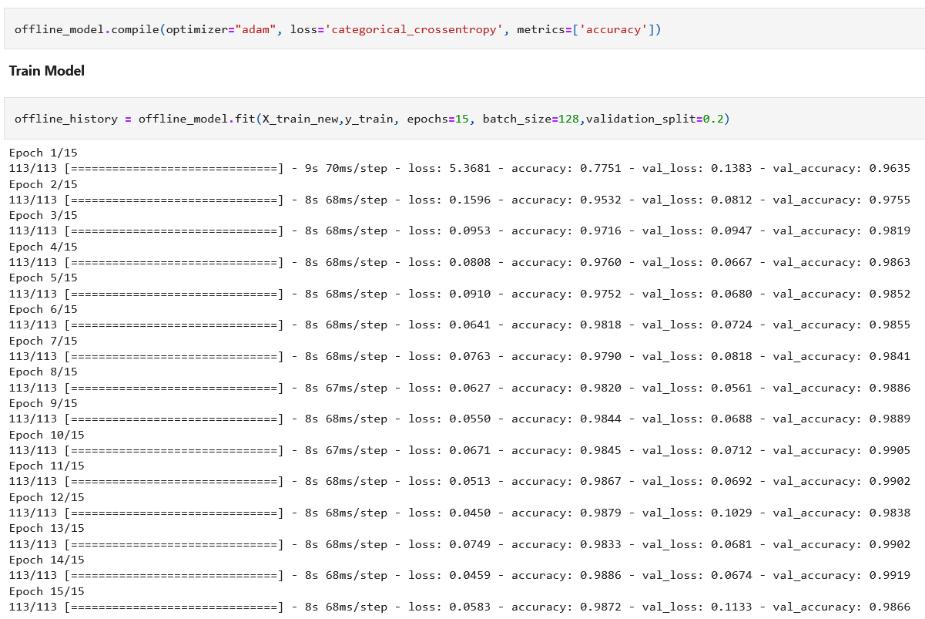
Model Training
The model is compiled using Adam optimizer and categorical cross entropy as the loss function. The accuracy is observed
Training is done with 15 epochs along with a batch size of 128 and validation split of 20%

Slide 16
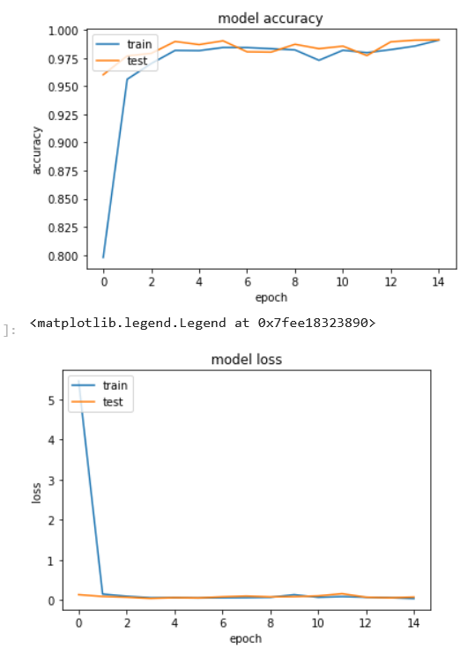
Model Evaluation
After training the model for 10 epochs, the training accuracy settled at 98.7% and the validation accuracy settled around 98.66% which indicates that there is no overfitting

Slide 17
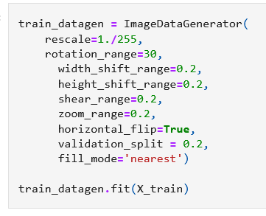
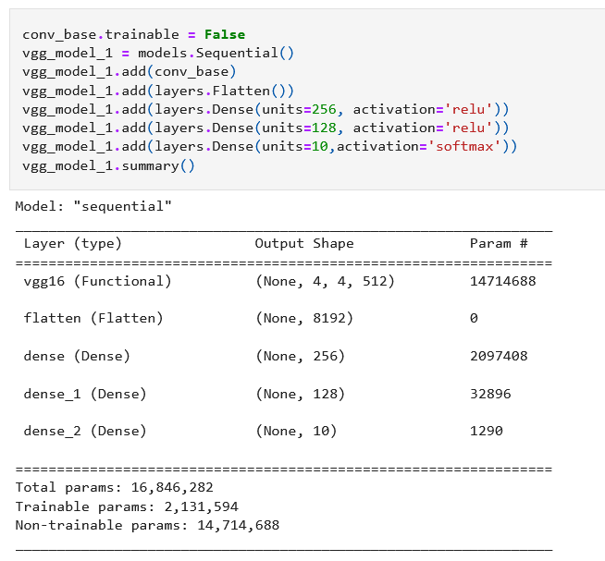
Model
Online Learning
Instead of using VGG16 model as it is, we apply data augmentation and add the VGG16 model as part of the entire model
The VGG16 model is set off and added to the entire model

Slide 18
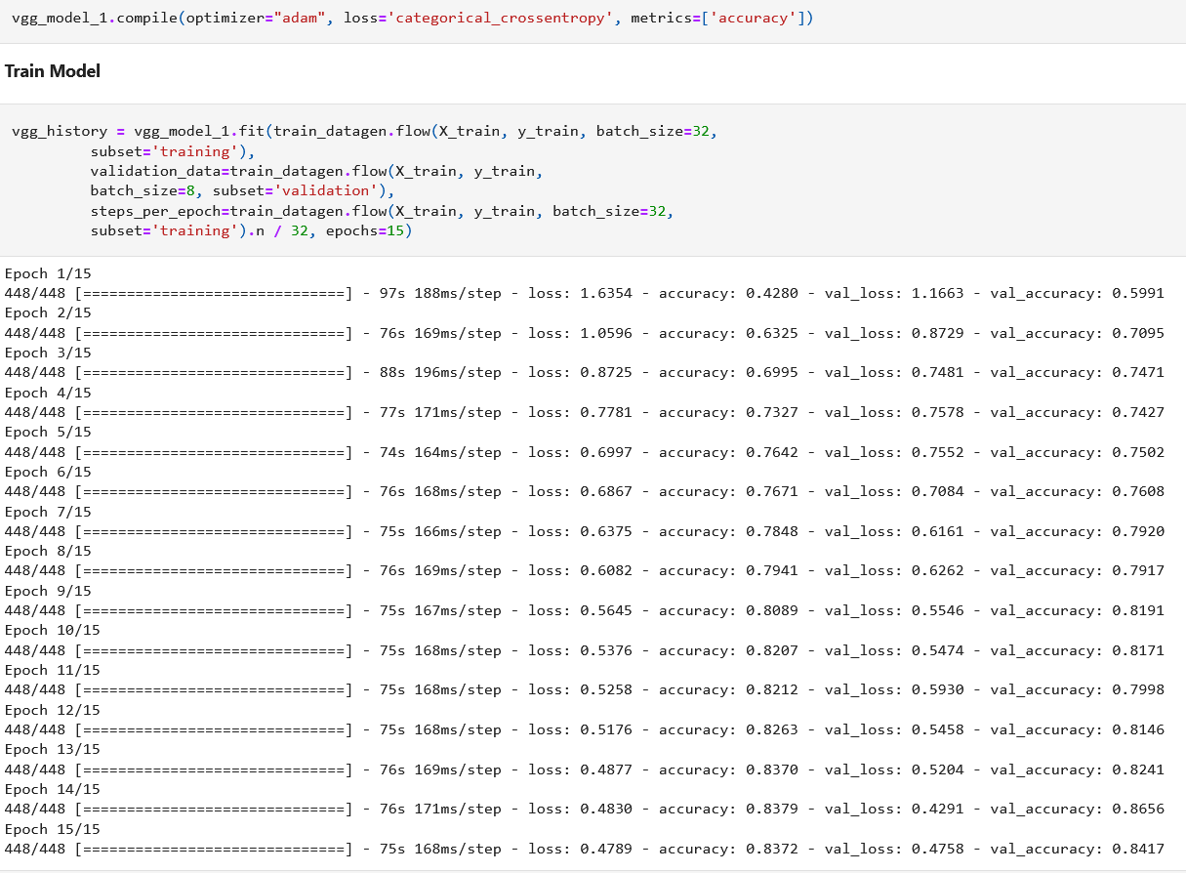
Model Training
The model is compiled using Adam optimizer and categorical cross entropy as the loss function. The accuracy is observed
Training is done with 15 epochs along with a batch size of 32 and validation split of 20%
The data used in training is the augmented data

Slide 19
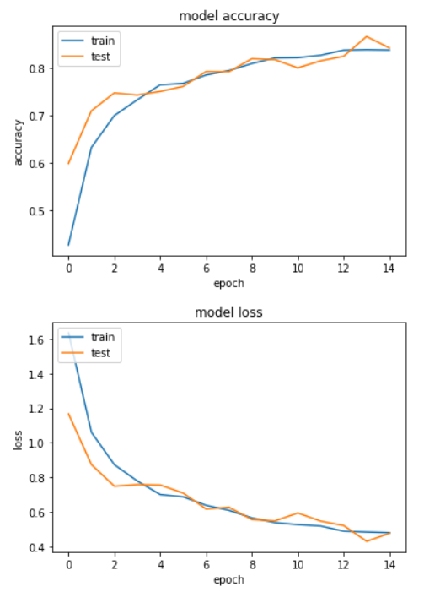
Model Evaluation
After training the model for 10 epochs, the training accuracy settled at 83% and the validation accuracy settled around 84%
Augmentation turns out to be not the best option for the dataset

Slide 20
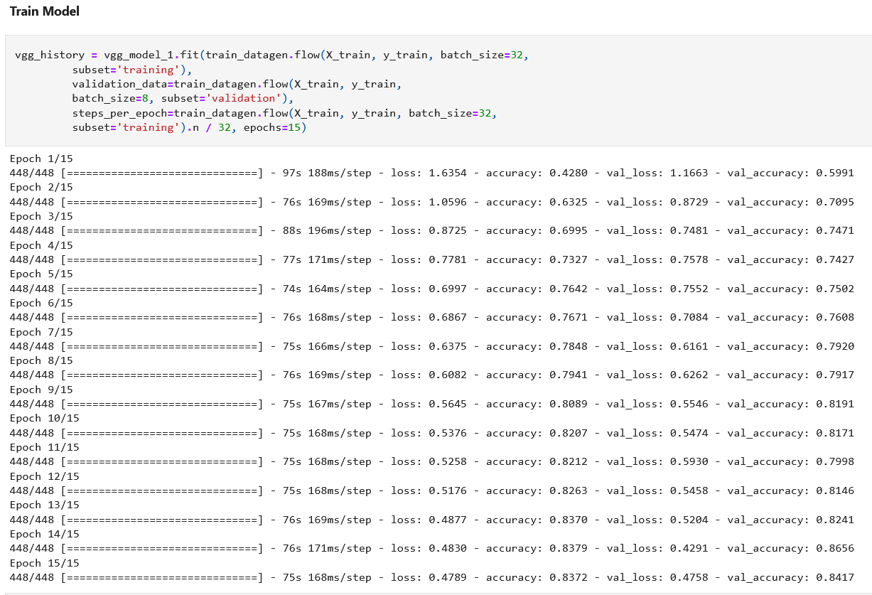
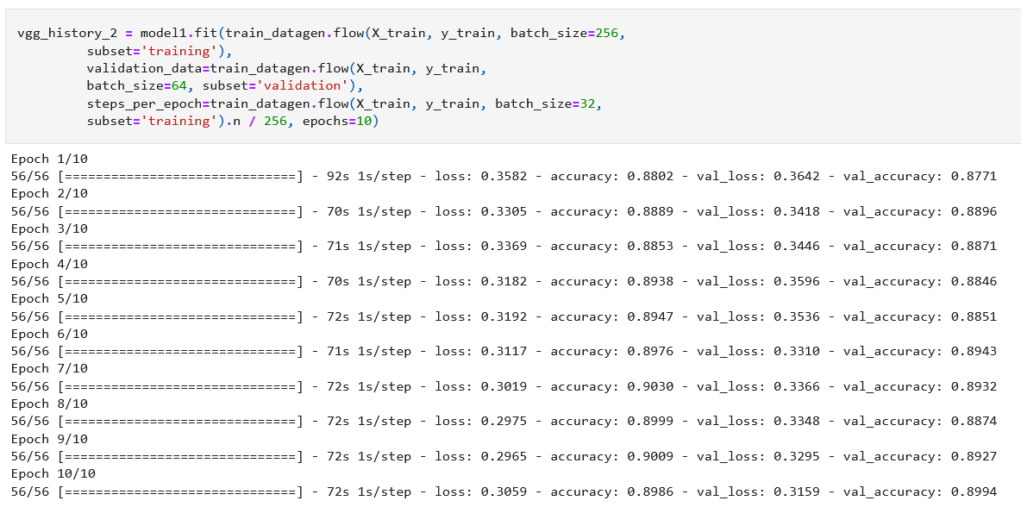
Model
Fine Tuning
The VGG16 model is turned off and the online learning is carried out and the output is saved
After that the previous output model is loaded and only the last layers and opened to be trainable again and training is carried out again

Slide 21
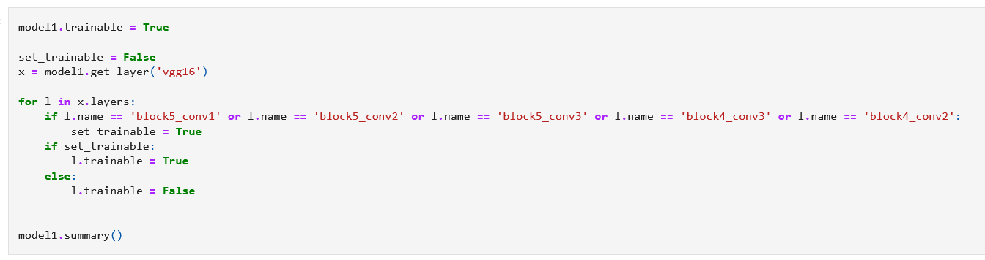
Model
Fine Tuning
An experiment was carried out by only making 2 of the layers in VGG16 trainable but the results wasn’t satisfactory
By making 4 layers of VGG16 trainable, the accuracy increases significantly

Slide 22
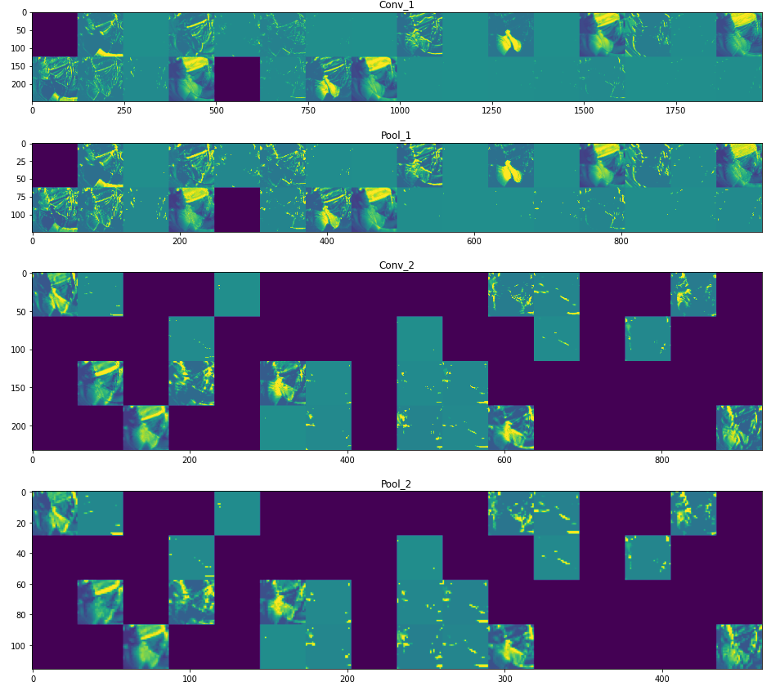
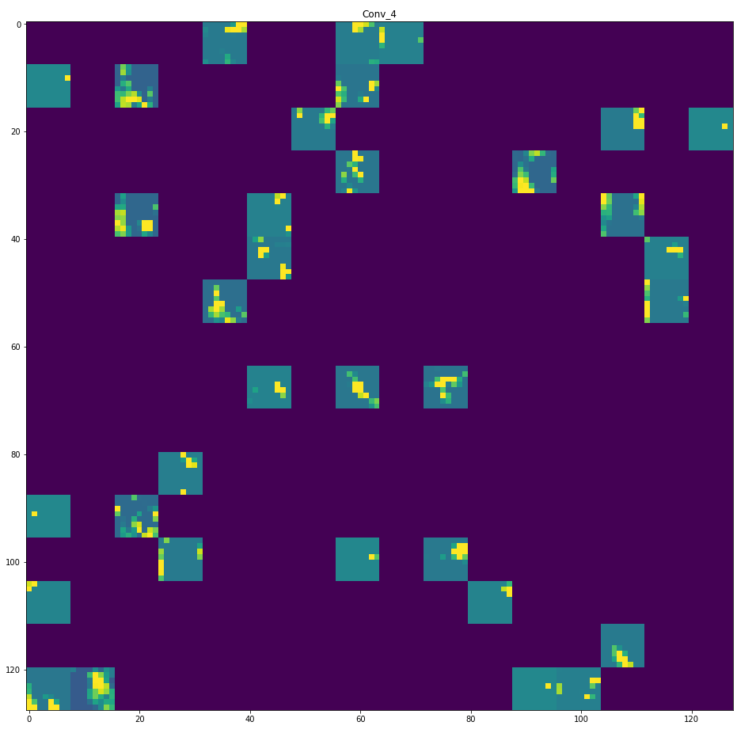
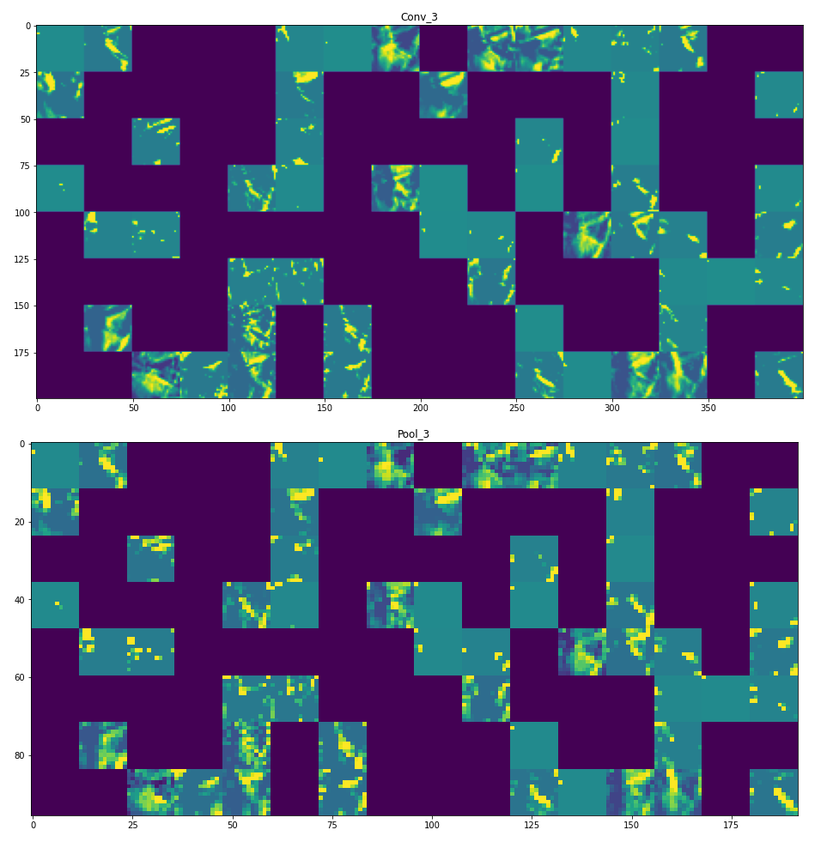
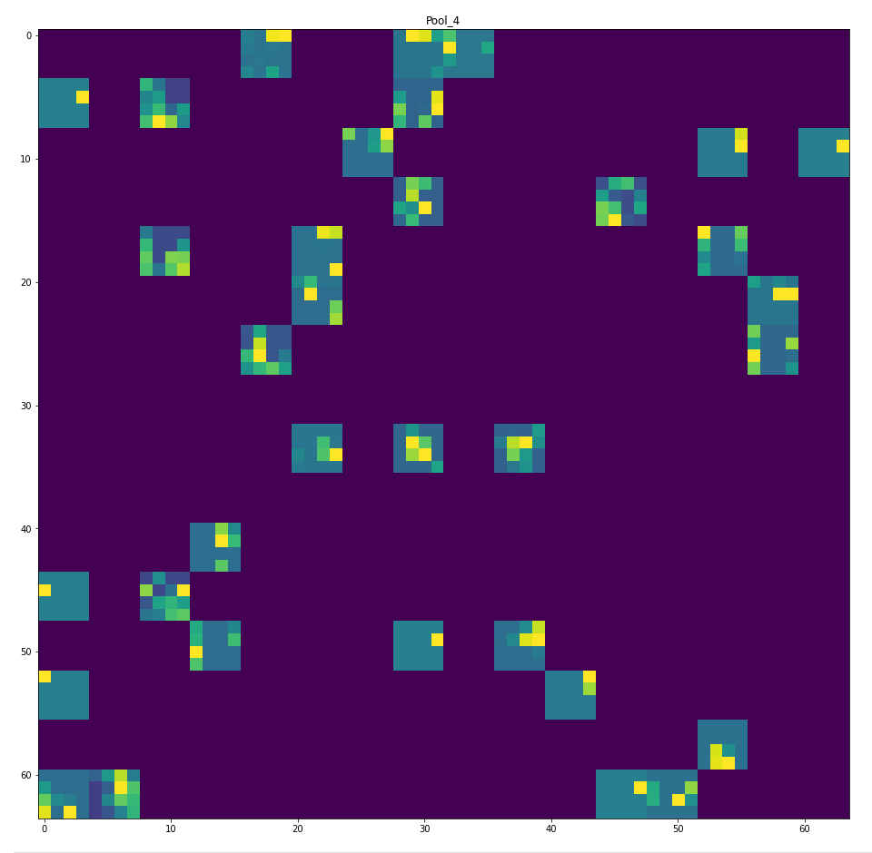
Visualization
Displayed is the visualization of the convNet Model and the feature maps of it after every filter to notice the effect of the kernels

Slide 23
Thank you!

