Slide 1
DEPI | MODERN DATA STACK
FUNNELVISION
E-Commerce Marketing Funnel Analytics
Prepared by
Al-Hassan Mohammed Hassan
Instructor: Mohamed Omer
Snowflake • dbt • Apache Airflow • Streamlit • Docker

Slide 2
Project Overview
Turning raw e-commerce data into analytics-ready insights
THE CHALLENGE
THE APPROACH
THE OUTCOME
Raw business data is difficult to use directly for consistent reporting.
Build a repeatable pipeline for ingestion, transformation, testing, and visualization.
Provide organized analytical datasets and an interactive dashboard.
• Focus: e-commerce marketing and performance analytics
• Demonstrates a practical Modern Data Stack workflow
2

Slide 3
Project Objectives
What FunnelVision is designed to demonstrate
CENTRALIZE
TRANSFORM
VALIDATE
Load source CSV data into Snowflake.
Organize data into dbt model layers.
Run data quality tests.
ORCHESTRATE
DELIVERY
VISUALIZE
Run transformations before tests with Airflow.
A documented, containerized analytics workflow.
Explore KPIs and charts in Streamlit.
3

Slide 4
System Architecture
High-level flow from source files to business insights
01 DATA SOURCES
02 WAREHOUSE
03 TRANSFORM
04 ORCHESTRATE
05 CONSUME
→
→
→
→
E-commerce CSV files
Snowflake • RAW
dbt • 6 staging, 2 intermediate, 2 marts
Airflow • dbt run → dbt test
Streamlit dashboard
Docker provides the containerized execution environment for the project components.
CSV → Snowflake → dbt → Airflow orchestration → Streamlit
4

Slide 5
Data Warehouse — Snowflake
Raw storage and analytics-ready data
RAW LAYER
TRANSFORMED DATA
ANALYTICS MARTS
Six source tables loaded from e-commerce CSV files.
dbt models organize data into layers for downstream use.
Final models provide structured data for reporting and dashboard queries.
• Snowflake acts as the central data warehouse.
• Evidence includes RAW tables, analytical models, and sample mart results.
5

Slide 6
Transformation Layer — dbt
Modular transformations with test coverage
STAGING
INTERMEDIATE
MARTS
6 models
Prepare source data
2 models
Reusable transformation logic
2 models
Reporting-ready datasets
Total: 10 dbt models built successfully
Layered models improve clarity, reuse, and maintainability.
6

Slide 7
Workflow Orchestration — Airflow
Automating transformation and validation
TASK 1 — dbt_run
TASK 2 — dbt_test
Executes dbt model transformations.
→
Runs tests after dbt_run succeeds.
• DAG: funnelvision_dbt_pipeline
• Recorded run completed successfully in the configured Airflow environment
7

Slide 8
Analytics Dashboard — Streamlit
Interactive access to key metrics and visual analysis
KPI SUMMARY
CHARTS
FILTERS
Four headline indicators provide a quick overview.
Visualize patterns in the analytical data.
Explore data through interactive filtering.
Dashboard screenshots are included in the project evidence folder.
Dashboard launched successfully in the configured environment.
8

Slide 9
Testing & Results
Recorded execution outcomes
10
11
0
dbt models built
dbt tests passed
test errors
• Airflow ran dbt_run followed by dbt_test successfully.
• The Streamlit dashboard was restored and opened successfully.
9

Slide 10
CONCLUSION
From raw data to analytics-ready insights
• Implemented a Snowflake + dbt analytics workflow.
• Validated models with 11 passing dbt tests.
• Orchestrated execution with Apache Airflow.
• Presented analytical outputs in a Streamlit dashboard.
Thank you | Questions?

Slide 11
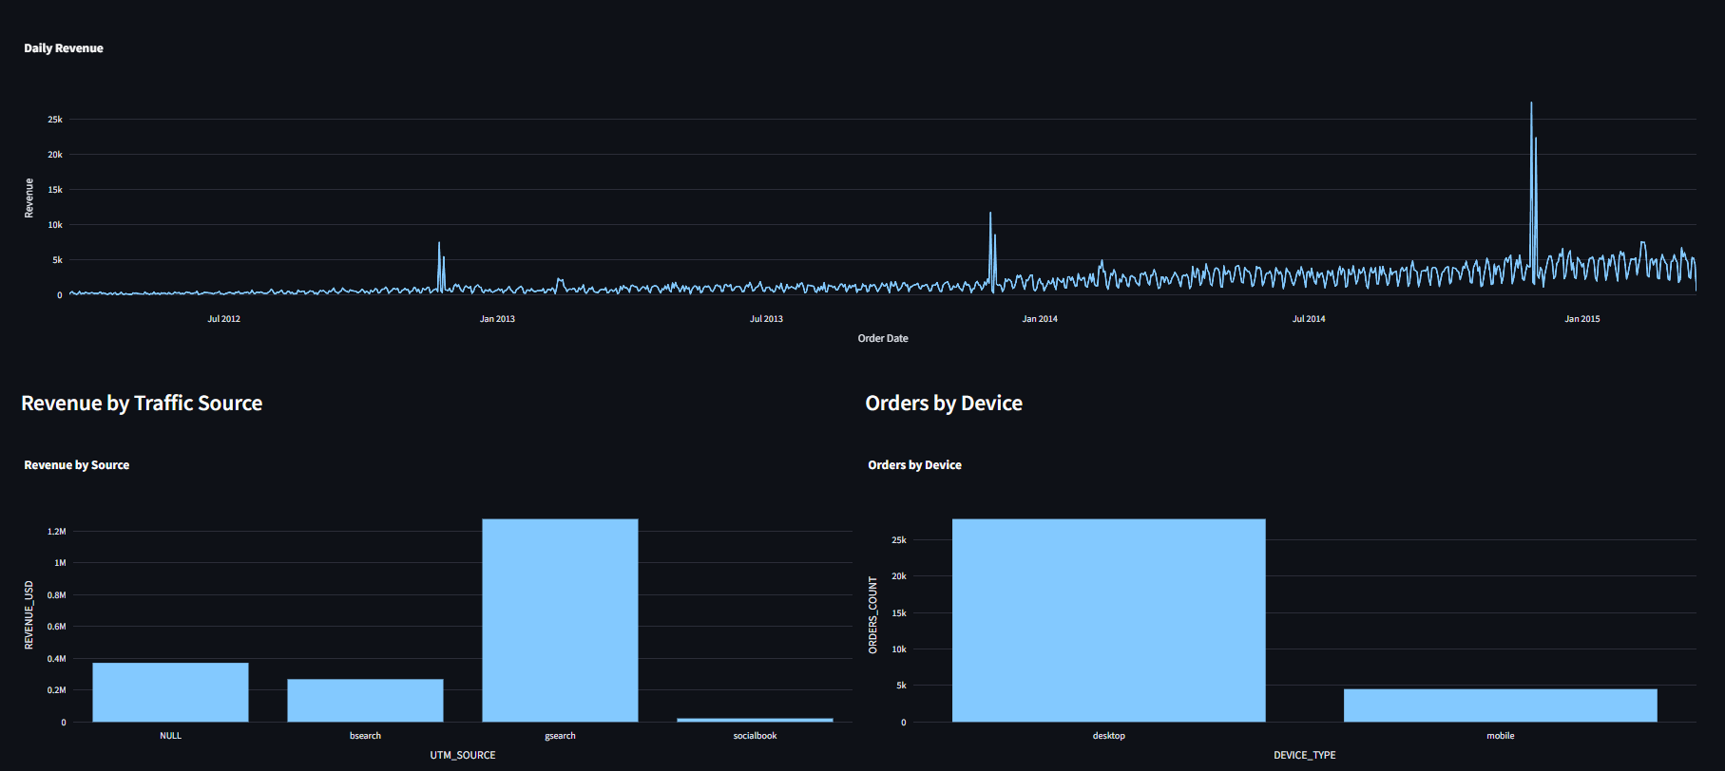
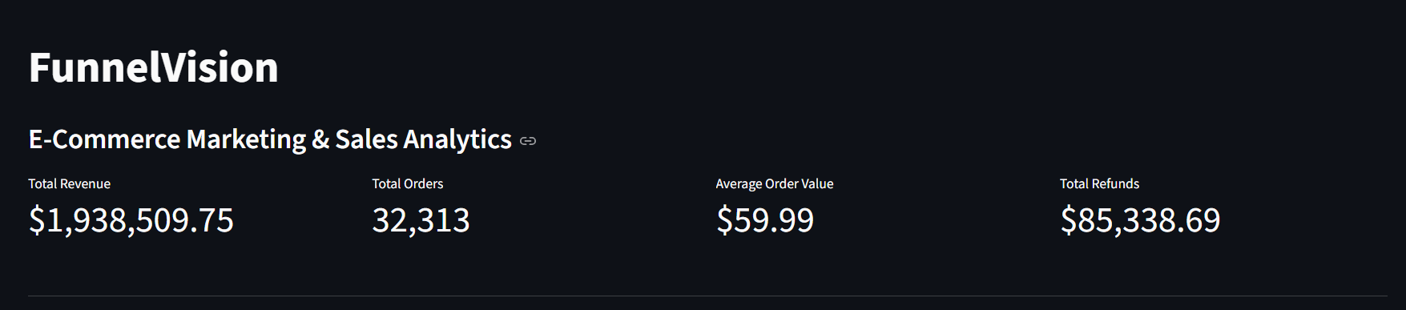
Live Dashboard Evidence
Actual Streamlit dashboard screenshots from the implemented project
KPI overview and project title
Revenue trend, traffic source, and device charts

Slide 12
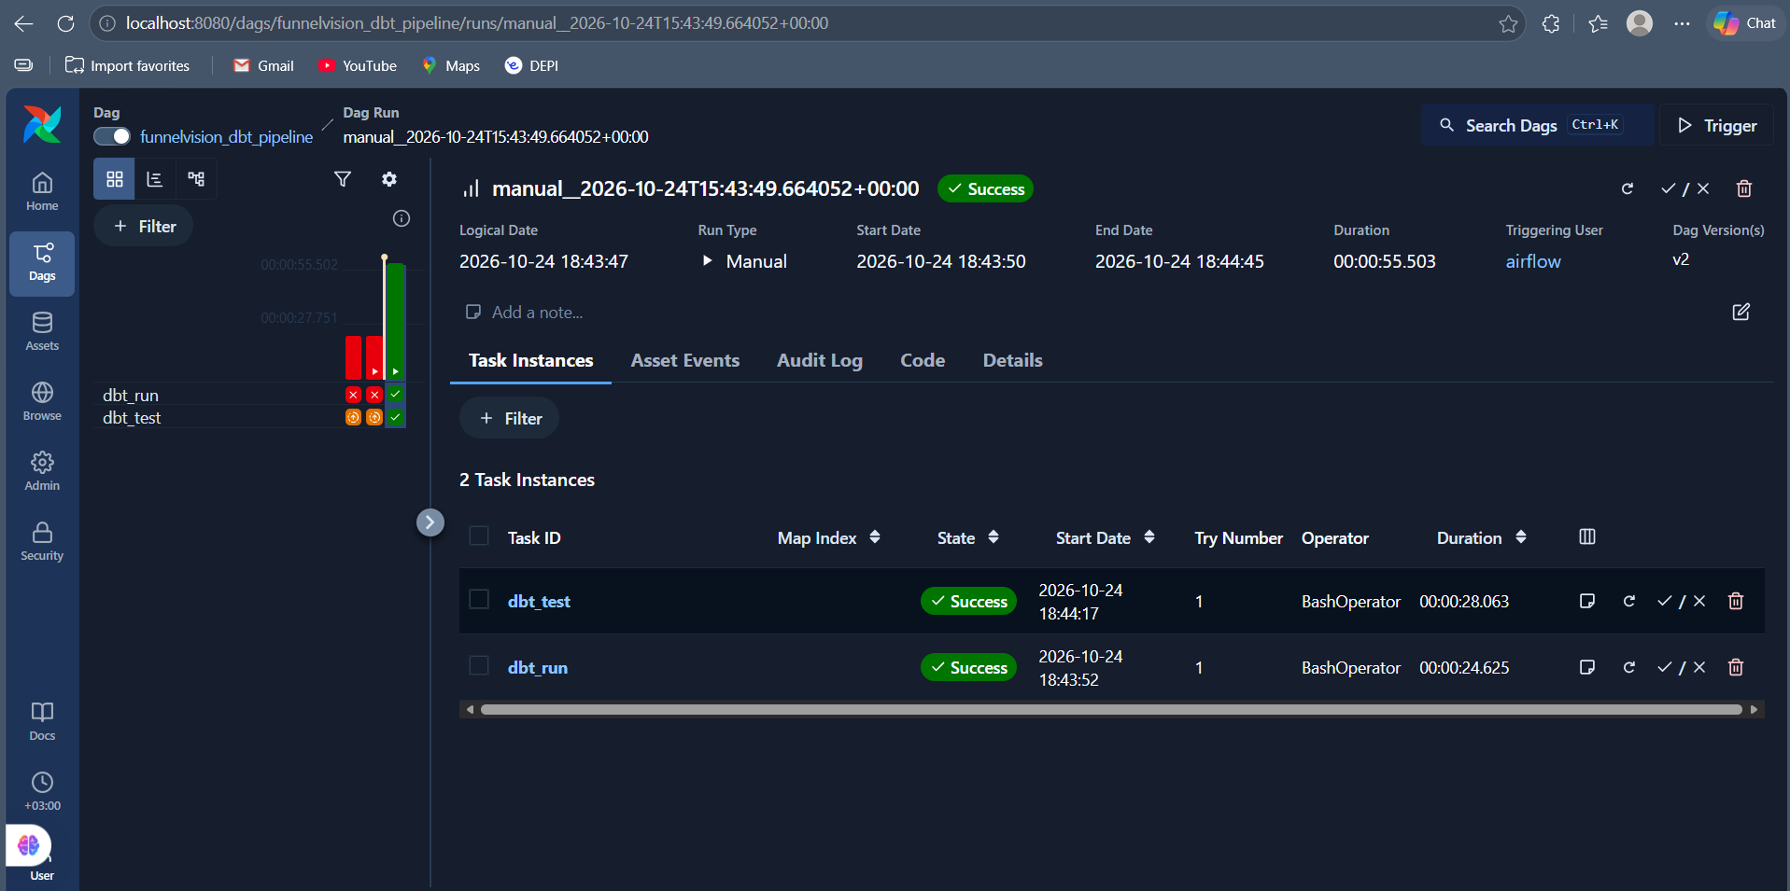
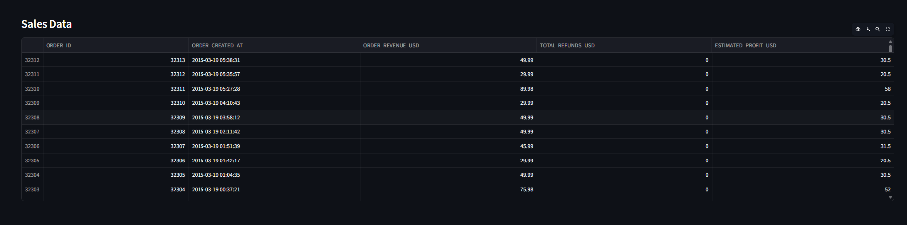
Pipeline & Data Validation Evidence
Successful orchestration run and sample analytical data
Airflow DAG completed successfully: dbt_run and dbt_test
Sales data with revenue, refunds, and estimated profit

Slide 13
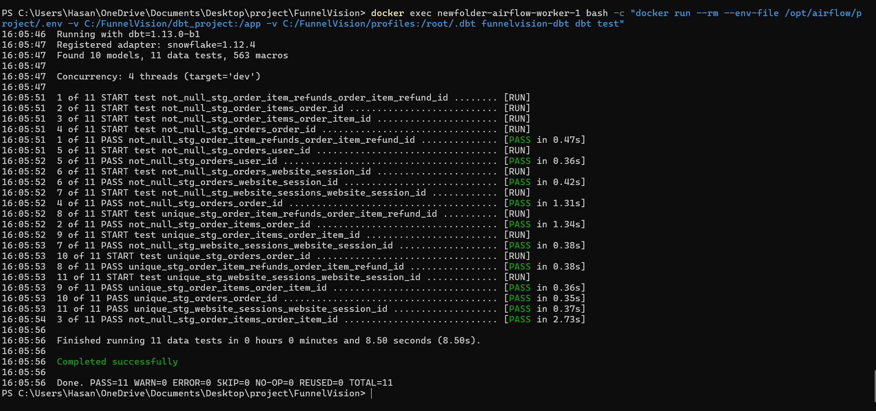
dbt Data Quality Tests
Actual terminal output from the completed dbt test run
11 of 11 tests passed • 0 warnings • 0 errors

Slide 14
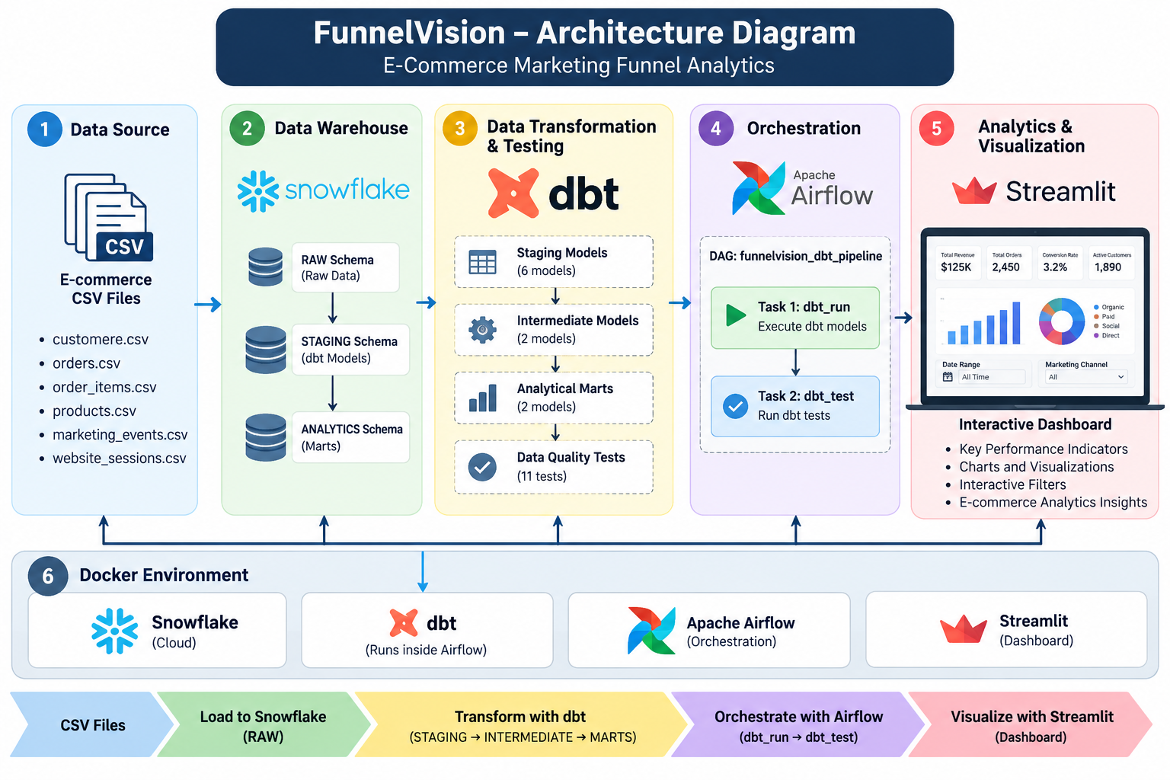
End-to-End System Architecture
Project architecture from raw CSV files to business analytics
Snowflake → dbt transformations and tests → Airflow orchestration → Streamlit dashboard

