Slide 1

New Micro-Brewery Location Analysis For Yuri Entrepreneurial Partners
Presented by The Data Analytics Group:
- Allison May
- Curtis Baucom
- Jamie Miller

Slide 2
Presentation Agenda
Part 1 – Executive Summary
Charter
Scope
Hypothesis and Goal
Approach
Project Findings and Recommendations
Part 2 – Data Analytics Framework
Analytics Paradigm
Questions

Slide 3
New Micro-Brewery
Location Analysis
Part 1
Executive Summary
(Audience: Business Sponsors)

Slide 4
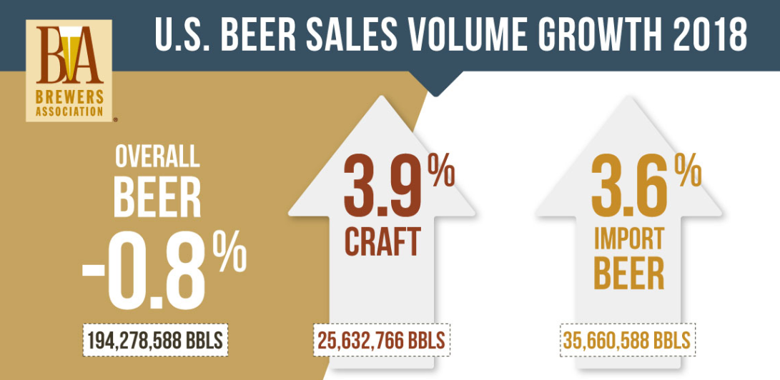
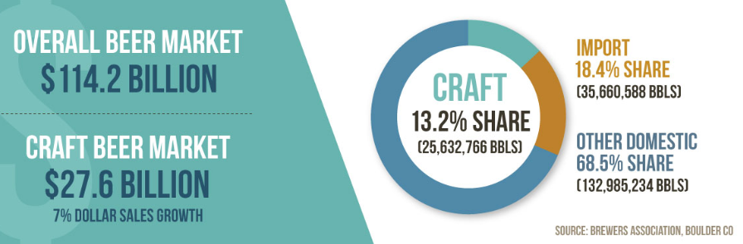
Project Charter
The craft beer industry has experienced nationwide rapid growth in recent years. The Data Analytics Group, based out of the University of Richmond, was engaged by Yuri Entrepreneurial Partners, a national private equity firm, capitalize on this trend.
Statement of Work
Provide analysis of the U.S. Microbrewery market
Deliver data-backed insight into likely risks and potential rewards at the national, regional and local level
Provide several recommendations on locations to invest in a microbrewery
Provide next steps, should engagement be extended
Budget for three resources at 40 hours each
Quick turnaround - delierables due NLT 15 JUN 2019

Slide 5
Hypothesis and goal
Project Hypothesis:
Hypothesis that there are differences between the following three market segments:
Project Goal:
Recommend ideal brewery locations based on demographics and the relative saturation (brewery density) of the location
Segment | # Breweries | Risk | Reward
Mature | 25+ | Low – established customer base | Low – possible market saturation
Up and Coming | 4-24 | Low -- established customer base | Medium – fewer competitors
Entry | 1-3 | High – limited customer base | High – open market

Slide 6
Project scope & Approach
Source data APIs:
Open Brewery Database (8,100+)
U.S. census
Merge brewery and census data by zip code
Population
Household Income
Median Age
Clense and sanitize datasets
Analyze for trends
Parse (bin) locations by number of breweries in each city: 1-3, 4-24, 25+
Layer in industry analysis and metrics from www.brewersassociation.org
Summarize findings and develop conclusions

Slide 7
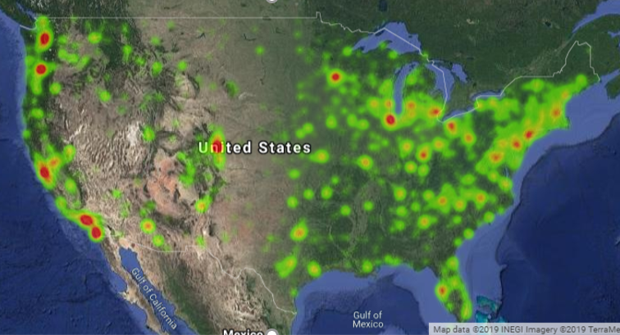
Project Findings & Recommendations (1 of 4)
Heatmap of U.S. Craft Brewery locations
Where is the craft brewery action?
Source:
The Data Analytics Group (us)

Slide 8
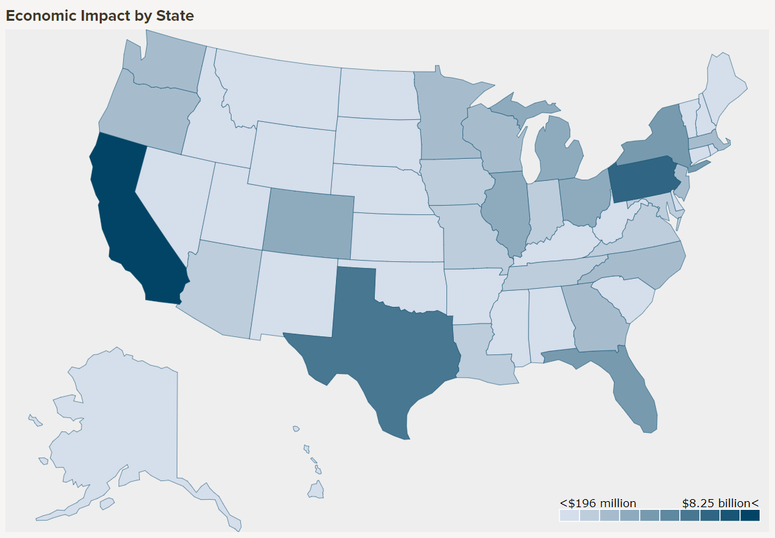
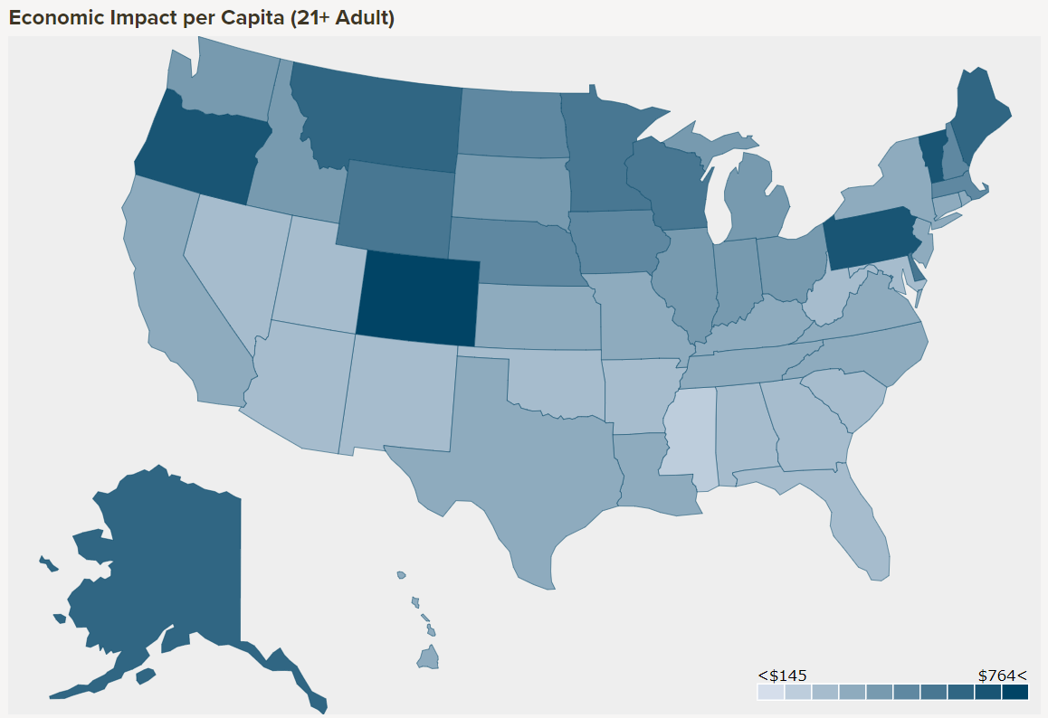
Project Findings & Recommendations (2 of 4)
Economic Impact by State ($Billions)
Economic Impact Per Capita (adult 21+)
Rank | State | Revenues
1 | CA | $8.2
2 | PA | $6.3
3 | TX | $5.3
4 | NY | $4.1
5 | FL | $3.6
Rank | State | Revenues
1 | CO | $764.19
2 | VT | $681.87
3 | PA | $658.52
4 | OR | $647.62
5 | ME | $592.89
Source:
Brewer Association

Slide 9
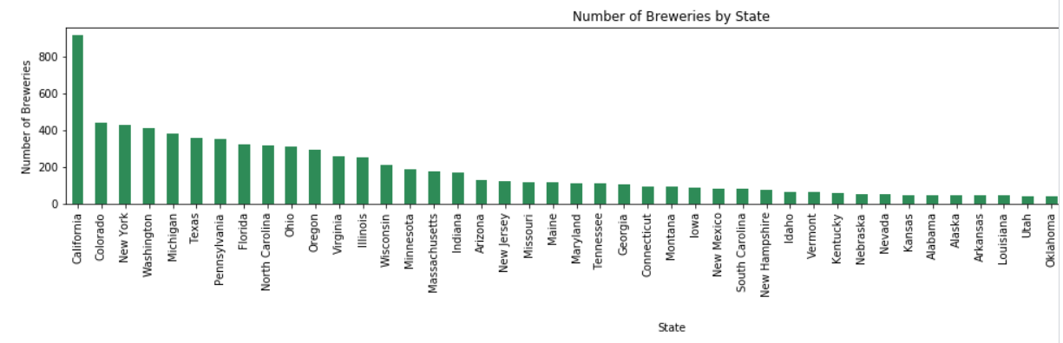
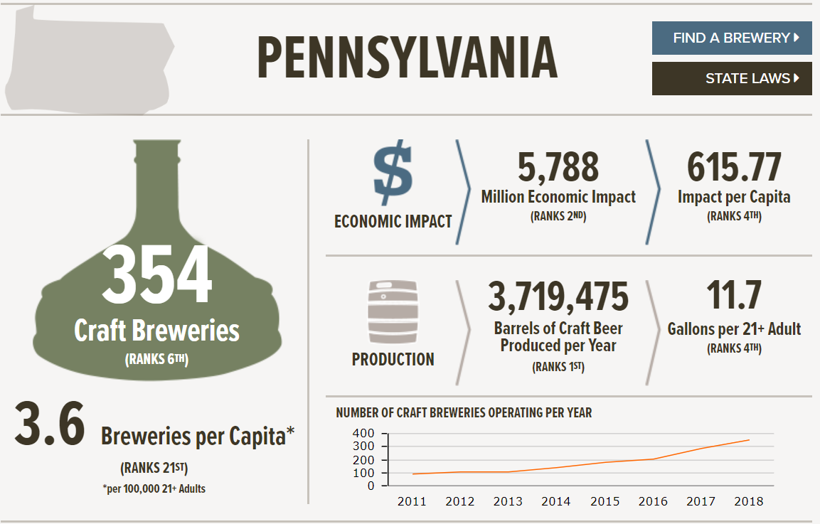
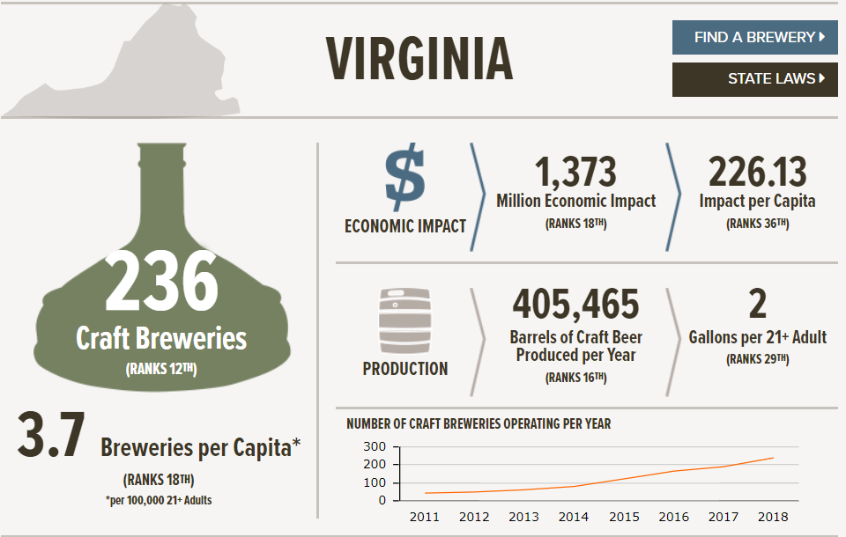
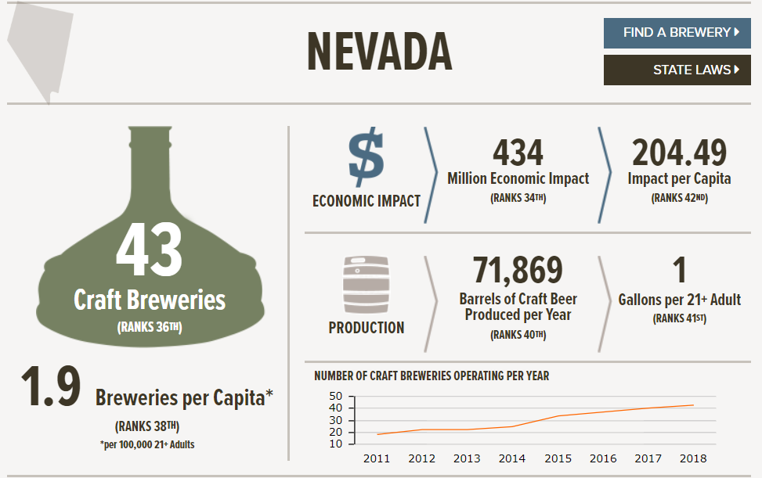
Project Findings & Recommendations (3 of 4)

Slide 10
Project Findings & Recommendations (4 of 4)
Recommended State: Pennsylvania
#2 in state economic impact
#3 in economic impact per capita
Recommended City: Greater Pittsburgh area All three markets segments are represented in this region

Slide 11
New Micro-Brewery Location Recommendations
Part 2
Data Analytics Framework
(Audience: Data Scientists)

Slide 12
ANALYTICS pARADIGM
Decompose the Ask
Identify Data Resources
Define Strategy and Metrics
Build Data Retrieval Plan
Retrieve the Data
Assemble and Clean
Analyze for Trends
Acknowledge Limitations
Make the Call or Tell the Story

Slide 13
Decompose the ask
The Ask:
Help Yuri Entrepreneurial Group to determine where to invest in a new craft brewery in the United States
The Breakdown:
Assume use of current state/city locations for legal regulatory purposes
Are there any geographic preferences?
Are there particular surrounding population requirements to proposed locations?

Slide 14
Identify data sources
Brewery dataset from OpenBreweryDB
Contains information 7,800+ different breweries
2013 Census data via Census API
Population
Median Age
Household Income
Google Maps API
Brewery industry associations - www.brewersassociation.org

Slide 15
Define strategy and Metrics
Extract available data from Brewery and Census APIs
Interrogate data and perform cleasing tasks
Build dataframes of each dataset
Join data on zip code
Aggreagte census data based on zip codes, grouped on city
Population
Household Income
Median Age
Plot data, analyze for trends
Augment analysis with industry association data
Derive final conclusions and recommendations

Slide 16
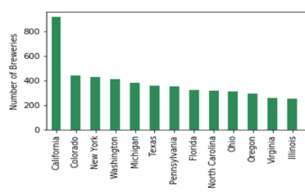
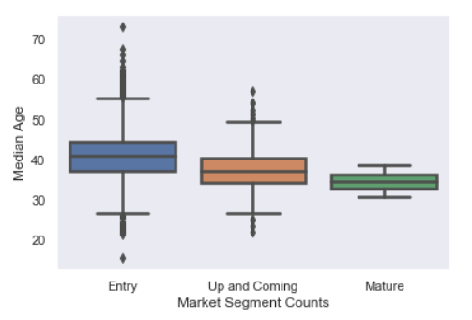
Build data retrieval plan
Literature Review
National Statistics
Analyze Results
Research Findings
#1 Entry
#2 Up & Coming
#3 Mature
Formulate Hypothesis
Brewery Data
Census Data
Recommendations
City #1
City #2
City #3
Merged Data

Slide 17
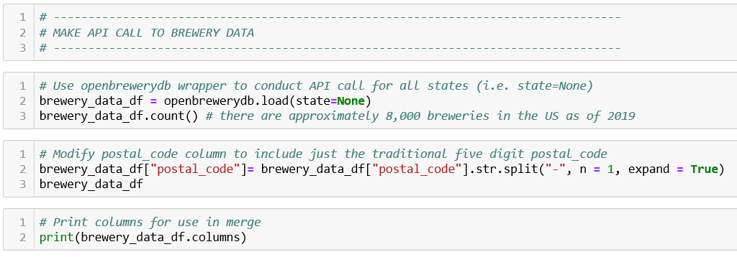
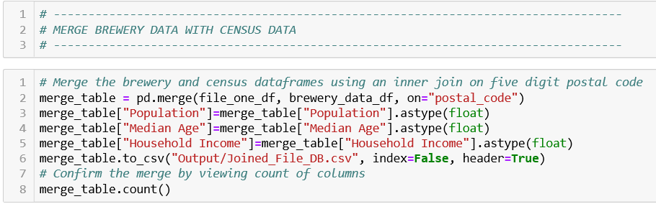
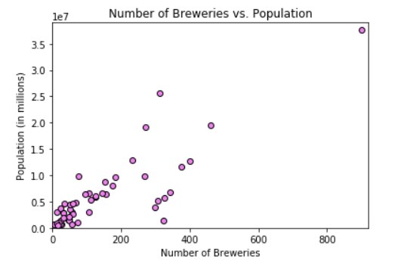
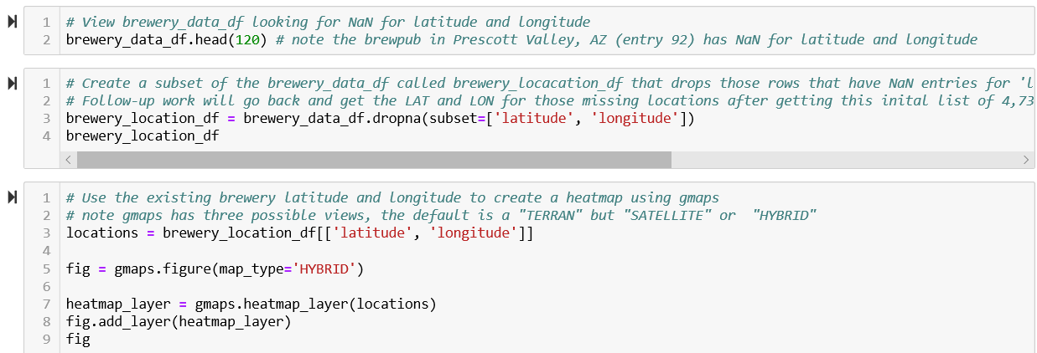
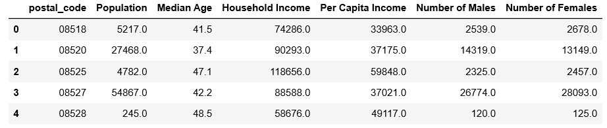
Retrieve the data
API Calls
Merge Data
Plot Data
Google Heat Maps
Census Data

Slide 18
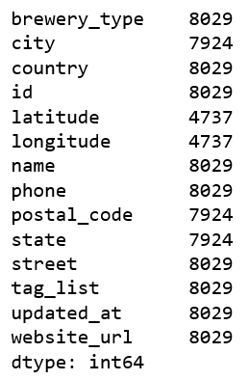
Assemble and clean
Data cleansing challenges encountered:
Brewery Data
Missing data values
Zip Code information was not consistent
Column names needed to be the same for join
Census Data
Location data available only by state or zip code, not exact city
Map Data
Initial pandas syntax not functional, additional installs were required

Slide 19
Analyze for trends – where are the breweries?

Slide 20
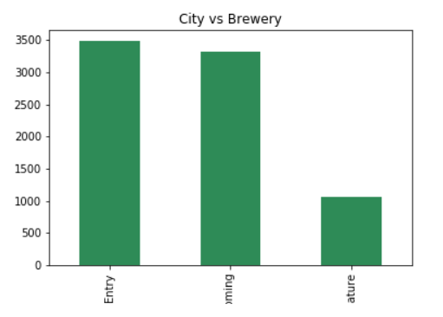
Analyze for trends – Market Segments
“Binned” number of breweries in a city:
1-3 (Entry)
4-24 (Up & Coming)
25+ (Mature)
3,487
3,316
1,067
Entry
Up & Coming
Mature

Slide 21
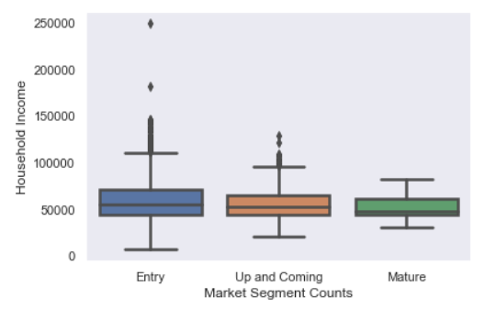
Analyze for trends – Household income

Slide 22
Analyze for trends – median age

Slide 23
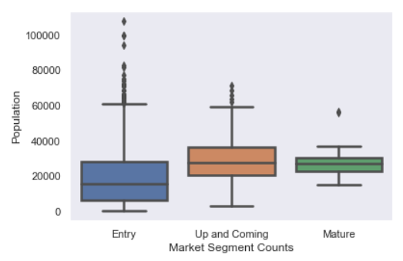
Analyze for trends – population

Slide 24
Acknowledge limitations
Brewery Data
Missing data values
Zip Code information was not consistent
Develop a Pandas function to determine the missing latitude and longitude coordinates for approximate 3,300+ brewery records, to support mapping plots
Census Data
Location data available only by state or zip code, not exact city
Map Data
Initial pandas syntax not functional, additional installs were required
Further research into why breweries would differ from state to state other than the information we examined
Analysis of the regulatory environment
Short turnaround, but guided client to a decision path

Slide 25
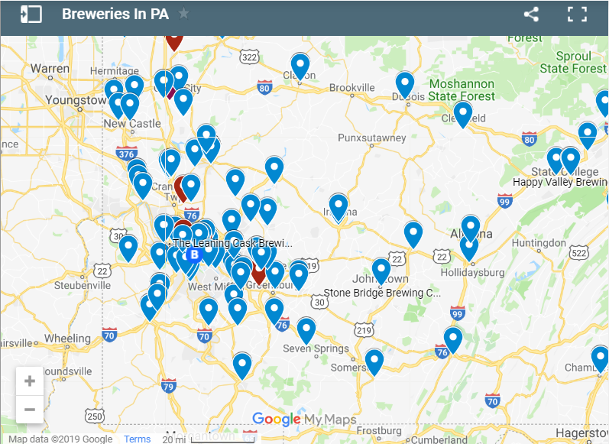
Make the call – Greater Pittsburgh, pa area
Segment | City | Breweries | Population | Household Income | Median Age
Mature | Pittsburgh | 26 | 302,000 | 44,015 | 38.5
Up & Coming | Butler | 4 | 13,107 | 43,968 | 44.7
Entry | Gibsonia | 2 | 2,733 | 93,210 | 44.4

Slide 26
Next Steps
Leverage Cenus Standard Metropolitan Area (SMA) for population analysis
Determine target market segment to address:
Entry – 1-3 breweries in city
Up & Coming – 4-24 breweries in city
Mature – 25+ breweries in city
Determine short list of three cities in selected market segment
Conduct in-depth research for each of three cities in conjuction with the Brewers Association trade organization

Slide 27
References
Literature Review of Craft Brewery Statistics
https://www.brewersassociation.org/insights/shifting-demographics-among-craft-drinkers/
https://www.brewersassociation.org/category/insights/
https://www.brewersassociation.org/statistics/by-state/
https://www.brewersassociation.org/statistics/national-beer-sales-production-data/
https://www.brewersassociation.org/statistics/economic-impact-data/
https://s3-us-west-2.amazonaws.com/brewersassoc/wp-content/uploads/2018/08/BrewersAssociation-Economic-Impact-Study-Methodology.pdf
https://www.brewersassociation.org/statistics/number-of-breweries/
https://s3-us-west-2.amazonaws.com/brewersassoc/wp-content/uploads/2018/08/State-by-State-Breakdown-2017.pdf
https://www.brewersassociation.org/statistics/market-segments/
https://www.brewersassociation.org/government-affairs/laws/barrel-cap-laws/

Slide 28
References (con’t)
Brewery API sites
https://www.openbrewerydb.org/ # includes a wrapper for making API calls by state, type brewery etc.
Other API sites considered / used
https://www.zipcodeapi.com/ #site that translates address, city, state into lat lon coordinates https://opencagedata.com #site that translates address, city, state into lat lon coordinates
Mapping using Google Maps
https://buildmedia.readthedocs.org/media/pdf/jupyter-gmaps/latest/jupyter-gmaps.pdf
Census data
https://github.com/CommerceDataService/census #wrapper for library documentation
https://gist.github.com/afhaque/60558290d6efd892351c4b64e5c01e9b #for labels

Slide 29

Questions

