Slide 1



I’m trying to teach my cat Java programming
But he keeps complaining about a “NullLaserPointerException”

Slide 2

Module 1-16
Exceptions
File Input

Slide 3

Objectives
Describe the concept of exception handling
Implement a try/catch structure in a program
Understand the java.io library File and Directory classes
Explain what a character stream is
Use a try-with-resources block
Handle File I/O exceptions and how to recover from them
Know how File I/O might be used on a job

Slide 4

Exceptions

Slide 5
What are Exceptions?
Exceptions are occurrences that alter the flow of the program away from the ideal or “happy” path.
Sometimes it’s the developer’s fault: i.e. accessing an array element greater than the actual number of elements present.
Other times it’s not: i.e. loss of internet connection, a data file that was supposed to be there has been removed by a systems admin.

Slide 6
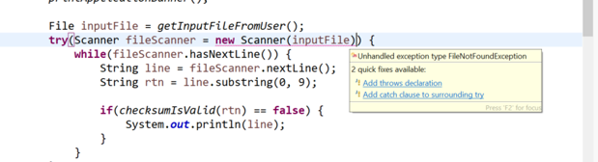
Checked vs. Unchecked Exceptions
Checked are compile-time exceptions
If code in a method throws a checked exception, method must handle it
Handle in method or pass up to parent
Unchecked are run-time exceptions
User or code does something that causes program to stop running

Slide 7
Compile-time Exceptions (Checked Exceptions)
They are not runtime exceptions, but they must be handled or declared.
FileNotFoundException: This is thrown programmatically, when the program tries to do something with a file that doesn’t exist.
IOException: A more general exception related to problems reading or writing to a file.
Note that FileNotFoundException extends from IOException.

Slide 8
Runtime Exceptions (Unchecked Exceptions)
Runtime exceptions are errors that occur whilst the program is executing in the JVM. Here are three common examples:
NullPointerException: you tried to call a method or access a data member for a null reference.
ArithmeticException: you tried to divide by zero.
ArrayIndexOutOfBoundsException: you tried to access an array element with an index that is out of bounds.

Slide 9

Exceptions “Throwing”
Throwing means making everyone aware that a deviation from normal program flow has occurred.
Throwing can be done behind the scenes by the JVM.
It can be triggered via code, by using the throw statement.

Slide 10

Exceptions “Handling”
Handling are the actions taken (defined by the programmer) when an exception is encountered.

Slide 11
Try / Catch
The Try Catch block follows the following format:
Both the catch and finally blocks are optional but one of them must be present (either try or finally, or both).
try {
// Code where an exception might be triggered
}
catch (FileNotFoundException e) {
// Catch and specify actions to take if an exception is encountered.
}
finally {
// Action to take regardless of whether an exception was encountered.
}

Slide 12
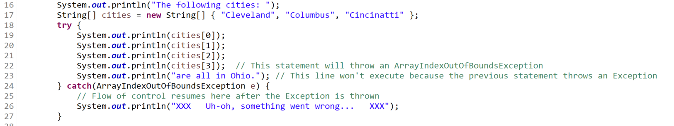
Try / Catch

Slide 13
Let’s throw some exceptions!

Slide 14
Exceptions Handling: Example
Consider the following example:
import java.io.FileNotFoundException;
public class SuspiciousClass {
public void doSomething() throws FileNotFoundException {
throw new FileNotFoundException();
}
}
public class MyMainClass {
public static void main(String[] args) {
SuspiciousClass test = new SuspciousClass();
test.doSomething();
}
}
Java will complain as we try to invoke doSomething() as it expects us to handle or catch the exception.
An exception is programatically thrown.

Slide 15
Exceptions Handling: Example
Our first choice is to just state that on the main method (from which we call doSomething) that there is a possibility an exception will be thrown:
public static void main(String[] args) throws FileNotFoundException {
SuspiciousClass test = new SuspiciousClass();
test.doSomething();
}

Slide 16
Exceptions Handling: Example
Or, we could use a try / catch block to both catch the exception and specify a set of actions to do in the event we run into the exception.
public static void main(String[] args) {
SuspciousClass test = new SuspciousClass();
try {
test.doSomething();
}
catch (FileNotFoundException e) {
System.out.println("ok... that's fine, moving on.");
}
}
You must specify the name of the exception along with a placeholder variable.

Slide 17

File Input

Slide 18
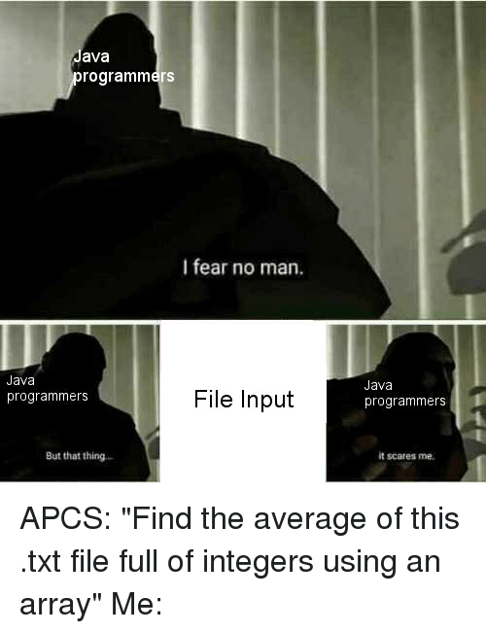
File Input
Java has the ability to read in data stored in a text file.
It is one of many forms of inputs available to Java:
Command Line user input (we have covered this one)
Through a relational database (Module 2)
Through an external API (Module 2)

Slide 19
File Input : The File Class
The file class is the Java class that encapsulates what it means to be a file containing data. This is an instantiation of a File object.
File <<variable name>> = new File(<<Location of the file>>);
In its simplest form it has a constructor that takes in the location of the file (including the name). Here is a concrete example:
File inputFile = new File("testFile.txt");

Slide 20
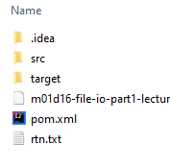
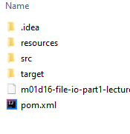
File Input : The File Class
The file location corresponds to the root of that particular Java project. Again, in this example our file is testFile.txt:
In this example, rtn.txt is located in the project root, we can refer to it like so:
File inputFile = new File(“rtn.txt");
In this example, rtn.txt has been moved inside a folder called resources.
File inputFile = new File("resources/rtn.txt");

Slide 21
File Input : The File Class Methods
There are several methods of the file class that can be used for file input:
.exists(): returns a boolean to check to see if a file exists. We would not want to proceed to parse a file if the file itself was missing!
.isFile(): returns a boolean to check to see if what we are looking at is a File. Returns false if it is not a file (perhaps a folder)
.getAbsoluteFile(): returns the same File object you instantiated but with an absolute path. You can think of this as a getter. It returns a File object.

Slide 22

File and Scanner
A File object and a Scanner object will work in conjunction with one another to read the file data.
Once a file object exists, we instantiate a Scanner object with the file as a constructor argument. Previously, we used System.in as the argument.

Slide 23
File and Scanner: Example
We need to handle an exception, but we can pass it up to the parent class.
Consider this example:
public static void main(String[] args) throws FileNotFoundException {
File inputFile = new File("resources/testFile.txt");
if (inputFile.exists()) {
System.out.println("found the file");
}
try (Scanner inputScanner = new Scanner(inputFile)) {
while (inputScanner.hasNextLine()) {
String lineInput = inputScanner.nextLine();
String [] wordsOnLine = lineInput.split(" ");
for (String word : wordsOnLine) { System.out.print(word + ">>>");
}
}
}
}
New file object being instantiated.
Instantiating a scanner but using a file object instead of System.in.
The while loop will iterate until it has processed all lines.

Slide 24
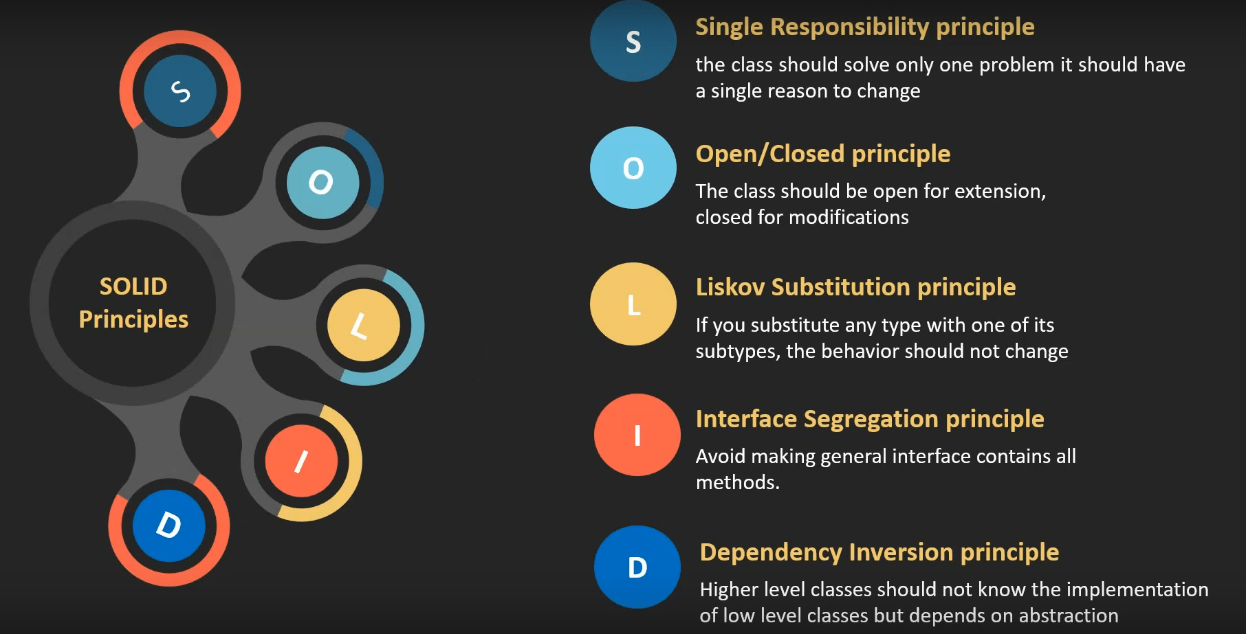
SOLID Principles
https://www.educative.io/edpresso/what-are-the-solid-principles-in-java
https://www.jrebel.com/blog/solid-principles-in-java

Slide 25
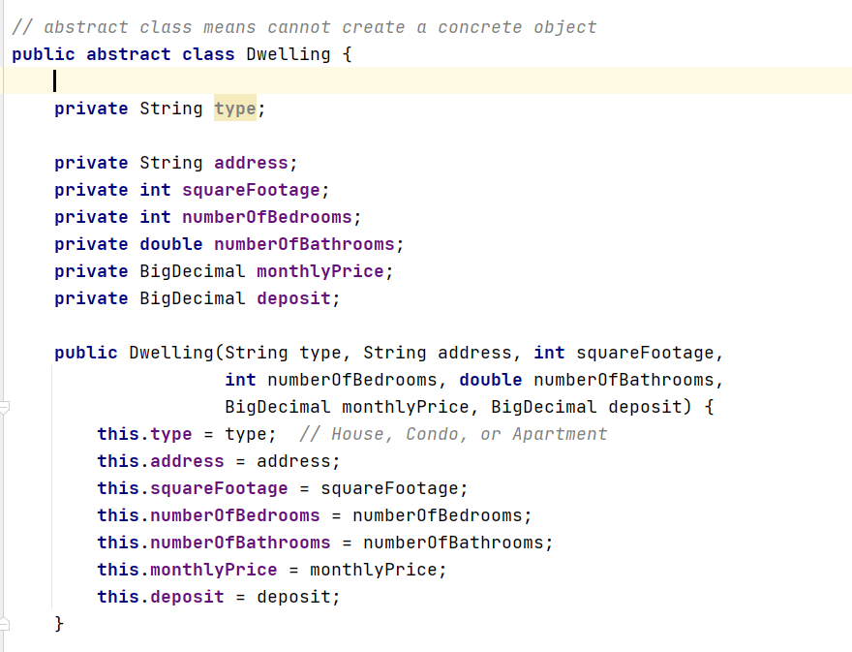
SOLID Principles
SRP – Single Responsibility Principle
Every class (or similar structure) should only have one job to do

Slide 26
SOLID Principles
SRP – Single Responsibility Principle
Every class (or similar structure) should only have one job to do
OCP – Open Closed Principle
Classes should be open for extension but closed for modification
LSP – Liskov Substitution Principle
In inheritance, design your classes so that dependencies can be substituted without needing modification in the client (use interfaces)
If it looks like a Duck, quacks like a Duck, but needs batteries, you probable have the wrong extraction (Tractor was not a child of FarmAnimal)
ISP – Interface Segregation Principle
Keep interfaces small so you don’t force classes to provide methods that have no meaning
DIP – Dependency Inversion Principle
High-level modules should not depend on low-level modules, they should depend on abstractions
https://www.jrebel.com/blog/solid-principles-in-java

Slide 27
Objectives
Describe the concept of exception handling
Implement a try/catch structure in a program
Understand the java.io library File and Directory classes
Explain what a character stream is
Use a try-with-resources block
Handle File I/O exceptions and how to recover from them
Know how File I/O might be used on a job

Slide 28
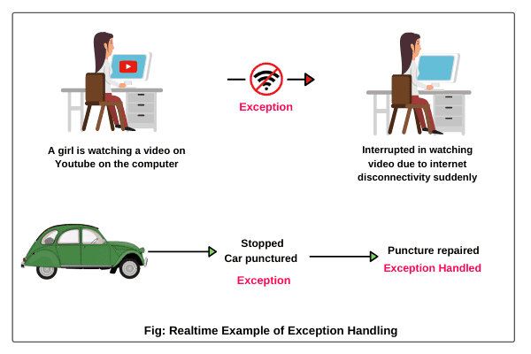
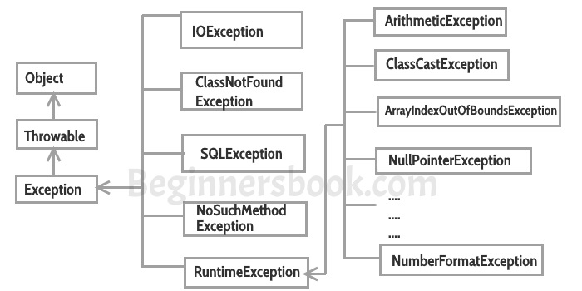
Objectives
Describe the concept of exception handling

Slide 29
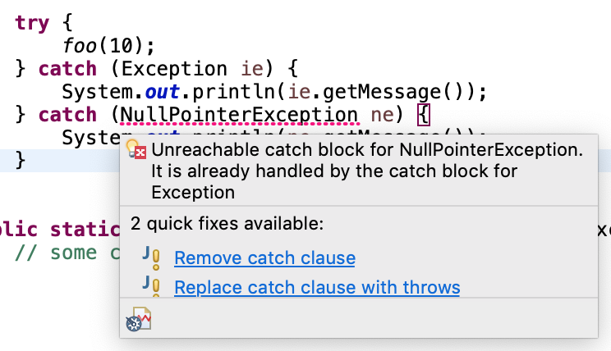
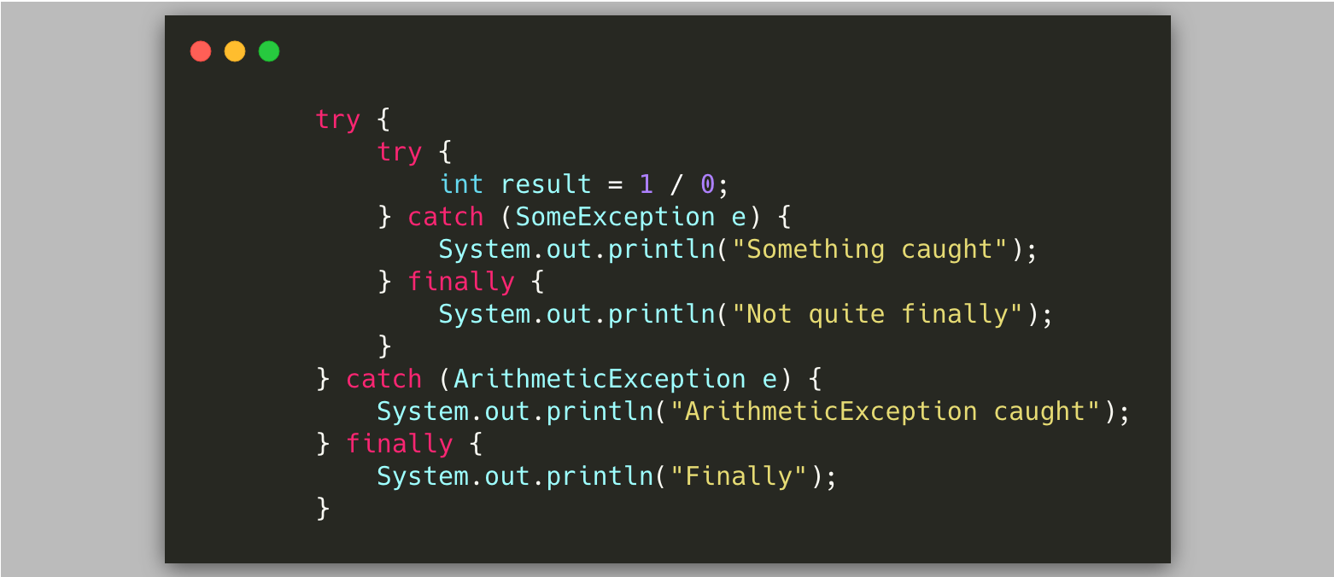
Objectives
Describe the concept of exception handling
Implement a try/catch structure in a program

Slide 30
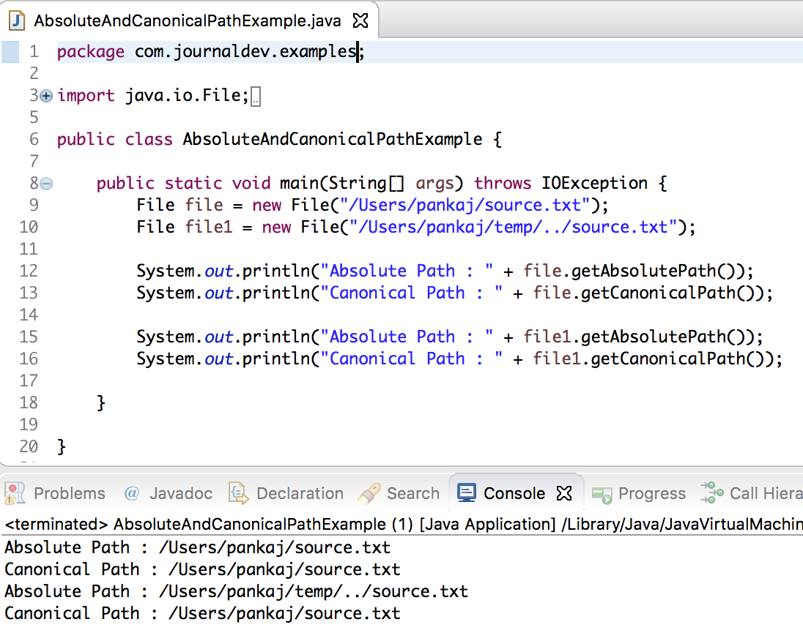
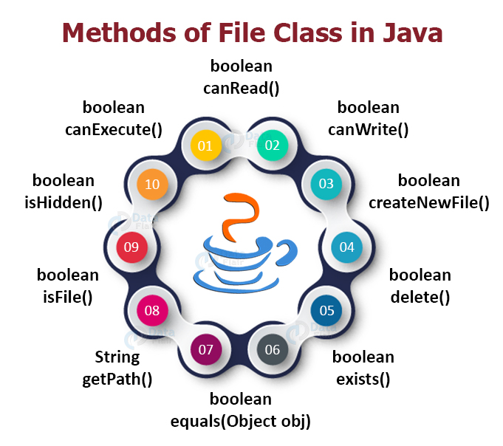
Objectives
Describe the concept of exception handling
Implement a try/catch structure in a program
Understand the java.io library File and Directory classes

Slide 31
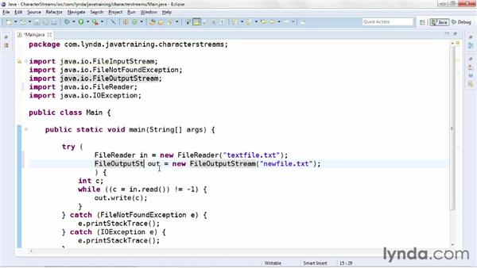
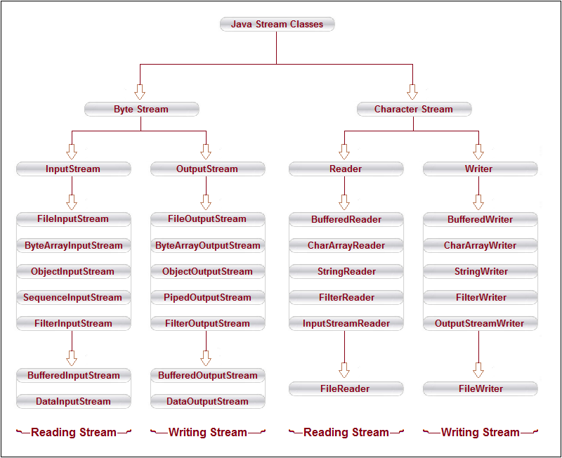
Objectives
Describe the concept of exception handling
Implement a try/catch structure in a program
Understand the java.io library File and Directory classes
Explain what a character stream is

Slide 32
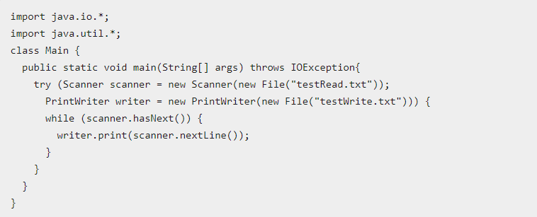
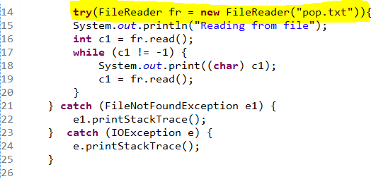
Objectives
Describe the concept of exception handling
Implement a try/catch structure in a program
Understand the java.io library File and Directory classes
Explain what a character stream is
Use a try-with-resources block

Slide 33
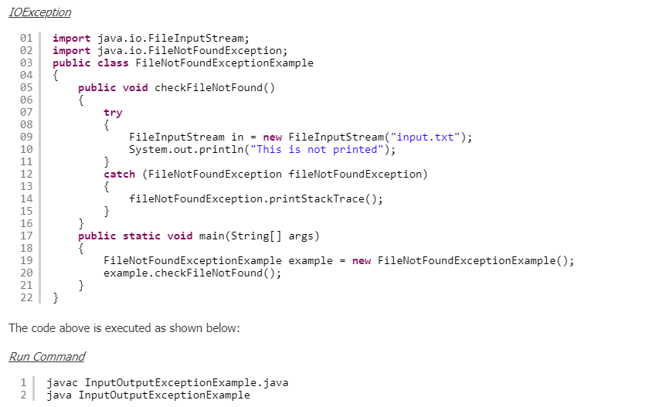
Objectives
Describe the concept of exception handling
Implement a try/catch structure in a program
Understand the java.io library File and Directory classes
Explain what a character stream is
Use a try-with-resources block
Handle File I/O exceptions and how to recover from them

Slide 34

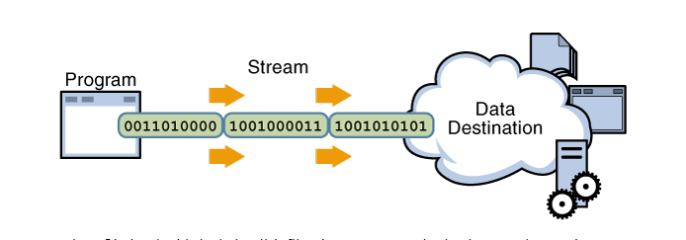
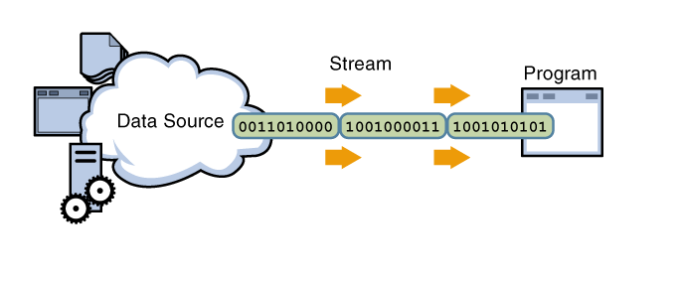
Objectives
Describe the concept of exception handling
Implement a try/catch structure in a program
Understand the java.io library File and Directory classes
Explain what a character stream is
Use a try-with-resources block
Handle File I/O exceptions and how to recover from them
Know how File I/O might be used on a job

