Slide 1

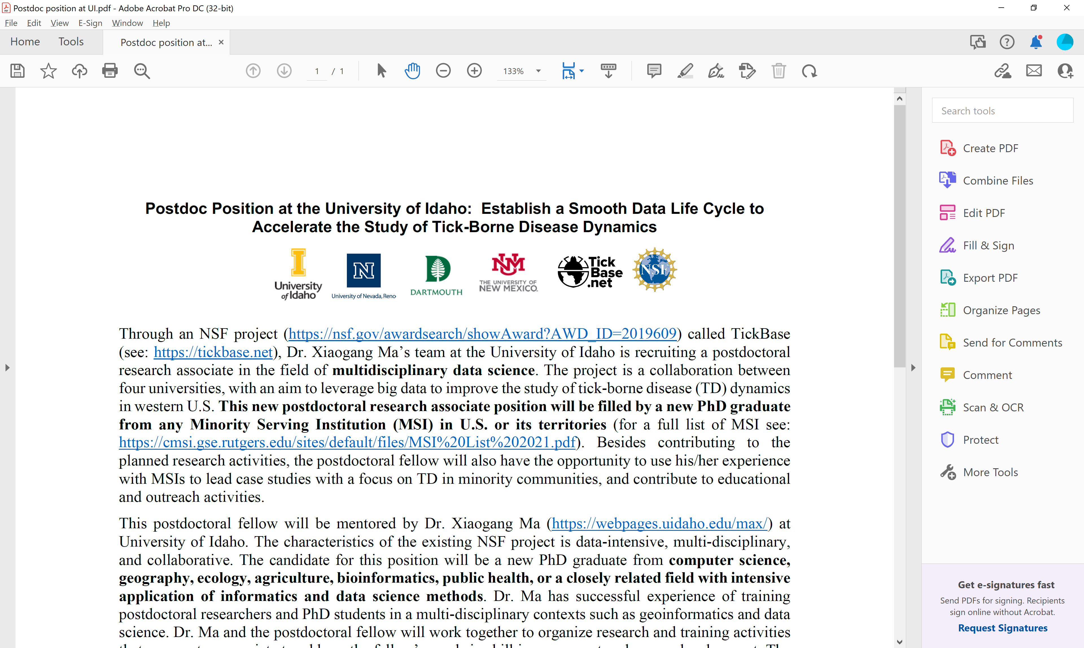
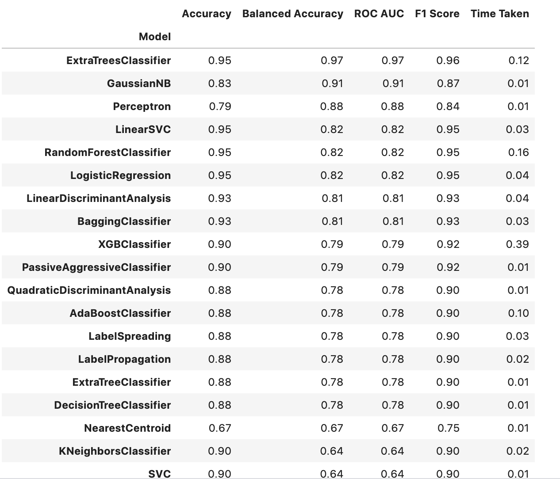
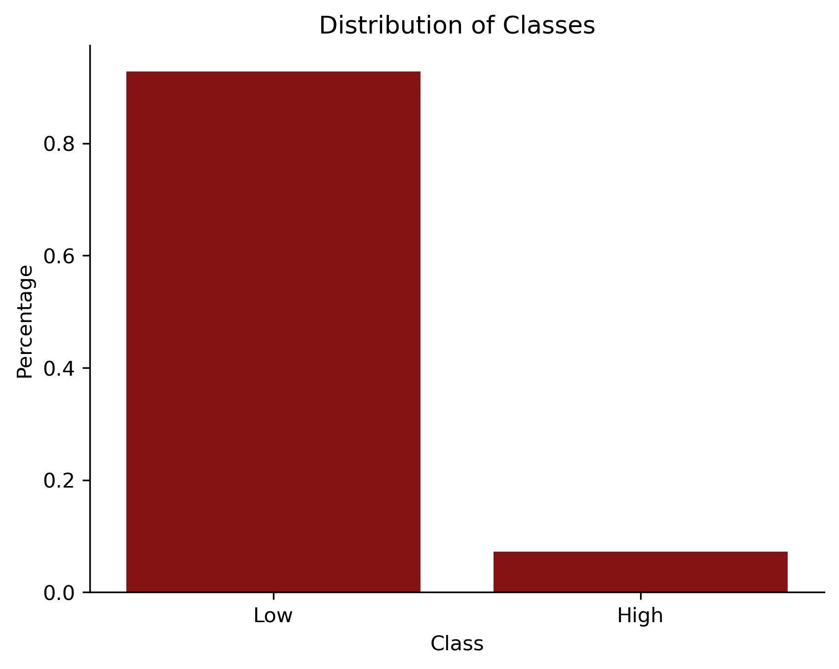
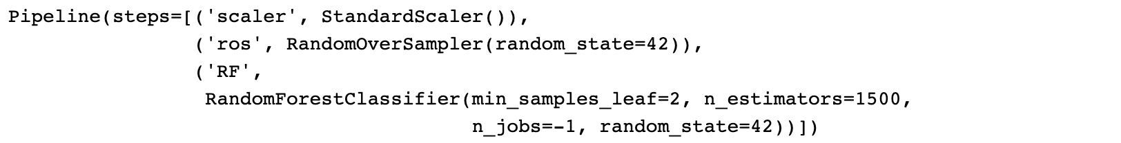
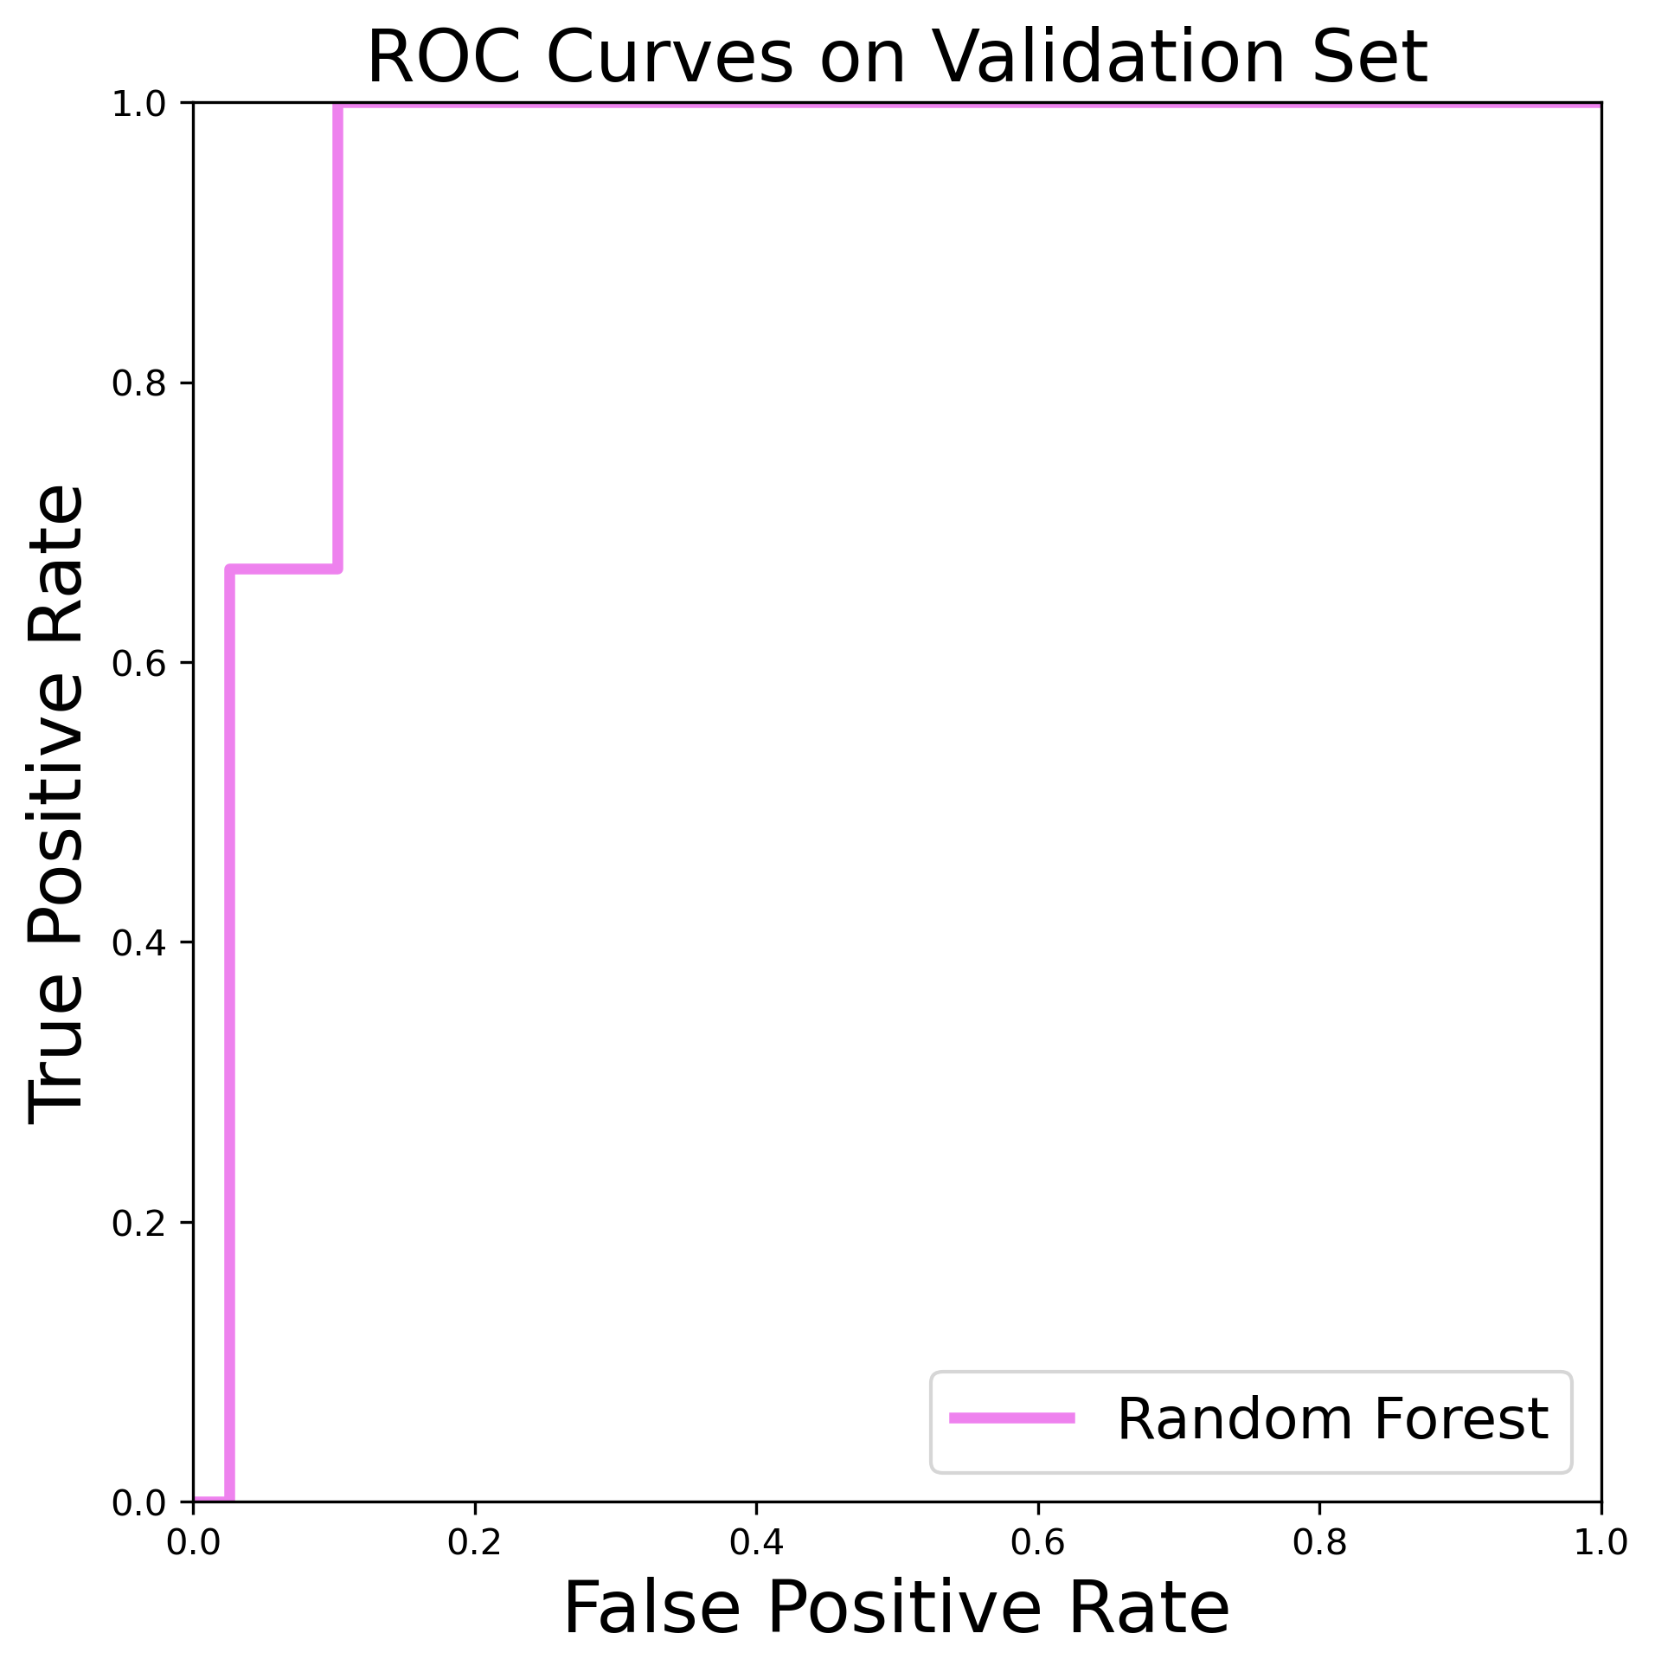
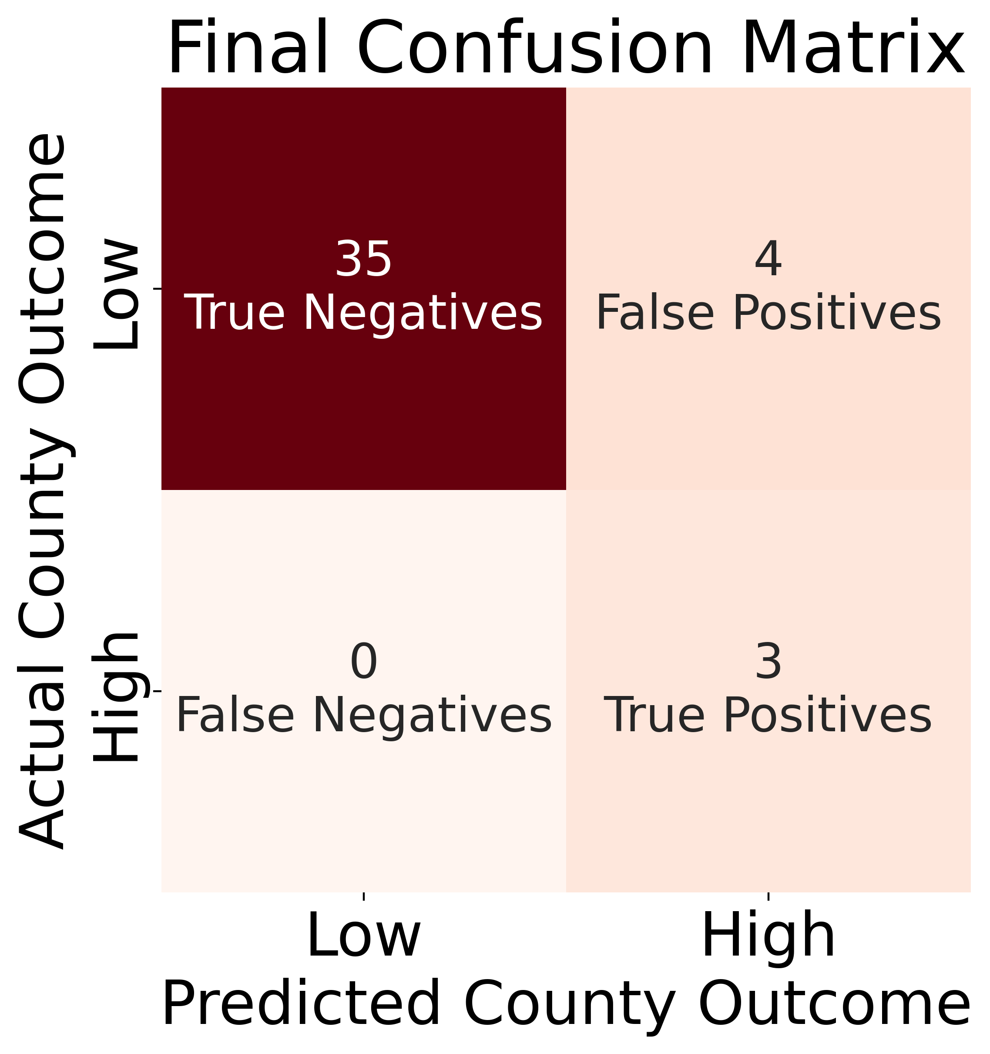
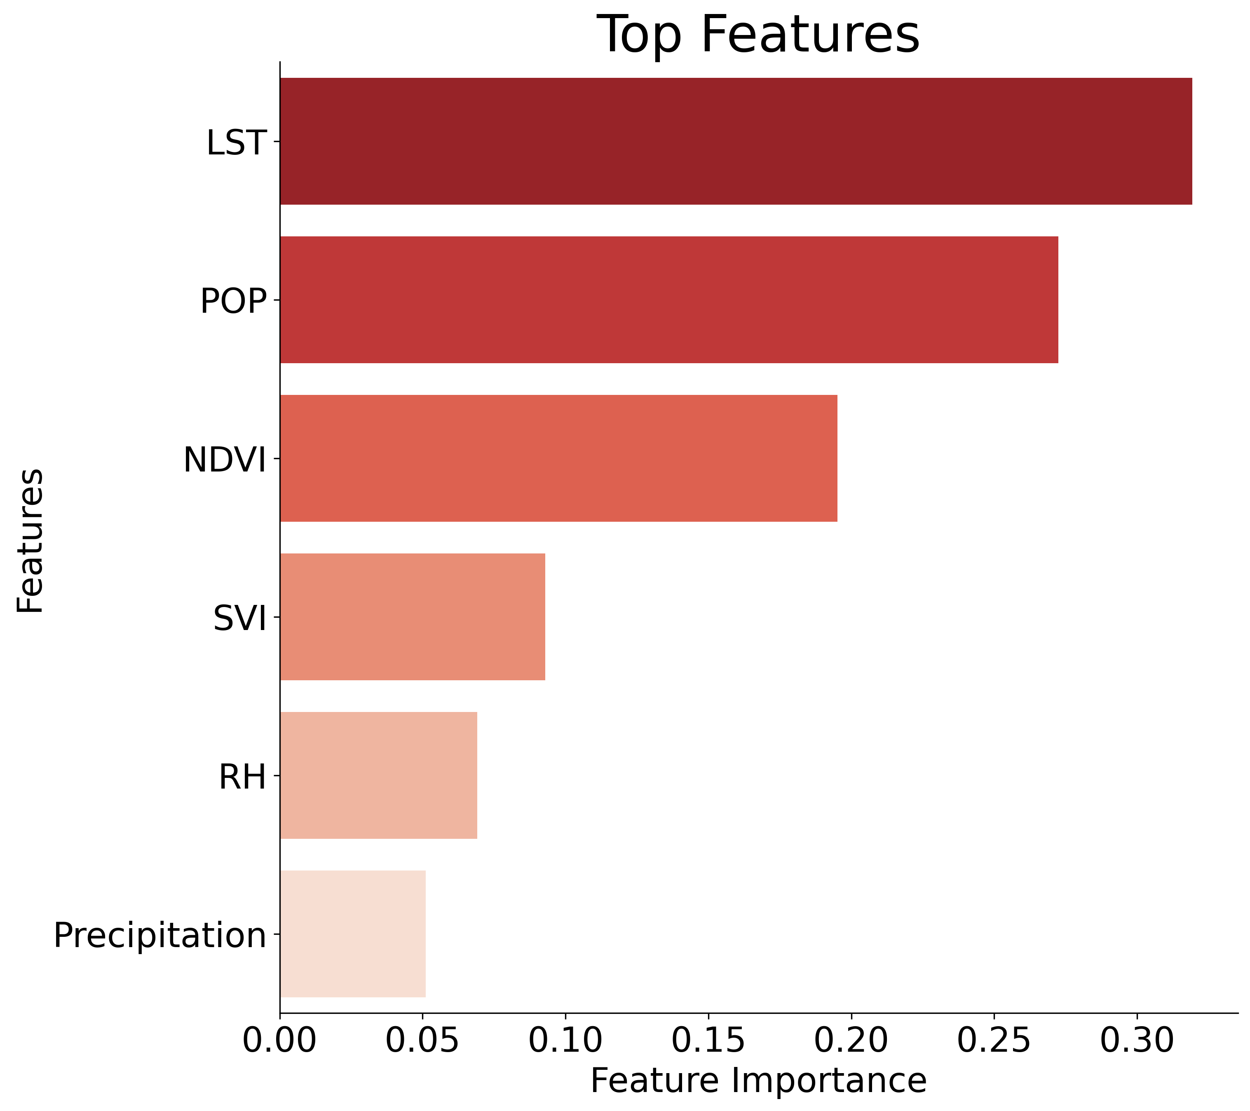
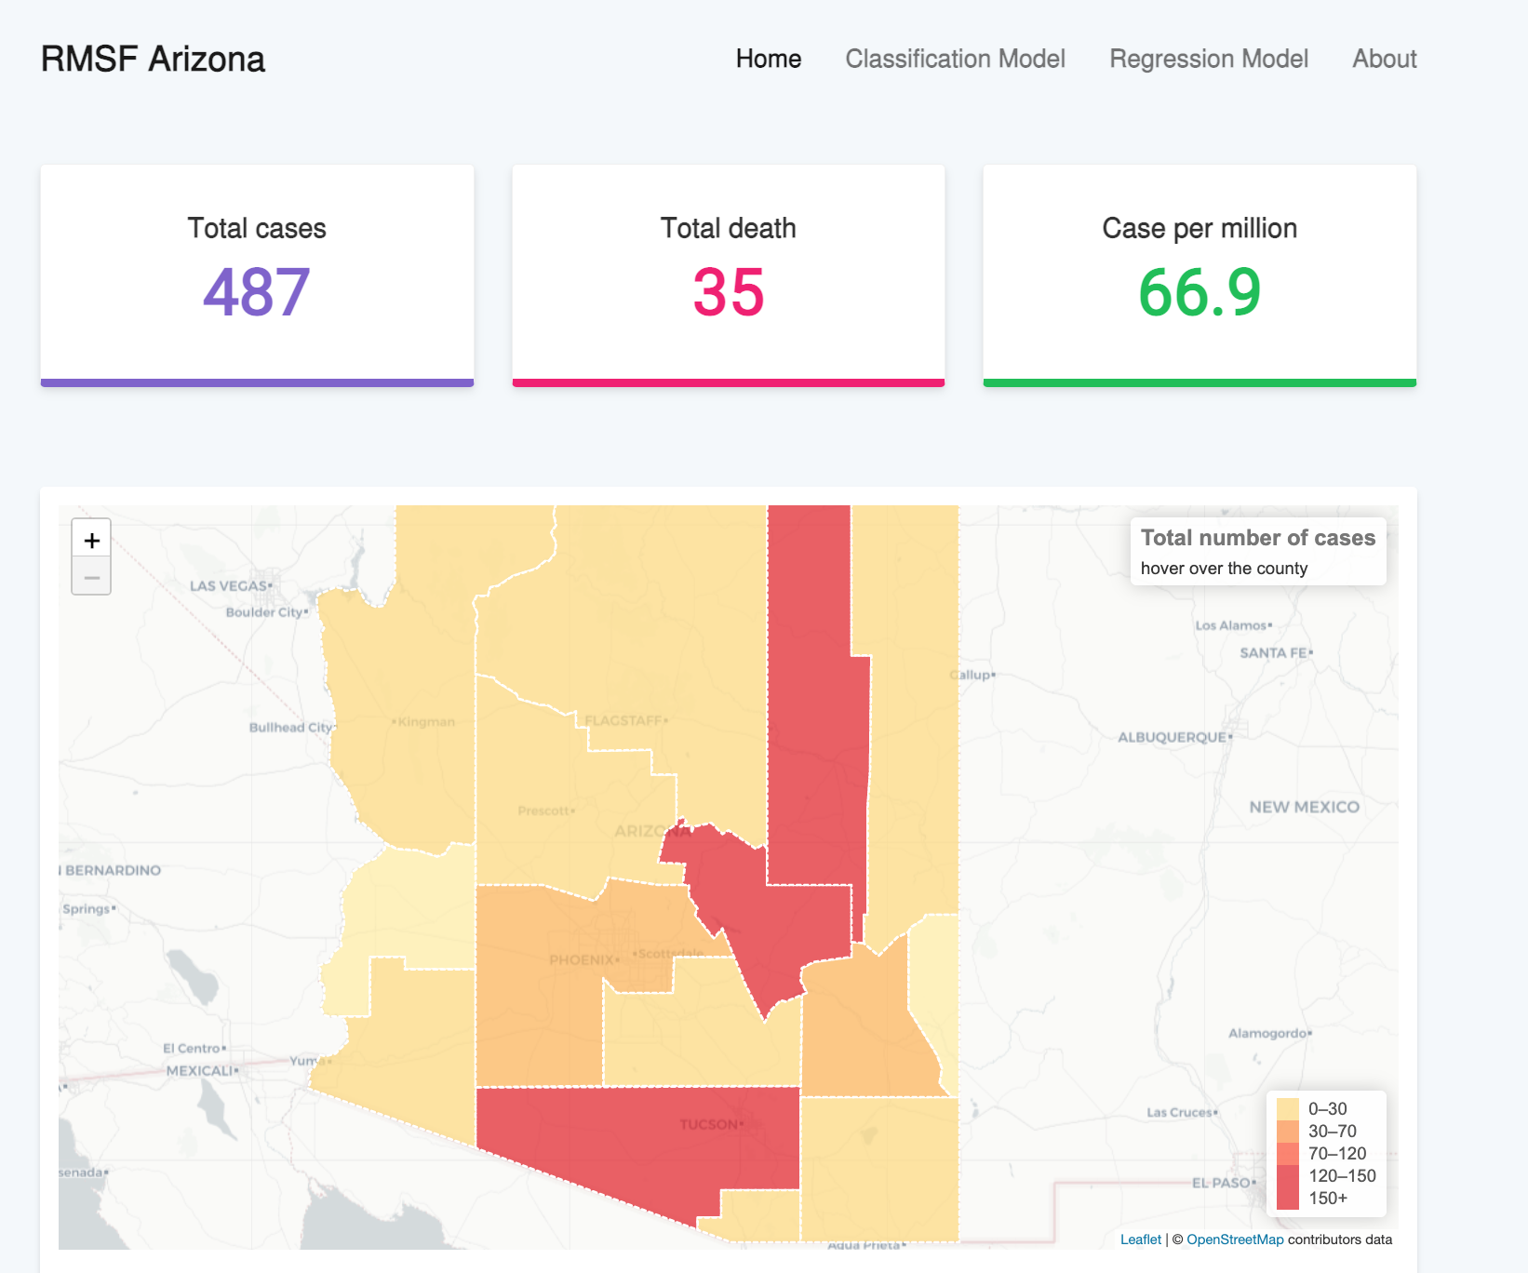
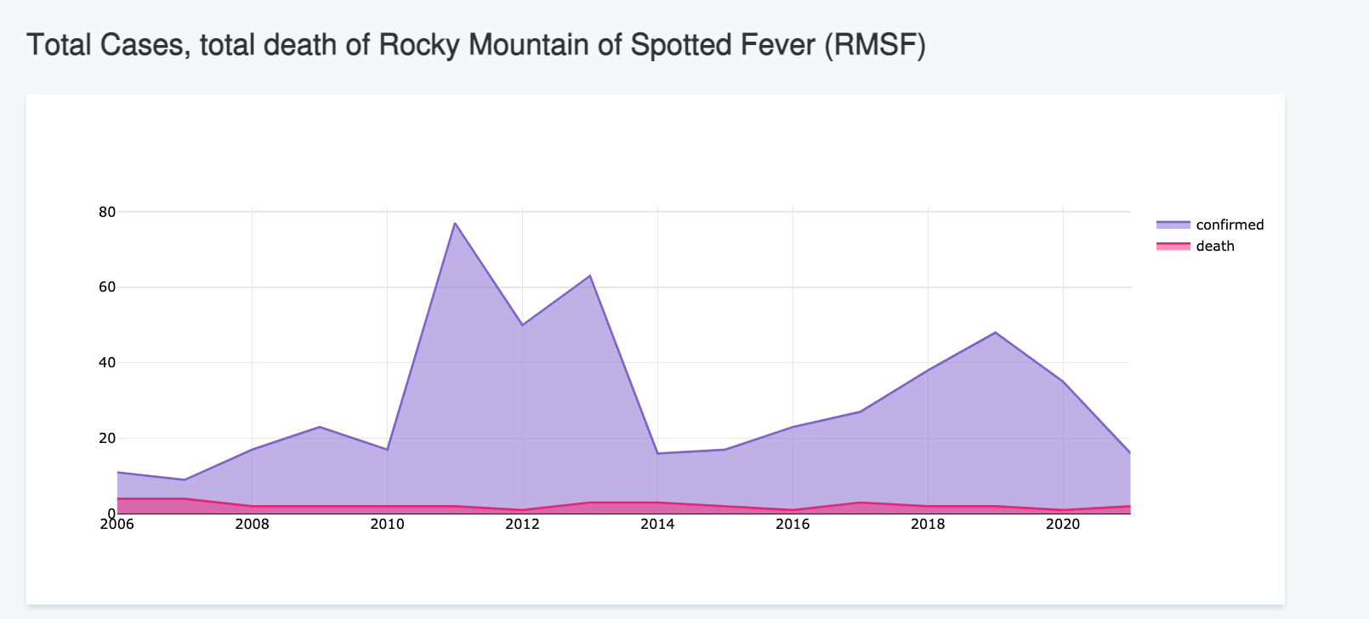
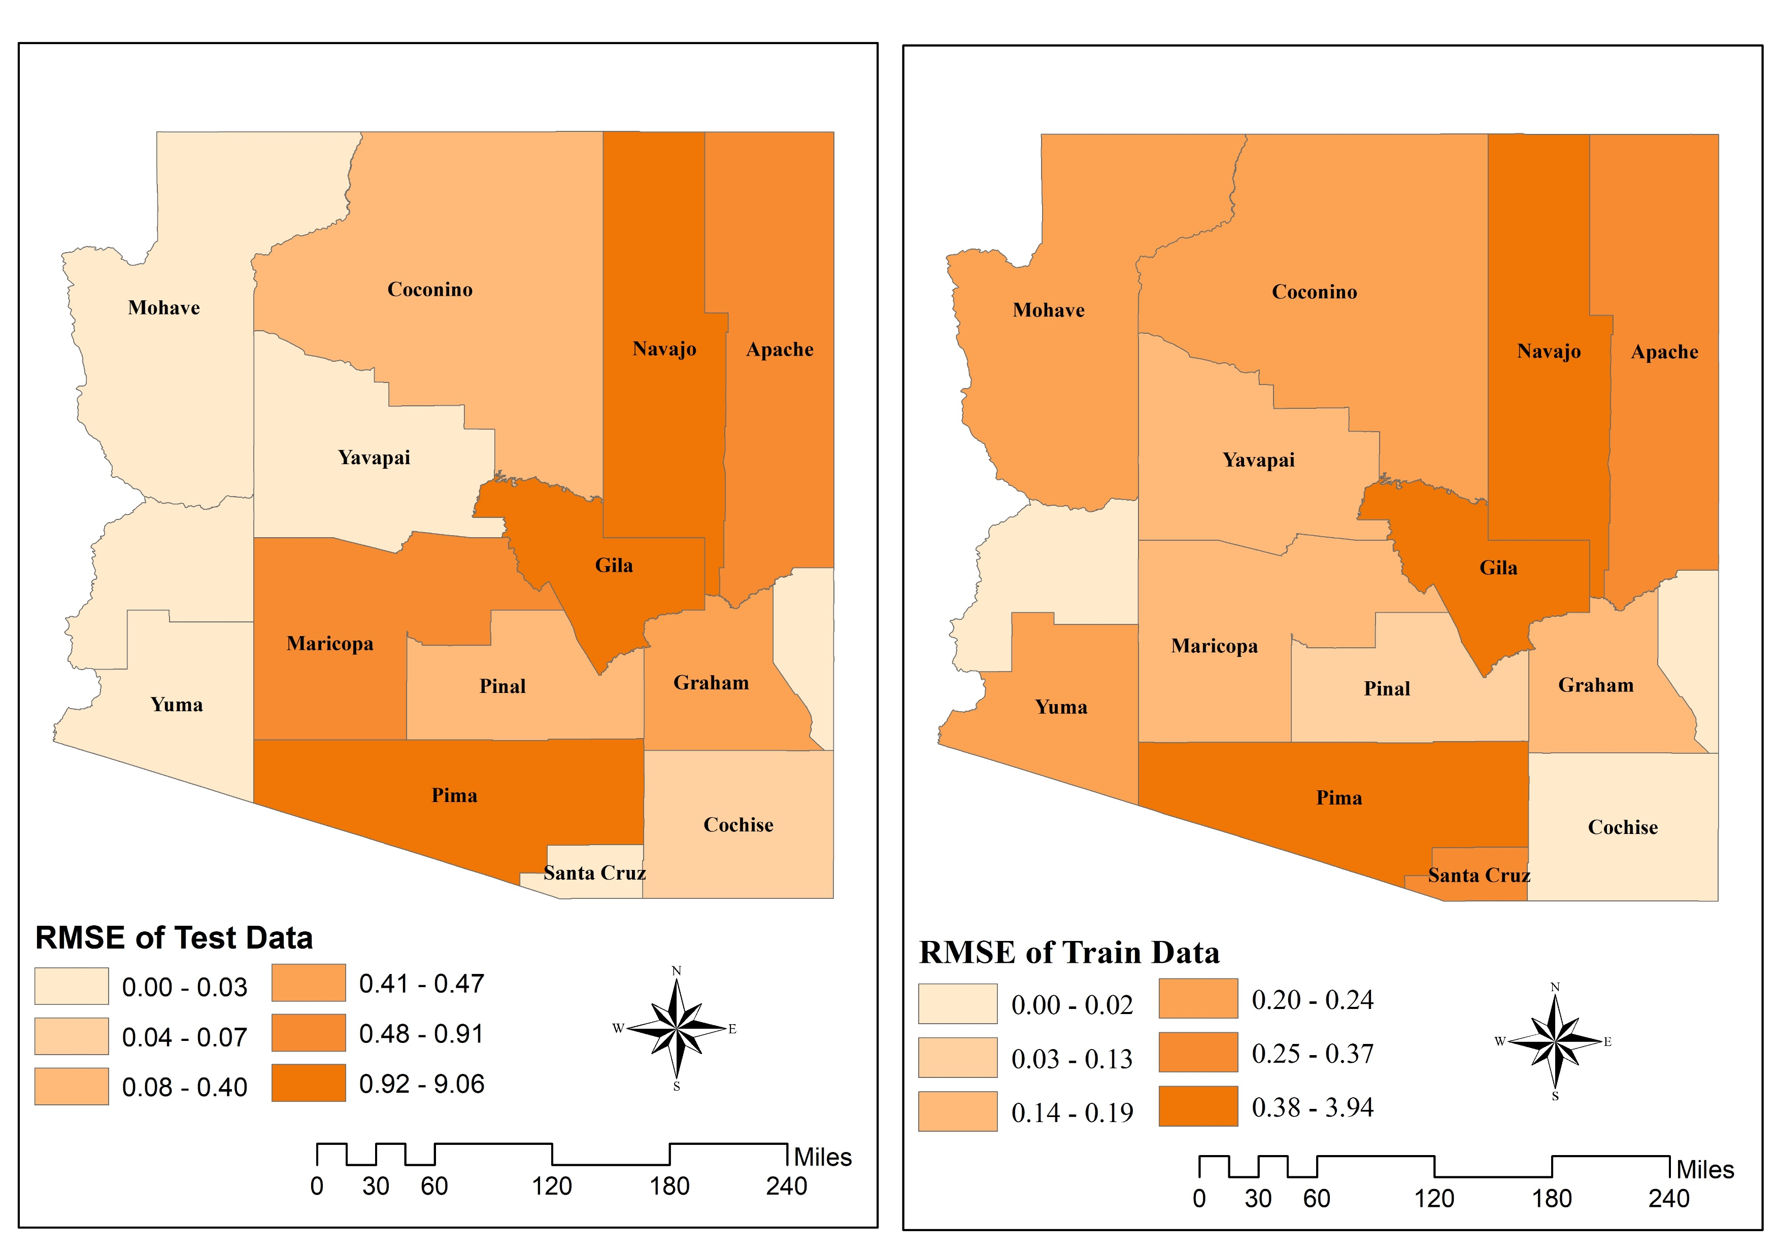
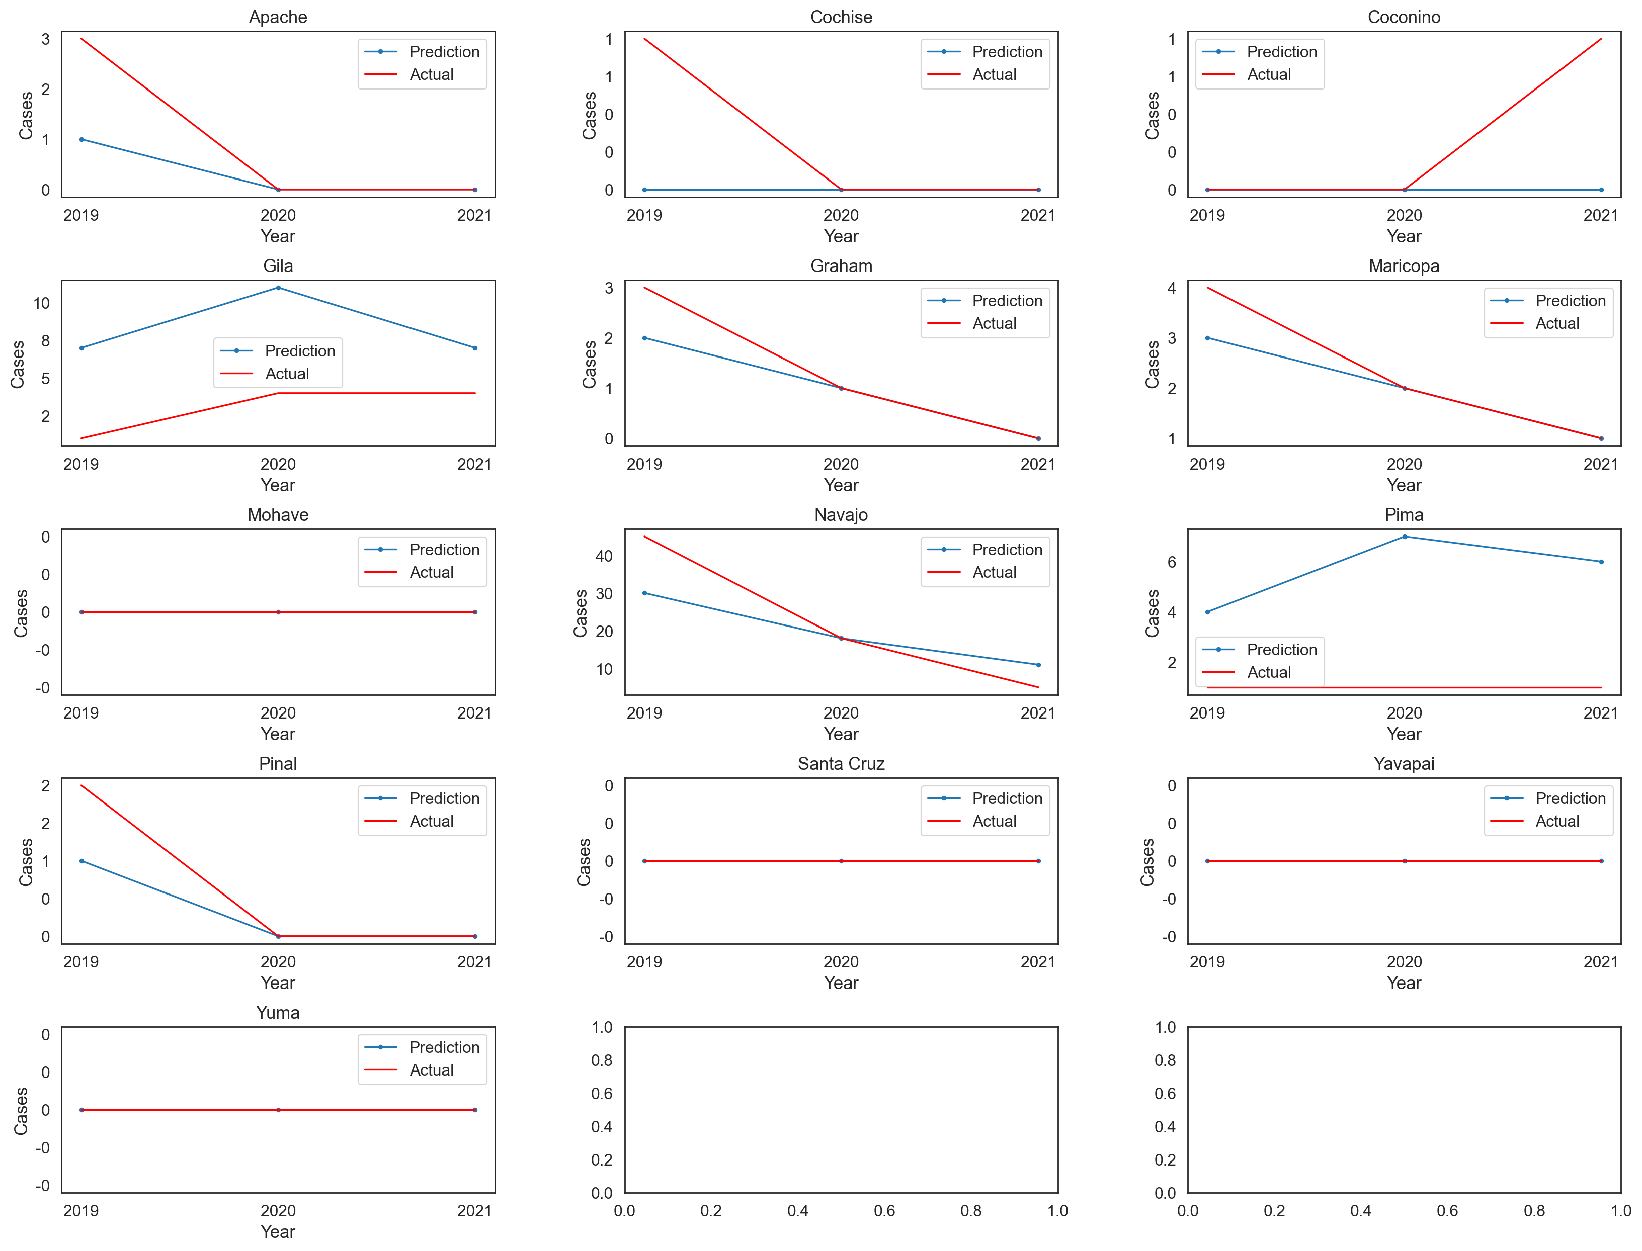
Integrating GeoVisualization, Machine Learning, and Deep Learning for Classification and Prediction of Rocky Mountain Spotted Fever in Arizona
Al Ekram Elahee Hridoy^{1,2}​, BS; Yan Lin^{1,2}, PhD; Zhuoming Liu^{2,3}, MS ¹Department of Geography and Environmental Studies, University of New Mexico​ ²UNM Advanced Spatial Informatics Research and Education(ASPIRE) ³Department of Computer Science, University of New Mexico
Problem statement
Methods
Results and Discussion
Rocky Mountain Spotted Fever (RMSF) is a potentially fatal Tick Disease (TD) caused by the bacterium Rickettsia and has disproportionally affected communities in southwest US (e.g., Arizona, and Navajo Nation) . Rocky Mountain Spotted Fever (RMSF) is caused by an infection with intracellular gram-negative Rickettsia. Dogs and rats act as reservoir hosts for the virus. . To address this problem, we have developed a machine learning prediction system that uses geovisualization techniques to identify high-risk areas for RMSF in Arizona.
Our system includes a first-of-its-kind climate-based classification model with a ROC AUC of 0.97, which can accurately predict which counties in Arizona are most likely to have a high incidence of RMSF. Additionally, we have implemented a deep learning method known as Long-Short Term Neural Networks(LSTM) to predict the possible occurrence of RMSF in each county.
Our approach to predicting the spread of RMSF will enable public health officials to take timely preventive measures and allocate resources to the areas at greatest risk. Our machine learning system has the potential to significantly reduce the incidence of this potentially fatal disease in the southwestern United States.
We used several machine learning methods for classification problems and built a Random Forest algorithm pipeline which gave 0.95 accuracy with ROC AUC 0.82 before tuning and after hyper parameter tuning we achieved ROC AUC of 0.974 with 5 k-fold cross validation. Class imbalance of high. Incidence and low incidence was addressed by RandomOverSampler technique.
For prediction of RMSF, we used a deep learning technique, Long Short Term Neural Networks( LSTMs). The architecture of the model consists of two LSTM layers, each with 64 units and a ReLU activation function, followed by a single Dense layer with one unit, and the model is compiled with the mean absolute error (MAE) loss function and the Adam optimizer .
For classification and prediction split our dataset into 60% (training), 20% ( validation), 20% (testing).
After GridSearch we adopted Random Forest algorithm for classification model with ROC AUC of 0.974 , recall of 1.0 and precision 0.42. We tested our model with 2021 data and found that Gila County 94.06% and Navajo county had 36.05 % of having a high incidence of RMSF. Also we found that LST and population are the most important predictor variables.
LSTM results suggest that test RMSE values ranging from 0.006 to 9.055.
Data sources
ARIZONA DEPARTMENT OF HEALTH SERVICES
ERA5 Daily Aggregates - Latest Climate Reanalysis Produced by ECMWF /Copernicus Climate Change Service
GRIDMET: University of Idaho Gridded Surface Meteorological Dataset
MODIS Land Surface Temperature and Emissivity (MOD11)
MODIS Terra Daily NDVI
ESRI 2020 Land Cover
CDC Social Vulnerability Index
Dataset and variable selection
We used yearly time-series data from 2006 to 2021.
Average Temperature( Degree Celsius)
Land Surface Temperature( Degree Celsius)
Relative Humidity( In Percentage)
Precipitation( mm, daily total)
NDVI( Unit Less)
CDC Social Vulnerability index (SVC)
Total population
Fig. 2: Machine Learning algorithms for classification of RMSF incidence
Fig. 3: Distribution of RMSF classes
Fig. 4: Final Random Forest pipeline with parameters
Geovisualization web interface
Fig 5: ROC Curve on Validation Set
Fig 6: Final Confusion Matrix
Fig 7: Feature importance of RF
Objectives
To visualize RMSF disease statistics in a web application.
To implement climate-based classification system to map most likely to have a high incidence of RMSF.
To implement deep learning based prediction of RMSF incidence system for each county.
Fig. 8 : RMSE of test and training data
Fig. 9 : LSTM prediction on 3 years of test data 2019-2021
website
Limitation and future work
Acknowledgments
https://alhridoy.github.io/RMSF-dashboard
The data is satellite derived ;thus, temporal and spatial resolution of data is a limitation of this study.
We had county-level RMSF cases. More, granular-level data will facilitate more accurate modelling of the disease dynamics.
In future work, authors want to integrate more granular RMSF data at zip-code level to improve the prediction model.
This work was facilitated with Google Earth Engine and ADHS, we thank to GEE team and ADHS.
Funding for this project provided by the National Science Foundation, Award Number 201960.
This work has not been formally reviewed by NSF. The views expressed are solely those of the authors and do not necessarily reflect those of these Agencies.

