Slide 1



Slide 2




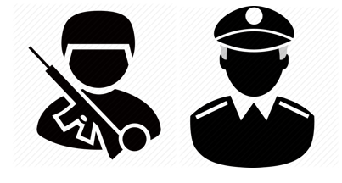









Info
Material
Police/Military (Armed Forces)
Where to inform?
Police/Military need special Attention in being informed, as they protect with Force the Beings, who destroy the Planet and Humanity.
(see Flyer)
Acting for the same Reason as an ‘ignorant Human: They see Money like a ‘Life Energy’ to survive, rather than opening to positive not ruling collective Alternatives and there Potential,
such as the Permaculture and a Life without Money
and to take personally active part in the Creation of a better World for our Children
How to inform?
LETTER BOX
POSTER
DISTRIBUTOR
CAR
PAPER BOY
FLYER

Slide 3


Info Material
Here you can find Print Material to inform the Police/Military as well as the Society.
Since it is a global Issue, it will be appropriate to have unified Information Material in their respective Language
(for Suggestions for Improvement and Support info@2y2d.org)
FLYER
Police/Military
POSTER
Various
ABOUT
What
FLYER
General

Slide 4


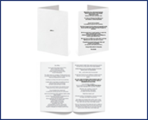
Police/Military (Armed Forces)
Police/Military need special Attention in being informed,
As they protect with Force the Beings, who destroy the Planet and Humanity.
Acting out of the same Reason as an ‘ignorant Human’:
They see Money like a ‘Life Energy’ to survive,
Rather than opening to positive not ruling collective Alternatives and its Potential,
Such as the Permaculture and a Lifestyle without Money
and to take personally active part in the Creation of a better World for our Children

Slide 5
It's not of much use, to share ‘Alternative News or Information’
only on the Walls/Profiles of like minded Groups or People, they will already know.
Instead, take Advantage of the Social Networks like Instagram, Twitter, Facebook or YouTube everyone is using and...
…post on the ‘Pin Walls’ of Artists
Singers
Actors/Actresses
Moderators
DJ’s
Music Groups
Painters
…post on the ‘Pin Walls’ of the Media
TV Stations
TV Programs
Magazines
Papers
Radio Stations
Radio Programs
…post on the ‘Pin Walls’ of Sports
Sportspersons
Athletes
Football/ Cricket/ Soccer Teams
Clubs
Organizations
…post on the ‘Pin Walls’ of
Multinational Companies
Governmental Sites
Police
Record Labels
Friends ‘asleep’…
The Hacker Community could get organized worldwide and put ‘out of Service’
Websites of Governmental Institutions or ‘delete Content’ of Multinationals and Financial Institutions
INFORM USERS/ THE PEOPLE ABOUT PLAN/SOLUTION (NETWORK OF NEW LIFESTYLE/THOUGHT FORM):
- Permaculture/local Networks with local Products
- Self Sufficiency (Interdependency)
- Using Money to create a Lifestyle without Money or Cryptocurrency

