Slide 1
TRANSITION
The Intention is to use Money to create a respectful and harmonious Lifestyle with Nature
and without Money or Cryptocurrency through interdependent Networks of
Self Sufficiency with the Help of local existing Groups/ Collectives/ Organizations/ Cooperation's etc.
SERVICE TO SELF
4D
3D
SERVICE TO OTHERS
Pursuing human Activities to
support your Human Existence:
Commitment to promoting others’
achieving a positive Reality along
with you
* Materialism
* Status
* Preoccupation with Self
* Wealth
* Power
Love is seen in all Things
Driven by the Ego:
* Fear
* Pride
* Ignorance
* Jealousy
* Arrogance
* Self-riteousness
Lack of Ego Satisfaction
Personal Journeys are
recognized and valued
Information is sold for
Recognition and Profit
Information is shared freely
It is understood that we are Individuals who are responsible for our own Achievements
Individuals seek to radiate
unconditional Love individually
and collectively
It is understood that Individuals are
responsable for each other in a collective
Strive for community Groth

Slide 2
THOUGHTS
How little it may seem, every Thought, Action or Conversation about Love=Truth, the collective Consciousness shifts a little bit to a higher Consciousness. So everything that happens on Earth has influence on our own Consciousness.
In this point in time Mankind is shifting from the 3rd Dimension to the 5th Dimension; the highest of Wisdom.
Prophet Mohammed said something about the collective Consciousness.
He said that when one Person hurts another Person, that this Person actually hurts whole Humanity.
This is true, because we are ONE Consciousness.
But what the Majority of Humanity forgets, is, that Animals are also Part of the collective Consciousness. When we hurt an Animal, we hurt ourselves...
This is very important to keep in Mind!
True Knowledge of our physical and spiritual Origin is essential.
Remembering will help, to free ourselves from the Chains of capitalist Hierarchy.
The industrial Revolution made us very vulnerable and affected us. It has made us lazy and separated us from Nature.
Moving from a Money-driven Society to a Society driven by People, their Talents and their Passion for Life.
Where everyone contributes their natural Talents or acquired Skills to the greatest Benefit of All in their Community.
Unity and Service to Others.
In the Past the Emotions/ the Wellbeing
(Energies) of Society
were bundled up and controlled
by Networks
of Temples and Pyramids worldwide.
Today the Emotions/ the Wellbeing
(Energies) of Society
are controlled by corrupt Networks of bureaucratic Institutions and Buildings
such as Churches, Mosques, Grand Masonic Lodges,
Printers, Castles, Palaces, Town Halls,
Parliaments, Inland Revenues, Schools,
Prisons, Banks, Courts, Chains of Supermarkets,
Fast Food
and many more.
You can also find these ‘Networks’ of the ‘Idea of Globalization’ within Fabrics, and the resulting Destruction of the Environment and Humanity
How much Time does Society spend in Nature and how much Time does Society spend in Buildings?
Time, that we erect interdependent Networks of Honest Towns
The Success of CommUnity is greater if:
...they know how to be self sufficient, how to grow their own Food, etc.
...they are emotionally independent, rather than emotionally dependent
...they rely on themselves, rather than social Services or a steady Income and stocked Shelves what will disappear...
The Assignment of a strong CommUnity puts the delicate Wife of a rich Man in the same Category as a solicitous Mother, and the Bum on the Street in the same Category as a Stock Broker. Both might lack Qualities, but could be a strong Team Member in the CommUnity.
Any true Service-to-Other Group will not need a Leader. One Person knows this and another one knows that (this covers Men and Women) and with a Combination of all Skills we start to rebuild. The Word ‘Leader’ does have a dictatorial Sound to it.
And, if one was born a true Leader, one would lead by good Example.
Time, to create OUR New World Order and to focus in the Organization !!!
Time to create a global Alliance (on the Streets and on the Internet)
--> collective Consciousness
We should unite with like-minded People in every Country, organize, form Networks of Self-Sufficiency and overthrow the Greedy, otherwise Humanity as we know it, wont exist much longer...
Internet (such as Money) with it's Thousands of Blogs, Websites, YouTube Channels, Videos, Presentations etc. as well as Groups, Businesses, Communities, Pages etc. on Social Networks have manipulated our Neurons with Information to such an extend, that we got totally disconnected from our Divine Self:
The Manifestation of Our Gods Consciousness by Acting

Slide 3
WHAT IS ‘2y2d.org’
2y2d.org is a “Thought Form”, to do Good and to help. It offers its Service to 'Humanity' and Gaia to make a smooth Transition possible.
An Idea...an Energy...a growing Awareness.
For spiritual Beings, a ‘State of Consciousness’, which is based on unconditional Love and mutual Help. An ‘alternative System’ to the ‘present System’.
It’s not a political Party, as the ‘Thought Form’ any Leadership, as well as Control, which takes the Freedom of each Individual from us, not supports.
Faith lies in the Community/Unity of interdependent Networks and Actions instead of Words.
2y2d.org was launched as Website in English, Spanish and German on the 11 of March 2011 synchronous to the Tsunami in Japan (…the ‘Second Coming’?)
Some Months earlier ‘States of Consciousness’ created the Collective ‘Anonymous’ and the ‘Arabic Spring’. The ‘Wave of Consciousness’ has since then also evolved into a ‘Tsunami’ worldwide... Coincidence? …Synchronicity.
The original Website of 2y2d.org was online during one year only, as Humanity wasn’t ready at that Time. On a new Strategy was worked on, in which ‘the Vision’ (The Power of Seeing) was brought to the Foreground for the Flow of Information. For easier Comprehension mainly Pictures with little Text were used to help to explain.
2y2d.org should serve as a Tool, help to remember (Who are we?, Where do we come from?, Where do we go? And Why are we here?) and with the free Download of Pdf-Files shared with the People on the Streets
The idea is, to accompany Mankind in its Evolution of Form of Thought and its State of Consciousness.
After 7 Years, the ‘2.0 Version’ will focus only on ‘Why are we here?’ and the ‘Organization of the Thought Form’… Solutions
We need to reeducate the Society ...
and before we inform the Society,
we need to re-educate US and remember...
...there is no Space for Ignorance
Knowledge is Power!
We are in this Together
The Inspiration and Meaning of ‘2y2d’ came with the Energy of the Song '2oo Young 2o Die' by 'Jamiroquai’.
The Society should change their Way of Thinking and Living and therefore Vibration.
"Those who love Peace, must learn to organize as effectively, as those who love War.“
We are all ‘Consciousness' with different Perceptions… Time to change it.

Slide 4
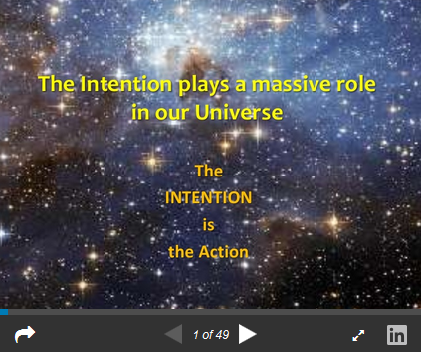
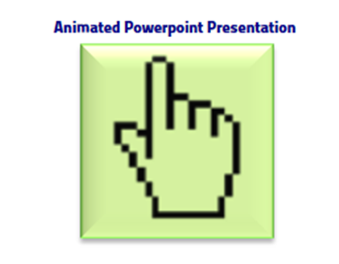
PRESENTATION
Do you feel addressed by the Idea of the "Neighborhoods of Self-Sufficiency" and the interdependent Networks?
Do you want to create and accompany yourself and your Fellow Man to a Life without Money?
To carry this out, you need Intelligence, Community Thinking and Stamina.
Because the Task of managing this Project is a Challenge.
You must always decide for the Benefit of the Community.
And you plan with Heart and Mind, so that you come into Independence.
to be added from here:
https://www.slideshare.net/2y2dorg/solution-proposal-idea-43599989?ref=http://2y2d.org/en/control_systems_solutions.htm

