Slide 1
Sentiment Analysis of Arabic Apps Reviews.
Lina Alhuri

Slide 2
1
2
GOALS & QUESTIONS
3
TABLE OF CONTENTS
EDA
4
METHODOLOGY
CONCLUSION
INTRODUCTION
5
LIMITATIONS & FUTURE WORK
6

Slide 3
01
INTRODUCTION
Interduce the concept od sentiment analysis and the used dataset

Slide 4
Sentiment Analysis
Sentiment analysis is a natural language processing (NLP) technique that identifies the emotional tone behind a text.

Slide 5
Dataset
Arb-AppsReview is the first Arabic dataset designed to capture popular review on Google Play store. It has 50k reviews related to 6 Saudi governmental apps.
LOGIN
NEW ACCOUNT

Slide 6






Apps Covered
Tawakalna
Sehah
Sehaty
tabauad
Tetamen
Mawid

Slide 7
DATASET DICTIONARY
 | DEFENITION
Review | The textual review of the app given by each user.
Score | The score fiven by the user(1 is better than 100).
Date/Time | The time and date of the posted review.
thumbsUp | 0 means no thumsup while 1 means the user gave the app a thumbs up.
app | The name of the app.
lan_review | Language used to write the review.

Slide 8
DATASET DICTIONARY
 | DEFENITION
Gender | Gender refers to the characteristics of women, men, girls and boys that are socially constructed. (Created using gender identification tools).
ReviewLength | The number of character in the review.
words_count | The number of words in the review.
Polarity sentiment | It is the expression that determines the sentimental of an opinion that can be (Positive, Negative, or Neutral).

Slide 9
02
QUESTIONS & GOALS

Slide 10
QUESTIONS.
How to avoid major programming problems and provide useful knowledge relevant to the app's improvement?
What makes a good/bad app?
USERNAME
PASSWORD
LOGIN

Slide 11
GOALS
Reduce the work needed to analyze and extract valuable information from reviews.
Get an overall recognition of user requirements and technical issues feedbacks .
Evaluate different models' performance.

Slide 12
03
EDA
Answers of the previously stated questions.

Slide 13
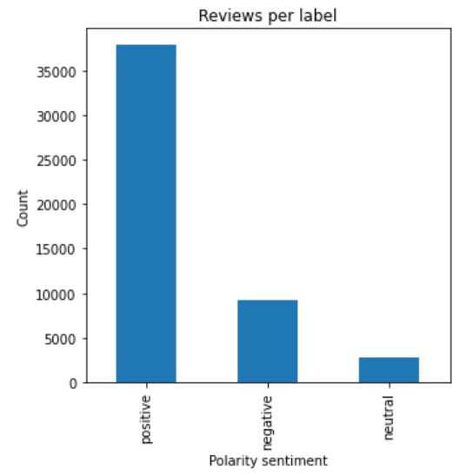
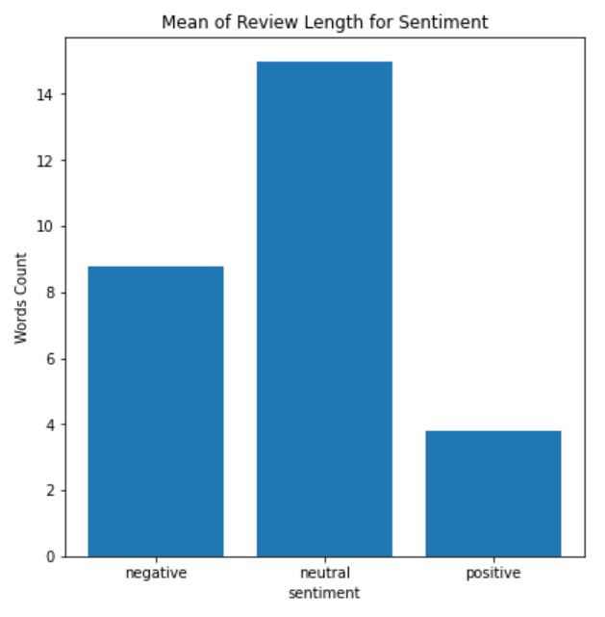
The Count of Reviews Per Label

Slide 14
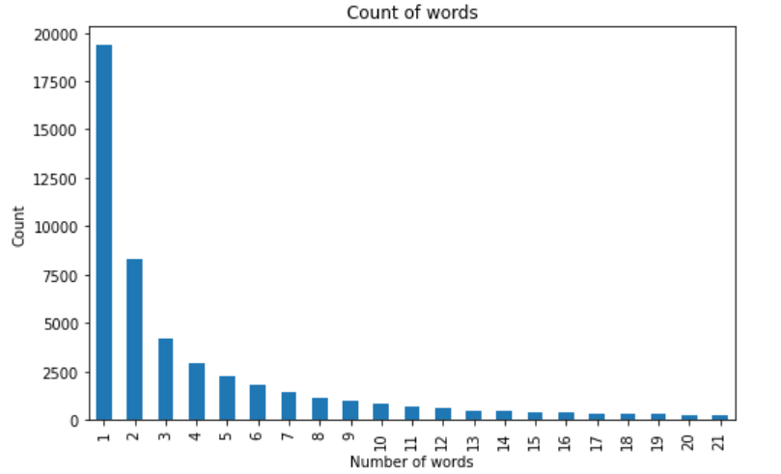
The Count of Reviews Per Label
Though we have more positive reviews, most of the positive reviews are 1-2 words with less details to observe

Slide 15
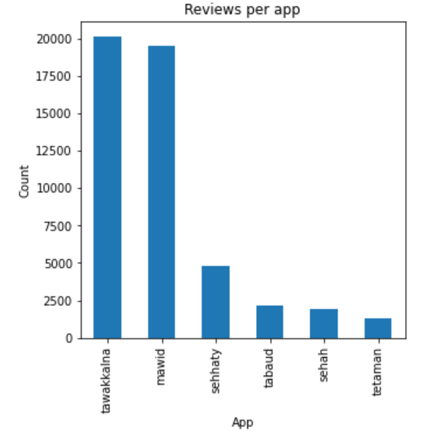
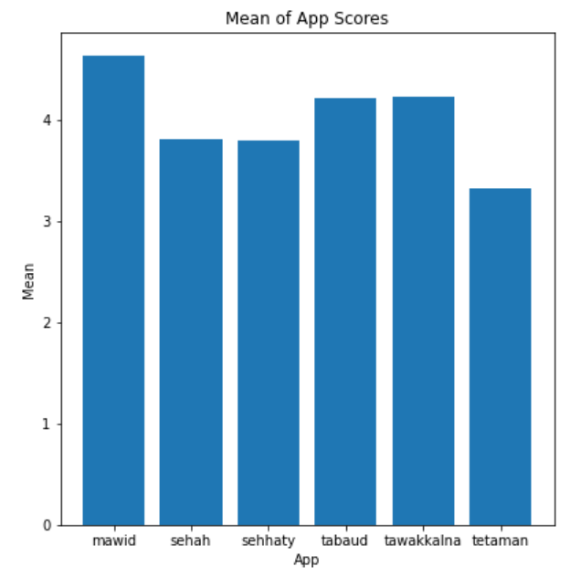
The Count of Reviews and Scores
Though most of the reviews are about tawakkalna, mawid got an over all higher score than tawakkalna. While tetamen is the app the users are least satisfied with.

Slide 16
What Kind of Issues/Requests Users Are mentioning?

Slide 17
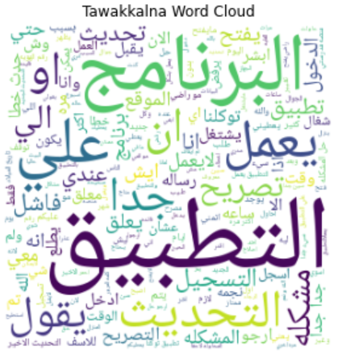
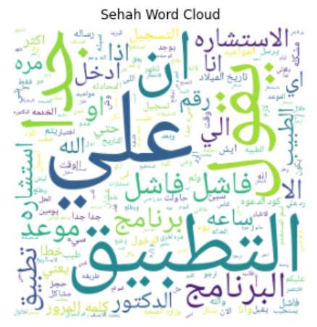
Negative Reviews
يعلق/التحديث/التسجيل/تصريح
ساعه/الاستشاره/موعد/المرور/كود

Slide 18
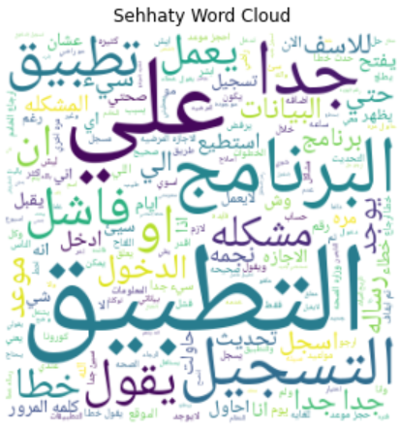
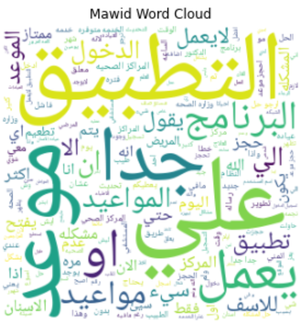
Negative Reviews
الاجازه/تسجيل/موعد/رساله
الاسنان/المواعيد/الدخول/لايعمل

Slide 19
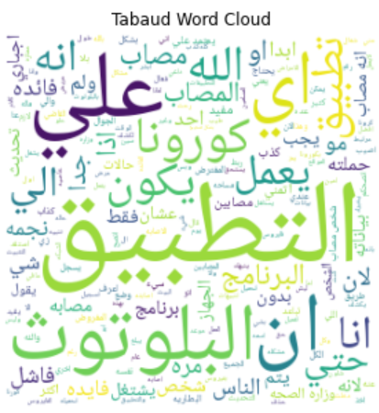
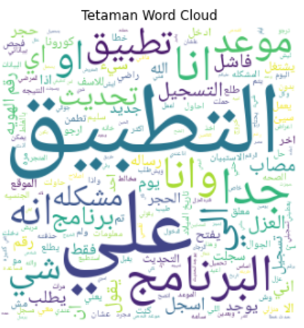
Negative Reviews
البلوتوث
تحديث/ التسجيل/ رقم الهوية

Slide 20
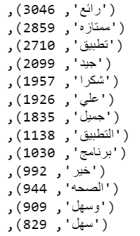
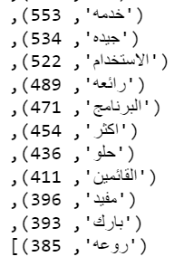
What Makes a Good App?

Slide 21
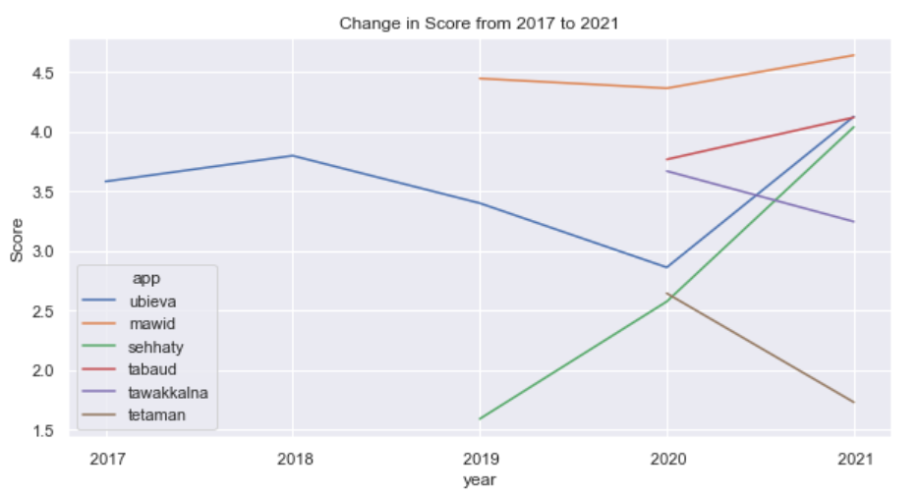
How Scores Changed?
Most of the apps have increase in score after 2020 except for tawakkalna and tatamen, and that can be due to logging in problems we discovered earlier as it seems like a major problems for these two apps

Slide 22
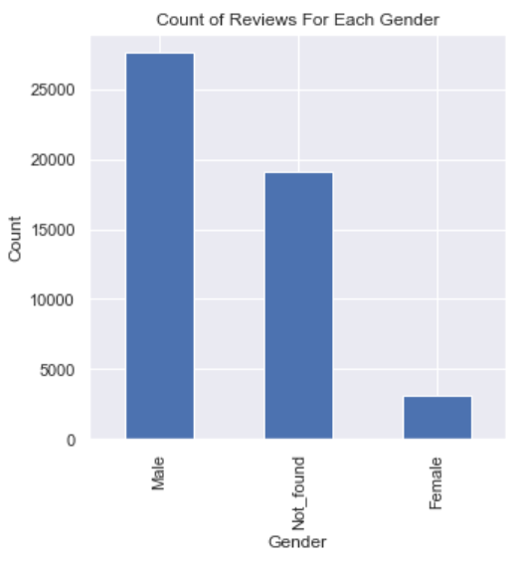
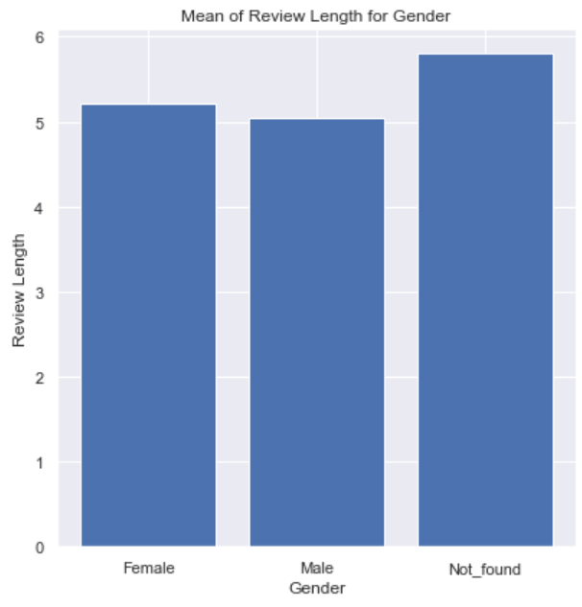
The Count of Reviews for Genders
Thus, user experience researchers might need to get more feedbacks from females and more detailed reviews from males.

Slide 23
01
METHODOLOGY
Steps followed to build ML

Slide 24
METHODOLOGY
Data Preprocessing
Stop words removal
Feature Engineering
TF-IDF
Training
Evaluation
F1 Score
Normalization
Emojis removal
Tokenization
Tashkeel removal
Characters or text of other languages
Split 80/20
Grid search
SVM
RF
MNB

Slide 25
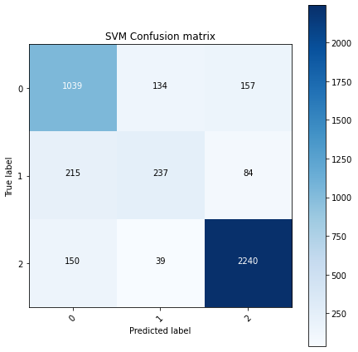
Results
SVM got the best F1 score of 0.82
Model | F1 Score
SVM | 0.82
Random Forest | 0.80
Multinomial Naïve Bayes | 0.78

Slide 26
Things that I tried that didn't work .. Why?
Removing repeated characters
راائع -> رائع
ممتاز -> متاز
Topic modeling
Hard to interpret
Ambiguity of results.

Slide 27
Challenges
Cleaning the data :)
Data cleaning is tricky and time-consuming

Slide 28
Limitations
Time !
Most reviews are short
Limited features
Some of the reviews are not written in Arabic
Future Work
Scrape more recent reviews.
Add new apps to the dataset such as( Abser, Nafath, ...etc)
Re-lablel the data using dialect specific tool
Study the gap of the user requirements needs between males and females and study functional and non-functional issues that every category notes and cares about improving.
Study the satisfaction rate based on the version of the app.
Extract more features such as Size, Installs, Age, Genre
Translate non-Arabic reviews
Build an interface

Slide 29
Conclusion
The most difficult part of working on Arabic dataset is cleaning and preprocessing
The need for similar datasets for Arabic language and frequently updating them.
More features can raise more questions. Leading to more in-depth understanding of user experience.

Slide 30
THANKS!
Do you have any questions?

Slide 31
References
Al-Sarem, Mohammed & Saeed, Faisal & Alshamani, Maha. (2021). Design of an Arabic Google Play Store User Reviews Dataset for Detecting Apps Requirements Issues.
https://pyarabic.readthedocs.io/ar/latest/README.html#id1
https://amueller.github.io/word_cloud/auto_examples/arabic.html
https://imbalanced-learn.org/stable/references/generated/imblearn.ensemble.BalancedRandomForestClassifier.html#imblearn.ensemble.BalancedRandomForestClassifier
https://www.oreilly.com/library/view/applied-text-analysis/9781491963036/ch04.html
https://github.com/motazsaad/process-arabic-text
https://towardsdatascience.com/arabic-sentiment-analysis-5e21b77fb5ea
https://medium.com/life-at-hopper/conducting-sentiment-analysis-on-app-reviews-to-inform-product-decisions-64fcc71822ed

