Slide 1
License plate detection and recognition system

Slide 2
1 Our Goals
Create a practical solution
Experiment with various approaches
Compare model architectures
Gain experience

Slide 3
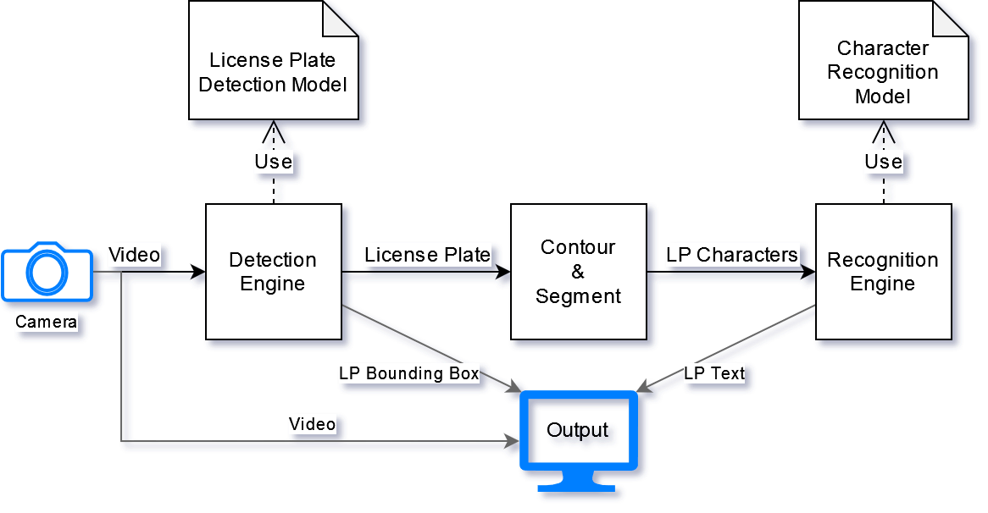
2 Project Outline

Slide 4
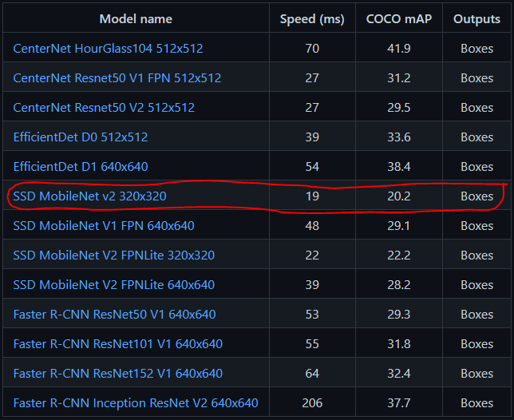
3 Detection Module – Characteristics
Pre-trained detection model
Easy comparison
Speed essential
Simple LP dataset
SSD MobileNet v2

Slide 5
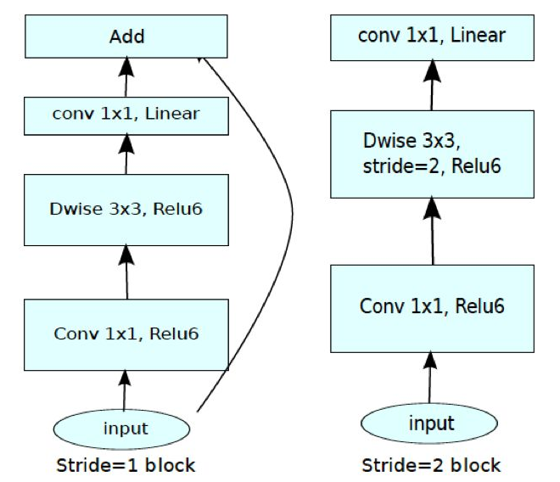
3 Detection Module – MobileNet v2 SSD

Slide 6
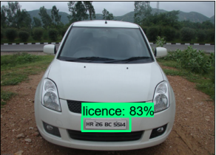
3 Detection Module – Results – Success

Slide 7
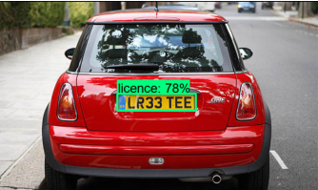
3 Detection Module – Results – Success

Slide 8
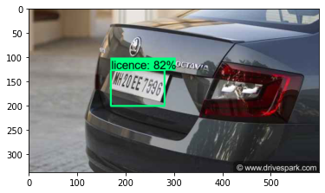
3 Detection Module – Results – Success

Slide 9
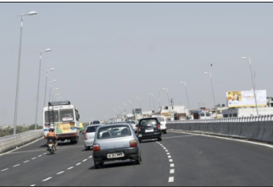
3 Detection Module – Results – Failure

Slide 10
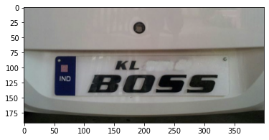
3 Detection Module – Results – Failure

Slide 11
4 Recognition Module – Characteristics
Well-known problem
Custom architecture – training from scratch
Problem with normalization
Pre-processing

Slide 12
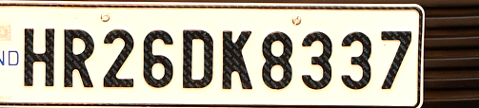

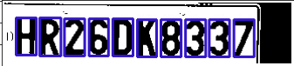
4 Recognition Module – Data Preparation
Crop
Contour
Segment

Slide 13
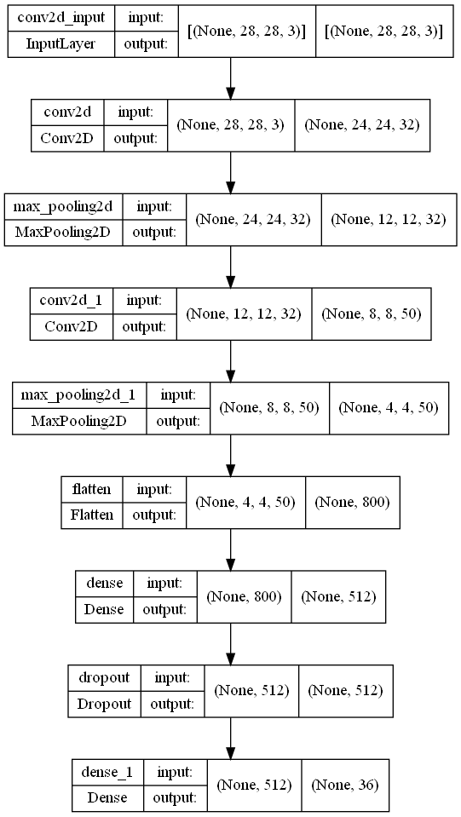
4 Recognition Module – Simple Architecture

Slide 14
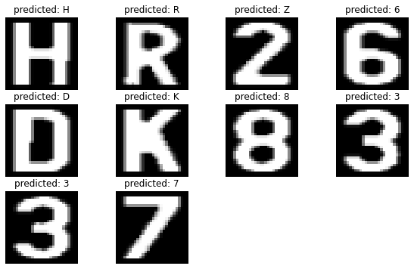
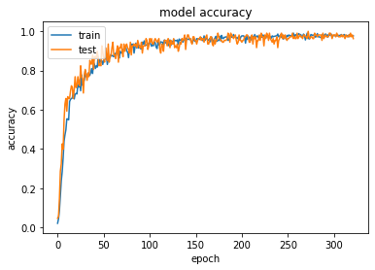

4 Recognition Module – Simple Architecture

Slide 15
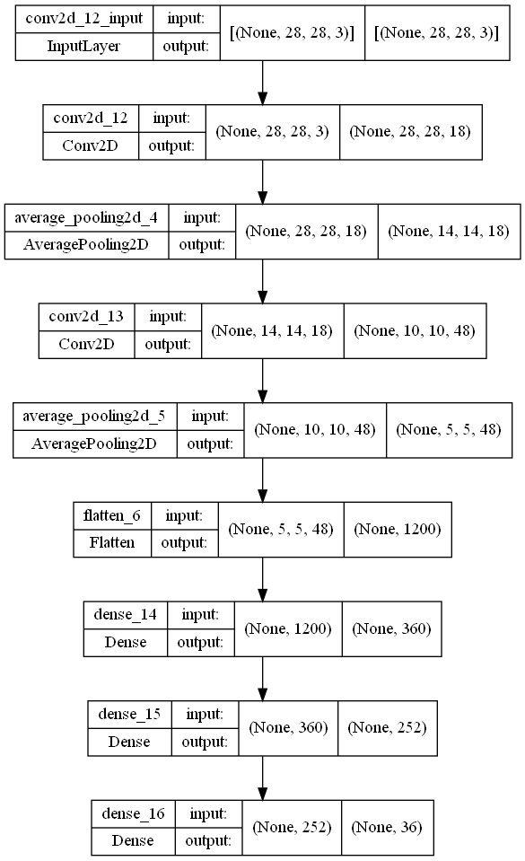
4 Recognition Module – LeNet Architecture

Slide 16
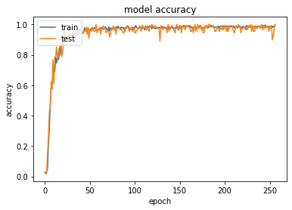

4 Recognition Module – LeNet Architecture

Slide 17
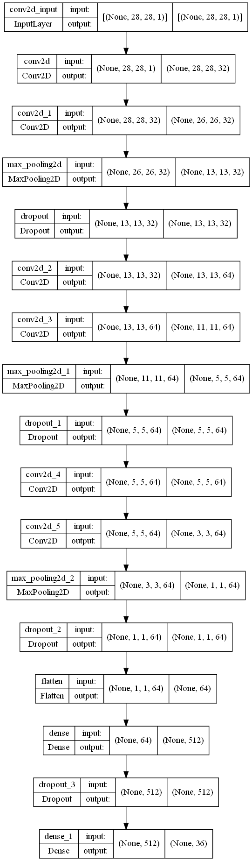
4 Recognition Module – Complex Architecture

Slide 18
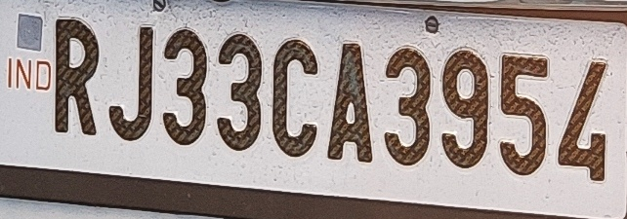
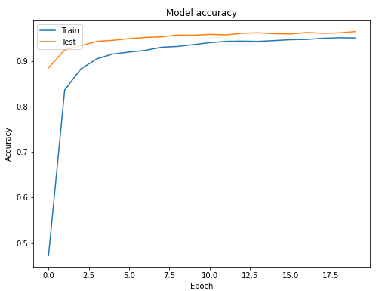
4 Recognition Module – Complex Architecture
Prediction: RJ33CA395L

Slide 19
5 Real-Time Demo

Slide 20
6 Conclusion
Practical implementation
Use-case for each
Difficult to debug
Inventing wheel

Slide 21
Thank you for your attention!
Sources:
https://github.com/tensorflow/models/blob/master/research/object_detection/g3doc/tf2_detection_zoo.md
https://my.oschina.net/u/4067628/blog/3234607
https://github.com/nicknochnack

